Slide 1

Compiler and Runtime for Memory Management on Software Managed Manycore Processors
Ph.D. Dissertation
Ke Bai
Ph.D. Candidate, Computer Science, ASU
Supervisory Committee:
Prof. Aviral Shrivastava (Chair)
Prof. Karamvir Chatha
Prof. Guoliang Xue
Prof. Chaitali Chakrabarti

Slide 2
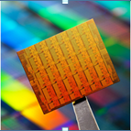
How will the processors of the future look like?
Multicore
State of the art: Coherent-cache multicore architectures
Scalability
Cache coherency protocols do not scale well
Power
The 4-core Intel Core i7-3770 (Ivybridge, 22nm) consumes 77W at 3.4GHz
100-core =>77*100/4 = 1925W, which is clearly unsustainable
Non-coherent-cache Architecture
The Intel SCC consumes 125W at 1.14V, out of which 87.7W is spent on cores.
1000-core => 87.7/48*1000 = 1827W
Intel 48 core chip

Slide 3
SMM Architecture
Tag Array
Data Array
One promising solution: Software-Managed Manycore Architecture
Scratchpad (local) memory, instead of caches in each core
30% less area and power than a direct mapped cache of the same effective capacity
Tag Comparators, Muxes
Address Decoder
Cache
SPM
Execution Core
Execution Core
Execution Core
Execution Core
Execution Core
Execution Core
Main Core
SPM
SPM
SPM
SPM
SPM
SPM
DMA
DMA
DMA
DMA
DMA
DMA
Interconnect Bus
Global Memory
[2] Banakar CODES’02.
DMA

Slide 4
Promise of SMM
Task based programming
Extremely power-efficient computation, if all code and data fit into the local memory of the cores
#include<libspe2.h>
extern spe_program_handle_t hello_spu;
int main(void)
{
int speid, status;
speid
(&hello_spu);
}
<spu_mfcio.h>
int main(speid, argp)
{
printf("Hello world!\n");
}
<spu_mfcio.h>
int main(speid, argp)
{
printf("Hello world!\n");
}
…
Local Core
Local Core
= spe_create_thread
<spu_mfcio.h>
int main(speid, argp)
{
printf("Hello world!\n");
}
<spu_mfcio.h>
int main(speid, argp)
{
printf("Hello world!\n");
}
…
Main Core
Local Core
Local Core
Power Efficiency: performance/power
Processor | Fab | Frequency | GFlops | Power | Power Efficiency
Cell/B.E. | 45nm | 3.2 GHz | 230 | 50 W | 4.6
Intel i7 4-core Bloomfield 965 XE | 45nm | 3.2 GHz | 70 | 130 W | 0.5

Slide 5
The Challenge of SMM Architecture
Execution Core
Execution Core
Execution Core
Execution Core
Execution Core
Execution Core
Main Core
SPM
SPM
SPM
SPM
SPM
SPM
DMA
DMA
DMA
DMA
DMA
DMA
Interconnect Bus
Global Memory
[2] Banakar CODES’02.
DMA
What happens when the code and data of the task mapped on the core do not fit in the local memory
Need to manage the code and data of the application
Bring it to the local memory when needed, and evict it when not needed in the near future.

Slide 6
How to manage data in a core?
int global;
f1() {
int a,b;
global = a + b;
f2();
}
int global;
f1() {
int a,b;
DMA.fetch(global)
global = a + b;
DMA.writeback(global)
DMA.fetch(f2)
f2();
}
Original Code
Local Memory Aware Code

Slide 7
Thesis Statement
The data/code of a task can be efficiently managed on the local memory of a core

Slide 8
Overview of our solution
Manage each kind of data in a constant amount of space in the local memory.
Opportunity: can manage each kind of data according to its access pattern
。
。
。
Smart Stack Management
Global
Memory
Stack
Heap
Heap cache
Global
Code
Statically Mapped
。
。
。
Limited Local Memory

Slide 9
Our Contributions
Techniques to manage stack data
[ASAP 2011] Complete Stack Data Management
[DAC 2013] Smart Stack Data Management
Techniques to manage heap data
Conference papers:
[CODES+ISSS 2010] Heap Data Management
[CASES 2011] Vector Class
[DATE 2013] Automatic and Efficient Heap Data Management
Journal Articles:
[TECS] A Software-Only Scheme for Managing Heap Data
Techniques to manage code
[ASAP 2010] Dynamic Code Mapping
[CODES+ISSS 2013] Efficient and Effective Code Management
Stack
Heap
Global
Code

Slide 10
Products
Papers accepted: 7
CODES+ISSS [2010], ASAP [2010], ASAP [2011], CASES [2011], DATE [2013], DAC [2013], CODES+ISSS [2013]
Journals accepted: 1
TECS
Movies explaining my techniques
Software Infrastructure
Patents pending: 2
Journals under review: 2
TECS, TCAD
More papers planned: 3
ASAP [2014], CODES+ISSS [2014]

Slide 11
Compiler and Runtime Infrastructure
Our infrastructure includes: code overlay script generating tool, runtime library and an optimized SPE compiler.
Runtime
Library
SPE
Objects
Optimized SPE Compiler
SPE
Source
SPE Linker
SPE
Executable
Code Overlay Script Generating Tool
Linker
Script
Runtime Library API
__ovly_load(char *funcName)
void * _malloc(int size);
void _free (void *globalAddr);
void _sstore();
void _sload();
void * _g2l(void *globalAddr, int size, int wrFlag);
void * _l2g(void *localAddr, int size, int wrFlag); void _wb(void *globalAddr, void *localAddr, int size);
Code
Heap data
Stack data
Stack/heap pointer

Slide 12
How to use SMM tool chain?
Management function insertions are implemented with three different passes in the LLVM compiler infrastructure
-stack-mgmt
-code-mgmt
-heap-mgmt
Source code in git repository (requires permission):
git clone git@deimos.eas.asu.edu:/opt/git/LLM_PRJ.git
Public release planned very soon

Slide 13
Regression Setup
Checks out the code, and builds it
llvm, gem5, benchmarks
Runs the compiler and simulator on several benchmarks, and then compare the results with the correct results
Creates a table of which benchmarks ran correctly, and which ones failed
This table will be emailed to all the developers
Some examples of the email:
Checking out llvm and gem5 is failed, please check the connection to the server…
Building llvm and gem5 is failed, please check it …
Benchmark | Run (Y/N) | Management | SPM size (KB) | Time (cycles)
Dijkstra | Y | stack | 64 | 500
Stringsearch | N | heap | 128 | X

Slide 14
Our Contributions
Stack data
[ASAP 2011] Complete Stack Data Management
[DAC 2013] Smart Stack Data Management
Heap data
Conference papers:
[CODES+ISSS 2010] Heap Data Management
[CASES 2011] Vector Class
[DATE 2013] Automatic and Efficient Heap Data Management
Journal Articles:
[TECS] A Software-Only Scheme for Managing Heap Data
Code
[ASAP 2010] Dynamic Code Mapping
[CODES+ISSS 2013] Efficient and Effective Code Management
Stack
Heap
Global
Code

Slide 15
Circular Stack Data Management
F1
F4
F2
Local Memory Size = 128 bytes
F3
F4
Old
SP
Global SP
F1
Function | Frame Size (bytes)
F1 | 28
F2 | 40
F3 | 60
F4 | 54
28
F2
54
68
F3
128
Local Memory
Global Memory
[ASAP 2011] Stack Data Management for Limited Local Memory (LLM) Multi-core Processors

Slide 16
How to manage stack data?
Keep the active portion of the stack on the local memory
Granularity of stack frames is chosen to minimize management overhead
It is a dynamic software technique
fci(func_stack_size)
Check for available space in local memory
Move old frame(s) to global memory if needed
fco(func_stack_size)
Check if the caller frame exists in local memory!
Fetch from global memory, if it is absent
F1() {
int a,b;
fci(F2);
F2();
fco(F1);
}
F2() {
fci(F3);
F3();
fco(F2);
}
F3() {
int j=30;
}
F1() {
int
a,b;
F2();
}
F2() {
F3();
}
F3() {
int j=30;
}

Slide 17

Experimental Setup
Sony PlayStation 3 running a Fedora Core 9 Linux
Only 6 SPEs available
MiBench Benchmark Suite and some other applications
Runtimes are measured with spu_decrementer() for SPE and _mftb() for the PPE provided with IBM Cell SDK 3.1

Slide 18
Results
int rcount(int n)
{
if (n==0) return 0;
return rcount(n-1) + 1;
}
Without management the program crashes! There is no space left in local memory for the stack.
Our technique works for arbitrary stack size.
Enable execution for arbitrary stack sizes
But quite high overheads!

Slide 19
Optimize Stack Management
Opportunities to reduce repeated API calls by consolidation
F1();
F2();
F1(){
F2();
}
while(<condition>){
F1();
}
fci(F1);
F1();
fco(F0);
fci(F2);
F2();
fco(F0);
fci(F1);
F1(){
fci(F2);
F2();
fco(F1);
}
fco(F0);
while(<condition>){
fci(F1);
F1();
fco(F0);
}
fci(F1);
while(<condition>){
F1();
}
fco(F0);
fci(max(F1,F2));
F1();
fco(F0);
F2();
fco(F0);
fci(F1+F2);
F1(){
F2();
}
fco(F0);
Call in loop
Sequential Calls
Nested Call

Slide 20
More Optimizations
Movement of functions
Biggest contributor
Consolidate management for multiple functions
Reduce the number of DMA calls
Extra instructions
Frame-level management is more complicated
Many fragmentations – so the management code is more

Slide 21
Smart Stack Data Management
Formulate the optimization problem of where to insert the management functions so as to minimize the management overhead
Finding an optimal cutting of a weighted call graph
Cut 0
F0
32
Cut 1
10
F1
128
50
5
F2
32
F4
32
A new runtime library with less management complexity
An effective heuristic (SSDM)
Takes Weighted Call Graph as input
Generates an effective management function placement scheme
25
Cut 0
F3
20
.c
Cut 0
Weighted Call Graph
SSDM
Place info about where to perform management
Runtime
Library .a
compiler
Executable
[DAC 2013] SSDM: Smart Stack Data Management for Software Managed Multicores (SMMs)

Slide 22
Stack: Problem Formulation
Formulate library placement as a problem of optimal cutting of a weighted call graph (WCG)
A cutting of the graph is defined as a set of cuts on graph edges, indicating a pair of function _sstore and _sload inserted respectively before and after a function call.
0
Cut 1
artificial edge
main: 128
1
1
stream: 1936
print: 32
1
1
Cut 5
Cut 2
10
0
init: 0
update: 160
final: 80
0
100
1
Cut 3
Transform: 352
0
Cut 4

Slide 23

Stack: Management Constraint
segment s = {$f_{1},$ $f_{2},$……} with function weights {$w_{f_{1},}$ $w_{f_{2}}$, ……}, the total weight must satisfy the weight constraint
$\sum_{f_{i}∈s}{w_{f_{i}}}≤ 𝕊,$where s is a segment, $𝕊$ is the size of stack space
0
Cut 1
segment
main: 128
1
1
stream: 1936
print: 32
1
1
Cut 5
10
0
init: 0
update: 160
final: 80
0
100
1
Transform: 352
root-leaf path
0
Notes:
Who does this management?
Runtime library functions: _fci & _fco
Compiler framework to instrument the application

Slide 24
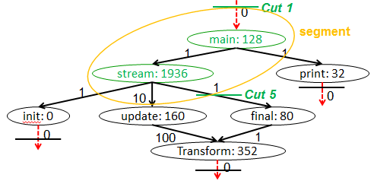
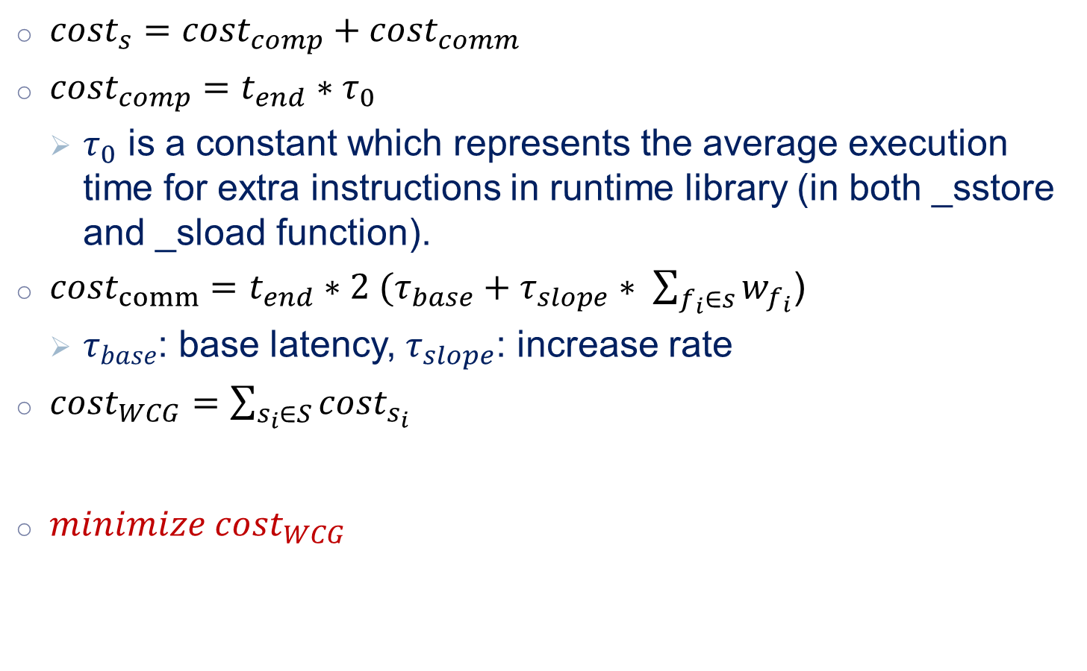
Stack: Overhead Estimation
${cost}_{s}={cost}_{comp}+{cost}_{comm}$
${cost}_{comp}=t_{end}{∗τ}_{0}$
$τ_{0}$ is a constant which represents the average execution time for extra instructions in runtime library (in both _sstore and _sload function).
${cost}_{comm}={t_{end}∗2 (τ}_{base}+τ_{slope}∗ \sum_{f_{i}∈s}{w_{f_{i}}}$)
$τ_{base}$: base latency, $τ_{slope}$: increase rate
${cost}_{WCG}=$ $\sum_{s_{i}∈S}{{cost}_{s_{i}}}$
$minimize {cost}_{WCG}$

Slide 25
Illustration of Heuristic SSDM[1]
$𝕊$ = 192 bytes, $τ_{0}$ = 50 ns, $τ_{base}$ = 91 ns, $τ_{slope}$ = 0.075
Cut 0
Cut 0
F0
32
F0
32
Cut 1
10
Cut 1
10
F1
128
F1
128
50
5
iteration 1
50
5
Cut 2
Cut 4
Cut 4
F2
32
F4
32
F2
32
F4
32
Cut 3
25
Cut 0
Cut 3
25
Cut 0
F3
20
F3
20
Cut 0
Cut 0
Segment: <F0>,<F1>,<F1>,<F2>,<F3>,<F4>
Segment: <F0>, <F1,F2>, <F1>,<F3>,<F4>
Cut | 1 | 2 | 3 | 4
Removing benefit | 2104 | 12080 | 5920 | 1256
Cut | 1 | 3 | 4
Removing benefit | 2224 | 6400 | 1256

Slide 26
Illustration of Heuristic SSDM[2]
$𝕊$ = 192 bytes, $τ_{0}$ = 50 ns, $τ_{base}$ = 91 ns, $τ_{slope}$ = 0.075
Cut 0
Cut 0
F0
32
F0
32
Cut 1
10
Cut 1
10
F1
128
F1
128
iteration 2
iteration 3
50
5
Cut 4
50
5
F2
32
F4
32
F2
32
F4
32
25
Cut 0
25
Cut 0
F3
20
F3
20
Cut 0
Cut 0
Segment: <F0>, <F1,F2,F3>,<F1>,<F4>
Segment: <F0>, <F1,F2,F3>,<F1,F4>
Cut | 1 | 4
Removing benefit | x | 1256
Cut | 1
Removing benefit | x

Slide 27
Stack Pointers
problem
solution
F1() {
int a = -1, *ptr = &a;
_sstore();
F2(ptr);
_sload();
}
F2(int *ptr){
printf(“val = %d\n”, *ptr);
return;
}
F1() {
int a = -1;
int *ptr = _l2g(&a, -1, -1);
_sstore();
F2(ptr);
_sload();
}
F2(int *ptr){
ptr = _g2l(ptr, sizeof(int), 0);
printf(“val = %d\n”, *ptr);
return;
}
F1
a
3180
Management
Table
3150
F1
F2
a
Global Memory
3130
3180
3180
&a?
Local Memory
3150
F1
F2
Stack Pointer
a
181350
F1
3130
3110
Stack Pointer
181320
181300
a
Local memory before F2 is called
Local memory
after F2 is called
Global Memory

Slide 28

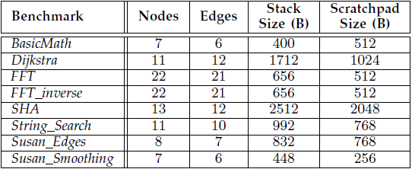
Experiment Setup
Hardware
IBM Cell BE
1 PPE @ 3.2 GHz
6 SPE @ 3.2 GHz
Benchmarks
Mibench – modified to multi-threaded

Slide 29
Overall Performance
11%

Slide 30
Reduction of Management Overhead
13X

Slide 31
Overhead Details
Static overhead (library size in bytes)
 | _sstore | _sload | _l2g | _g2l | _wb
SSDM | 184 | 176 | 24 | 120 | 80
CSM | 2404 | 1900 | 96 | 1024 | 1112
Dynamic instructions per function
 | _sstore |  | _sload |  | _l2g | _g2l |  | _wb
 | F | NF | F | NF |  | hit | miss | hit | miss
SSDM | 46 | 0 | 44 | 0 | 6 | 11 | 30 | 4 | 20
CSM | 180 | 100 | 148 | 95 | 24 | 45 | 76 | 60 | 34

Slide 32
Comparison with Caches
Cache miss penalty = # of misses * miss latency
SPM miss overhead = # of times API function is called * # of instructions in API function + # times of DMA is called * delay of the DMA (dep. on DMA size)
Much less number of DMA calls
Even though extra instructions
The total memory latency is lower
Notes:
The penalty per miss used for calculating miss penalty is 91 nano seconds, which is the time of DMA latency on the IBM Cell processor.

Slide 33
Impact of Stack Space
Dijkstra
Performance is improved with more stack space

Slide 34
Scalability of SSDM

Slide 35
Code Management
stack
F1
heap
F1
F1
F2
global
F2
F2
Code
region
F1
F3
F3
F3
F3
F2
(a) Application call graph
SECTIONS {
OVERLAY {
F1.o
F3.o
}
OVERLAY {
F2.o
}
}
(c) Local Memory
(d) Global Memory
# of Regions and Function-To-Region Mapping
Two extreme cases
Need careful code placement – Problem is NP-Complete
Minimum data transfer with given space
(b) Linker script
Notes:
I haven’t mentioned that the architecture is the Cell processor

Slide 36
Heap Data Management
typedef struct{
int id;
float score;
}Student;
main() {
for (i=0; i<N; i++) {
student[i] = malloc( sizeof(Student) );
}
for (i=0; i<N; i++) {
student[i].id = i;
}
}
Heap Size = 32bytes
sizeof(student)=16bytes
malloc3
malloc2
malloc1
HP
GM_HP
Local Memory
Global Memory
malloc()
allocates space in local memory
New malloc()
May need to evict older heap objects to global memory
It may need to allocate more global memory

Slide 37
Overall Results (stack, heap, code)
When N0 = 6800, system crashes without management

Slide 38
Summary
Need to manage stack, heap, and code in SMM architectures
Do not work without management
Need different strategies for different data
Code (statically linked)
Stack (Circular)
Heap (Low associativity)
Our data management is comprehensive and intuitive for all SMM architectures
It’s automated, and there increase productivity of programmers
Each data is in a constant region
DMA overhead can be comparable or better than cache
Stack
Heap
Global
Code

Slide 39
Products
Papers accepted: 7
CODES+ISSS [2010, 2013], ASAP [2010, 2011], CASES [2011], DATE [2013], DAC [2013]
Journals accepted: 1
TECS
Patents pending: 2
Journals under review: 2
TECS, TCAD
More papers planned: 3
ASAP [2014], CODES+ISSS [2014]
Movies explaining my techniques
Software Infrastructure

Slide 40


Thank you !

Slide 41
Dynamic Memory Allocation
Hybrid DMA + Communication
Can use DMA to transfer stack data to global memory
DMA is very fast – no core-to-core communication
But eventually, you can overwrite some other data
Need OS mediation
DMA write from local memory to global memory
_sstore() {
if (enough space in
global memory)
then
write function
frame using DMA
else
request more
space in global
memory
}
S
allocate ≥ S space
mail-box based communication
send start and end address to execution core
Ms, Me
Memory Management
Thread on main core
Global
Memory
Execution Thread on execution core

Slide 42
What’s happening underneath?
Original Code
Modified Code
_malloc()
allocates space in local memory and global memory and return a global address
_free()
frees space in the global memory
_sstore()
makes sure func frame can be located in local memory
_sload()
makes sure caller frame is in local memory
_g2l()
Assures variable exists in the local memory and uses local address
_l2g()
Translates the local address back to global address
typedef struct{
int id; …
}Item;
main() {
for (i=0; i<N; i++) {
item[i] = _malloc(sizeof(Item));
……
T = item[i];
T = _g2l(T, 4, 1);
T->id = i;
}
_sstore();
process();
_sload();
}
typedef struct{
int id; …
}Item;
main() {
for (i=0; i<N; i++) {
item[i] = malloc(sizeof(Item));
……
item[i]->id = i;
}
process();
}

Slide 43

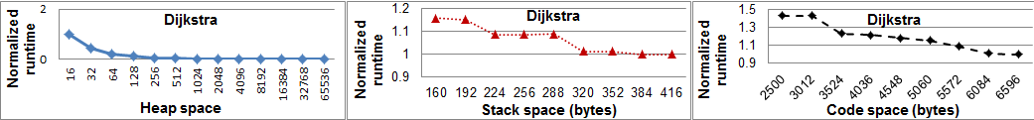
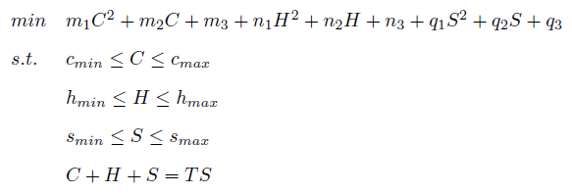

Memory Partition
Brute fore simulations
Small number of simulations

Slide 44
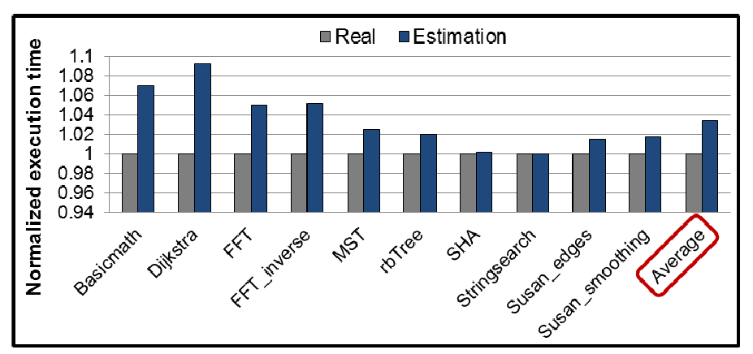
Memory Partition Results
Using our heuristic, the simulation time is reduced to 19% of the exhaustive scheme, but the runtime is only increased by an average of 3%.

Slide 45
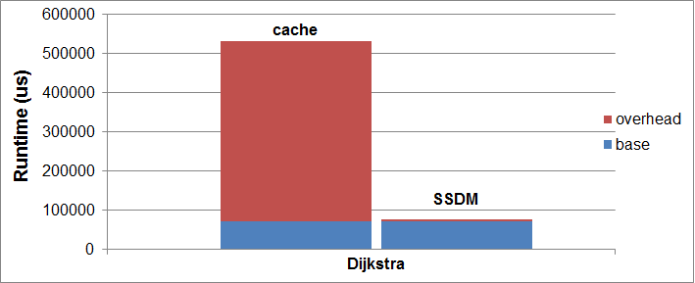
Comparison with Caches

