Slide 1


LASER: A Hardware/Software Approach to Accelerate Complicated Loops on CGRAs
Mahesh Balasubramanian¹, Shail Dave¹, Aviral Shrivastava¹ and Reiley Jeyapaul²
1. Arizona State University, Tempe, USA
2. ARM, Cambridge, GB

Slide 2
Accelerators Today
ASICs – Poor usability
FPGAs – Reconfigurable but, less power efficient (fine-grained)
SIMDs/Vector Processors – Hard to program.
– Inefficient if parallelism is irregular
GPUs – Popular. Unable to efficiently accelerate loops that {are non-parallel, incurs conditionals, have low trip-counts}
Need an alternative that can achieve more acceleration with much higher power-efficiency!

Slide 3
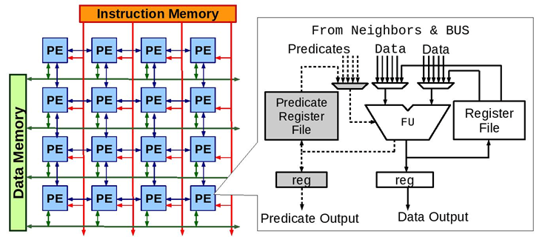
Coarse-Grained Reconfigurable Array (CGRA)
A PE contains a functional unit, which computes fixed-point logic. Intermediate values are stored in the registers.
Predominantly used to accelerate compute-intensive loops in streaming and multi-media applications, e.g.,
set-top boxes, TVs, projectors, for filtering and decoding etc.
4x4 CGRA with a 2-D mesh interconnect.

Slide 4
Mapping Applications on CGRAs
for(i=0;i<100;i++)
{
a = b - 4;
b = a * 2;
c = b * d;
d = c - a;
}
A
Compute-Intensive loops can be extracted from application.
CGRA compiler generates data dependency graph (DDG); each node represents operation being computed and the edges represent dependencies among the operations.
A:
1
B:
B
C:
D:
C
Sample Loop
1
Compiler Maps DDG
onto CGRA
D
Data Dependency Graph
1
2
1x2 CGRA Architecture

Slide 5
Mapping Loops on CGRAs
Time
PE1
PE2
A
1
a⁰
Iterative Modulo Scheduling – Each operation is executed at every II cycles.
Initiation Interval aka II is performance metric.
Software Pipelining:
Operations from different loop iterations execute simultaneously.
1
A
B
C
2
a⁰
B
1
D
a⁰
3
A
a¹
C
DDG
II=2
D
a⁰
B
1
2
4
a¹
1x2 CGRA
A
a²
5
a¹
C

Slide 6
The Challenge: Accelerating Complicated Loops
Perfectly and imperfectly nested loops
[1, 2] execute nested loops with maximum depth of 2
We assume that nested loops can be flattened to a single loop with conditional statements, therefore, we focus on techniques to execute the loops with complex conditionals on CGRAs.
Loops with conditional nests (if-then-else’s)
[3] accelerates a loop with a single if-then-else construct or
[4] allows loops with arbitrary nesting of conditionals, but incurs high overhead
This paper proposed an efficient way to execute loops with arbitrary nesting of conditionals on CGRAs
for(i=0; i<100; i++){
p = i*4;
q = i*2;
if(x > i)then
r = p - 4;
s = q - 2;
if(y > p)
a--;
else
a = 255 - a;
else {
r = p + 4;
s = q + 2;
if(y > i)
a++;
else
a = 255 & a;
}
1. Y. Kim et al., “Improving performance of nested loops on reconfigurable array processors”, TACO ‘12
2. D. Liu et al., “Polyhedral Model based Mapping Optimization of Loop Nests for CGRAs”, DAC ‘13
3. S. RajendranRadhika et al., "Path selection based acceleration of conditionals in CGRAs." DATE ‘15
4. H. Kyuseung et al., "Power-efficient predication techniques for acceleration of control flow
execution on cgra." ACM TACO ‘13

Slide 7
Executing Loops with Control Flow on CGRA
Prior techniques to execute loops with an if-then-else are
Partial Predication [1] – Execute operations from both the if and else paths simultaneously and selects right value based on the condition evaluated.
Dual Issue Scheme [2] – fetches 2 instructions and issues the right instruction to CGRA PE based on the branch outcome.
Path Selection Based approach [3] – fetches 1 instruction selectively based on the branch outcome.
[2,3] works for loops with single conditional statement. For complicated condition nest, they rely on the partial predication. So, partial predication is the only viable approach to execute loops with the complex control-flow.
[1] H. Kyuseung et al., "Power-efficient predication techniques for acceleration of control flow execution on cgra." ACM TACO 2013
[2] M. Hamzeh et al., "Branch-aware loop mapping on CGRAs." DAC 2014.
[3] S. RajendranRadhika et al., "Path selection based acceleration of conditionals in CGRAs." DATE 2015

Slide 8
Partial Predication
Time
for (i=0;i<100;i++)
{
a = a+1;
b = b+1;
c = a*b;
d = b*2;
if(x>i)
e = c+1;
else
e = d+1;
}
a
a⁰
b
b⁰
i
i⁰
1
a
1
b
1
i
1
c
d
a⁰
c
b⁰
d
i⁰
cmp
2
e_{t}
e_{f}
a⁰
e_{t}
b⁰
i⁰
II = 3
3
e_{f}
cmp
sel
4
a⁰
b⁰
i
i⁰
a
b
sel
i¹
1
2
a¹
b¹
9 operations, 4 PEs
4
3
For a conditional (e.g., operation e), need to execute 3 operations instead of just 1 operation
PEs require predicate registers and muxes.
2x2 CGRA

Slide 9
Key Idea: Selective Execution
for (i=0;i<100;i++)
{
a = a+1;
b = b+1;
c = a*b;
d = b*2;
if(x>i)
e = c+1;
else
e = d+1;
}
a
b
i
a
b
i
1
1
1
1
1
1
c
d
cmp
c
d
cmp
Semantics of
e
e_{t}
e_{f}
Compiler Transformation
If ‘cmp’ is evaluated as:
True: e gets input from c
False: e gets input from d
sel
e
DDG with Partial Predication
DDG with Selective Execution
The operations in conditional paths are replaced by a single operation ‘e’.
PEs selectively execute only useful computations, based on branch outcome.

Slide 10
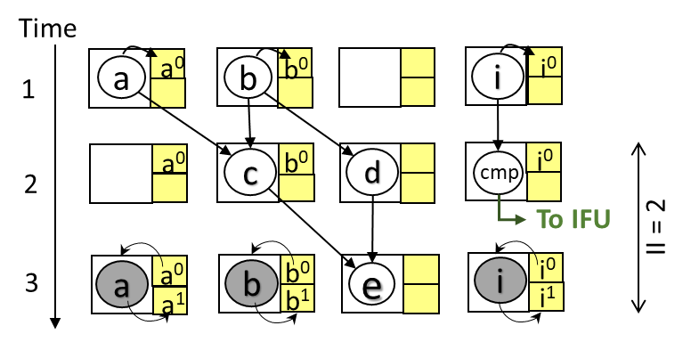
New semantics of cmp
cmp <operator>, <op1>, <op2>, <k>
Example, cmp gt, c, d, 1
If c gt d, then Issue first k=1 instructions to PEs and skip next k=1 instructions
If c ngt d, then Skip first k=1 instructions and issue next k=1 instructions to PEs
Instruction Memory Layout
 | PE1 | PE2 | PE3 | PE4
1 | idle | c | d | cmp
2 | a | b | e_{t} | i
3 | a | b | e_{f} | i
k = 1
cmp=true
cmp=false

Slide 11
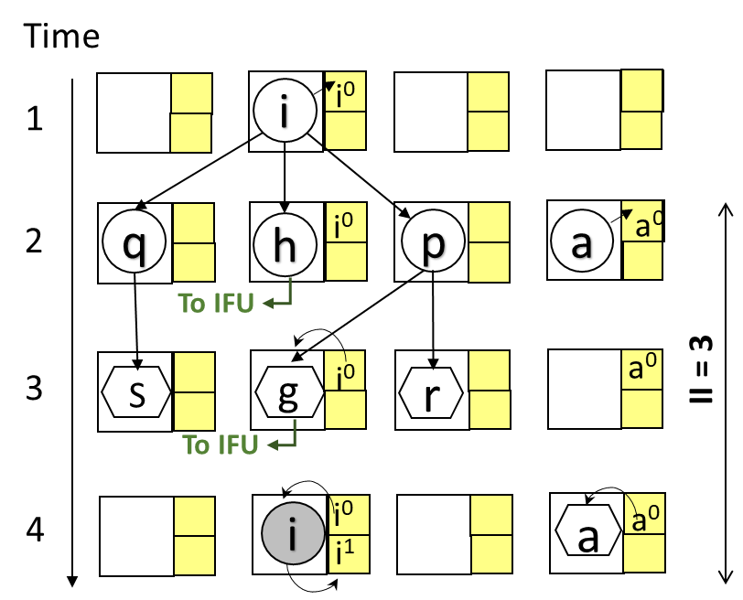
How does it work for more complex loops?
Instruction Memory Layout
 | PE1 | PE2 | PE3 | PE4
1 | q | h | p | a
2 | s_{t} | g_{t} | r_{t} | idle
3 | idle | i | idle | a_{tt}
4 | idle | i | idle | a_{tf}
5 | s_{f} | g_{f} | r_{f} | idle
6 | idle | i | idle | a_{ft}
7 | idle | i | idle | a_{ff}
k_{h} = 3
h=true
k_{g} = 1
g=true
g=false
h=false
Execute g, s, r based on condition h
Execute a based on conditions h and g
g=true
g=false

Slide 12
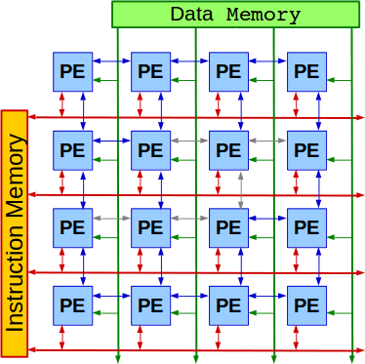
Instruction Fetch Unit Architecture
Interface with core
(code and data)
MMU
Once a condition is evaluated by the PE, the result is <Predicate, k> is communicated to IFU.
CLB keeps track of the information about the corresponding k values for the conditionals.
If the condition evaluated is false, hardware can look-up for needed k value and IFU skips k instructions.
Branch Outcome
Fetch
Signals
Instruction Fetch Unit
Conditional Look-aside Buffer (CLB)
PC
[K]
Branch Outcome From PEs
<Predicate, K>
Fetch
Signal
Fetch Signal Generator

Slide 13
Experimental Setup
We extracted 12 compute-intensive loops from MiBench, which are nested and/or have conditional nest.
Data dependency graph generation phase is modified to combine the operations inside all the true and false paths of the nested conditionals.
LASER is compared with partial predication scheme – only viable approach to map loops with nested conditionals.
The performance is evaluated on 4x4 CGRA and then on CGRAs of larger sizes, to determine the scalability of LASER.

Slide 14
LASER Improves Performance by 42%
Lower is better
On a 4x4 CGRA, LASER performs better for loops featuring complex nests of conditionals (up to the depth of 24).
Performance improvement of LASER can be attributed to less number of operations to be executed on the PEs.

Slide 15
Partial Predication Incurs High Overhead
for(i=0; i<100; i++) {
p = i*4;
q = i*2;
if(x > i){
r = p - 4;
s = q - 2;
if(y > p)
a--;
else
a = 255 - a;
}
else {
r = p + 4;
s = q + 2;
if(y > i)
a++;
else
a = 255 & a;
}
}
1
i
h
q
p
h
g_{t}
s_{t}
a
s_{f}
r_{t}
r_{f}
g_{t}
g_{f}
1
a_{tt}
a_{tf}
a_{ft}
a_{ff}
s
r
a_{t}
a_{f}
g_{f}
a_{sel}
20 operations, 4 PEs i.e., II >= 5
Useful operations: 9

Slide 16
Combining the Operations inside Conditional Paths
for(i=0; i<100; i++) {
p = i*4;
q = i*2;
if(x > i){
r = p - 4;
s = q - 2;
if(y > p)
a--;
else
a = 255 - a;
}
else {
r = p + 4;
s = q + 2;
if(y > i)
a++;
else
a = 255 & a;
}
}
1
i
h
q
p
h
g
a
s_{t} , s_{f}
r_{t} , r_{f}
g_{t} , g_{f}
1
<a_{tt} , a_{tf}>
<a_{ft} , a_{ff}>
Fused operation indicates that only one operation will be executed based on the branch outcomes
Total Operations: 20 --> 9

Slide 17
Mapping of simplified DDG onto CGRA
Time
1
i
i
i⁰
1
q
p
h
2
q
i⁰
p
a
a⁰
h
s_{t} , s_{f}
r_{t} , r_{f}
g_{t} , g_{f}
To IFU
a
1
i⁰
a⁰
II = 3
3
S
g
r
<a_{tt} , a_{tf}>
To IFU
<a_{ft} , a_{ff}>
4
i⁰
a
a⁰
i
i¹

Slide 18
LASER Reduces Total Operations by 43%
Lower is better
The performance improvement of LASER is due to the reduction in total number of operations being executed.
On average, about 43% less operations need to be mapped and executed on CGRA PEs.

Slide 19
LASER is Scalable With Better Performance
Lower is better
Geomean Performance (II) of LASER over Partial Predication
Performance improvement of LASER is consistent over Partial Predication for 8x8 and 16x16 CGRA configurations.

Slide 20
Summary
Nested loops and loops with nested conditionals are common and should be efficiently executed on CGRAs.
Previous techniques either accelerates loops with simple control flow or imposes high performance overhead.
LASER is a hybrid approach; the operations from various paths of the conditionals are fused altogether and the IFU architecture selectively issues right instructions based on branch outcomes.
LASER improves performance by 40% over partial predication and reduces total operations to be executed by 43%.

Slide 21
Thank you!

