Slide 1

Power-Accuracy Tradeoffs in Human Activity Transition Detection
Prepared for DATE 2010
Dresden, Germany
Jeffrey Boyd, Hari Sundaram, Aviral Shrivastava
Arizona State University

Slide 2
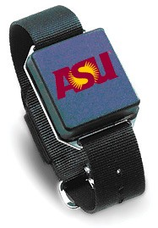
The Ideal
Small
Lightweight
Unobtrusive
Battery Life: Days, Weeks

Slide 3
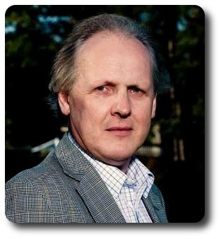
On Low-power HW & SW:
“…hardware technology has a first-order impact on the power efficiency of the system, but you've also got to have software at the top that avoids waste wherever it can. You need to avoid, for instance, anything that resembles a polling loop because that's just burning power to do nothing.” (my emphasis)
-Prof. Steve Furber
“A Conversation with Steve Furber,” ACM Queue, Vol. 8 No. 2, February 2010.

Slide 4
Tour Highlights
Why activity transition detection
Design Space
The great compromise
Design Space revisited
Low-power transition detection
Future tours

Slide 5
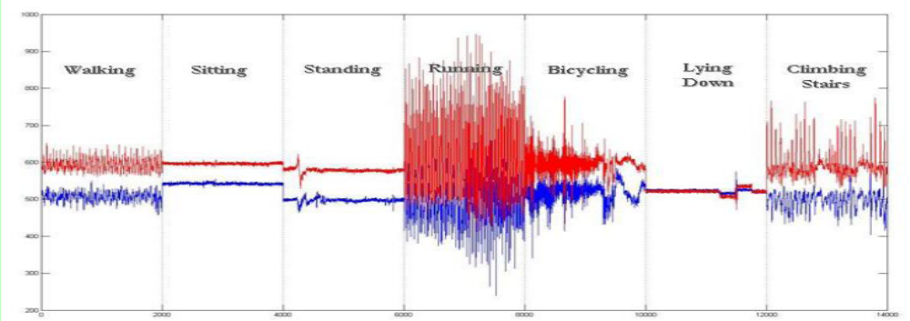
Context & Motivation
WORK
Monitor patients at home
  Stroke rehab – Is the patient using their impaired arm?
  Replace surveys with objective data
Classify only when you need to—at the transitions
  Do the minimum amount of work
  “Do Nothing Well”
Notes:
Monitor activities of daily living

Slide 6
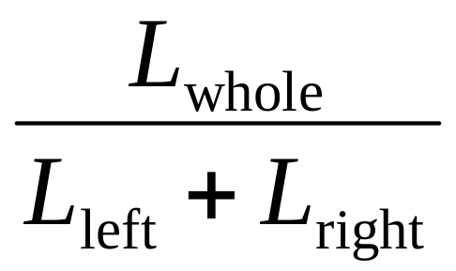
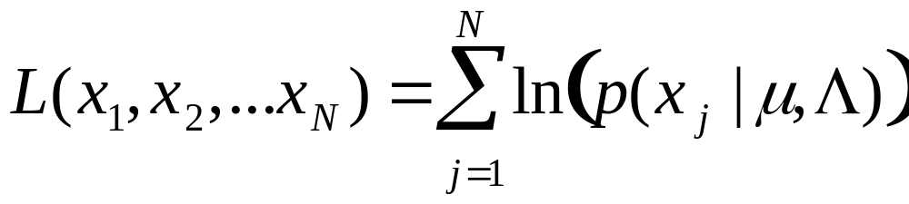
Samples, Frames, Windows, and Panes
Sampling Frequency (F_{s})
Window Size (S_{w})
Window Pane
Frame Size (S_{f})
Possible Transition

Slide 7
Features & Temporal Resolution
F_{s}={100, 50, 20, 10} Hz
S_{f}={10, 20} samples per frame
S_{w}={6, 8, 10, 12, 14, 16, 18, 20} seconds
All combinations of accelerometer axis
4480 combinations!
Feature | Computational Complexity
Max | O(N)
Mean | O(N)
Min | O(N)
FFT | O(N log N)
DCT | O(N log N)
Haar Wavelet | O(N)
Daubechies Wavelet | O(N)
Notes:
Italicized features are vectors

Slide 8
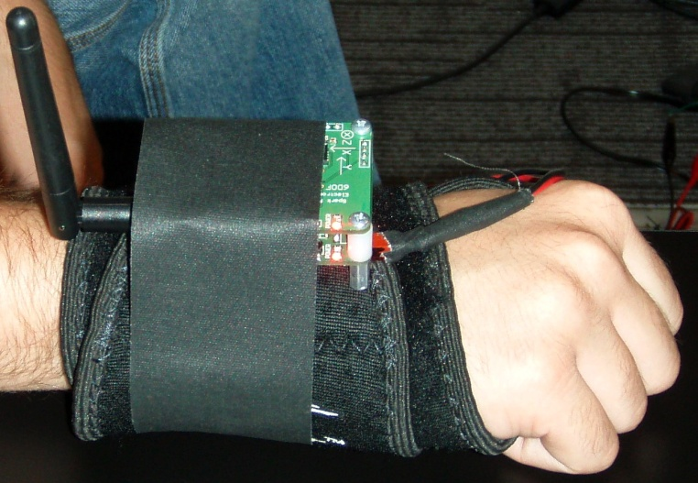
Experimental Setup
Five activities: Sitting, Standing, Walking, Eating, Reaching
Four combinations of activities
Wrist-mounted
Bluetooth Connectivity
3-axis Accelerometer
Processing done offline in Matlab
y-axis
x-axis
z-axis

Slide 9
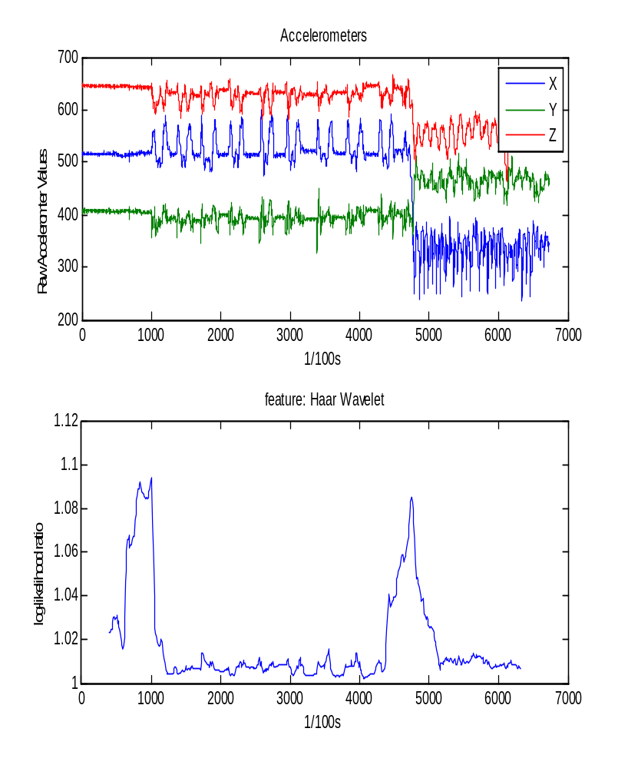
Sample Dataset & Evaluation
Sit – Eat - Walk
Peaks indicate times where the probability of transition is greatest
Detect peaks, then measure:
  Precision: P=Hits/(Hits + False Positives)
  Recall: R=Hits/(Hits + Misses)
  F-Score: F=2*P*R/(P + R)
    Reverse F-Score: RF = 1-F
Time for each combination to process test files

Slide 10
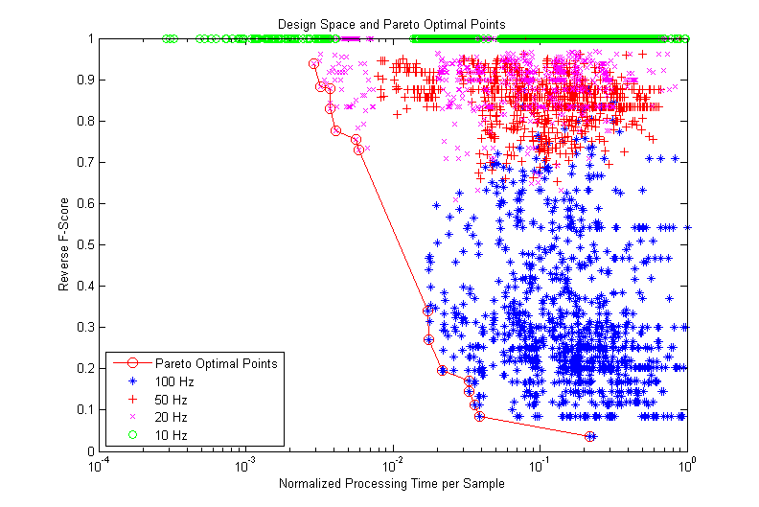


Design Space & Pareto Optimal Points
Faster

Slide 11
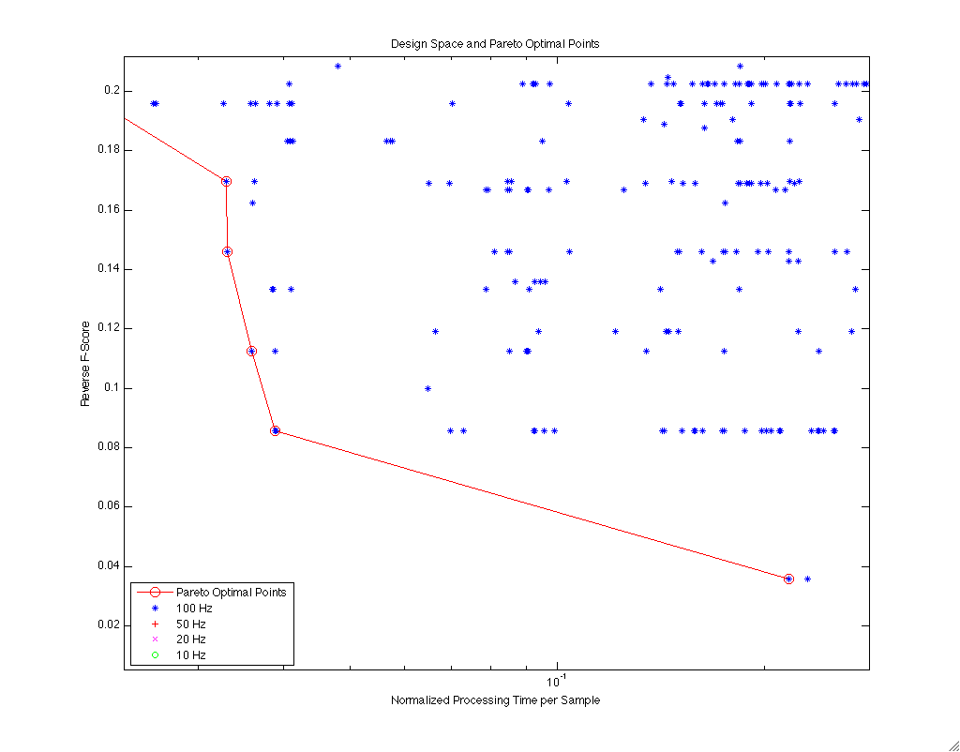
Sacrifice Little, Gain Much
5% Loss
5.5x Gain
Notes:
The Great Compromise

Slide 12
Optimal Points in Detail
RF | Norm. Time | Signal (axis) | Feature | Freq. (Hz) | Frame Size | Window Size (s)
0.036 | 0.2172 | x | DCT | 100 | 10 | 16
0.086 | 0.0388 | y | min | 100 | 20 | 18
0.112 | 0.0359 | x | mean | 100 | 20 | 16
0.146 | 0.0331 | y | max | 100 | 20 | 14
0.170 | 0.0330 | x | min | 100 | 20 | 14
0.196 | 0.0216 | x | max | 100 | 20 | 8
0.270 | 0.0176 | x | min | 100 | 20 | 6
0.340 | 0.0172 | x | max | 100 | 20 | 6
0.729 | 0.0059 | x | variance | 20 | 20 | 10
0.754 | 0.0056 | x | variance | 20 | 20 | 8
0.775 | 0.0041 | x | min | 20 | 20 | 10
0.829 | 0.0037 | x | mean | 20 | 20 | 8
0.878 | 0.0037 | z | min | 20 | 20 | 6
0.882 | 0.0032 | x | mean | 20 | 20 | 6
0.938 | 0.0029 | x | max | 20 | 20 | 6
Notes:
Let’s revisit the time space
If you can tolerate some false positives, you can run much faster
From top 2 combos: Top is 3% better, but ~18% slower
12 of 15 combos the x-axis
14 combos use simple, O(N) features
Split between 100 & 20 Hz. 39% decrease in accuracy, ~3x speed increase
14 combos use 20 samples/frame

Slide 13
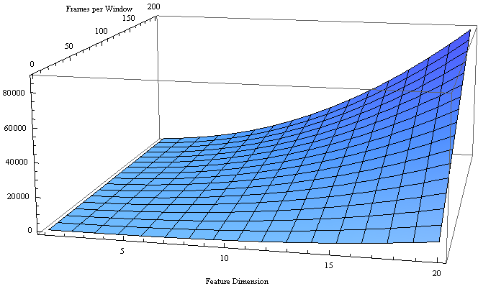
Scalars and Vectors
Notes:
N_f is the number of frames per window
Z axis is approx. number of operations for each log-likelihood calculation
Low-power transition detection can be achieved through careful choice of features

Slide 14
Summary
Single-axis, simple feature
  Vectors are (computationally) expensive
The Great Compromise
  5% better accuracy or 5x battery performance
Do Nothing Well
5% Loss
5.5x Gain

Slide 15
Future Tour Offerings
Collect More Data!
  Multiple users
  Different Activities
Train activity classifiers
Build custom low-power device
  Implement algorithm in device firmware
Reduce power by approximating features and classifiers
Directed Search (for best feature and time combinations)
  Compare it with genetic algorithm and Monte Carlo search techniques

Slide 16
Fragen - Questions
?
Contact Info:
Jeffrey Boyd
  Jeffrey.Boyd@asu.edu
Hari Sundaram
Hari.Sundaram@asu.edu
Aviral Shrivastava
Aviral.Shrivastava@asu.edu

