Slide 1

Software Coherence Management on Non-Coherent-Cache Multicores
Jian Cai, Aviral Shrivastava
Compiler Microarchitecture Lab
Arizona State University, USA

Slide 2
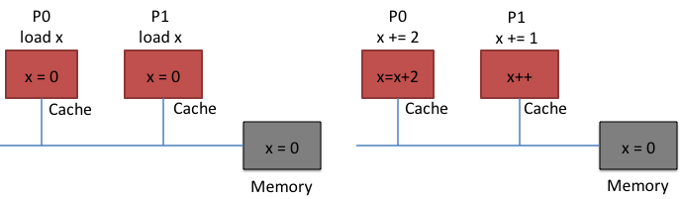
Non-coherent-Cache Multicores
Coherence
Mechanism by which cores get the latest copy of shared data
The overheads of cache-coherence increase with the number of cores
Each core has to tell every other core about the data it is accessing
Area and power of the coherence logic increases dramatically
Remove the cache coherence logic
Intel 48-core Single-chip Cloud Computer
Digital Signal Processors, e.g., the 8-core TI 6678

Slide 3
Software Coherence Management
One way is to disable caches, and execute from main memory
Software Coherence Management
identify the shared data
fetch the latest copy of shared data before it is used –> by DMA instructions
update it
merge the updates back
Overhead of extra instructions
Performance will be dependent on:
the memory consistency model
how much we can reorder
granularity of management
how often we need to read/write
Notes:
Timing of propagating writes is critical to implementation of coherence management

Slide 4
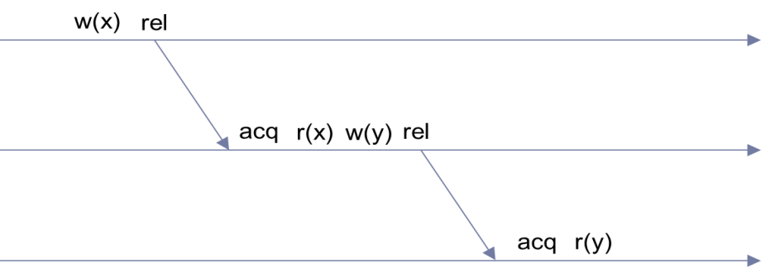
Memory Consistency
Sequential consistency
The order to each read and write to the memory must be maintained
no out-of-order execution allowed
Relaxed consistency
Memory accesses that can be reordered are within critical section, surrounded by acquire() and release()
requires strict ordering only of acquire() and release()
loads and stores can be reordered
Proc0 Proc1
acquire(lock)
write x
release(lock)
acquire (lock)
read x
write y
release (lock)
Notes:
Timing of propagating writes is critical to implementation of coherence management

Slide 5
Granularity of Management
Inter-core coherence is traditionally done in hardware at cache block granularity
fine-grain management
Software cache coherence is typically implemented among processors
page-level granularity
coarse-grain management
Inter-core software cache-coherence must be:
fine-grain
less false sharing
fast inter-core communication
Notes:
IBM Cell processor is around 20 GFLOPS, while that of a conventional Intel Xeon processor reaches up to 600 GFLOPS

Slide 6
State-of-the-Art: COMIC
Page-level granularity
Requires a core to serve as coherence manager
Duplicates pages at acquire, and merges pages at release
Coherence Manager
P0
P1
original
acquire
write req.
write ack.
twin
modified
acquire
time
write req.
release
twin
modified
updated
modified page
write ack.
modified
release
twin
modified
updated
modified page
Notes:
When multiple writes try to write to different locations of the same page (false sharing), the coherence manager needs to create a twin page of the original page, and then creates a private copy of twin (not the original page) for each write request. When a requesting core finishes its modifications, it notifies the coherence manager, which then compares the modified private copy with twin , get the differences and apply the differences to the original page (not twin). The creation of the twin page and private copies for the writers are necessary, as otherwise the later modifications may overwrite the earlier modifications if all the writers writes to the original page directly. This whole process, especially the comparison of modified private copy of a writer to the twin page (which is done byte by byte), requires a lot of computation.

Slide 7
Our approach
Byte-level granularity
No coherence manager
No duplicates and merges are required at acquire and release, respectively
Main Memory
P0
P1
time
acquire
write req.
write ack.
writes
create write notices
writes + write notices
release
update original data
acquire
write req.
write ack. + write notice
update modified bytes
read
release

Slide 8
Write Notices
A record of a write (but not the value)
Write notices can be merged to improve performance
a write:
x = 5;
write notice:
address: &x
size: sizeof(x)
write1:
a[i]++;
write notice:
address: &a[i]
size: sizeof(a[i])
write2:
a[i+1]++;
write notice:
address: &a[i+1]
size: sizeof(a[i+1])
merge
write notice:
address: &a[i]
size: sizeof(a[i])*2
Notes:
Make an example of merging write notice

Slide 9
Performance Improvement

Slide 10
Management Overhead Reduction
comic
our approach

Slide 11
Summary and Future Work
Overhead of hardware coherence increases dramatically with the no. of cores
Software implemented coherence on Non-coherent-Cache architectures
light hardware,
but need to keep the software overhead of coherence management low
Presented
Fine-grain coherence management in software
No extra management core required
Ongoing work
Integrate our approach into compiler
Currently our work is provided as a run-time library
Future Work
Software coherence management can be extended to SPM-based multicores
SPM has 34% less area and consumes 40% less power than a cache of the same capacity
Data transfers between main memory and SPM have to be managed by software

Slide 12
Speaker: Aviral Shrivastava
Aviral Shrivastava is Associate Professor in the School of Computing, Informatics and Decision Systems Engineering at the Arizona State University, where he has established and heads the Compiler and Microarchitecture Labs (CML). He received his Ph.D. and Masters in Information and Computer Science from University of California, Irvine, and bachelors in Computer Science and Engineering from Indian Institute of Technology, Delhi. He is recipient of the 2011 NSF CAREER Award, and 2012 Outstanding Junior Researcher in the School of Computing, Informatics, and Decision Systems Engineering. His research focuses in three important directions, 1. Manycore architectures and compilers, 2. Programmable accelerators and compilers, and 3. Quantitative Resilience. His research is funded by DOE, NSF and several industries including Intel, nVIDIA, Microsoft, Raytheon Missile Systems, Samsung etc. He serves on organizing and program committees of several premier embedded system conferences, including ISLPED, CODES+ISSS, CASES and LCTES, and NSF and DOE review panels.

Slide 13
If two cores modify the same data, then the updates will be overwritten
Yes, but that is what the programmer intended.
If the programmer wanted the updates to the same data in an order, or exclusively, they would have used locks or barriers
In parallel programming, the programmer has some responsibility in deciding the order to execution.
locks provide exclusive access
barriers provide ordered execution
If none of present
implies that overwrites are acceptable

Slide 14
Why does COMIC need triplicate pages?
Coherence Manager
Core 1
Core 2
original
twin
update
modified
update
compare
modified
compare

Slide 15
Coherence vs. Consistency
Coherence is about memory accesses to the same address
by different cores
one core writes 5 to address A, and another one reads, it
will it get the new value or the old
Consistency is about memory accesses to different addresses
Core 1 writes to address X first, and address Y second
Can these two writes to the main memory be reordered
If they can be, then another core could read new value to Y, but old value of X
sequential consistency says no reordering
Relaxed consistency says, between acquire() and release(), all reordering is allowed.

Slide 16
Previous Work: COMIC
Creating and merging duplicates is compute-intensive, but required when multiple writers try to modify different locations of the same page (false sharing), to prevent a writer from overwriting modifications of others, which may happen if writers write to the original page directly
Coherence Manager
P0
P1
time
acquire
write req.
create a twin page, and a copy for P0
write ack.
write to its private copy
modified copy
release
create write notice, update original page
acquire
write req.
create a twin page, and a copy for P1
write ack. + write notice
Invalidate page
page req.
Main Memory
updated page
read
release
Notes:
Write notices are needed to tell processors if pages they need to access has been updated

Slide 17
Advantages of Our Approach
False sharing happens at smallest resource block (such as a cache line or a page) which depends on the granularity of coherence management
Our byte-level approach eliminates false sharing, and thus avoid creating duplicates and merging them at acquire and release operations as in COMIC
Main Memory
P0
P1
original
acquire
write req.
write ack.
modified
acquire
write req.
time
write ack.
release
modified
updated
modified bytes
updated
modified bytes
release
Notes:
False sharing happens at smallest resource block (such as a cache line or a page) which depends on the granularity of coherence management. Since our approach manages coherence at bytes, it guarantees no two writes will happen in the same resource block (otherwise it is a true sharing, which should be taken care by programmers). This property eliminates false sharing and thus the compute-intensive process of creating and merging duplicates as in COMIC.

