Slide 1
RESIDUE NUMBER SYSTEM ENHANCEMENTS FOR PROGRAMMABLE PROCESSORS
Rooju Chokshi
7th November, 2008
Compiler-Microarchitecture Lab
Computer Science and Engineering
Arizona State University

Slide 2

Power and Performance Demand
Perpetual demand for higher performance and power
Real-time computing environments require high speed computation
  Cellular phones
Battery power is a limited resource
How do we reduce power gap without performance loss?

Slide 3
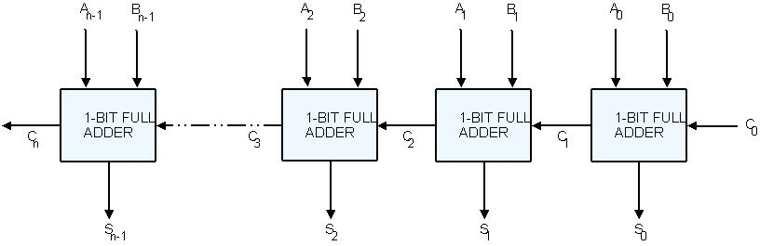
Limitation of 2’s complement
2’s complement system limits parallelism
  O(n) carry propagation chains in adders
    Carry prediction schemes consume area, power
  Limited parallelism due to carry
Do better alternatives exist?

Slide 4
Residue Number System
Non-positional number system, characterized by relatively prime integers P = (P1,P2,…,Pk)
2’s complement integer N transforms to k-tuple (R1,R2,…,Rk), Ri = N mod Pi
  Convert back to 2’s complement by application of Chinese Remainder Theorem
Perform operation OP in parallel on smaller bit-widths
  X→ (x1,x2,…,xk), Y→(y1,y2,…,yk)
  X OP Y = (x1 OP y1,…,xk OP yk)
X
Y
P₁
P₂
P₃
X OP Y

Slide 5
Residue Number System
Pros and Cons
Advantages
  Splits an n-bit integer into multiple smaller independent components
  Computation on smaller bit-widths, in parallel.
  Faster computation
  Lower power consumption
Limitations
  Fast arithmetic does not extend to division, general comparison, bit-wise operations.
  Conversion from 2’s complement to RNS and vice-versa has high overhead.

Slide 6
Research Objectives
Utilize RNS to design faster, lower power programmable processors.
  Design hardware that enables hiding overhead
Automate code mapping
  Formalize the code mapping problem
  Develop compiler techniques for code mapping
    Focus on maximizing application performance

Slide 7
Agenda
Towards alternative number systems
Introduction to RNS
Research Objectives
Previous RNS Research
RNS Processor Challenges
Proposed Microarchitecture
Compiler Technique
Experimental Results
Conclusions

Slide 8
Previous RNS Research
RNS typically used in fixed-function DSP architectures
  Digital filters, DFT, DWT
Griffin, Taylor proposed programmable RNS RISC processors as a topic of future research.
Chavez, Sousa developed a RNS-based RISC DSP
  Focus is on reducing area, power not improving execution time
Ramirez et al developed a RNS DSP microprocessor.
  Pure RNS ALU
  ISA does not include conversion operations
  Conversions need to be added as separate stages.
    Overhead is not hidden effectively

Slide 9
Agenda
Towards alternative number systems
Introduction to RNS
Research Objectives
Previous RNS Research
RNS Processor Challenges
Proposed Microarchitecture
Compiler Technique
Experimental Results
Conclusions

Slide 10
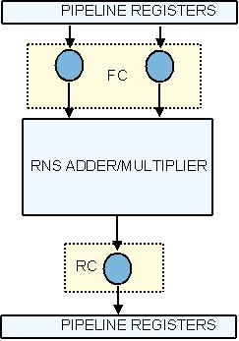
RNS Processor Challenges
Parallel operations limited to (+,-,x)
  Need to keep 2’s complement units also
Conversion overheads
  Software-transparent operation needs that conversions be done before and after every computation
    High overhead of conversions
  Design should enable hiding overheads
Notes:
Ease of programming
Mapping code to RNS manually is tedious
Need automated techniques

Slide 11
Agenda
Towards alternative number systems
Introduction to RNS
Research Objectives
Previous RNS Research
RNS Processor Challenges
Proposed Microarchitecture
Compiler Technique
Experimental Results
Conclusions

Slide 12
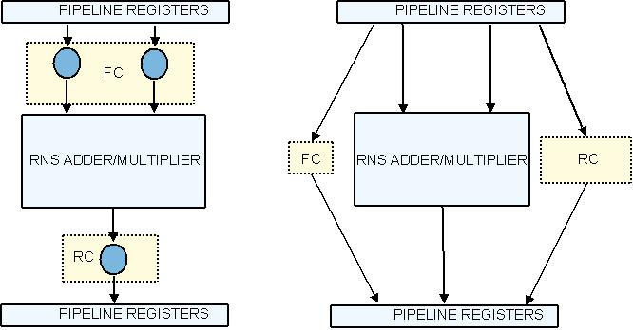
Separate conversion and computation
Augment ISA with explicit conversion instructions
Conversions can now be scheduled and optimized like any other instruction.
Enables better hiding of conversion latencies.

Slide 13
Carry-save Operand Representation
Basis of functional units are CSA trees
  Produce sum and carry vectors S and C
  Final modulo adder stage combines S and C
    Larger delay, area and power
  Store both S and C for a RNS value
    Modulo adder removed
    Use existing register file with double precision load, store and mov instructions
X
Y
CSA Tree
S
C
Modulo Adder (S+2C)
Z

Slide 14


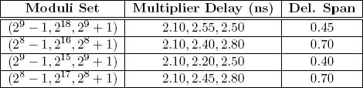
Selection of Moduli Set
Moduli set affects channel delays
    operates on same number of bits in every channel
      Power-of-two channel is much faster than other
    Propagation delays should be as close as possible
    What about , k > n ?

Slide 15
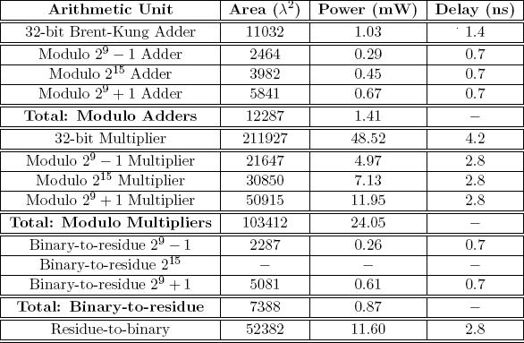
Synthesis Results – 0.18 

Slide 16
Pipeline Model
Multiplier
Integer Reg File
Adder
FC
IF
ID
RC
WB
COM
RNS Multiplier
RNS Adder
33-bit RNS Reg File/GP Floating Point Reg File
EX

Slide 17
Agenda
Towards alternative number systems
Introduction to RNS
Aims and Objectives
Previous RNS Research
RNS Processor Challenges
Proposed Microarchitecture
Compiler Technique
Experimental Results
Conclusions

Slide 18
Compiler Technique - Aims
Analyze data dependency graphs of applications for RNS profitability.
  Identify potential subgraphs
  Profit model needed
Map profitable subgraphs to RNS instructions.
  Cycle time is metric for profit
No previous compiler technique for RNS.

Slide 19
Definitions
RNS Eligible Node
Node that is (+, - , x)
L
L
L
L
RNS Eligible Subgraph (RES)
Subgraph G_{RES}(V_{RES},E_{RES}) such that V_{RES} consists only of RNS Eligible Nodes.
*
+
+
L
L
+
>>
*
*
*
+
Maximal RNS Eligible Subgraph (MRES)
A RES G_{MRES}(V_{MRES},E_{MRES}) of DFG G(V,E) is maximal if, for all v in V_{MRES} there is no edge (u,v) or (v,u) in E, s.t. u is RNS eligible node.
/

Slide 20
Problem Definition
Aim is to map as many operations to RNS, provided doing so is profitable.
Given a set of dataflow graphs of program basic blocks,
  Find all Maximal RNS Eligible Subgraphs
  Estimate profitability
  Map profitable MRESs to RNS.

Slide 21
Finding MRESs
Start with unvisited RNS eligible node as seed node.
Expand to include adjacent RNS eligible nodes, until no more can be included
  BFS
L
L
L
L
*
+
+
L
L
+
>>
*
*
*
+
/

Slide 22



Evaluating profit of MRES
A pair of forward conversions is overhead of 1 cycle.
  Dataflow , s.t.
A reverse conversion is overhead of 2 cycles.
  Dataflow , s.t.
Every 3-operand addition (x+y+z) is a profit of 1 cycle.
  Pair addition nodes before profit analysis
Every multiplication is a profit of 1 cycle.
Apply profit model to every MRES found earlier.

Slide 23
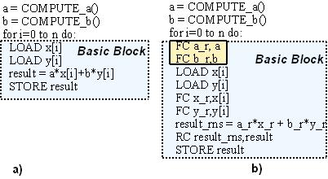
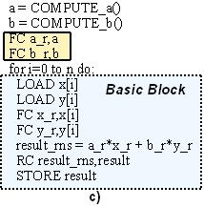
Forward Conversions In Loops
Basic Algorithm
With FC Improvement
Move FC if:
  Register is not written in loop
  Is written only in the same MRES as the FC

Slide 24
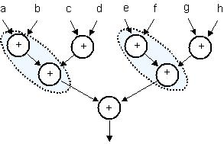

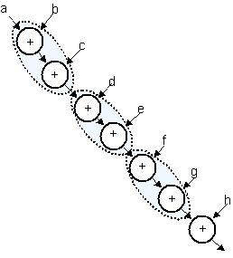
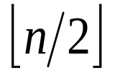
Improving Addition Pairing
Given an addition expression with n additions , what DFG structure enables best pairing?
  Expression with n additions can have pairs at best.
  Some DFG structures do not enable best pairing
  Linear structures enable best pairing

Slide 25
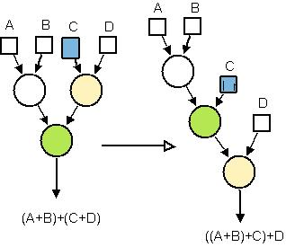
Improving Addition Pairing
Take an addition tree and linearize it
  Apply transformation repeatedly
  Each application linearizes a sub-tree
  Eventually entire tree is linearized

Slide 26
Agenda
Towards alternative number systems
Introduction to RNS
Aims and Objectives
Previous RNS Research
RNS Processor Challenges
Proposed Microarchitecture
Compiler Technique
Experimental Results
Conclusions

Slide 27
Experimental Setup
Simulation Model
  Simplesim-ARM
  Augmented with RNS units according to synthesis numbers
  Measure cycle-time and functional unit power.
  Benchmarks
    FIR, Gaussian smoothing, 2D-DCT, MatMul, some Livermore Loops
GCC 3.0.4
binutils-2.14
arm-linux
RTL Generation
Flow Analysis
RNS Optimization
Flow Analysis
Scheduling
Register Alloc
Assembly

Slide 28
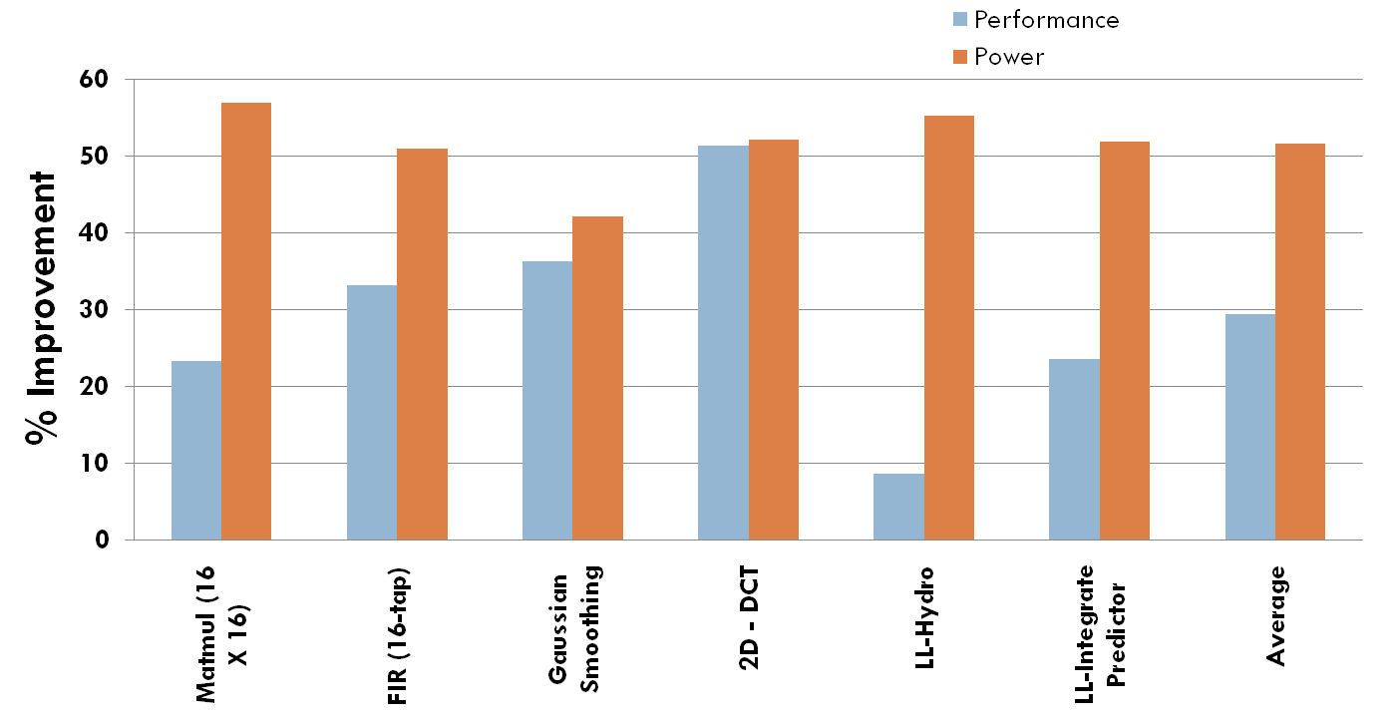
Experimental Results
Simulation of manually optimized binaries

Slide 29
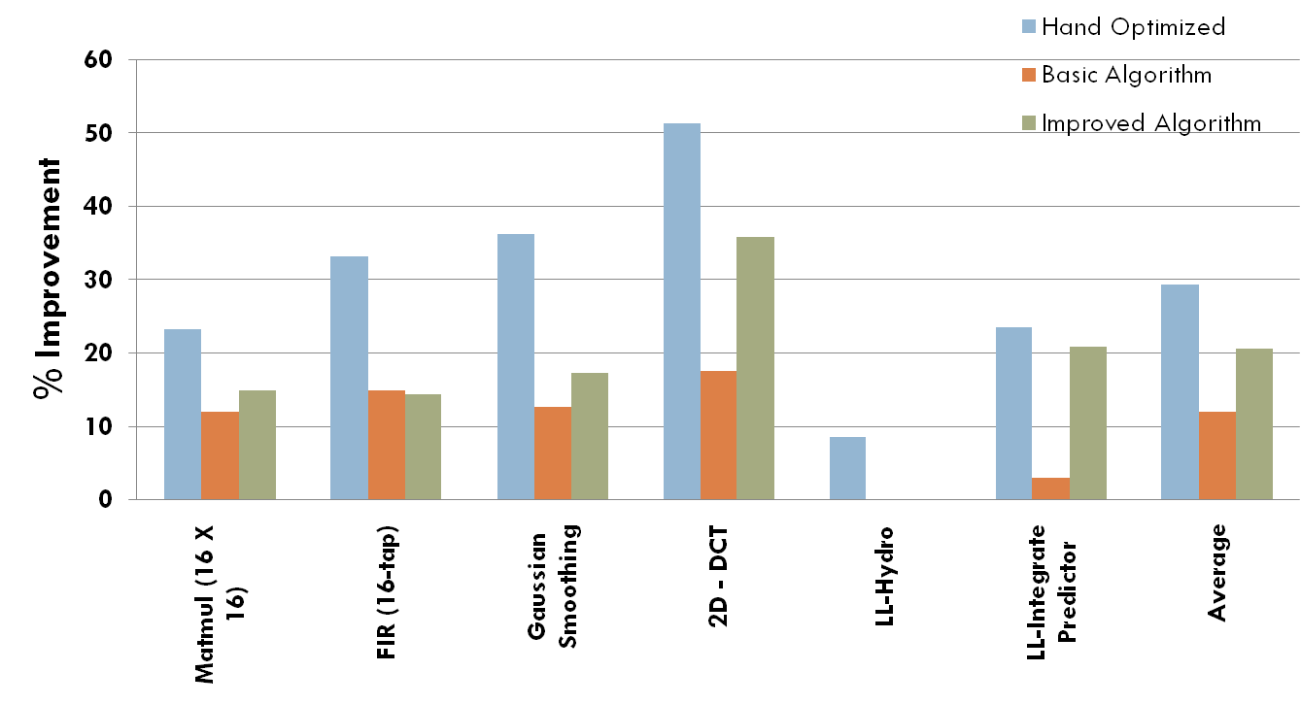
Experimental Results
Simulation of compiled binaries & comparison with manually optimized code

Slide 30
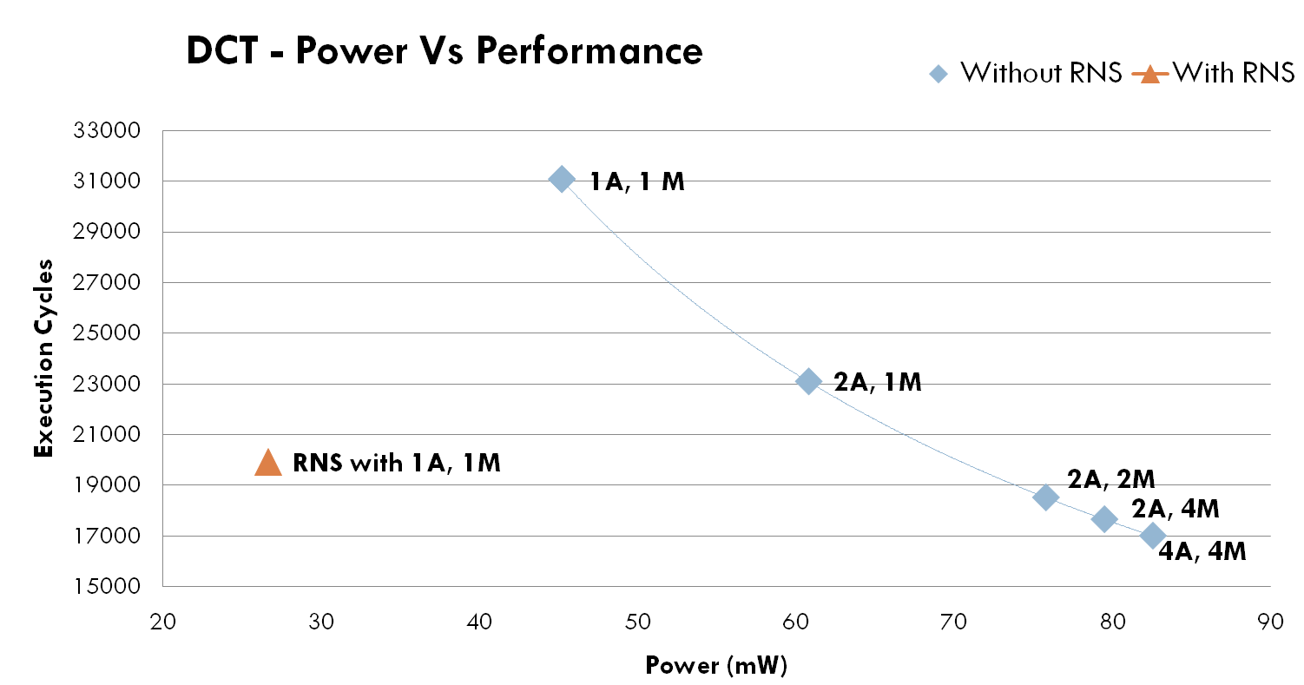
Experimental Results
Power vs Performance across multiple resource configurations

Slide 31
Agenda
Towards alternative number systems
Introduction to RNS
Aims and Objectives
Previous RNS Research
RNS Processor Challenges
Proposed Microarchitecture
Compiler Technique
Experimental Results
Conclusions

Slide 32
Future Directions
More aggressive ISA optimizations
Moving conversions out of the processor pipeline?
Extend technique from operating at basic block level to super-block or hyper-block level
Code annotation for improved compiler analysis?

Slide 33
Publications
Residue Number Enhancements For Programmable Processors – to be submitted to Design Automation Conference (DAC)
Residue Number Enhancement For Programmable Processors – to be submitted to IEEE Transactions on Computer Aided Design (T-CAD)

Slide 34
Conclusions
Proposed a RNS-based extension for RISC processors.
  Computation separated from conversion, carry-save operand representation, balanced moduli
  Enables hiding overheads
Developed first compiler techniques for automated analysis and code mapping to RNS units.
  Basic technique finds and maps profitable MRES
  Improvements for conversions in loops, addition pairing
20.7% improvement in performance.
51.6% improvement in functional unit power.
Thank You !

Slide 35
Extra Slides

Slide 36
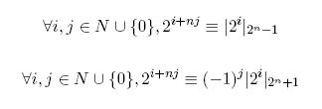
Design of Hardware Units
Property of Periodicity of Residues
Bit at (i+nj)^{th} is equivalent to bit at i^{th}
  Align bits according to this rule when reducing bits in CSA tree

Slide 37
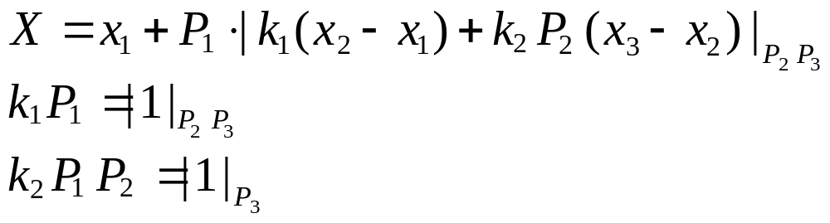
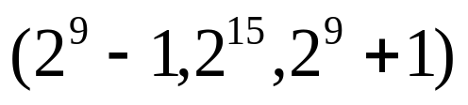
Design of Hardware Units
Reverse Converter
  Based on New Chinese Remainder Theorem by Wang et al.
  Designed for

