Slide 1

Scalable Register File Architectures for CGRA Accelerators
Shail Dave
Compiler Microarchitecture Lab
Arizona State University
http://aviral.lab.asu.edu/cgra/

Slide 2
Need for Power-Efficient Acceleration
Ubiquitous problem of computing
Required power-efficiency cannot be provided by multicores alone.
Need some form acceleration.
Possible Alternatives
ASICs – Poor usability
FPGAs – Reconfigurable but, less power efficient (fine-grained)
SIMDs/Vector Processors - Hard to program. Inefficient if parallelism is irregular
GPUs – Popular. Unable to accelerate loops that {are non-parallel, incurs conditionals, have low trip-counts}
Need a technology that can achieve more acceleration with much higher power-efficiency!

Slide 3
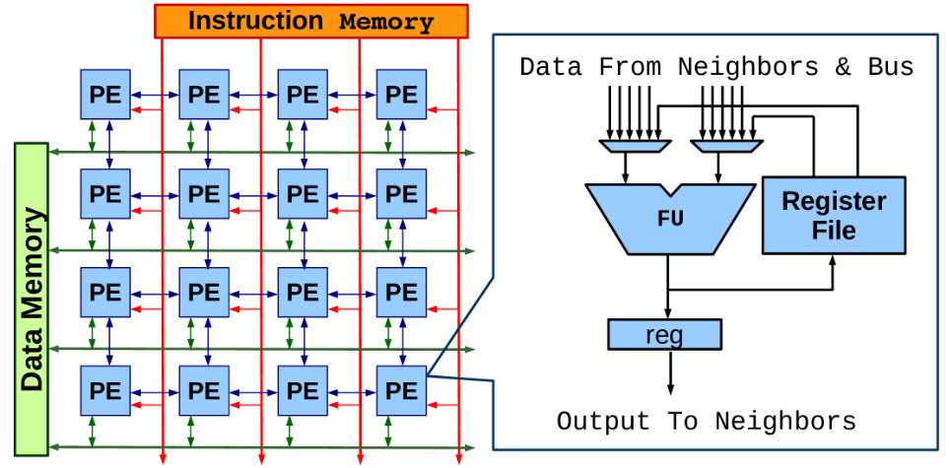
CGRAs: A Promising Technology
Coarse Grained Reconfigurable Array (CGRA) is array of Processing Elements (PEs). Each PE has a functional unit that works on an operation on every cycle.
Array configurations very in terms of –
Array Size
Functional Units
Interconnection N/w
Register File Architectures
4x4 CGRA with local RF and 2-D mesh interconnect. PE computes fixed point logic.
Quick Facts
Can achieve power-efficiency of several 10s of GOPS/sec per watt!
Popular in Embedded Systems and Multimedia. (Samsung SRP processor)
Notes:
Recent works* also demonstrate that CGRAs are 2x more energy-efficient than SIMDs for imaging applications; FPGA takes 1.4 times more energy than CGRAs.
*Vasilyev et al., MICRO 2016 (Stanford)

Slide 4
Mapping Applications On CGRAs
for (i=2; i<1000; i++) {
A[i] = B[i-2] – 4;
B[i] = A[i] + 5;
C[i] = B[i] * 3;
}
a:
a
A[i] = B[i-2] – 4;
2
b:
B[i] = A[i] + 5;
b
c:
C[i] = B[i] * 3;
c
a Critical Loop
Data Dependency Graph
1
R
2
R
R
R
Compiler Provides Mapping of DDG to CGRA
1x2 CGRA with local rotating RF (1 register, depth = 2)
Rotating RF employs shift registers, Values are shifted at some cycles.
Notes:
- RFs are rotating and with a depth.

Slide 5
Mapping Applications On CGRAs
time
a
A[2] will use B[0] = 2 (initial)
a
i = 2
i = 3
i = 4
0
2
Iterative Modulo Scheduling – Every operation is executed at II cycles.
b
b
b
1
A[3] will need B[1] = 4 (initial)
c
a
c
2
b
Data Dependency Graph
Initiation Interval aka II is performance metric.
b
b
1
R
2
R
3
b
R
R
a
b
c
II = 2
4
b
A[4] gets prior computed B[2]
Let’s assume that B[1000] = {2, 4, -3, 29, …..}
Software Pipelining– Array can execute operations from two iterations simultaneously. This empowers to accelerate even non-parallel loops through the CGRAs.
Registers are rotated at every 2 cycles.

Slide 6
Not All Variables are Recurring
Recurring (Repeatedly Written and Read)
Generated during kernel execution (for intermediate use)
Stored in the rotating registers.
Nonrecurring
Constants in program (e.g., base address of an array)
Immediate (constants in instructions) CGRA instructions has to deal with more fields and complexity, meaning immediate bits can be about 10 bits.
for(i=0; i < 1000; i++) { sum += series[i]; count += 1; 16bitLSB = sum & a;
}
recurring
immediate
constant

Slide 7
Why I Cannot Store Constants in Rotating RF?
If the constants are stored into rotating RF, they must undergo rotation.
So, incorrect values can be accessed or values can be easily overwritten. This results into incorrect output!!!
const
const
Read constant from index 0
After rotation at II cycles
RF is rotated at each II cycles.
Rotating RF

Slide 8
How to manage both recurring and non-recurring variables in an efficient and scalable manner?

Slide 9
Prior Approaches
Recurring variables (repeatedly read and written) are frequently accessed. Hence, are stored into local rotating RF.
Nonrecurring variables (constants) can be accessed via –
1) On-Chip Memory 2) Global Register File
PE
PE
PE
PE
Global RF
PE
PE
PE
PE
PE
PE
PE
PE
Local Data Memory
PE
PE
PE
PE
PE
PE
PE
PE
PE
PE
PE
PE
PE
PE
PE
PE
PE
PE
PE
PE

Slide 10
Limitations of Using Memory for Constants
Although simple, accessing on-chip memory results in extra load operations, which reduces potential performance because-
In most of CGRAs, only few PEs (green) can perform memory operation.
Often the load/store bandwidth is limited in CGRAs.
PE
PE
PE
PE
PE
PE
PE
PE
Local Data Memory
PE
PE
PE
PE
PE
PE
PE
PE
Few works* considered issue of increased pressure on memory.
Solution? Use registers of global RF.
Can do Memory Operation
* Park et al., PACT 2008 & LCTES 2009 (Univ. of Michigan)

Slide 11
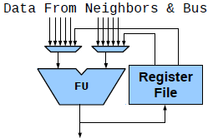
Limitations of Using Global RF for Constants
Global RF may not Scale; Degrades Performance
Prior RF explorations* demonstrated need of connecting as much as PEs to global RF. However, it is also shown and evident that increasing R/W ports to connect more PEs can certainly degrade performance.
Global RF
PE
PE
PE
PE
PE
PE
PE
PE
PE
PE
PE
PE
Increases Instruction Width
Example: Need about 64 registers for a 4x4 CGRA
Each PE need 6 bits; PE has two inputs from RF, and an output to be written to RF. We need 18 (3*6) bits just to access global RF, in 32-bit instruction.
Increasing ISA width results in increased memory bus width and consequently, increase in area and power.
PE
PE
PE
PE
A CGRA with Global RF
1
2
3
A PE with a RF
* Kwok et al., FCCM 2005 (Univ. of British Columbia)

Slide 12
Local Unified RF: A SW/HW Hybrid Approach
Recurring Values (Rotating Section)
Local
Not global/within each PE
Better Performance, Scalable
Unified
Will manage both recurring and non-recurring variables in the RF
Each PE has flexibility to use different number of rotating and nonrotating registers, for each loop!)
Hybrid
Software/Hardware mixed approach to manage the register lookup
sum⁰
PE
sum¹
totalCount
Local Unified RF
Constant (Nonrotating Section)

Slide 13
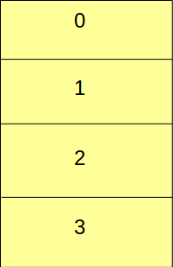
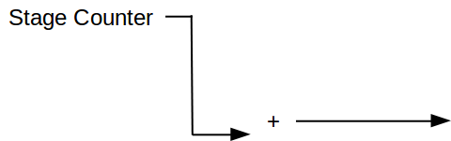


Modulo Addition Based Indexing for Rotating RF
Example: We need to store loop-carried values of variable d across four different iterations. We can do so by implementing rotation through modulo addition based indexing.
Example: We need to store loop-carried values of variable d across four different iterations.
Iteration 4
Iteration 3
Modulo 4 Results Into Register 0
Iteration 2
Iteration 0
Iteration 1
3
2
1
4
d⁰
0
d⁴
d⁴
d³
d²
d⁰
d¹
32
d¹
Virtual Register Index
3
2
Ri = 0
0
1
0
d²
32
(Log4) = 2 bit adder for modulo operation
d³
Overflow from addition results in modulo operation!
Regular or Nonrotating Register File
We need to still merge registers for constants!

Slide 14
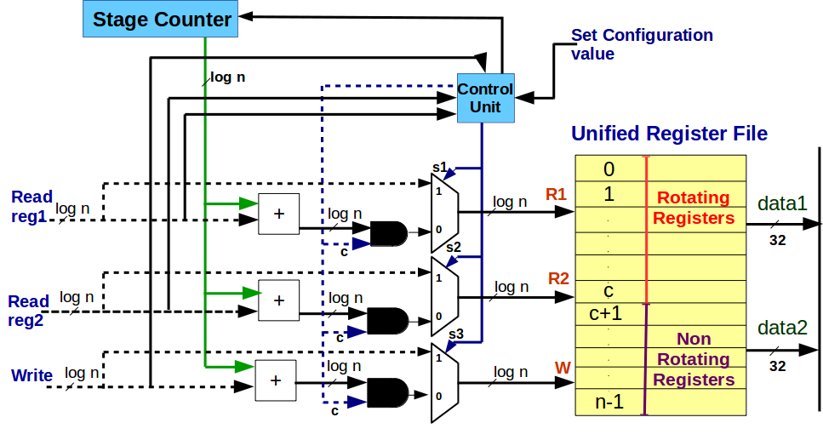
Unified RF and Its Configuration
Example: RF size = 6, c =3 (4 rotating registers)
Compiler generates value ‘c’ to configure the boundary
Case 2: Reg index = 0 Iteration = 4
Case 1: Reg index = 5
Generate s = 1
Generate s = 0
5
4
4
0
0
3
c = 3
32
‘c’ is max. register index inside rotating section.

Slide 15
Key Contributions
Proposal of Local Unified RF as an efficient and scalable solution
Compiler management of unified RF
Register calculations/reservations
Generation of configuration boundary
Integration with any CGRA compiler technique

Slide 16
What a Compiler Must Do?
For each operation being mapped on a PE, calculate and reserve –
Nonrotating registers required (based on constant predecessor or live-in data)
Rotating registers required (based on the dependency with successor node)
Maintain the configuration boundary to separate rotating and nonrotating section of RF.
Recurring Values (Rotating Section)
boundary
Constants (Nonrotating Section)
If PE does not have enough registers, it should try other PEs or increase II. (Integration of solution with a mapping technique enables such flow.)
Pre-Load
Unified RF
Pre-load the constants into nonrotating registers of the RF
Produce final configuration boundary for each PEs

Slide 17
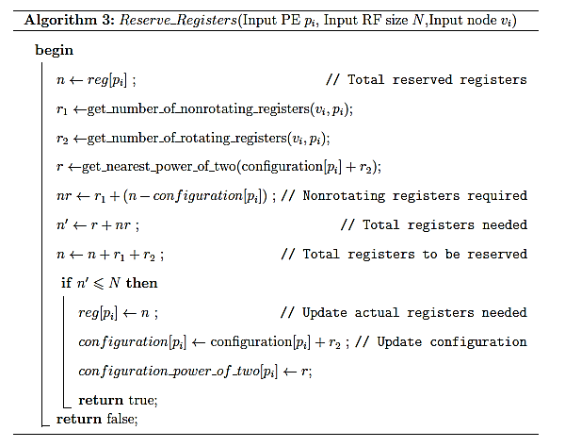
SW Management of Unified RF

Slide 18
Integration with a Mapping Technique
Input Data Dependency Graph
Generate Edge Set/Clusters/Cliques
Initialization
II ← MII
II ← II + 1
Retry
Calculate Costs/Reserve Resources
No
Yes
II > Total Attempts?
Yes
All Nodes Mapped?
Yes
No
No
Map All Nodes
Generate Configurations
Select Target Node & PE
Another PE Available?
No
Mapping
Mapping Failed
Success?
No
Yes
Mapping Succeeded
Reserve Registers
No
Success?
Yes
Update Costs/Resources

Slide 19
Experimental Setup
Compiler
LLVM v3.6
Mapping Technique
Register-Aware Mapping (REGIMap)
Validation
Gem5 processor simulator
Benchmarks
MiBench (Important, Performance-critical kernels)
RTL Validations
32 nm (Cadence Library)
PrimeTime (power)
Baseline
4x4 Homogeneous CGRA
Operation Latency: 1 cycle
Memory bus is shared with each row of array
On-chip Memory (4 kB)

Slide 20
Experiments
Accessing constants from memory, local rotating RF for recurring values
Comparing performance (in terms of mapping, number of cycles required)
Accessing constants from global RF, local rotating RF for recurring values
Global RF can certainly be beneficial in terms of sharing same data to multiple PEs and avoiding data duplication. However, local RF can provide performance at par of global RF.
Hence, comparison is made on basis of a cycle time (scalability).

Slide 21
Unified RF Performs Better than On-chip Memory
Lower the better
18%

Slide 22
Unified RF Reduces Mapped Nodes By 22.4%
Proposed approach reduces memory accesses!
Notes:
(it’s all about extra loads)

Slide 23
Local Unified RF Scales Better than Global RF
CGRA with Local Unified RF
Notes:
RTL validation achieves about 30 GOPS per sec per watt. 17.38% better cycle time

Slide 24
RF Configuration Improves Register Utilization than Separate RFs for Recurring Values and Constants
~ 4
~ 3

Slide 25
Summary
Advocated for a scalable solution of local unified RF.
Improves performance, compared to accessing on-chip memory.
Also scales better than global RF.
Managed all variables in a single register file; Compiler tackles the complexity -
Determines register requirements, allocate registers, and configures the boundary of the unified RF, which results in the effective register utilization.
Preloads the constants into RF
Can be integrated with any mapping technique.

Slide 26

Thank you !

Slide 27
FAQ

Slide 28
Q: Why I cannot completely manage register rotation/indexing in software?
A:
Yes, it can be definitely managed. However, to do so, you need to access different register index due to loop carried dependence or software pipelining. This means that if there is a loop-carried dependence of 5 or 10, you need to have kernel enrolled for 5 iterations.
This implies that for a 8x8 CGRA, now 5 times more instructions should be generated and provided for each PE, means instruction memory size should increase by 5X, meaning increased area and power.
So, there is a design trade-off, depending on applications. Here, proposed solution is very general, targeting management of both variables in a single register file and proposed compiler solution does that successfully.

Slide 29
Q: Why it is hybrid approach (HW role vs. software role)
A:
Hardware manages both the variables (recurring values and constants) in a single regular register file. To do so, it adopts modulo addition based indexing to correctly access recurring values. Hardware has flexibility through configuration to access different number of registers in both – rotating and nonrotating sections.
Compiler tackles all sort of complexity to generate such configuration for hardware, depending on the applications. It efficiently allocates registers and also preloads the constants in the prologue. Proposed software approach is generic for any CGRAs and can be well integrated with any CGRA mapping technique.

Slide 30
Q: What are the limitations of your work?
A:
Work faces few limitations -
1) due to incorporation of modulo based indexing
Modulo addition based indexing requires the number of rotating registers (to store recurring values) must be some power of 2 and it is trade-off between simple hardware design vs. modulo 2 operation. This work targets managing both the variables and so has to adopt such indexing mechanism.
2) CGRA compilers cannot break down register requirements
CGRA compilers can map an operation only if a processing element (PE) can accommodate register requirement in register file. This is also applicable to this work.

Slide 31
Q: Future Work
A:
1) Register allocations in case of different RF structures for CGRAs
CGRA design can choose to have both local and global RF. In such case, registers should be allocated in which register file first, by the compiler? Such decisions can affect the design cost and the performance, leaving a room for such optimizations. Well designed scheme can achieve better management and power-efficient acceleration.
2) CGRA compilers cannot break down register requirements
CGRA compilers can map an operation only if a processing element (PE) can accommodate register requirement in register file. Hence, approach of breaking down register requirements and distributing allocations through multiple RF can certainly be a good optimization.

Slide 32
Q: Why not compare against shift registers?
A: Firstly, NO Prior Works Can Manage BOTH recurring values and constants altogether.
Implementing rotation through modulo based indexing is intuitive and well adopted now-a-days by in place of shift registers, by CGRA chip designers and few other research groups*. Still, they cannot manage both variables together. In case of global RF, RTL results already show that cycle time increases in case of using global RF. So, certainly local unified RF is a better choice.
Accessing memory increases load operations, degrades performance (with much higher cycles; generates bus contention) and again not the best approach. (Imagine 18% extra cycles or 18*II extra cycles). * essen et. al , FPL 2010 (Univ. of Washington), Mei et al. (Springer)
Notes:
It incurs little higher area (12%) but better energy savings (34%)

Slide 33
Q: How this work is different than prior works on RFs or RF explorations?
A: Prior works have been RF explorations, where they do not compare on basis of scalability. Mainly, they do not provide information on how register management can be done at compiler level.
Scalability experiment and comparison with prior approaches make this work unique to establish as an efficient solution. Besides, whole idea is based on transferring the complexity at compiler level to correctly calculate and allocate registers needed. It also provides correct configuration to hardware for flexibly allocate different registers for both variables, depending on application kernel. Finally, the proposed software approach can be well integrated with any CGRA mapping technique.

