Slide 1


URECA: A Compiler Solution to Manage Unified Register File for CGRAs
Shail Dave, Mahesh Balasubramanian, Aviral Shrivastava Compiler Microarchitecture Lab Arizona State University

Slide 2
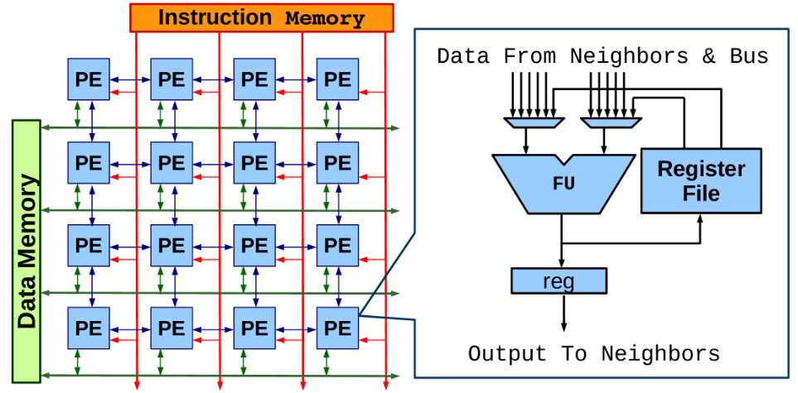
Coarse Grained Reconfigurable Array (CGRA)
An array of Processing Elements (PEs); each PE has ALU-like functional unit that works on an operation at every cycle.
Array configurations vary in terms of –
• Array Size • Reg. File Architectures
• Functional Units • Interconnect Network
Quick Facts
CGRAs can achieve power-efficiency of several 10s of GOps/sec per Watt!
- ADRES CGRA, upto 60 GOps/sec per Watt (HiPEAC 2008)
- HyCUBE, M. Karunaratne et al., about 63 MIPS/mW (DAC 2017)
Popular in Embedded Systems and Multimedia. (Samsung SRP processor)

Slide 3
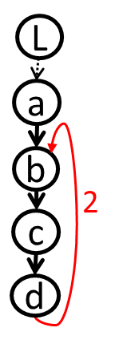
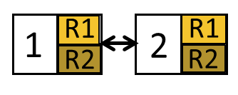
Mapping Loops on CGRAs
for (i=2; i<1000; i++){
A[i] = L - 4;
B[i] = A[i] + D[i-2];
C = B[i] * 3
D[i] = C + 7;
}
a:
time
i
i-1
L
b:
c
c:
t
d:
a
d
Sample Loop
t+1
II = 3
Iterative Modulo Scheduling
Each loop iteration is executed at II cycles
t+2
b
i+1
DDG
t+3
L
c
Software Pipelining:
Operations from 2 different loop iterations execute simultaneously
a
d
t+4
1x2 CGRA

Slide 4
Recurring Variables are Managed in Rotating RF
In a software pipelined schedule, liveness of a variable outcomes can overlap.
E.g., Loop-carried dependence.
b^{i} (operation b in i^{th} iteration) needs d^{i-2}. 2 different values to be stored in 2 registers.
Register read/write occurs with same register index.
b always reads from R2.
d always writes to R1.
time
i
i-1
L
c
d
i-3
t
d
i-2
a
i-1
d
t+1
d
i-1
d
i-2
II = 3
load
b
d
i-1
t+2
d
i-2
i+1
Rotate Reg. Values
L
c
d
i-2
t+3
d
i-1
a
d
d
i
t+4
d
i-1
Rotation of register values occurs at every II cycles to avoid overwrite.

Slide 5
Not All Variables are Recurring
Recurring (Repeatedly Written and Read)
Generated during kernel execution (for intermediate use)
Stored in the rotating registers.
for(i=0; i < 1000; i++) { sum += series[i]; count += 1; 16bitLSB = sum & a;
}
recurring
immediate
Nonrecurring
Constants in the program (e.g., live-in values including larger 32-bit values such as base address of an array or signed values)
Immediate (constants in the instructions) CGRA instructions have to deal with more fields and complexity, meaning immediate bits can be about 8 to 12 bits.
constant

Slide 6
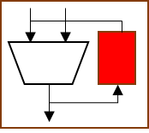
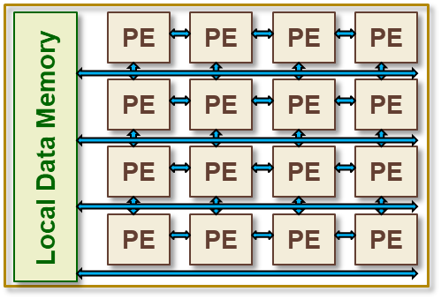
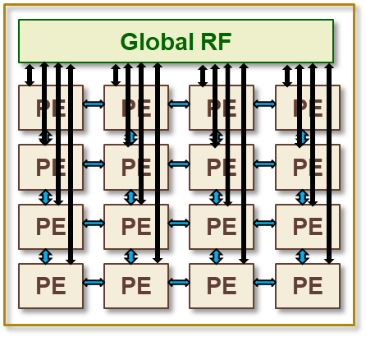
Prior Approaches of Managing Variables
Recurring variables (repeatedly read and written) are frequently accessed, stored into local rotating RF.
Nonrecurring variables (constants) can be accessed via –
1) On-Chip Memory 2) Global Register File
PE

Slide 7
Unified Register File
Unified RF can contain both recurring and nonrecurring values
The separation is determined by the RF configuration
URECA targets local unified RF*
Local RFs are Smaller and Scalable
configuration boundary
Recurring Values (Rotating Section)
sum⁰
sum¹
PE
totalCount
inputPtr
Nonrecurring
Variables (Nonrotating Section)
Local Unified RF*
*M. Hamzeh, Compiler and Architecture Design for Coarse-Grained Programmable Accelerators. 2015

Slide 8
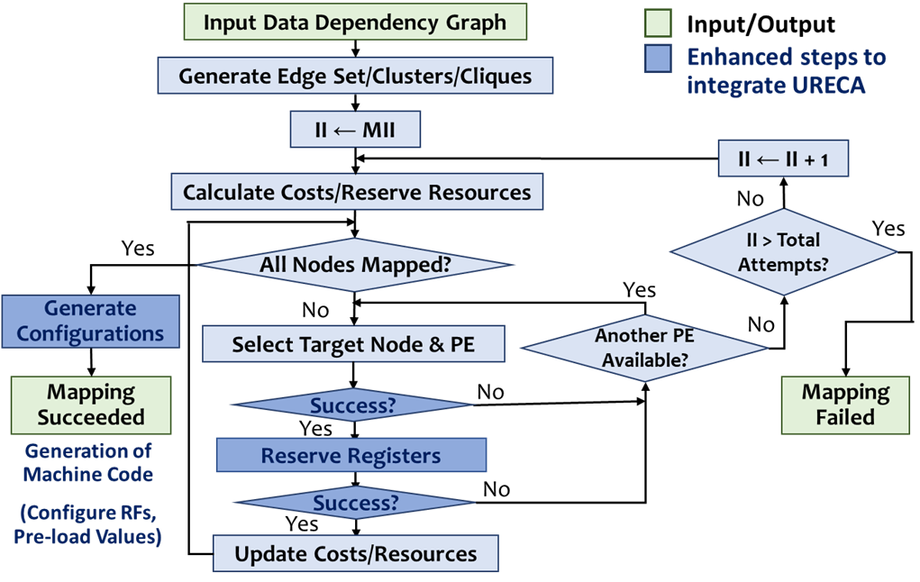
What Must the Compiler Do?
Register allocation is integrated with P&R phase of the compiler. To ensure valid and efficient mapping, the compiler needs to:
Analyze register requirements for each operation being mapped and determine the registers are required inside the rotating and nonrotating sections of the RF.
For the operations mapped, keep track of allocated registers.
Determine RF configurations for all PEs.
Generate the code to pre-load nonrecurring variables.
Generate machine instructions to dynamically configure RFs of the PEs.

Slide 9
How URECA Analyzes Register Requirements?
For each operation being mapped, compiler determines total registers for –
Nonrotating registers required (for nonrecurring variables)
Compiler determines live-in/live-out values for the variable based on the User-Definition analysis.
If any constant value (e.g., 0xFFFF) is larger than size of immediate bits in CGRA instruction, it is also a nonrecurring variable.
In allocating registers, data reuse analysis avoids duplication; same nonrecurring variable is required by multiple operations mapped on a PE.
Rotating registers required (for recurring variables)
Determined based on the modulo schedule time of the dependent predecessor/successor operations.
Honor inter/intra-iteration dependencies.

Slide 10
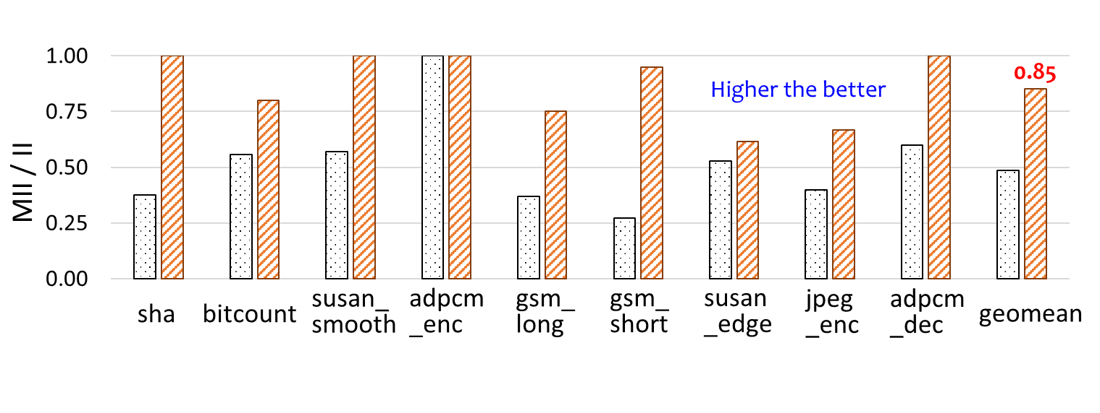
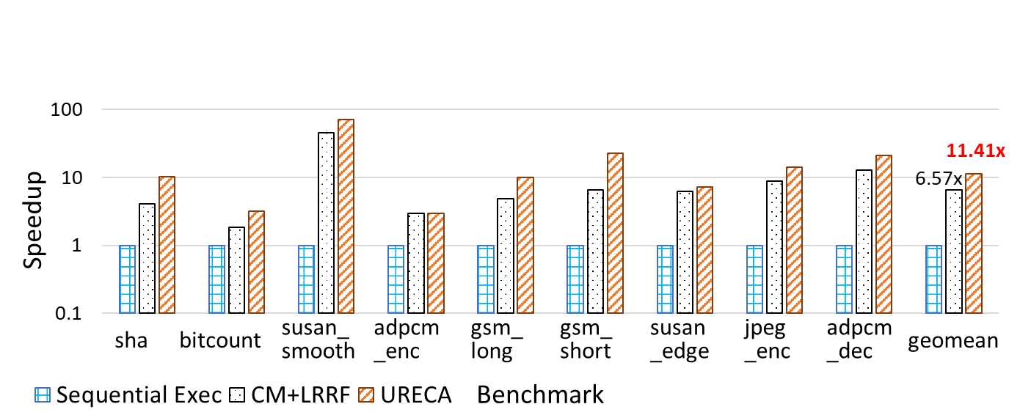
URECA Improves CGRA’s Acceleration Capability by 1.74x

Slide 11
Summary
URECA efficiently manages all the variables in unified RF
Compiler promotes variables from the memory to CGRA registers.
It improves performance by 1.74x, as compared to CGRA accessing nonrecurring variables from the on-chip memory.
Reduces register requirements by about 39% and reduces energy consumption by 32%.
Compiler determines register requirements and allocates registers for both recurring and nonrecurring variables.
Configures boundary of the RF and enables CGRA PEs to flexibly support different register requirements for different mappings of different loops, promoting general-purpose computing on CGRAs.

Slide 12

Thank you !

