Slide 1
nZDC: A compiler technique for near-Zero silent Data Corruption
Moslem Didehban, Aviral Shrivastava
Arizona State University

Slide 2
Need to detect SDCs by software techniques
Transient faults/Soft errors as a major threat for reliability
Silent data corruption (SDC) as the most difficult errors to detect
Usually not generating any symptom
Not detectable by simple hardware/software detectors
Full replication
Software-level
Flexible
Hardware-level
Considerable hardware modification is necessarily!
Not possible in resource-constrained embedded systems
Check the results for error detection
Notes:
Ever-increasing usage of digital devices in todays life, has made reliability as one of the most important design concerns.
Transient faults or soft errors have been considered as the major threat for modern microprocessor reliability.
Some soft errors cause abnormality in program execution and are easily detectable by operating systems. However, some errors go unnoticeable and lead to an incorrect output. These errors are called Silent Data Corruptions or SDC.
Full duplication is one way to protect the computation from soft errors.
If full duplication takes place in hardware-level it will be very expensive – because a fully duplicated processor needs as more than twice transistors as a normal processor
Software-level full duplication, however, can provide full error coverage without any additional hardware cost.

Slide 3
Software-level full duplication is not as easy as it sounds!
Process-level duplication
I/O can not get duplicated
Checking before library calls
How to check? – inter-process communication is needed
What to check? – arguments are usually pointers
Needs operating system modifications
Assembly-level Instruction replication
Provide fine details of the actual execution
Compatible with compiler optimizations
SWIFT (SoftWare Implemented Fault Tolerance)
Notes:
SWIFT has more than 500 citatins
Works after SWIFT, admit to near perfect fault coverage of SWFT and try to improve its performance overhead

Slide 4
SWIFT (SoftWare Implemented Fault Tolerance)
Duplicate computational instructions
Check before memory and compare instructions
= Vulnerable
= Protected
mov x1, #0x04
mov x1*, #0x04
mov
mov
cmp x1, x1*
b.ne error
load x2, [x1]
mov x2*, x2
Checking Value
Unreliable Code
load
mov x1, #0x04
load x2, [x1]
add x2, x2, #0x10
and x1, x2, #0x10
store x2, [x1]
Load value duplication
add x2, x2, #0x10
add x2*, x2*, #0x10
and x1, x2, #0x10
and x1*, x2*, #0x10
add
add
and
and
cmp x2, x2*
b.ne error
cmp x1, x1*
b.ne error
store x2, [x1]
Checking Address
Checking Value
store
Notes:
In this slide, I show the state-of-the-art instruction duplication technique, which is called SWIFT. Leveraging this fact that the memory subsystem can be protected by ECC efficiently, SWIFT duplicates all instructions and check for the errors before memory and compare instructions.
SWIFT transformation divides the instructions inside a program into two groups: 1) duplicable or protected, and, non-duplicable or unprotected. So, the question is how big are these unprotected instructions.

Slide 5
SWIFT leaves more than 40% of the instructions as unprotected
Source: “MiBench: A free, commercially representative embedded benchmark suite.” The University of Michigan.
Notes:
This figure show the dynamic instruction distribution for Mibench and speech benchmarks program.

Slide 6
SWIFT Sphere of protection
Protected by ECC
Data and Instruction caches
Not Protected
Only unduplicated instructions using these resources (loads, Stores and branches)
Partially Protected
Unprotected during the execution of unduplicated instructions (loads, Stores, branches and Compares)
Completely Protected by SWIFT
Always duplicated instructions (logical and computational instructions)
Protected by ECC
Unprotected
L1 Instruction Cache
Partially Protected
Fetch
Completely Protected
Decode
Register
File
Issue
S
L
F1
F2
M
B
I1
I0
Load-Store Unit
Store
Load
NEON/FPU
NEON/FPU
Multi-Cycle ALU
Branch
Integer ALU
Integer ALU
Store Buffer
L1 Data Cache
Write Back

Slide 7
nZDC: Compiler transformations for complete protection
Goal
Protect the execution of all instructions in all hardware components
Duplicate all instructions
Logical and Computational Instructions
Already duplicated by SWIFT
Memory read instructions
Memory write instructions!
Checking load instructions as duplication
for Stores
Compare instructions
Get duplicated by nZDC CFC
Branch instructions!
Direction is checked as well as the
target address
Protected by ECC
L1 Instruction Cache
Unprotected
Partially Protected
Fetch
Completely Protected
Decode
Register
File
Issue
Load-Store Unit
S
L
F1
F2
M
B
I1
I0
Store
Load
NEON/FPU
NEON/FPU
Multi-Cycle ALU
Branch
Integer ALU
Integer ALU
Store Buffer
L1 Data Cache
Write Back

Slide 8
nZDC data flow transformation
Duplicate all data-flow instructions
Check for correct execution after stores
Load back the written value from the memory and check against the stored value
mov x1, #0x04
mov x1*, #0x04
load x2, [x1]
load x2*, [x1*]
Unreliable Code
mov x1, #0x04
load x2, [x1]
add x2, x2, #0x10
and x1, x2, #0x10
store x2, [x1]
add x2, x2, #0x10
add x2*, x2*, #0x10
and x1, x2, #0x10
and x1*, x2*, #0x10
store x2, [x1]
load x2, [x1*]
cmp x2, x2*
b.ne error
Notes:
Main idea: Duplicates all data-flow instructions and check for the correct execution after stores by loading back from the memory and comparing the loaded value against the written value

Slide 9
Check memory write instructions
Check after store
nZDC
SWIFT
Checking load
Duplicable
computations
Duplicable
computations
Duplicable
computations
Duplicable
computations
cmp x1, x1*
b.ne error
cmp x2, x2*
b.ne error
store x2, [x1]
store x2, [x1]
cmp x1, x1*
b.ne error
cmp x2, x2*
b.ne error
store x2, [x1]
load x2*, [x1*]
cmp x1, x1*
b.ne error
cmp x2, x2*
b.ne error
store x2, [x1]
load x2, [x1*]
cmp x2, x2*
b.ne error
-- RF vulnerable intervals
-- “store” is unprotected
++ address part is protected
-- data part is vulnerable
++ Eliminate RF vulnerable intervals
-- “store” is unprotected
++ “store” is protected
++ optimal number of checks

Slide 10
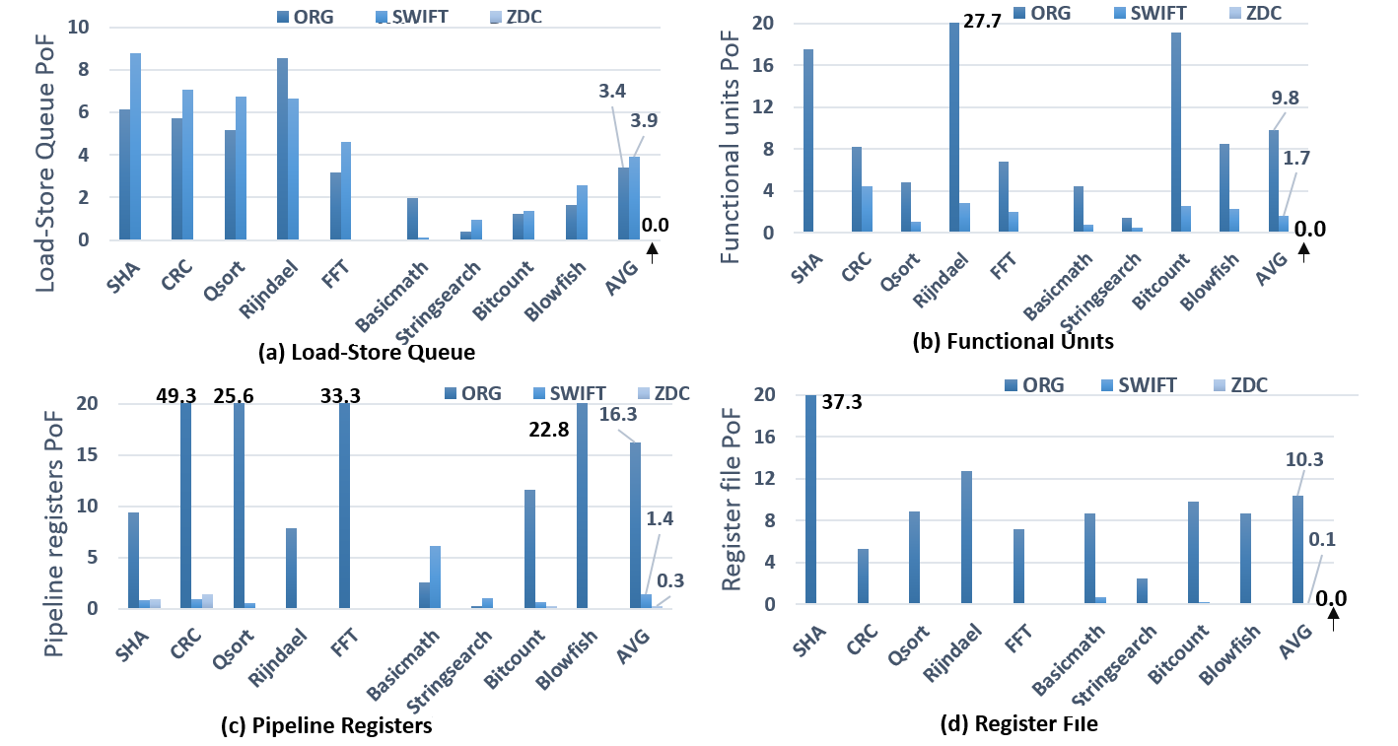
nZDC detects all SDC
nZDC and SWIFT are implemented as late backend passes in LLVM 3.7
More than 70K faults are injected in an ARM-cortex A53 like processor in Gem5
0.0

Slide 11
nZDC Control flow mechanism is very effective
Faults are injected on Branch and compare instructions
18%
0.4%
nZDC-protected programs execute faster than SWIFT-protected ones

Slide 12
Summary
Soft error problem can be solved by software-only fault tolerant techniques
Full instruction duplication should solve the problem
Full duplication is not effective in some cases…
Memory write operations
Branches
FLAG register
However, the correct execution should be checked
Branch direction checking is important
nZDC provides complete processor-level protection in software, at competitive overhead as hardware techniques

