Slide 1

InCheck: An In-application Recovery Scheme for Soft Errors
Moslem Didehban
Sai Ram Dheeraj Lokam
Aviral Shrivastava

Slide 2
Silent Data Corruption in processor-wide Fault Injection
Segmentation Fault
Recognizable Change
in program behaviour
ARM Cortex
A 53
Program Abort
Masked
No Change
in program behaviour
Recovered (Not applicable to unprotected programs)
Silent Data Corruption - SDC
Un-Recognizable Change
in program behaviour
72,000 Random Faults
Processor components subjected to FI
Register File
Load Store Queue
Pipeline Registers
Functional Units
Notes:
ITRS roadmap for 2015 lists Muon-induced soft-errors as a major reliability challenge in both near term and long term microprocessor designs.

Slide 3
Goal of InCheck:
Implementing a software level protection technique which,
guarantees “Zero” Output Corruption
provides “Safe” recovery from detected soft-errors

Slide 4
Software techniques to detect SDCs
Flexibility
They can optimized based on the workload characteristics without having to change the hardware
Coverage
There are software techniques that can provide very good SDC coverage.
Eg. nZDC (DAC 2016)
Notes:
Safety critical applications are mixed critical

Slide 5
SWIFT-R Transformation
SWIFT-R
mov x1, #0x04
mov x1*, #0x04
mov x1**, #0x04
Original Code
mov x1, #0x04
load x2, [x1]
add x2, x2, #0x10
and x1, x2, #0x10
store x2, [x1]
majority_voting (x1, x1*, x1**)
load x2, [x1]
mov x2*, x2
mov x2**,x2
majority_voting (R, R*, R**)
cmp R, R*
b.ne recover from R**
cmp R,R**
b.ne recover from R*
cmp R*,R**
b.ne recover from R
add x2, x2, #0x10
add x2*, x2*, #0x10
add x2**, x2**, #0x10
and x1, x2, #0x10
and x1*, x2*, #0x10
and x1**, x2**, #0x10
majority_voting (x2, x2*, x2**)
majority_voting(x1, x1*, x1**)
store x2, [x1]

Slide 6
Original vs SWIFT-R SDC Distribution

Slide 7
Pitfalls of SWIFT-R
cmp x1, x1* b.ne recover from x1** cmp x1, x1**
b.ne recover from x1*
cmp x1*, x1**
b.ne recover from x1
load x2, [x1]
mov x2*, x2
mov x2**,x2
LET happens on x1 after compare
Majority
Voting
load x2, [x1]
Un-safe Recovery
x1 recovered at next majority voting

Slide 8
Pitfalls of SWIFT-R
majority_voting (x2, x2*, x2**)
majority_voting(x1, x1*, x1**)
store x2, [x1]
Majority
Voting in performance critical path
store x2, [x1]
++ Vulnerability ++ Execution time
majority_voting (R, R*, R**)
cmp R, R*
b.ne recover from R**
cmp R,R**
b.ne recover from R*
cmp R*,R**
b.ne recover from R
Notes:
Reserved 60% of regs. Talk about register spilling.

Slide 9
SWIFT-R vs InCheck SDC Distribution
0
0
0
0
0
0
0
0
0
0

Slide 10
InCheck Framework
Verified Register Preservation
(*Ensures no Latent Error)
.BB
Recovery
Memory Restoration
Registers Restoration
Rollback to .BB
Redundant
Computations
YES
Memory Checkpointing
Store
Diagnosis
Error Detected?
YES
Is recovery Safe?
NO
Unrecoverable
Error

Slide 11
Performance evaluation:
nZDC+InCheck programs run 36% faster than their SWIFT-R counterparts

Slide 12
Breakdown of Recoverable & UnRecoverable Errors in InCheck

Slide 13
Thank you!

Slide 14
Back up

Slide 15
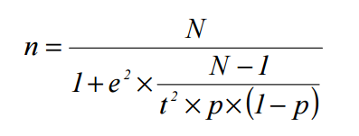
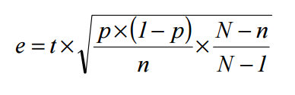
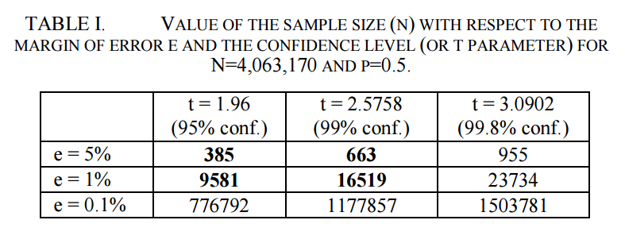
Statistical Fault Injection
N – Initial Population Size
p – estimated probability of faults resulting in a failure (standard error)
e – margin of error
t – confidence level. Probability that the exact value is actually within the error interval (computed w.r.t Normal distribution)
*Leveugle, Régis, et al. "Statistical fault injection: quantified error and confidence." 2009 Design, Automation & Test in Europe Conference & Exhibition. IEEE, 2009.

Slide 16
SWIFT vs SWIFT-R

