Slide 1


NEMESIS: A Software Approach for Computing in Presence of Soft Errors
Moslem Didehban, Aviral Shrivastava, Sai Ram Dheeraj Lokam

Slide 2


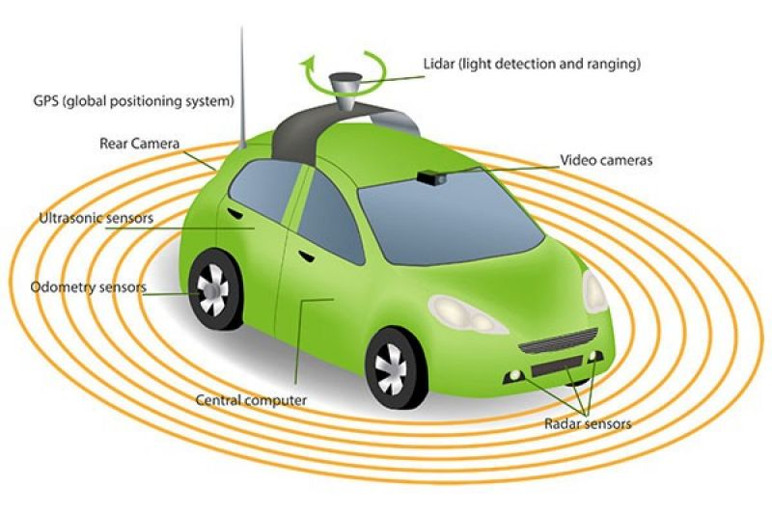
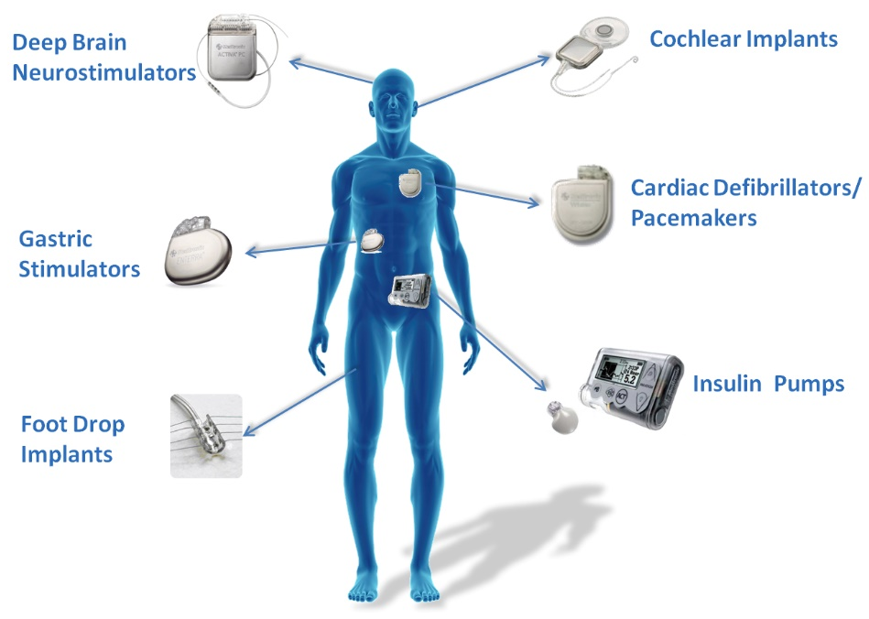
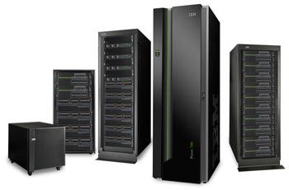
Reliability is important!
Notes:
Todays computer based systems are virtually everywhere,
inside our body … wearables and
Many of this applications are either safety or mission critical
For example, CPS systems like autonomous cars and drones, are clearely safety critical … and their failure come with severe consequences…

Slide 3
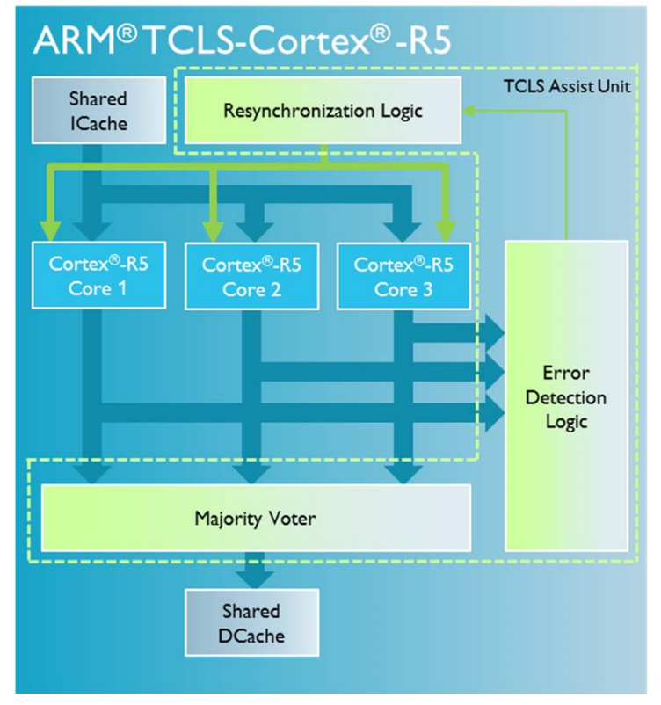
Soft error protection is required
Soft errors: Historically, a problem for high-altitude applications
ITRS 2015 predicts soon even ground-level applications will be at risk.
Failure rate is expected to increase:
More components → more failures
Solution: Redundancy
Hardware-level solutions
ARM Cortex-R Dual lockstep processor
Software-level solutions
Time redundancy (Flexible)
Notes:
Transient faults/Soft errors a major thread for reliability
Die size grows by ~14% to satisfy mores low
Threshold voltage decreases
Hundred times more frequent than hard errors
Sources of soft errors
Cosmic rays and alpha particles
Noise in power supply
Electromagnetic interference
Temperature, pressure, voltage, vibrations
“The nation depends on fragile software”
Information Technology Research: Investing in Our Future, 1999

Slide 4
Software-level error resilience scheme
Instruction-level soft error tolerant schemes
Error Detection
Majority-voting
Examples: EDDI[2002], SWIFT[2005], Shoestring[2010], DRIFT[2013], SIMD-Based Soft Error Detection [16], IPAS [2016], nZDC [2016]
Examples: SWIFTR[2007], selective-SWIFTR[2013], ELZAR [2016]

Slide 5
A Closer Look into SWIFR
movl -4(%rbp), %eax
cmpl -8(%rbp), %eax
jne .L2
movl -4(%rbp), %eax
cmpl -12(%rbp), %eax
jne .L2
movl -8(%rbp), %eax
cmpl -12(%rbp), %eax
je .L6
.L2:
movl -4(%rbp), %eax
cmpl -8(%rbp), %eax
jne .L4
movl -4(%rbp), %eax
movl %eax, -12(%rbp)
jmp .L6
.L4:
movl -4(%rbp), %eax
cmpl -12(%rbp), %eax
jne .L5
movl -4(%rbp), %eax
movl %eax, -8(%rbp)
jmp .L6
.L5:
movl -8(%rbp), %eax
cmpl -12(%rbp), %eax
jne .L6
movl -12(%rbp), %eax
movl %eax, -4(%rbp)
.L6:
Redundant computations
if ((adr != adr*) || (addr != adr **) || (adr * != adr **)){
if (adr == adr *) // addr ** is faulty
adr ** = adr;
else if (adr * == adr **) // addr is faulty
adr = adr *;
else if (adr == adr **) // addr * is faulty
adr * = adr;
}
val*, addr*
Val**, addr**
val, addr
Majority-voter(val, val*, val**)
Majority-voter(adr, adr*, adr**)
store val→[addr]

Slide 6
Limitations of SWIFTR
Almost half of instructions (memory and control flow) are unprotected
Register file vulnerability introduced by frequent and long voting operations
Majority voting operations should take place before all memory and compare operations
~45%

Slide 7
Experimental results
Segmentation Fault
Recognizable Change
in program behaviour
ARM Cortex
A 53
Program Abort
Masked
No Change
in program behaviour
Recovered
Silent Data Corruption
Wrong Output
(~2.4%)
(~5%)
Notes:
10 million micro-architectural level random fault injection experiments on Original and SWIFT-R protected programs
Schirmeier, Horst, Christoph Borchert, and Olaf Spinczyk. "Avoiding pitfalls in fault-injection based comparison of program susceptibility to soft errors." Dependable Systems and Networks (DSN), 2015 45th Annual IEEE/IFIP International Conference on. IEEE, 2015.

Slide 8
Reliability is hard to achieve!
“Organization of redundancy and fault-tolerance for ultra-high reliability is a challenging problem: redundancy management can account for half the software in a flight control system and, if less than perfect can itself become the primary source of system failure.”
-- John Rushby https://shemesh.larc.nasa.gov/fm/fm-ft.html

Slide 9
NEMESIS
Goal: Protecting the execution of all
instructions without any vulnerable window
M- and D- streams are used for error detection and R-stream is used just for error recovery
Checking the result of critical instructions instead of their operands
Error detectors instead of voting-operations
Off performance-critical-path error handling
R-stream
D-stream
M-stream
Critical Operation
Off performance-critical-path error handling
Error
Diagnosis
routine
Error
Detector
Recoverable
Memory restoration
Majority-voting
No Error
Detected Not-Recoverable
Critical Operation
Restart

Slide 10
Error detection on the result of store operations
Main idea: Load back the result of store and check it against redundant version
M-stream
D-stream
Val
[adr]
Val, Adr
Val*, Adr*
store Val→[Adr]
load SCR← [Adr*]
if (SCR != Val*) Diagnosis();
Checking the results of store, verifies the execution of store as well as the correct operand computations
Memory
Notes:
Rather than checking store register operands, NEMESIS detects errors on the results of store

Slide 11
Challenges in checking the result of Store
M-stream
D-stream
Val
Faulty Address
Val
[adr]
Store is silent.
(The Store Value is presented in Store target address even before the execution of store)
Val, Adr
Val*, Adr*
store Val→[Adr]
load SCR← [Adr*]
if (SCR != Val*) Diagnosis();
Undetected
Memory
Errors on address part of silent stores remain undetected.
Notes:
First lest define silent stores..
On average ~20% of stores are silent

Slide 12
Solving the problem of Silent Stores
Main idea: Skip over silent stores
M-stream
D-stream
M-stream
D-stream
Val, Adr
Val*, Adr*
Val, Adr
Val*, Adr*
load VCR ← [Adr]
load SCR ← [Adr*]
If (SCR == Val)
mov SCR, VCR
Jump L;
store Val→[Adr]
mov SCR, VCR
load VCR← [Adr*]
L:
if (VCR != Val*) Diagnosis();
Silent Store Check
Silent Store Check
load SCR ← [Adr]
If (SCR == Val) Jump L;
store Val→[Adr]
load SCR← [Adr*]
L: if (SCR != Val*) Diagnosis();
Store Result Check
Store Result Check
Suffer from missing-memory-update errors

Slide 13
Error Diagnosis and recovery on store operations
Why do we need diagnosis routine?
Inter-stream error propagation
Unavailable memory backup
Errors altering store effective address computations
If error is diagnosed as recoverable:
mov R^{m}, 10
mov R^{d}, 10
mov R^{r}, 10
add R^{m}, R^{m}, 10
add R^{d}, R^{d}, 10
add R^{r}, R^{r}, 10
Error alters first add destination register pointer (R^{m}) to the R^{d}
R^{m} = 10
R^{d} = 30
R^{m} = 20
Three different values! Voting cannot solve the problem
(1) Restore the state of memory
(2) Masking the effect of error from registers
(3) Program resume by store re-execution

Slide 14
Error detection on the result of branch operations
Simple Control Flow
BB0
BB0
cmp r1, r2
If (cond) .BB1
cmp r1, r2
If (cond) .BB1
Taken
NEMESIS Control-Flow Transformation
Taken
BB1
cmp r1*, r2*
If (!cond) Diagnosis()
Not-Taken
BB1
Not-Taken
BB2
BB2
cmp r1*, r2*
If (cond) Diagnosis()

Slide 15
Error detection on the result of branch operations
Fan-in Basic blocks
cmp r1, r2
If (cond) .BB11
cmp r1, r3
If (cond) .BB12
cmp r1, r2
If (cond) .BB1
cmp r1, r3
If (cond) .BB1
NEMESIS Control-Flow Transformation
.BB11
.BB12
cmp r1*, r2*
If (!cond) . Diagnosis()
Jump BB1
Jump BB1
cmp r1*, r3*
If (!cond) . Diagnosis()
Jump BB1
Jump BB1
Taken
Taken
BB1
BB1

Slide 16
Experimental setup
LLVM 3.7
NEMESIS was implemented as late backend pass
Gem5 simulator
5 million faults in various components (registerFile, Pipeline registers, FUs, LSQ)

Slide 17
NEMESIS-protected programs never produce wrong result!
Load-Store Unit
Register file
Pipeline Registers
Functional Units

Slide 18
Performance Overhead
NEMESIS protected programs are on average around 25% faster than SWIFT-R protected ones.
NEMESIS is faster because:
Off-performance critical path error recovery
Relax memory read instruction triplication
Register Hungary benchmarks, i.e., rijndeal and adpcm, show significant slow-down

Slide 19
Detected but not recoverable errors

Slide 20
Summary
This work
A compiler technique, named NEMESIS, for fault detection and recovery is proposed
Safe off-critical-path error recovery
Checking the results of critical operations rather that their operands
A CFC mechanism
Future work
Enhancing the coverage of NEMESIS to permanent errors

Slide 21


