Slide 1


Software Techniques for Soft Error Resilience
Moslem Didehban
Committee Members:
Aviral Shrivastava
Carole-Jean Wu
Lawrence Clark
Scott Mahlke

Slide 2

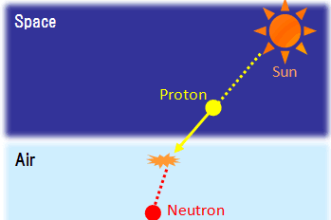


Resilience Against Soft Errors
MTBF (One car perspective) | 1 year | 120 years
MTBF (Toyota perspective: 10 million cars sold last year) | 3 seconds | ~6 minutes
Microprocessor
1
0
1
0
1
0
0
1
0

Slide 3
Scope of Research
Redundancy as the main protection strategy
Flexibility
Main Program
Process-Level
Thread-Level
add R1, R2, R3
Check
Fine-grained
Coarse-grained
Check
Function-Level
add R2, R2, R3
Redundant Program
Program Statement Level
Scope of my dissertation
Detection Latency

Slide 4
Publications
Dissertation
DAC, 2016, “nZDC: A compiler technique for near Zero Silent Data Corruption.”
IEEE Transactions on Reliability, “A Compiler Technique for Processor-Wide Protection From Soft Errors in Multithreaded Environments.” 67.1 (2018): 249-263.
DAC, 2017, “InCheck: An in-application recovery scheme for soft errors.”
ICCAD, 2017, “NEMESIS: A Software Approach for Computing in Presence of Soft Errors”.
IEEE Transactions on Dependable and Secure Computing, “Generic Soft Error Data and Control Flow Error Detection by Instruction Duplication” (under review).
DATE, 2018, “Expert: Effective and flexible error protection by redundant multithreading.”
DATE, 2019, “A software-level Redundant MultiThreading for Soft/Hard Error Detection and Recovery”.
ACM Transactions on Architecture and Code Optimization, “A Software-level Redundant MultiThreaded Scheme for Protection against Hardware Random Faults” (to be submitted).
DAC 2019, “WholeSafe: Whole Microprocessor Soft Error Detection and Recovery” (to be submitted)

Slide 5
Presentation Organization
Need for new fine-grained error protection
Overview of our proposed techniques
Verilog level fault injection results
Memory and data path protection
Core redundancy for soft and hard error protection

Slide 6
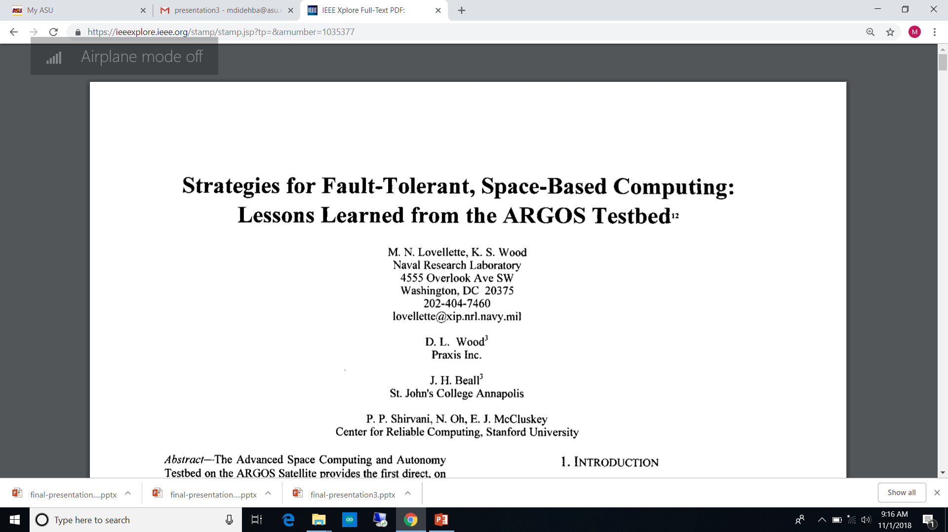
On the Shoulders of Giants
Fault Model: Transient Single Bit-Flip
EDDI
Stanford 2002
ADD R3, R1, R2
ADD R3*, R1*, R2*
MUL R4, R3, R5
MUL R4*, R3*, R5*
BNE R4, R4*, Error
store 0(SP)⬅ R4
Store offset(SP)⬅R4*
Original Code
ADD R3, R1, R2
MUL R4, R3, R5
store 0(SP)⬅R4
Instruction Duplication
Memory Duplication
Notes:
EDDI Paper: Strategies for Fault-Tolerant, Space-Based Computing:
Lessons Learned from the ARGOS Testbedl

Slide 7
On the Shoulders of Giants
Performance
Fault Model: Transient Single Bit-Flip
EDDI
Stanford 2002
SWIFT
Princeton 2005
Shoestring
UMich 2010
ADD R3, R1, R2
ADD R3*, R1*, R2*
MUL R4, R3, R5
MUL R4*, R3*, R5*
BNE R4, R4*, Error
store 0(SP)⬅ R4
Store offset(SP)⬅R4*
ADD R3, R1, R2
ADD R3*, R1*, R2*
MUL R4, R3, R5
MUL R4*, R3*, R5*
BNE R4, R4*, Error
BNE SP, SP*, Error
store 0(SP)⬅R4
ADD R3, R1, R2
ADD R3*, R1*, R2*
MUL R4, R3, R5
MUL R4*, R3*, R5*
BNE R4, R4*, Error
store 0(SP)⬅R4
Original Code
ADD R3, R1, R2
MUL R4, R3, R5
store 0(SP)⬅R4
Pre-store error detection leaves store operations unprotected.
Instruction Duplication
ECC-protected Memory
Selective Duplication
ECC-protected Memory
Instruction Duplication
Memory Duplication
Notes:
EDDI Paper: Strategies for Fault-Tolerant, Space-Based Computing:
Lessons Learned from the ARGOS Testbedl

Slide 8
Our Error Detection Solution
Philosophy: Error Protection First
Failure mode: SDC
“SDC occurs when incorrect data is delivered by a computing system to the user without any error being logged.”
nZDC
ASU 2016
Original Code
ADD R3, R1, R2
ADD R3*, R1*, R2*
MUL R4, R3, R5
MUL R4*, R3*, R5*
store 0(SP)⬅ R4
load 0(SP*)➔ R4
BNE R4, R4*, Error
ADD R3, R1, R2
MUL R4, R3, R5
store 0(SP)⬅R4
Post-Store Data Flow Error Detection

Slide 9
Evaluation Set up
OpenRISC architecture
Synthesizable Verilog Code of OR1k implementation
Randomly pick a fault site and a cycle, and flip the value for one cycle by XORing that value with ‘1’.
No micro benchmarking
Notes:
Randomly generate a number <1792
Find component and fault site
Fault Injection Time randomly selected from trace

Slide 10
Fault Injection Results
10,600 FI experiments per each version of a program
nZDC
Reliability based on number of nines
Version | Coverage | Overhead
ORG | 90% | 1x
SWIFT | 90% | 2.7x
nZDC | 99.9% | 2.9x
Scaled-SDC = # of SDCs * runtime overhead
SWIFT: 3.8x SDC Reduction nZDC: 104x SDC Reduction
Notes:
No micro benchmarking or switching from ISS to RTL

Slide 11
nZDC: Branch Direction Check (1)
.BB0
.BB0
BNE R1, R2, . BB3
BNE R1, R2, .BB3
Post-Branch Direction Checking
Fall Through Path
Fall Through Path
Taken Path
Taken Path
BNE R1*, R2*, .Err
BEQ R1*, R2*, .Err
.BB3
.BB2
.BB2
.BB3
.BB3

Slide 12
nZDC: Branch Direction Check (2)
.BB0
.BB0
BNE R1, R2, .BB-CH
Jump .BB3
Jump .BB3
BNE R1, R2, .BB3
Taken Path
Fall Through Path
Fall Through Path
.BB-CH
Taken Path
BEQ R1*, R2*, .Err
Jump .BB3
Jump .BB3
Post-Branch Direction Checking
BNE R1*, R2*, .Err
.BB2
.BB2
.BB3
.BB3

Slide 13
nZDC: Unexpected Jump Error Detection (1)
Equal-points-of-execution are points that the state of master and redundant registers are same.
R0 == R0*
R1 == R1*
R2 == R2*
R3 == R3*
.
.
.
R7 == R7*
A program protected by instruction-duplication.
M
R
M
R
M
R
M
R
An unwanted jump from an EPoE to another EPoE cannot be detected by instruction duplication based schemes.
Examples:
Errors hitting nPC
Opcode changes to branch
Error affecting address of a jump operation
Solution: Reducing number of Equal-points-of-execution will decrease the chance of undetected unwanted jumps.
1) Changing Instruction Scheduling
2) Two registers R_{i} and R_{j} as always R_{i} != R_{j}
M
R
M
R
M
R
M
R
M
R
Notes:
Number of undetected branch = number of (EPoE * EPoE -1)/2

Slide 14
nZDC: Unexpected Jump Error Detection (2)
M
M
M
M
MICR += 5;
R
R
R
R
RICR += 6;
M
R
M
R
M
R
M
R
M
M
M
M
R
R
R
R
Scheduling
Asymmetric Signatures
M
R
RICR += 1;
M
M
MICR +=2;
R
R
M
R
M
R
M
R
M
M
R
R
M
MICR +=1;
R
Printf()
Printf()
Printf()
If (RICR != MICR) Error

Slide 15
Importance of unwanted jump error detection
nZDC--
nZDC
Reliability based on number of nines
Version | Coverage | Overhead
ORG | 90% | 1x
nZDC-- | 99% | 2.7x
nZDC | 99.9% | 2.9x

Slide 16
nZDC Vulnerability
.L1
Random memory write errors
Opcode change-to-store
Random write (control signals)
Silent Stores
Unwanted jumps
r3 = r3 +4
r3 = r3* + 4
load r1, [r3]
load r1*, [r3*]
add r5, r1, #10
add r5*, r1*, #10
bnq r5, r6, .L1
store
Memory
store r1 → [mem]
load r1 ← [mem*]
bnq r1, r1*, Error
r1
r1
[mem] = [mem*]
// Do something

Slide 17
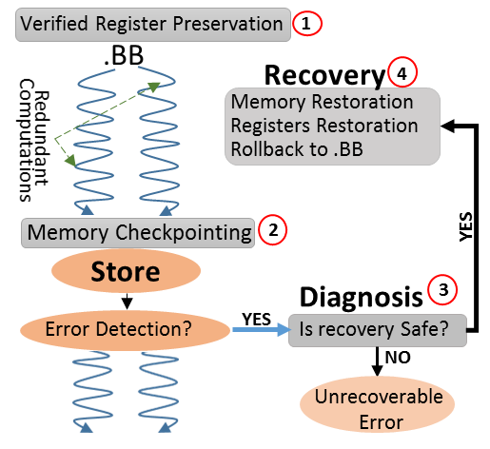
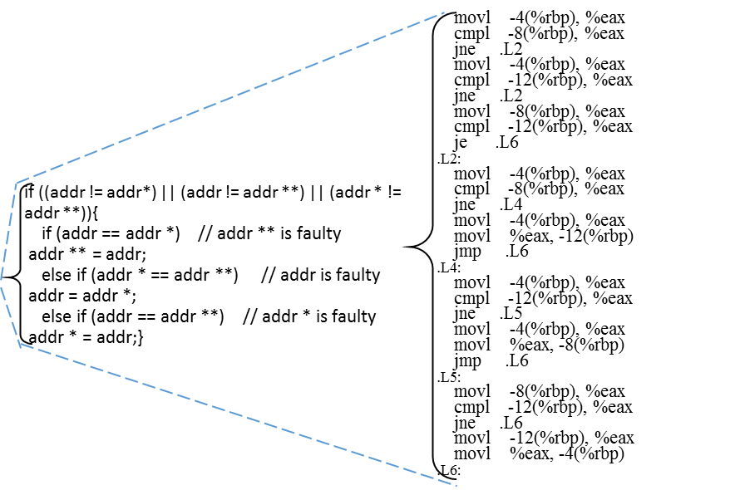
Error Recovery
NEMESIS 2017 ASU
SWIFTR 2007
Princeton
InCheck 2017 ASU
Memory Checkpointing
Store Operation
Error
Diagnosis
routine
Error
Detector
Recoverable
voting (val, val *, val **)
voting (addr, addr*, addr**)
No Error
Memory restoration
Majority-voting
store val→ [addr]
Store Reply
DUR
Too much complexity because of single memory.
Vulnerable against random write errors.

Slide 18
Revisiting soft error recovery solutions
Too much complexity because of single memory.
Vulnerable against random write errors.
Code Size Increases drastically.
ECC cannot take care of all memory errors i.e. MBE and errors on cache controllers.
What if hardware does not provide protection? Or only parity?

Slide 19
WholeSafe: Instruction and Memory Triplication
Recovery challenge:
Delivering the correct answer is the goal, not getting rid of wrong answer.
Used-to-be-friend hardware error detection mechanisms (exceptions) are now Enemy!
Error masking in exception routines
Ignoring exceptions
Safe recovery from unwanted jumps is challenging!
store r₁ → [r₂]
store r₁* → [r₂* + offset 1]
store r₁* * → [r₂* * + offset 2]
store r₁ → [r₂]
store r₁* → [r₂* + offset 1]
store r₁* * → [r₂* * + offset 2]
If (RICR != MICR) Error;

Slide 20
WholeSafe RTL FI Results (on going)
For ORG and SWIFT-R we assume ECC in memory and inject 2100 errors only of microprocessor data path and register file.
For WholeSafe we inject errors (single and MBU up to 5 bit flips) in instruction cache and memory. We inject 3000 faults for each WholeSafe-protected program.
# scaled-SDCs
 | Correct Results
ORG | 81.3%
SWIFTR | 91.3%
WholeSafe | 96.0%

Slide 21
What about MBEs and permanent faults?
Applying nZDC error detection strategy to multicore systems [DATE 2018]
Core i
Core j
More than 65x better error coverage than SRMT¹!
Shared Memory
1
data
2
store data→[mem]
load tmp←[mem]
If (tmp != data) Error;
81K transient fault and ~16K permanent fault
3000 transient faults + 600 permanent faults for each version of program
[1] Wang, Cheng, et al. "Compiler-managed software-based redundant multi-threading for transient fault detection." CGO, 2007.
Notes:
Performance overhead of permanent nZDC is around 5x. SRMT around 4x.

Slide 22
FiSHER: Flexible Soft and Hard Error Resiliency

Slide 23
Publications
Dissertation
DAC, 2016, “nZDC: A compiler technique for near Zero Silent Data Corruption.”
IEEE Transactions on Reliability, “A Compiler Technique for Processor-Wide Protection From Soft Errors in Multithreaded Environments.” 67.1 (2018): 249-263.
DAC, 2017, “InCheck: An in-application recovery scheme for soft errors.”
ICCAD, 2017, “NEMESIS: A Software Approach for Computing in Presence of Soft Errors”.
IEEE Transactions on Dependable and Secure Computing, “Generic Soft Error Data and Control Flow Error Detection by Instruction Duplication” (under review).
DATE, 2018, “Expert: Effective and flexible error protection by redundant multithreading.”
DATE, 2019, “A software-level Redundant MultiThreading for Soft/Hard Error Detection and Recovery”.
ACM Transactions on Architecture and Code Optimization, “A Software-level Redundant MultiThreaded Scheme for Protection against Hardware Random Faults” (to be submitted).
DAC 2019, “WholeSafe: Whole Microprocessor Soft Error Detection and Recovery” (to be submitted)

Slide 24
What I learned
Effient error resilience is great only if protection is accomplished.
Simple triplication and voting!
Protection package encompasses data-flow errors, wrong-direction branches and unexpected-jump errors.
User-level resilience
Seemingly small vulnerability windows add up quickly.
Hard to achieve five nine reliability
Recovery is challenging.
Maybe that’s why restarting is the preferable recovery strategy

Slide 25
Thank you.

Slide 26
 | Non-Failure |  |  | System-Visible Error |  |  | SDCs
 | ORG | SWIFT-R | WholeSafe | ORG | SWIFT-R | WholeSafe | ORG | SWIFT-R | WholeSafe
ADPCMC | 80.1% | 90.2% | 95.1% | 8.7% | 6.8% | 4.5% | 11.24% | 3.00% | 0.37%
BITCOUNT | 78.5% | 91.7% | 96.3% | 9.8% | 6.5% | 3.2% | 11.71% | 1.81% | 0.57%
CRC | 77.7% | 91.9% | 95.8% | 10.1% | 6.3% | 4.1% | 12.19% | 1.76% | 0.03%
SHA | 80.1% | 90.1% | 95.8% | 8.7% | 6.2% | 4.0% | 11.24% | 3.62% | 0.17%
STRINGSEARCH | 86.24% | 91.48% | 95.97% | 9.81% | 6.00% | 3.30% | 3.95% | 2.52% | 0.73%
QSORT | 85.05% | 92.24% | 96.93% | 10.29% | 6.09% | 2.87% | 4.67% | 1.67% | 0.20%
Average | 81.3% | 91.3% | 96.0% | 9.6% | 6.3% | 3.7% | 9.17% | 2.40% | 0.34%

Slide 27
nZDC is multithreaded Environment: Load transformation

Slide 28
nZDC is multithreaded Environment: Store transformation

Slide 29
InCheck: Performance overhead

Slide 30
Detected but not recoverable errors

Slide 31
Example of Nemesis memory write error detection/recovery

Slide 32
Check memory write instructions
Check after store
nZDC
SWIFT
Checking load
Duplicable
computations
Duplicable
computations
Duplicable
computations
Duplicable
computations
cmp x1, x1*
b.ne error
cmp x2, x2*
b.ne error
store x2, [x1]
store x2, [x1]
cmp x1, x1*
b.ne error
cmp x2, x2*
b.ne error
store x2, [x1]
load x2*, [x1*]
cmp x1, x1*
b.ne error
cmp x2, x2*
b.ne error
store x2, [x1]
load x2, [x1*]
cmp x2, x2*
b.ne error
-- RF vulnerable intervals
-- “store” is unprotected
++ address part is protected
-- data part is vulnerable
++ Eliminate RF vulnerable intervals
-- “store” is unprotected
++ “store” is protected
++ optimal number of checks

