Slide 1


An Efficient Compiler Technique for Code Size Reduction using Reduced Bit-width ISAs
S. Ashok Halambi, Aviral Shrivastava, Partha Biswas, Nikil Dutt, Alex Nicolau
Center for Embedded Computer Systems
University of California, Irvine, USA

Slide 2
Outline
Introduction to rISA
Challenges
Problem definition
Existing approach
Our approach
Architectural Model for rISA
Compiling for rISA
Summary
Future directions

Slide 3
Introduction
Code Size is a critical design factor for many Embedded Applications.
“reduced bit-width Instruction Set Architecture” is a promising architectural feature for code size reduction.
Support for a “reduced Bit-width Instruction Set”, along with normal IS.
Many contemporary processors use this feature
  ARM7TDMI, MIPS, ST100, ARC-Tangent.

Slide 4
reduced Bit-width Instruction Set
The “reduced Bit-width Instruction Set” along with the supporting hardware is termed “reduced Bit-width Instruction Set Architecture (rISA)”.
rISA Features
  Instructions from both the IS reside in the memory.
  rIS are dynamically expanded to normal instructions before or during decode stage.
  Execution of only normal instructions.

Slide 5
rISA
Most frequently occurring instructions are compressed to make reduced Bit-width Instruction Set.
Each rISA instruction maps to a unique normal instruction.
  Simple and fast lookup table based “translator” logic.
  Can be implemented without increasing cycle length or cycle penalty.
Achieve good code size reduction, without much architectural modification.
  Best Case : 50 % code size reduction

Slide 6
Architectures supporting rISA
ARM7TDMI
  32-bit normal IS, and 16-bit rIS.
  Switching between normal and rISA instructions is done by BX (Branch Exchange) instruction.
    Basic block level granularity.
  Kwon et. al made each rISA instruction to write to a partition of register file.
MIPS
  32-bit normal IS, and 16-bit rIS.
  Switching between normal and rISA instructions is done implicitly by code alignment.
    Routine not aligned to word bounday → rISA Instructions.
    Routine level granularity.
ST100 from STMicro and Tangent ARC core also support rISA

Slide 7
Bit-width Restrictions
Only a few instructions in rIS.
  Not all normal instructions can be converted to rISA instructions.
  7-bit opcodes in a 3-address ARM Thumb instruction.
Operands of rISA instructions can access only a part of register file.
  Code in terms of rISA instructions has high register pressure causing extra move/load/store instructions.
  3-address instructions in ARM Thumb have accessibility to only 8 registers (out of 16).

Slide 8
Challenges in code generation
16-bit rISA instruction format
7-bit
3-bit
3-bit
3-bit
Fewer opcodes
Accessibility to only 8 registers
Register pressure increases in the block which contains rISA instructions, resulting in
  Increased code size because of spilling.
  Performance degradation.
Estimating code size increase due to spilling, before register allocation is difficult.
  A heuristic to estimate spill code because of rISA might be useful.

Slide 9
Problem Definition
Compile for rISA to achieve –
  Maximum code size reduction.
  Least degradation in performance.

Slide 10
Existing Compilers for rISA
Work on routine level or basic-block level granularity.
  Convert to reduced bit-width instructions only if all the instructions in the routine/basic-block have mappings to rISA instructions.
Code generation for rISA is done as a post-assembly pass or a pre-instruction selection pass.

Slide 11
Our Approach
rISA architectural model contains a mode exchange instruction to change mode at an instruction level granularity.
Code generation for rISA is done as a part of instruction selection
  Tightly coupled with the compiler flow.
  Use rISA instructions whenever profitable even within a function.
We term the process of code generation for rISA, rISAization.

Slide 12
Advantage of Our Approach
Existing approach
Our approach
32 bit
Function 1
16 bit
Function 1
Function 2
Function 2
Function 3
Function 3
Function level granularity
Instruction level granularity
Higher Code density

Slide 13
Architectural Model
rISA instructions to normal instructions mapping.
Explicit mode exchange instructions (mx and rISA_mx).
  Allow instruction level granularity for Conversion to rISA instructions.
Useful rISA instructions:
  rISA_nop: To align the code to word boundary.
  rISA_move: To access all the registers in the register file and minimize spills in rISA code.
  rISA_extend: To increase the length of the immediate in the successive instruction.
  The bit-width restrictions for the above three rISA instructions are relaxed because they have lesser number of operands.

Slide 14
Compiling for rISA
Source File C/C++
Generic Instruction Set
3-address code
gcc Front End
Instruction Selection - I
Augmented Instruction Set
(with rISA Blocks)
Profitability Analysis
Instruction Selection - II
Target Instruction Set
(Normal + rISA)
Register Allocation
Assembly

Slide 15
Compiling for rISA – An Example
Source File C/C++
G_ADD GR1 GR2 4
G_MUL GR3 GR1 GR2
G_ADD GR4 GR3 1
G_SUB GR4 GR4 16
G_LI GR4 200
G_ADD GR5 GR6 GR7
G_MUL GR9 GR8 GR6
G_ADD GR10 GR5 GR9
G_SUB GR11 GR10 R7
Generic Instruction Set
3-address code
gcc Front End

Slide 16
Compiling for rISA – An Example
Source File C/C++
1. Mark Instructions that can be converted to rISA instructions.
Generic Instruction Set
3-address code
gcc Front End
G_ADD GR1 GR2 4
G_MUL GR3 GR1 GR2
G_ADD GR4 GR3 1
G_SUB GR4 GR4 16
G_LI GR4 200
G_ADD GR5 GR6 GR7
G_MUL GR9 GR8 GR6
G_ADD GR10 GR5 GR9
G_SUB GR11 GR10 GR7
Instruction Selection - I
Augmented Instruction Set
(with rISA Blocks)
Candidates for rISA instructions

Slide 17
Compiling for rISA – An Example
Source File C/C++
2. Decide whether it is profitable to convert a rISA Block.
Generic Instruction Set
3-address code
gcc Front End
G_ADD GR1 GR2 4
G_MUL GR3 GR1 GR2
G_ADD GR4 GR3 1
G_SUB GR4 GR4 16
G_LI GR4 200
G_ADD GR5 GR6 GR7
G_MUL GR9 GR8 GR6
G_ADD GR10 GR5 GR9
G_SUB GR11 GR10 GR7
Instruction Selection - I
Augmented Instruction Set
(with rISA Blocks)
Profitability Analysis

Slide 18
Compiling for rISA – An Example
Source File C/C++
3. Replace marked instructions with rISA instructions.
Generic Instruction Set
3-address code
gcc Front End
T_ADD_R GR1 GR2 4
T_MUL_R GR3 GR1 GR2
T_ADD_R GR4 GR3 1
T_SUB_R GR4 GR4 16
T_MX_R
T_LI GR4 200
T_ADD GR5 GR6 GR7
T_MUL GR9 GR8 GR6
T_ADD GR10 GR5 GR9
T_SUB GR11 GR10 GR7
Instruction Selection - I
Augmented Instruction Set
(with rISA Blocks)
Profitability Analysis
Instruction Selection - II
Target Instruction Set
(Normal + rISA)

Slide 19
Compiling for rISA – An Example
4. Perform register allocation.
Source File C/C++
Generic Instruction Set
3-address code
T_ADD_R TR1 TR2 4
T_MUL_R TR3 TR1 TR2
T_ADD_R TR4 TR3 1
T_SUB_R TR4 TR4 16
T_MX_R
T_LI TR4 200
T_ADD TR5 TR6 TR7
T_MUL TR9 TR8 TR6
T_ADD TR10 TR5 TR9
T_SUB TR11 TR10 TR7
gcc Front End
Instruction Selection - I
Augmented Instruction Set
(with rISA Blocks)
Profitability Analysis
Instruction Selection - II
Target Instruction Set
(Normal + rISA)
Register Allocation
Assembly

Slide 20
Compilation for rISA
Source File C/C++
1. Mark Instructions that can be converted to rISA instructions.
  Contiguous marked instructions form a “rISA Block”.
2. Decide whether it is profitable to convert a rISA Block.
3. Replace marked instructions with rISA instructions.
4. Perform register allocation.
Generic Instruction Set
3-address code
gcc Front End
Instruction Selection - I
Generic Instruction Set
(with rISA Blocks)
Profitability Analysis
Instruction Selection - II
Target Instruction Set
(Normal + rISA)
Register Allocation
Assembly

Slide 21
Profitability Heuristic
Decides whether or not to convert a rISA Block to rISA Instructions.
  Ideal decrease in code size
    rISA_block_size(normalMode) – rISA_block_size(rISAMode)
  Increase in code size
    CS1 : due to mode change instructions.
    CS2 : due to NOPs.
    CS3 : due to extra rISA load/store/move instructions.

Slide 22
Register Pressure Heuristic
Estimate the extra spill/load/move instructions.
  CS3 = Spill/Reload code needed if block is converted to rISA Instructions
  – Spill/Reload code needed if block is converted to normal instructions
Spill code for a block is a function of
  average register pressure
  number of instructions
  average live length

Slide 23
Spill Code Estimation
  Estimate extra average register pressure:
  average register pressure – K1*number of registers
  Estimate the number of spills needed to reduce the register pressure by 1 for the block:
  number of instructions / average live length
  Estimate number of spills:
  average extra register pressure * number of spills needed to reduce the register pressure by 1

Slide 24
Register Pressure Heuristic
Spill code if converted to rISA = (1) + (2)
  (1) Estimated spill code for rISA variables in block
  number of available registers = rISA RF size
  (2) Estimated spill code for non-rISA variables in block.
  number of available registers = RF size – rISA RF size – average extra rISA register pressure
Spill code if converted to normal IS
  Estimated spill code for all variables in block
  number of available registers = RF size
Reload code is estimated as:
  K2 * Spill code * average number of uses per variable definition

Slide 25
Experimental Set-up
Platform : MIPS 32/16 architecture
Benchmarks : Livermore loops
Baseline Compiler: GCC for MIPS32 and MIPS16 optimized for code size
  %age code size reduction in MIPS16 over MIPS32
Our Compiler : Retargetable EXPRESS compiler for MIPS 32/16
  %age code size reduction
  %age Performance degradation

Slide 26
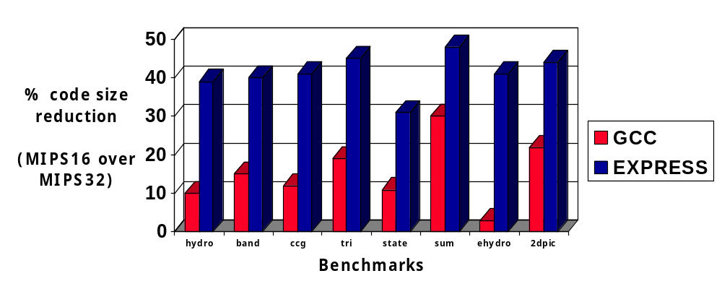
Experiments
EXPRESS achieves 38% while GCC 14% average code size reduction.
Performance impact: average 6% (worst case: 24%)

Slide 27
Summary
rISA is an architectural feature that can potentially achieve huge code size reduction with minimal hardware alterations.
We presented a compiler technique to achieve code size reduction using rISA.
  Ability to operate at instruction level granularity.
  Integration of this technique in the compiler flow.
  A heuristic to estimate the amount of spills/reloads/moves due to restricted availability of registers by some instructions.
On an average 38% improvement in code size.

Slide 28
Future directions
The profitability heuristic for code generation can be modified to account for the performance degradation due to rISA.
Design space exploration for choosing the best rISA suitable for a given embedded application.

