Slide 1
A Design Space Exploration framework for rISA Design
Ashok Halambi, Aviral Shrivastava,
Partha Biswas, Nikil Dutt, Alex Nicolau.
Centre for Embedded Computer Systems,
University of California, Irvine, USA.

Slide 2
Outline
Motivation
rISA Model
rISA Design Space Exploration
Experiments
Results and Conclusions

Slide 3
Code Size Reduction
Reducing code size results in
  Less memory area ➔ Lower Cost
  Less cache misses ➔ Higher Performance
  Less accesses to memory ➔ Lower power/energy consumption
Code Size Reduction is Important

Slide 4
rISA: reduced bit-width Instruction Set Architecture
rISA has “dual Instruction Set” Capability.
  Normal 32-bit Instruction Set (normal IS).
  Compressed 16-bit instruction set (reduced bit-width IS).
  Instructions from both the ISs reside in memory.
  The rISA instructions are dynamically expanded to normal 32-bit instructions before/during the decode.
  Execution of only normal Instructions.

Slide 5
Typical rISA Implementation
Most frequently occurring instructions are compressed to make reduced bit-width Instruction Set
Each rISA instruction maps to a unique normal instruction
  Simple and fast lookup table based “translator” logic
  Can be implemented without increasing cycle length or cycle penalty
Achieve good code size reduction, without much architectural modification
  Best Case : 50 % code size reduction

Slide 6
Sample architectures supporting rISA
ARM7TDMI
  32-bit normal IS, and 16-bit rIS
  Switching between normal and rISA instructions is done by BX (Branch Exchange) instruction (basic blocks)
MIPS
  32-bit normal IS, and 16-bit rIS
  Switching between normal and rISA instructions is done implicitly by code alignment (function-level)
ARM-Thumb and MIPS16 report 30% code size reduction on small functions.
ST100 and Tangent ARC core also support rISA

Slide 7
Bit-width Restrictions
32-bit normal instruction:
20-bit
4-bit
4-bit
4-bit
Accessibility to 16 registers
16-bit rISA instruction:
7-bit
3-bit
3-bit
3-bit
Fewer opcodes
Accessibility to only 8 registers
Only a few instructions in rIS
Operands of rISA instructions can access only a part of register file
This paper: explore rISA designs for code size reduction

Slide 8
rISA Model
A rISA instruction maps to a unique normal instruction.
Mode change at instruction level granularity
  mx, and rISA_mx
Other special rISA instructions
  rISA_nop
    To align instructions to the word boundary.
  rISA_move
    To access all registers even in rISA mode.
  rISA_extend
    Increase the length of immediate field in rISA instructions.

Slide 9
rISA Design Space
opcode
dest
op1
op2
rISA_wxyz
w-bit
x-bit
y-bit
z-bit
x + y + z + w = 16
No. of bits to specify opcode
  No of rISA instructions
No. of operands
No. of bits to specify rISA operand
  Register accessibility of rISA instruction

Slide 10
Interesting rISA Designs
Implied Operand Format for rISA instruction
  add R₁ R₂ R₂ ➔ rISA_add_1 R₁ R₂
  add R₁ R₁ 4 ➔ rISA_add_2 R₁
Customized immediate field size
Operands can access different sets of registers.
opcode
dest
op1
op2
rISA_wxyz
w-bit
x-bit
y-bit
z-bit

Slide 11
rISA Design Space Exploration (DSE)
rISA Design Space is Large
  Exploration Framework
Mechanism to specify rISA architectural model.
  ADL-driven
Compiler-in-the-loop DSE

Slide 12
rISA Design Space Exploration Framework
EXPRESSION description
+ rISA description
Parameters
No. of opcodes
No. of operands
Bits per operand
Implicit operand
Custom Immediate value
Architecture
Model
rISA Model
Application
Compiler
Simulator
Analysis

Slide 13
ADL based DSE
Specify the rISA design in an EXPRESSION ADL
  rISA to normal instructions mapping
  rISA register restrictions on operands
  Immediate field size
  Special instructions
    mx, rISA_mx, rISA_nop, rISA_extend, rISA_move etc…
Create a rISA model
Evaluate the rISA model
  code size
  performance

Slide 14
Compiler-in-the-loop DSE
Generate the compiler from the rISA Model.
  Instruction Selection
    Profitability Analysis
  Register Allocation
    Honor register restrictions
  Scheduling
    Reduce register life times

Slide 15
Compilation for rISA
- An Efficient Compiler Technique … Halambi et. al, DATE 2002
Source File C/C++
1. Mark Instructions that can be converted to rISA instructions.
  Contiguous marked instructions form a “rISA Block”.
2. Decide whether it is profitable to convert a rISA Block.
3. Replace marked instructions with rISA instructions.
4. Perform register allocation.
Generic Instruction Set
3-address code
GCC Front End
Mark rISA Blocks
Generic Instruction Set
(with rISA Blocks)
Profitability Analysis
Instruction Selection
Target Instruction Set
(Normal + rISA)
Insert mode change Instrs.
Register Allocation
Insert nops
Assembly

Slide 16
Profitability Heuristic
Decides whether or not to convert a rISA Block to rISA Instructions.
  Ideal decrease in code size
    rISA_block_size(normalMode) – rISA_block_size(rISAMode)
  Increase in code size
    CS1 : due to mode change instructions.
    CS2 : due to NOPs.
    CS3 : due to extra rISA load/store/move instructions.

Slide 17
Register Pressure Heuristic
Estimate the extra spill/load/move instructions.
CS3 = Spill/Reload code needed if block is converted to rISA Instructions
  – Spill/Reload code needed if block is converted to normal instructions
Spill code for a block is a function of
  average register pressure
  number of instructions
  average live length

Slide 18
Experimental Setup
Platform : MIPS 32/16 architecture
Benchmarks : Livermore loops
Compare 5 rISA Designs for code size reduction
Our Compiler : Retargetable EXPRESS compiler for MIPS 32/16, with register pressure based code rISA generation.

Slide 19
rISA Designs
opcode
dest
op1
op2
rISA_wxyz
w-bit
x-bit
y-bit
z-bit
5 rISA Designs
  rISA_7333
    Opcode 7 bits, each operand 3 bits.
  rISA_7333_imm
    Opcode 7 bits, each operand 3 bits, immediate field is extended by using unused bits from opcode field.
  rISA_imp_opnd
    Similar to rISA_7333_imm, but allows implicit operands.
  rISA_4444
    Opcode 4 bits, each operand 4 bits.
  rISA_hybrid
    Variable bits for opcode and operand, allows immediate extensions, and implicit operands.

Slide 20
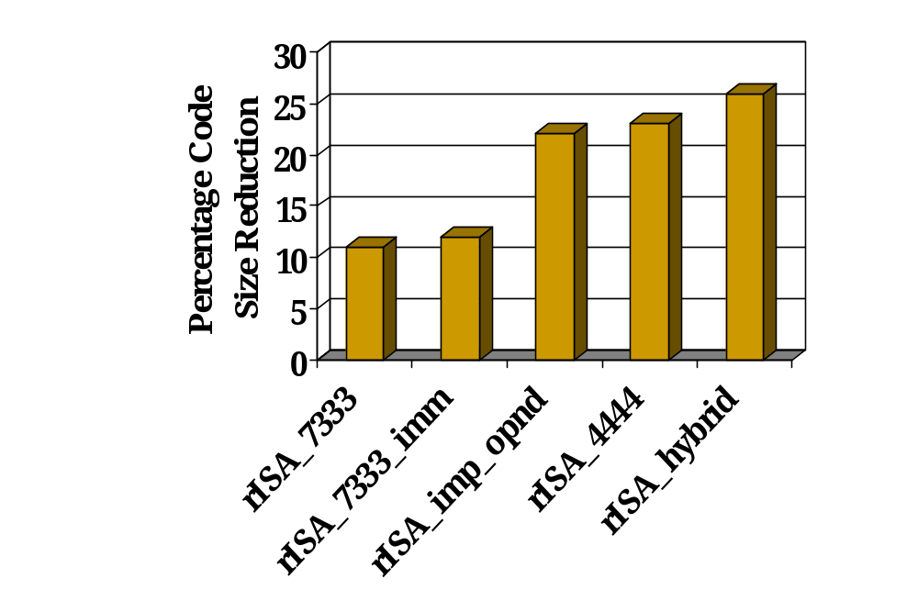
Results: Code Size Variation for rISA
Custom immediate field size
Implicit Operand
Greater register accessibility
More opcodes and greater register accessibility
Less Register Accessibility

Slide 21
Conclusions
rISA is an effective technique for code size reduction.
rISA design space is huge and thus the need of a Design Space Exploration tool.
We presented a Design Space Exploration framework for rISA Designs
Significant variation of Code Size Reduction using different rISA designs.
Automated design space exploration
ISA exploration
Future Work

