Slide 1

EPIMap: Using Epimorphism to Map Applications on CGRAs
Mahdi Hamzeh, Aviral Shrivastava, and Sarma Vrudhula
School of Computing, Informatics, and Decision Systems Engineering
Arizona State University
June 2012
This work was supported in part by NSF IUCRC Center for Embedded Systems under Grant DWS-0086, by the Science Foundation of Arizona (Grant SRG 0211-07), and by the Stardust Foundation.

Slide 2
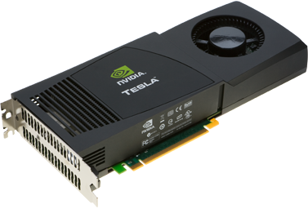
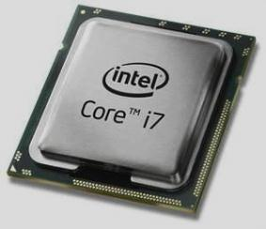
Accelerators for Energy Efficiency
Demand for performance
Power consumption
Technology scaling
Processor
Accelerator
Giga Ops
per Sec
Shared Memory
100
DRESC CGRA
60 GOpS/W
10
NVIDIA Tesla™ c2050
1.4 GOpS/W
4.3 GOpS/W
Intel Core i7
1
50
100
150
200
250
Power (W)

Slide 3
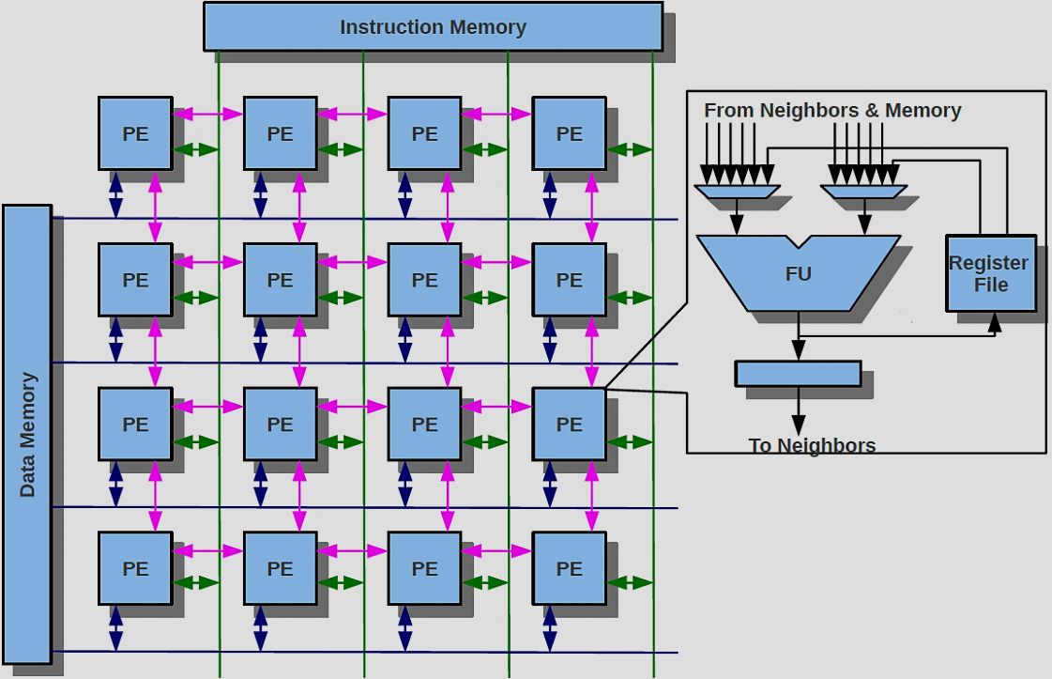
Coarse-grained Reconfigurable Architectures
Time
1
2
1
2
2D array of Processing Elements (PEs)
ALU + local register File -> PE
Mesh interconnection
Shared data bus
PE inputs:
4 Neighboring PEs
Local register file
Data memory
3
4
3
4
1
2
3
4

Slide 4
What to Map on CGRA and How?
Time
4
1
2
a
b
1
2
0
3
4
3
4
b
b
b
b
b
a
b
a
a
a
1
2
c
d
1
2
1
3
4
b
II is the performance metric
3
4
d
d
d
c
d
c
c
c
2
1
2
1
2
e
e
e
f
e
2
f
f
f
3
4
3
4
g
g
g
g
1
2
1
2
3
3
4
3
4

Slide 5
Re-Computation
1
2
a
1
2
4
0
3
4
3
4
3
a
a
a
a
1
2
1
b
2
3
4
b
1
3
4
b
b
b
b
b
b
b
Re-computation can lead to better mapping
c
1
2
2
1
2
c
c
c
c
c
c
c
d
d
d
d
d
d
d
d
d
d
2
3
4
3
4
e
e
e
e
e
e
e
e
e
e
f
f
f
f
f
f
f
f
f
f
1
2
1
2
3
3
4
3
4
Re-computation is necessary

Slide 6
Re-Computation and Routing
a
a
3
a
0
1
2
1
2
3
4
3
4
b
b
b
b
b
b
b
b
1
2
1
2
a
1
3
4
3
4
2
b
d
b
c
e
b
d
1
c
1
2
2
f
2
d
b
d
3
4
3
4
c
c
c
d
e
f
e
1
e
1
2
2
f
f
f
e
3
4
3
4
3

Slide 7
Related Works and Contributions
Several CGRAs architectures been designed
XPP, PADDI, PipeBench, KressArray etc. Survey in [Harstentien 2001]
Compilers for CGRA
EMS [Park 2008], Semi-simulated annealing based [Mei 2004] , Simulated annealing based [Hatanaka 2007, Friedman 2009]
Use routing to resolve resource limitation problem
No techniques exist that exploit re-computation for mapping.
Contributions of this work
General problem formulation
Re-computation, routing, or both for resource limitation problem
Application mapping heuristic EPIMap
More accurate MII extraction
Resource aware routing
Efficient placement (Maximum Common Subgraph problem)
Use information from unsuccessful attempts for next mapping

Slide 8
Experimental Setup
Loops from SPEC2006 and multimedia benchmarks
4 × 4 CGRA with enough instruction and data memory
Shared data bus for each row
Latency is 1 cycle and 2 registers at PEs
EMS[Park 2006] and BCEMS (best among 500 runs)

Slide 9
Mapping Results
The lower II, the better performance
EPIMap improves performance on average by 2.8X more than EMS
2.2X less than BCEMS
2.8X less than EMS

Slide 10

Achieved II vs. Minimum II
Minimum II may be not achievable
Relative to MII=$\frac{MII}{Achieved II}$
The higher the value, the closer to optimum II
EPIMap finds MII in 9 out of 14 loops
92.9%

Slide 11
Reasonable Running time
252
38

Slide 12
Summary
Accelerators for energy efficiency
Coarse-grained reconfigurable architecture, a programmable accelerator
Contributions
Problem formulation
Re-computation, routing, or both
EPIMap
Better mappings 2.8X performance improvement
Optimum mapping in 9 out of 14
Reasonable compilation time

