Slide 1

REGIMap: Register-Aware Application Mapping on Coarse-Grained Reconfigurable Architectures
Mahdi Hamzeh, Aviral Shrivastava, and Sarma Vrudhula
School of Computing, Informatics, and Decision Systems Engineering
Arizona State University
June 2013
This work was supported in part by CSR-EHS 0509540, CCF-0916652, CCF 1055094, NSF IUCRC for Embedded Systems (IIP-0856090), Center for Embedded Systems grant DWS-0086; Science Foundation Arizona grant SRG 0211-07, Raytheon and by the Stardust Foundation.

Slide 2
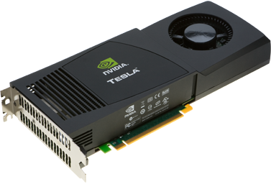
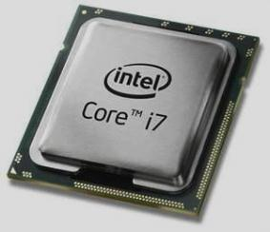
Accelerators for Energy Efficiency
Demand for performance
Power consumption
Technology scaling
Core
Accelerator
Private cache
Private cache
Giga Ops
per Sec
Shared Cache
100
ADRES[1] CGRA
60 GOpS/W
10
NVIDIA Tesla™ c2050
1.4 GOpS/W
4.3 GOpS/W
Intel Core i7
1
50
100
150
200
250
Power (W)
[1] BOUWENS, F., BEREKOVIC, M., SUTTER, B. D., AND GAYDADJIEV, G. Architecture enhancements for the adres coarse-grained reconfigurable array. In Proc. HiPEAC (2008), pp. 66–81.

Slide 3
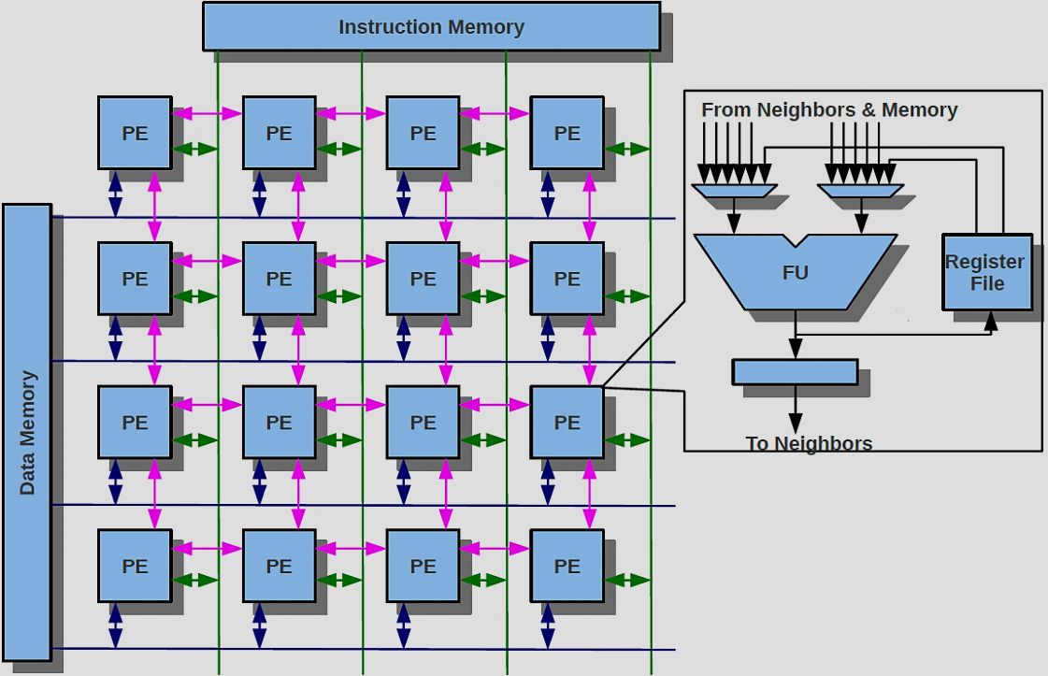
Coarse-grained Reconfigurable Architectures
2D array of Processing Elements (PEs)
ALU + Local register file → PE
Mesh interconnection
Shared data bus
Data memory
PE inputs:
4 Neighboring PEs
Local register file

Slide 4
Map Loops on CGRA and Minimize Initiation Interval
Time
P
1
Q
1
P
1
Q
1
4
2
a
a
a
1
II is the performance metric
2
2
2
2
P
1
Q
1
P
1
Q
1
a
a
a
a
a
a
2
2
2
2
2
P
1
Q
1
Register utilization decreases II
P
1
2
2
b
Q
1
P
1
Q
1
b
b
b
a
a
3
2
2
2
2
c
c
c
P
1
Q
1
P
1
Q
1
d
4
2
2
2
2
d
d

Slide 5
Register Files for Inter-Iteration Dependencies
P
1
Q
1
1
P
2
2
1
Q
1
b
2
b
P
2
2
1
Q
1
a
a
a
a
3
2
2
Register Utilization is essential for Inter-iteration Data Dependencies
P
1
Q
1
3
P
1
Q
1
4
f
f
c
b
2
2
c
b
c
b
c
b
P
1
Q
1
2
2
b
b
2
5
f
P
2
2
1
Q
1
e
e
e
6
P
2
2
1
Q
1
f
7
f
f
f
f
2
2
P
1
Q
1
8
b
2
2

Slide 6
Insight to the problem
Size of resource graph ≈ O(n)
Partition the resources n+1 partitions
Huge number of possible partitions (exponential)
Assign operations to sets such that
All operations are mapped
Data dependency between operations are obeyed
Intractable
Existing techniques are
Exploratory
Huge search space
If fail, start from scratch
Adhoc register allocation

Slide 7
Contributions
General Problem formulation
Reduce search space
Partition the problem to Scheduling and integrated placement and register allocation
No register in resource graph
Constructive search
Integrated placement and register allocation
REGIMap
Schedule DFG
Construct Resource graph
Construct a compatibility graph between DFG and resource graph
Model register requirement of operation in the weight of arcs in compatibility graph
Find a restricted maximal clique

Slide 8
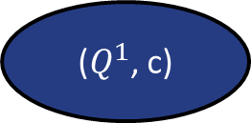
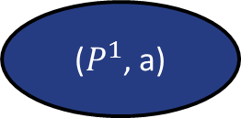
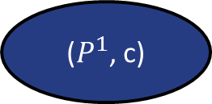
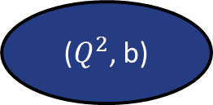
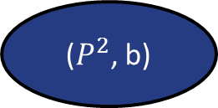
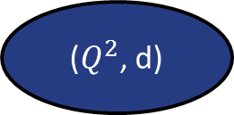
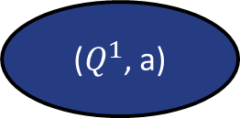
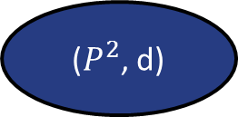
P
Q
P
Q
($P^{2}$, b)
($Q^{1}$, a)
($Q^{2}$, b)
a
P
1
Q
1
($P^{1}$, a)
($P^{1}$, c)
b
2
2
2
($P^{2}$, d)
c
($Q^{1}$, c)
($Q^{2}$, d)
d

Slide 9
Experimental Setup
Loops from SPEC2006 and multimedia benchmarks
4 × 4 CGRA with enough instruction and data memory
Shared data bus for each row
Latency is 1 cycle
Compared with register-aware DRESC [2]
[2] DE SUTTER, B., COENE, P., VANDER AA, T., AND MEI, B. Placement-and-routing-based register allocation for coarse-grained reconfigurable arrays. In Proc. LCTES (2008), pp. 151–160.

Slide 10
Mapping Results
REGIMap improves performance on average by 1.8X more than DRESC*

Slide 11
Reasonable Running Time
REGIMap maps loops on average 56X faster than DRESC*

Slide 12
Summary
Accelerators for energy efficiency
Coarse-grained reconfigurable architecture, a programmable accelerator
Contributions
Problem formulation
Search space reduction
Constructive search
Integrated register allocation
REGIMap
Better mappings 1.8X performance improvement
On average 56 times better compilation time
Please join my poster presentation for more details

