Slide 1
Branch-Aware Loop Mapping on Coarse-Grained Reconfigurable Accelerators
Mahdi Hamzeh, Aviral Shrivastava, and Sarma Vrudhula
School of Computing, Informatics, and Decision Systems Engineering
Arizona State University

Slide 2
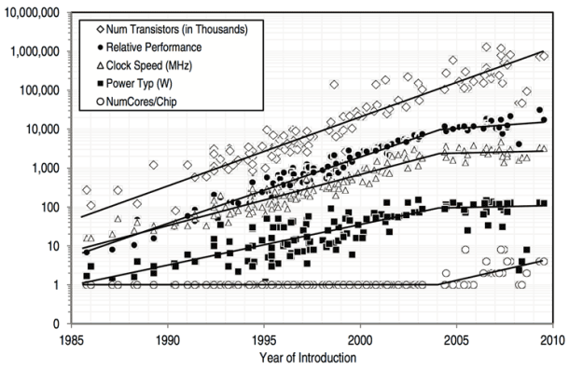
Improve performance at the pace of transistor density increasing
Source: Intel

Slide 3
Goal: Increase performance at lower power vs. utilization
Power Efficiency
Hardware accelerators
DSPs
GPUs
FPGAs
Goal
General purpose processors
CGRAs
Flexibility

Slide 4
Branch divergences damage resource utilization in accelerators
Time
A
A
A
B
B
C
B
C
C
D
D
D

Slide 5
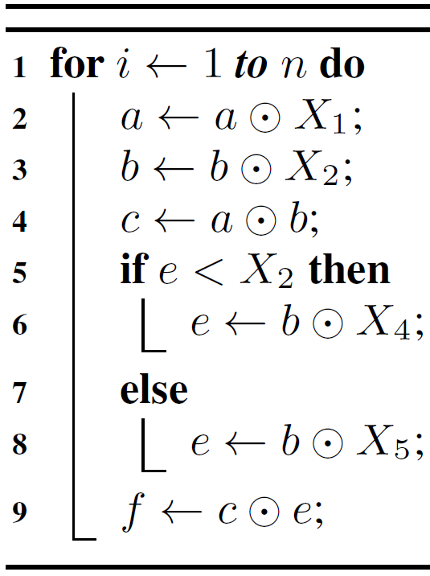
Control Flow Acceleration on CGRAs

Slide 6
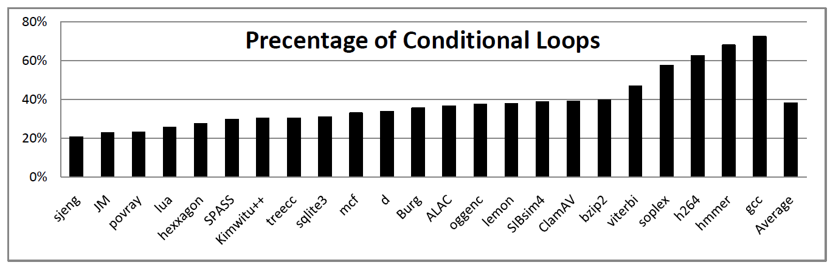
Loops with conditionals are frequent

Slide 7
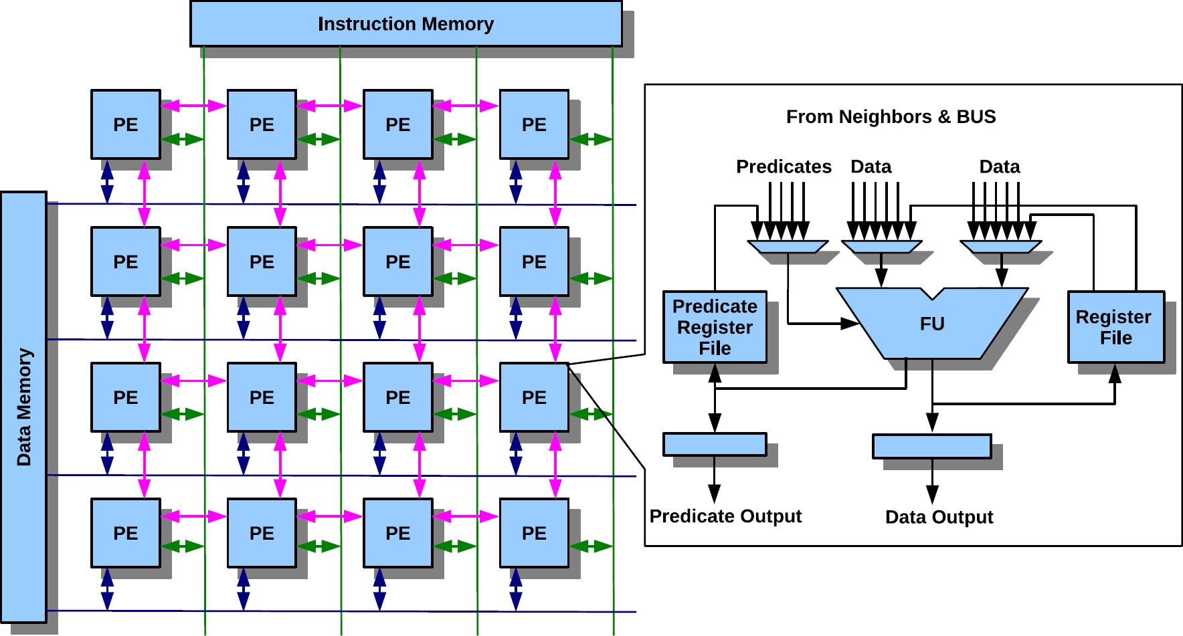
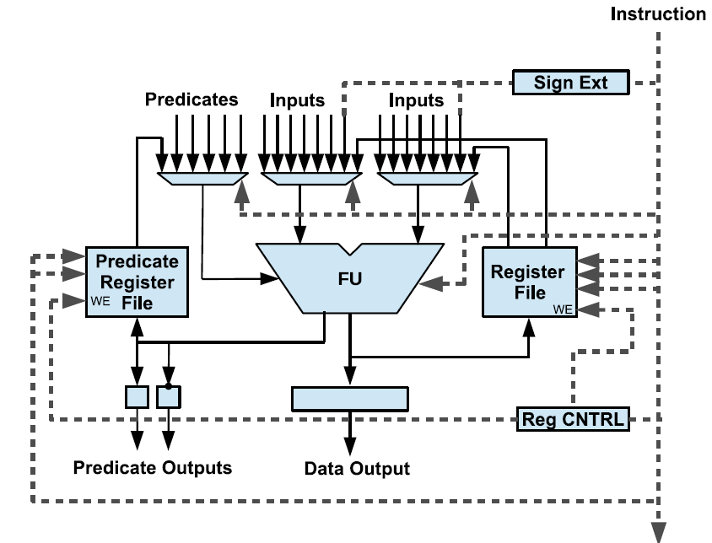
Coarse-grained reconfigurable accelerators: a promising solution for high performance, power, and utilization

Slide 8
Loop Acceleration and Modulo Scheduling
1
2
1
2
3
4
4
3
a
a
b
b
a
b
II
c
c
d
c
d
d
b
f
f
e
e
g
g
b

Slide 9
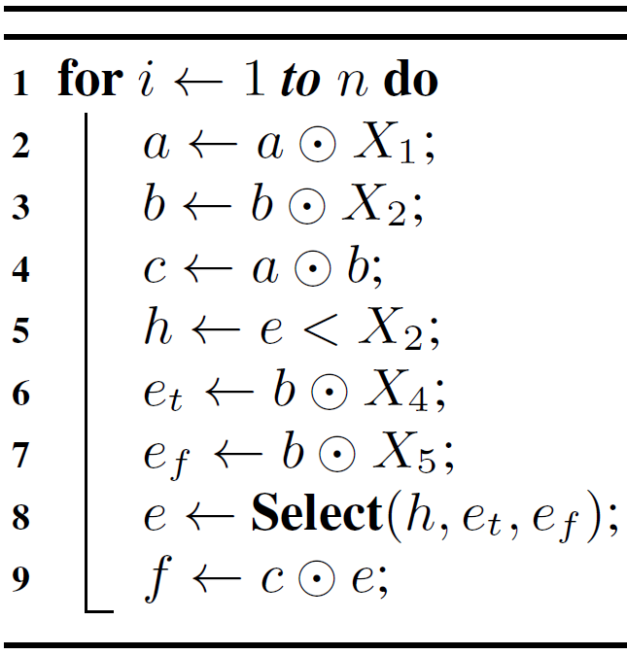




Partial Predication
a
b
a
b
h
a
b
II
c
$$e_{f}$$
h
$$e_{t}$$
a
h
c
$$e_{f}$$
h
$$e_{t}$$
e
e
c
f
f

Slide 10
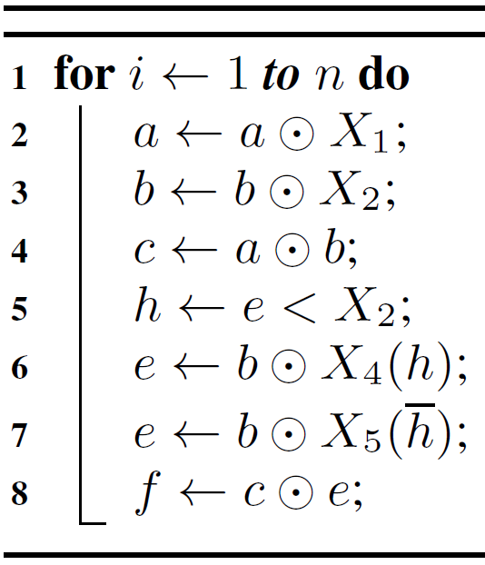


Full Predication
a
b
h
b
h
a
II
a
b
h
c
$$e$$
b
h
a
c
e
b
e
$$e$$
b
a
e
c
e
f
b
a
f
e

Slide 11
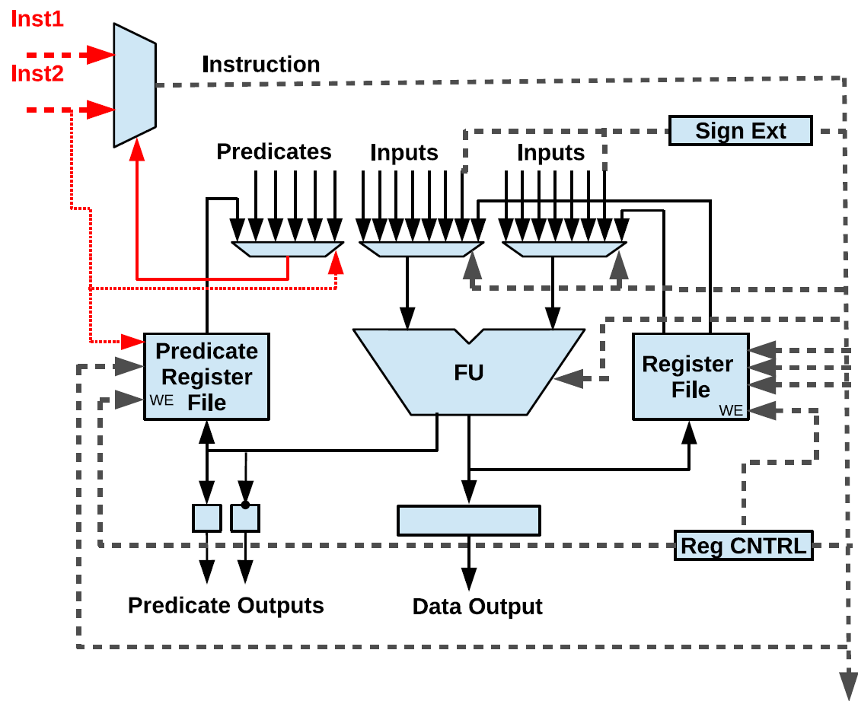
Dual Issue Architecture

Slide 12


How to map kernels on Dual Issue CGRA
II
a
b
h
a
b
a
b
a
b
h
c
$$e_{f}$$
h
$$e_{t}$$
c
e
a
b
c
e
e
f
f
f

Slide 13
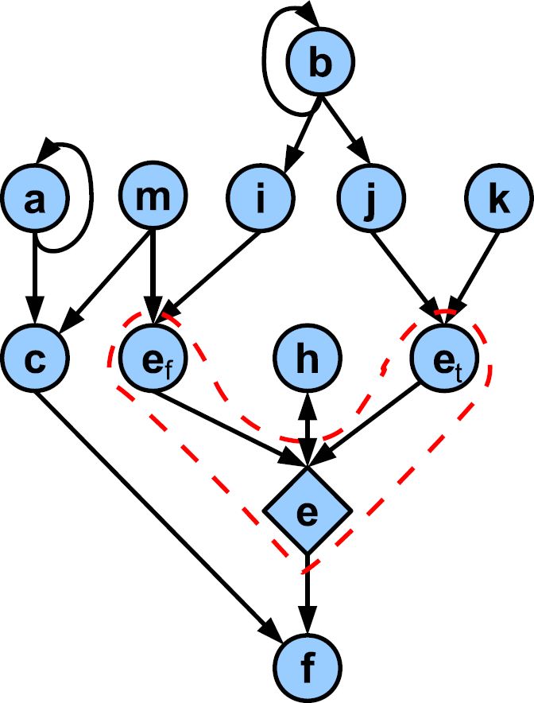
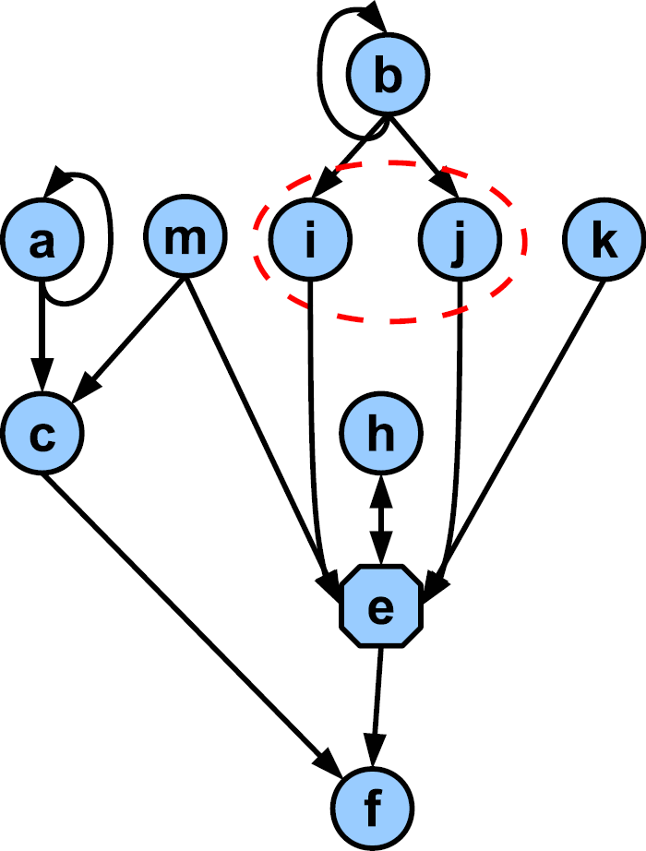
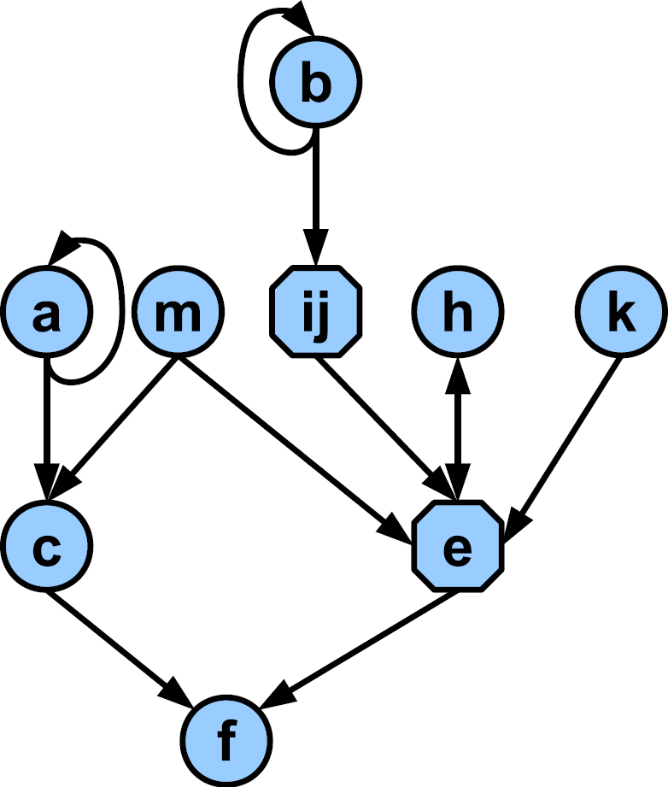
Proposed graph transformation

Slide 14
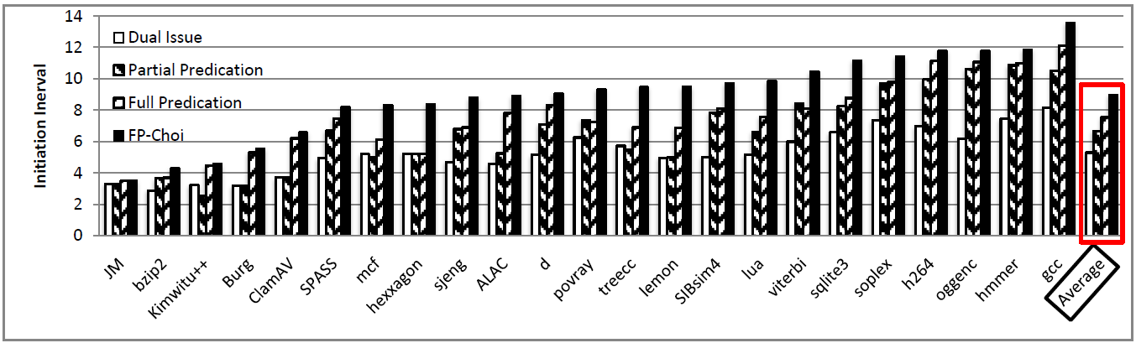
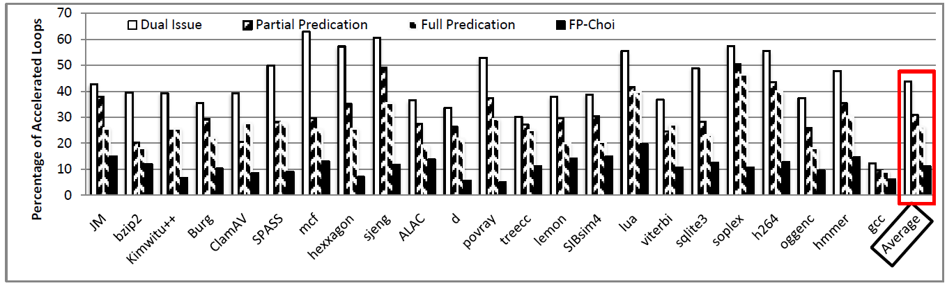
Best Performance: Dual Issue

Slide 15
Summary
Performance improvement using software accelerators such as CGRAs
Control flows are common in benchmarks
Most accelerators use classic predication scheme for accelerating loops with conditional
Acceleration of loops with divergence in CGRAs, opportunities and challenges
Dual issue scheme: potential performance gain and compiler challenges

Slide 16






The market demands for higher computation power
1973
1989
1999
2002
2007
2014

Slide 17
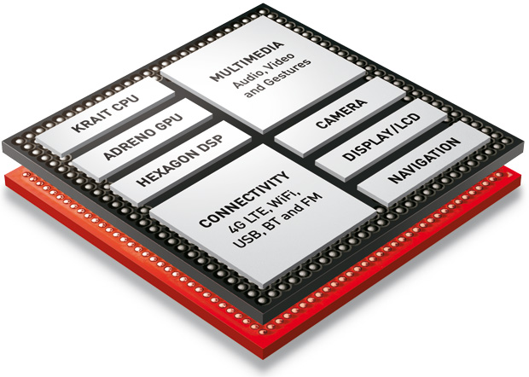
Hardware accelerators achieve best performance at least power but result in low utilization
Snapdragon 800
Source: Qualcomm

Slide 18
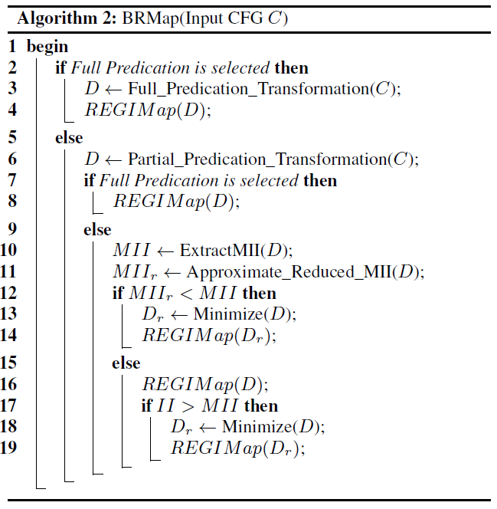
Mapping Algorithm

Slide 19
Accelerators are needed
Branch divergence problem
CGRAs: Opportunity through hw/sw codesign
How CGRAs work
Partial Predication
Full predication
Dual issue – idea is simple, but need compiler support
What does the compiler do
Results
Summary

