Slide 1
LA-LRU: A Latency-Aware Replacement Policy for Variation Tolerant Caches
Aarul Jain, Cambridge Silicon Radio, Phoenix
Aviral Shrivastava, Arizona State University, Tempe
Chaitali Chakrabarti, Arizona State University, Tempe

Slide 2
Introduction: Variations
Process Variation: Due to loss of control in manufacturing process. Variation in channel length, oxide thickness and doping concentration.
Systematic Variation: wafer to wafer variation
Random Variation: within-die variation
Voltage Variation: Voltage within a chip varies.
IR drop ~ 3%.
LDO tolerance ~ 5%.
Temperature Variation.

Slide 3
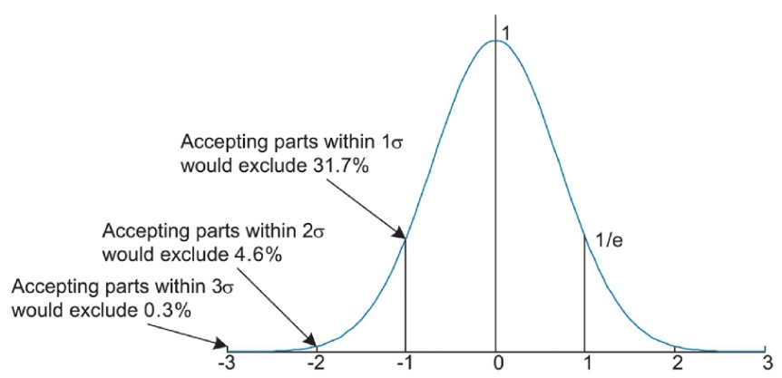
Introduction: Variations
To design reliable circuits, we use worst case corner as a sign-off criteria.
The worst case corner is a compromise between yield and performance.
The delay variation in sub 100nm impacts maximum operable frequency significantly.
Cell Type | FF | TYP | SS
SEN_INV_1 | 6.11ps | 7.97ps | 10.95ps
8192x16 memory | 960ps | 1330ps | 2110ps

Slide 4
Introduction: Techniques to Compensate for Variation
System level techniques for compensating variation at expense of performance. [Roy, VLSI Design ‘09]
CRISTA: Critical Path Isolation for Timing Adaptiveness
Variation Tolerance by Trading Off Quality of Results.
Memories suffer from more variation than logic due to small transistor size and caches often decide the maximum operable frequency of a system.
Our paper present system-level techniques to improve performance of a variation-tolerant cache by reducing usage of cache blocks having large delay variation.
LA-LRU: Latency Aware LRU policy.
Block Rearrangement.

Slide 5
Agenda
Adaptive Cache Architecture [Ben Naser, TVLSI ‘08]
LA-LRU
Block Rearrangement
Simulation Results
Summary

Slide 6
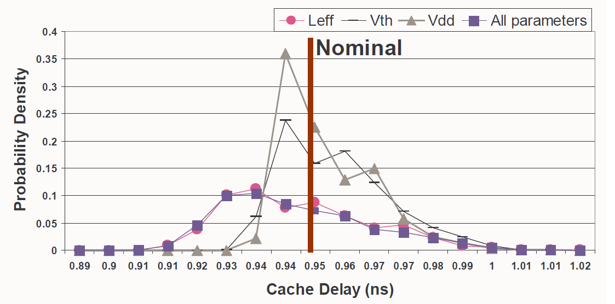
Adaptive Cache Architecture (1/2)
[Ben Naser, TVLSI ‘08]: Monte Carlo simulations using 32nm PTM models showed that access to 25% of cache blocks requires two cycle access and occasionally even three cycle accesses to account for delay variability.

Slide 7
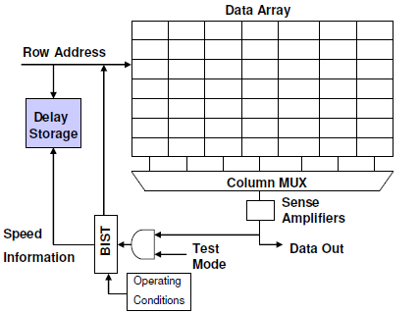
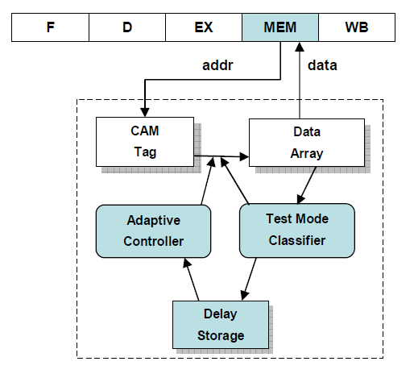
Adaptive Cache Architecture (2/2)

Slide 8
LA-LRU (1/6)
Adaptive Cache architecture with LRU policy
The delay storage provides information on latency of each cache block which can be used to modify the replacement policy to increase single cycle access.
Type of Access | %of Cache Accesses
Hit with one cycle access | 77.076
Hit with two cycle access | 19.940
Hit with three cycle access | 2.224
Miss | 0.760

Slide 9
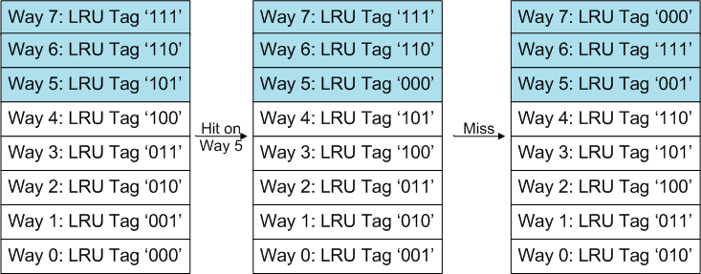
LA-LRU (2/6)
Conventional Least Recently Used Replacement Policy (LRU)
MRU data can be in high latency ways.
LRU mechanism in conventional Cache
(000 -> MRU data, 111->LRU data)

Slide 10
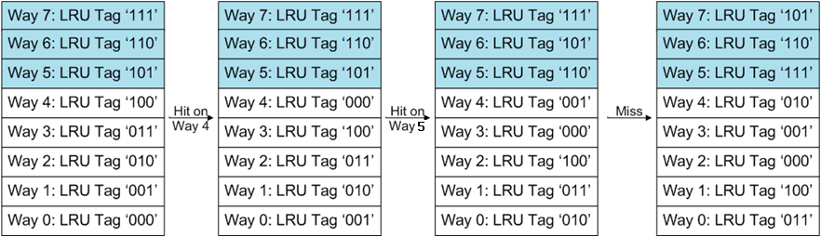
LA-LRU (3/6)
Latency-Aware Least Recently Used Replacement Policy (LA-LRU)
The LRU data is always in high latency ways.
LA-LRU mechanism
(000 -> MRU data, 111->LRU data)

Slide 11
LA-LRU (4/6)
Cache Access Distribution
Significant increase in one cycle accesses.
Type of Access | %of Cache Accesses
 | LRU | LA-LRU
Hit with one cycle access | 77.076 | 99.034
Hit with two cycle access | 19.940 | 0.200
Hit with three cycle access | 2.224 | 0.006
Miss | 0.760 | 0.760

Slide 12
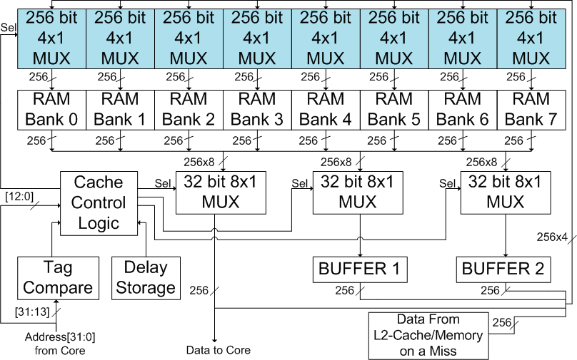
LA-LRU (5/6)
Architecture Block Diagram: 64KB/8/32

Slide 13
LA-LRU (6/6)
Latency overhead with LA-LRU
Hit in ways with latency 1 = 1 cycle
Hit in ways with latency 2 = 2-4 cycles
Hit in ways with latency 3 = 3-6 cycles
Miss in cache = cache miss penalty
Assume tag array is unaffected by process variation and exchanges in it can be made within one cycle.
Synthesis using Synopsys shows that power overhead is only 3.5% of the total LRU logic.

Slide 14
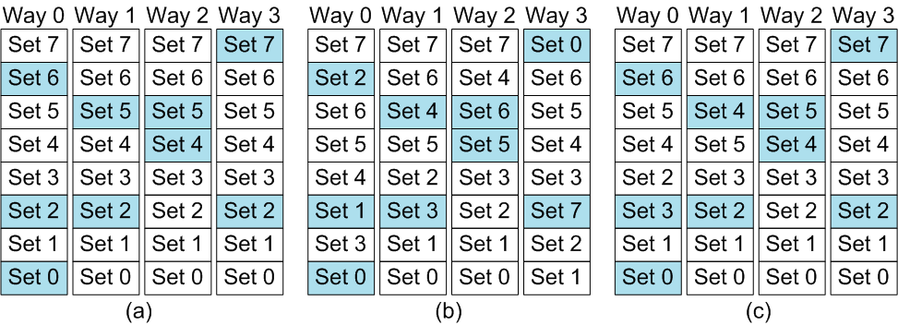
Block Rearrangement (1/1)
High Latency blocks randomly distributed.
Modify Address decoder to have uniform distribution of high latency ways among sets.
Overhead of Perfect BRT: (log₂(number of sets)) mux stages in decoder.
No block
rearrangement
Perfect block
rearrangement
Paired block
rearrangement

Slide 15
Simulation Results (1/3)
Comparing following architectures:
NPV : No process variation.
WORST: Each access takes three cycles.
ADAPT: Cache access depends on the latency of block.
LA-LRU: The proposed replacement policy.
LA-LRU with PairedBRT: LA-LRU with block re-arrangement within two adjacent sets.
LA-LRU with PerfectBRT: LA-LRU with block re-arrangement amongst all sets.

Slide 16
Simulation Results (2/3)
Simulation Environment
Modified Wattch Simplescalar to measure performance for Xscale, PowerPC and Alpha21265 like processor configurations using SPEC2000 benchmarks.
Generate random distribution of latency for following two variation models:
15% two cycle and 0% three cycle latency blocks.
25% two cycle and 1% three cycle latency blocks.

Slide 17
Simulation Results (3/3)
Average Degradation in Memory Access Latency
LA-LRU is sufficient for Xscale and PowerPC.
LA-LRU + PerfectBRT is better than LA-LRU for Alpha21265.
Cache Architecture | %degradation for Xscale (32K/32/32) |  | %degradation for PowerPC (32K/8/32) |  | %degradation for Alpha21265 (64K/2/64)
 | (a) | (b) | (a) | (b) | (a) | (b)
NPV | 0.00 | 0.00 | 0.00 | 0.00 | 0.00 | 0.00
WORST | 161.86 | 161.86 | 158.94 | 158.94 | 172.57 | 172.57
ADAPT | 11.41 | 21.62 | 14.23 | 20.42 | 12.53 | 21.31
LA-LRU | 0.11 | 0.21 | 0.11 | 0.23 | 3.69 | 7.53
LA-LRU+PairedBRT | 0.11 | 0.21 | 0.11 | 0.23 | 0.81 | 2.69
LA-LRU+PerfectBRT | 0.10 | 0.20 | 0.10 | 0.20 | 0.19 | 0.36

Slide 18
Summary (1/1)
LA-LRU combined with adaptive techniques to vary cache access latency, improves performance of cache affected by variation significantly.
LA-LRU reduces memory access latency degradation due to variation to almost 0 for almost any cache configuration.
For low-associative caches, block rearrangement with LA-LRU may be used to further reduce any performance degradation.
The power overhead of implementing the LA-LRU scheme is negligible because LA-LRU logic is excited less than 1% of time and is only 3.5% of the power consumption of LRU logic.
Observed similar results for policies such as FIFO etc.

