Slide 1

Static Analysis to Mitigate Soft Error Failures in Processors
Master’s Thesis Presentation
by
Reiley Jeyapaul
Advisory Committee:
Dr. Aviral Shrivastava
Dr. Lawrence Clark
Dr. Yu Cao
Compiler Microarchitecture Laboratory

Slide 2
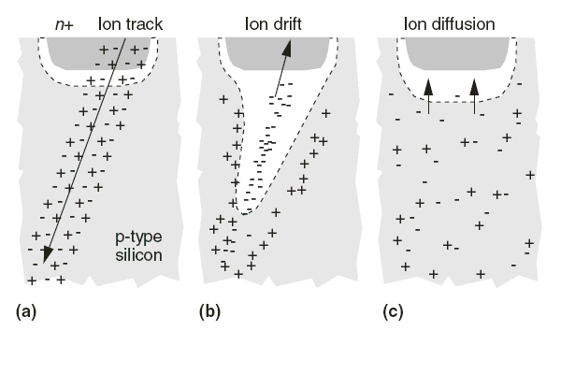
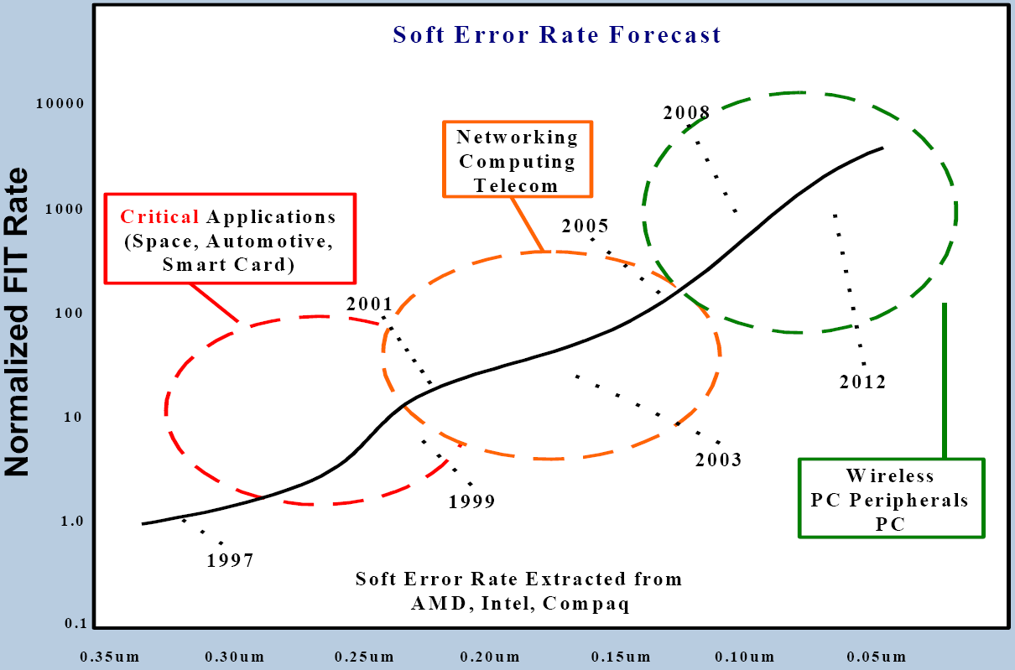
Soft Errors
Radiation induced transient faults – Soft Errors, result in random erroneous program states, causing system failure.
Soft Errors, are a rapidly increasing menace to the dependability of laptops and handheld devices of tomorrow.
Rapid reduction in device dimensions and growing circuit complexity will only make things worse.
Documented soft error instances at sea level :
SUN server crashes of Nov, 2000.
CISCO 12000 series routers experience unexpected resets.

Slide 4
The Path To a Solution
Circuit-level techniques
TMR technique using a majority voter.
Error masking using the I/O propagation delay of circuits.
SEU hardened CMOS circuits
Drawback :
Area, power and implementation cost overhead
Microarchitecture-level techniques
Selective re-fetching and store-through caches
Partially protected caches
SEC-DED techniques
Drawback:
Requires modification of existing architecture
Includes design and verification complexity
Software - level techniques
(SWIFT) Reclaiming unused instruction resources and Control flow check.
SMT thread for redundancy based error detection and correction
Drawback:
Performance overhead is involved because of additional resource usage.
No compiler technique to reduce the impact of soft errors
in caches has been proposed till date.

Slide 5
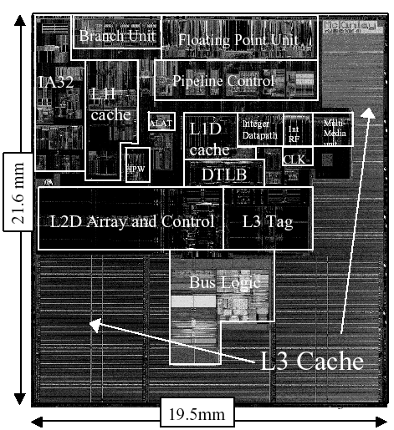
Soft Errors and the Cache
Caches occupy more than 50% of the processor chip-area.
90% of the chip transistors are in caches.
Low operating voltages of caches are required for improved performance.
Low masking capabilities in SRAM cells
Caches are most susceptible to radiation impact and directly translate to system failure
Majority of overall soft errors occur in memories:
Probability of multi-bit errors is greater in memories
The high transistor density increases probability of neutron impact and secondary emissions.
ECC techniques in L1 cache has a performance overhead owing to the small memory latency.
Notes:
Refs:
1) Graph : S. Mitra, N. Seifert, M. Zhang, Q. Shi, and K. S. Kim. Robust system design with built-in soft-error resilience. Computer, 38(2):43–52, 2005.
2) Processor cache specifications from the information about the Intel Itanium II processor at 0.18um technology.
Masking
Timing window is very small, causing temporal masking nearly impossible.
No depth in logic involved and therefore no logical masking
Involves reinforcing inverters which are very critically designed for maximum performance therefore no electrical masking capabilities.
No microarchitecture masking possible.

Slide 6
Measuring Soft Errors in Cache
Vulnerability is a measure of the “susceptibility of data in the cache”.
A datum is vulnerable in the cache only if,
it will be read by the processor
it will be committed to memory after a write operation (dirty data)
A datum is not vulnerable if,
it will be overwritten
it will be evicted from cache, and not written back (when not dirty)
CE
CE
R
W
R
R
R
Time
X
X
X
WV
RV
Notes:
Refs:
1) Graph : S. Mitra, N. Seifert, M. Zhang, Q. Shi, and K. S. Kim. Robust system design with built-in soft-error resilience. Computer, 38(2):43–52, 2005.
2) Processor cache specifications from the information about the Intel Itanium II processor at 0.18um technology.
Masking
Timing window is very small, causing temporal masking nearly impossible.
No depth in logic involved and therefore no logical masking
Involves reinforcing inverters which are very critically designed for maximum performance therefore no electrical masking capabilities.
No microarchitecture masking possible.

Slide 7
Motivation for Compiler Technique
Performance trend irregular when compared to vulnerability variation.
An optimal loop order exists, with reduced vulnerability and low runtime.
13X variation in vulnerability for less than 30% variation in runtime
Such a “Performance – Vulnerability” tradeoff is required for an optimal robust application.
At the compiler, such tradeoffs can be identified through static estimation of vulnerability and performance.
Our principal motive :
An efficient analytical methodology to evaluate vulnerability statically.

Slide 8
Outline
Motivation
Overview
Vulnerability Estimation
Vulnerability Modes
Program Analysis
Read vulnerability
Write vulnerability
Reuse Vectors
Experiments
Conclusion

Slide 9
Vulnerability Modes
RRV
RRV ( Read Reuse Vulnerability)
The time that the data is present in the cache before any read operation, it is vulnerable to data corruption in the cache.
R
RRV
I
RRV
E
WBV (Write Back Vulnerability)
The time that data is present in the cache after the last write operation to the point of eviction, it is vulnerable. The data present in the cache before eviction is updated in the memory.
WBV
Can we know statically(without simulation), how long a data will remain in the cache ?
W
For Example, an array with a RW access to the data on each access.
CE
CE
a₁
a₃
a₄
a₅
a_{n}
a₂
. . . . . . . . .
Iterations
WBV
WBV
RRV
RRV

Slide 10
Modeling A Cache Access
n
Data Space in the cache
for (i=0; i < N; i++)
for (j=0; j < N; j++)
for (k=0; k < N; k++)
A[i][k] += B[i][j] * C[j][k]
endFor
endFor
endFor
Iteration Space:
Every node is an iteration point of the loop
C(4,2)
j(0,1,0)
(0,0)
m
CacheAddr(4,2) = Mapping of an array data to a cache location
y
Array element accessed in any iteration is represented by the access function on the loop indices.
Data Space
C(4,2)
N
i(1,0,0)
i_{N}(N,4,2)
C(4,2)
i₂(1,4,2)
i = N
C(4,2)
An iteration point is represented by the loop indices.
C(4,2)
i₁(0,4,2)
(0,0)
x
i = 1
N
(0,0,0)
k(0,0,1)

Slide 11
Data Reuse and Cache Miss
y
Data Space in the cache
Cache Space:
Every data element is directly mapped to a location in cache.
for (i=0; i < N; i++)
for (j=0; j < N; j++)
for (k=0; k < N; k++)
A[i][k] += B[i][j] * C[j][k]
endFor
endFor
endFor
N
The element of array C is evicted from the cache and replaced with one from array B.
Iteration Space:
Every node is an iteration of the loop
B(0,7)
X
Reuse Vector :
Direction of reuse of the data element at (i) is represented by (r = i-p)
C(4,2)
j(0,1,0)
(0,0)
x
N
y
Data Space
C(4,2)
N
B(0,7)
i(1,0,0)
i_{N}(N,4,2)
C(4,2)
B(0,7)
i(1,4,2)
(1,0,0)
p(0,7,4)
i = N
C(4,2)
Another iteration accesses data of array B, mapped to the same cache location causing a Cache Miss.
C(4,2)
p(0,4,2)
(0,0)
N
x
i = 1
Cache miss iteration
k(0,0,1)
(0,0,0)

Slide 12
Read Reuse Vulnerability
j(0,1,0)
Read Vulnerability
CE
CE
a₁
a₃
a₄
a₅
a_{n}
a₂
. . . . . . . .
Iterations
C(4,2)
i_{N}(N,4,2)
Reuse Direction:
Direction along which the data element is reused.
i(1,0,0)
Access Iterations:
The iterations accessing the array element.
i = N
C(4,2)
i₀(0,4,2)
k(0,0,1)
Cache Miss Iterations:
The iterations at which reuse vector is not realized.
(0,0,0)
Vulnerable Accesses (Cache Hits):
The iterations at which the reuse is realized.
Vulnerable Iterations (Read Reuse Vulnerability):
The number of iterations between successive reuses.

Slide 13
Vulnerability Equations ( RRV )
Cache Miss Iterations on array R, is due to interference by any array accessed within the program.
Vulnerability Calculation:
Cache Hit Iterations,
Vulnerability =

Slide 14
Cache-Interference Analysis
y
Data Space in the cache
Cache Space:
Every data element is directly mapped to a location in cache.
for (i=0; i < N; i++)
for (j=0; j < N; j++)
for (k=0; k < N; k++)
A[i][k] += B[i][j] * C[j][k]
endFor
endFor
endFor
N
Iteration Space:
Every node is an iteration of the loop
B(0,7)
Vulnerable Iterations:
Iterations between the last write access, and point of eviction from the cache.
C(4,2)
X
j(0,1,0)
(0,0)
x
N
The element of array C is evicted from the cache and replaced with one from array B.
Cache-Interference-Point(CIP)
the iteration at which the data of array C is evicted from the cache.
C(4,2)
i(1,0,0)
i_{N}(N,4,2)
B(0,7)
C(4,2)
p(0,7,4)
VI
i(1,4,2)
(1,0,0)
The iteration at (i) accessing C(4,2) can’t reuse the data from iteration (p), and therefore experiences
a cache miss along (r)
i = N
C(4,2)
Iteration accessing data of array B, mapped to the same cache location causing a Cache Miss.
p(0,4,2)
i = 1
(0,0,0)
k(0,0,1)

Slide 15
Cache-Interference Point (CIP)
v : iterations between i and any existing j point
For every cache miss, there exist many possible interference points: { i, j }
The cache line is evicted at the first interference point.
Calculating first CIP:
The set of Intermediate Iterations between a possible CIP and i : { v }
This guarantees that all “v” points isolated, for a cache-miss iteration “i ”, are greater than the first cache-interference point “q”.
y
j₄
j₃
j₂
q
j₁
VI
x
Vulnerable Iterations(VI) for i is given by,

Slide 16
Vulnerability Equations ( WV )
Determining Intermediate Iterations (II)
Identifying the first CIP at which cache evictions occur.
Isolating the Intermediate Iterations for every i due to array x:
The set II for the array R :
Vulnerability Calculation:
Subtracting the II iterations from |r| iterations for every accessed iteration i,
Vulnerability =

Slide 17
Outline
Motivation
Overview
Vulnerability Estimation
Reuse Vectors
Types of Reuse Vectors
Smallest Valid Reuse Vector
Derived Reuse Vector
Experiments
Conclusion

Slide 18
Types of Reuse Vectors
for (i=0; i < N; i++)
for (j=0; j < N; j++)
for (k=0; k < N; k++)
A[i][k] += B[i][j] * C[j][k]
endFor
endFor
endFor
j(0,1,0)
When a reference accesses a data element on the same cache line in different iterations, it is Spatial Reuse, denoted by r_{s}
C(4,2)
i(1,0,0)
i_{N}(N,4,2)
(0,0,1)
i(1,4,2)
(1,0,0)
i = N
C(4,2)
When a reference accesses the same data on different iterations, it is Temporal Reuse, denoted by r_{t}
p(0,4,2)
i = 1
C(4,2)
(0,0,0)
k(0,0,1)
Multiple references to the same array with the same array index and distinguished by only the constant coefficient demonstrate a Group Reuse.
For example C[j+3][k], C[j+5][k] forms a group temporal reuse along r(1,0,0).
Only the smallest reuse vector guarantees a cache-interference at iteration i.
However,
not all reuse vectors are valid over all the Access Iterations of the array
the smaller reuse vector cannot be identified globally for the entire iteration space.

Slide 19
Determining Smallest Valid Reuse Vector
for (i=0; i < 16; i++)
for (j=0; j < 16; j++)
for (k=0; k < 16; k++)
A[i][k] += B[i][j] * C[j][k]
endFor
endFor
endFor
Iteration Space of the loop, can be partitioned into domains, in which each reuse vector of the array is valid.
j(0,1,0)
(15,15,15)
Spatial Reuse:
The first element of a memory-line does not have a preceding element in the same line.
Spatial reuse vector is not valid for those data.
i(1,0,0)
i = 15
(0,0,0)
k = 15
k(0,0,1)
k=1
K=8
j(0,1,0)
(15,15,15)
Temporal Reuse:
First accesses on data elements do not have a preceeding iteration that accesses the same element.
Temporal reuse vector is not valid for the first accesses on the array elements.
i(1,0,0)
i = 15
i = 1
(0,0,0)
k = 15
k(0,0,1)
Disjoint Domains are formed from the overlapping domains.
The smallest reuse vector identified in each disjoint domain is used in the vulnerability equations for each disjoint domain formed.

Slide 20
Derived Reuse VectorS
for (i=0; i < N; i++)
for (j=0; j < N; j++)
for (k=0; k < N; k++)
A[i][k] += B[i][j] * C[j][k]
endFor
endFor
endFor
j(0,1,0)
There exists a reuse pattern between the last access on a cache line and the first access to the same cache line (on a subsequent iteration).
C(4,2)
i(1,0,0)
i_{N}(N,4,2)
C(4,2)
i(1,4,2)
(1,0,-7)
Derived Reuse Vector:
The vector which defines this reuse pattern is Derived Reuse : r_{d} = i – p.
i = N
C(4,9)
i₀(0,4,2)
p(0,4,9)
i = 1
C(4,2)
(0,0,0)
k(0,0,1)
Derivation of Derived Reuse Vector
The difference between temporal and spatial reuse vectors offset by the cache line size/loop bound, gives the Derived Reuse vector.
If r_{t} > r_{s} , r_{l} = r_{t} – (C_{L}-1).r_{s} Where, C_{L} = size of cache line.
If r_{s} > r_{t} , r_{l} = r_{s} – (N_{k}-1).r_{t} N_{k} = loop bound along k.

Slide 21
Outline
Motivation
Overview
Cache Vulnerability
Calculating Vulnerability
Reuse Vectors
Optimizing Vulnerability Equations
Experiments
Experimental setup
Program Model
Validation experiments
Code transformation experiments
Conclusion

Slide 22
Experiment Setup
Benchmarks:
Loop kernels from MiBench benchmark suite
Compiled using –O3 option.
Analytical Modelling
Vulnerability equations were generated by hand
Solving the vulnerability equations:
Omega library (for solving vulnerability equations)
Barvinok library (for enumerating the solved equations of closed form polyhedrons)
Validated against simulation results for the same kernel.
Simulation Environment
Simulator:
Simplescalar 3.0 toolset
Architecture Configuration:
5 stage uni-processor model
Direct mapped L1-cache in write-back mode

Slide 23
Program Model
Only nested loops of the program are considered to estimate the vulnerability of the application.
The loop characteristics:
Perfectly nested loops with well defined loop bounds
Array references in which access functions are affine relations of the loop indices.
Multiple references to the same array should have the same indices.
No conditional statements exist within the basic block.
S.Gosh et al in their work have determined 72% of the loop kernels of SPECfp suite, satisfy the above restrictions.
Vulnerability is calculated in iterations of the nested loop which has a nearly constant relation to the number of processor cycles.

Slide 24
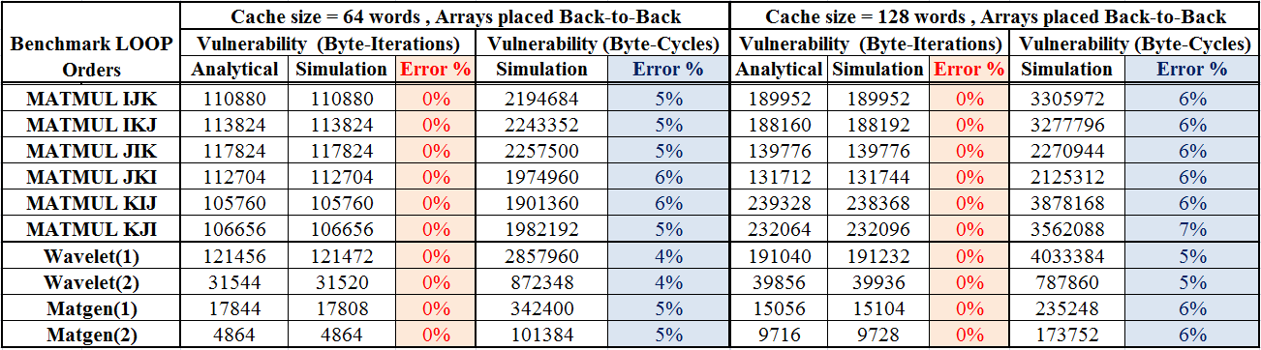
Validation Experiments
Loop kernels were validated for different cache sizes against simulation values of vulnerability.

Slide 25
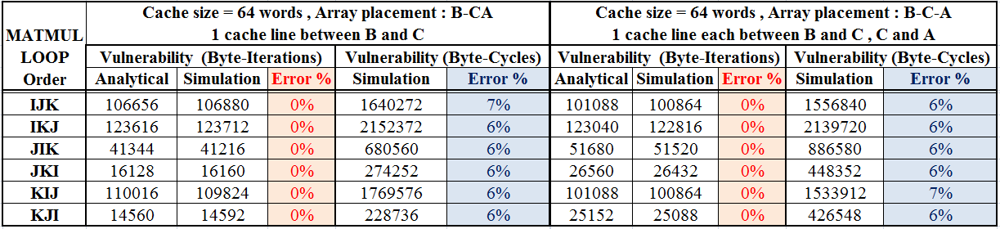
Validation Experiments
Validation of the vulnerability equations for different array placement configurations.

Slide 26
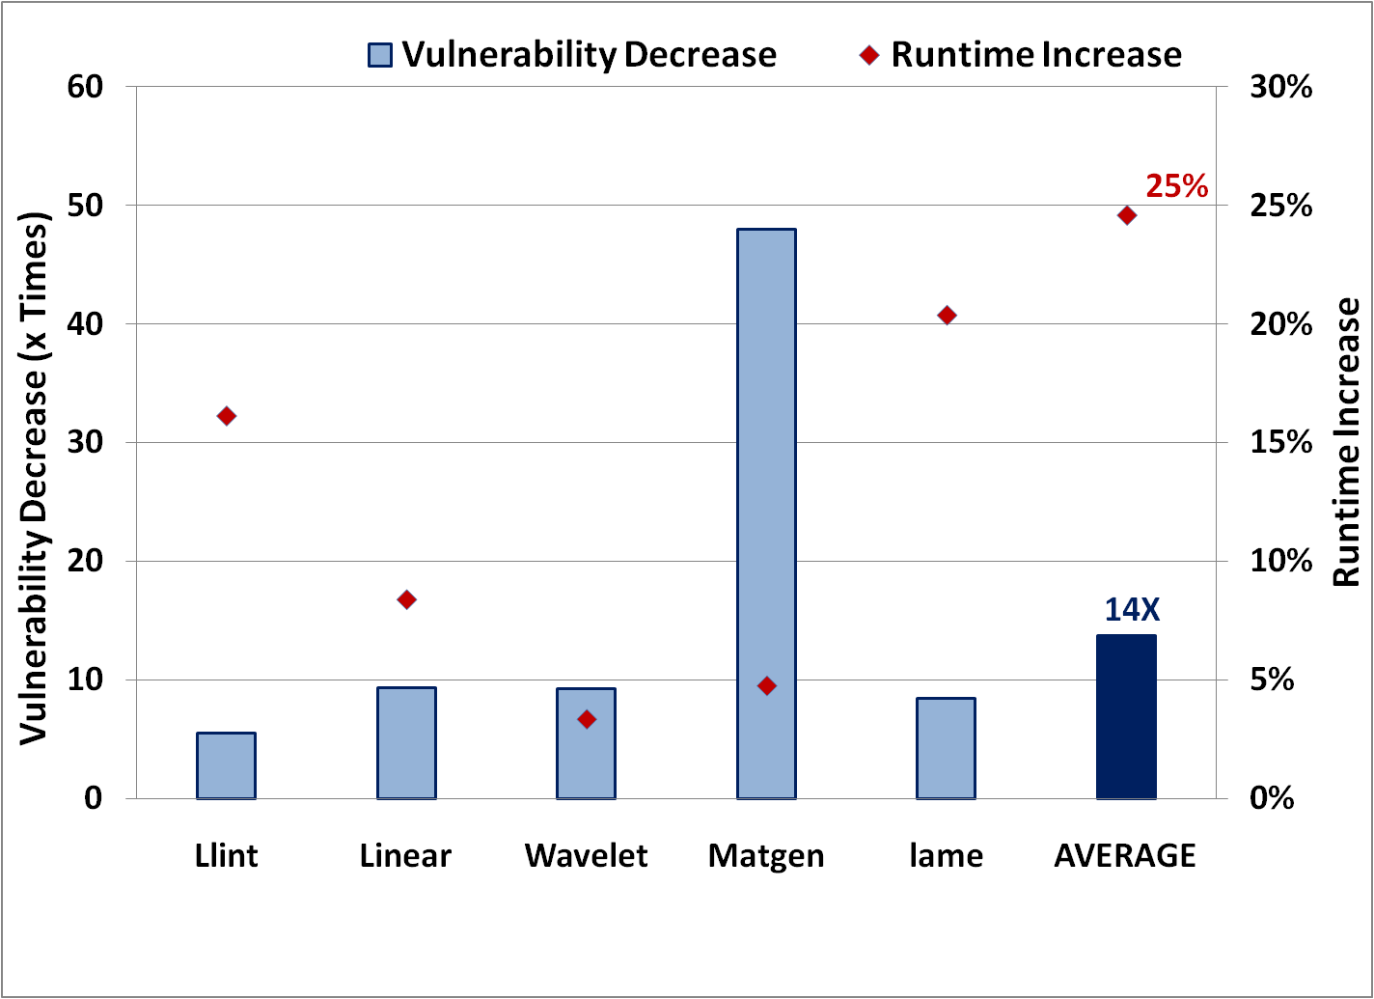
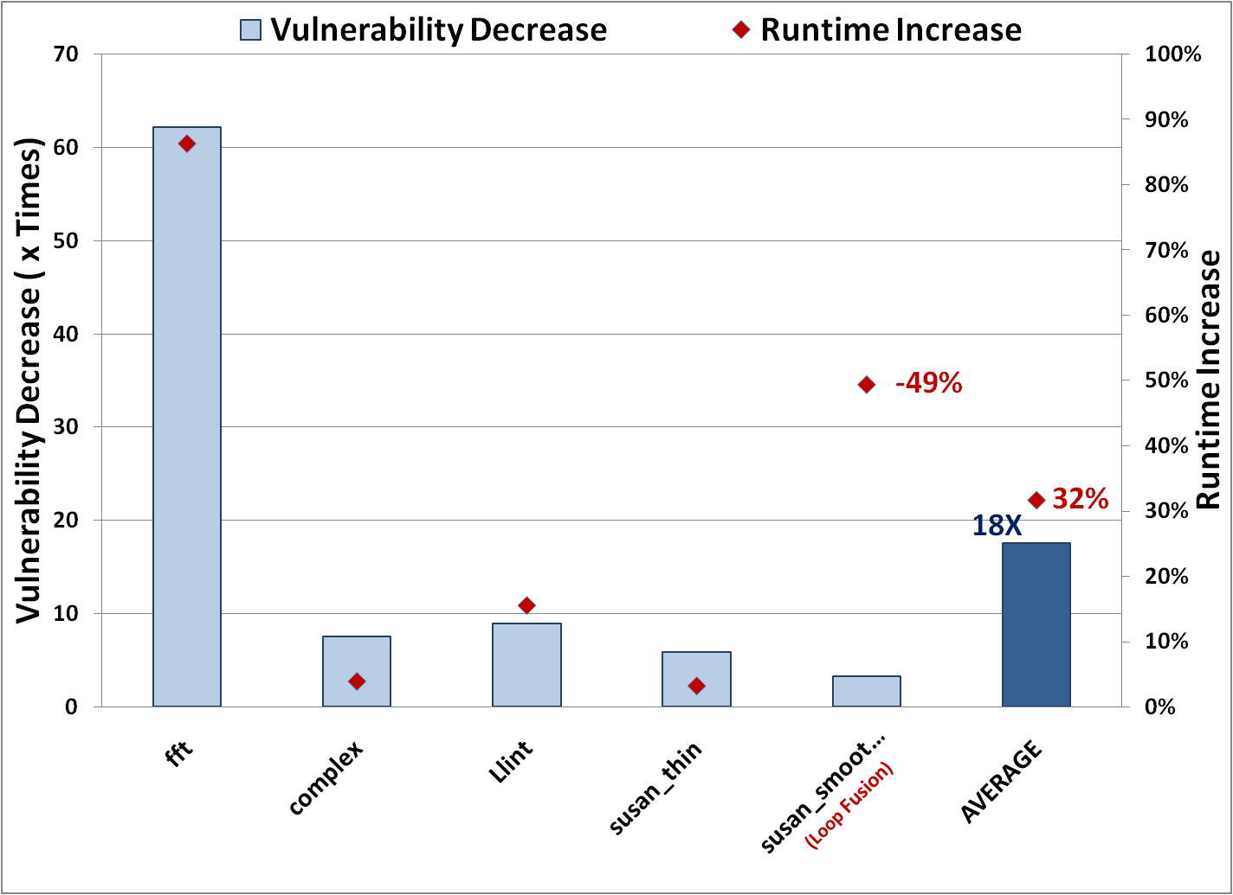
Application of Vulnerability Equations
Impact of Loop Interchange
The order of the loop indices accessing the data is varied across all combinations.
Vulnerability reduction ( 14 X )
Performance tradeoff ( 25% )
Impact of Loop Fission/Fusion
Independent instructions within the loop nest, are executed as separate loops.
Increase in runtime (32 %)
Reduced runtime during fusion ( -49%)
Reduced vulnerability due to reduced reuse capabilities ( 18 X )

Slide 27
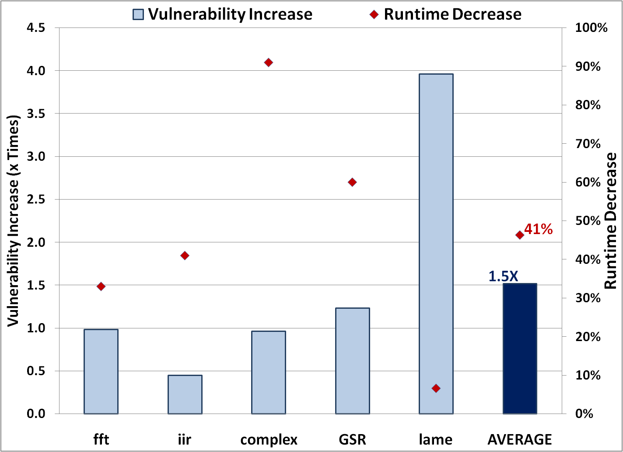
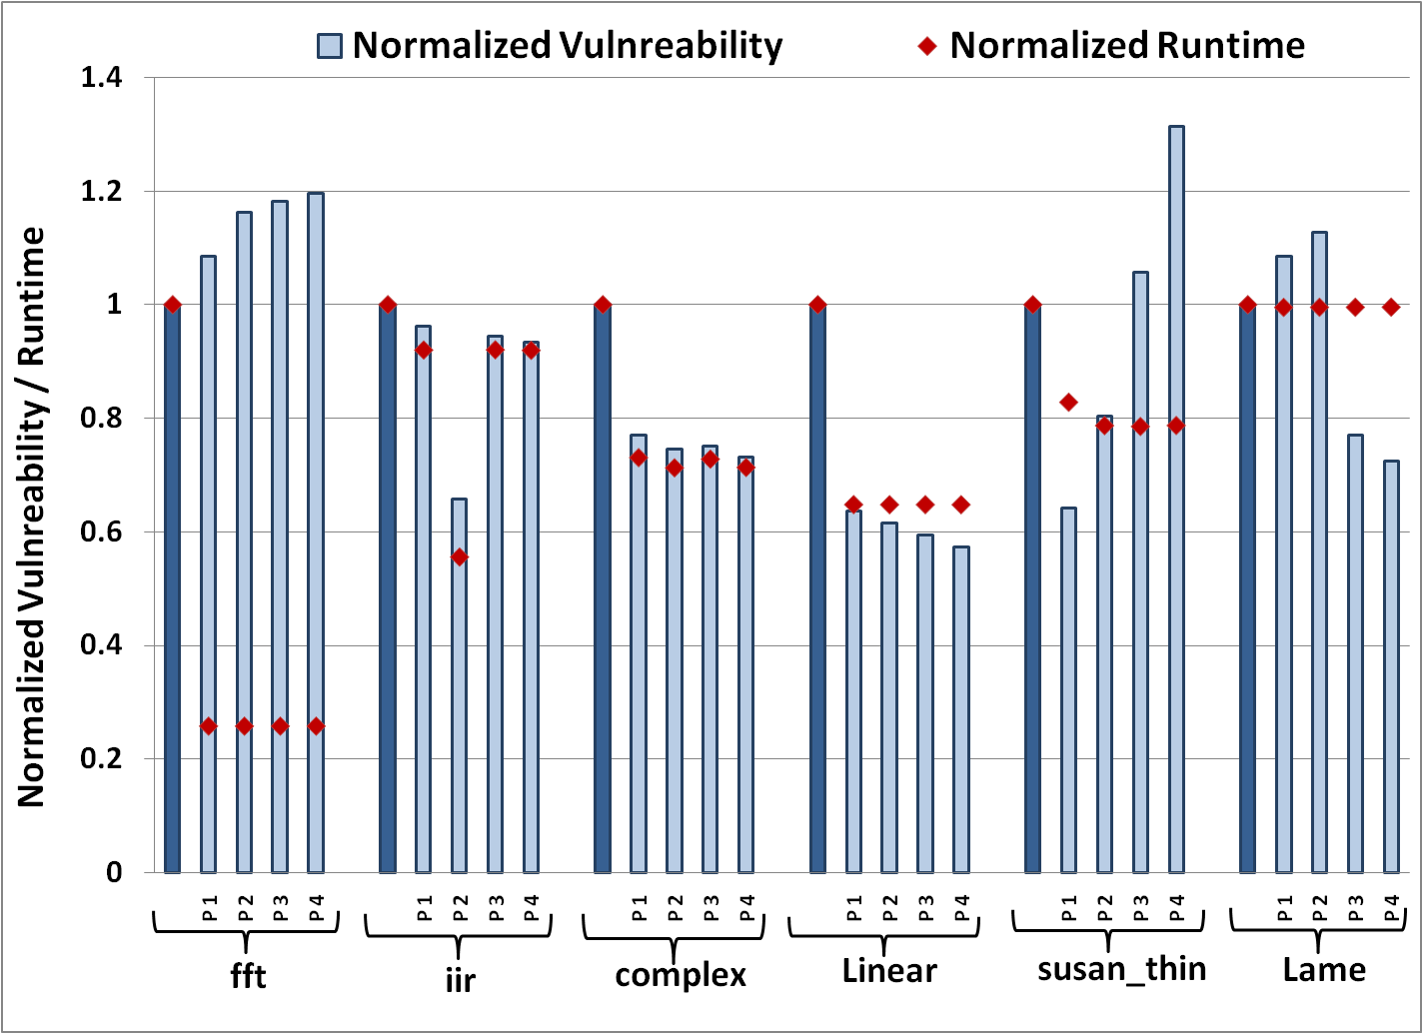
Application of Vulnerability Equations
Impact of Array Interleaving
Arrays accessed within the same nested
loop are interleaved.
Improved performance (41 %)
Vulnerability tradeoff (1.5 X )
Impact of Relative Array Placement
Multiples of cache-line distance is
introduced between array memory locations:
No defined variation pattern
Extensive exploration required
Analytically, an optimal placement can be determined efficiently

Slide 28
Conclusion
A novel static analysis methodology has been proposed for the accurate evaluation of data cache vulnerability.
Worst case time complexity for implementation of the analytical technique is polynomial time (comparable to existing compiler optimizations).
The model has been validated through experiments on benchmark loops across code transformations.
The application of the vulnerability model in optimizing for robustness and optimal performance, across various code transformations has been demonstrated.
Notes:
The total number of vulnerability equations generated = O(narr^2 x nreuse)
Worst case time to calculate numerical values for the closed convex polyhedrons is polynomial time for

Slide 29
Future Work
To incorporate versatility in the analytical model accommodating nested loops with more complex access functions.
To model the vulnerability of data in cache architectures of arbitrary associativity.
To model vulnerability for multi-core architectures.

Slide 30
Related Publication
“Code Transformations for TLB Power Reduction”, Reiley Jeyapaul, Sandeep Marathe, Aviral Shrivastava [VLSI’09]
Proposed compiler techniques to reduce page switches:
page-switch aware instruction and operand reordering
page-switch aware array interleaving
page-switch aware loop unrolling
Implemented the technique for the use-last TLB architecture design.
The comprehensive page-switch reduction algorithm results in 39% reduction in the data-TLB page switching energy, with negligible variation in performance.

Slide 31
Thank you and God Bless !

Slide 32
Backup Slides

Slide 33
Application of Vulnerability Equations Vulnerability variation on Cache Configurations

Slide 35
The Path To a Solution
Circuit-level techniques
TMR technique using a majority voter.
Nieuwland et al [IOLTS’06]
Error masking using the I/O propagation delay of circuits.
Krishnamohan et al [SOC’04]
Area, power and implementation cost overhead
Microarchitecture-level techniques
Selective re-fetching and store-through caches
Sridharan et al [IEEE Trans’06]
Partially protected caches
Shrivastava et al [CASES’06]
Require modification of existing architecture
Include design and verification complexity
System- level techniques
(SWIFT)Reclaiming unused resources during the execution.
Reis et al [CGO’05]
SMT thread for redundancy based error detection and correction
Gomaa et al [SIGARCH’05]
No compiler technique to reduce the impact of soft errors on applications has been proposed till date.

