Slide 1
B2P2: Bounds Based Procedure Placement for Instruction TLB Power Reduction in Embedded Systems
Reiley Jeyapaul and Aviral Shrivastava
Compiler-Microarchitecture Lab
Arizona State University, Arizona, USA

Slide 2
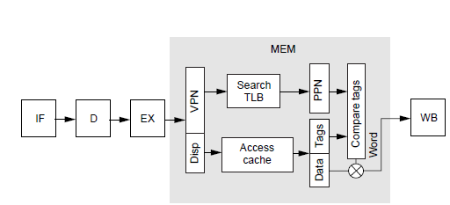
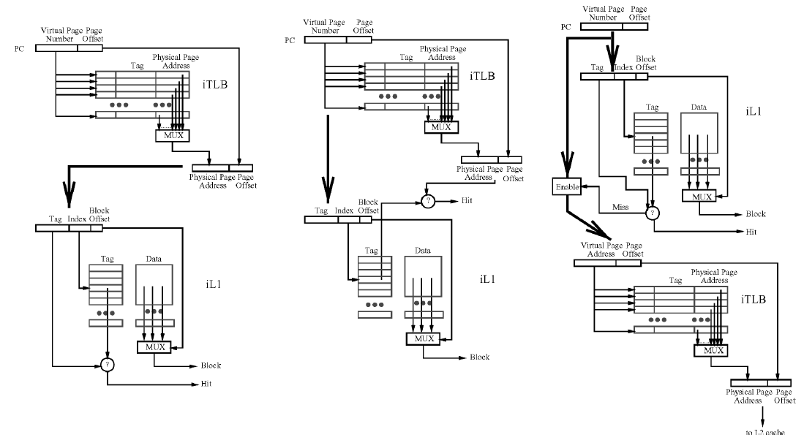
TLB an Integral Hot-Spot of Virtual Memory Management in a processor
Memory Virtualization
Application programmers see a single, almost unlimited memory
Page access control, for privacy and security
Cache access mechanism on a
virtual memory processor
Cache addressing modes in a virtual memory processor
TLB activated on
every cache access
TLB Power:
- 20-25% cache power
TLB Power Density:
- ~ 7.820 nW/mm²
- 8X that of iL1
PI-PT
VI-PT
VI-VT

Slide 3
Efficient Hybrid Approach is the need of the day
Hardware Approaches
Banked Associative TLB [Manne, 1997]
2-level TLB [Lee, ISPLED’03]
Use-last TLB [Clark, ISLPED’03]
Software Approaches
Energy-oriented instruction scheduling [Parikh, VLSI-SP’04]
No software only approach for I-TLB power reduction.
Hybrid Approaches
Translation Registers used in conjunction with compiler optimizations to enhance TR usage [Kandemir, CODES+ISS’04]
We implement compiler optimizations utilizing the use-last TLB architecture for I-TLB power reduction.

Slide 4
Use-Last TLB Architecture : Reduces power on successive accesses to same page
Current Page #
Previous Page #
Triggered iff page Numbers differ
Use-last TLB architecture
Achieves 75% power savings in I-TLB
Power distribution: 40%(tag arrays), 60%(data arrays)
Less than 1% in physical tag due to lookup squashing
TLB power is reduced by reducing total number of
page-switches by the program.
Notes:
Make animations to explain the power on page-switching

Slide 5
Type of Page Switches in the Instruction Memory
Function_1()
Function_2();
PS_{L}:Loop-Execution
Page-Switches
PS_{F}:Function-Call
Page-Switches
PAGE 1
Loop1
Function_2()
PAGE 2
Loop2
PS_{S}:Sequential-Execution
Page-Switches
PAGE 3

Slide 6
Code Placement in the GCC
PAGE 1
Function_1()
Function_2();
Loop1
(i: 1-10)
Function_2()
PAGE 2
Loop2
(i: 1-10)
Function_3();
Function_3()
Loop3
(i: 1-10)
PAGE 3

Slide 7
Page Switches (Un-Optimized)
Function_1()
PAGE 1
Function_2();
Loop1
(i: 1-10)
1x10 = 10
1x10 = 10
Function_2()
Loop2
(i: 1-10)
PAGE 2
10x1=10
Function_3();
10x(1x10) =100
Function_3()
Loop3
(i: 1-10)
10x(1x10)=100
PAGE 3
Total Page-Switches = 10+(100+100+10)+10+1 = 231

Slide 8
Page Switches (naïve Optimization) - Placing each function in a separate page
Function_1()
PAGE 1
1
Function_2();
1
Loop1
(i: 1-10)
nop()
Total Page-Switches = 1+10+100+10+100+1 = 222
Function_2()
Loop2
(i: 1-10)
PAGE 2
10x1=10
Function_3();
10x1=10
Function_3()
Loop3
(i: 1-10)
PAGE 3
10(1x10)=100
10(1x10)=100
Notes:
Add two more placement techniques showing basic-block level and also instruction level granularity of code placement.

Slide 9
Code Placement can be performed at different granularities
Instruction Level Granularity
Fine grained code placement | Increase in code-size
Greatest flexibility in placement | Additional executable instructions
Maximum Page-Switch Reduction | Increased branch instructions
Basic-Block Level Granularity
Only basic-blocks can be moved | Lower increase in code-size
Reduced flexibility in placement | Reduced (> 0) executable instructions
Reduced Page-Switch Reduction | Reduced (> 0) branch instructions
Procedure Level Granularity
Only procedures can be moved | Least increase in code-size
Lowest flexibility in placement | No executable instructions
Lower Page-Switch Reduction | No branch instructions

Slide 10
Procedure Placement Problem
Definition: Assign start addresses to the procedures such that, the program execution incurs reduced number of page-switches and thereby i-TLB power.
Input:
-Program profile information (Function-Call count, loop count)
-CFG of the program (function size, loop size, call site, etc.)
Output:
-New Start address for functions
Constraint:
- No two functions overlap in their memory allocation
Objective:
- Minimize page-switches incurred by the placement

Slide 11
An Optimal solution to the Procedure Placement Problem
Function_1()
PAGE 1
nop()
Procedures repositioned by providing appropriate padding.
nop()
Function_2();
Loop1
(i: 1-10)
1
Function_2()
To achieve such a result, we employ a Branch Based Procedure Placement heuristic
Loop2
(i: 1-10)
PAGE 2
10
Function_3();
10
Function_3()
Loop3
(i: 1-10)
PAGE 3
Total Page-Switches = 1+10+10 = 21

Slide 12
B2P2 Heuristic (step 1): Bound formation
Sorted by decreasing weights (call-count, loop count)
Program + Profile Information
<Page_List>P
Pages occupied by program
Generate
edge-annotated DCFG
DCFG
<Functions_List>F
List of Functions in the program
<Elements_List>E
Call-Sites, Loops
Form bound B: (to remove page-switches by element)
B = [ P.SA , Element , P.EA ]
Element E from top of List

Slide 13
B2P2 Heuristic Demonstration
0
Elements_List:
<Id, Count, [offsets from Fn.SA]>
Pagewise Bounds_List:
F1()
0
F1()
Page 1
10
F2();
10
F2();
L1, 10, [20-70]
L2, 10, [10-60]
CS.F3(), 10, [40]
L3, 10, [10-90]
20
20
L1
(I: 1-10)
L1
(I: 1-10)
70
Page 2
70
F2()
90
F2()
100
L2
(I: 1-10)
100
L2
(I: 1-10)
100
F3();
120
F3();
130
nop()
Bounds B formed for the Element
(To reduce page-switches(if any))
140
Page 3
150
F3()
160
100 ≤ F2.SA < F2.SA+70 ≤ 200
&& 100 ≤ F3.SA ≤ 200
100 ≤ F2.SA+10 < F2.SA+60 ≤ 200
L3
(I: 1-10)
0 ≤ F1.SA+20 < F1.SA+70 ≤ 100
200 ≤ F3.SA+10 < F3.SA+90 ≤ 300
100 ≤ F2.SA < F2.SA+70 ≤ 200
&& 100 ≤ F3.SA + 100 ≤ 200
F3()
200
200
L3
(I: 1-10)
200
Sizeof(F1)+Sizeof(F2) > PageSize
Therefore next element in new page
Placing End of F3 within Page 2
Conflicts with existing bounds ➔ Drop bound
240
Placing Loop L1 within Page 1
Placing Start of F3 within Page 2
280
Placing Loop L3 within Page 3
Placing Loop L2 within Page 2
300
Function Sizes
F1() : 80
F2() : 70
F3() : 100
300
Loop Sizes
L1 : 50
L2 : 50
L3 : 80

Slide 14
B2P2 Heuristic Flow-Chart
Sorted by decreasing weights (call-count, loop count)
Program + Profile Information
<Page_List>P
Pages occupied by program
Generate
edge-annotated DCFG
DCFG
<Functions_List>F
List of Functions in the program
<Elements_List>E
Call-Sites, Loops
Form bound B: (to remove page-switches by element)
B = [ P.SA , Element , P.EA ]
Element E from top of List
Does B conflict with existing PB_{i}.bounds?
<Page_Bounds>PB
Set of bounds placing functions into each page.
For each page PB_{i}
NO
Add to page-bounds list PB_{i}
YES
PB.bounds exists for function F_{x} associated to E?
Get next element E
Disregard the bound B
YES
NO
Continue
Add bound B to a new page.
Add to page-bounds list Pb_{i+1}

Slide 15
Page-Switch Reduction by applying B2P2 on applications
Large nested loop structures restrict the optimization
Large sized functions with high call-counts are rightly analyzed by B2P2

Slide 16
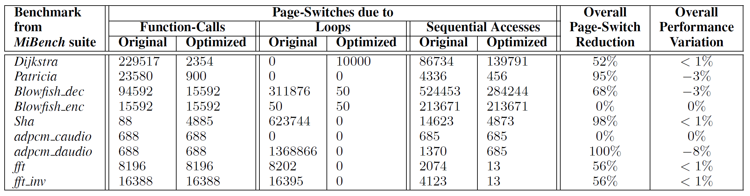
Impact of the Greedy Heuristic
Dijkstra:
While reducing PS due to function-calls, position of 1 loop created new page-switches.
Blowfish:
An if condition enabling a different loop only for the decode functionality incurred page-switches, which could be optimized through profile information.

Slide 17
Summary
Proposed a greedy Bounds Based Procedure Placement heuristic for i-TLB power reduction.
Power consumption of i-TLB can be reduced by 76% over and above that achieved through Use-Last TLB architecture.
Performance impact is less than 2% with negligible code-size increase.

Slide 18
Future Work
Procedure placement at basic-block level can be implemented and performance tradeoff analyzed
Formulating the PPP as a network-flow problem opens the possibility of a more efficient heuristic.
Evaluating the combined effects of compiler techniques on D-TLB[18] and I-TLB using the Use-Last TLB architecture.
[18] R. Jeyapaul, S. Marathe, and A. Shrivastava. Code Transformations for Tlb Power Reduction.
In VLSID ’09, pages 413–418, Washington, DC, USA, 2009. IEEE Computer Society

