Slide 1

Smart Cache Cleaning: Energy Efficient Vulnerability Reduction in Embedded Processors
Reiley Jeyapaul, and Aviral Shrivastava
Compiler Microarchitecture Lab,
Arizona State University, Tempe, Arizona, USA

Slide 2
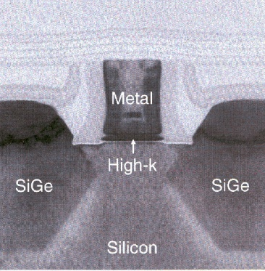
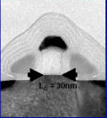
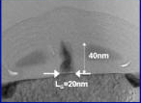
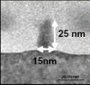
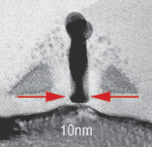
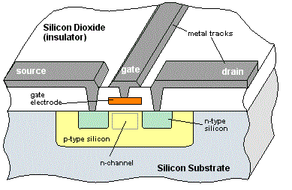
Scaling Drives Technology Advancement
Processor device size rapidly shrinks every generation
45nm [2008]
30nm [2010]
20nm [2011]
15nm [2013*]
10nm [2015*]
Smaller device dimensions improve on performance and reduce power consumption
Notes:
Change pic to research direction …

Slide 3

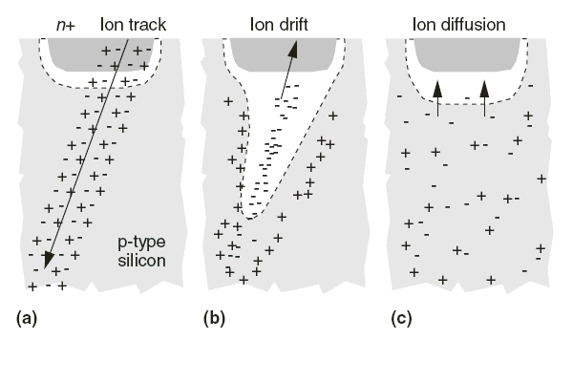

Reliability a consequence: Transient Faults induce Soft Errors
Electrical disturbances can disrupt the operation causing Transient Faults

Slide 4
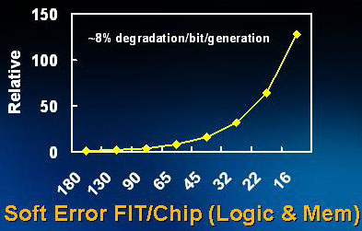
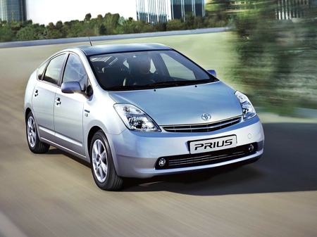
Soft Errors - an Increasing Concern with Technology Scaling
Charge carrying particles induce Soft Errors
Alpha particles
Neutrons
High energy (100KeV -1GeV)
Low energy (10meV – 1eV)
Soft Error Rate
Is now 1 per year
Exponentially increases with technology scaling
Projected→1 per day in a decade
Performance is useless if not correct !
Toyota Prius: SEUs blamed as the probable cause for
unintended acceleration.

Slide 5

Agenda
Why cache vulnerability?
Cache Cleaning to Improve Reliability
Smart Cache Cleaning Methodology
Experimental Evaluation and Results

Slide 6
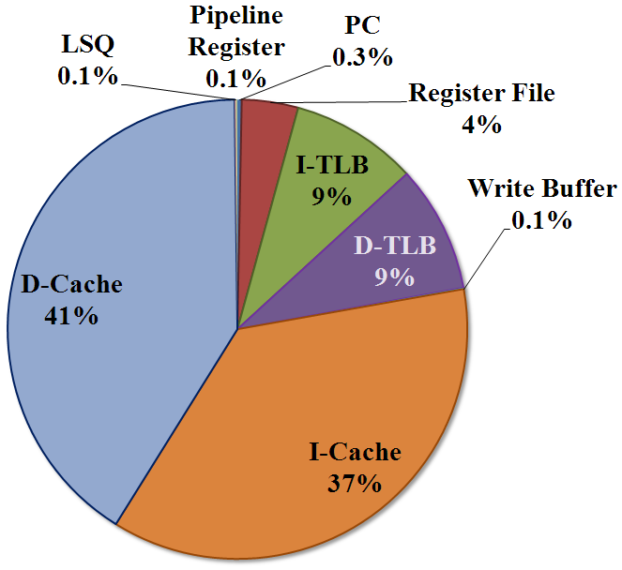
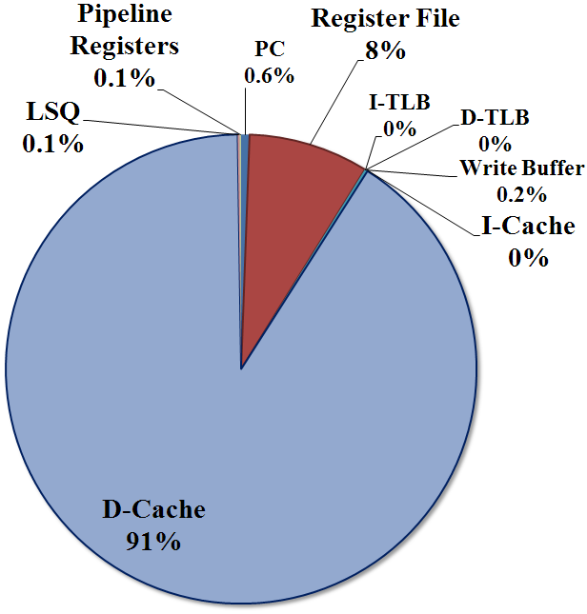
Caches are most vulnerable
Caches occupy majority of chip-area
Much higher % of transistors
More than 80% of the transistors in Itanium 2 are in caches.
Low operating voltages
Frequent accesses
Small and tight SRAM cell layout
Majority contributor to the total soft errors in a system
With cheap Error detection, cache still the most susceptible architecture block.
Cache (split I/D) = 32KB
I-TLB = 48 entries
D-TLB = 64 entries
LSQ = 64 entries
Register File = 32 entries
Notes:
Cache soft error percentage over all architecture blocks
When 1-bit error detection applied to all the architecture blocks
MIPS based processor
Indicate it is first unprotected

Slide 7
How to protect L1 Cache ?
Features | SECDED | Parity
Error detection | 1 bit and 2 bit | 1 bit
Error Correction | 1 bit | No correction
Cache Access Latency | +95% increase (can be hidden) | No Impact
Cache Area Increase | +22% | + <1%
Cache Power Increase | +22% | + <1%
Enabled Processors | SPM of IBM Cell | ARM, Intel Xscale, Intel Atom
To Detect + Correct:
Consequences render it impractical.
Practical Method:
Needs supporting method to correct errors.

Slide 8
Cache Vulnerability
CE
CE
R
W
R
R
W
R
Time
How to protect dirty
L1 cache data ?
Assume: Parity based error detection to detect 1-bit errors.
Non-dirty data is not vulnerable
Can always re-read non-dirty data from lower level of memory
Parity based error detection can correct soft errors on non-dirty data
Dirty data cannot be reloaded (recovered) from errors.
Data in the cache is vulnerable if
It will be read by the processor, or it will be committed to memory
AND it is dirty
Notes:
Let us assume that it is the timeline of the data processed
We assume that the cache has 1-bit error detection capabilities
So if there was a 1-bit error, the correct value could be re-loaded from the memory
Vulnerability is defined as the time that the only correct/updated copy of the data is present in the cache
If it will update the memory or be read by the processor, data corruption occurs and therefore can cause failures in the system.
Vulnerability calculation

Slide 9
Agenda
Why cache vulnerability?
Cache Cleaning to Improve Reliability
Write-through cache
Early Write-back cache
Proposed Smart Cache Cleaning
Smart Cache Cleaning Methodology
Experimental Evaluation and Results

Slide 10
Possible Solution 1: Write-Through Cache
Data Accessed
for(i:1~3){
for(j:1~3){
A[i]+=B[j]
}
}
A[1]
A[1]
A[1]
A[2]
A[2]
A[2]
A[3]
A[3]
A[3]
Program
Timeline
(cycles)
RW
RW
RW
RW
RW
RW
RW
RW
RW
End of Loop
Memory
Write-back
or Cache
Cleaning
E
Error Recovery:
Data reloaded from memory
A copy of cache-data is written into the memory
If error detected on subsequent access,
can reload from memory to recover.
NO dirty data in cache NO vulnerability
HIGH L1-M traffic
Vulnerability = 0
# write-backs = 9

Slide 11
Possible Solution 2: Early Write-back Cache
Data Accessed
for(i:1~3){
for(j:1~3){
A[i]+=B[j]
}
}
A[1]
A[1]
A[1]
A[2]
A[2]
A[2]
A[3]
A[3]
A[3]
Program
Timeline
(cycles)
RW
RW
RW
RW
RW
RW
RW
RW
RW
End of Loop
Periodic
Write-back
E
4 Cycles
Vulnerability
A[1]
A[1]
A[2]
A[2]
A[3]
A[3]
Vulnerability ≠ 0
What went wrong?
Data unused but vulnerable
Unnecessary cleaning while data is being reused
Vulnerability = 48
# write-backs = 0
Hardware-only cleaning has
no knowledge of the program’s data access pattern.
Vulnerability = 13
# write-backs = 8
Notes:
Mention as too late and too early !

Slide 12
Proposed Solution: Smart Cache Cleaning
Data Accessed
for(i:1~3){
for(j:1~3){
A[i]+=B[j]
}
}
A[1]
A[1]
A[1]
A[2]
A[2]
A[2]
A[3]
A[3]
A[3]
Program
Timeline
(cycles)
RW
RW
RW
RW
RW
RW
RW
RW
RW
End of Loop
Smart
Cache
Cleaning
E
Vulnerability
A[1]
A[2]
A[3]
Data is vulnerable while being reused by the program
Vulnerability = 0 for unused data.
Smart program analysis can help perform Cache Cleaning only when required.
Vulnerability = 18
# write-backs = 3
For this program, Clean data,
ONLY when not in use
by the program.
Notes:
Mention it is at the right time !

Slide 13
Agenda
Why cache vulnerability?
Cache Cleaning to Improve Reliability
Smart Cache Cleaning Methodology
When to clean data ?
SCC Hardware Architecture
How to clean data ?
Which data to clean ?
Experimental Evaluation and Results

Slide 14
How to do Smart Cache Cleaning
Program
IF
ID
EX
M
WB
Memory
Profile data
R/W Cache
Accesses
LSQ
Store
Insn Addr
SCC Analysis
L1 Cache
Which data
to clean ?
Controller: Issue clean signal when required
Cache
Cleaning
Memory
Write-backs
SCC Insn Addr
SCC Pattern
Memory
When to clean ?
clean
Targeted cache cleaning architecture
How to clean ?

Slide 15
When to clean data ?
Data Accessed
A[1]
A[1]
A[2]
A[2]
A[2]
A[3]
A[3]
A[3]
for(i:1~3){
for(j:1~3){
A[i]+=B[j]
}
}
A[1]
Program
Timeline
(cycles)
RW
RW
RW
RW
RW
RW
RW
RW
RW
End of Loop
SCC_Pattern
0
0
1
0
0
1
0
0
1
E
Instantaneous
Vulnerability
(per access)
3
3
A[1]
19
If end of loop execution is not end of program, then instantaneous vulnerability of last access extends till subsequent cache eviction.
Execute: store + clean
If Instantaneous Vulnerability of access > SCC_Threshold
Execute: store + clean → assign 1 to SCC_Pattern
Else
Execute: store only → assign 0 to SCC_Pattern
SCC_Threshold = 4

Slide 16
How to do Smart Cache Cleaning
Program
IF
ID
EX
M
WB
Memory
Profile data
R/W Cache
Accesses
LSQ
Store
Insn Addr
SCC Analysis
L1 Cache
Which data
to clean ?
Controller: Issue clean signal when required
Cache
Cleaning
Memory
Write-backs
SCC Insn Addr
SCC Pattern
Memory
When to clean ?
clean
Targeted cache cleaning architecture
How to clean ?

Slide 17
How to clean data ?
Instruction Pipeline
Cycle count :
6
9
12
3
LSQ
SCC_Pattern
0
1
0 0 1 0 0 1 0 0 1
0
Controller
L1 Cache
clean
No Cleaning
Cache
Cleaning
Targeted cache cleaning architecture
Memory
Program Execution
for(i:1~3){
for(j:1~3){
A[i]+=B[j]
}
}
A[1]
A[1]
A[1]
A[2]
A[2]
A[2]
A[3]
A[3]
A[3]
Program
Timeline
(cycles)
RW
RW
RW
RW
RW
RW
RW
RW
RW
End of Loop
SCC Pattern
0
0
1
0
0
1
0
0
1
E

Slide 18
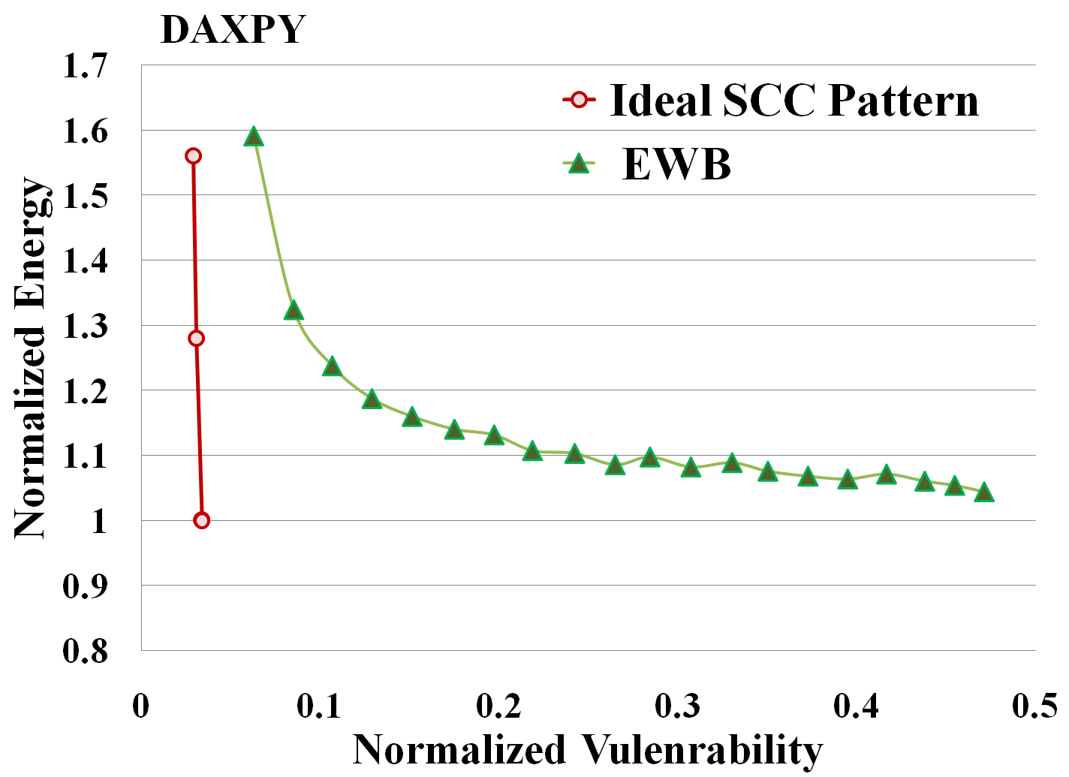
SCC Achieves Energy-efficient Vulnerability Reduction
Hardware-only cache cleaning trades-off energy for vulnerability
Smart Cache Cleaning can achieve
≈0 Vulnerability, at
≈0 Energy cost

Slide 19
SCC_Pattern Generation: Weighted k-bit Compression
SCC Cleaning
sequence:
1 1 0 1 1 0 0 1 1 0 0 0 0 1 0 1 0 1 0 1 0 0 0 1 1 1
SCC Pattern:
- - - - - - - -
- - - - - - - 1
Sliding window of 8 bits
K = 8
To determine matching bit value for position 0
if ( cost_of_1 ≤ cost_of_0 )
Bit value [0] = 1
Choose bit value = 1,
iff # of 1s > 2X # of 0s
Cost of not cleaning clean when required.
Bit count in position 0
Num of 1s = 3
Num of 0s = 1
Cost for placing 0 in pos [0] of SCC Pattern:
cost_of_0 = Num of 1s X 1
= 3 X 1 = 3
Cost of cleaning when not required.
Cost for placing 1 in pos 0 of SCC Pattern:
cost_of_1 = Num of 0s X 2
= 1 X 2 = 2

Slide 20
SCC_Pattern Generation: Weighted k-bit Compression
SCC Cleaning
sequence:
0 0 0 0 0 0
1 1 0 1 1 0 0 1 1 0 0 0 0 1 0 1 0 1 0 1 0 0 0 1 1 1
if ( cost_of_1[i] ≤ cost_of_0[i] )
Bit value [i] = 1
else
Bit value [i] = 0
Remaining 6 bits are 0-padded
SCC Pattern:
- - - - - - 1 1
- - - - - 1 1 1
- - - - 0 1 1 1
- - - 0 0 1 1 1
- - 0 0 0 1 1 1
- 0 0 0 0 1 1 1
0 0 0 0 0 1 1 1
0 0 0 0 0 1 1 1
- - - - - - - 1
K = 8
Greater # of 1s
Greater # of 1s
Greater # of 0s
Position [1] :
cost_of_1[1] = 2
cost_of_0[1] = 3
Position [4] :
cost_of_1[4] = 6
cost_of_0[4] = 1
Position [2] :
cost_of_1[2] = 2
cost_of_0[2] = 3
Equal # of 0s and 1s
Position [6] :
cost_of_1[6] = 4
cost_of_0[6] = 2
All 0s → Bit value = 0

Slide 21
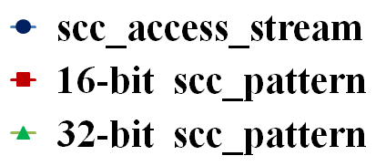
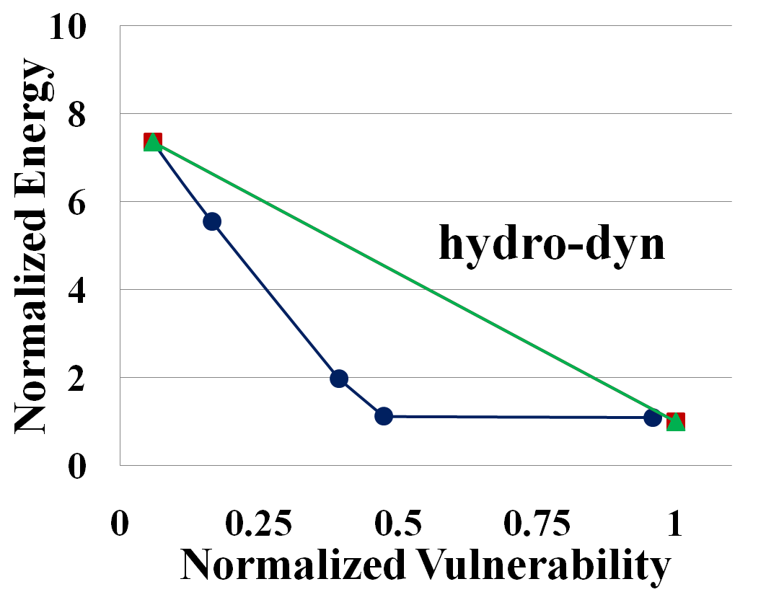
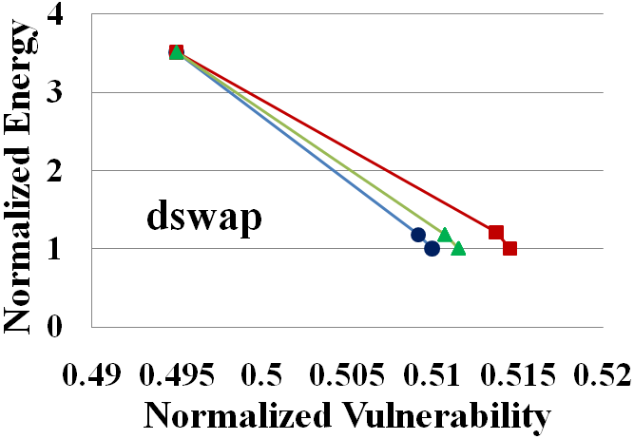
Accuracy of the Weighted Pattern-Matching Algorithm
Weights used in the algorithm define the accuracy.
Size of k affects accuracy

Slide 22
How to do Smart Cache Cleaning
Program
IF
ID
EX
M
WB
Memory
Profile data
R/W Cache
Accesses
LSQ
Store
Insn Addr
SCC Analysis
L1 Cache
Which data
to clean ?
Controller: Issue clean signal when required
Cache
Cleaning
Memory
Write-backs
SCC Insn Addr
SCC Pattern
Memory
When to clean ?
clean
Targeted cache cleaning architecture
How to clean ?

Slide 23
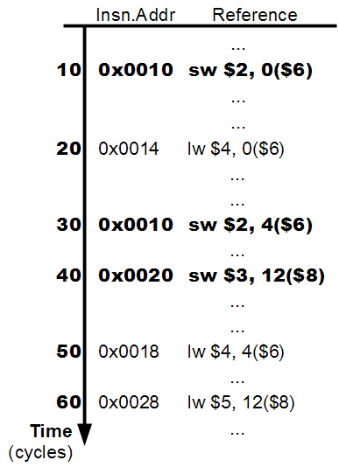
Which data to clean ?
Parameters | Ref A | Ref B
Vulnerability
Access #
30
2
20
1
A1
10
Profit (V/A)
15
20
Instantaneous Vulnerability(IV)
by each access of reference A
A2
20
Average Vulnerability per access
B1
20
Overlapping accesses:
Choosing B, precludes the choice of A
How to choose one over anther ?
One SCC InsnAddr Register

Slide 24
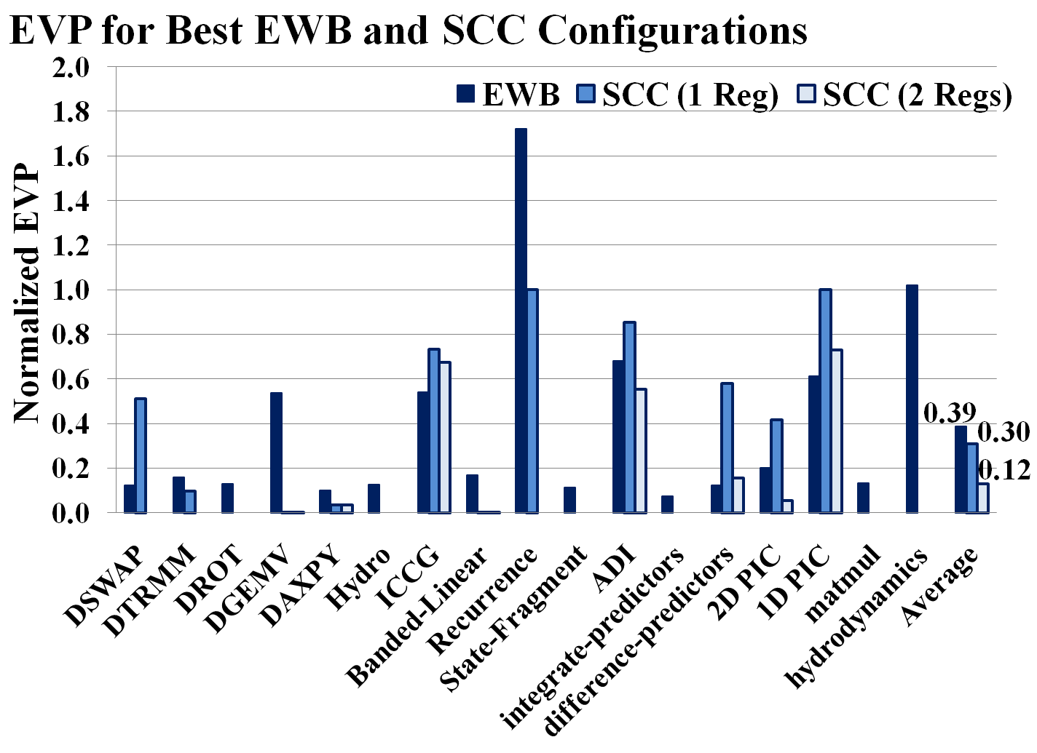
Energy Efficient Vulnerability Reduction with SCC

Slide 25
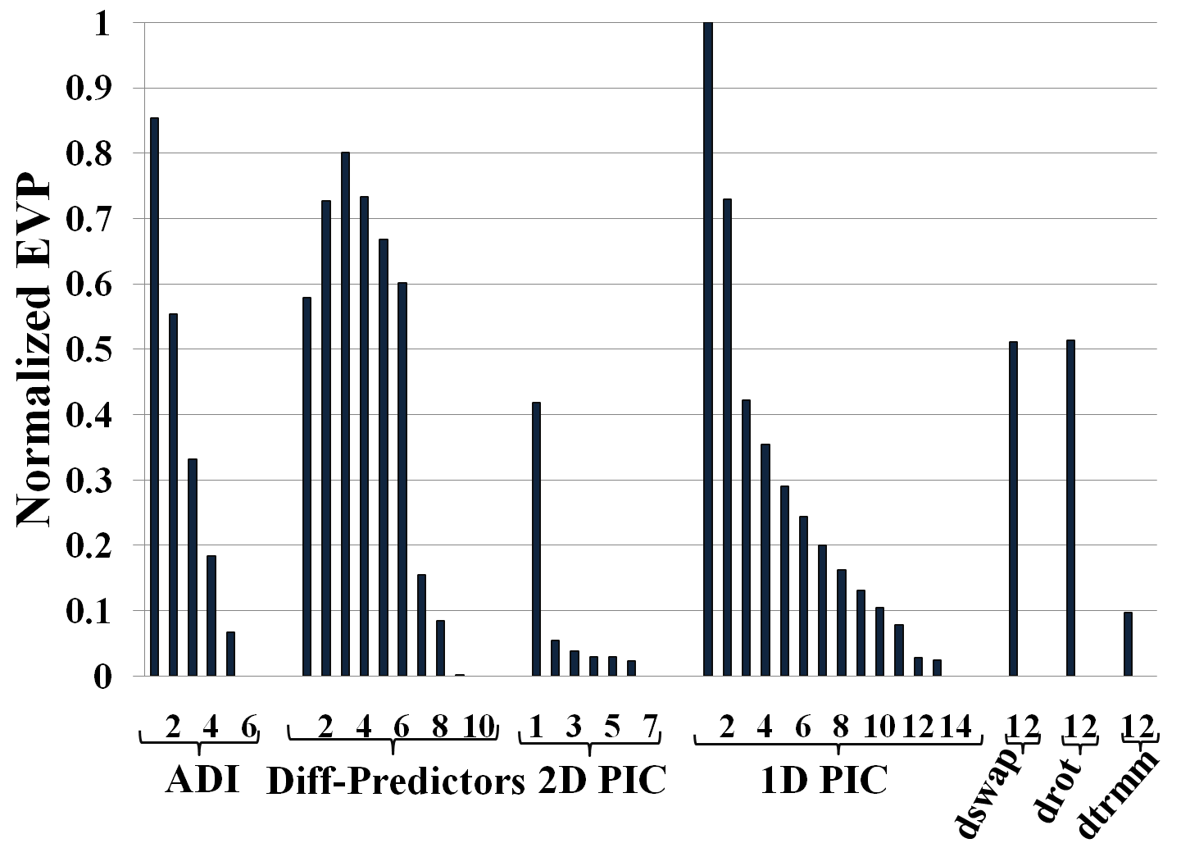
SCC: Better results with more hardware registers
With more SCC registers, vulnerability is reduced further,
at the cost of hardware overhead

Slide 26
Summary
We develop a Hybrid Compiler & Micro-architecture technique for Reliability – SCC
Soft Errors are a major concern, and Caches are most vulnerable to transient errors by radiation particles
Cache Cleaning can reduce vulnerability, at the possible cost of power overhead
ECC gains 0 vulnerability, but 70X power overhead
EWB gains 47% vulnerability reduction, with 6X power overhead
Our Smart Cache Cleaning technique:
performs Cleaning on the right cache blocks at the right time
achieves energy-efficient reliability in embedded systems

Slide 27
Future Work
SCC-hardware overhead can be eliminated through compiler-based instrumentation and loop unrolling.
Compile-time SCC analysis, and instrumentation can be performed using Cache Vulnerability Equations [LCTES’10].
Pure software-only SCC solution.
NO hardware overhead
By introducing methods to accurately calibrate the weights used in the algorithm, accuracy can be improved.

Slide 28
e-mail : reiley.jeyapaul@asu.edu
Home Page : www.public.asu.edu/~rjeyapau/
CML Lab : http://aviral.lab.asu.edu

Slide 29
SCC Architecture Overview
IF
ID
EX
M
WB
R/W Cache
Accesses
LSQ
L1 Cache
Memory
Write-backs
L2 Cache/
Memory

Slide 30
Possible Solution 1: Write-Through Cache
Cache
Accesses
R
W
R
W
R
W
R
E
R
W
Memory
Write-back
or Cache
Cleaning
A copy of cache-data is written into the memory
o
4
If error detected on subsequent access,
can reload from memory to recover.
Vulnerability (cycles)
# of Write-backs
Vulnerability = 0
# of Writebacks = 4
x
0
2
3
4
Period (cycles)

Slide 31
Possible Solution 2: Early Write-back Cache
Cache
Accesses
R
W
R
W
R
W
R
E
R
W
Cache
Cleaning
Vulnerability
EWB Period Vulnerability
# of WBs
o
o
o
4
Cache to memory transfer of dirty data
x
6
o
3
Periodic write-back with no dirty data
Vulnerability (cycles)
# of Write-backs
3
x
1
x
Irregularity in trend due to data-access pattern
x
0
2
3
4
Period (cycles)

Slide 32
Proposed Solution: Smart Cache Cleaning
Cache
Accesses
R
W
R
W
R
W
R
E
R
W
Cache
Cleaning
Vulnerability
Considering the cache-eviction in 2 cycles, the additional write-back is avoided.
2 cycle vulnerability trade-off for reduced # of write-backs
Analyzing the data-access pattern, prudent choices for cache cleaning can be made during a specific set of store instructions.
Vulnerability = 2
# of Writebacks = 3

Slide 33
SCC Working: When to clean data ?
Cache
Accesses
R
W
R
W
R
W
R
E
R
W
Instantaneous
Vulnerability (IV)
3
4
2
Vulnerability generated by a store operation on the cache: W-R, W-E
Using SCC Threshold parameter = 3, no clean operation is performed
SCC Threshold
Parameter used to choose the right instruction accesses to clean.
If IV ≥ SCC Threshold
perform clean (represented by a 1 in SCC Bit Pattern)
Else
donot clean (represented by a 0 in SCC Bit Pattern)

Slide 34
SCC Hardware Architecture
Program
IF
ID
EX
M
WB
Memory
Profile data
R/W Cache
Accesses
LSQ
SCC Analysis
Which data
to clean ?
Store
Insn Addr
L1 Cache
SCC Insn Addr
Controller: Issue clean signal when required
SCC Pattern
Memory
Write-backs
Cache
Cleaning
When to clean ?
clean
L2 Cache/
Memory
Targeted cache cleaning architecture
How to clean ?

Slide 35
SCC Working: How to clean data ?
Cache
Accesses
R
W
R
W
R
W
R
E
R
W
Cache
Cleaning
SCC Pattern
1
1
0
1
Instruction Pipeline
store
Insn Addr
LSQ
1
1
0
1
Controller
L1 Cache
clean
clean
clean
Cache
Cleaning
Cache
Cleaning
Cache
Cleaning
SCC Pattern
Bit value for each instance of the target instruction access
Targeted cache cleaning architecture
Memory

