Slide 1


UnSync: A Soft Error Resilient Redundant Multicore Architecture
Reiley Jeyapaul¹, Fei Hong¹, Abhishek Rhisheekesan¹,
Aviral Shrivastava¹, Kyoungwoo Lee²
¹Compiler Microarchitecture Lab,
Arizona State University, Tempe, Arizona, USA
²Dependable Computing Lab,
Yonsei University, Seoul, South Korea

Slide 2
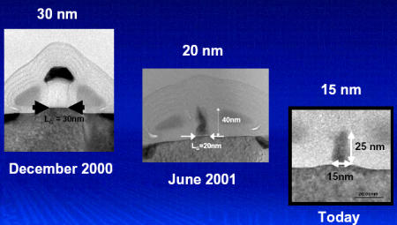
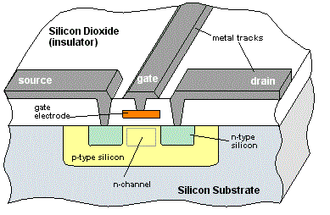
Scaling Drives Technology Advancement
Scaling: The Transistor Gate
shrinks in size every year
Smaller device dimensions improve on performance and reduce power consumption

Slide 3

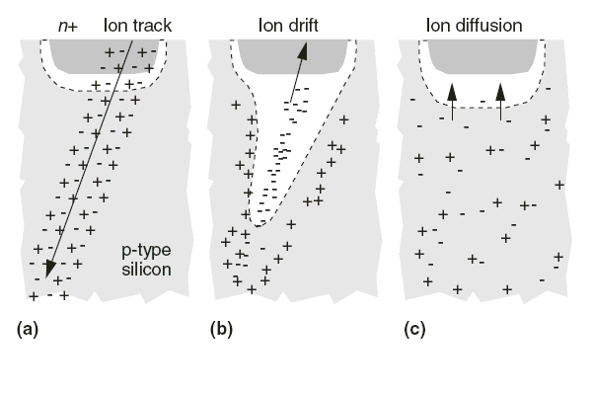

Reliability - a consequence: Transient Faults induce Soft Errors
Electrical disturbances can disrupt the operation causing Transient Faults

Slide 4
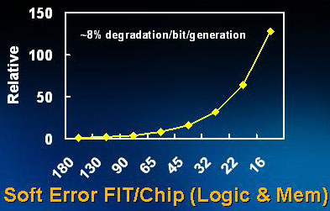

Soft Errors - an Increasing Concern with Technology Scaling
Charge carrying particles induce Soft Errors
Alpha particles
Neutrons
High energy (100KeV -1GeV)
Low energy (10meV – 1eV)
Soft Error Rate
Is now 1 per year
Exponentially increases with technology scaling
Projected→1 per day in a decade
Performance is useless if not correct !
Toyota Prius: SEUs blamed as the probable cause for
unintended acceleration.

Slide 5
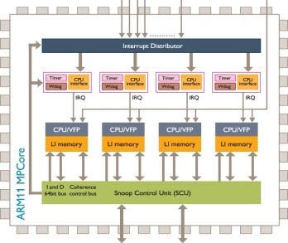
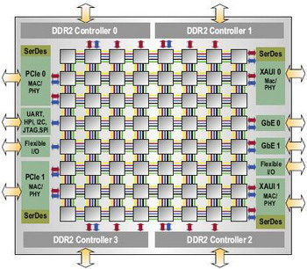
Chip Multi-Processors and Redundancy
ARM11 MPCore
Tilera
TILE64
CMPs : Good candidates for redundancy based techniques
Cores and hardware, available for use with low performance impact
Redundancy can be implemented at larger granularity
Effective performance overhead can be reduced
Popular redundancy based techniques:
Triple Modular Redundancy – error in data is voted out
Dual Modular Redundancy – detection by comparing two identical executions
Checkpointing – check execution at regular intervals and save state for recovery (when error is detected)

Slide 6
Soft Error Resilience in Chip Multi-Processors
ARM11 MPCore
Tilera
TILE64
Cost of redundancy based soft error resilience is high
Redundancy reduces performance by 50%
Cannot afford more loss
Hardware overhead is amplified with core count
Inter-core communication overhead is amplified with scaling
Power cost per effective computation ratio is low
Cannot afford increased power overhead (hardware or software)
Requirements for efficient error resilience in CMPs
Effective Performance ~ 50%
Low hardware overhead
Low inter-core communication overhead
Smart use of available power efficient resources (hardware or software)

Slide 7
Relevant Previous Work
Checkpointing
At periodic intervals, perform system integrity check
Store architectural state at this point = checkpoint
If error detected, recover from previous checkpoint
Checking requires synchronization
Storage of architecture state requires hardware
Lock-step [Meaney2005]
Redundant executions compared to detect errors
Observe identical cache accesses, and interrupts
100% penalty in performance and hardware
Redundant Multi-Threading [Reinhardt2000]
SMT architecture where store and load values are checked
Load Value Queue (LVQ) for consistent replication
Inter-thread synchronization, and performance overheads

Slide 8
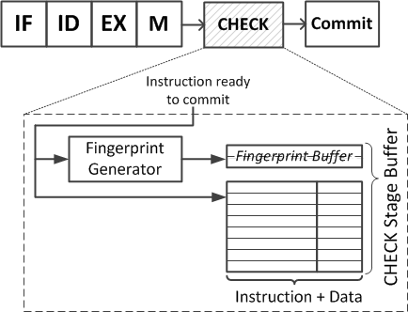
State-of-the-art Soft Error Resilient Redundant Multicore Architecture
For fingerprint transfer
Mute Core
Vocal Core
L1
L1
ECC
protected
ECC
protected
Shared L2
Error Detection and Recovery:
Reunion [Smolens2006]
Physically tagged vocal and mute cores executing redundantly
Fingerprint (hash of instructions and output) compared before commit
Instruction + output buffered till fingerprints compared on both cores
Execution state check-pointed, on every fingerprint comparison
Hardware overheads and inter-core synchronization penalty

Slide 9
UnSync Architecture Construction
Core 1
(a)
Core 2
(b)
Redundant Cores:
- identical architecture
- execute same thread
L1
L1
Multi-Core Architecture:
- private L1 cache
- shared L2 cache
- independent memory bus
Communication
Buffer (CB)
Communication Buffer:
- ECC protected
a b
Existing memory bus is bypassed when executing redundantly
L2 Cache
(ECC Protected)

Slide 10
UnSync Architecture Working: Error-free execution
Identical cores execute the same thread
Core 1
(a)
Core 2
(b)
L1
L1
L1-L2 data writeback:
to respective
CB sections
cache-line address compared:
to ensure completion on both cores
a b
One cache-line written to L2:
Data written is guaranteed correct
L2 Cache
(ECC Protected)

Slide 11
Communication Buffer: Working
Faster core
Core 1
Core 2
Slower core
L1
L1
OX0003 D3
OX0001 D1
Instruction completed execution on both cores
OX0001 D1
OX0001 D1
OX0003 D3
Wait for “OX0002” to execute in core 2
OX0002 D2
Commit: OX0001 D1
Shared L2

Slide 12
UnSync Architecture Working: Error-detection
EIH
EIH
Error detected in a core is reported to the
Error Interrupt Handler (EIH)
a
Core 1
(a)
Core 2
(b)
RECOVERY
L1
L1
Power efficient hardware-only error detection
DMR
- Program counter
- Pipeline register
1-bit Parity
- L1 cache
- Register file
- Queuing structures
a b
UnSync feature:
Hardware based error-detection and handling eliminates the need for inter-core communication
L2 Cache
(ECC Protected)

Slide 13
UnSync Architecture Working: “Always forward execution” Recovery
EIH
Core execution and L1-L2 traffic are STOPPED
Core 1
(a)
Core 2
(b)
fault in a
fault in b
CB content of one core copied over the other
L1
L1
Architectural state of correct core copied over faulty core
a b
After Recovery:
Both cores resume execution
from PC of correct core
Re-execution (if any) occurs only
in faulty core
L2 Cache
(ECC Protected)

Slide 14
Salient Features of UnSync
Power-efficient error detection in Hardware
Parity for detection in cache, instead of ECC for correction
Detection techniques (DMR, TMR) with reduced hardware
Eliminates the need for inter-core communication
No Inter-Core Synchronization
Detection does not require data comparison between cores
CB at L1-L2 interface, prevents error leakage into memory
Commit only one copy of data to memory, ensure data consistency
Always Forward Execution (After Recovery)
Both cores resume execution from PC of correct core
Repeat execution after recovery, if correct core was faulty
Correct core execution pattern is not disturbed.

Slide 15
Experimental Setup: H/w Synthesis
Compare and contrast area and power of single core
RTL of the MIPS processor is implemented
Synthesize at 300MHz, 65nm using Cadence Encounter
Perform place-and-route (PNR) to incorporate datapaths
For cache power we use CACTI cache simulator.
Hardware components added for Reunion
fingerprint size = 16bits
fingerprint interval = 10 instructions
CHECK stage buffer = 17 entries (each of 66 bits)
Hardware components added for UnSync
L1 cache is write-through
Communication buffer = 10 entries

Slide 16
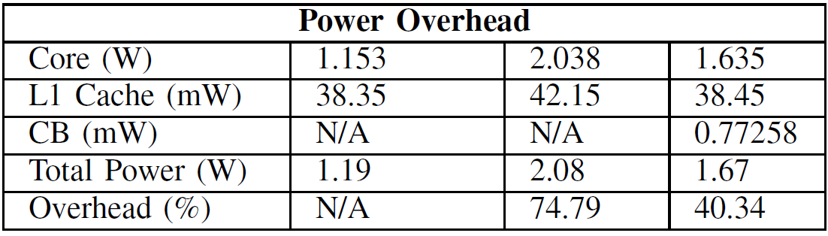
UnSync : Low Power Overhead
Increased power consumption in Reunion
Large storage buffers within the core
Fingerprint generation on every cycle
CHECK stage to perform inter-core fingerprint comparisons
SECDED on L1 Cache
Power overhead in UnSync by error detection blocks
can be reduced by advanced power-efficient methods

Slide 17
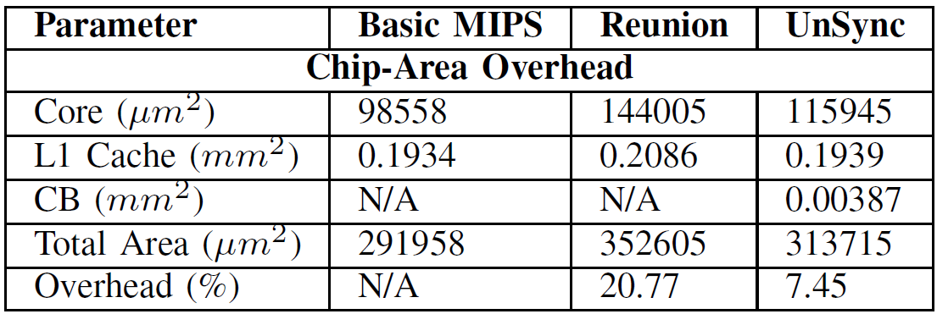
UnSync : Low Area Overhead
UnSync Hardware added
Error detection components
1-bit parity (L1 cache, RF, Queues)
DMR (PC, pipeline registers)
ECC protected Communication buffer

Slide 18
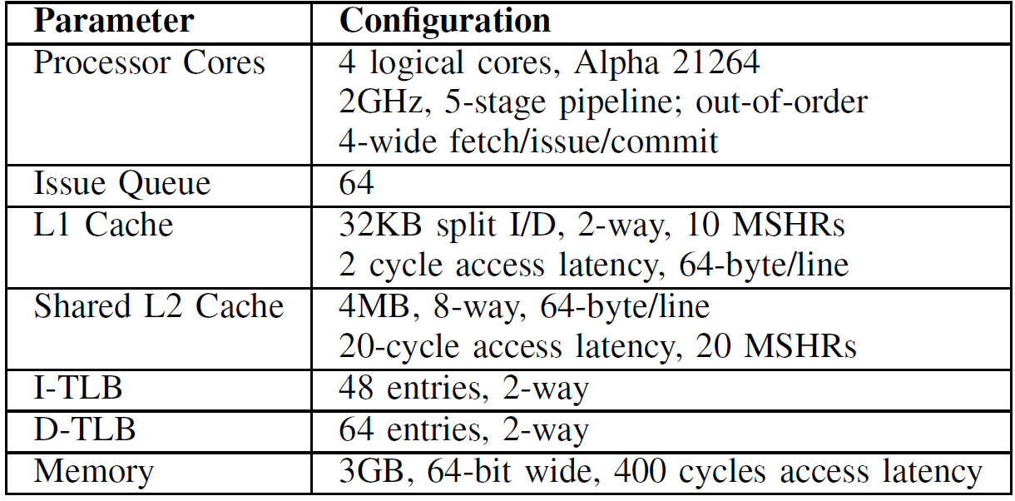
Experimental Setup: Simulation
Cycle-accurate M5 simulator with the above configuration.

Slide 19
Salient Features of UnSync
Power-efficient error detection in Hardware
Parity for detection in cache, instead of ECC for correction
Detection techniques (DMR, TMR) with reduced hardware
Eliminates the need for inter-core communication
No Inter-Core Synchronization
Detection does not require data comparison between cores
CB at L1-L2 interface, prevents error leakage into memory
Commit only one copy of data to memory, ensure data consistency
Always Forward Execution (After Recovery)
Both cores resume execution from PC of correct core
Repeat execution after recovery, if correct core was faulty
Correct core execution pattern is not disturbed.

Slide 20
Synchronization Affects Performance
Fingerprint comparison and memory synchronization
No Synchronization → Improved Performance
Mute Core
Vocal Core
Core 1
Core 2
Reunion
UnSync

Slide 21
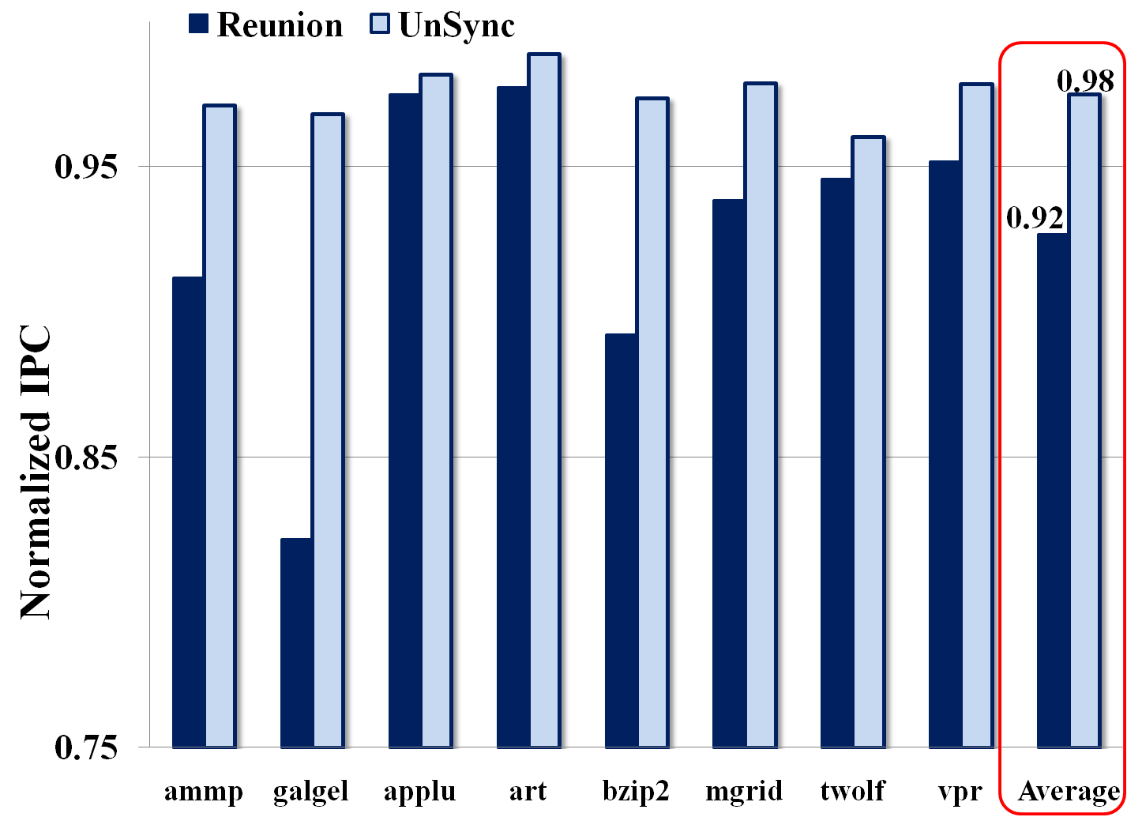
Improved Performance Without Synchronization

Slide 22
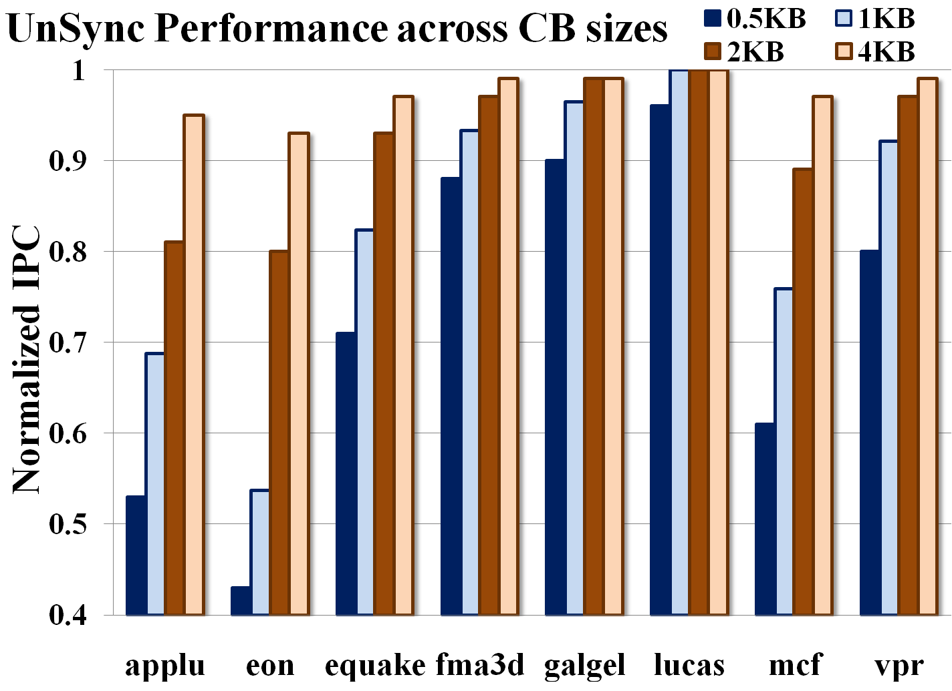
Larger CB removes resource occupancy bottleneck

Slide 23
Limitations
If a SEU manifests into error on both cores simultaneously, execution cannot be recovered
Hardware based interrupt handling provide immediate recovery activation
If error is detected in a register file when copying from correct (during recovery)
Execution cannot be recovered
Probability of such undetected errors in RF is very low
Recovery subroutine will use the shared L2 to transfer architectural state (RF+ PC) from correct core to erroneous core.

Slide 24
Summary
Soft Errors are soon to become a major concern even in terrestrial computing systems
CMPs are good candidates for redundancy based methods for soft error resilience
UnSync is an efficient, soft error resilient CMP architecture
Power efficient hardware based detection reduces overheads
13.32% reduced area, 34.5% less power consumption
Always forward execution based recovery improves performance
20% improved performance over Reunion
Larger Region of Error Coverage improving reliability of core
Architecture framework allows for possible customization
Achieve varied degrees of redundancy/resilience tradeoffs

Slide 25
Thank you !

