Slide 1
Smart Compilers for Reliable and Power-efficient Embedded Computing
PhD Dissertation
Reiley Jeyapaul,
PhD Candidate, SCIDSE, ASU
Supervisory Committee:
Prof. Aviral Shrivastava (Chair)
Prof. Charles Colbourn
Prof. Sarma Vrudhula
Prof. Lawrence T. Clark

Slide 2

Agenda
Why Embedded Processor Technology?
Key System Requirements
Power Efficiency
Reliability
Why a Compiler Approach ?
Thesis Statement & Supporting Contributions

Slide 3
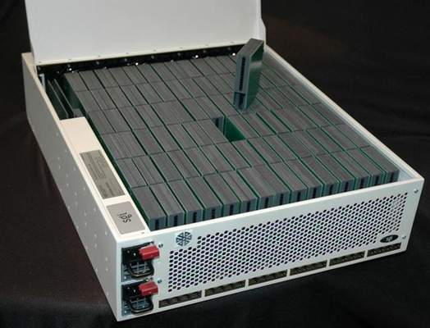
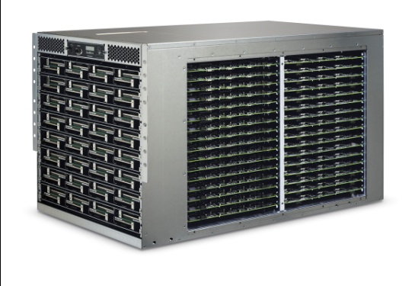
Embedded processors: A technology to watch
Growing range of Applications:
Security/Safety
Mobile computing
Automotive
Medical
Even high-end computers now using embedded processors
Molecule
10,000 Intel Atom dual-core
SM10000
512 Atom chips
SM10000 (SeaMicro)
Molecule (SGI)
Notes:
- Why embedded processor technology is so special ?
- power efficiency and performance achieved make it amenable to use in many applications
- Check supercomputer or not

Slide 4
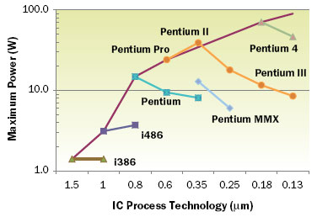
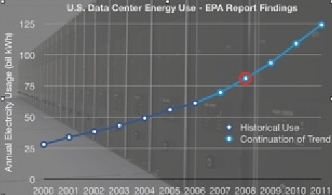
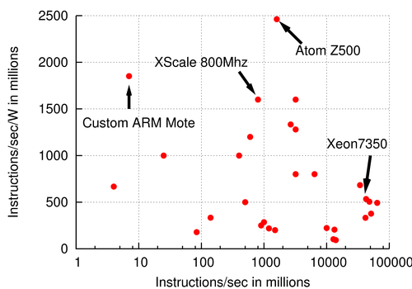
Power efficiency: A Key System Requirement
$4 Billion Electricity charges alone
Power-efficient embedded computing is critical to the future
Power consumption in processors follows Moore’s Law too
In mobile devices, battery
Life: defines its usability, re-charging freq, etc.
Size: affects its handling.
Power consumption in processors follows Moore’s Law too
In servers, power consumption,
Limits performance throughput
Increases cooling cost
Notes:
- Power density plot shows, that at our current technology node, we are easily close to that of a rocket nozzle
In embedded processors on handheld devices, it defines the usability etc..
In high end systems, power consumption translates to the cooling cost

Slide 5
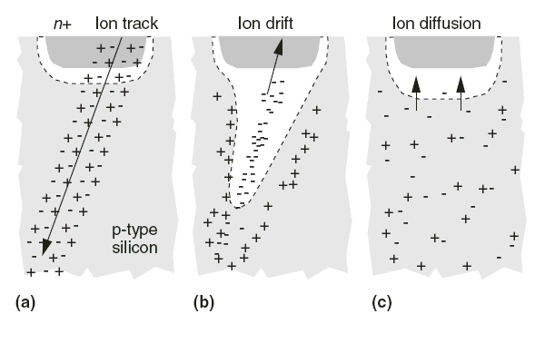
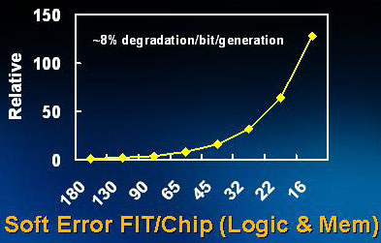
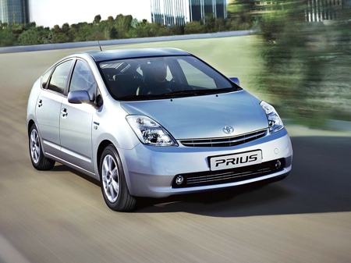
Soft Errors - an Increasing Concern with Technology Scaling
Charge carrying particles induce Soft Errors
Alpha particles
Neutrons
High energy (100KeV -1GeV)
Low energy (10meV – 1eV)
Soft Error Rate
Is now 1 per year
Exponentially increases with technology scaling
Projected→1 per day in a decade
Performance is useless if not correct !
Toyota Prius: SEUs blamed as the probable cause for
unintended acceleration.

Slide 6

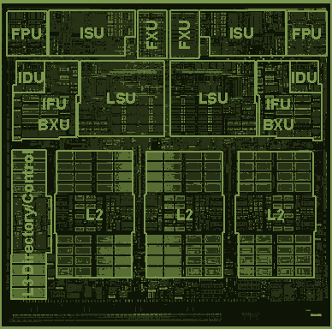
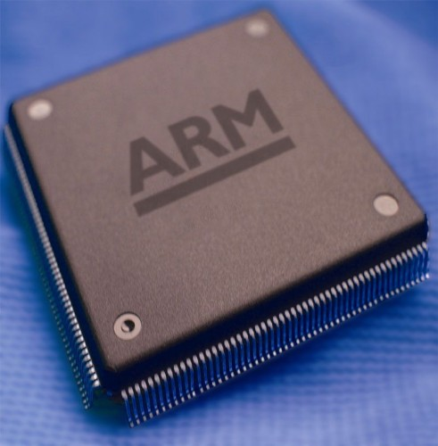
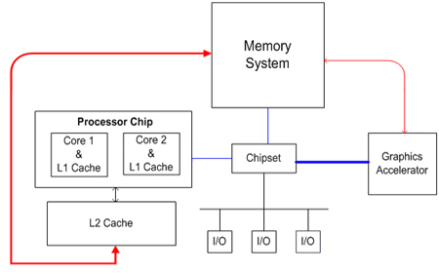

Compilers: At a Unique Interface
Pros
Flexibility, and portability across machines
Detailed hardware knowledge and interaction
Detailed Application analysis
Limited (to No) hardware cost
Cons
Implementation and analysis is difficult
Huge compiler source code
Flexibility of C programs introduce interdependencies
Development cost and time is high
COMPILER
Notes:
Compiler with their interesting position has a wide array of advantages
- While being able to perform, is also able to keep the overheads in check
Limitations are its use, implementation and standardization.

Slide 7

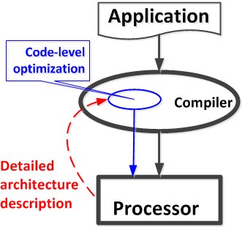
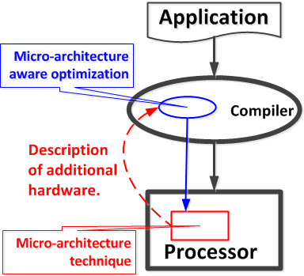
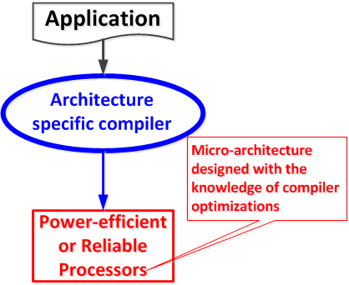
Thesis Statement
Smart compilers, with detailed knowledge of hardware and deeper program analysis can achieve power-efficient and reliable computing.
Demonstrated through:
Pure compiler techniques,
Hybrid compiler and micro-architecture techniques,
Compiler techniques to enable compiler-directed architectures.
Application
Program Info
Compiler
Smart
Compiler
Smart
Analysis
Processor
H/w Details
Notes:
Compilers can help achieve power-efficient and reliable computation through
Pure compiler techniques
Hybrid techniques
By enabling compiling directed architectures
Change thesis words

Slide 8
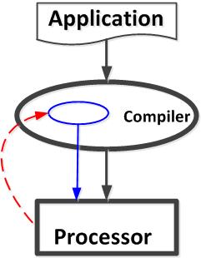
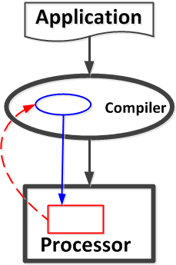
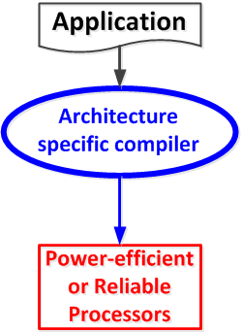
Our Contributions
Pure Compiler Techniques
Static reliability estimation
Cache Vulnerability Equations [LCTES’10]
Hybrid Compiler & Micro-architecture Techniques
Power reduction
D-TLB [VLSID’09], ITLB [SCOPES’10], [IJPP’10]
Reliable Computing
Smart Cache Cleaning [CASES’11]
Compiler-directed Architectures
Coarse Grained Reconfigurable Architectures
Application Mapping onto CGRAs [ASP-DAC’08]
Notes:
My contributions to support the claims in my thesis
In this presentation, I will go into the details of our pure compiler technique, and then briefly describe contributions in the other two areas

Slide 9
List of Publications
Pure Compiler Techniques
[LCTES 2010] Cache Vulnerability Equations
[TACO*] Static Estimation of Cache Vulnerability (Submitted)
Hybrid Compiler & Micro-architecture Techniques
[VLSI-D 2009] D-TLB Power Reduction
[SCOPES 2010] I-TLB Power Reduction
[IJPP 2010] TLB Power Reduction Techniques
[CASES 2011] Smart Cache Cleaning
[TECS] Cache Cleaning for Reliable Computing (Planned)
[ICPP 2011] UnSync Error Resilient CMP Architecture
[TECS] Redundant Multicore Architecture (Planned)
Compiler-directed Architectures
[ICPP 2011] Enabling Multithreading in CGRA
[TCAD] Multithreading in CGRA (Planned)
[ASP-DAC 2008] SPKM CGRA Mapping
Papers accepted: 7, Journals accepted: 1, Journals planned and in-submission: 4

Slide 10

Our Contributions
Pure Compiler Techniques
Static reliability estimation
Cache Vulnerability Equations [LCTES’10]
Hybrid Compiler & Micro-architecture Techniques
Power reduction
D-TLB [VLSID’09], ITLB [SCOPES’10], [IJPP’10]
Reliable Computing
Smart Cache Cleaning [CASES’11]
Compiler-directed Architectures
Coarse Grained Reconfigurable Architectures
Application Mapping onto CGRAs [ASP-DAC’08]

Slide 11
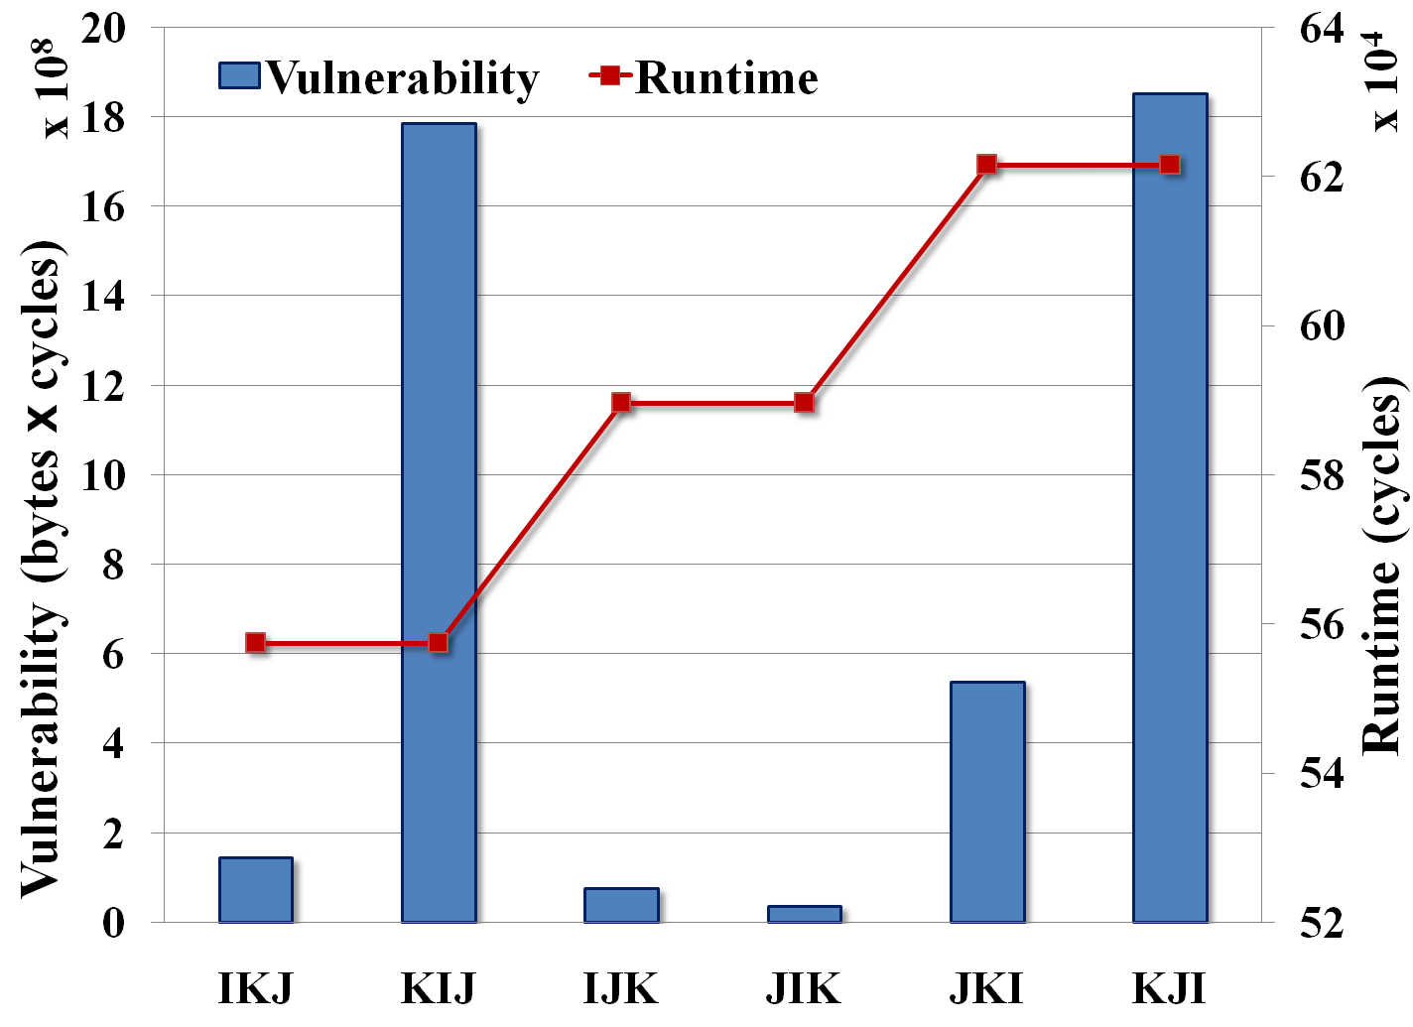
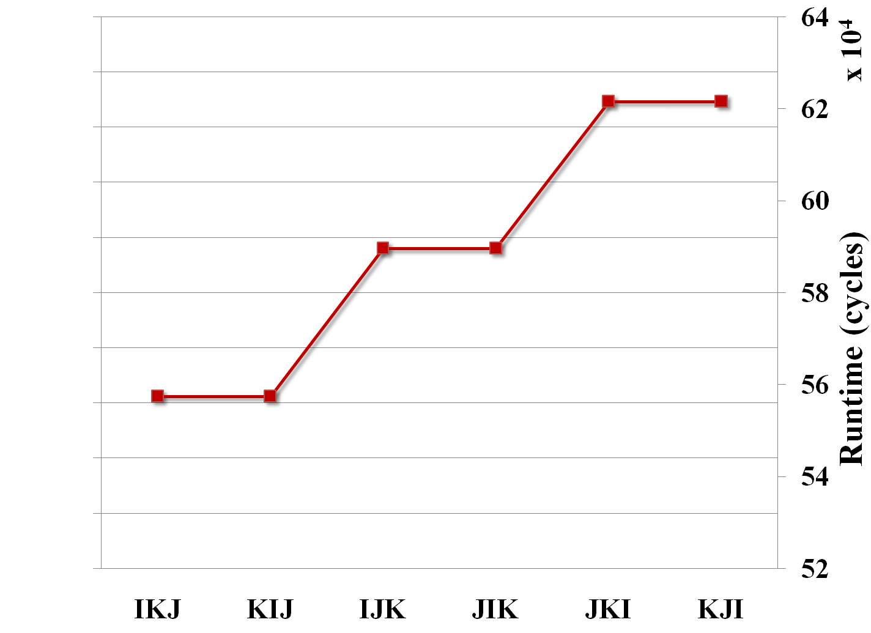

Smart Program Analysis Reveals Vulnerability Reduction Potential
Loop Interchange on Matrix Multiplication
Vulnerability trend not same as performance
Interesting configurations exist, with either low vulnerability or low runtime.
52X variation in vulnerability for
1% variation in runtime
Opportunities may exist to trade off little runtime for large savings in vulnerability

Slide 12
CVE Toolset for Vulnerability – Performance Trade-off Analysis
Program
Cache Parameters
Using Cache Miss Equations (CME)
CVE Toolset
Using Cache Vulnerability Equations (CVE)
Cache Vulnerability Equations
Cache Misses
Cache Vulnerability
Notes:
Remove toolset

Slide 13

Our Contributions
Pure Compiler techniques
Static reliability estimation
Cache Vulnerability Equations [LCTES’10]
Hybrid Compiler & Microarchitecture Techniques
Power reduction
D-TLB [VLSID’09], ITLB [SCOPES’10], [IJPP’10]
Reliable Computing
Smart Cache Cleaning [CASES’11]
Compiler-directed architectures
Coarse Grained Reconfigurable Architectures
Application Mapping onto CGRAs [ASP-DAC’08]

Slide 14
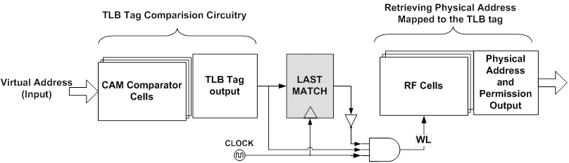
Compiler & Microarchitecture Solution: TLB Power Reduction
The TLB
Composed of dynamic circuitry
Accessed on every cache lookup
Consumes 20-25% of cache power
Has power density ~ 2.7 nW/mm²
Knowing that the TLB architecture is modified, a smart compiler can modify the program accordingly.
Compiler optimizations to modify data cache accesses
Instruction scheduling
Operand re-ordering
Loop unrolling & Array interleaving
39% additional power reduction
Code placement to modify instruction cache accesses
76% additional power reduction
The Use-last TLB architecture
Triggers CAM lookup iff successive accesses are to different cache pages.
Achieves power saving of:
25% in D-TLB
75% in I-TLB

Slide 15

Our Contributions
Pure Compiler techniques
Static reliability estimation
Cache Vulnerability Equations [LCTES’10]
Hybrid Compiler & Microarchitecture Techniques
Power reduction
D-TLB [VLSID’09], ITLB [SCOPES’10], [IJPP’10]
Reliable Computing
Smart Cache Cleaning [CASES’11]
Compiler-directed architectures
Coarse Grained Reconfigurable Architectures
Application Mapping onto CGRAs [ASP-DAC’08]

Slide 16

Agenda - SCC
Why cache vulnerability?
Cache Cleaning to Improve Reliability
Smart Cache Cleaning Methodology
Experimental Evaluation and Results

Slide 17
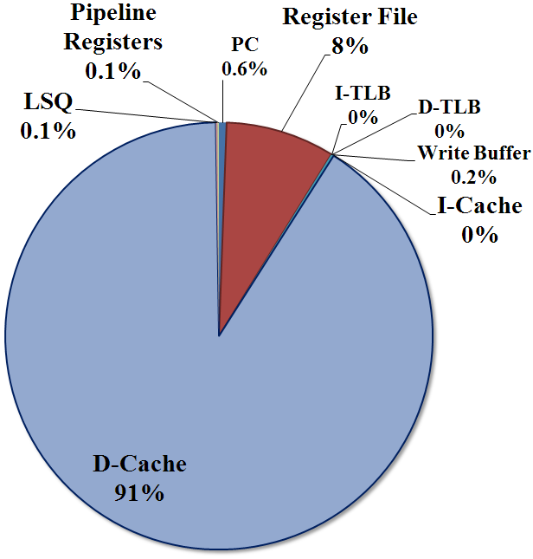
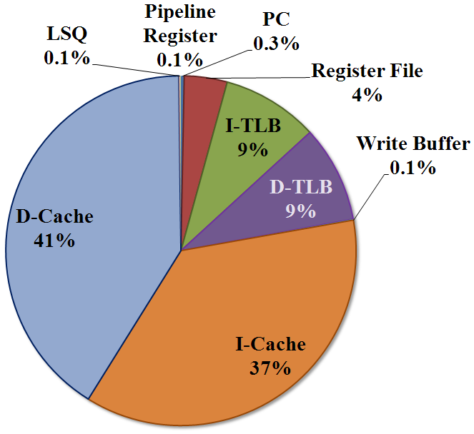
Caches are most vulnerable
Caches occupy majority of chip-area
Much higher % of transistors
More than 80% of the transistors in Itanium 2 are in caches.
Low operating voltages
Frequent accesses
Small and tight SRAM cell layout
Majority contributor to the total soft errors in a system
With cheap Error detection, cache still the most susceptible architecture block.
Cache (split I/D) = 32KB
I-TLB = 48 entries
D-TLB = 64 entries
LSQ = 64 entries
Register File = 32 entries
Notes:
Cache soft error percentage over all architecture blocks
When 1-bit error detection applied to all the architecture blocks
MIPS based processor
Indicate it is first unprotected

Slide 18
How to protect L1 Cache ?
Features | SECDED | Parity
Error detection | 1 bit and 2 bit | 1 bit
Error Correction | 1 bit | No correction
Cache Access Latency | +95% increase (can be hidden) | No Impact
Cache Area Increase | +22% | + <1%
Cache Power Increase | +22% | + <1%
Enabled Processors | SPM of IBM Cell | ARM, Intel Xscale, Intel Atom
To Detect + Correct:
Consequences render it impractical.
Practical Method:
Needs supporting method to correct errors.

Slide 19
Cache Vulnerability
CE
CE
R
W
R
R
W
R
Time
How to protect dirty
L1 cache data ?
Assume: Parity based error detection to detect 1-bit errors.
Non-dirty data is not vulnerable
Can always re-read non-dirty data from lower level of memory
Parity based error detection can correct soft errors on non-dirty data
Dirty data cannot be reloaded (recovered) from errors.
Data in the cache is vulnerable if
It will be read by the processor, or it will be committed to memory
AND it is dirty
Notes:
Let us assume that it is the timeline of the data processed
We assume that the cache has 1-bit error detection capabilities
So if there was a 1-bit error, the correct value could be re-loaded from the memory
Vulnerability is defined as the time that the only correct/updated copy of the data is present in the cache
If it will update the memory or be read by the processor, data corruption occurs and therefore can cause failures in the system.
Vulnerability calculation

Slide 20
Agenda - SCC
Why cache vulnerability?
Cache Cleaning to Improve Reliability
Write-through cache
Early Write-back cache
Proposed Smart Cache Cleaning
Smart Cache Cleaning Methodology
Experimental Evaluation and Results

Slide 21
Possible Solution 1: Write-Through Cache
Data Accessed
for(i:1~3){
for(j:1~3){
A[i]+=B[j]
}
}
A[1]
A[1]
A[1]
A[2]
A[2]
A[2]
A[3]
A[3]
A[3]
Program
Timeline
(cycles)
RW
RW
RW
RW
RW
RW
RW
RW
RW
End of Loop
Memory
Write-back
or Cache
Cleaning
E
Error Recovery:
Data reloaded from memory
A copy of cache-data is written into the memory
If error detected on subsequent access,
can reload from memory to recover.
NO dirty data in cache NO vulnerability
HIGH L1-M traffic
Vulnerability = 0
# write-backs = 9

Slide 22
Possible Solution 2: Early Write-back Cache
Data Accessed
for(i:1~3){
for(j:1~3){
A[i]+=B[j]
}
}
A[1]
A[1]
A[1]
A[2]
A[2]
A[2]
A[3]
A[3]
A[3]
Program
Timeline
(cycles)
RW
RW
RW
RW
RW
RW
RW
RW
RW
End of Loop
Periodic
Write-back
E
4 Cycles
Vulnerability
A[1]
A[1]
A[2]
A[2]
A[3]
A[3]
Vulnerability ≠ 0
What went wrong?
Data unused but vulnerable
Unnecessary cleaning while data is being reused
Vulnerability = 48
# write-backs = 0
Hardware-only cleaning has
no knowledge of the program’s data access pattern.
Vulnerability = 13
# write-backs = 8
Notes:
Mention as too late and too early !

Slide 23
Proposed Solution: Smart Cache Cleaning
Data Accessed
for(i:1~3){
for(j:1~3){
A[i]+=B[j]
}
}
A[1]
A[1]
A[1]
A[2]
A[2]
A[2]
A[3]
A[3]
A[3]
Program
Timeline
(cycles)
RW
RW
RW
RW
RW
RW
RW
RW
RW
End of Loop
Smart
Cache
Cleaning
E
Vulnerability
A[1]
A[2]
A[3]
Data is vulnerable while being reused by the program
Vulnerability = 0 for unused data.
Smart program analysis can help perform Cache Cleaning only when required.
Vulnerability = 18
# write-backs = 3
For this program, Clean data,
ONLY when not in use
by the program.
Notes:
Mention it is at the right time !

Slide 24
Agenda - SCC
Why cache vulnerability?
Cache Cleaning to Improve Reliability
Smart Cache Cleaning Methodology
When to clean data ?
SCC Hardware Architecture
How to clean data ?
Which data to clean ?
Experimental Evaluation and Results

Slide 25
How to do Smart Cache Cleaning
Program
IF
ID
EX
M
WB
Memory
Profile data
R/W Cache
Accesses
LSQ
Store
Insn Addr
SCC Analysis
L1 Cache
Which data
to clean ?
Controller: Issue clean signal when required
Cache
Cleaning
Memory
Write-backs
SCC Insn Addr
SCC Pattern
Memory
When to clean ?
clean
Targeted cache cleaning architecture
How to clean ?

Slide 26
When to clean data ?
Data Accessed
A[1]
A[1]
A[2]
A[2]
A[2]
A[3]
A[3]
A[3]
for(i:1~3){
for(j:1~3){
A[i]+=B[j]
}
}
A[1]
Program
Timeline
(cycles)
RW
RW
RW
RW
RW
RW
RW
RW
RW
End of Loop
SCC_Pattern
0
0
1
0
0
1
0
0
1
E
Instantaneous
Vulnerability
(per access)
3
3
A[1]
19
If end of loop execution is not end of program, then instantaneous vulnerability of last access extends till subsequent cache eviction.
Execute: store + clean
If Instantaneous Vulnerability of access > SCC_Threshold
Execute: store + clean → assign 1 to SCC_Pattern
Else
Execute: store only → assign 0 to SCC_Pattern
SCC_Threshold = 4

Slide 27
How to do Smart Cache Cleaning
Program
IF
ID
EX
M
WB
Memory
Profile data
R/W Cache
Accesses
LSQ
Store
Insn Addr
SCC Analysis
L1 Cache
Which data
to clean ?
Controller: Issue clean signal when required
Cache
Cleaning
Memory
Write-backs
SCC Insn Addr
SCC Pattern
Memory
When to clean ?
clean
Targeted cache cleaning architecture
How to clean ?

Slide 28
How to clean data ?
Instruction Pipeline
Cycle count :
6
9
12
3
LSQ
SCC_Pattern
0
1
0 0 1 0 0 1 0 0 1
0
Controller
L1 Cache
clean
No Cleaning
Cache
Cleaning
Targeted cache cleaning architecture
Memory
Program Execution
for(i:1~3){
for(j:1~3){
A[i]+=B[j]
}
}
A[1]
A[1]
A[1]
A[2]
A[2]
A[2]
A[3]
A[3]
A[3]
Program
Timeline
(cycles)
RW
RW
RW
RW
RW
RW
RW
RW
RW
End of Loop
SCC Pattern
0
0
1
0
0
1
0
0
1
E

Slide 29
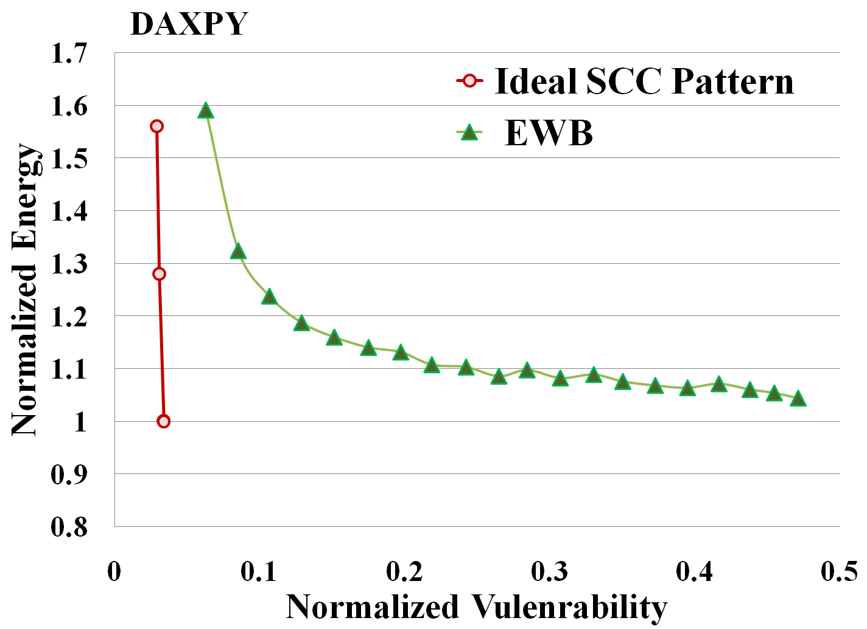
SCC Achieves Energy-efficient Vulnerability Reduction
Hardware-only cache cleaning trades-off energy for vulnerability
Smart Cache Cleaning can achieve
≈0 Vulnerability, at
≈0 Energy cost

Slide 30
SCC_Pattern Generation: Weighted k-bit Compression
SCC Cleaning
sequence:
1 1 0 1 1 0 0 1 1 0 0 0 0 1 0 1 0 1 0 1 0 0 0 1 1 1
SCC Pattern:
- - - - - - - -
- - - - - - - 1
Sliding window of 8 bits
K = 8
To determine matching bit value for position 0
if ( cost_of_1 ≤ cost_of_0 )
Bit value [0] = 1
Choose bit value = 1,
iff # of 1s > 2X # of 0s
Cost of not cleaning clean when required.
Bit count in position 0
Num of 1s = 3
Num of 0s = 1
Cost for placing 0 in pos [0] of SCC Pattern:
cost_of_0 = Num of 1s X 1
= 3 X 1 = 3
Cost of cleaning when not required.
Cost for placing 1 in pos 0 of SCC Pattern:
cost_of_1 = Num of 0s X 2
= 1 X 2 = 2

Slide 31
SCC_Pattern Generation: Weighted k-bit Compression
SCC Cleaning
sequence:
0 0 0 0 0 0
1 1 0 1 1 0 0 1 1 0 0 0 0 1 0 1 0 1 0 1 0 0 0 1 1 1
if ( cost_of_1[i] ≤ cost_of_0[i] )
Bit value [i] = 1
else
Bit value [i] = 0
Remaining 6 bits are 0-padded
SCC Pattern:
- - - - - - 1 1
- - - - - 1 1 1
- - - - 0 1 1 1
- - - 0 0 1 1 1
- - 0 0 0 1 1 1
- 0 0 0 0 1 1 1
0 0 0 0 0 1 1 1
0 0 0 0 0 1 1 1
- - - - - - - 1
K = 8
Greater # of 1s
Greater # of 1s
Greater # of 0s
Position [1] :
cost_of_1[1] = 2
cost_of_0[1] = 3
Position [4] :
cost_of_1[4] = 6
cost_of_0[4] = 1
Position [2] :
cost_of_1[2] = 2
cost_of_0[2] = 3
Equal # of 0s and 1s
Position [6] :
cost_of_1[6] = 4
cost_of_0[6] = 2
All 0s → Bit value = 0

Slide 32
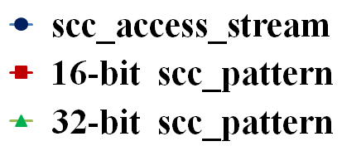
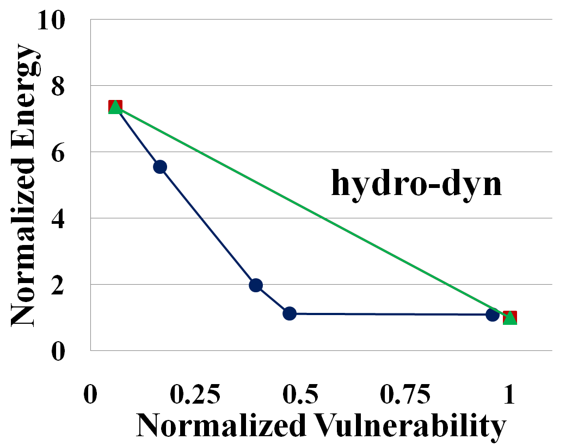
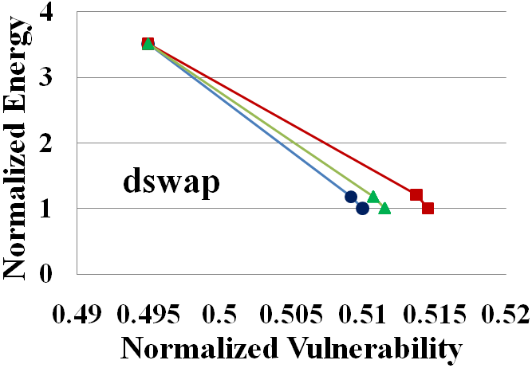
Accuracy of the Weighted Pattern-Matching Algorithm
Weights used in the algorithm define the accuracy.
Size of k affects accuracy

Slide 33
How to do Smart Cache Cleaning
Program
IF
ID
EX
M
WB
Memory
Profile data
R/W Cache
Accesses
LSQ
Store
Insn Addr
SCC Analysis
L1 Cache
Which data
to clean ?
Controller: Issue clean signal when required
Cache
Cleaning
Memory
Write-backs
SCC Insn Addr
SCC Pattern
Memory
When to clean ?
clean
Targeted cache cleaning architecture
How to clean ?

Slide 34
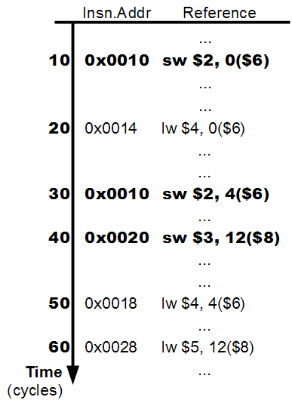
Which data to clean ?
Parameters | Ref A | Ref B
Vulnerability
Access #
30
2
20
1
A1
10
Profit (V/A)
15
20
Instantaneous Vulnerability(IV)
by each access of reference A
A2
20
Average Vulnerability per access
B1
20
Overlapping accesses:
Choosing B, precludes the choice of A
How to choose one over anther ?
One SCC InsnAddr Register

Slide 35
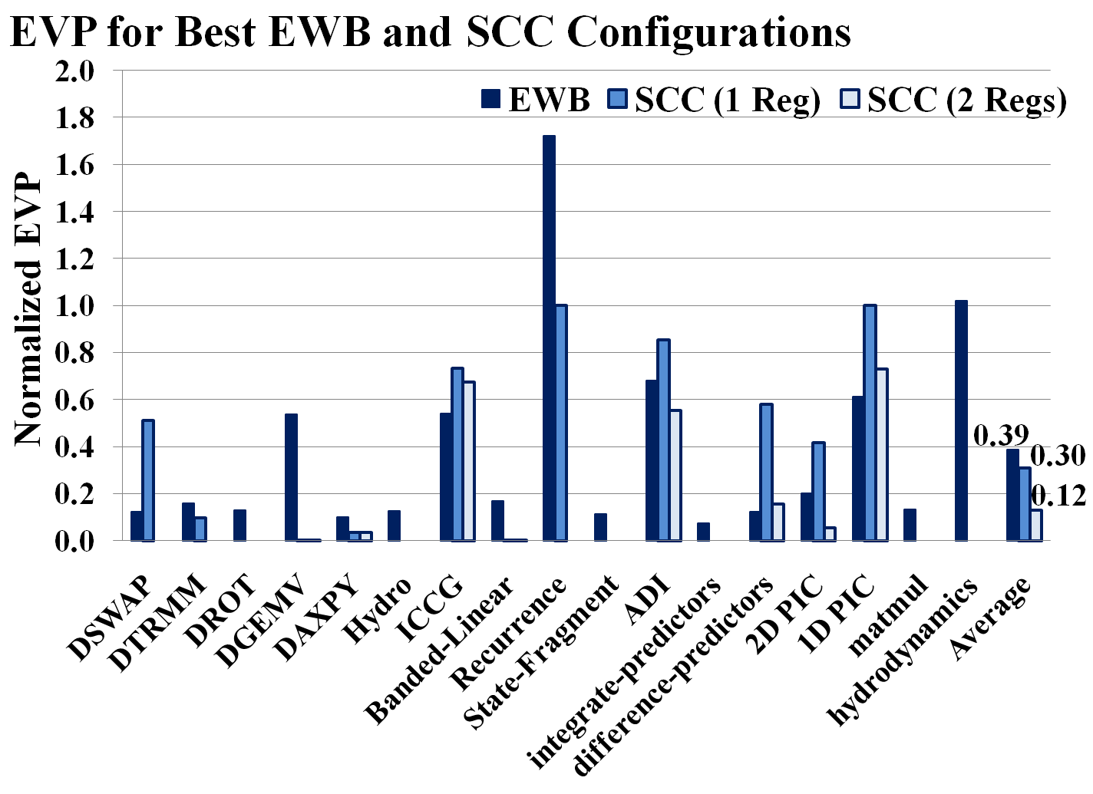
Energy Efficient Vulnerability Reduction with SCC

Slide 36
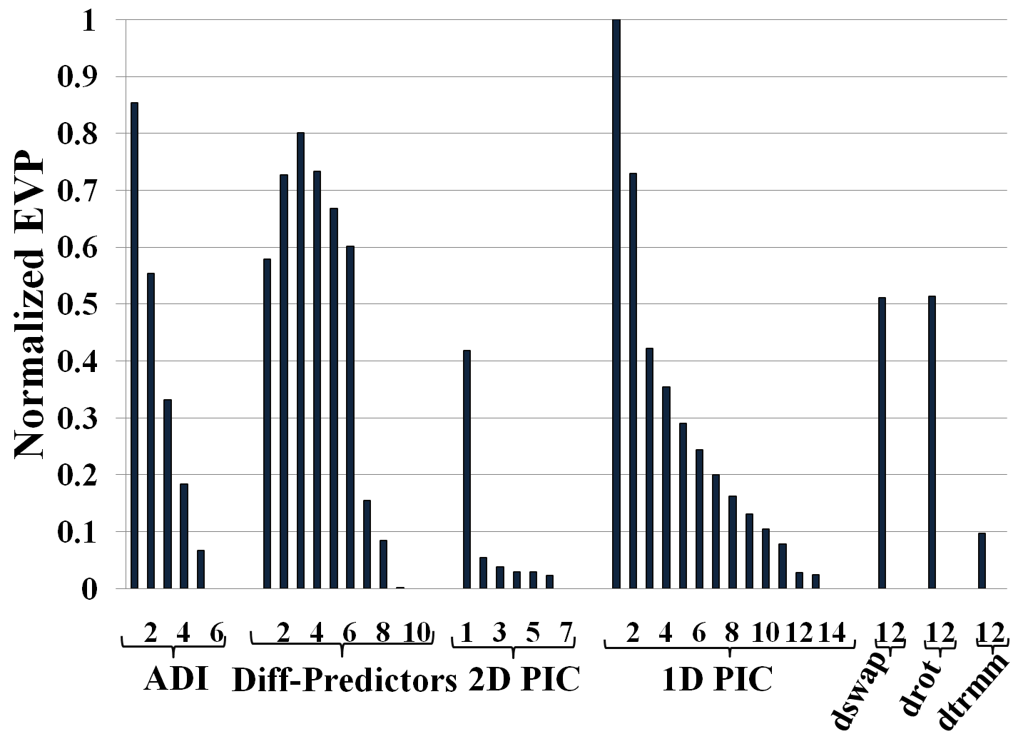
SCC: Better results with more hardware registers
With more SCC registers, vulnerability is reduced further,
at the cost of hardware overhead

Slide 37
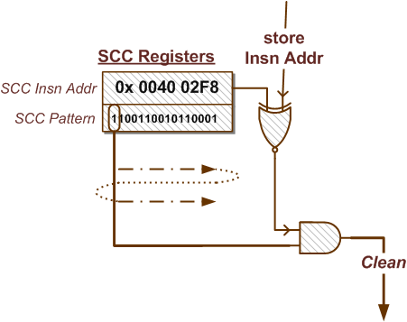
Smart Cache Cleaning : H/w
Program
IF
ID
EX
M
WB
Registers +
Counter like h/w logic implementation
Memory
Profile data
R/W Cache
Accesses
LSQ
Store
Insn Addr
A smart compiler can eliminate such hardware overheads
SCC Analysis
L1 Cache
Which data
to clean ?
Controller: Issue clean signal when required
Cache
Cleaning
Memory
Write-backs
SCC Insn Addr
SCC Pattern
Memory
When to clean ?
clean
Targeted cache cleaning architecture
How to clean ?

Slide 38
Compiler Directed SCC
Final List of H/w Requirements
ISA modification to include csw instruction
Which performs : store+clean on a cache block
for(i=0; i<10; i++){
for(j=0;j<9;j+=2){
A[j] += B[i];
C[j] += D[i];
A[j+1] += B[i];
C[j+1] += D[i];
}
}
Procedure
Generate k-bit SCC Pattern
Unroll the loop k times
Instrument marked instructions as csw
for(i=0; i<10; i++){
for(j=0;j<10;j++){
A[j] += B[i];
C[j] += D[i];
}
}
csw
sw
sw
csw
R_{A}
1 0
R_{C}
0 1

Slide 39
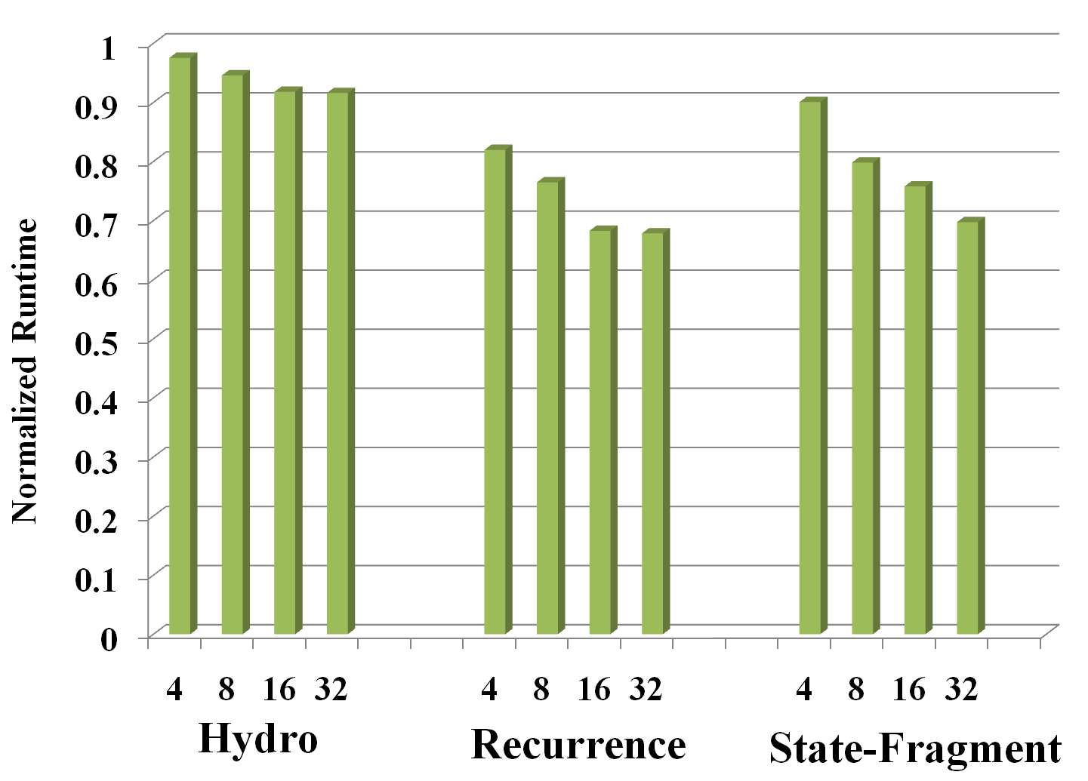
Unrolling + SCC Achieves Low EVP and also Improved Performance
EVP for these loops ≈ 0
Unrolling delivers improved performance

Slide 40
Compiler Directed SCC has Interesting Advantages
 | Hardware based SCC | Compiler Directed SCC
Hardware Requirement | Require: 32-bit SCC Registers Bit-iterator circuitry Targeted cache cleaning logic | Require: ISA modification to include instruction triggered “target-cache cleaning logic”.
Program Analysis | Memory Profile analysis | Memory Profile analysis
 | Can be Implemented on all types of programs / loops | Not all loops can be unrolled
Capabilities | Need 2 SCC Registers for every additional reference | Can enable concurrent cache cleaning on any number of references in the loop
 | Negligible performance impact | Can improve (or also reduce) performance due to unrolling.

Slide 41
Smart Cache Cleaning
We develop a Hybrid Compiler & Micro-architecture technique for Reliability – SCC
Soft Errors are a major concern, and Caches are most vulnerable to transient errors by radiation particles
Cache Cleaning can reduce vulnerability, at the possible cost of power overhead
ECC gains 0 vulnerability, but 70X power overhead
EWB gains 47% vulnerability reduction, with 6X power overhead
Our Smart Cache Cleaning technique:
performs Cleaning on the right cache blocks at the right time
achieves energy-efficient reliability in embedded systems

Slide 42

Our Contributions
Pure Compiler Techniques
Static reliability estimation
Cache Vulnerability Equations [LCTES’10]
Hybrid Compiler & Micro-architecture Techniques
Power reduction
D-TLB [VLSID’09], ITLB [SCOPES’10], [IJPP’10]
Compiler-directed Architectures
Coarse Grained Reconfigurable Architectures
Application Mapping onto CGRAs [ASP-DAC’08]

Slide 43
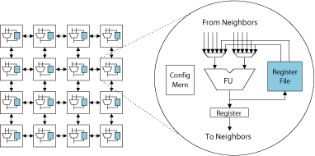
Compiler-Directed Architectures: CGRA
Compiler-directed power efficient architecture: CGRA
Each core contains an ALU with limited data storage capabilities.
Mesh based inter-connected cores
Data and PE operation governed by static mapping
Usability of CGRAs is limited by compiler support
Application instructions and data have to be mapped
to execute on the right PE with right data
at right time
We develop SPKM – A mapping technique to provide efficient compiler support to improve CGRA usability.

Slide 44

Summary
Smart compilers, with detailed knowledge of hardware and deeper program analysis can achieve power-efficient and reliable computing.
Pure Compiler Techniques
Static reliability estimation
Cache Vulnerability Equations [LCTES’10]
Hybrid Compiler & Micro-architecture Techniques
Power reduction
D-TLB [VLSID’09], ITLB [SCOPES’10], [IJPP’10]
Reliable Computing
Smart Cache Cleaning [CASES’11]
Compiler-directed Architectures
Coarse Grained Reconfigurable Architectures
Application Mapping onto CGRAs [ASP-DAC’08]
Notes:
My contributions to support the claims in my thesis
In this presentation, I will go into the details of our pure compiler technique, and then briefly describe contributions in the other two areas
Thesis Statement

Slide 45

List of Publications
Pure Compiler Techniques
[LCTES 2010] Cache Vulnerability Equations
[TACO*] Static Estimation of Cache Vulnerability (Submitted)
Hybrid Compiler & Micro-architecture Techniques
[VLSI-D 2009] D-TLB Power Reduction
[SCOPES 2010] I-TLB Power Reduction
[IJPP 2010] TLB Power Reduction Techniques
[CASES 2011] Smart Cache Cleaning
[TECS] Cache Cleaning for Reliable Computing (Planned)
[ICPP 2011] UnSync Error Resilient CMP Architecture
[TECS] Redundant Multicore Architecture (Planned)
Compiler-directed Architectures
[ICPP 2011] Enabling Multithreading in CGRA
[TCAD] Multithreading in CGRA (Planned)
[ASP-DAC 2008] SPKM CGRA Mapping
Papers accepted: 7, Journals accepted: 1, Journals planned and in-submission: 4

Slide 46
Thank you !

Slide 47
References
[1] Vasudevan et al, FAWNdamentally Power-efficient Clusters, HOTOS 2009
[2] http://www.electronics-cooling.com/2009/02/when-moore-is-less-exploring-the-3rd-dimension-in-ic-packaging/
[3] http://www.treehugger.com/files/2008/08/radically-efficient-profitable-data-centers.php

