Slide 1

Presented by: Aseem Gupta, UCI
Deepa Kannan, Aviral Shrivastava,
Sarvesh Bhardwaj, and Sarma Vrudhula
Compiler and Microarchitecture Lab
Department of Computer Science and Engineering
Arizona State University, Tempe, AZ, USA - 85281
http://www.public.asu.edu/~ashriva6/cml

Slide 2

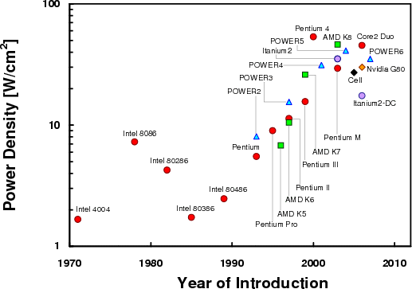
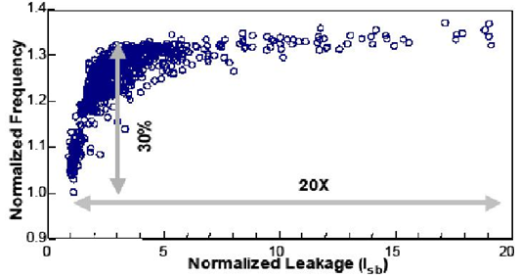
Reducing device dimensions for last four decades
  More than 2000X shrinkage in gate length
Driven by market constraints
  Higher performance at lower power and cost
Increase in Power (density)
  Increase in leakage
Increase in Variation of Power
  Process Variations
http://www.public.asu.edu/~ashriva6/cml

Slide 3

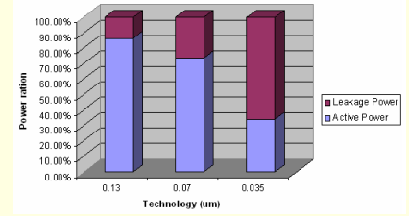
Technology scaling
  Per transistor dynamic power decreases
  Per transistor leakage power increases
  Number of transistors increase
Contribution of Leakage increases
  Reduction in threshold voltage
  Increasing power density (temperature)
Gate size
Leakage
Power Density
http://www.public.asu.edu/~ashriva6/cml

Slide 4

Loss of control in lithography and channel doping
  Error in device dimensions are nearing the device dimensions
Linear error in gate length L_{eff} translates to exponential variation in leakage
Intel observed more than 20X variation in leakage for 30% variation in performance in high-end processors manufactured in 0.18µ technology [Borkar DAC 2003]
Significant yield loss!
Need to reduce both:
power and variation in power
http://www.public.asu.edu/~ashriva6/cml

Slide 5
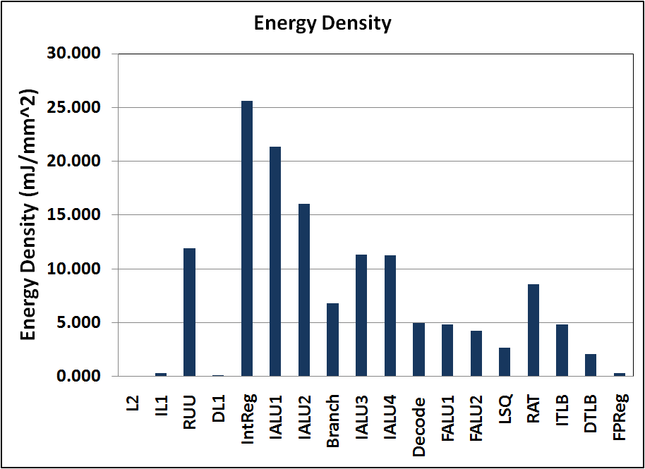
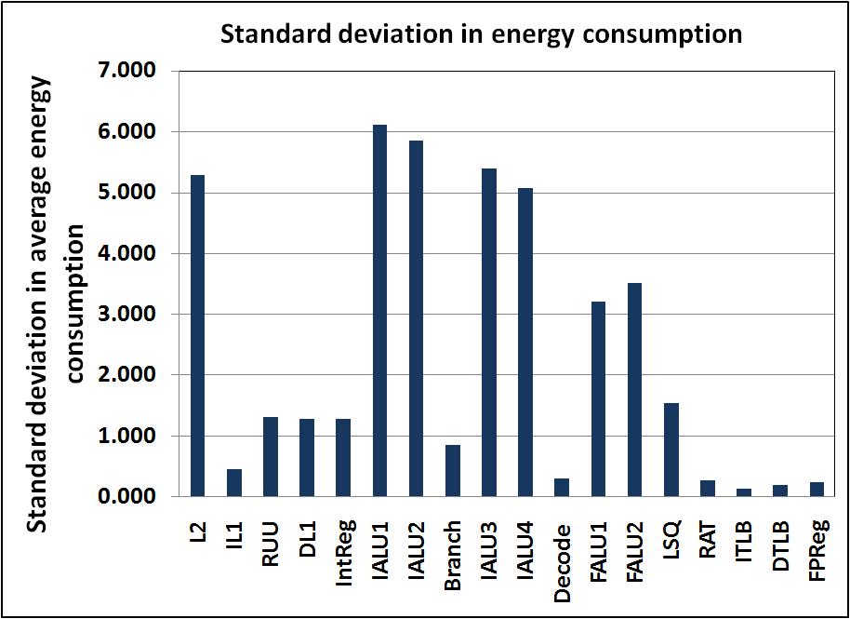
FUs may consume significant fraction (up to 20%) of the processor power
High variation in FU power consumption
  Regions of high activity ➔ Increase in temperature ⬅➔ Increase in leakage
  Leakage amplifies the variation in power
Need to reduce:
FU power and variation in FU power
This paper focuses on reducing leakage power & variation in leakage power
  power = leakage power;
  total power = leakage power + dynamic power
http://www.public.asu.edu/~ashriva6/cml

Slide 6

Power Reduction of Caches
  [Yang et al., 2001], [Hanson, ICCD 2001] [Li et al., ICCD 2005] etc.
FU Power Reduction
  Power Gating
    Proposed Power Gating of FUs [Hu et al., ISLPED 2004]
    Idle-time based Power Gating of FUs [Rele et al., CC 2002]
    Use profile information to find out idle times, and use compiler instructions to explicitly power on/off FUs [Talli et al., IPCC 2007]
  Synthesis
    Temperature-Aware Resource Allocation and Binding [Mukherjee et al., DAC 2005], [Gopalakrishnan et al., VLSID 2003]
None of these consider “variation in power”
http://www.public.asu.edu/~ashriva6/cml

Slide 7

OFBM - Policy that issues ready operations to FUs
Default OFBM is Fixed Priority OFBM or FP-OFBM
  Each FU is assigned a priority
    Priority does not change with time
  An FU will be issued to an operation only if operations have been issued to all FUs with higher priority
OFBMs become important now
  Similar FUs have different leakage power characteristics
    Process Variations
    Temperature Differences
OFBM can significantly affect
  FU power consumption
  Variation in FU power consumption
http://www.public.asu.edu/~ashriva6/cml

Slide 8

[Mutayam et al., LCTES 2006] explored OFBMs
  Observed that the default FP-OFBM concentrates activity on high priority FUs
  This results in a skew in temperatures and therefore leakages of FUs
  Proposed Load Balancing OFBM, or LB-OFBM to balance temperature of all FUs
    Round robin policy of issuing operations to FUs
  LB-OFBM reduces variation in FU power without any knowledge about the variation.
This Work: Exploit knowledge about FU power variations to simultaneously reduce power and variation in power
http://www.public.asu.edu/~ashriva6/cml

Slide 9

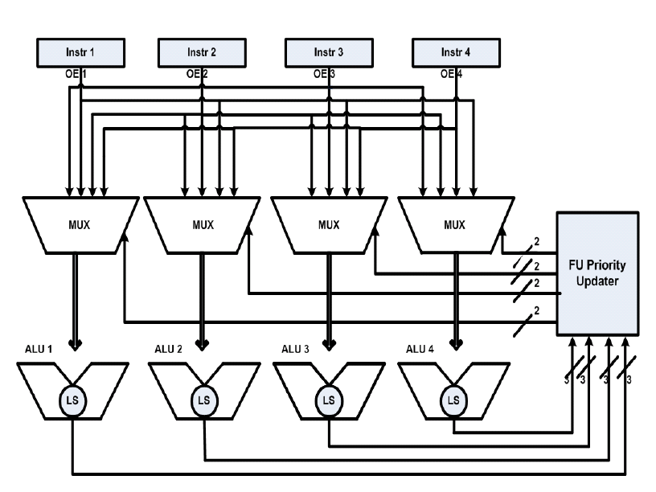
LA-OFBM : Leakage-Aware OFBM
  Introduce a leakage sensor in each ALU[Kim et al., IEEE TVLSI 2006]
  Set the priorities of the ALUs in reverse order of leakages
    High leakage → low priority
  Update the FU priorities every 10,000 cycles
    Temperature changes are slow
Overheads
  Minimal Performance penalty
    additional mux in the critical path
  Minimal Power penalty
    < 1% of any ALU power
Leakage Sensor-based OFBM
Detailed Architecture description is in the paper
http://www.public.asu.edu/~ashriva6/cml

Slide 10
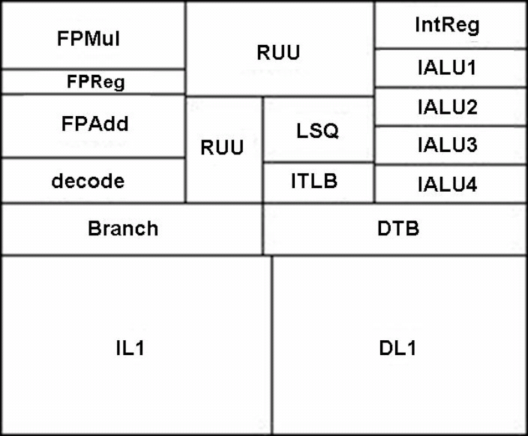
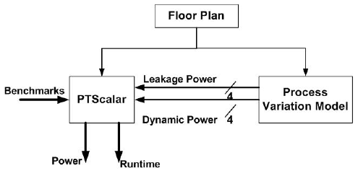
Experimental Setup
Processor Power and Performance Simulation on Alpha 21364 floorplan scaled to 45nm
Process Variation Model : Generates dynamic and leakage power of the 4 ALUs for 1000 sample dies using Karhunen-Loeve Expansion (KLE) model
PTScalar : Simplescalar based power-performance-temperature simulator
Benchmarks : From MiBench and Spec2000 suite

Slide 11

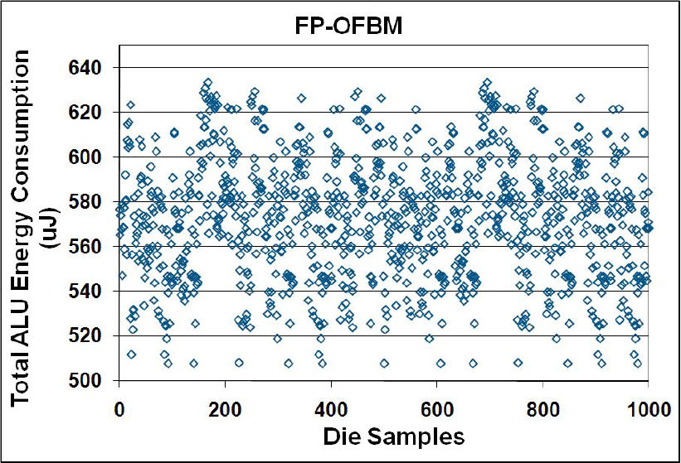
Variation of FP-OFBM
Mean of FP-OFBM
Total ALU Energy Consumption for susan corners (MiBench) for 1000 die samples
Average ALU energy consumption µ = 573 µJ
Standard deviation of ALU energy consumption = 28 µJ
http://www.public.asu.edu/~ashriva6/cml

Slide 12

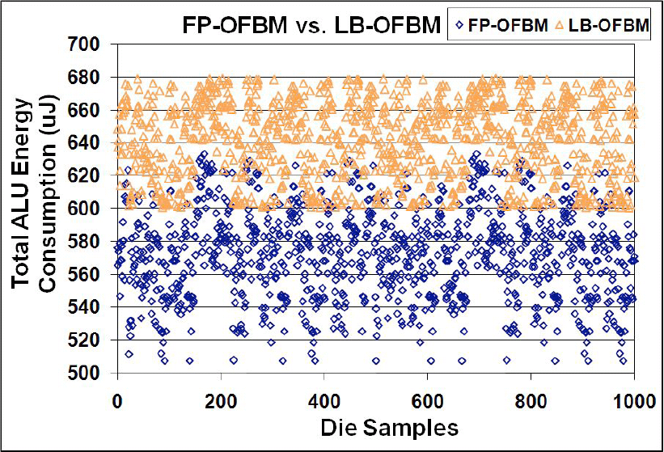
Variation of LB-OFBM
Mean of LB-OFBM
Variation of FP-OFBM
Mean of FP-OFBM
Total ALU Energy Consumption for susan corners (MiBench) for 1000 die samples
15% reduction in standard deviation, but 13% increase in average ALU power consumption
  Circular dependence of Leakage and temperature amplifies the power variation
  Leaky FUs get a high number of operations
http://www.public.asu.edu/~ashriva6/cml

Slide 13

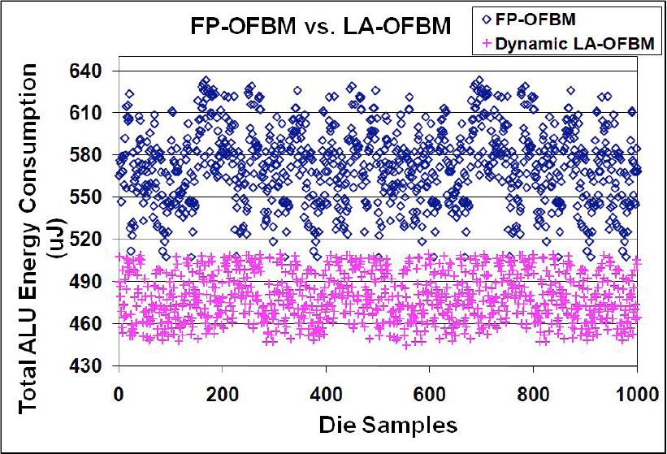
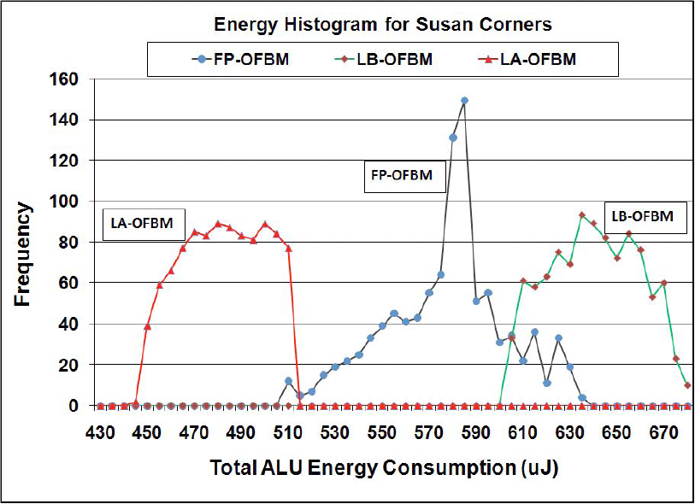
FP-OFBM results in lower power & variation in power
14% reduction in the average and 44% reduction in the standard deviation of total ALU power
http://www.public.asu.edu/~ashriva6/cml

Slide 14
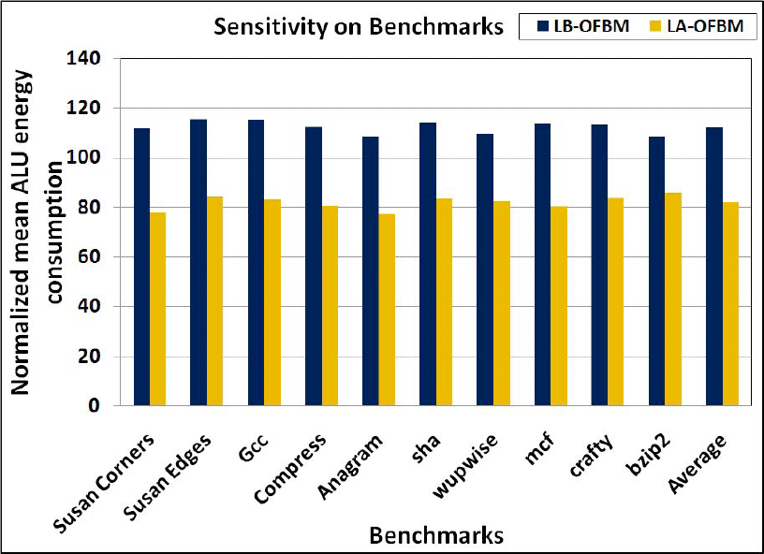
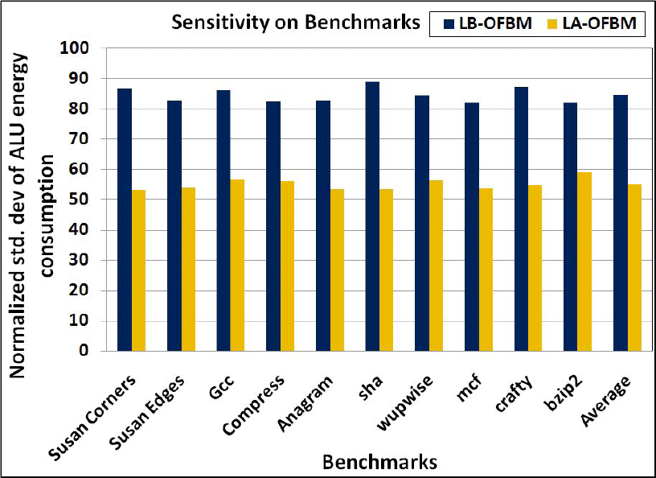
LA-OFBM obtains reduction in power and variation in power consistently over all benchmarks
The reduction in average and standard deviation of ALU power consumption is consistent across benchmarks
http://www.public.asu.edu/~ashriva6/cml

Slide 15
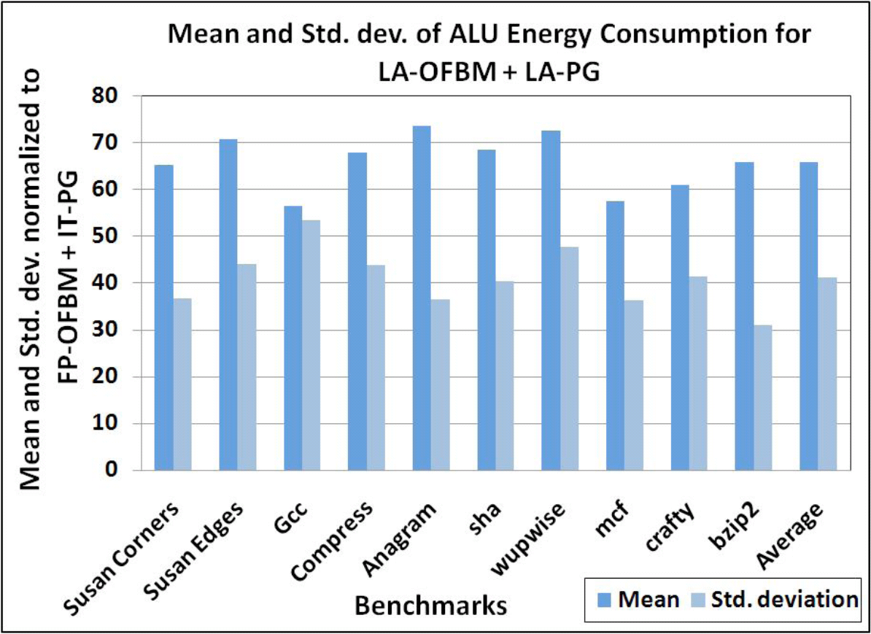
2 techniques to exploit process and temperature variations to reduce power and variation in power through leakage sensors
  New OFBM policy
  New Power Gating Mechanism
Can be applied together to achieve additive affect
  34% reduction in mean and 30% reduction in standard deviation of total ALU power
http://www.public.asu.edu/~ashriva6/cml

Slide 16

Technology Scaling
  Increase in power → Impacts Performance
  Increase in variation in power → Impacts Yield
Need to reduce both power and variation in Power
OFBM – Operation to FU Binding Mechanism
  Becomes important now because FUs will have different power
  Default: FP-OFBM – Concentrates Activity – High power variation
  Previous: LB-OFBM – Lesser variation, but higher power
Our Approach: LA-OFBM – Low power, low variation
  14% reduction in power and 44% reduction in standard deviation of ALU power
http://www.public.asu.edu/~ashriva6/cml

