Slide 1
CuMAPz: A Tool to Analyze Memory Access Patterns in CUDA
Yooseong Kim and Aviral Shrivastava
Compiler-Microarchitecture Lab.
Arizona State University

Slide 2
Why GPGPU and CUDA ?
GPU provides high performance and power efficiency
CUDA has lowered the entry barrier to GPGPU
CUDA is now used in various embedded systems including military, aerospace, and medical applications
12x
6x
A_{NM}*B_{MN} Matrix multiplication in C
CUDA equivalent
...
for (int i = 0; i < N; i++)
for (int j = 0; j < N; j++)
for (int k = 0; k < N; k++)
C[i*N+j] = A[i*M+k] * B[k*N+j];
...
int i = bIdx.y*bDim.y + tIdx.y;
int j = bIdx.x*bDim.x + tIdx.x;
for (int k = 0; k < N; k++)
C[i*N+j] = A[i*M+k] * B[k*N+j];

Slide 3
CUDA Program Optimization is Difficult
Many considerations due to architectural details
EX) Matrix transpose (2048x2048 matrix)
All performance critical factors need to be considered simultaneously Programmers need help!
SP
SP
SP
SP
SP
SP
SP
SP
SP
SP
SP
SP
SP
SP
SP
SP
SP
SP
SP
SP
SP
SP
SP
SP
Shared Memory
Shared Memory
Shared Memory
Bk0
Bk1
Bk2
Bk3
Bk4
Bk5
Bk6
Bk7
Bk0
Bk1
Bk2
Bk3
Bk4
Bk5
Bk6
Bk7
Bk0
Bk1
Bk2
Bk3
Bk4
Bk5
Bk6
Bk7
Off-chip Global Memory
Ch 0
Ch 1
Ch 2
Ch 3
Ch 4
Ch 5
Ch 6
Ch 7
 | Execution Time | Speedup
No shared mem. | 1482.4 ms
Shared mem. | 181.7 ms | 8.2X
No channel skew | 59.4 ms | 3.1X
 | Execution Time | Speedup
No shared mem. | 1482.4 ms
Shared mem. | 181.7 ms | 8.2X
No bank conflict | 181.0 ms
No channel skew | 49.2 ms | 3.7X
 | Execution Time | Speedup
No shared mem. | 1482.4 ms
 | Execution Time | Speedup
No shared mem. | 1482.4 ms
Shared mem. | 181.7 ms | 8.2X
No channel skew | 59.4 ms | 3.1X
No bank conflict | 49.2 ms | 1.2X
 | Execution Time | Speedup
No shared mem. | 1482.4 ms
Shared mem. | 181.7 ms | 8.2X
No speedup

Slide 4
Related Work
Analytical performance model for CUDA
Ryoo et al. [CGO 2008], Hong et al. [ISCA2009, ISCA2010]
Rough estimate to compare performance of different kernels
Not detailed enough to capture performance variation of one kernel caused by various design choices
Not helpful in optimizing performance of a program
ld.global
…
st.shared
…
ld.shared
…
st.global
# threads
# computation instructions
# memory instructions
…
compile
CUDA
Program
analyze
The amount of parallelism
Latency of each instruction
...

Slide 5
Our Contribution
Comprehensive analysis of performance critical factors throughout the architecture
Estimate the performance of a program to optimize the CUDA programs
Branch divergence
SP
SP
SP
SP
SP
SP
SP
SP
SP
SP
SP
SP
Data reuse
SP
SP
SP
SP
SP
SP
SP
SP
SP
SP
SP
SP
Shared Memory
Shared Memory
Shared Memory
Shared memory bank conflict
Bk0
Bk1
Bk2
Bk3
Bk4
Bk5
Bk6
Bk7
Bk0
Bk1
Bk2
Bk3
Bk4
Bk5
Bk6
Bk7
Bk0
Bk1
Bk2
Bk3
Bk4
Bk5
Bk6
Bk7
Global memory access coalescing
Off-chip Global Memory
Ch 0
Ch 1
Ch 2
Ch 3
Ch 4
Ch 5
Ch 6
Ch 7
Channel skew

Slide 6
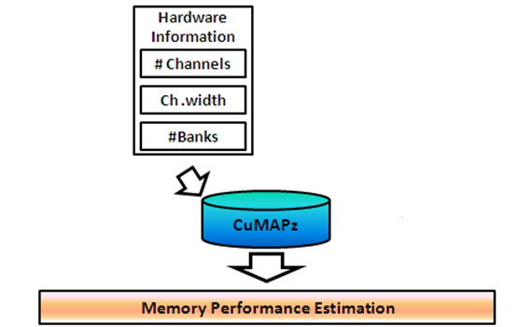
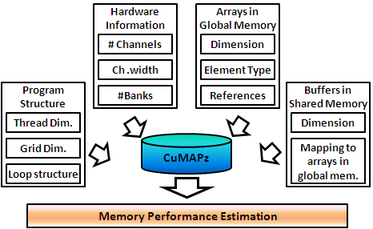
Our Approach - Overview
Input: Hardware information and a design choice
How to optimize the program
Output: Performance estimation for the given design choice
A design choice for better optimization

Slide 7
The Impact of Different Design Choices
We analyze the memory addresses requested by the program
Which addresses will be accessed in which order?
Determines what happen in hardware
thd0
thd1
thd2
thd3
0
1
2
3
EX) Channel skew
ch0
ch1
ch2
ch3
ch0
ch1
ch2
ch3
0
1
2
3
0
1
Narrow bus width
Wide bus width
2
3
EX) Shared memory bank conflict
bk0
bk1
bk2
bk3
bk0
bk1
bk2
bk3
0
1
2
3
0
1
Latency: 1 cycle
2
Latency: 4 cycle
3

Slide 8
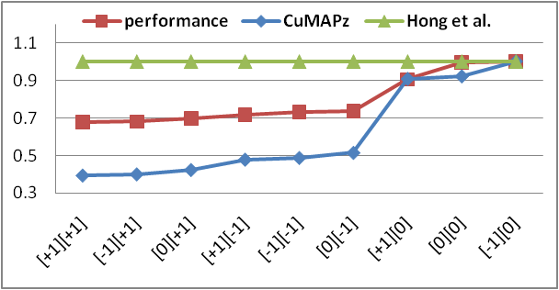
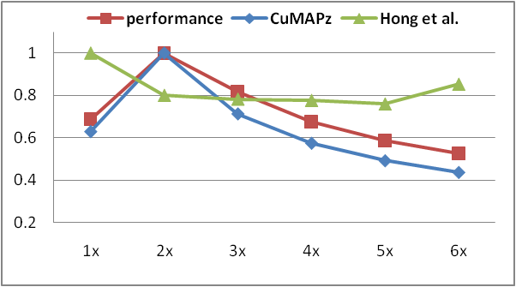
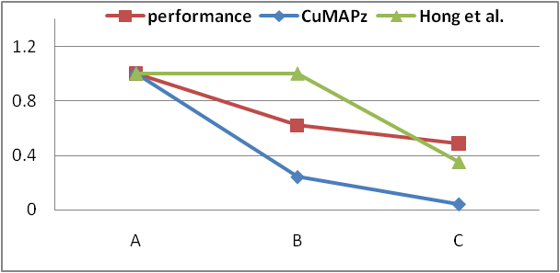
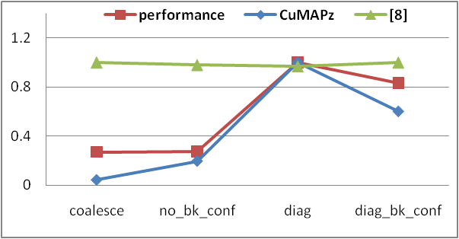
Validation – How accurate is our estimation?
X-axis: Different design choices
Laplace
Wavelet
MatMul
Transpose

Slide 9
Performance Improvement
Performance improvement obtained by applying the best design choices found by our technique
Average performance improvement of
32% over the previous approach
62% over no optimization

Slide 10
Conclusion
CUDA - Easy to start, Difficult to optimize
Because of many performance considerations
Our approach
Accurate performance estimation with comprehensive analysis
How can this be used?
Programmer can find a better design choice
Hardware Info.
Performance Estimation
CuMAPz
Performance Estimation
Performance Estimation
Performance Estimation
Design choice
Design choice
Design choice
Design choice
Better Optimization

