Slide 1
Splitting Functions in Code Management on Scratchpad Memories
Youngbin Kim¹, Jian Cai², Yooseong Kim², Kyoungwoo Lee¹, Aviral Shrivastava²
¹Department of Computer Science
Yonsei University, Seoul, Korea
²Compiler-Microarchitecture Lab
Arizona State University, Tempe, AZ
Notes:
Good afternoon. I’m Youngbin Kim from Yonsei University, Korea. I’m going to present the paper titled “splitting functions in code management on scratchpad memories”. This work is done as a collaboration with Compiler Microarchitecture Lab in Arizona State University.

Slide 2
Outline
Background
Our Approach: Function Splitting
Evaluation
Conclusion
Notes:
This is an outline of this presentation. (@) I’ll first talk about the background.

Slide 3
Scratchpad Memory
Background
Scaling cache in multi/many-core architecture is getting more difficult
Scratchpad memory (SPM) is popular among modern processors as an alternative to the cache
Software-managed on-chip SRAM memory
Good: performance, energy/area efficiency, predictability
Challenge: data movement between SPM and memory should be explicitly managed (by DMA)
CPU
SPM
DMA
Memory
Notes:
Scaling cache in multi or many core architecture is getting more difficult due to the high cost of cache coherency and power. (@) So, scratchpad memory is becoming a popular alternative to the conventional cache. It is basically software-managed on-chip SRAM memory. (@) Unlike the cache, it doesn’t have tag comparison. Therefore, it shows better performance, energy and area efficiency, and predictability compared to the cache. (@) On the other hand, the major challenge that SPM has is that data movement between SPM and main memory should be explicitly managed by DMA.

Slide 4
Need for Data Management on SPM
Background
Program size > SPM size
Only part of data can be loaded on the SPM
Explicit data movement before the memory access is required
Manage each memory region separately
Each region has its own access pattern to exploit
Our work targets optimizing code management
Function-to-region mapping technique is widely studied previous approach for the code management
…
Stack
Unallocated
Heap
Uninitialized data
Initialized data
Code
…
Notes:
Since the size of the program is generally larger than the SPM size, only part of data can be loaded on the SPM. Therefore, before the memory access, explicit data movement is required. (@) It is usual to manage each memory region such as stack or heap separately, because each region has its own access pattern to exploit. (@) In this work, we only focus on the optimization of the code management. (@)
In code management, function-to-region mapping technique is widely studied previous approach. In next few slides, I’d like to introduce this technique.

Slide 5
Code Management: Function-to-Region Mapping
Background
main
1. Split the given SPM into regions
F0
Region 1 | Region 2
F1
Function sizes
2. Map each function into a region
main
Region 1 |  | Region 2
F0 |  | main
F1
Mapping Algorithm
F0
loop 1
*Only one function can be loaded on each region at the same time
3. Insert management instructions before the every function calls
F1
CFG
… | Check Region 1
Call F0 | If F0 is not loaded: load F0
… | Call F0
SPM
SPM size
Notes:
In function-to-region mapping technique, three parameters are given as an input to the management algorithm. They are function sizes, control flow graph with loop information, and the SPM size. Using these information, (@) mapping algorithm first split the given SPM into regions. (@) Then, it maps each function into a region. In the slide, function F0 and F1 are mapped to the region 1, and function main is mapped to the region 2. At runtime, only one function can be loaded on each region at the same time. (@) Finally, management instructions are inserted before the every function calls. These instructions check the region which the called function is mapped to, and if the function is not loaded, load that function. In the slide, management instruction checks the region 1 since F0 is mapped to the region 1. Then it makes sure that F0 is loaded on the region by loading the function if it is not loaded.

Slide 6


















What makes good mapping?
Background
128 KB
64 KB
Region 1 |  | Region 2
main |  | F0
F1
main
128 KB
M1
F0
64 KB
loop 1
Region 1 | Region 2
main | F0
 | F1
F1
64 KB
M2
Better mapping
SPM size: 192 KB
# of DMA | Total DMA size (KB)
M1
F1
F0
main
Region 1 | Region 2
$$1$$
$$3$$
$$6$$
$$0$$
$$4$$
$$128$$
$$+64$$
$$+64$$
$$+128$$
$$+64$$
$$+128$$
$$+64$$
$$+128$$
$$=768$$
$$8$$
$$5$$
$$2$$
$$7$$
F0
main
F1
M2
Region 1 | Region 2
$$1$$
$$2$$
$$3$$
$$128$$
$$+64$$
$$+64$$
$$=256$$
$$0$$
It is important to separate functions which frequently call each other!
Notes:
So, there are lots of possible mappings for the given program. In this slide, I want to talk about what makes some mappings be better than others.
The graph describes the example program. It has three functions, main, F0 and F1. Function main calls F0, then calls F1 in the loop 1.
(@) For a given example program, two mappings, M1 and M2 are depicted in the slide. M1 put main and F1 in the same region, while M2 put F0 and F1 in the same region. (@) To decide which mapping is better, I will track the number of DMAs and the total DMA size for each mapping.
(@) When main is called, the function should be loaded on the SPM. (@) Main calls F0, and F0 is also loaded on the region 2. (@) When F0 returns, main is called but no management is needed since the function main is already on the SPM in both mappings. (@) Then main calls F1. In M1, F1 is loaded on Region 1, evicting main. On the other hand, in M2, F1 evicts F0. (@) After the execution of F1, it returns to main. While M2 doesn’t need any additional DMA since main is already on the SPM, M1 requires a DMA to load the main. This conflict between main and F1 is repeated, because they are in a loop. (@@@@)
Therefore, after 3 executions of the loop 1, M1 requires much more DMAs with the same SPM size. In real application, it can result in up to xx% performance difference. (@) So, we can say that M2 is a better mapping than M1.
(@) Also, we can observe that it is important to separate functions which frequently call each other. In this example, main and F1 call each other frequently. M2 is good mapping because it separates these two functions, while M1 doesn’t.

Slide 7
Related Works on the Mapping Algorithms
Background
There were many efforts to make mapping algorithms which generates efficient mapping
Pabalkar¹, Jung², Baker³, and Jang⁴
Key component: function estimating the DMA costs of the given mapping
CMSM⁵ is the most recent technique for the code management
Improved the performance by 12% by accurate cost calculation and considering branches
¹Pabalkar, Amit, et al. “SDRM: simultaneous determination of regions and function-to-region mapping for scratchpad memories”, HPC, 2008
²chul Jung, Seung, Aviral Shrivastava, and Ke Bai. “Dynamic code mapping for limited local memory systems”, ASAP, 2010
³Baker, Michael A., et al. “A performance model and code overlay generator for scratchpad enhanced embedded processors”, CODES+ISSS, 2010
⁴Jang, Choonki, et al. “Automatic code overlay generation and partially redundant code fetch elimination”, TACO, 2012
⁵Bai, Ke, et al. “CMSM: an efficient and effective code management for software managed multicores”, CODES+ISSS, 2013
Notes:
There were many efforts to make mapping algorithms which generates efficient mapping, because mapping has critical effect on the performance. Several works were proposed by these researchers. (@) The key component of the mapping algorithms is a function that estimates the data movement cost of the given mapping. (@) Among them, CMSM is the most recent technique for the code management. It improved the performance by 12% by accurate cost calculation and considering branches.

Slide 8
Outline
Background
Our Approach: Function Splitting
Evaluation
Conclusion
Notes:
In this section, I’m going to talk about our approach, the function splitting.

Slide 9
Limitation of Function-to-Region Mapping
Function Splitting
Performance is highly dependent on the mapping
However, the quality of a mapping is fundamentally limited by the size of functions and their call patterns
Splitting functions can mitigate these limitations
*Frequently call each other
caller'() {
...
g0()
...
}
Region 1
caller
callee
caller() {
...
for {
callee()
}
...
}
g0() {
for {
callee()
}
}
Region 1 |  | Region 2
caller' |  | g0
callee
Notes:
So, there were many efforts to make good mappings, since the performance is highly dependent on the mapping. (@) However, we observed that the previous approaches have fundamental limitations. That is, the quality of a mapping is fundamentally limited by the size of the functions and their call patterns. (@) Here is an example. In the slide, the function caller calls callee in a loop. Unfortunately, Mapping algorithm has to put caller and callee in the same region due to the tight SPM size budget. (@) In this case, any mapping algorithm cannot generate efficient mapping although the caller and callee frequently call each other.
(@) We proposed a function splitting technique to solve this problem. (@)
In this optimization, we singled out the for loop in the function caller. After singling out this loop in the caller into a new function g0, caller now calls g0 instead of the callee. In g0, callee is called in the loop. Basically the modified code does the same things. However, by this modification, callee now returns to the function g0, rather than the caller. (@) That is, function g0 and callee call frequently each other, rather than function caller and callee. It gives a chance to make more efficient mapping because g0 is generally much smaller than the caller. In our example, efficient mapping can be made by separating callee and g0.

Slide 10
Our Approach: Optimization by Splitting Function
Function Splitting
main
1. Split the given SPM into regions
F0
Splitting policy
Region 1 | Region 2
F1
Function sizes
Function Splitting
2. Map each function into a region
main
Region 1 |  | Region 2
F0 |  | main
F1
Mapping Algorithm
F0
loop 1
*Only one function can be loaded on each region at the same time
3. Insert management instructions before the every function calls
F1
CFG
… | Check Region 1
Call F0 | If F0 is not loaded: load F0
… | Call F0
SPM
SPM size
Optimization orthogonal to the previous mapping techniques
Notes:
Based on this idea of the function splitting, we proposed an optimization step which automatically finds the splitting points and performs splitting. (@) We applied this optimization before the mapping algorithm. (@) It makes the optimization orthogonal to the previous mapping techniques. We can get a more efficient mapping while fully exploiting previously proposed mapping algorithms.

Slide 11
Deciding Where to Split
Function Splitting
Basic idea: single out a loop into a function, which has a function call in it
Separately mapping g0 and callee is easier than separating caller and callee
Size of g0 < caller
However, function splitting is not a free operation
Runtime overhead (additional function call) and
Size overhead (management codes)
caller() {
...
for {
callee()
}
...
}
g0
caller() {
...
g0()
...
}
g0() {
for {
callee()
}
}
Notes:
Let me introduce the proposed technique in more detail. To split function automatically, we have to decide where to split in the code. Our basic idea is to single out a loop into a function, which has a function call in it. (@) As we saw before, separately mapping g0 and callee is easier than separating caller and callee, since the size of function g0 is generally smaller than caller.
(@) However, function splitting also incurs some overheads. (@) It adds an additional function call, which is runtime overhead. Also, all the management codes incur size overhead. We can see the amount of theses overheads in the next slide.

Slide 12
Implementation of Function Splitting
Function Splitting
void f1(const int len) {
for (i = 0; i < len; i++) {
sum += arr[i] * arr[i];
}
printf("%d, %d", len, sum);
}
Get pointer for the variable written
Pass variables used in the loop
void f1(const int len) {
__generated__0(i, len, &sum);
printf(“%d, %d", len, sum);
}
void __generated__0(
int i, const int len, int *sum) {
int __sum = *sum;
for (i = 0; i < len; i++) {
__sum += arr[i] * arr[i];
}
*sum = __sum;
}
Get value for the variable read only or dead after the loop
Cost of function splitting
Additional function call (performance)
New function generated (size)
Splitting is beneficial, but cannot single out every loop!
Management code for the written variables
Notes:
This is an example of splitting a for loop into a new function. For loop in the original code is singled out into the new function, generated__0.
(@) The new function takes the variables used in a loop, such as i, len and sum. (@) For the variables which are read only or dead after the execution, it takes only their values. (@) However, for the variables which are written in the new function, it should take pointers of them. (@) Management code for these pointers are also inserted.
(@) Important thing to notice here is that there are overheads in function splitting, in terms of the performance and the size. (@) First, It adds an additional function call. This is an overhead in terms of the performance. (@) In addition, there is size overhead. Except for the original for loop in the generated__0, all the red parts are overheads in terms of the code size. (@) Therefore, it is true that function splitting has a chance of improving the mapping, but at the same time, it also incurs performance and size overhead. So, it is better to carefully choose the loops to single out, rather than singling out every loop.

Slide 13
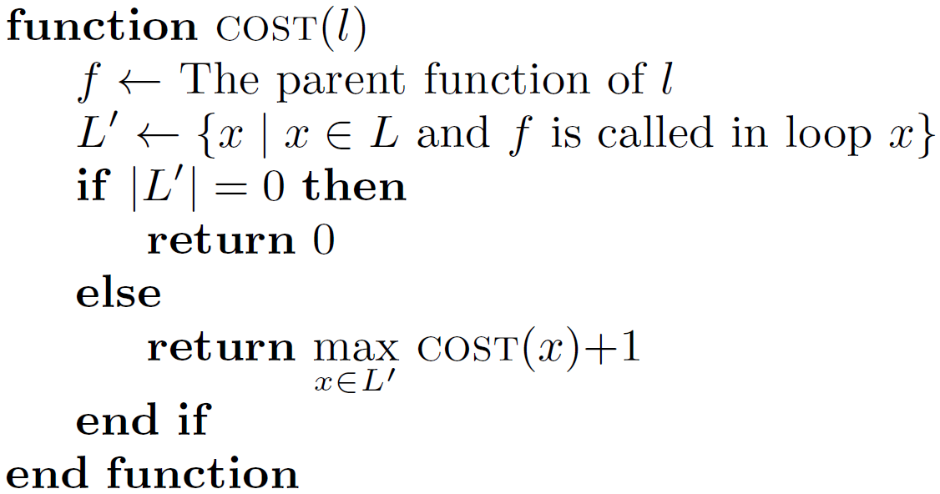



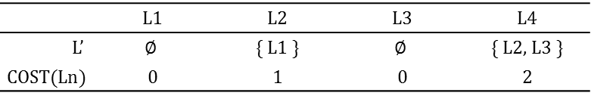
Deciding Which loop to split
Function Splitting
Benefit of a splitting can be different
Depending on the frequency the loop executed
If all the loops are executed 10 times
L4 is executed >1000 times
L3: 10 times
COST estimates the maximum possible nesting levels of a loop
$$×10$$
F1
F2
F3
F4
$$×10$$
$$×10$$
$$×10$$
L1: { call F2 }
L2: { call F4 }
L3: { call F4 }
L4: { call X }
Separate L4!
L is a set of all loops containing function calls
 | L1 | L2 | L3 | L4
L’ | $$∅$$ | { L1 } | $$∅$$ | { L2, L3 }
COST(Ln) | 0 | 1 | 0 | 2
The deepest level of the loops calling l + 1
Notes:
To decide which loop to split, we used the fact that the benefit of a splitting depends on the frequency the loop executed. The figure shows the call patterns of an application. F1 calls F2 in the loop L1 and F2 calls F4 in the loop L2. Finally, F3 calls also F4 in the loop L3. (@) In the example, if all the loops are executed 10 times, (@) L4 is executed roughly 1000 times, because F4 is called by F2 and F2 is called by F1 in loops. (@) On the other hand, L3 is just executed for 10 times, because no other function calls F3 in a loop. In this scenario, splitting L4 is likely to be more beneficial than splitting L3, since L4 is executed much more times.
(@) Based on this observation, we use heuristic function COST to estimate the maximum possible nesting levels of a loop. For each loop, it finds L’, (@) which is a set of loops calling it. (@) Then it decide the cost of the loop as the deepest level of the loops calling it plus 1. (@) This table shows the COST of the loops after calculation. For example, L’ for the loop L4 is L2 and L3. Its cost is 2 since the loop that has highest cost in L’ is L2, which is 1. We can apply same calculation for the other loops. (@) Therefore, we can say that splitting L4 is likely to be most beneficial, since it has the highest cost.

Slide 14
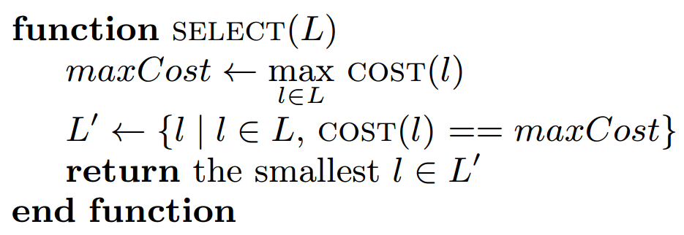





Splitting Algorithm
Function Splitting
Greedy algorithm based on the cost calculation
SELECT picks a loop to single out
Highest cost, smallest size
$S_{spm}←$ available SPM size
$M^{′}←$ mapping before function splitting
$C^{′}←$ code management overhead by $M′$
$L←$ All the loops containing function calls
Is $L$ empty?
Yes
No
Mapping doesn’t fit the SPM
No
$l←SELECT(L)$
Single out $l$ as a new function
$S←$ Overall size after splitting
$M←$ Mapping after splitting
$C←$ code management overhead by $M$
$S> S_{spm}$
or
$$C ≤C′$$
Return $M′$
Splitting doesn’t show the improvement
Yes
Notes:
Finally, we proposed a greedy algorithm based on the cost calculation. (@) For a given SPM size and set of all the loops L, it repeats the splitting until L is empty. (@) If L is not empty, the algorithm picks the loop to single out and make it into a new function. (@) Function SELECT does this selection. It picks the loop with the highest cost. If there are many loops having same cost, it selects the loop with the smallest size, since the smaller loop is likely to be result in the smaller function. (@) After the splitting, it checks the size and performance constraints. (@) If the size overhead is too high or (@) the performance is not improved, the algorithm quits. (@) If the result doesn’t violate the constraints, the algorithm repeats one more time.
SELECT 에서 maxCost 로 변경. 여전히 좀 약함.

Slide 15
Outline
Background
Our Approach: Function Splitting
Evaluation
Conclusion
Notes:
In the next section, I’ll talk about the evaluation.

Slide 16
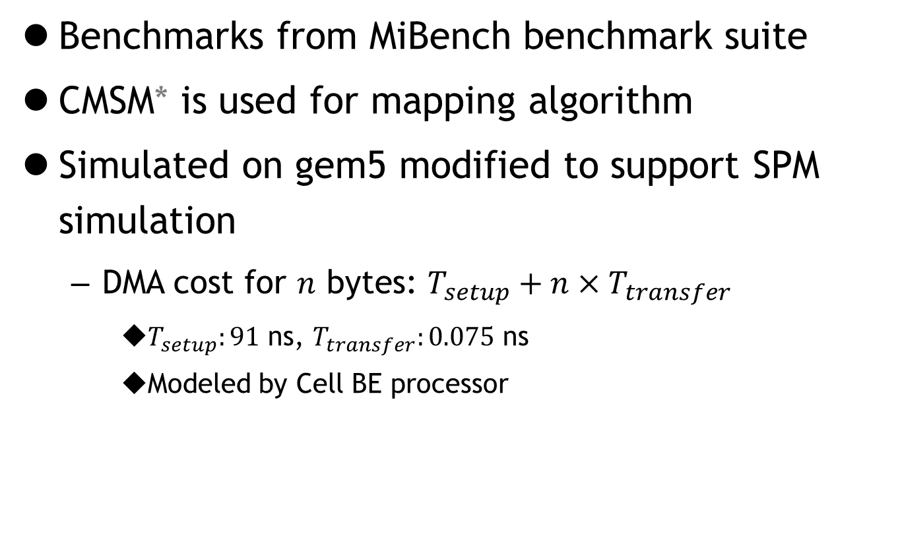
Experimental Setup
Evaluation
Benchmarks from MiBench benchmark suite
CMSM* is used for mapping algorithm
Simulated on gem5 modified to support SPM simulation
DMA cost for $n$ bytes: $T_{setup}+n×T_{transfer}$
$T_{setup}:91$ ns, $T_{transfer}:0.075$ ns
Modeled by Cell BE processor
* Bai, Ke, et al. “CMSM: an efficient and effective code management for software managed multicores”, 2013
Notes:
We evaluated the proposed splitting algorithm on the benchmarks from MiBench benchmark suite. (@) CMSM, which is state-of-the-art mapping technique, is used for the mapping algorithm (@) and they are simulated on gem5 simulator. We modified the gem5 simulator to support SPM simulation. (@) We also modeled DMA cost, which consists of setup cost and transfer cost. Setup cost represents the base cost for initiating DMAs and transfer cost represents the cost proportional to the bytes transferred. The actual data is referenced by Cell BE processor.

Slide 17
Experiment Configurations
Evaluation
Three configurations
1-region, 2-regions: original program, different SPM sizes
ours: function splitting is applied
Smallest function
Largest function
Smallest function
Largest function
Functions: (after splitting)
F1 | F2 | …
Functions:
F1 | g0 | …
1-region: original + has one region
Configurations
(SPM Size)
2-regions: increase SPM size of 1-region to have two regions (original)
Ours: has two regions after the splitting (optimized)
Notes:
We used three SPM size configurations for the evaluation, 1-region, 2-regions and ours. 1-region and 2-regions represent the configuration with original program with different SPM sizes. ours is configuration with the function splitting optimization enabled.
(@) 1-region is the smallest SPM size that can run the application. Then we increase the size of the SPM to have two regions. This size configuration is called 2-regions.
Finally, we used ours to represent the configuration with function splitting. (@) After splitting, function sizes are changed due to the split functions and newly generated functions. (@) We set ours represent the size that has two regions after the splitting. The size of ours is generally located between the sizes of other two regions.

Slide 18
Ours vs. 1-region
Evaluation
16% performance improvement on average
DMAs are almost eliminated in most cases
Benchmarks like rijndael.decode
Call large function repeatedly in a small loop
DMA takes a large portion of the execution time
Benchmarks like adpcm
Computation contributes to most of execution time
Structure showing the largest benefits
Fig 1. Comparison between ours and 1-region
Notes:
This slide shows the comparison between ours and 1-region. X axis shows the benchmarks. Bar graph shows the performance improvement and the line graph shows the DMA reduction. (@) On average, ours shows 16% performance improvement compared to the 1-region. In most cases, DMAs are almost eliminated. (@) Benchmarks like rijndael.decode shows the large performance improvement. It is because it has a structure that call large function repeatedly in a small loop. This structure fits well on the optimization since separating small loop can be done with small SPM space. Also, in these benchmarks, DMA takes a large portion of the execution time. (@) On the other hand, benchmarks that computation contributes to most of their execution time, like adpcm, shows the marginal improvement.

Slide 19
Ours vs. 2-regions
Evaluation
Ours reduces the size requirement by 20% at the cost of performance overhead by 2.4% on average
Benefits are dependent on applications
FFT, adpcm: mapping algorithm generated optimal mapping by exploiting split function
basicmath: more choice to trade-off size and performance
25% size reduction with 3% performance overhead
Fig 2. Comparison between ours and 2-regions
Notes:
This slide shows the comparison between ours and 2-regions. In the figure, dark bar shows the size reduction and light bar shows the performance improvement of ours. (@) Ours successfully reduces the size requirement by 20% at the cost of performance overhead by 2.4% on average. (@) The benefits also dependent on the benchmarks.
For the benchmarks like FFT and adpcm, size requirement is reduced at the negligible performance overhead. In these cases, mapping algorithm generated optimal mapping by exploiting split function.
(@) On the other hand, in basicmath, the optimization gives more choice to trade-off size and performance. In this benchmark, size requirement is reduced by 25% while the performance is degraded by 3%.

Slide 20
Scalability
Evaluation
The optimization doesn’t degrade the performance with larger SPM in most cases
Showing performance improvement with all SPM sizes
Splitting is beneficial only when the SPM size is small
Benchmarks are not sensitive to the SPM size
Fig 3. Performance improvement from function splitting when various SPM sizes are given
Notes:
We also evaluated the speedup of the proposed technique on the various SPM size. Overall, the optimization is especially efficient when the SPM size is small, but doesn’t degrade the performance with larger SPM in most cases.
We classified the results into three groups. Benchmarks in the figure show performance improvement with all SPM sizes. In these benchmarks, performance is improved or at least not degraded with larger SPM sizes. (@) For benchmarks in bottom left, they are not sensitive to the SPM size. In these benchmarks, computation takes the most of their execution time and doesn’t call functions frequently. Finally, for benchmarks in bottom right, splitting is beneficial only when the SPM size is small.

Slide 21
Outline
Background
Our Approach: Function Splitting
Evaluation
Conclusion
Notes:
Let me conclude the presentation.

Slide 22
Conclusion
In function-level code management, quality of the mapping determines the performance
This paper proposed a technique to split functions that can result in a better mapping while fully exploiting previous mapping algorithms
The optimization gives 16% performance improvement on average (compared to 1-region)
To achieve comparable performance without optimization, SPM size have to be 20% larger
Notes:
Thank you for listening. Do you have any questions?

