Slide 1
Static Function Prefetching for Efficient Code Management on Scratchpad Memory
Youngbin Kim, Kyoungwoo Lee, Aviral Shrivastava
* Yonsei University, Korea
** Arizona State University, USA
ICCD’19
Notes:
Good morning.
Thank you for attending.
I’m Youngbin Kim from Yonsei university, Korea.
The title of the talk is “Static Function Prefetching for Efficient Code Management on Scratchpad Memory”.

Slide 2
Summary of the Talk
In SPM-based code management, prefetching has not been extensively studied
Hard to recover from incorrect prefetching
We proposed a technique to insert prefetch instructions at compile-time without any run-time data structure
Reduces CPU idle time by 58.5% and execution time by 14.7% on average by enabling parallel executions of DMA and CPU
Notes:
Before starting the talk, I’d like to highlight the contents of our work.

Slide 3
Outline
Introduction
Our Approach
Finding Load Locations
Inserting Prefetch Instructions
Experimental Results
Conclusion
Notes:
This is outline of the talk.

Slide 4
Outline
Introduction
Our Approach
Finding Load Locations
Inserting Prefetch Instructions
Experimental Results
Conclusion

Slide 5
Scratchpad Memory
Introduction
Scratchpad Memory (SPM) is a software-managed on-chip SRAM memory
Simple hardware: latency, energy/area efficiency
No run-time tag matching: predictability
Challenges: data movement between SPM and memory should be explicitly managed (by DMA)
Requires management algorithms to insert DMA instructions in compile-time
Focus of this work: improving code management efficiency on SPM-base systems
CPU
SPM
DMA
Memory
Notes:
Scratchpad memory is a software-managed on-chip SRAM memory.
*
Due to its simple design, it shows good latency, energy/area efficiency as well as predictability.
*
On the other hand, the challenge is that data movement between SPM and memory should be explicitly managed by DMA.
*
Therefore, SPM-based system usually requires management algorithms to insert DMA instructions in compile-time.
*
In this work, I’d like to focus on how we can improve the performance of code management on SPM-based systems.

Slide 6
Function-to-Region Mapping: SPM-based Code Management
Introduction
Mapping algorithm splits memory into regions and maps each function onto a region
Similar to direct-mapped cache but has an important difference
SPM size
R0
R1
mapping algorithm
F0
F2
func F0:
...
F1()
...
F2()
Mem:
F1
R0:
F0
CPU
F0
F1
F0
F2
R1:
F1, F2
load F1
load F2
DMA
Notes:
So, let me briefly introduce How the code management works.
This is one of the most popular code management techniques on SPMs, called function-to-region mapping.
*
Let’s say we have function F0 which calls F1 and F2.
*
First, the program and the available SPM space are given to the mapping algorithm.
*
Then, the mapping algorithm splits memory into regions and maps each function in the program onto a region.
In the example here, memory is divided into two regions R0 and R1.
*
Function F0 is mapped to R0 and F1 and F2 are mapped to R1.
*
At run-time, when F1 is called,
*
it is loaded on the region R1 by DMA instruction.
*
When F2 is called later,
*
it will evict F1 and will be loaded on R1 since the two functions are mapped to the same region.
*As described in the example, it works like direct-mapped cache, but it has an important difference.

Slide 7
SPM vs. Cache: Recovery from a Fault
Introduction
SPM does not have a mechanism to recover from a fault at run-time
If wrong data is loaded on the target address, SPM silently executes the code with the incorrect data
Restricts speculative executions (e.g. prefetching) on SPMs
CPU
CPU
load F1
load F2
call F1
call F1
F1
call F1
F2
tag
F2
F2
cache:
F1
SPM:
time
F1
Silently executes F2 instead of F1
Memory
Memory
Notes:
The difference is that SPM does not have a mechanism to recover from a fault at run-time.
*
If wrong data is loaded on the target address, SPM silently executes with the incorrect data.
*
Let's say we have a CPU which calls function F1 but F2 is actually loaded on that address.
In the case of direct-mapped cache, this mismatch is detected by comparing the tags.
*
Once it is detected, the correct code can be fetched from the lower-level memory
*
*
and CPU can execute the correct code.
*
However, in the case of SPM,
*
*
the same scenario results in silent execution of the incorrect code.
*
This significantly restricts the speculative executions such as prefetching on SPM-based systems.
*
As shown in the figure, if we speculatively load F1 before its execution
*
but in-between, if F2 replaces its region,
*
it results in the silent incorrect execution of F2 instead of F1.

Slide 8
Previous Method: On-Demand Loading
Introduction
Most of the previous techniques do on-demand loading
Load the callee right before the call
Guarantees no fault but executions of DMA and CPU are serialized
Up to 58.8% CPU idle time in our evaluation
R0
R1
Mem:
CPU
F0
idle
F1
F0
idle
F2
load F1
load F2
DMA
Notes:
Therefore, most of the previous techniques rely on on-demand loading.
*
In this scheme, the callee is loaded right before the call.
This scheme is simple and guarantees no fault since it starts to load the callee right before the call.
*
On the other hand, it completely serializes the executions of DMA and CPU.
*
As shown in the example, there is no overlap between CPU and DMA executions.
In our evaluation, this CPU idle time can be up to 58.8% of the entire program execution time.

Slide 9
Our Work: Static Function Prefetching
Introduction
Our work: automatically inserting prefetch instructions on safe and efficient locations for every call inst.
Safe: guarantees correct execution (no faults)
Efficient: prefetch sufficiently early
entry:
load F1
1
for.cond:
for.body:
block(F1)
buffer(F2)
call F1
drain()
for.end:
buffer(F3)
...
_call(F3)
1
3
entry:
2
3
CPU
F0
F1
F0
F2
2
for.end.1:
buffer(F4)
...
_a_call(F4)
for.cond:
for.body.1:
...
block(F2)
call F2
load F1
load F2
4
DMA
for.body:
call F1
call F2
...
for.end:
call F3
...
call F4
2
4
for.body.2:
load(F1)
...
CPU
F0
F1
F0
F2
1
load F1
load F2
for.inc:
for.inc:
DMA
Notes:
So, the goal of our work is to automatically insert prefetch instructions on safe and efficient locations for every call instructions.
*
Here, safe means it should guarantee the correct execution.
*
And efficient represents that the prefetch should be done sufficiently early so that CPU and DMA engine can run in parallel.
*
Through our complilation technique, the program like this *
will be transformed to into this, where most of the DMA execution overlaps the CPU execution.
As a result,
*
*
the program can be executed more efficiently with less CPU idle time and more DMAs can be done in parallel.

Slide 10
Summary of the Contributions
Introduction
Reduces CPU idle time by 58.5% and execution time by 14.7% on average without changing the mapping algorithm
Only relies on static analysis: no profiling or run-time data structure
Orthogonal to the mapping algorithms and other optimization methods
Notes:
This is the summary of our contributions.
Our technique reduces CPU idle time by 58.5% and execution time by 14.7% on average, without changing the mapping algorithm.
Also, it only relies on static analysis, which means no profiling or run-time data structure is needed.
Finally, our technique is orthogonal to the mapping algorithms and other optimization methods so that it can be applied with the different mapping algorithms.

Slide 11
Outline
Introduction
Our Approach
Finding Load Locations
Inserting Prefetch Instructions
Experimental Results
Conclusion

Slide 12

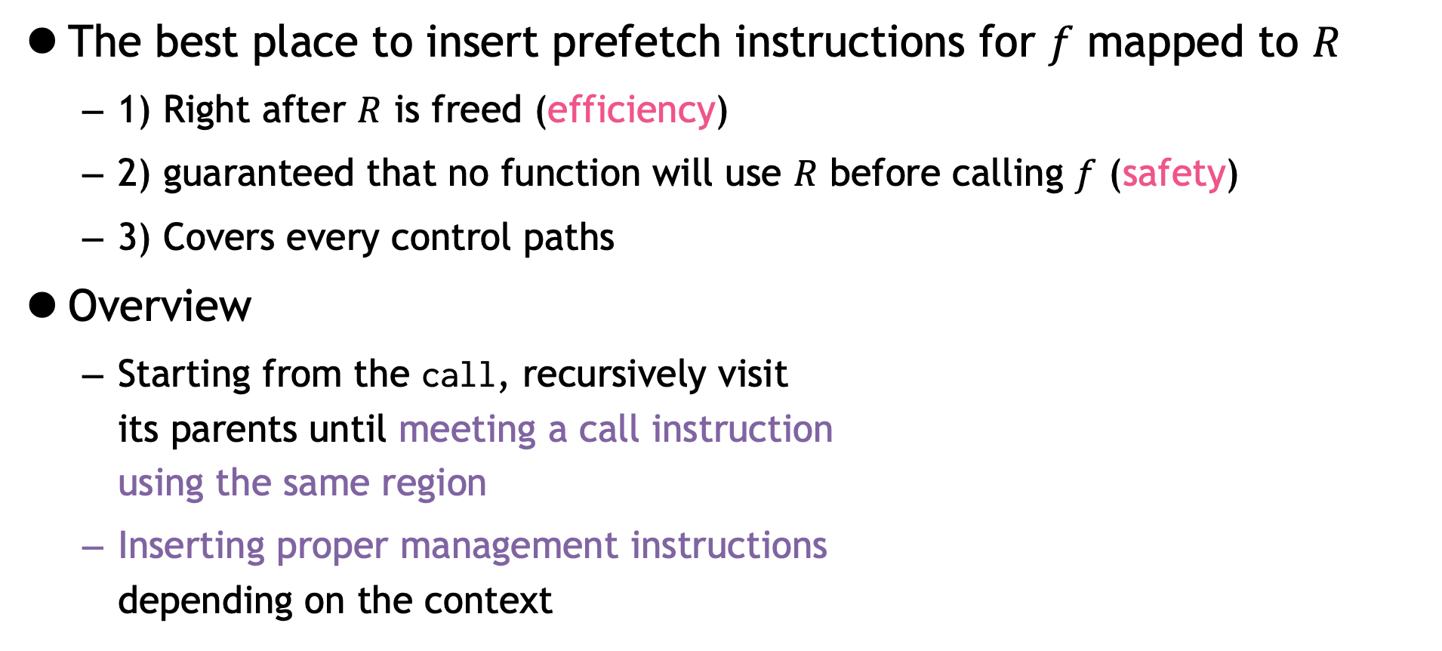





The Motivational Idea
Our Approach
The best place to insert prefetch instructions for $f$ mapped to $R$
1) Right after $R$ is freed (efficiency)
2) guaranteed that no function will use $R$ before calling $f$ (safety)
3) Covers every control paths
Overview
Starting from the call, recursively visit its parents until meeting a call instruction using the same region
Inserting proper management instructions depending on the context
R0:
g1
call $g2$
R1:
f, g2
dma($f$)
call $g1$
call $g2$
dma($f$)
...
call $f$
Notes:
So, where is the best place to insert prefetch instructions for a function f mapped to the region R?
*
First, to maximize the efficiency, it is better to be placed right after R is freed.
*
Second, it should be guaranteed that no function will use R before calling F.
*
Finally, it should cover every control paths so that the correct function can be executed regardless of the control paths.
*
Based on these intuitions, our basic idea is that
*
starting from the call, recursively visit its parents until meeting a call instruction using the same region.
*
For example, in this program, we start from the call instruction here. (강조 넣기)
*
We can skip the first block since it does not have any function call.
*
However, when we meet call g2, we cannot go further since f and g2 are in the same region.
If we load f earlier than this block, g2 will overwrite the region.
*
So we should stop here and insert DMA after the call instruction.
*
In the second path, we can skip the block having call g1 since f and g1 are mapped to the different regions.
**
So, the final prefetch location should be here.
*
Once we find all the load locations, we will insert the proper management instructions depending on the context.
These are the two major steps of our technique.
Let's first look at the first step.

Slide 13
Outline
Introduction
Our Approach
Finding Load Locations
Inserting Prefetch Instructions
Experimental Results
Conclusion

Slide 14
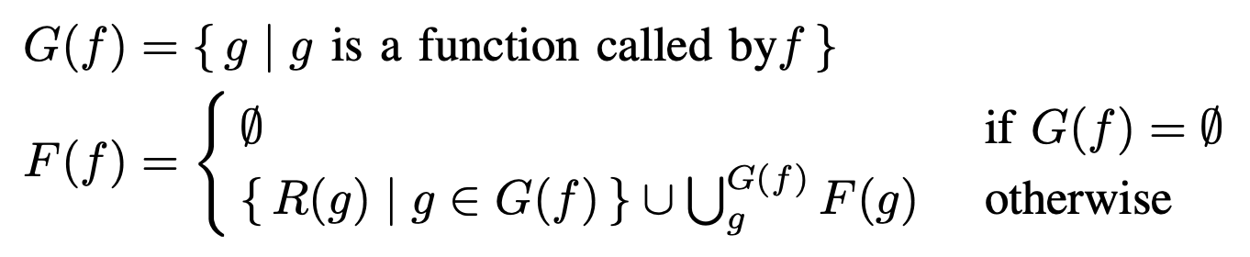

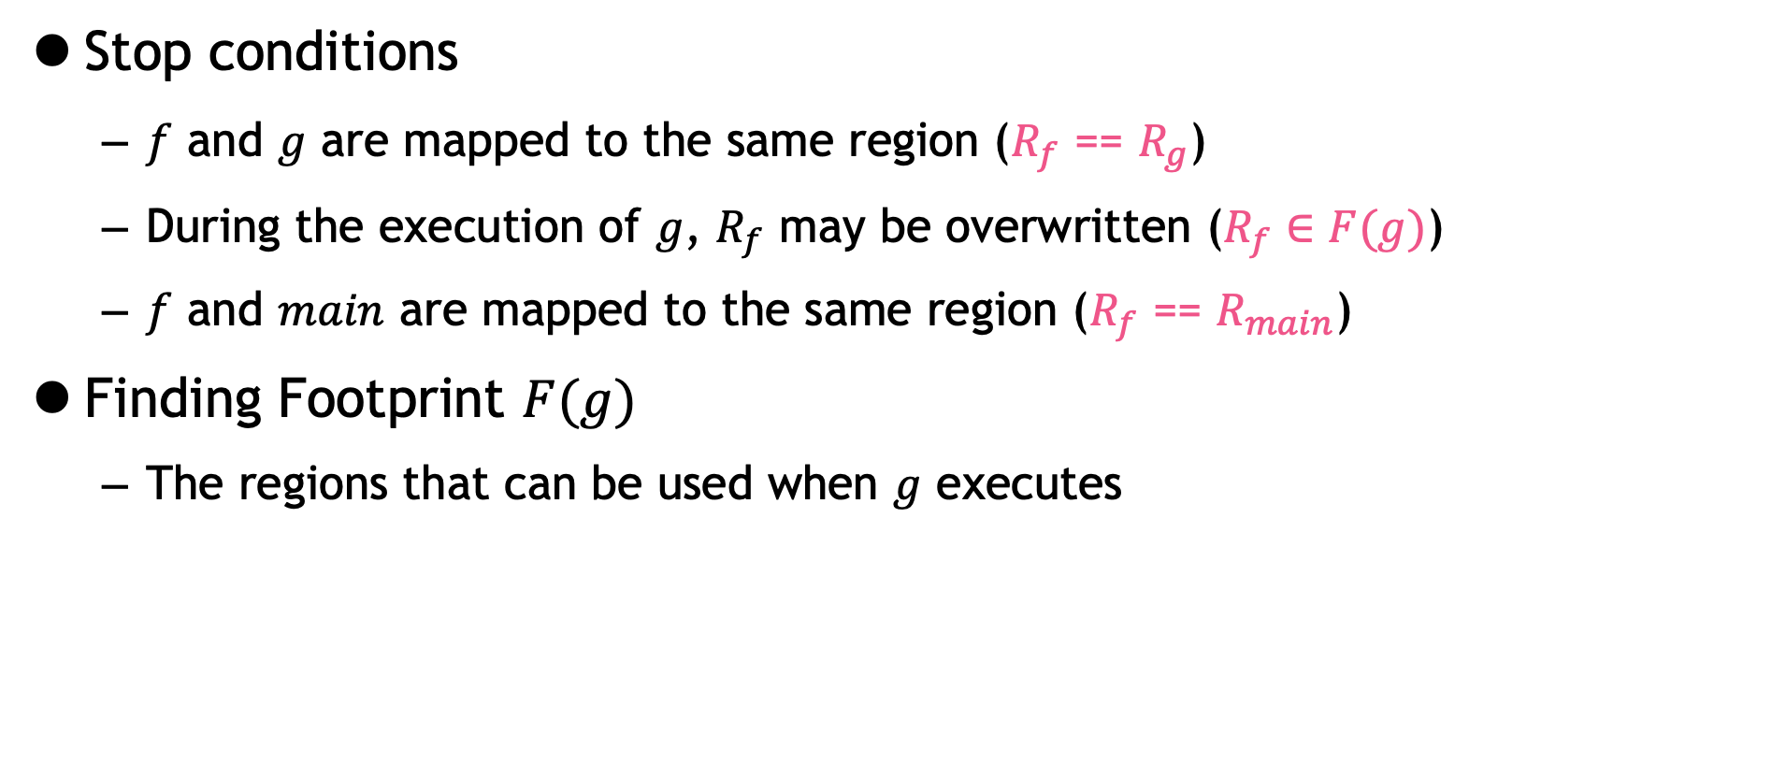




Finding Load Locations
Our Approach
Stop conditions
$f$ and $g$ are mapped to the same region ($R_{f}$ == $R_{g}$)
During the execution of $g$, $R_{f}$ may be overwritten ($R_{f}∈F(g)$)
$f$ and $main$ are mapped to the same region ($R_{f}$ == $R_{main}$)
Finding Footprint $F(g)$
The regions that can be used when $g$ executes
* $R_{f}$: the region $f$ is mapped
$main$:
call $g$
stop?
...
call $f$
func main:
g1()
g2()
$$F\left(main\right): \left\{R_{g1}, R_{g2}\right\} ∪F\left(g1\right) ∪F(g2)$$
Notes:
As introduced in the previous slide, to find the load locations, we need the stop conditions telling whether we stop or pass the current block.
*
The most intuitive condition is when f and g are mapped to the same region, as shown in the previous slide.
*
However, even if they are not in the same region, it is possible that during the execution of g, R_f may be overwritten.
*
To describe this situation, we introduce footprint F for a function g.
*
This represents the regions that can be used when g executes.
*
For example, if function main calls g1 and g2, the regions of g1 and g2 are in the footprint of main.
*
In addition, since g1 and g2 also can call other functions, we need to add the footprints of these functions too.
*
This can be represented in general form like this and it is an important information when we find the load locations.
*
Finally, if f and main are mapped to the same region, we should stop here because the control will eventually return to the main, which implies that the region is overwritten by function main.

Slide 15
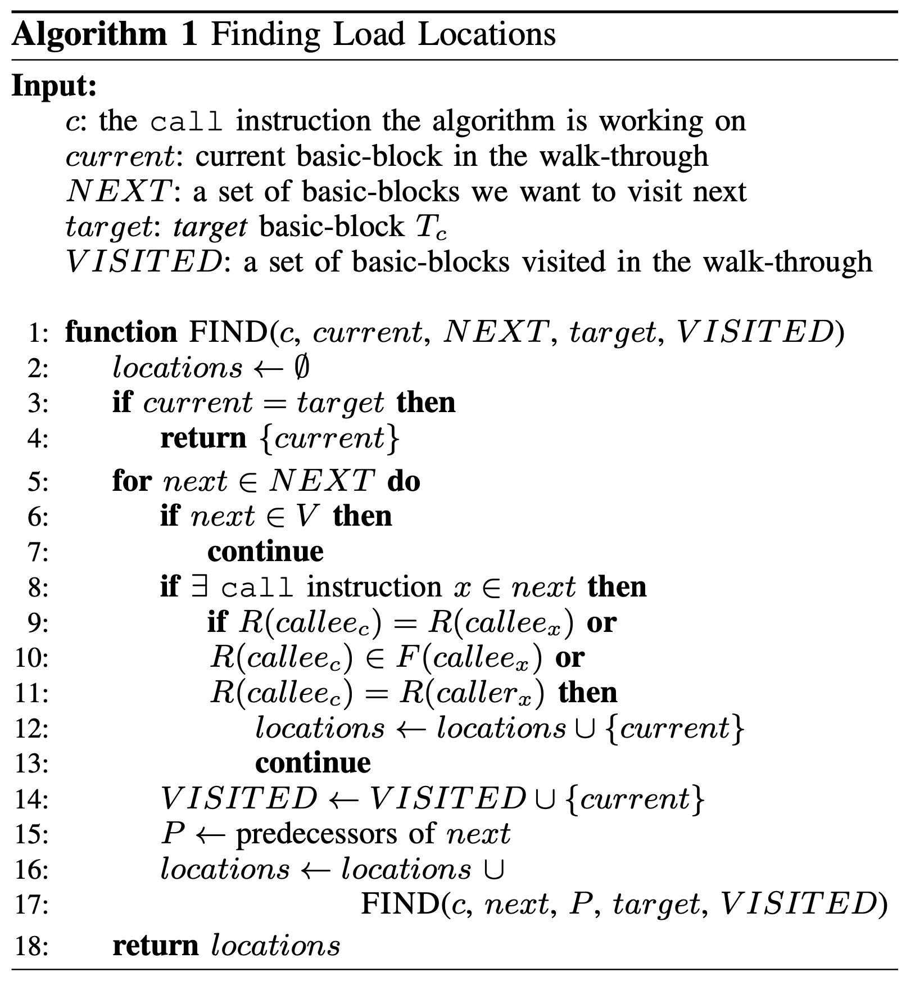

Finding Load Locations
Our Approach
Find load locations $L(c)$ for a call instruction $c$ in the program
Set target basic-block $T_{c}$ for $c$
If $c$ is in a loop, $T_{c}$: the predecessor of the loop header
Otherwise, $T_{c}$: immediate dominator of $c$
Recursively visits parents until
The algorithm reaches $T_{c}$ or
One of the stop conditions are met
Apply for every call instruction
Notes:
Using these stop conditions, we developed an algorithm to find load locations for a call instruction in a program.
*
We first set target basic block T_c which represents the desired load location for the call instruction.
*
For example, if c is in a loop, T_c is set to the predecssor of the loop header.
*
Once the target block is set, we recursively visits parents until
*
the algorithm reaches T_c or
*
one of the stop conditions are met.
We apply this algorithm for every call instruction in the program to find the complete load locations.

Slide 16
Outline
Introduction
Our Approach
Finding Load Locations
Inserting Prefetch Instructions
Experimental Results
Conclusion
Notes:
In the next section, I'd like to show how we insert the prefetch instructions.

Slide 17
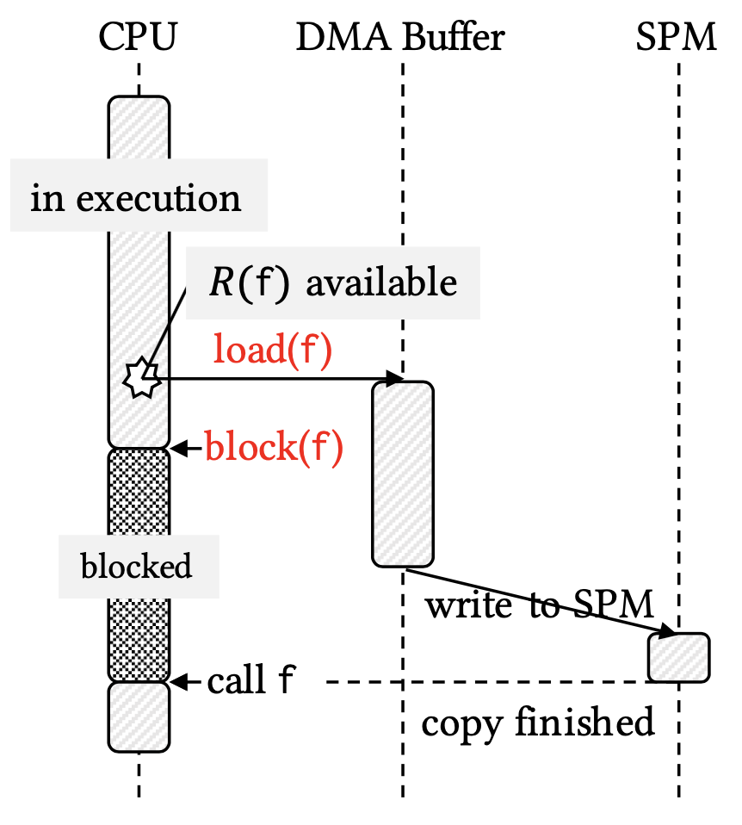


Inserting Prefetch Instructions
Our Approach
Insert DMA instructions on the found Load Locations
load(f) and block(f) management functions
Observations
A DMA transaction consists of two tasks: memory-to-buffer and buffer-to-SPM
Memory-to-buffer takes majority of the time
Idea: managing the two transactions separately for more parallelization
Load location $$L(c)$$
BB0:
call G
call G
load(F)
BB1:
...
block()
call F
$$c$$
BB2:
call F
Notes:
In this step, we actually insert DMA instructions on the found Load locations.
*
Here, we need two management functions, load and block.
*
This figure shows the behaviors of two management functions.
*
When load(f) is called, DMA engine copies the function from the memory and writes it to SPM.
*
On the other hand, block(f) makes the control wait until the DMA for f is finished.
Once the SPM is filled with the function F, CPU can continue the execution.
*
So, if we have a function like this and load location for call F is BB1,
*
it will be changed like this.
We insert load(F) on the load location and insert block() before calling F.
*
In this scenario, we can make two observations.
*
First, a DMA transaction consists of two tasks:
*
memory-to-buffer
*
and buffer-to-SPM.
*
Secondly, memory-to-buffer takes majority of the time.
*
Based on these observations, we came up with the idea of managing the two transactions separately for more parallel executions.

Slide 18
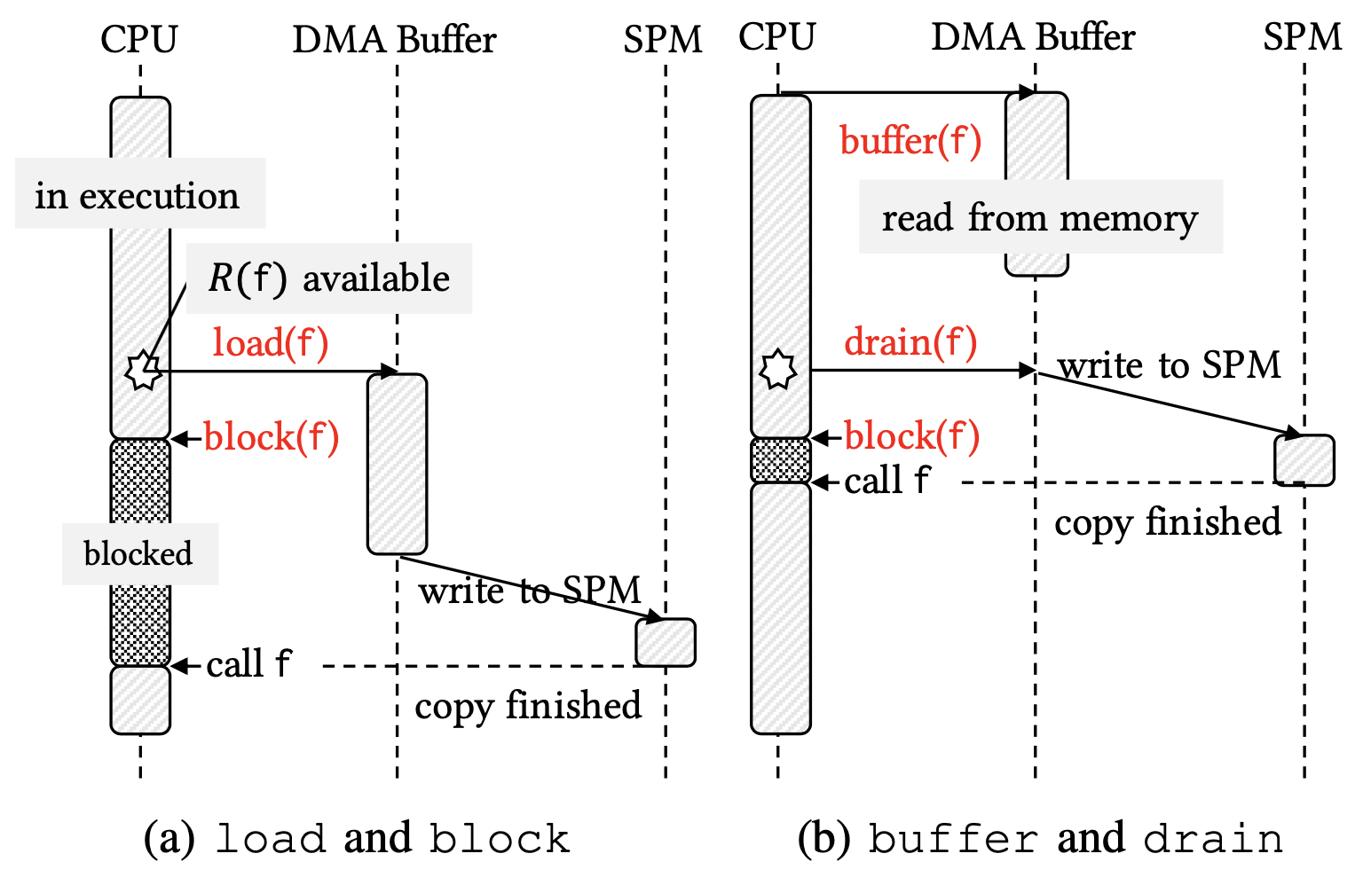



Inserting Prefetch Instructions
Our Approach
Two additional management functions for aggressive management
load() ➝ buffer() and drain()
Only can be applied if $F\left(G\right)=∅$
BB0:
call G
call G
buffer(F)
call G
drain()
Load location $$L(c)$$
load(F)
BB1:
...
block()
call F
$$c$$
block()
call F
BB2:
call F
Notes:
So, we added two more management functions, buffer and drain, by splitting the load function into two parts.
*
The scenario using these functions are presented in the right part.
*
Buffer() makes the DMA engine fill its buffer by reading the data from the memory, but it does not write the data to the SPM automatically.
*
When drain() is called later, the data in the buffer is copied to the SPM.
*
So, While load can be called only after the region is available,
*
we can issue memory-to-buffer transaction even before the SPM becomes available using buffer management function.
*
After the region is available, we can call drain() to execute buffer-to-SPM transaction, which takes much less time.
*
This figure shows how these management functions can be inserted.
*
Instead of inserting load on the load location, we insert buffer and drain around the function call in the parent block.
By doing this, function F can be loaded in parallel with the execution of function G.
*
Note that using buffer and drain is possible only when the footprint of G is empty, because buffer prevents issue of a new DMA transaction.

Slide 19
Inserting Prefetch Instructions
Our Approach
Our technique automatically inserts the most efficient management functions depending on the context
SFP (Static Function Prefetching): use only load()-block() pattern
A-SFP (Aggressive SFP): + buffer()-drain()-block() when available
BB0:
call G
call G
buffer(F)
call G
drain()
Load location $$L(c)$$
load(F)
BB1:
...
block()
call F
$$c$$
block()
call F
BB2:
call F
Notes:
In summary, our technique automatically inserts the most efficient management functions depending on the context.
*
Especially, we call our technique SFP and A-SFP, which uses only load()-block() pattern and
*
also exploits buffer()-drain()-block() pattern, respectively.

Slide 20
Outline
Introduction
Our Approach
Finding Load Locations
Inserting Prefetch Instructions
Experimental Results
Conclusion
Notes:
Next, I’d like to present the experimental results.

Slide 21
Experimental Setup
Experimental Results
Implemented as a pass in LLVM
MiBench benchmark suite compiled with –O3 for the workloads
To find mapping, CMSM is used (state-of-the-art)
Extended gem5 with SPM and DMA engine
3.6GHz, x86 out-of-order CPU
DDR4 model of gem5, 64kB data cache, 2-cycle latency SPM
DMA buffer is assumed large enough for storing any single function in the workload (~2.5kB)
baseline: only use on-demand loading
Bai, Ke, et al. "CMSM: an efficient and effective code management for software managed multicores.”, CODES+ISSS 2013
Notes:
Our technique is implemented as a pass in LLVM.
Mibench benchmark suite is used for evaluation and we use CMSM, which is the state-of-the-art apping technique, to find the mapping.
*
For the experiment, we extended gem5 simulator with SPM and DMA engine.
We compare our result with baseline, which manages function loading on-demand manner.

Slide 22
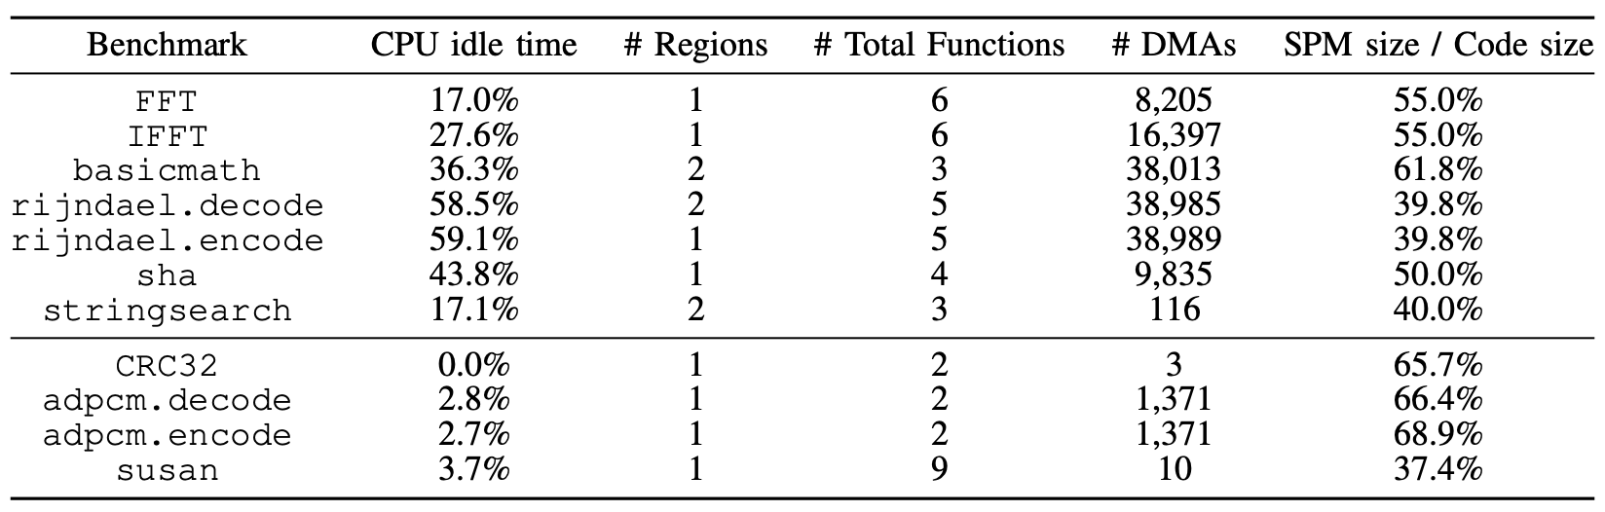
Effectiveness on Execution Time
Experimental Results
For evaluating execution time, we study the configurations with 1~2 regions
Adjust SPM sizes to have CPU idle time more than 10% of the execution time
Our main optimization target: group A
benchmarks showing >10% CPU idle time
Group A:
Group B:
Benchmarks which don’t have large synchronization overhead
Notes:
To evaluate the effectiveness of A-SFP on execution time, we study the configurations with 1 or two regions.
*
In this experiment, we adjusted SPM sizes to have CPU idle time more than 10% of the execution time.
*
This table shows the CPU idle time and the number of regions of the benchmarks.
We divicdd the benchamrks into two groups.
*
Group A represents the benchmarks showing more than 10% CPU idle time.
*
On the other hand, benchmarks in group B don’t have large CPU idle time since they do not have many function calls or complex control flow graphs.
*
Therefore, our main main optimization target is group A.

Slide 23
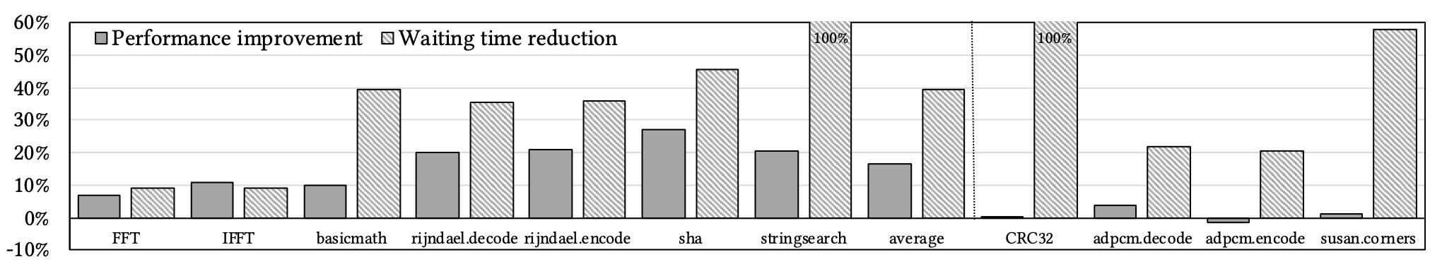
Effectiveness on Execution Time
Experimental Results
Execution time of benchmarks in A is improved by 14.7% on average
sha shows the largest improvement
Had a large improvement margin (43.8% CPU idle time on baseline)
Heavy functions can be managed by aggressive management functions
Group B: 43.3% reduction on CPU idle time, similar execution time
Performance improvement and reduction on CPU idle time enabled by A-SFP
Notes:
This graph shows the effectiveness of our technique on execution time.
The x-axis of the graph represents the different benchmarks and the y-axis shows the performance improvement along with the CPU idle time reduction compared to the baseline.
On average, execution time of benchamrks in group A is improved by 14.7% on average.
*
Especially, sha shows the largest improvement
*
since it had a large improvement margin before the optimization and
*
heavy functions can be managed by aggressive management functions.
*
Group B also shows 43.3% reduction on CPU idle time but exhibits similar execution time since the portion of CPU idle time was small in this group.

Slide 24
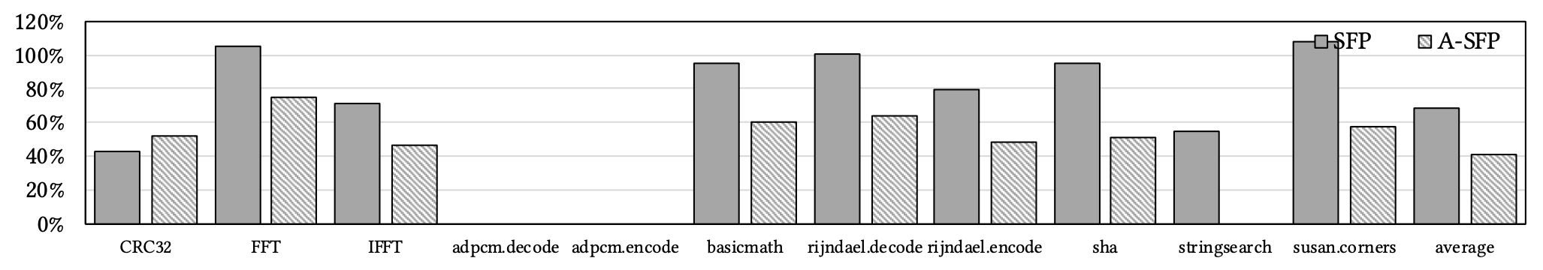
Effectiveness of Aggressive Buffer Management
Experimental Results
SFP vs. A-SFP in terms of CPU idle time reduction
SPM size is set to have two regions (most of benchmarks have 2~6 functions)
IFFT, rijndael.encode, sha and stringsearch show the largest improvements
A-SFP reduces the idle time by 58.5% (SFP: 35.6%)
CPU idle time of SFP and A-SFP, normalized to baseline
Notes:
Finally, we show the effectiveness of aggressive buffer management by comparing SFP and A-SFP.
The graph shows the CPU idle time of the two techniques, normalized to baseline.
*
SPM size is set to have two regions in this experiment.
Among the benchmarks, IFFT, rijndael.encode, sha and stringsearh showed the largest improvements.
*
Especially, A-SFP completely removes the CPU idle time in the benchmark stringsearch.
*
On average, A-SFP reduces the idle time by 58.5%, compared to the SFP which can reduce it by only 35.6%.

Slide 25
Outline
Introduction
Our Approach
Finding Load Locations
Inserting Prefetch Instructions
Experimental Results
Conclusion
Notes:
Let me conclude the talk.

Slide 26
Conclusion
In SPM-based code management, compile-time code prefetching has not been extensively studied
Hard to recover from faults, thus relies on on-demand loading
We propose an algorithm (A-SFP) to find safe and efficient prefetch locations for all function calls in a program
A-SFP can reduce CPU idle time by 58.5% on average
Results in 14.7% execution time improvement without changing the mapping algorithm

Slide 27
THANK YOU!
Notes:
Thank you for listening.

