Slide 1

WCET-Aware Stack Frame Management of Embedded Systems using Scratchpad Memories
Yooseong Kim, Mohammad Khayatian, Aviral Shrivastava
Arizona State University

Slide 2


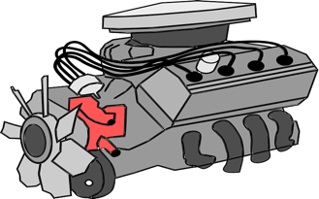
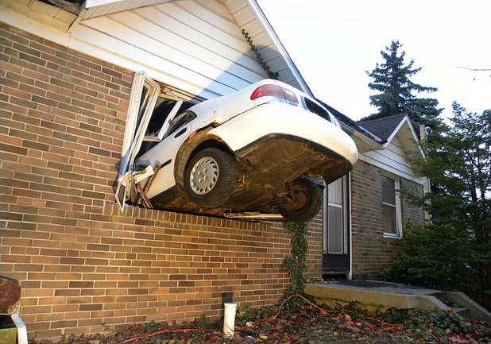
Hard Real-time Systems
Strict timing constraints
Tasks have deadlines to finish execution
Timing determines correctness, not just performance
Missing a deadline can be catastrophic!
Sensing
Deadlines!
Actuation
Image credit: JasonParis@Flickr

Slide 3
Ensuring Timing Correctness
Guarantee the absence of missed deadlines
Worst-case execution time (WCET) analysis
How?
Testing based on measurement
No Guarantee!
Static analysis
Use structural information of HW/SW
Number of occurrences
Execution Time
WCET

Slide 4
Challenges of Static Timing Analyses
WCET is Pessimistic
Microarchitectural state uncertainties
Cache, branch predictors, pipelines, …
All execution scenarios
Observed by testing
Analysis pessimism
Frequency of occurrence
Execution Times
WCET observed by testing
WCET
WCET calculated
by static analysis

Slide 5
Scratchpad Memories (SPM) : A Promising Alternative
Raw directly-addressable SRAM
Explicitly controlled by DMA (Direct Memory Access)
Provide time predictability
Determine a memory access is a hit or miss
SPM
0
1
…
DMA load A to 0
…
DMA load B to 1
…
DMA load C to 0
…
A
A
B
C
B
Can completely avoid preemption delay
τ₁
τ₁
τ₂
τ₂
τ₃
time

Slide 6
Stack Frame Management
Perform code transformation
Store frame stack in SPM before a function call
Load frame stack from SPM after a function call
Inserted code before a call
DMA_store(); // DMA stores the stack in the main memory
Sp_reset(); // reset the stack pointer
Foo(); // call a function
DMA_load(); // DMA loads the stack from the main memory
Sp_restore(); // restore the stack pointer
Inserted code after a call

Slide 7
Virtual Stack in Main Memory
Moving stack frames needs previous execution history
Previously evicted stack frames
Main Memory
CPU
SPM
Stack
Evict/Restore stack frames by DMA

Slide 8
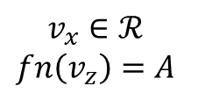

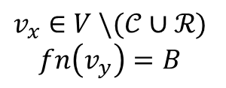

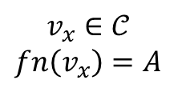


Problem Formulation from CFG
Use inline Control Flow Graph (CFG) presentation
$V$ is set of all basic blocks ($v_{x},v_{y},v_{z}∈V$)
$𝒞$ and $ℛ$ are set of basic blocks containing Call and Return
A()
{
…
B();
…
}
B()
{
…
return;
}
$$v_{x}$$
…
B();
$$v_{x}∈𝒞$$
$$fn\left(v_{x}\right)=A$$
$$v_{y}$$
$$v_{x}∈V \backslash (𝒞∪ℛ)$$
$$fn\left(v_{y}\right)=B$$
…
return …;
$$v_{z}$$
$$v_{x}∈ℛ$$
$$fn\left(v_{z}\right)=A$$
…
(a)
(b)

Slide 9

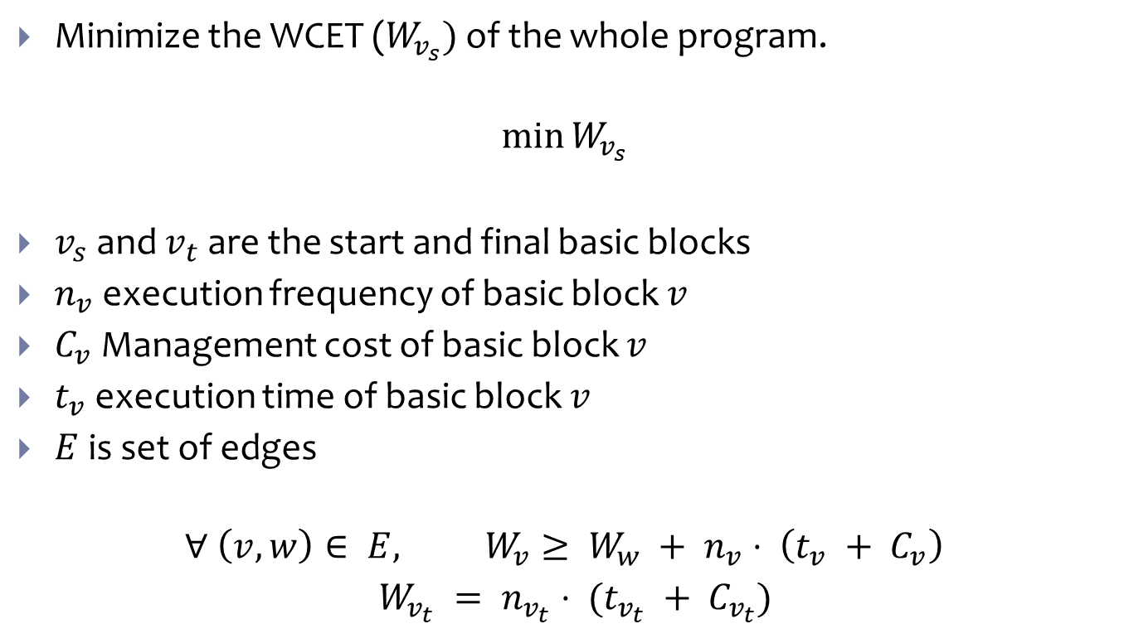



Formulate as a Minimization Problem
Minimize the WCET ($W_{v_{s}})$ of the whole program.
$$\min{W_{v_{s}}}$$
$v_{s}$ and $v_{t}$ are the start and final basic blocks
$n_{v}$ execution frequency of basic block $v$
$C_{v}$ Management cost of basic block $v$
$t_{v}$ execution time of basic block $v$
$E$is set of edges
$$∀ \left(v,w\right)∈ E, W_{v}≥ W_{w} + n_{v}⋅ \left(t_{v} + C_{v}\right)$$
$W_{v_{t}} = n_{v_{t}}⋅ (t_{v_{t}} + C_{v_{t}})$
$$v$$
$$W_{v}$$
$$w$$
$$W_{w}$$

Slide 10
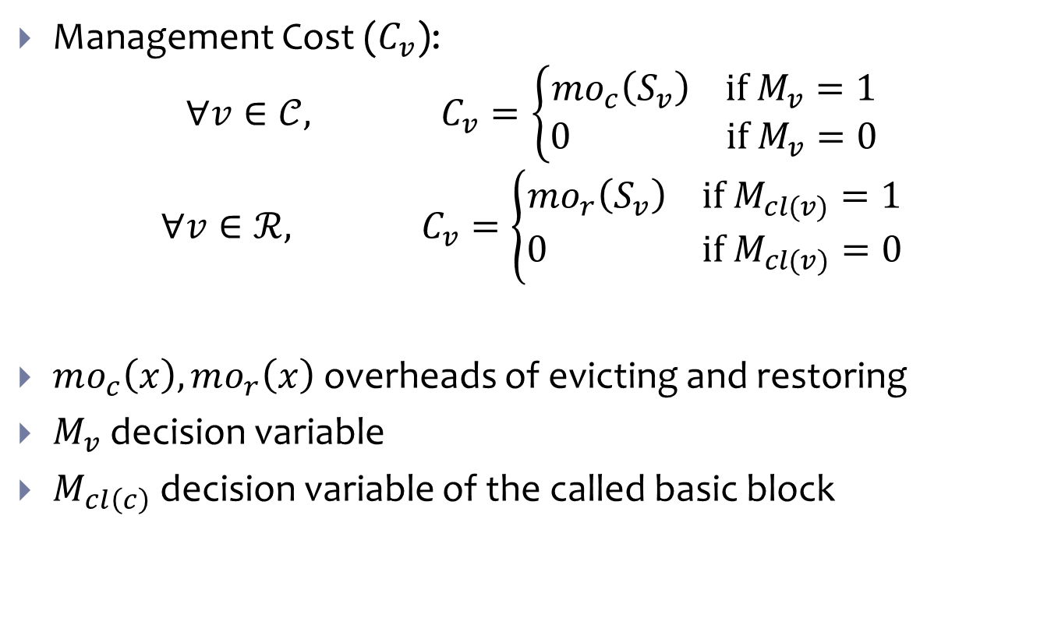
Decision Variable
Management Cost ($C_{v}$):
$$∀v∈𝒞, C_{v}=\left\{\begin{matrix}mo_{c}\left(S_{v}\right) if M_{v}=1 \\ 0 if M_{v}=0\end{matrix}\right.$$
$$∀v∈ℛ, C_{v}=\left\{\begin{matrix}mo_{r}\left(S_{v}\right) if M_{cl(v)}=1 \\ 0 if M_{cl(v)}=0\end{matrix}\right.$$
$mo_{c}\left(x\right), mo_{r}\left(x\right)$ overheads of evicting and restoring
$M_{v}$ decision variable
$M_{cl\left(c\right)}$ decision variable of the called basic block

Slide 11
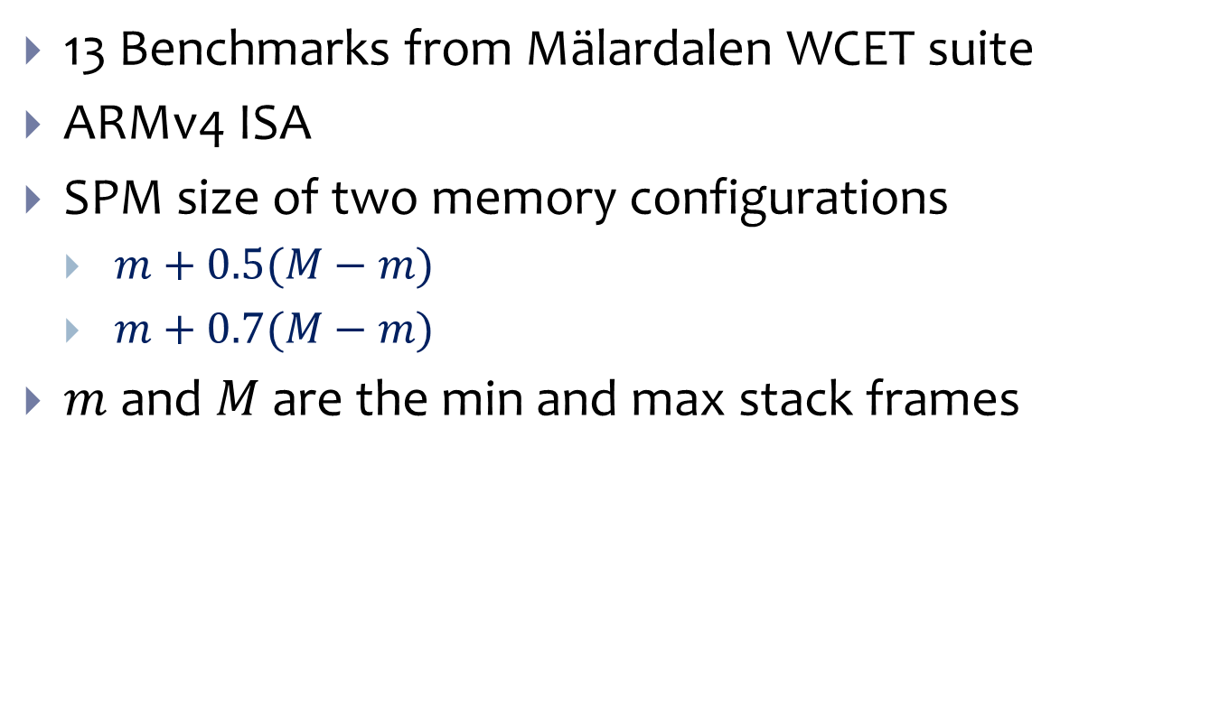
Testbed
13 Benchmarks from Mälardalen WCET suite
ARMv4 ISA
SPM size of two memory configurations
$m+0.5(M−m)$
$m+0.7(M−m)$
$m$ and $M$ are the min and max stack frames

Slide 12
WCET and Memory Overhead

Slide 13
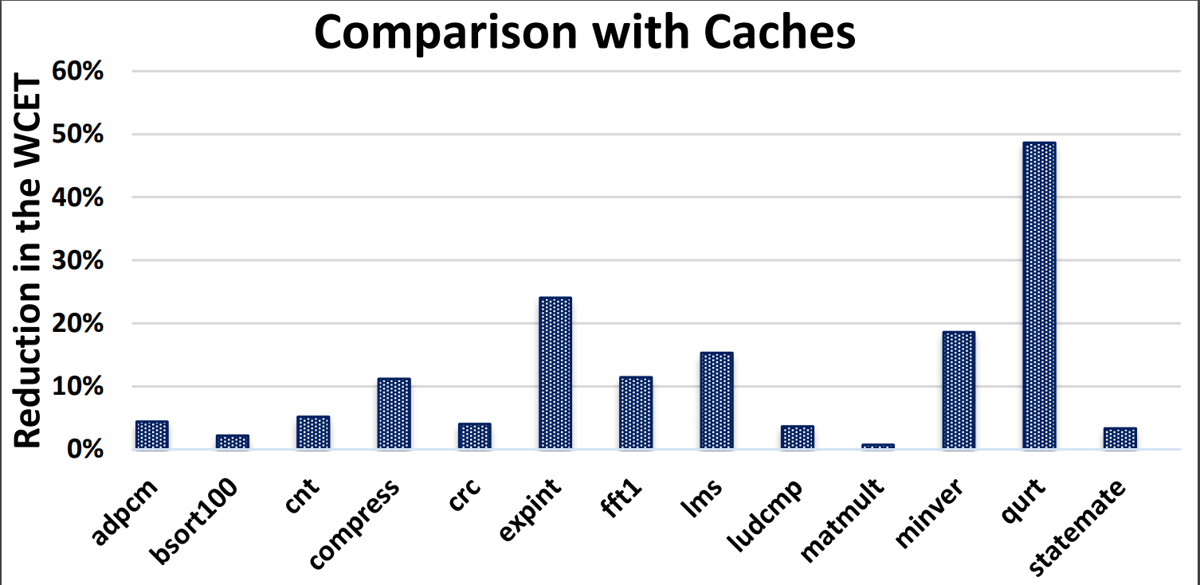
Comparing with Caches

Slide 14
Conclusion
We Proposed a technique to find optimal locations to perform stack management operations in order to minimize the WCET of a given program.
We allocate the whole Stack in SPM which simplifies the WCET analysis.
Up to 48% reduction in WCET is achieved.

