Slide 1



Guidelines to Design Parity Protected Write-back L1 Data Cache
Yohan Ko
June 9, 2015
M
C
L

Slide 2
Contents
Motivation
Related Work
Cache Vulnerability Estimation
Experiments
Conclusions

Slide 3
Contents
Motivation
What is Soft Error?
Why Cache?
Related Work
Cache Vulnerability Estimation
Experiments
Conclusions

Slide 4
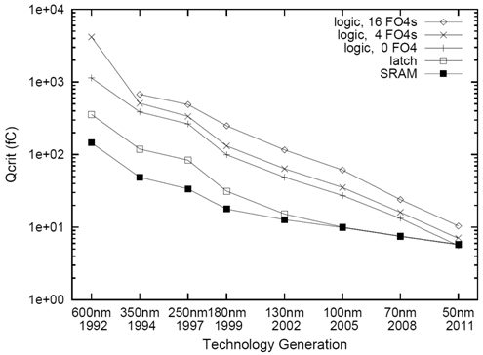
What is Soft Error?
Temporary bit flip in a semiconductor device
Q_{critical}
SER
∝
N_{flux}
x
CS
x
exp
{-
}
Q_{s}
where
Q_{critical}
=
Capacitance
x
Voltage
source
+
drain
1
+
0
-
+
Soft error rate
Is now 1 per year
Exponentially increases with technology scaling
+
-
-
-
Transistor
Soft errors are becoming a critical design concern
D. Shivakumar et al. “Modeling the effect of technology trends on the soft error rate of combinational logic” 2002 DSN

Slide 5
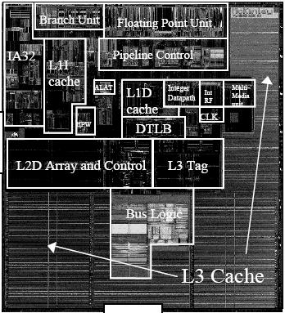
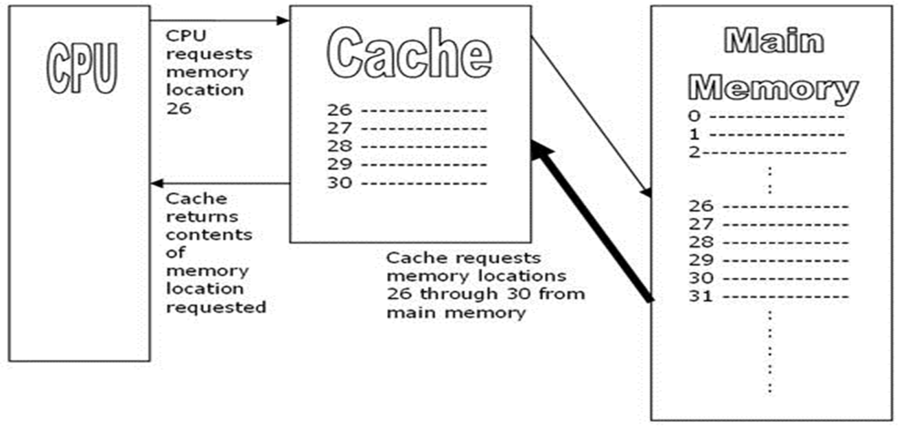
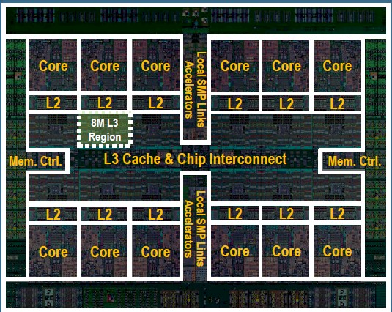
Why Cache?
Intel Itanium
Soft error rate in cache?
High due to large area
Soft error in cache?
Easily propagate to CPU & lower-level memory
IBM POWER8

Slide 6
Contents
Motivation
Related Work
What is CVF?
Cache Protection Techniques
Cache Vulnerability Estimation
Experiments
Conclusions

Slide 7
What is CVF?

Slide 8
Cache Protection Techniques

Slide 9
Contents
Motivation
Related Work
Cache Vulnerability Estimation
CVF Estimation with Parity Protection
Validation through Fault Injection
Experiments
Conclusions

Slide 10
CVF Estimation with Parity Protection

Slide 11
Validation through Fault Injection

Slide 12
Contents
Motivation
Related Work
Cache Vulnerability Estimation
Experiments
Experimental Setup
When Should Parity be Checked?
Granularity
Conclusions

Slide 13
Experimental Setup

Slide 14
When Should Parity be Checked?

Slide 15
Granularity

Slide 16
Contents
Motivation
Related Work
Cache Vulnerability Estimation
Experiments
Conclusions
Conclusion
Future Work

Slide 17
Conclusion & Future Works

Slide 18
Presentation kit
Introduction
Electronic projection
Assistance
Submission
Form considerations
General remarks
Choice of templates
Colors
Tips
Examples

Slide 19
Introduction
For more tips on how best to present your paper, carefully read the "guidelines on slide preparation and presentation" on this web site.
Your written paper is available to your audience prior to your presentation. It presents your contribution in detail, including a lengthy introduction to the subject, a description of your work with proofs and detailed results, and a list of references. Many of those in the audience will have already read or glanced through your paper.
Your presentation to the audience should be less formal and less analytical and you must make every word count!

Slide 20
Electronic projection
DAC will only support one means of visual aid this year consisting of the use of a video projector connected to a desktop computer with PowerPoint and Adobe Acrobat Reader.
"PDF"-files can be shown in those cases where the use of MS PowerPoint proves to be impossible. They are static presentations however (no animation), and we advise against it.
PowerPoint recommended for the following reasons:
By far the most popular program
Good animation capabilities
Widely available and well equipped to convert between various formats

Slide 21
Submission
Information about how and when to make your files available can be found in the "guidelines on slide presentation and preparation" Read this information carefully!
Notes:
3

Slide 22
Form considerations
General remarks
Because presentation quality is the area which has received the most criticism from attendees, we decided to pay extra attention to it and provide you with professionally prepared templates

Slide 23
Form considerations
Choice of templates
Proven to be well suited for technical presentations
Provide more than usual space to accommodate the often different needs of a technical presentation versus a business presentation

Slide 24
Form considerations
Colors
Try to use only the 8 colors of the color scheme. They are the only ones that convert for black and white printing
The distinction between blues and reds for text and thin lines is especially weak
Red filled-in objects (circles, rectangles, etc.) with white text are well-suited for highlighting important text
Be aware that the contrast of your computer monitor is much higher than that of a projector in a partly lit room

Slide 25
Form considerations
Tips
Use the MS equation editor or MathType
Define style and size the first time
Use “recolor” to change from black to white
Copy existing equation to make another one with the same specification
Only use clipart when it helps state your point
Use at least 2 pt line width in drawing
Stick with one transition effect throughout the presentation

Slide 26
Examples
Animated examples show that animation is a great tool to clarify a concept or an algorithm
Flow controls (mouseclick or PgDn) should be added in the animations according to the pauses you need to explain a point
Most examples are made in Powerpoint95 except for "Binate covering problem" where each step is a different slide as required to achieve animation in version 4
Notes:
3

Slide 27
Maze run example
13
12
11
10
9
8
9
10
11
12
13
13
12
11
10
9
8
7
8
9
10
11
12
13
13
12
11
10
9
8
7
6
7
8
9
10
11
12
13
13
12
11
10
9
8
7
6
5
6
7
8
9
10
11
12
13
T
12
11
10
9
8
7
6
5
6
7
8
9
10
11
12
13
8
7
6
5
4
7
8
9
10
11
12
13
13
7
6
5
4
3
8
9
10
11
12
13
13
12
11
10
9
8
7
6
5
4
3
2
9
10
11
12
13
13
12
11
10
9
8
7
6
5
4
3
2
1
8
9
10
11
12
13
13
12
10
9
8
7
6
5
3
2
1
S
7
8
9
11
4
10
11
12
13
13
12
11
10
9
8
7
6
5
4
3
2
1
6
7
8
9
10
11
12
13
13
12
11
10
9
8
3
2
5
6
7
8
9
10
11
12
13
13
12
11
10
9
4
3
4
5
6
7
8
9
10
11
12
13
13
12
11
10
5
4
5
6
7
8
9
10
11
12
13
13
12
11
6
5
6
7
8
9
10
11
12
13
13
12
11
10
9
8
7
6
7
8
9
10
11
12
13
13
12
11
10
9
8
7
8
9
10
11
12
13
13
12
11
10
9
8
9
10
11
12
13

Slide 28
Line search example
sink
source

Slide 29
Bottom-up clustering
Clustering groups of modules and clustering groups generates a partitioning tree bottom-up
Floorplanning can be seen as a labeling of the nodes in the partitioning tree with patterns
What patterns to choose?

Slide 30
The left edge algorithm
track 4
track 3
track 2
track 1

Slide 31
Binate covering problem
f =
(y₁ + y₂ + y₄)
(y₁ + y₂ + y₄)
(y₂ + y₃ + y₄)
(y₂ + y₃ + y₄)
Cost(y_{k} = 0) = 0
Cost(y_{k} = 1) = 1

Slide 32
Binate covering problem
y₁
y₂
y₃
y₄
f = y₂y₃ + (y₁ y₄)
y₁ + y₃ + y₄
1
1
1
Cost(y_{k} = 0) = 0
y₁ + y₂ + y₄
Cost(y_{k} = 1) = 1
y₂ + y₃ + y₄
y₂ + y₃ + y₄

Slide 33
Binate covering problem
y₁
y₂
y₃
y₄
f = y₂y₃ + (y₁ y₄)
y₁ + y₃ + y₄
1
1
1
Cost(y_{k} = 0) = 0
y₁ + y₂ + y₄
0
1
0
Cost(y_{k} = 1) = 1
y₂ + y₃ + y₄
y₂ + y₃ + y₄

Slide 34
Binate covering problem
y₁
y₂
y₃
y₄
f = y₂y₃ + (y₁ y₄)
y₁ + y₃ + y₄
1
1
1
Cost(y_{k} = 0) = 0
y₁ + y₂ + y₄
0
1
0
Cost(y_{k} = 1) = 1
y₂ + y₃ + y₄
1
0
1
y₂ + y₃ + y₄
0
1
0

Slide 35
Binate covering problem
y₁
y₂
y₃
y₄
f = y₂y₃ + (y₁ y₄)
y₁ + y₃ + y₄
1
1
1
Cost(y_{k} = 0) = 0
y₁ + y₂ + y₄
0
1
0
Cost(y_{k} = 1) = 1
y₂ + y₃ + y₄
1
0
1
y₂ + y₃ + y₄
0
1
0
Minimum solutions:
y₁ = 1, y₂ = y₃ = y₄ = 0
y₁ = y₂ = y₃ = 0, y₄ = 1

