Slide 1
Static Analysis of Processor Idle Cycle Aggregation (PICA)
Jongeun Lee, Aviral Shrivastava
Compiler Microarchitecture Lab
Department of Computer Science and Engineering
Arizona State University
http://enpub.fulton.asu.edu/CML

Slide 2

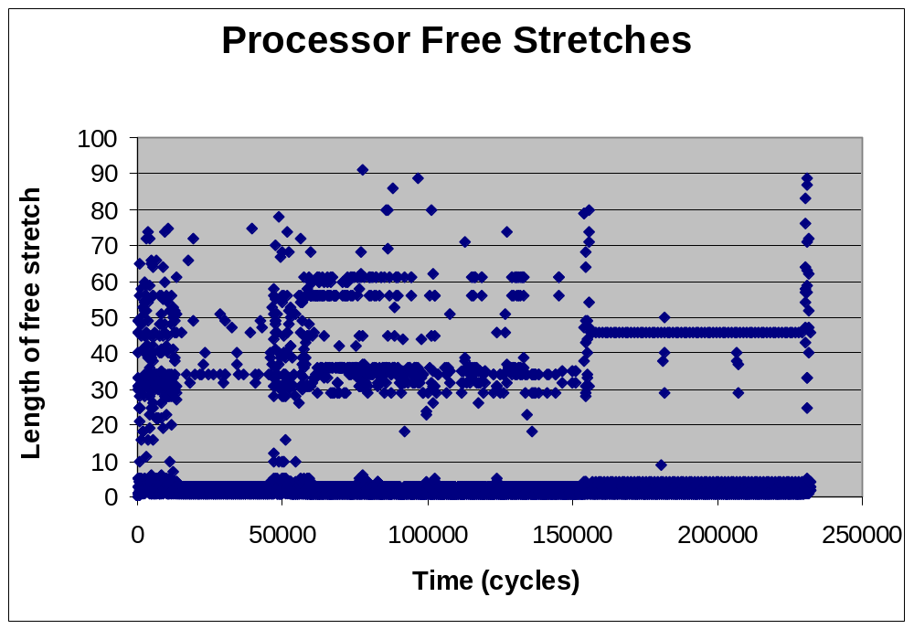
Cold Misses
Processor Stalls
Duration of each stall (cycles)
Multiple Misses
Single Miss
Pipeline Stall
Each dot denotes the time for which the Intel XScale was stalled during the execution of qsort application

Slide 3




Processor Stall Durations
Each stall is an opportunity for low power
  Temporarily switch the processor to low-power state
  Low power states
    IDLE: clock is gated
    DROWSY: clock generation is turned off
State transition overhead
  Average stall duration = 4 cycles
  Largest stall duration <100 cycles
Aggregating stall cycles
  Can achieve low power
  w/o increasing runtime
450 mW
RUN
>> 36,000 cycles
180 cycles
10 mW
0 mW
IDLE
36,000 cycles
SLEEP
1 mW
DROWSY

Slide 4
Before Aggregation
for (int i=0; i<1000; i++)
c[i] = a[i] + b[i];
1. L: mov ip, r1, lsl#2
2. ldr r2, [r4, ip] // r2 = a[i]
3. ldr r3, [r5, ip] // r3 = b[i]
4. add r1, r1, #1
5. cmp r1, r0
6. add r3, r3, r2 // r3 = r2+r3
7. str r3, [r6, ip] // c[i] = r3
8. ble L
Computation
Activity
Data Transfer
Time
Computation is dis-continuous
Data transfer is dis-continuous

Slide 5
Prefetching
for (int i=0; i<1000; i++)
c[i] = a[i] + b[i];
Each processor activity period increases
Memory activity is continuous
Total execution time reduces
Computation
Activity
Data Transfer
Time
Computation is dis-continuous
Data transfer is continuous

Slide 6
Aggregation
for (int i=0; i<1000; i++)
c[i] = a[i] + b[i];
Aggregated processor free time
Aggregated processor activity
Comp. & Data Transfer end at the same time
Computation
Activity
Data Transfer
Time
Computation is continuous
Data transfer is continuous
Activity
Computation
Data transfer
Time

Slide 7
Aggregation Requirements
Programmable Prefetch Engine
  Compiler instructs what to prefetch
  Compiler sets up when to wake it up
Processor low-power state
  Similar to IDLE mode, except that Data Cache and Prefetch Engine are active
Memory-bound loops only
Code Transformation
Request Buffer
Processor
L1 Data Cache
Prefetch
Engine
Load
Store
Unit
Request Bus
for (int i=0; i<1000; i++)
C[i] = A[i] + B[i];
Data Bus
Memory Buffer
Set up prefetch engine once,
Start it once, and
It runs thruout
// Set up the prefetch engine
setPrefetchArray A, N/k
setPrefetchArray B, N/k
setPrefetchArray C, N/k
startPrefetch
for (j=0; j<1000; j+=T)
procIdleMode w
for (i=j; i<j+T; i++)
C[i] = A[i] + B[i];
Memory
Tile the loop
Aggregation
Put processor to sleep until w lines are fetched.
Activity
Computation
Data transfer
When processor wakes up, it starts to execute
Time

Slide 8
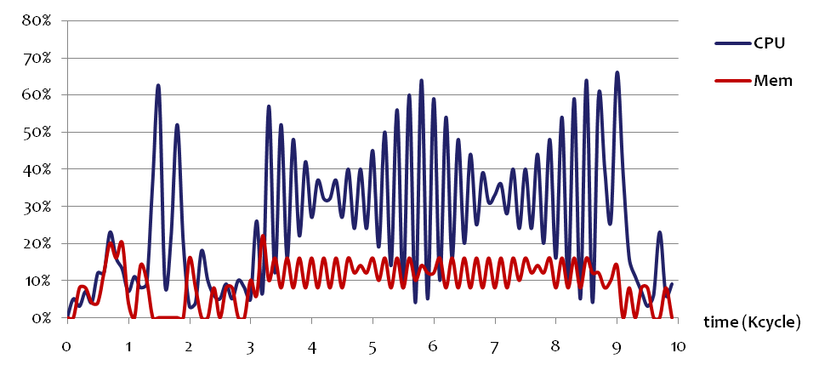
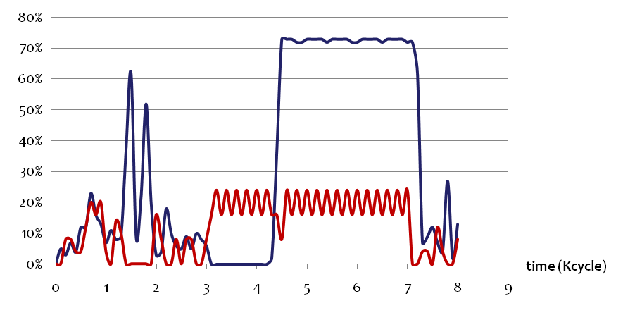
Real Example
Loop
begins
Before aggregation
for (int i=0; i<1000; i++)
S += A[i] + B[i] + C[i];
After aggregation
IDLE State
Setup_and_start_Prefetch
Put_Proc_IdleMode_for_sometime
for (int i=0; i<1000; i++)
S +=A[i] + B[i] + C[i];
Prefetch
Higher CPU & Mem Util

Slide 9
Aggregation Parameters
Key parameters
Cache status change over time
Find w
  After fetching w cache lines, wake up processor
Find T
  Tile size in terms of iterations
Cache
size
for (int i=0; i<1000; i++)
C[i] = A[i] + B[i];
# Useful Cache Lines
L
// Set the prefetch engine
setPrefetchArray A, N/k
setPrefetchArray B, N/k
setPrefetchArray C, N/k
startPrefetch
for (j=0; j<1000; j+=T)
procIdleMode w
M = min(j+T, 1000);
for (i=j; i<M; i++)
C[i] = A[i] + B[i];
Computation
L^{reuse}
Data transfer
0
T_{w}
T_{p}
time
Prefetch Only
Prefetch & Use
Parameter w
Parameter T

Slide 10
Challenges in Aggregation
Finding Optimal aggregation parameters
  w : Processor should wake up before useful lines are evicted
  T : Processor should go to sleep when there are no more useful lines
Find aggregation parameters by Compiler Analysis
  How to know when there are too many or too little useful lines in the presence of:
    Reuse: A[i] + A[i+10]
    Multiple arrays: A[i] + A[i+10] +B[i] + B[i+20]
    Different speeds: A[i] + B[2*i]
Find aggregation parameters by simulations
  Huge design space of w and T
Run-time challenge
  Memory latency is not constant and predictable
    Pure compiler solution is not good
  How to do aggregation automatically in hardware?

Slide 11

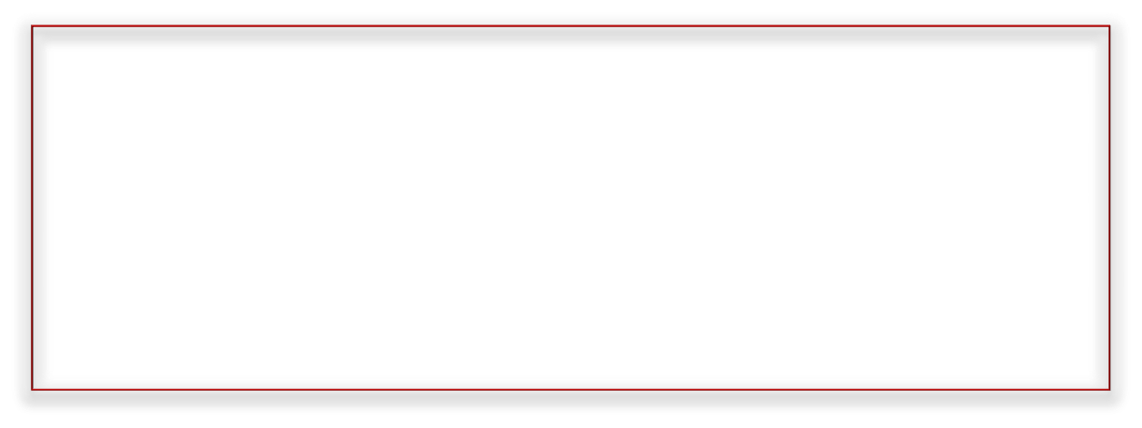
Loop Classification
Type | Multiple Arrays | Multiple Ref (Reuse) | Same Speed | Example
1 | Multi | Single | All refs | A[i], B[i], C[i]
2 | Multi | Single | None | A[i], B[2i]
3 | Single | Multi | All refs | A[i], A[i+10]
4 | Multi | Multi | All refs | A[i], A[i+10], B[i], B[i+20]
5 | Multi | Multi | All refs to same array | A[i], A[i+10], B[2i], B[2i+30]
6 | Single | Multi | None | A[i], A[2i]
7 | Multi | Multi | None | A[i], A[2i], B[i+10], B[3i+15]
Previously
Our
static
analysis
Studied loops from multimedia, DSP applications
Identified most common patterns
Covers all references with linear access functions

Slide 12
Array-Iteration Diagram
Producer
Fixed buffer
Consumer
L
Prefetch
Engine
Data Cache
Processor
Computation
Memory
Data transfer
0
T_{w}
time
T_{p}
Prefetch Only
Prefetch & Use
0
I_{w}
I_{p}
for (int i=0; i<1000; i++)
sum += A[i];
iteration
lifetime
setPrefetchArray A, N/k
startPrefetch
for (j=0; j<1000; j+=T)
procIdleMode w
M = min(j+T, 1000);
for (i=j; i<M; i++)
sum += A[i];
L
c i+k₁
Consumption
p i
array elements
Production
Unit: cache line

Slide 13
Analytical Approach
Problem: Find I_{w}
  Objective: Number of useful cache lines at I_{w} should be as close to L as possible
  Constraint: No useful lines should be evicted
0
I_{w}
I_{p}
iteration
L
c i+k₁
Consumption
array elements
p i
Production
Compute w and T from I_{w}
  Input parameter
    Speed of production: how many cache lines per iteration
    B[a i]: p = min(a/k, 1)
  Architectural parameter
    Speed ratio between C (Computation) & D (Data transfer)
    γ = D/C = W_{line}/W_{bus} ∙ r_{clk} Σ_{i} p_{i} / C > 1
    w = I_{w} Σ_{i} p_{i}
    T = I_{w} γ /(γ – 1)
k : number of words in a cache line
Assumptions on cache:
Fully associative cache, FIFO replacement policy

Slide 14

Finding I_{w}
Type 4 : Reuse in multiple arrays
Previous Tile
Prefetch Only
Prefetch & Use
for (int i=0; i<1000; i++)
s += A[i]+A[i+10]+B[i]+B[i+20];
t₂
t₁
0
I_{w}
I_{p}
iteration
d₁
k = 32/4 = 8
p_{A} = 1/8 = p_{B}
Reuse → 1 production line
t₁ = -10
t₂ = -20
At I_{w}, the cache is shared equally between A & B
Why? No preferential treatment between A & B.
I_{w} = L/Np – max_{i}(d_{i} /p)
In general,
I_{w} = L/Σ_{i} p_{i} – max_{i}(d_{i} /p_{i})
L/2
c i+k₄
Array A
p i
p i+k₃
d₂
c i+k₆
L/2
Array B
p i
array elements
p i+k₅

Slide 15
Runtime Enhancement
Processor may never wake up (deadlock) if
  Parameters are not set correctly
  Memory access time changes
Low-cost solution exists
  Guarantee there are at least w lines to prefetch
Parameter exploration
  Optimal parameter selection through exploration
setPrefetchArray A, N/k
setPrefetchArray B, N/k
setPrefetchArray C, N/k
startPrefetch
for (j=0; j<1000; j+=100 )
procIdleMode 50
M = min(j+T, 1000);
for (i=j; i<M; i++)
C[i] = A[i] + B[i];
1000
Request Buffer
Modified Prefetch Engine behavior
Processor
Data Cache
setPrefetchArray
  Add to Counter1 the number of lines to fetch
startPrefetch
  Start Counter1 (decrement it by one for every line fetched)
procIdleMode w
  Put the processor into sleep mode only if w ≤ Counter1
Prefetch
Engine
Load
Store
Unit
Added
Counter1
Request Bus
Data Bus
Memory Buffer
Memory

Slide 16

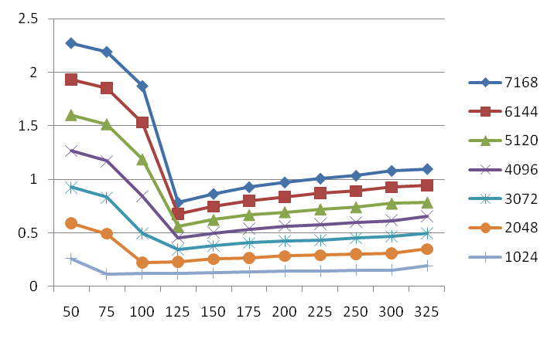
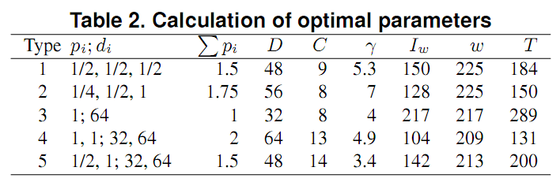
Validation
Type 4 exploration
w = 209
Varying N
Energy (mJ)
T
Matches analysis results

Slide 17
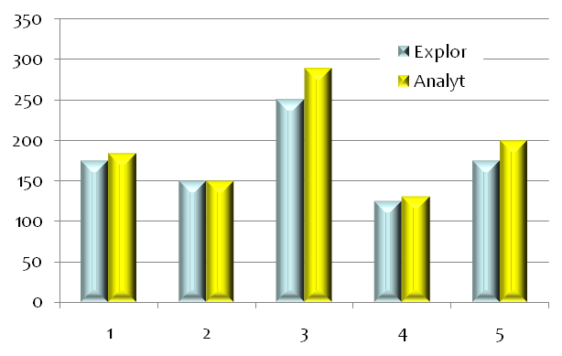
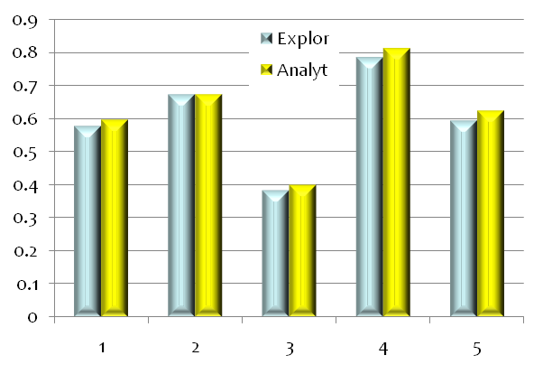
Analytical vs. Exploration
In terms of parameter T
In terms of energy
T
Energy (mJ)
Type
Type
Analytical vs. exploration optimization difference
  Within 20% in terms of parameter T
  Within 5% in terms of system energy
Analytical optimization
  Enables static analysis based Compiler approach
  Also can be used as starting point for further fine-tuning

Slide 18
Experiments
Benchmarks
  Memory-bound kernels from DSP, Multimedia, SPEC benchmarks
    All of them are indeed of type 1 ~ 5
  Excluding
    Compute-bound loops (e.g., cryptography)
    Irregular data access pattern (e.g., JPEG)
Architecture
  XScale: cycle accurate simulator with detailed bus and memory modeling
Optimization
  Analytical + exploration based fine-tuning
Benchmark | Memory-bound loops (type)
DSPStone | Matrix (2), LMS (4)
SPEC95 | Swim1 (4), Swim2 (4), Swim3 (1)
Multimedia | SNR (1), LowPass (1), GSR (3), Laplace (4), Compress (3), SOR (4), Wavelet (3)

Slide 19
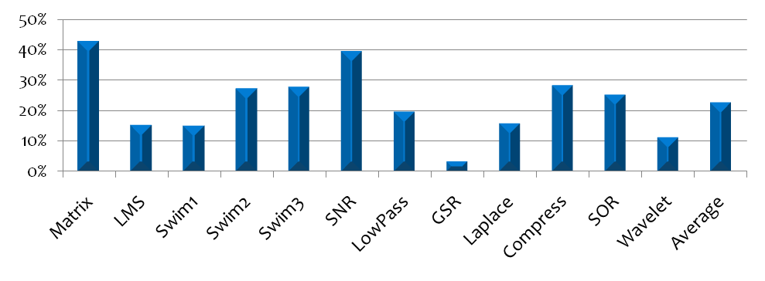
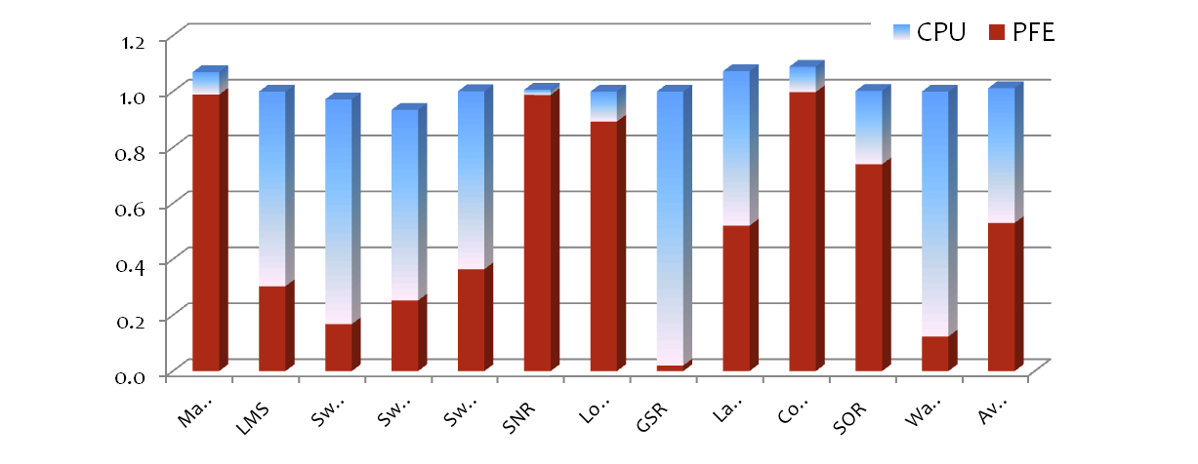
Simulation Results
Energy Reduction (Processor + Memory + Bus)
w.r.t. Energy
without PICA
Average 22%
Maximum 42%
Number of Memory Accesses
Total remains the same
Normalized to without PICA
Strong correlation with energy reduction

Slide 20
Related Work
DVFS (Dynamic Voltage Frequency Scaling)
  Exploit application slack time [1] -> OS level
  Frequent memory stalls can be detected and exploited [2]
Dynamically switching to low-power mode
  System-level Dynamic Power Management [3] -> OS level
  Microarchitecture level dynamic switching [4] -> Small part of processor
  Putting entire processor to IDLE mode is not profitable without stall aggregation
Prefetching
  Both software and hardware prefetching techniques fetch only a few cache lines at a time [5]
    [1] T. Burd, and R. Broderson, Design issues for dynamic voltage scaling, In ISLPED, pages 9-14, 2000
    [2] K. Choi et al., Fine-grained dynamic voltage and frequency scaling for precise energy and performance tradeoff based on the ratio of off-chip access to on-chip computation times, IEEE Trans. CAD, 2005.
    [3] L. Benini, A. Bogliolo, and G. D. Micheli. A survey of design techniques for system-level dynamic power management, In IEEE Transactions on VLSI Systems, 2000
    [4] M. K. Gowan, L. L. Biro, and D. B. Jackson. Power considerations in the design of the alpha 21264 microprocessor. In Design Automation Conference, pages 726–731, 1998
    [5] S. P. Vanderwiel and D. J. Lilja. Data prefetch mechanisms, in ACM Computing Surveys (CSUR), pages 174-199, 2000
Notes:
DVFS switching time: 20us
Additive

Slide 21
Conclusion
PICA
  Compiler-microarchitecture cooperative technique
  Effectively utilize processor stalls to achieve low power
Static analysis
  Covers most common types of memory-bound loops
  Small error compared to exploration-optimized results
Runtime enhancement
  Facilitates exploration-based parameter optimization
Improved energy saving
  Demonstrated average 22% reduction in system energy on memory-bound loops using XScale processor
Notes:
Static analysis + Runtime enhancement (making it robust) -> greater usability + improved energy saving

