Slide 1
Data Partitioning Techniques for Partially Protected Caches to Reduce Soft Error Induced Failures
Kyoungwoo Lee¹, Aviral Shrivastava², Nikil Dutt¹, and Nalini Venkatasubramanian¹
¹Department of Computer Science
University of California at Irvine
²Department of Computer Science
and Engineering
Arizona State University

Slide 2
Outline
Motivation and Problem Statement
Our Solution
Experiments
Conclusion
DIPES 08 #<number>

Slide 3
Motivation
Soft errors threaten the reliability of the system
  Soft errors are expected to increase by several orders of magnitude beyond sub-micron technology
    Exponential increase of soft error rate as technology scales [Hazucha, 00]
  Redundancy techniques incur high overheads of power and performance
    TMR (Triple Modular Redundancy) exceeds 200% overheads without optimization [Nieuwland, 06]
    ECC (Error Correction Codes) incurs overheads of performance by 95% [Li, 05] and power by 22% in caches [ARM, 03]
PPC (Partially Protected Caches) [Lee, 06] is promising for multimedia applications
  No obvious solutions to partition data into a PPC for general applications
DIPES 08 #<number>

Slide 4

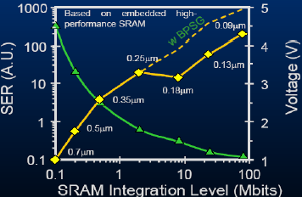

Soft Errors on an Increase
SER increases exponentially as technology scales
Integration, voltage scaling, altitude, latitude
[Baumann, 05]
Transistor
5 hours MTTF
0
1
1 month MTTF
Bit Flip
MTTF: Mean time To Failure
DIPES 08 #<number>

Slide 5
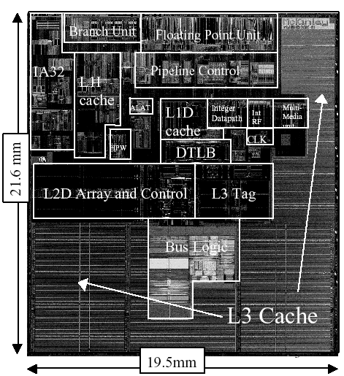
Most Vulnerable Caches
Caches are most hit due to:
  Larger portion in processors (more than 50%)
  No masking effect (e.g., no logical masking)
Intel Itanium II Processor
DIPES 08 #<number>

Slide 6
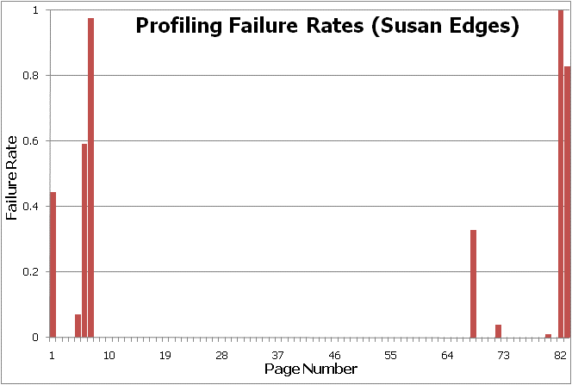
Unequal Data Protection
All pages are not equally failure critical
  (e.g.) Multimedia data is failure non-critical
  (e.g.) Program variables are failure critical
  Failures: system crash, infinite loop, segmentation faults, etc
Only 9 pages out of 83 are failure critical
DIPES 08 #<number>

Slide 7

PPC – Partially Protected Caches
PPC architectures provide an unequal protection for mobile multimedia systems [Lee, 06]
  Unprotected cache and Protected cache at the same level of memory hierarchy
  Protected cache is typically smaller to keep power and delay the same as or less than those of Unprotected cache
  Very efficient in terms of power and performance
Processor
Pipeline
PPC
Unprotected
Cache
Protected
Cache
Memory
DIPES 08 #<number>

Slide 8
Data Partitioning in a PPC
Unprotected
Cache
PPC
Protected
Cache
Multimedia Applications
  Multimedia data is failure non-critical ➔ Map multimedia data into the unprotected cache in a PPC
  All other data is failure critical ➔ Map all other data into the protected cache in a PPC
General Applications
  No obvious partitioning exists
  This limits the applicability of the PPC
Problem Statement
  Find data partitions for a PPC to minimize the overheads of power and performance with maximal reliability
Memory
DIPES 08 #<number>

Slide 9
Outline
Motivation and Problem Statement
Our Solution
  Exploitation of Vulnerability to Partition Data
  Data Partitioning Heuristics
Experiments
Conclusion
DIPES 08 #<number>

Slide 10
Our Solution
Data Partitioning Techniques – DPExplore
  Design space exploration using Vulnerability metric rather than failure rates
    Just one evaluation (vulnerability) vs. hundreds simulations (failure rate)
    Efficient explorations compared to Exhaustive Search or Genetic Algorithm
  Data partitioning for general applications
    Now PPC is effective not only for multimedia applications but also for general applications
DIPES 08 #<number>

Slide 11
Vulnerable Time
Incoming
Invulnerable
Vulnerable time
  It is vulnerable for the time when eventually data is read by CPU or written back to Memory
  Vulnerability of a Page
    Sum of vulnerable times of data in a page
    Page is of 1 KB data in our study
Eviction
Read
Write
data
t₀
t₁
t₂
t₃
Vulnerable
Vulnerable
Soft errors between t₀ and t₁
(t₂ and t₃) can cause failures of
applications – data is vulnerable
between t₀ and t₁ (t₂ and t₃)
Soft errors between t₁ and t₂
do not cause failures of
applications since data will be
updated by CPU – data is
invulnerable between t₁ and t₂
DIPES 08 #<number>

Slide 12
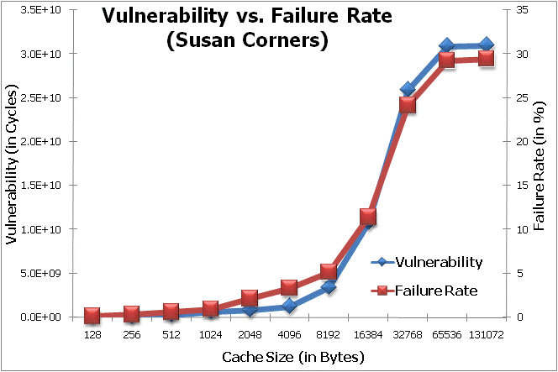
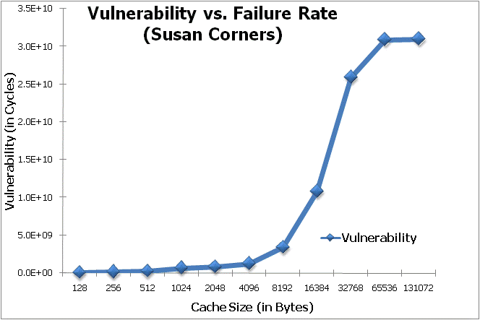
Vulnerability and Failure Rate
Vulnerable time closely estimates failure rate
DIPES 08 #<number>

Slide 13
Data Partitions using Vulnerability
Pages causing high vulnerable time are failure critical (FC)
  They are mapped into the Protected Cache in a PPC
  Others are failure non-critical (FNC) mapped into the Unprotected Cache
Processor
Processor Pipeline
PPC
Unprotected
Cache
Protected
Cache
Memory
FNC
FC
FC
Pages
FNC
Pages
DIPES 08 #<number>

Slide 14
Goal of Data Partitioning
Must be careful when partitioning pages
  Too many pages onto the (smaller) protected cache incurs many misses causing high overheads
Goal of data partitions
  discovers interesting pages to be mapped into a PPC
  finds the best partitions in terms of vulnerability under the performance constraint
Processor
Processor Pipeline
PPC
Unprotected
Cache
Protected
Cache
Memory
FNC
Pages
FC
Pages
DIPES 08 #<number>

Slide 15
DPExplore – Data Partitioning Heuristics
DPExplore
  Estimate page vulnerability
  Add a page from the pool into the protected cache
  Evaluate current page partitions
  Find a page mapping with minimal vulnerability under runtime constraint
  Repeat 2 to 4 until no more partitions can be found
PPC
Unprotected
Cache
Protected
Cache
Memory
P₁
PV₁=9
R₁ > R
P₂
PV₂=6
R₂ < R
V₂ < V
R₃ < R
P₃
PV₃=2
V₃ >V₂
PV_{n} – Page Vulnerability
V – Vulnerability of unprotected cache for page partitions
R – Runtime Constraint
R_{n} – Runtime when n^{th} page is mapped into the protected cache
P₄
PV₄=1
R₄ > R
DIPES 08 #<number>

Slide 16
Outline
Motivation and Problem Statement
Our Solution
Experiments
Conclusion
DIPES 08 #<number>

Slide 17
Experimental Setup
Runtime
Energy
Vulnerability
Application
Compiler
Executable
Platform
Page
Vulnerability
Estimator
Page
Mapping
Page
Vulnerabilities
DPExplore
Data Partitioning Framework
DIPES 08 #<number>

Slide 18
Evaluation
Data Caches
  PPC data caches – 2 KB Unprotected Cache and 256 Byte Protected Cache
  Conventional data cache – 2 KB Unprotected Unified Cache
Simulator
  SimpleScalar sim-outorder simulator [Burger, 97]
Benchmarks
  Several benchmarks from MiBench [Guthaus, 01]
Evaluation
  Runtime for performance
  Energy consumption of memory subsystem for power
  Vulnerability for reliability
DIPES 08 #<number>

Slide 19
Experimental Results
Effectiveness of DPExplore
  Find data partitions with minimal vulnerability under 5% runtime penalty
Comparison of DPExplore to Monte Carlo Exploration and Genetic Algorithm Exploration
  Number of simulations to find interesting data partitions
DIPES 08 #<number>

Slide 20
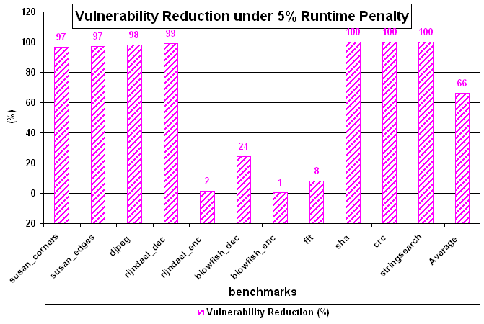
Significant Reduction of Vulnerability
On average, DPExplore finds page partitions to reduce the vulnerability by 66% compared to the unprotected cache
DIPES 08 #<number>

Slide 21
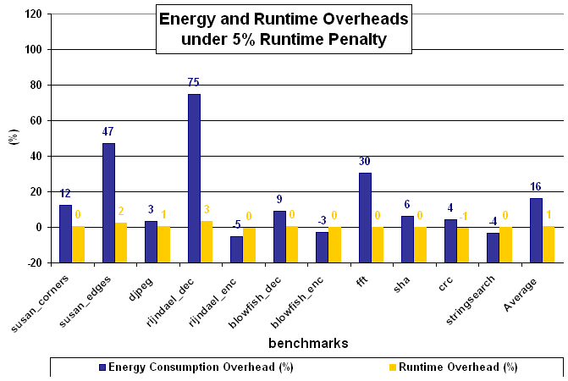
Min Overheads of Energy and Runtime
Under 5% runtime penalty, DPExplore causes less than 1% runtime and 15% energy consumption overheads
PSNR: Peak Signal to Noise Ratio
DIPES 08 #<number>

Slide 22
Experimental Results
Effectiveness of DPExplore
  Find data partitions with minimal vulnerability under 5% runtime penalty
Comparison of DPExplre to Monte Carlo Exploration and Genetic Algorithm Exploration
  Number of simulations to find interesting data partitions
DIPES 08 #<number>

Slide 23
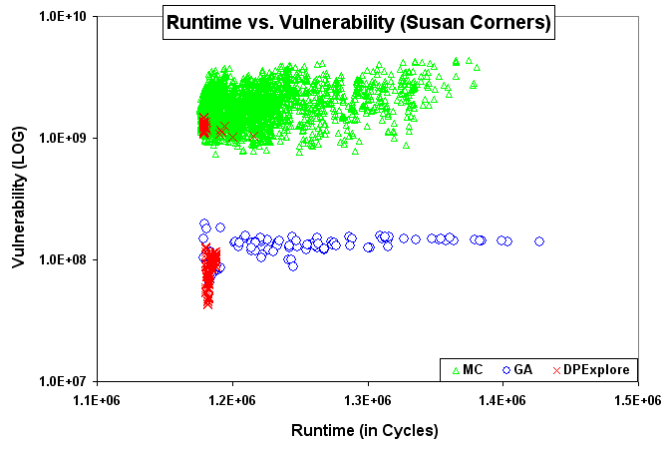
DPExplore vs. MC and GA
MC – Monte Carlo Simulation
GA – Genetic Algorithm Exploration
DPExplore is aware of runtime and vulnerability
DIPES 08 #<number>

Slide 24
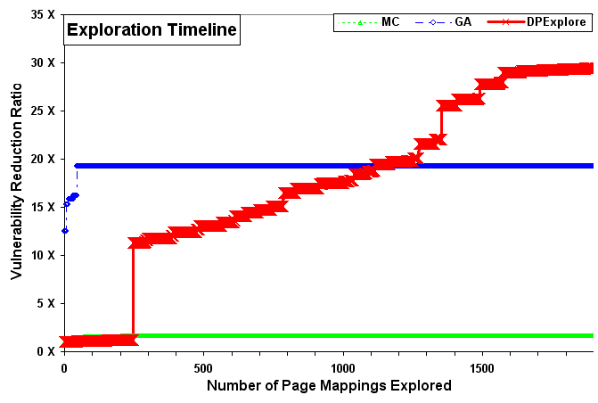
DPExplore vs. MC and GA
MC – Monte Carlo Simulation
GA – Genetic Algorithm Exploration
DPExplore is more effective to explore interesting data partitions than MC and GA
DIPES 08 #<number>

Slide 25
Outline
Motivation and Problem Statement
Our Solution
Experiments
Conclusion
DIPES 08 #<number>

Slide 26
Conclusion
PPC (Partially Protected Caches) is promising to achieve low-cost reliability using unequal data protection
Propose data partitioning heuristics (DPExplore)
  Vulnerability metric closely estimates the failure rate for reliability of caches
  DPExplore explores data partitions with minimal vulnerability under runtime constraint
  DPExplore is more effective than random explorations
Future Work
  Partitioning techniques for instruction caches
  Intelligent schemes to improve costs and vulnerability
DIPES 08 #<number>

Slide 27
Thanks!
Any Questions?
kyoungwl@ics.uci.edu
Notes:
Thank you! Any questions?

Slide 28
Backup Slides

Slide 29
Soft Errors on Increase
Increase exponentially due to technology scaling
  0.18 µm
    1,000 FIT per Mbit of SRAM
  0.13 µm
    10,000 to 100,000 FIT per Mbit of SRAM
Voltage Scaling
  Voltage scaling increases SER significantly
Q_{critical}
SER
∝
N_{flux}
x
CS
x
exp
{-
}
Q_{s}
where
Q_{critical}
=
C
x
V
DIPES 08 #<number>

Slide 30
Related Work in Combating Soft Errors
Process Technology Solutions
  Hardening: [Baze et al., IEEE Trans. On Nuclear Science ’00]
  SOI: [O. Musseau, IEEE Trans. On Nuclear Science ‘96]
  Process complexity, yield loss, and substrate cost
Microarchitectural Solutions for Caches
  Cache Scrubbing: [Mukherjee et al., PRDC ’04]
  Low Power Cache: [Li et al., ISLPED ’04]
  Area Efficient Protection: [Kim et al., DATE ’06]
  Multiple Bit Correction: [Neuberger et al., TODAES ’03]
  Cache Size Selection: [Cai et al., ASP-DAC ’06]
  High overheads in terms of power, performance, and area
PPC
  Compiler-based Microarchitectural Technique
  Provide protection from soft errors while minimizing the power, performance, and area overheads
DIPES 08 #<number>

Slide 31
ECC Protection
ECC (Error Correcting Codes) is popular technique to protect memory from soft errors
But has high overheads in terms of Area, Performance and Power
  e.g., SEC-DED
  - Hamming Code (32, 6)
    Performance by up to 95 %
      [Li et al., MTDT ’05]
    Energy by up to 22 %
      [Phelan, ARM ’03]
    Area by more than 18 %
      [Phelan, ARM ’03]
Protected Cache
Coding
Unprotected Cache
Data
ECC
Decoding
ECC protection for caches is expensive!
DIPES 08 #<number>

Slide 32
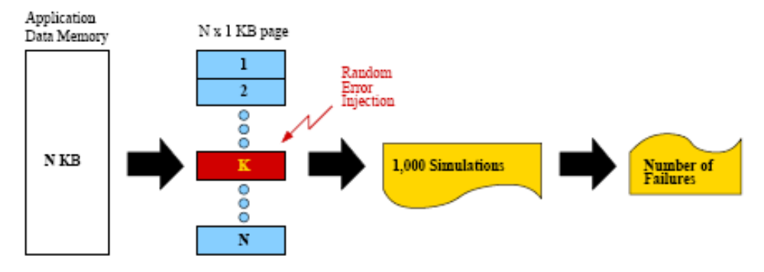
Experimental Setup for Page Failures
DIPES 08 #<number>

Slide 33
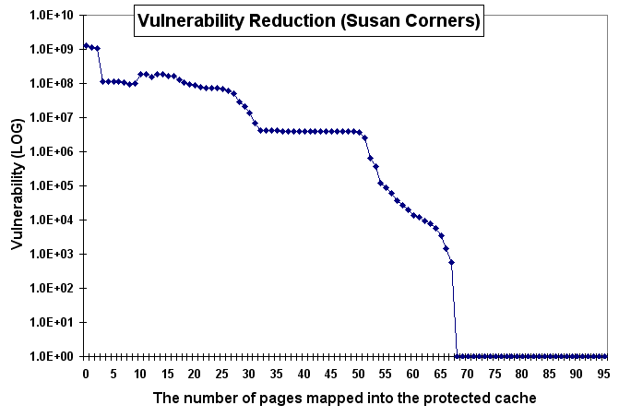
Impact of Page Partitions to a PPC
Failure rate reduction by moving pages from the unprotected cache to the protected cache in a PPC
DIPES 08 #<number>

Slide 34
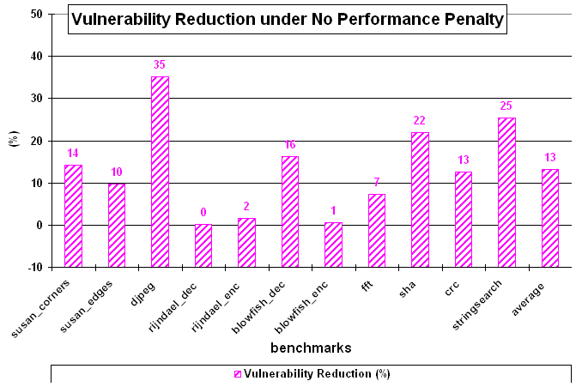
Vulnerability under No Runtime Penalty
DIPES 08 #<number>

Slide 35
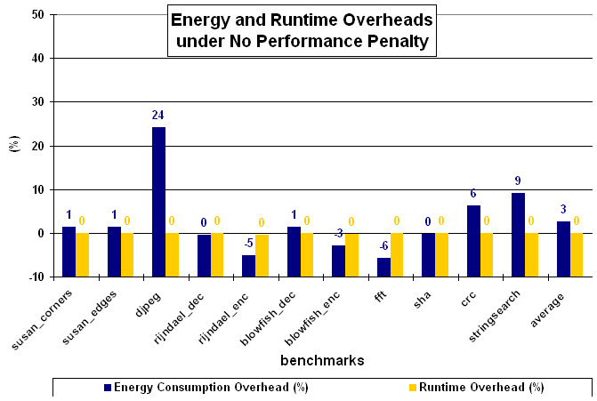
Energy and Runtime under No Penalty
DIPES 08 #<number>

