Slide 1
Mitigating the Impact of Hardware Defects on Multimedia Applications – A Cross-Layer Approach
¹Kyoungwoo Lee, ²Aviral Shrivastava, ¹Minyoung Kim, ¹Nikil Dutt, and ¹Nalini Venkatasubramanian
¹Department of Computer Science
University of California at Irvine
²Department of Computer Science and Engineering
Arizona State University
Notes:
Our problem of this study is hardware defects such as soft errors.
We’d like to reduce the negative impact of hardware defects for mobile embedded systems, especially for mobile video encoding systems.

Slide 2
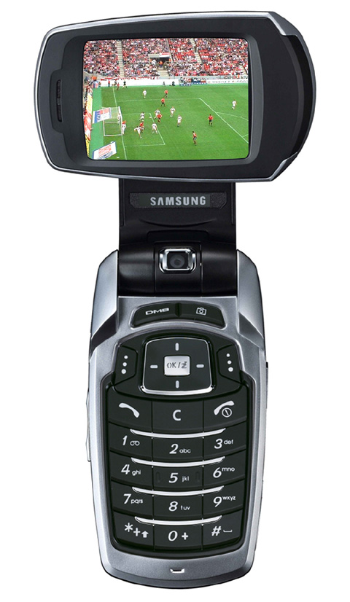
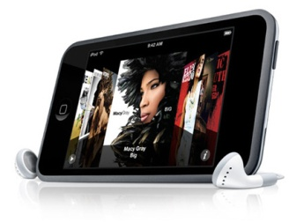

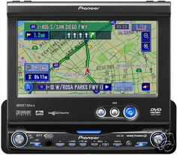


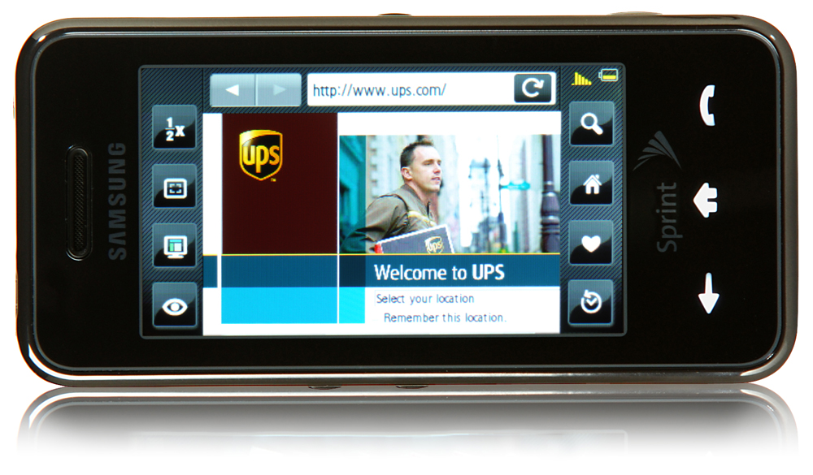
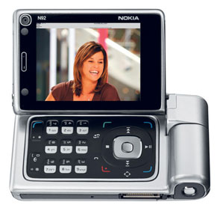


Multimedia Mobile Devices are Popular
3D Graphics
Map Routing
Image Browsing
Animation
Mobile TV
Web Browsing
Video Streaming
Satellite TV
Video Conferencing
Resource-limited mobile devices!
Main problem is to achieve low power with high performance, high QoS, and high reliability
Notes:
Mobile multimedia applications are becoming popular and popular such as 3D graphics, satellite TV, video streaming, and video conferencing.
However, the fundamental problem we are facing is to achieve low power with minimal cost, since they are running on battery-limited mobile devices.

Slide 3
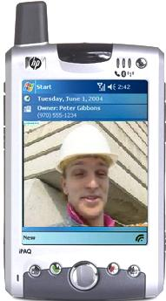

Mobile Multimedia System
network
Mobile Video Conferencing
Raw
video data
Bug
Compressed
video data
Packet
Loss
Application
(e.g., Video Encoding)
Wireless Network
Exception
Low cost
reliability
Operating System
Soft Error
Hardware
Mobile Video Encoding
Notes:
Several types of errors exist across system layers.
The thing is to achieve reliability with minimal costs.

Slide 4
Temporary Hardware Faults
Application
Middleware/ Operating System
Temporary hardware faults such as transient faults (=soft errors) or intermittent faults cause failures
  System crash, infinite loops, segmentation faults, etc.
Soft Error
Hardware
Causes of transient faults or soft errors
  Environmental causes – Natural or man-made external radiation such as alpha particle, proton, and neutron
  Technology factors – Technology scaling, increase of transistor densities, lower operating voltages, etc.
  Marginal design parameters – Timing problems due to races, hazards, and skew
  Signal integrity problems – Crosstalk, ground bounce, etc.
Notes:
Temporary hardware faults, especially soft errors (transient faults), can result from several causes.

Slide 5
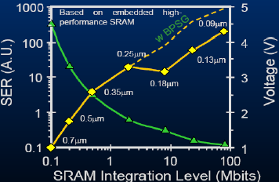


Soft Errors on an Increase
Application
Soft error rate (SER) increases exponentially as technology scales
Integration, voltage scaling, altitude, latitude, etc.
Middleware/ Operating System
Soft Error
Hardware
[Baumann, 05]
Transistor
0
5 hours MTTF
1
Soft Error
= Transient Fault
= Bit Flip (memory)
1 month MTTF
Q_{critical}
SER
∝
N_{flux}
x
CS
x
exp
{-
}
Q_{s}
where
Q_{critical}
=
Capacitance
Voltage
MTTF: Mean Time To Failure
x
N_{flux}: Neutron flux intensity, CS: Area of cross section, Q_{S}: Charge collection efficiency
Notes:
Soft error rate is increasing, and is very sensitive where we’re running applications.
Thus, soft error is becoming critical due to technology scaling and emerging ubiquitous computing environments.

Slide 6
Soft Error is an Every Second Concern
Soft Error Rate (SER)
  FIT (Failures in Time) – How many errors in one billion operation hours
    SER per Mbit @ 0.13 µm = 1,000 FIT ≈ 104 years in MTTF
Soft error is becoming an every second problem
 | SER (FIT) | MTTF | Reason
1 Mbit @ 0.13 µm | 1000 | 104 years
64 MB @ 0.13 µm | 64x8x1000 | 81 days | High Integration
128 MB @ 65 nm | 2x1000x64x8x1000 | 1 hour | Technology scaling and Twice Integration
A system @ 65 nm | 2x2x1000x64x8x1000 | 30 minutes | Memory takes up 50% of soft errors in a system
A system with voltage scaling @ 65 nm | 100x2x2x1000x64x8x1000 | 18 seconds | Exponential relationship b/w SER & Supply Voltage
A system with voltage scaling @ flight (35,000 ft) @ 65 nm | 800x100x2x2x1000x64x8x1000 FIT | 0.02 seconds | High Intensity of Neutron Flux at flight (high altitude)

Slide 7

Caches and Video Encoding
Soft error rate is proportional to the time and area to be exposed [Cai, 06]
  Soft error rate (SER) is measured in FIT (Failures in Time) per unit size
  SER = 1,000 FIT per Mbit for SRAM
    The larger memory system, the higher SER
    The longer the execution, the higher SER
Application
Middleware/ Operating System
Hardware
Caches are most hit due to:
  Larger portion in processors (more than 50%)
Video encoding consists of complex algorithms
  Also, processes the huge amount of video data
Motion
Estimation
Discrete
Cosine
Transform
Quantization
Scale
Variable
Length
Encoding
Video encodings are time-intensive and memory-intensive, thus very vulnerable to soft errors
H.263 Video Encoding
Y. Cai, et al., “Cache size selection for performance, energy and reliability of time-constrained systems”, ASP-DAC, 2006.
Notes:
Video encoding on mobile devices are very vulnerable to soft errors, since soft error rate is proportional to the time and area to be exposed, and mobile video encodings are time- and memory-intensive.

Slide 8
Soft Error Protection Within-HW
Application
ECC (Error Correction Codes)
  Forward Error Recovery (FER)
  ECC incurs high overheads in terms of:
    power (22% [Phelan,03]), performance (95% [Li,05]), and area (25% [Kreuger,08])
Conventional micro-architectural techniques within hardware layer still exploit ECC
EDC (Error Detection Codes)
  EDC is much less expensive than ECC in terms of power, performance, and area
    up to 73% less in power and 47% less in performance than ECC [Li, 04]
  Need to correct the detected error ➔Checkpoints and Roll backward (BER – Backward Error Recovery)
    Bad for real-time requirement
Middleware/ Operating System
Hardware
BER
FER
time
Checkpoint K
K+1
Error
Detection
Notes:
ECC is the most effective method while it incurs high overheads.
On the contrary, EDC is much less expensive but it is not good for real-time applications such as video encodings since it doesn’t guarantee the completion time of the task.

Slide 9
Within-Layer Approach
Cross-Layer Approach?
Application
Packet
Loss
(e.g., Error Resilient
Video Encoding)
Middleware/ Operating System
Hardware
Soft Error
(e.g., HW-Based
Protection)
Cross-layer approach
  Integrate and coordinate techniques across system layers in a cooperative manner for system optimization
Can we coordinate within-layer approaches across layers to combat errors for minimal cost reliability?
Notes:
Previously, cross-layer approaches have shown the effectiveness for QoS and Energy tradeoffs.
However, they didn’t talk about reliability issues much across system layers.
This work mainly contributes to low cost reliability in a cross-layered manner.

Slide 10
Related Cross-Layer Work
GRACE project @ UIUC [W. Yuan Ph.D. thesis in ’04 and A. F. Harris III, Ph.D. thesis in ’06]
  QoS/Power tradeoffs
    Primarily OS adaptation for power management in multimedia mobile devices
    Network adaptation for power management in multimedia communications
DYNAMO middleware for FORGE project @ UCI [S. Mohapatra Ph.D. thesis in ’05 and R. Cornea Ph.D. thesis in ’07]
  QoS/Power tradeoffs for mobile embedded systems
  Middleware-driven coordination and proxy-based cooperation
    Content transcoding at the application layer
    Network traffic shaping at the network layer
    Backlight (LCD display) setting at the hardware layer
    NIC shutdown, CPU DVS/DFS at the hardware layer
xTune framework @ UCI and SRI [M. Kim Ph.D. thesis in ’08]
  QoS/Power/Timeliness adaptation for distributed real-time embedded systems
  A Formal Methodology for cross-layer tuning and verifiable timeliness of Mobile Embedded Systems
Our Contribution
  QoS/Power/Reliability system optimization for mobile multimedia embedded systems
  Use cross-layer approach to provide reliability with minimal cost
Notes:
GRACE project presented several adaptation techniques for mobile multimedia applications.
DYNAMO from FORGE project is a proxy-based middleware approach for QoS/Energy tradeoffs for mobile multimedia applications.

Slide 11
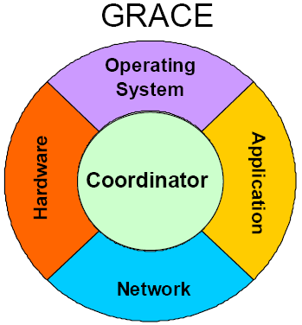
Related Cross-Layer Work -- GRACE
GRACE project @ UIUC
  Primarily OS adaptation for power management in multimedia mobile devices
  Network adaptation for power management in multimedia communications
[GRACE, 05]
W. Yuan and K. Nahrstedt, “Practical voltage scaling for mobile multimedia devices”, ACM international conference on Multimedia, 2004.
D. G. Sachs, et al., “GRACE: A cross-layer adaptation framework for saving energy”, IEEE Computer, special issue on Power-Aware Computing, Dec 2003
Notes:
GRACE project presented several adaptation techniques for mobile multimedia applications.

Slide 12
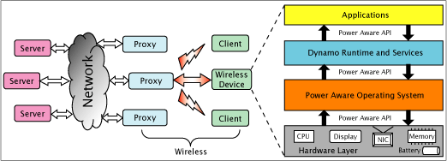
Related Cross-Layer Work -- Dynamo
DYNAMO – Proxy-based middleware-driven cross-layer approach for QoS/Energy Tradeoffs
  Content transcoding at application layer
  Network traffic shaping at network layer
  Backlight (LCD display) setting at hardware layer
  NIC shutdown, CPU DVS/DFS at hardware layer
Middleware Coordination
Shivajit Mohapatra, "DYNAMO: Power aware middleware for distributed mobile computing", Ph.D. Thesis, University of California, Irvine, 2005
Radu Cornea, “Content annotation for power and quality trade-offs in mobile multimedia systems”, Ph.D. Thesis, University of California, Irvine, 2007
Shivajit Mohapatra, et al., "DYNAMO: A cross-layer framework for end-to-end QoS and energy optimization in mobile handheld devices", IEEE JSAC, May 2007
Radu Cornea, et al., “Software annotations for power optimization on mobile devices”, DATE, 2006
Shivajit Mohapatra, et al., "Integrated power management for video streaming to mobile handheld devices", ACM Multimedia, Nov2003
Notes:
DYNAMO from FORGE project is a proxy-based middleware approach for QoS/Energy tradeoffs for mobile multimedia applications.

Slide 13


Related Cross-Layer Work -- xTune
xTune – A Formal Methodology for Cross-layer Tuning of Mobile Embedded Systems
Server
Handheld
  Informed selection from formal model and analysis
  Enhanced by integrating it with observations of system
  ➔Adaptive reasoning and proactive control
Minyoung Kim, " xTune: A formal methodology for cross-layer tuning of mobile real-time embedded systems", Ph.D. Thesis, University of California, Irvine, 2005
Minyoung Kim, et al., “xTune: A formal methodology for cross-layer tuning of mobile embedded systems”, ACM SIGBED Review, Jan2008
Minyoung Kim, et al., PBPAIR: An energy-efficient error-resilient encoding using probability based power aware intra refresh”, ACM SIGMOBILE MCCR, 2006
Notes:
xTune proposed a formal method to adaptively tune the system parameters of mobile embedded systems while formal execution and system realization are running at the proxy server.
Mainly, xTune framework focuses on timing issue with energy consumption in a cross-layer manner.

Slide 14
Outline
Motivation and Related Work
Problem Statement
Our Solution
  CC-PROTECT – Cooperative Cross-Layer Protection
  Mitigate the impact of soft errors with minimal cost
Experiments
Conclusion

Slide 15
Problem Statement and Our Goals
Soft Errors on Caches for Video Encoding
  Soft errors are transient faults at hardware layer
  SER is becoming a critical concern as technology scales
  Caches are most hit
  Video encoding is time-intensive and memory-intensive
Impact of Soft Errors
  Failures
  Quality Degradation
Problem
  Develop Cross-Layer approach to mitigate the impact of soft errors
    Reducing the failure rate
    Minimizing the quality loss
  Minimize the cost (power and performance)
Application
(e.g., video encoding)
Middleware /
Operating System
Error-Prone Hardware
(e.g., error-prone cache)
Soft Error
Mobile Video Encoding
Notes:
Recap about soft errors
Soft errors at the hardware layer affects mobile video encoding system with two aspects, 1. failures and 2. video quality.
We need develop a cost-efficient approach to reduce the impact of soft errors on these two aspects.

Slide 16
CC-PROTECT Overview
Application
PBPAIR -
Error Resilience
CC-PROTECT -
Cooperative
Cross-layer
Protection
Middleware/ Operating System
DFR -
Error Correction
ECC
Hardware
EDC
Soft Error
Unprotected
Cache
Protected
Cache
Previously,
Hardware-based
Error Protection
(ECC, etc.)
ECC: Error Correction Codes
EDC: Error Detection Codes
DFR: Drop and Forward Recovery
PBPAIR: Probability-Based Power Aware Intra Refresh
Notes:
Our CC-PROTECT exploits existing energy-efficient schemes at each system abstraction layer, and minimizes the cost at the system level while satisfying the reliability and the video quality.

Slide 17
Failure Mitigation
Goal 1 – Reduce soft error induced failures
Notes:
Our first goal is to reduce failure rates due to soft errors.

Slide 18
Partial Cross-Layer Protection -- PPC
Processor
PPC (Partially Protected Caches) [Lee, 06]:
  One protected cache
    ECC, etc.
    Typically smaller
  The other unprotected cache
Compiler
  Maps failure-critical (FC) data into the protected cache
  Maps failure-non-critical (FNC) data into the unprotected cache
Still incurs overheads due to high expensive ECC protection
  29% energy reduction compared to the protected cache
  10% energy overhead compared to the unprotected cache
Processor Pipeline
PPC
Unprotected
Cache
Protected
Cache
Memory
FNC
FC
FC
Pages
FNC
Pages
K. Lee, et al., “Mitigating soft error failures for multimedia applications by selective data protection”, CASES, Oct 2006.
Notes:
One of promising technique is PPC, which is in part a cross-layer approach, since it exploits the multimedia content to partition data.
However, it still incurs overheads due to expensive ECC protection.

Slide 19
PPC with EDC at Hardware
Application
Middleware/ Operating System
Resource
Saving
Hardware
EDC
Soft Error
Unprotected
Cache
Protected
Cache
Non-
Video
Data
Video
Data
ECC: Error Correction Codes
EDC: Error Detection Codes
Notes:
We apply PPC architecture at the hardware layer, but we install error detection codes rather than error correction codes.
Thus, we can improve the resource efficiency as compared to ECC-installed PPC.

Slide 20
DFR across HW & MW/OS
Application
Drop and Forward Recovery (DFR) at video encoding
  Transform components into the next correct state
    (e.g.) detect an error and move forward to the next frame encoding
    BER rolls backward
  Especially, well-suited for multimedia applications
    Hardware defects will be managed by DFR (with timeliness)
    Quality degradation due to DFR will be minimized by inherent error-tolerance of video data
Middleware / Operating System
Soft Error
Hardware
BER
FER
DFR
time
Resource
Saving
Frame K
Frame K+1
Error
Detection
Notes:
Since EDC only detects an error, we develop DFR technique at the middleware layer to correct an error.
DFR drops a currently encoding frame when an error is detected, and moves forward to the next frame encoding while BER rolls backward to the last saved checkpoint.

Slide 21
Mitigation of QoS Degradation
Goal 2 – Mitigate quality degradation due to soft errors and frame drops
Notes:
Our second goal is to reduce the negative impact of soft errors and frame drops on QoS.

Slide 22
Resilience to Network-induced Packet Losses
network
Error-Resilient
Compressed
video data
Packet
Loss
Raw
video data
Error-Resilient
Video Encoding
Error-Prone Network
PLR
Middleware /
Operating System
Error-Resilient Video Encoding
compresses video data resilient against errors in networks such as packet losses
goal: improves the VIDEO QoS
(e.g.) PBPAIR – energy efficient
Hardware
PLR: Packet Loss Rate
PBPAIR: Probability-Based Power Aware Intra Refresh
Mobile Video Encoding
ACM Multimedia’08 #<number>
Notes:
Have a look at network errors and previously proposed error resilient video encodings at the application layer.

Slide 23
PBPAIR – Error Resilient Video Encoding
PBPAIR (Probability Based Power Aware Intra Refresh) [Kim,06]
network
Packet
Loss
PLR
PBPAIR
Intra_Threshold
Two Parameters
  PLR (Packet Loss Rate) – Network Status
    The higher PLR, the more intra macro blocks
  Intra_Threshold – User-level Resilience Request
    The higher Intra_Threshold, the more intra macro blocks
Error resilient and energy efficient video encoding
  Tradeoffs among energy efficiency, compress efficiency, and QoS
    Up to 34% energy reduction compared to previous encodings at 10% PLR
Minyoung Kim, et al., PBPAIR: An energy-efficient error-resilient encoding using probability based power aware intra refresh”, ACM SIGMOBILE MCCR, 2006
ACM Multimedia’08 #<number>
Notes:
PBPAIR is energy-efficient and error-resilient video encoding.
PBPAIR can tradeoff multiple properties such as energy consumption, performance, and QoS.
However, it is designed to compress video data as efficient as possible in case of error-free network, which consume high energy.

Slide 24
Resilience to Soft Error induced Frame Drops
network
Resource
Saving
Error-Resilient
Compressed
video data
Packet
Loss
Raw
video data
Error-Resilient
Video Encoding
Error-Prone Network
PLR
FLR (Frame Loss Rate)
Middleware /
Operating System
Middleware
translates SER into FLR
Middleware
translates SER into FLR
Error-Resilient Video Encoding
compresses video data resilient against not only packet losses but also soft errors
Soft Error
Induced
Frame Drop?
SER (Soft Error Rate)
Hardware
PLR: Packet Loss Rate
PBPAIR: Probability-Based Power Aware Intra Refresh
Mobile Video Encoding
Notes:
To combat the soft error-induced frame drops using error-resilient video encodings at the application layer, we need to convert SER to an error rate, which can be translated to an existing error-resilient video encoding.
Since our middleware translates SER into FLR, now PBPAIR can compress video data not only resilient against packet losses but also resilient against soft errors.

Slide 25
Translation from SER to FLR
N_{SE} = S_{cache} × N_{inst} × R_{SE}
  N_{SE} is the number of soft errors per frame encoding
  S_{cache} is the size of caches in KB
    32 KB unprotected cache and 2 KB protected cache for a PPC in our study
  N_{inst} is the number of instructions for one frame encoding
    ACET (Average Case Execution Time) is used in our study
  R_{SE} is a soft error rate per KB and per instruction
    10⁻¹¹ per KB and per instruction is used in our study (accelerated by several orders of magnitude)
N_{SE} is converted into % value, which is FLR
  (e.g.) N_{SE} = 32 x 10⁹ x 10⁻¹¹ = 0.32 ➔FLR = 32%
Notes:
We have developed a simple method to translate SER to FLR.
Since SER is measured in the number of soft errors per time per size, we can estimate the number of soft errors per frame encoding by using the cache size and the (average or worst) execution time.

Slide 26
Adaptive CC-PROTECT
Naïve DFR
  Always DFR when an error is detected
  Significant quality degradation
Adaptive DFR/BER
  Slack-Aware DFR/BER
    Depends on elapsed time
  Frame-Aware DFR/BER
    Depends on frame importance
  QoS-Aware DFR/BER
    Depends on feedbacked video quality
Error
Error
K-1
K
K+1
K+2
DFR
DFR
BER
DFR
Frame K
Frame K+1
T_{elapsed}
Error
Detection
if Frame K is important (e.g., I-frame)
BER
else
DFR
if T_{elapsed} < T_{threshold}
BER
else
DFR
where T_{threshold} is portion of ACET
if QoS_{feedback} < QoS_{requirement}
BER
else
DFR
Where QoS_{feedback} is from decoding
side
ACET: Average Case Execution Time
Notes:
Since naïve DFR (DFR whenever an error is detected) may degrade the video quality significantly in case of multiple consecutive frame drops, we present several adaptive DFR/BER techniques, which select one policy between DFR and BER by exploiting available information on mobile devices at the time when an error is detected.

Slide 27
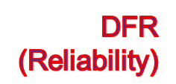


Within-Layer Protections
CC-PROTECT -- Cross-Layer Protection
network
Compressed
video data
Packet
Loss
Raw
video data
Application
(e.g., Video Encoding)
Error-Prone Network
Error-Resilient
Video Encoding
(e.g., PBPAIR)
PLR
Resilience
FLR
Middleware /
Operating System
Middleware /
Operating System
Local Optimization within Layers
Middleware
relates SER at HW to FLR at Application
selects a policy based on available information (parameters & constraints)
No Coupling, No Cooperation
Mitigation (QoS)
SER
Error-Protected
Data Cache (e.g., PPC)
Hardware
Soft Error
CC-PROTECT
1. achieves system-level optimization
2. extends the applicability of existing schemes
PPC with ECC
PPC with EDC
Mobile Video Encoding
Notes:
In summary, our CC-PROTECT achieves system-level optimization, which is low cost reliability, i.e., mitigating the negative impact of soft errors on failure rate and video quality.
Further, our CC-PROTECT extends the applicability of existing error-resilient techniques across system abstraction layers.

Slide 28
Outline
Motivation and Related Work
Problem Statement
Our Solution
Experiments
  Experimental Setup and Compositions
  Effectiveness of CC-PROTECT in terms of failure rate, QoS, runtime, and energy consumption
  Effectiveness of Adaptive DFR/BER Schemes
Conclusion

Slide 29


Experimental Framework
AKIYO
FOREMAN
COASTGUARD
Application
(H.263 Video
Encoding)
1.Error Prone Video
Encoding (GOP-K)
2.Error Resilient Video
Encoding (PBPAIR)
Low
Activity
Mid
Activity
High
Activity
Video Data
DFR Parameters
Soft Error Rate
Power Numbers
Delay Penalties
Compiler
(gcc)
Cache
Simulator
(SimpleScalar)
Executable
Analyzer
Page Mapping
1.Protected Cache
Parameters
2.Unprotected Cache
Parameters
REPORT : Failure Rate
Access Time
Energy
QoS
Notes:
We have built an experimental framework.
We consider error-prone video encoding (GOP) and error-resilient video encoding (PBPAIR) based on H.263 video encoding.
We modified SimpleScalar cache simulator to configure protected cache and PPC architecture, and inject soft errors in simulations.
Multiple video clips with different activities have been simulated to analyze failure rate for reliability, access time to memory subsystem for performance, energy consumption for power, and video quality for QoS.

Slide 30
Compositions
GOP-K
PBPAIR
1 - NO
Protection
BASE – No Protection
  Error-Prone Video Encoding (GOP-K) + Unprotected Cache
HW-PROTECT
  Error-Prone Video Encoding (GOP-K) + PPC with ECC
APP-PROTECT
  Error-Resilient Video Encoding (PBPAIR) + Unprotected Cache
MULTI-PROTECT
  Error-Resilient Video Encoding (PBPAIR) + PPC with ECC
CC-PROTECT
  Error-Resilient Video Encoding (PBPAIR) + DFR + PPC with EDC
Application
(Video Encoding)
2, 3, & 4
Within-
Layer
Protections
Selection b/w
DFR & BER
SER
Translation
Middleware/ Operating System
DFR
Soft Error
Monitoring
Hardware
(Data Cache)
5 - Cross-
Layer
Protection
EDC
Unprotected Cache
PPC
Notes:
Cross-products from error-prone video encoding vs. error-resilient video encoding and unprotected cache vs. protected cache (PPC) have been evaluated with our CC-PROTECT.

Slide 31
Effectiveness of CC-PROTECT
First Set of Experiments – Evaluate CC-PROTECT with existing protections in terms of failure rate, video quality, energy consumption, and performance for FOREMAN.QCIF (mid activity)
Notes:
Our first set of experiments will show the effectiveness of our CC-PROTECT.

Slide 32
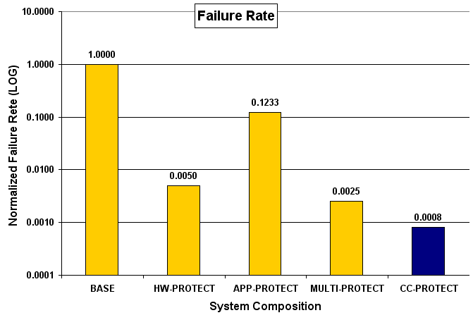
Failure Rate
Failure Rate is the number of failures (e.g., system crash) due to soft errors, out of thousands simulations
CC-PROTECT reduces the failure rate by more than 1,000 times, as compared to BASE
Notes:
CC-PROTECT reduces the failure rate by more than 1,000 times than BASE.

Slide 33
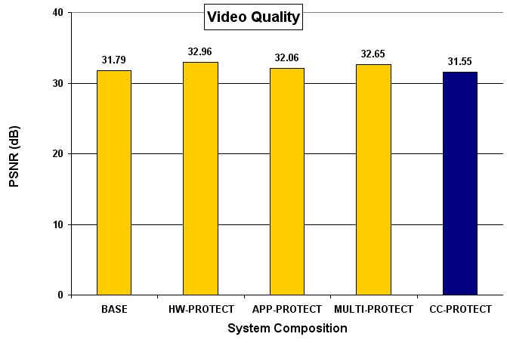
Video Quality
QoS is the video quality measured in PSNR
CC-PROTECT demonstrates the video quality close to those of other compositions
Notes:
CC-PROTECT shows the close video quality to other compositions.

Slide 34
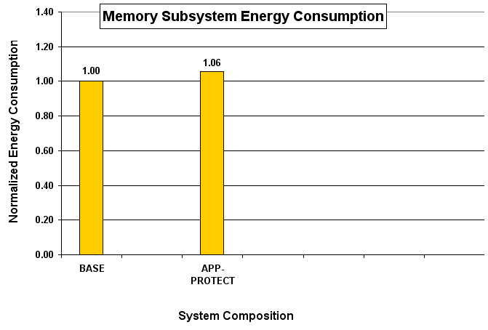
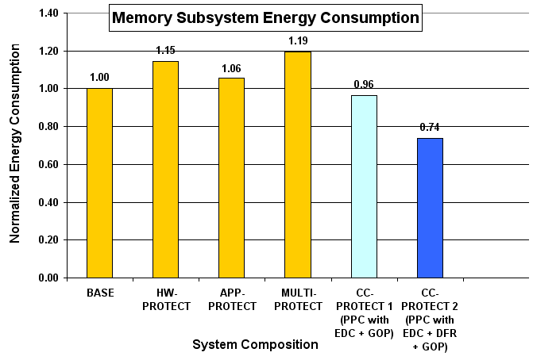
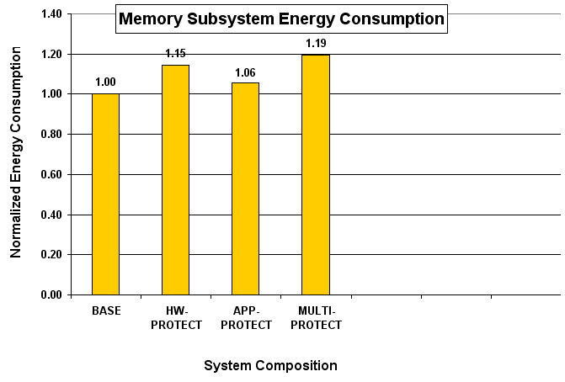
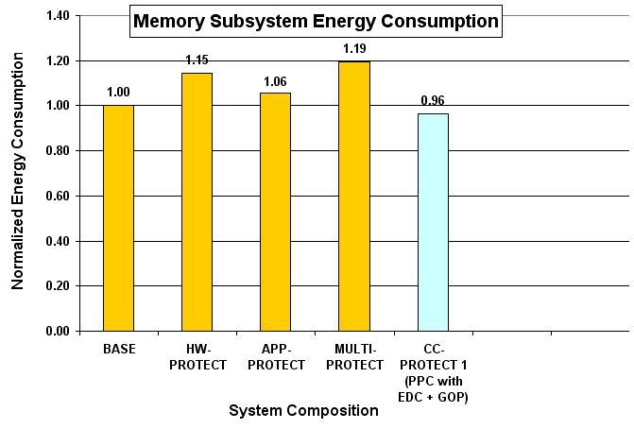
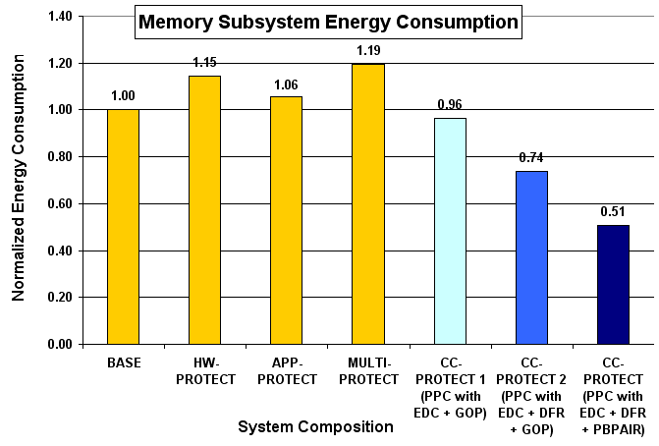
Energy Consumption
Energy consumption includes the energy consumptions of caches, bus, and main memory
EDC + DFR impact
36% Reduction compared to HW-PROTECT
26% Reduction compared to BASE
EDC impact
17% Reduction compared to HW-PROTECT
4% Reduction compared to BASE
EDC + DFR + PBPAIR(CC-PROTECT) impact
56% Reduction compared to HW-PROTECT
49% Reduction compared to BASE
CC-PROTECT reduces the energy consumption of memory subsystem by 49%, compared to BASE
Notes:
CC-PROTECT is a combined and cooperative approach, and this animation in this slide shows the effectiveness of each approach we combined for CC-PROTECT in terms of energy consumption.
CC-PROTECT reduces the energy consumption of memory subsystem by 49% compared to BASE.

Slide 35
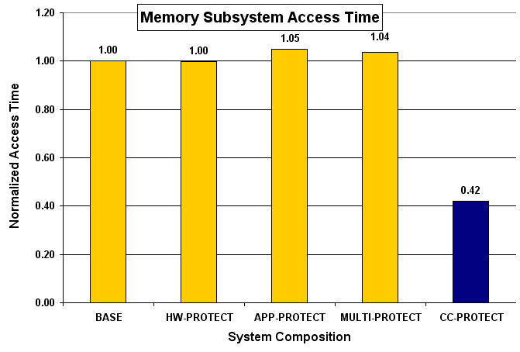
Performance
Performance is estimated in access time to memory subsystem (caches, bus, and memory)
CC-PROTECT reduces the memory access time by 58%, compared to BASE
Notes:
CC-PROTECT reduces the access time to memory subsystem by 58% compared to BASE.

Slide 36
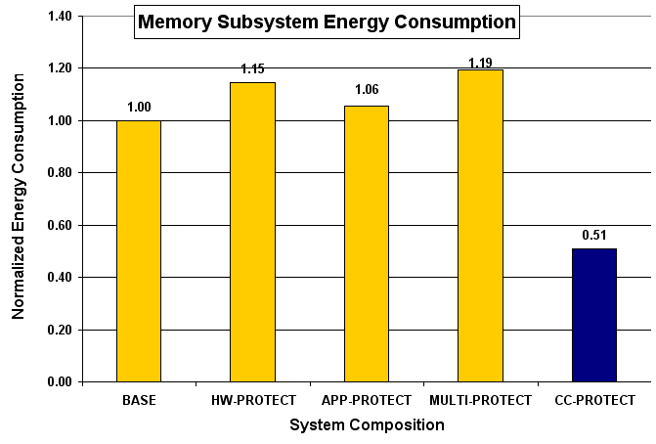
Effectiveness of CC-PROTECT
CC-PROTECT achieves
low-cost reliability
(more than 50%
cost reduction and more
reliable, at the cost of QoS,
than within-layer
protections)
Notes:
In summary, CC-PROTECT achieves low-cost reliability.
I’d like to emphasize that CC-PROTEC improves the cost compared to BASE while other protection techniques incur overheads. It is very effective since our CC-PROTECT achieves similar or even better reliability than other composition protections while ours improves the energy consumption and performance.

Slide 37
Effectiveness of Adaptive CC-PROTECT
Second Set of Experiments – Evaluate adaptive CC-PROTECT schemes (SA-DFR/BER, FA-DFR/BER, and QA-DFR/BER) to naïve schemes (Naïve DFR and Naïve BER) in terms of video quality and energy consumption with FOREMAN.QCIF (mid activity)
  For failure rate and performance, please refer to our paper
SA-DFR/BER – 60% ACET (Average Case Execution Time) is the threshold value
  60% is the least threshold value, causing better QoS than BASE
FA-DFR/BER – 2nd Frame must be protected
  Losing 2nd frame affects the QoS most
QA-DFR/BER – 31.79 dB is the threshold value to select DFR or BER
  31.79 dB is the PSNR value in case of BASE for FOREMAN
Notes:
Second set of experiments evaluate our adaptive CC-PROTECT technique with naïve approaches.

Slide 38
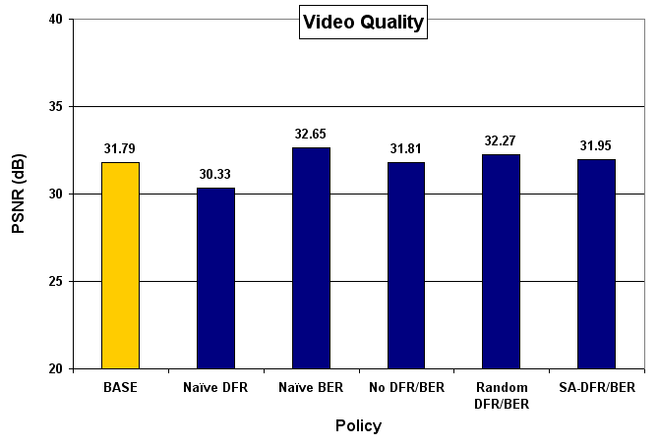
QoS
Adaptive CC-PROTECT improves the video quality, as compared to Naïve DFR
Notes:
Naïve DFR can degrade the video quality when consecutive frame drops induce. In this set of experiments, one or two frame drops happen in our simulations.
Adaptive CC-PROTEC with DFR and BER selection improves the video quality as compared to Naïve DFR.

Slide 39
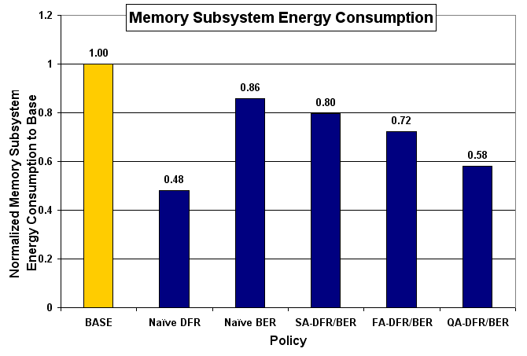
Energy Consumption
Adaptive CC-PROTECT balances energy consumption between Naïve DFR and Naïve BER, and QA-DFR/BER is the best in terms of energy
Notes:
Adaptive CC-PROTECT balances the energy consumption between Naïve DFR and Naïve BER.

Slide 40
Conclusion
Soft error is a critical design concern for mobile multimedia embedded systems
  Previously proposed protection techniques within layers are expensive for resource-constrained mobile devices
Propose CC-PROTECT approach, which cooperates existing schemes across layers to mitigate the impact of soft errors on the failure rate and video quality in mobile video encoding systems
  PPC (Partially Protected Caches) with EDC (Error Detection Codes) at hardware layer
  DFR (Drop and Forward Recovery) at middleware
  PBPAIR (Probability-Based Power Aware Intra Refresh) at application layer
Demonstrate the effectiveness of low-cost (about 50%) reliability (1,000x) at the minimal cost of QoS (less than 1%)
Future work includes:
  Expand CC-PROTECT for various errors and for runtime approach
  Intelligent schemes to improve the effectiveness
  Design space exploration techniques
Notes:
Our CC-PROTECT achieves two goals, 1. failure rate reduction and 2. minimal quality degradation, with minimal costs.
Indeed, our CC-PROTECT improves the energy consumption and performance, as compared to conventional techniques without protection.

Slide 41
Thanks!
Any Questions?
kyoungwl@ics.uci.edu
Notes:
Thank you! Any questions?

Slide 42
Backup Slides

Slide 43
Soft Errors on an Increase
Q_{critical}
SER
∝
N_{flux}
x
CS
x
exp
{-
}
Q_{s}
where
Q_{critical}
=
C
x
V
Increase exponentially due to technology scaling
  0.18 µm
    1,000 FIT per Mbit of SRAM
  0.13 µm
    10,000 to 100,000 FIT per Mbit of SRAM
Voltage Scaling
  Voltage scaling increases SER significantly
Soft Error is a main design concern!
[Hazucha et al., IEEE] P. Hazucha and C. Svensson. Impact of CMOS Technology Scaling on the Atmospheric Neutron Soft Error Rate. IEEE Trans. on Nuclear Science, 47(6):2586–2594, 2000.

Slide 44
Soft Error is an Every Second Concern
Soft Error Rate (SER)
  FIT (Failures in Time) – How many errors in one billion operation hours
    SER per Mbit @ 0.13 µm = 1,000 FIT ≈ 104 years in MTTF
Soft error is becoming an every second problem
  SER for 64 MB @ 0.13 µm = 64x8x1,000 FIT ≈ 81 days in MTTF
  SER for 128 MB @ 0.65 nm = 2x1,000x64x8x1,000 FIT ≈ 1 hour in MTTF
  SER for a system @ 0.65 nm = 2x2x1,000x64x8x1,000 FIT ≈ 30 minutes in MTTF
  SER with voltage scaling for a system @ 0.65 nm = 100x2x2x1,000x64x8x1,000 FIT ≈ 20 seconds in MTTF
  SER with voltage scaling for a system @ flight (35,000 feet) @ 0.65 nm = 800x100x2x2x1,000x64x8x1,000 FIT ≈ 0.02 seconds in MTTF
Actel, “Neutrons from above – Soft Error Rates”, Actel tech. rep., 2002
Robert Baumann, “Soft errors in advanced computer systems”, IEEE Design and Test of Computers, 2005
Gorden E. Moore, “Cramming more components onto integrated circuits”, Electronics, 1965
S. Mitra, et al., “Robust system design with built-in soft-error resilience”, IEEE Computer 2005
P. Hazucha et al., “Impact of CMOS technology scaling on the atmospheric neutron soft error rate”, IEEE Trans. on Nuclear Science, 2000
Ritesh Mastipuram and Edwin C. Wee, “Soft errors’ impact on system reliability”, http://www.edn.com/article/CA454636, 2004

Slide 45
Problem Statement and Our Goals
network
Mobile Video Conferencing
Compressed
video data
Raw
video data
Application
(e.g., video encoding)
Error-Prone Network
Middleware /
Operating System
Two Impacts
Failure
Quality
Soft Error
Error-Prone Hardware
(e.g., error-prone cache)
Mobile Video Encoding
Notes:
Soft errors at the hardware layer affects mobile video encoding system with two aspects, 1. failures and 2. video quality.
We need develop a cost-efficient approach to reduce the impact of soft errors on these two aspects.

Slide 46
FER and BER
Forward Error Recovery (FER)
  Transform components into any correct state
  ECC
  Overkill for multimedia applications
Backward Error Recovery (BER)
  Roll back into the previous correct state
  EDC + Checkpoint and Roll backward
  Bad for the real-time requirement
BER
FER
Checkpoint K
Checkpoint K+1
Error
Detection

Slide 47
Error-Resilience at Application
Application
PBPAIR [Kim, 06] takes into account packet loss rate to determine the error resilience level
  <original PBPAIR>
    Error Rate = Packet Loss Rate
Middleware / Operating System
Soft Error
Hardware
EE-PBPAIR [Lee, 08] has a mechanism to adjust packet loss rate
  EE-PBPAIR at application encodes the video data resilient against not only packet losses but also soft errors
  <EE-PBPAIR in CC-PROTECT>
    Error Rate = PLR + FLR (Frame Loss Rate)
    SER (Soft Error Rate) at Hardware is translated into FLR (Frame Loss Rate) at Middleware

Slide 48
Preliminary and Extra Experimental Results

Slide 49
Energy Consumption

Slide 50
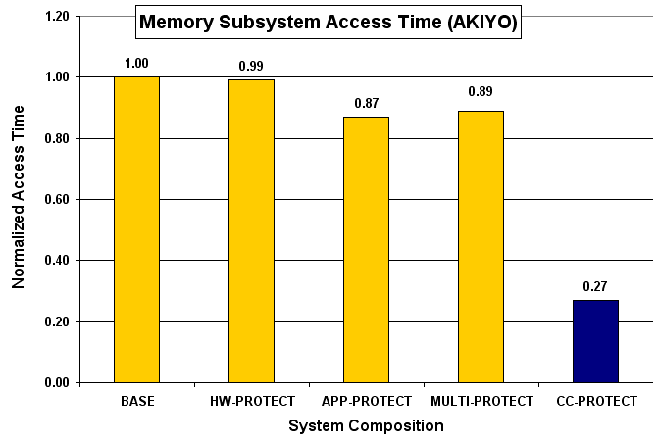
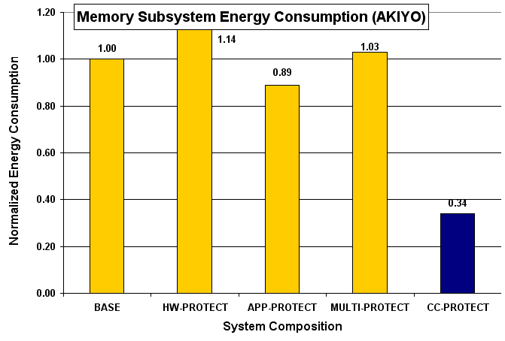
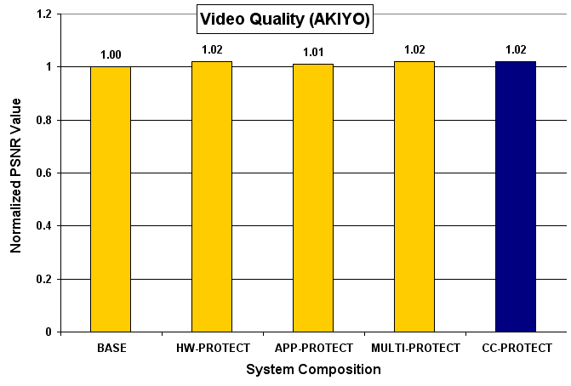
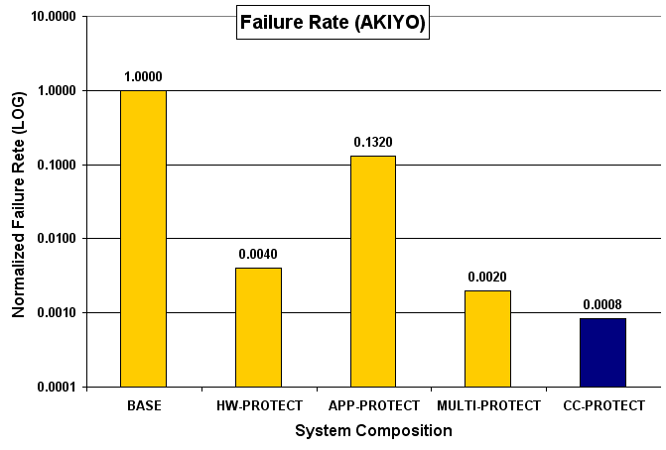
CC-PROTECT for AKIYO (low activity)
CC-PROTECT obtains better results with low activity of video streams
Notes:
This slide shows the similar results when we run simulations with AKIYO.
Interestingly, our CC-PROTECT achieves the better video quality than BASE, since soft errors on multimedia data reduced the video quality more than a frame drop affected since AKIYO has low activity.
CC-PROTECT obtains better results with AKIYO.

Slide 51
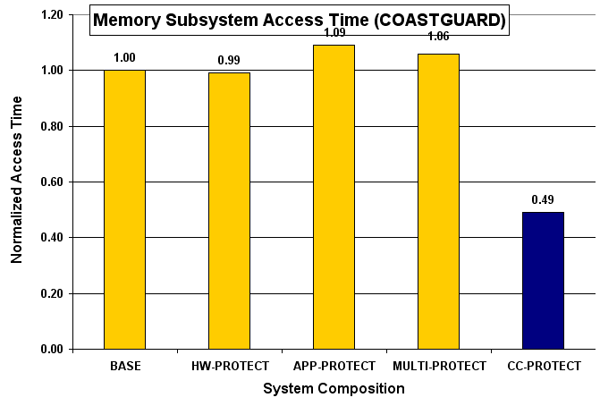
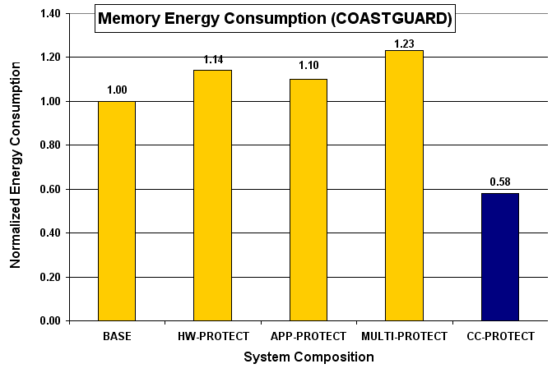
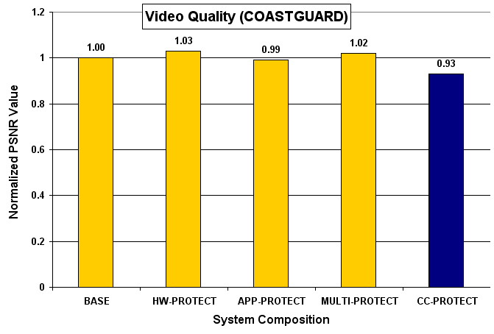
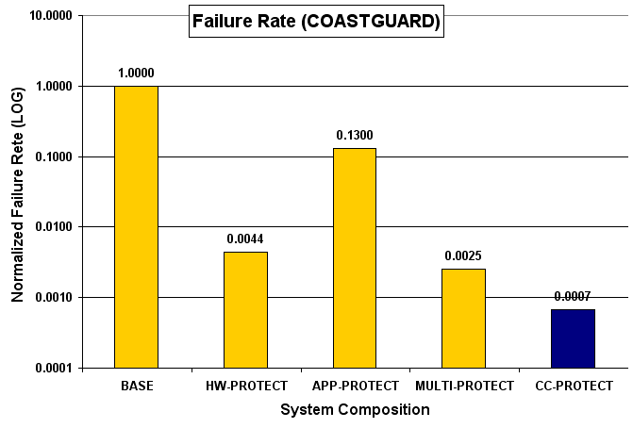
CC-PROTECT for COASTGUARD (high activity)
CC-PROTECT obtains effective results with various video streams
Notes:
CC-PROTECT with COASTGUARD achieves less effectiveness than those with FOREMAN and AKIYO since a frame drop affects more with COASTGUARD due to high co-relation between frames.
In summary, CC-PROTECT obtains effective results with various video streams we have studied.

Slide 52
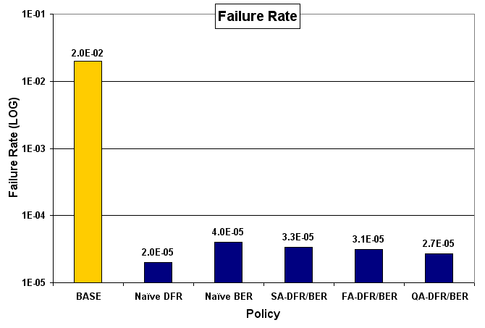
Failure Rate
Adaptive CC-PROTECT obtains the worse failure rate than Naïve DFR, still better than BASE
Notes:
Adaptive CC-PROTECT increase the failure rate compared to Naïve DFR due to increasing execution time, but it is still better than BASE.

Slide 53
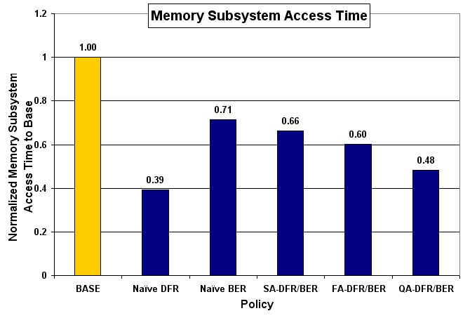
Performance
Adaptive CC-PROTECT balances between Naïve DFR and Naïve BER
Notes:
Adaptive CC-PROTECT balances between Naïve DFR and Naïve BER.

Slide 54
Compositions in the following slides
Base
  GOP + Unprotected Cache
HW-Protection 1
  GOP + Protected Cache with ECC
HW-Protection 2
  GOP + Protected Cache with EDC + BER (checkpoint and roll-backward)
App-Protection
  PBPAIR + Unprotected Cache
All-Protection
  PBPAIR + Protected Cache with ECC
Cross-Layer Protection 1
  GOP + PPC with EDC + DFR (drop and forward recovery)
Cross-Layer Protection 2
  PBPAIR + PPC with EDC + DFR (drop and forward recovery)

Slide 55
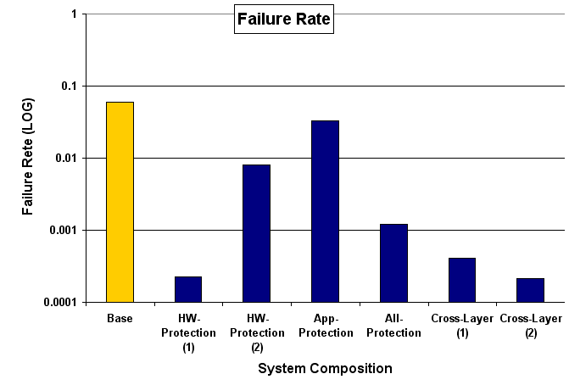
Failure Rate

Slide 56
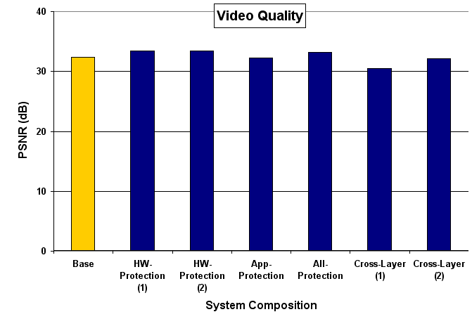
Video Quality

Slide 57
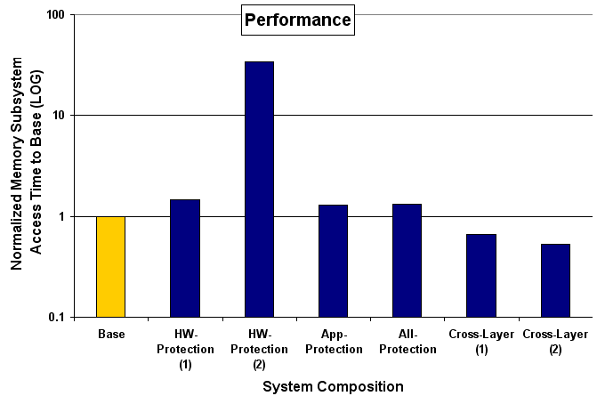
Performance

Slide 58
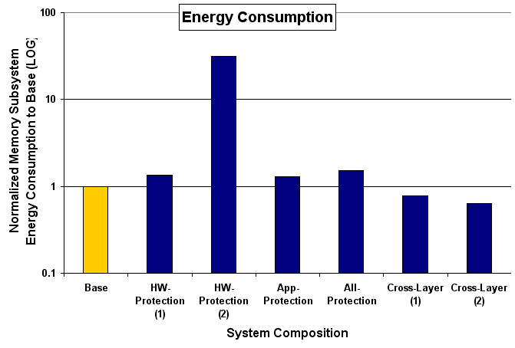
Energy Consumption

Slide 59
Naïve DFR
Naïve DFR
Strategy – Any soft error results in DFR
Pros – High Energy Saving and High Reliability
Cons – QoS degradation
  e.g.) Consecutive frames dropped
DFR
Frame K
Frame K+1
Error
Detection
Error
Error
K-1
K
K+1
K+2
QoS ?
Drop
Drop

Slide 60
Slack-Aware Adaptive DFR/BER
SA-DFR/BER
Strategy – Enough slack time can help improve the QoS by retrying it
Pros – QoS Improvement
Cons – Increasing Energy Consumption
BER
DFR
Frame K
Frame K+1
Error
Detection
ACET
Error
Error
if T_{elapsed} < T_{threshold}
go back to Frame K
else
drop and move forward
to Frame K+1
where T_{threshold} is C% of ACET
K+1
K-1
K
K+1
K+2
BER
Drop

Slide 61
Frame-Aware Adaptive DFR/BER
FA-DFR/BER
Strategy – Important frame with perspective of QoS should not be dropped
Pros – QoS Improvement
Cons – Increasing Energy Consumption and need to change the encoder
BER
DFR
Frame K
Frame K+1
Error Detection
A
if F_{K} == F_{I-frame}
go back to Frame K
else
drop and move forward to F_{K+1}
B
if F_{K-1}(previous frame) was dropped
go back to Frame K
else
drop and move forward to F_{K+1}
Error
Error
K+1
K-1
K
K+1
K+2
C
if Diff_{K-1 and K} > Diff_{threshold}
go back to Frame K
else
drop and move forward to F_{K+1}
BER
Drop

Slide 62
QoS-Aware Adaptive DFR/BER
QA-DFR/BER
Strategy – QoS/Delay feedback from receiver helps adjust DFR policies.
  (e.g.) QoS degradation makes BER work
  (e.g.) QoS degradation can increase the time threshold, increasing the chance to retry it
  (e.g.) if delay matters, apply DFR aggressively
Pros – QoS is managed by user-end
Cons – it may call BER always
BER
DFR
Frame K
Frame K+1
Error Detection
stream
sender
receiver
feedback
Low quality-feedback increases error-
resilience aggressively or decreases DFR
by adjusting threshold values
T_{threshold} is increasing by quality-feedback
BER will be applied more often
T_{threshold} is decreasing by delay-feedback
➔ DFR will be applied more often

Slide 63
Randomly Adaptive DFR/BER
Random DFR/BER
Strategy – select DFR or BER based on pseudo random generation with Probability
Pros – new knob to adjust DFR policy
Cons – no intelligence
BER
DFR
Frame K
Frame K+1
Error
Detection
if P_{pseudo-random} > P_{threshold}
go back to Frame K
else
drop and move forward
to Frame K+1
where P_{threshold} is weight of DFR
and P_{pseudo-random} is one number
b/w 0 to 100 in pseudo-random
Error
Error
K+1
K-1
K
K+1
K+2
BER
Drop

Slide 64
Results for DFR + BER

