Slide 1
Compiler-Managed Protection of Register Files for Energy-Efficient Soft Error Reduction
Jongeun Lee, Aviral Shrivastava*
Compiler Microarchitecture Lab
Department of Computer Science and Engineering
Arizona State University
http://www.public.asu.edu/~ashriva6

Slide 2
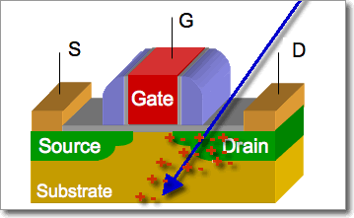
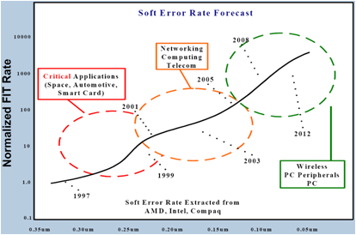
Reliability Problem
Soft Errors
  Transient errors caused by voltage and signal fluctuations and interference
  Radiation strike causes majority of soft errors
Soft Error Rate
  Current soft errors are about 1 per year
  Soft error rate increasing exponentially with technology
  Will be 1 per day in a decade
[ ??? ]
http://www.public.asu.edu/~ashriva6

Slide 3
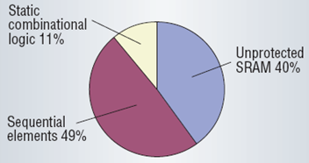
Soft Errors in Processor Core
Masking Effect
  Logical masking
  Temporal masking
  Electrical masking
Visible Errors
  Faults occurring to combinational circuits are far less visible
  For ARM926EJ, most architecturally visible errors within a processor core actually occur in register files [Blome ’06]
1
→ 0
0
Logical masking
[Mitra ’05]
http://www.public.asu.edu/~ashriva6

Slide 4
Mitigating Soft Errors in RF
Microarchitectural Techniques
  Shield [Montesinos ’07]: ECC table for a fraction of registers chosen dynamically
  Replication in unused physical registers [Memik ’05]: for superscalar processors
  Register value cache [Blome ’06]: replicating recent values in a tiny cache
  In-register replication [Kandala ’07]: for register values fitting in 16 bits or less
Partial protection reduces the area overhead,
but not necessarily the power overhead!
http://www.public.asu.edu/~ashriva6

Slide 5
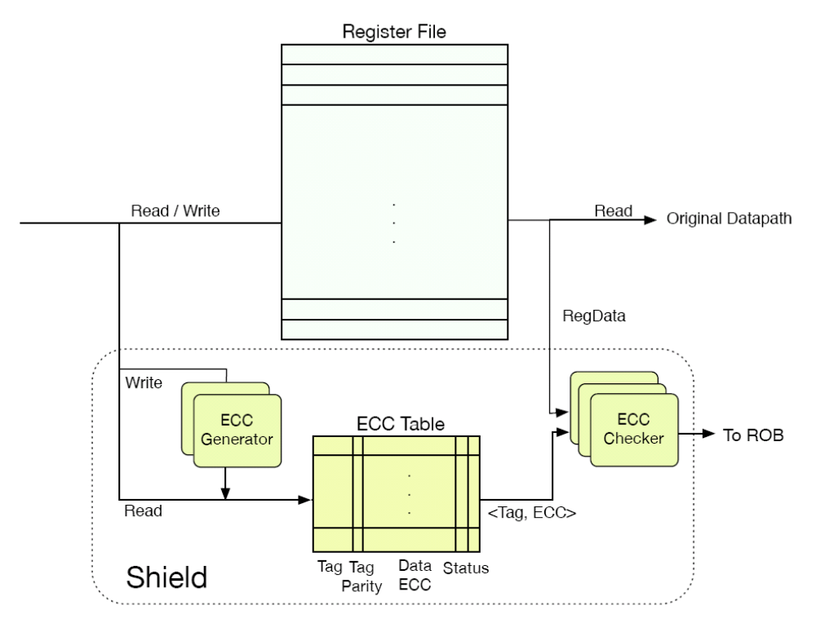
Hardware Partial Protection
Write: To protect or not?
Write: Generate ECC
Write: Where to put it?
[Montesinos ’07]
http://www.public.asu.edu/~ashriva6
Notes:
Although this particular architecture is based on ECC, it could be based on parity or replication. Essentially all hardware scheme doing partial protection has the same structure.

Slide 6
Hardware Partial Protection
Read: Is this value protected or not?
Read: Check ECC
Read: Where to get it?
[Montesinos ’07]
http://www.public.asu.edu/~ashriva6

Slide 7
Compiler Approach
 | Action | Hardware Approach |  | Compiler Approach
 |  | Protected | Unprotected | Protected | Unprotected
Write | Decide to protect | √ | √ | X | X
 | Which entry to use | √ | X | X | X
 | Generate ECC | √ | X | √ | X
Read | Decide if it was protected | √ | √ | X | X
 | Which entry to find | √ | X | X | X
 | Check ECC | √ | X | √ | X
Hardware Approach
  Non-zero overhead even for unprotected values!
Compiler Approach
  Removes power overhead in Decision / Selection
  Could make better decisions by using program information
http://www.public.asu.edu/~ashriva6
Notes:
We should add power numbers here!

Slide 8
Compiler Approach Issues
Compiler Approach
  Protection decision is made at compile-time and embedded in instructions
Issues
  How to embed protection decision in instructions?
    ISA incompatibility has a great disadvantage
  How to make optimal protection decision?
    Global optimum is likely to be NP-complete; local optimum may not be good
  What is the right metric to use for optimization?
    Soft error rate or energy, or a combination of the two?
  Runtime should not be increased
    How to ensure little or no runtime increase?
http://www.public.asu.edu/~ashriva6

Slide 9
Our Compiler Approach
Architecture: Register Number Based Protection
  Protection for only K highest-numbered registers
  No ISA modification
  No decision/selection logic
Compiler Optimization Method: Register Swapping
  After usual compilation, swap register allocation
  So that important variables are in protected registers
  No runtime increase
  Two versions: ARS, FRS (can be combined)
Partially
Protected RF
To protect R3
# assembly code
...... .. .. R9
...... R9 .. R25
...... .. R25 ..
...... .. R9 ..
...... .. R25 ..
# assembly code
...... .. .. R25
...... R25 .. R9
...... .. R9 ..
...... .. R25 ..
...... .. R9 ..
R0
…
Unprotected
R24
R25
Protected
…
R31
http://www.public.asu.edu/~ashriva6

Slide 10
Optimization Metric
Vulnerability
  Combined length of live ranges (from write to last read)
  Directly proportional to soft error rate
Energy Overhead
  Approximately proportional to access count to protected registers
Energy Efficiency Metric
  Weighted sum of vulnerability and energy overhead
  Minimizing for both ensures high energy-efficiency
Examples
W
R
High V
Seldom accessed
Good
time
W
R
R
R
R
W
W
R
Low V
Frequently accessed
Bad
time
http://www.public.asu.edu/~ashriva6

Slide 11
Register Swapping
ARS (Application-level Register Swapping)
  All registers can be swapped
  Except for architecturally distinguished registers: eg. R31 in MIPS (implicitly accessed by JAL instruction)
  Globally one register swap rule
FRS (Function-level Register Swapping)
  Register swap rule for each function
  Must respect calling convention: eg. a caller-saved register can be swapped with another caller-saved register
  FRS/t: swapping between caller-saved registers (t-registers)
    Live range is limited to one function
  FRS/s: swapping between callee-saved registers (s-registers)
    Live range may extend over multiple functions
http://www.public.asu.edu/~ashriva6

Slide 12
T-register vs. S-register
Call
depth
f₅
f₅
f₃
f₄
f₂
f₁
time
T-register live ranges
var1
var2
var3
var4
S-register live ranges
var1
var2
var3
var4
var5
Live range of t-register variable do not cross any function transition.
Live range of s-register variable is limited to one function instance
but may cross function transitions.
http://www.public.asu.edu/~ashriva6

Slide 13
Optimal ARS, FRS/t
ARS
  ARS is a special case of FRS/t with only one function
FRS/t
  Each function can be independently optimized
  Input: V and E of each register (before swapping) for each function
  Sort registers in increasing order of (V – β E), and protect the K highest numbered ones
  Very efficient: O(R ∙ N)
    R: number of registers
    N: number of functions
http://www.public.asu.edu/~ashriva6

Slide 14
Challenges in Optimizing FRS/s
Can we find the vulnerability of s-register in a function?
  Vulnerability in F2 (callee) depends on F1 (caller)
  Vulnerability in F3 (caller) depends on F4 (callee)
  Potentially every caller-callee pair has inter-dependence
Finding optimal FRS for s-registers
  Finding global optimum is intractable -> simple heuristic
call
return
call
return
Vulnerable if t7 is R
F2
F4
F1
F1
F3
F3
t1
t2
t3
t4
t5
t6
t7
W
R
W
R/W?
W
R
W
Vulnerable if t4 is R
Vulnerable if reg is accessed in F4
http://www.public.asu.edu/~ashriva6

Slide 15
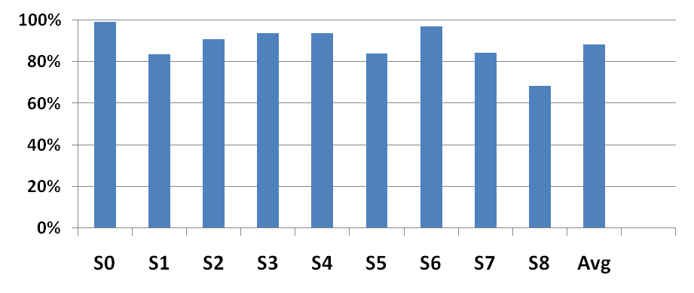
Heuristic
Observation
  Next access after current basic block is almost always a read (~90%)
  Our heuristic assumes s-registers are always “read” afterwards
  Thus we can optimize each function separately
Chances of s-registers being first read after a basic block
http://www.public.asu.edu/~ashriva6

Slide 16
Experiments
Comparisons
  Compiler approach vs. Hardware approach
  Optimizing for energy-efficiency vs. Optimizing for vulnerability only
Setting
  SimpleScalar simulator (MIPS instruction set), in-order execution
    T-registers: R1, R8~R15, R24, R25
    S-registers: R16~R23, R30
  Application benchmarks from MiBench
  Design parameter (β ):
    RF vulnerability-to-energy ratio of the entire program
http://www.public.asu.edu/~ashriva6

Slide 17
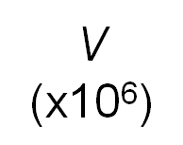
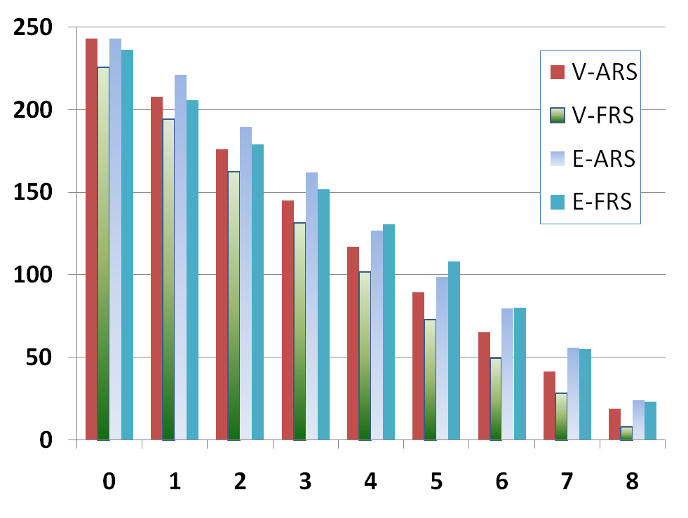
V-K Plot
Optimizing for vulnerability only
Optimizing for energy-efficiency
K (s-registers)
http://www.public.asu.edu/~ashriva6

Slide 18
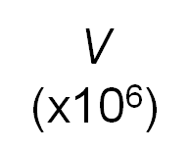
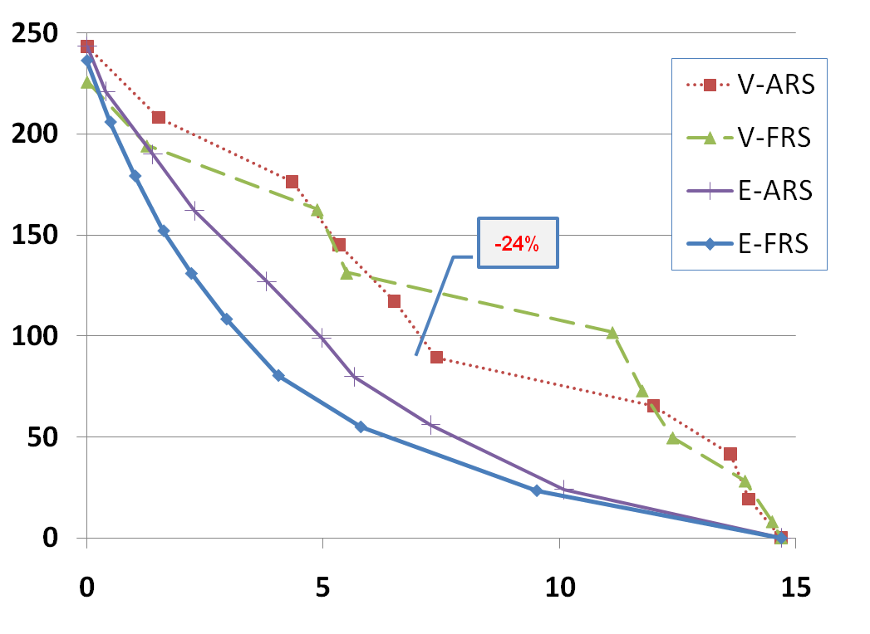
V-E Tradeoff
K=5
K=6
K=6
-28%
E (x10⁶)
Optimizing for energy-efficiency may cut energy overhead to 50%
compared to optimizing for vulnerability only.
http://www.public.asu.edu/~ashriva6

Slide 19
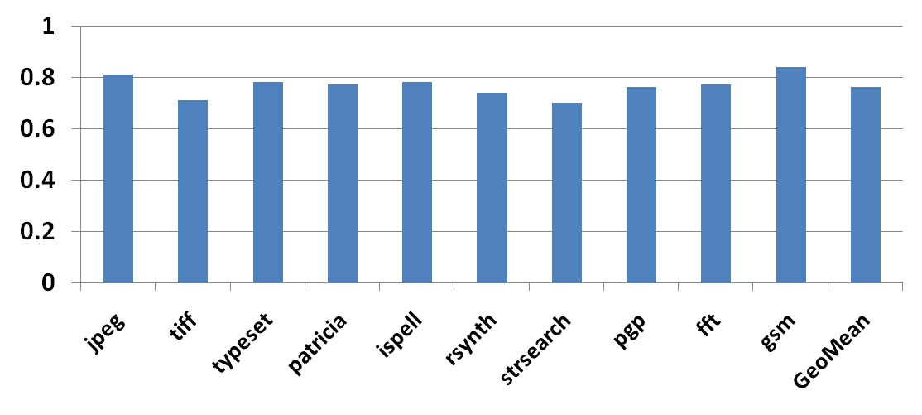
Energy Efficiency of Our Technique
Weighted Sum of Vulnerability and Energy
(Normalized to Vulnerability Only)
24% on
average
http://www.public.asu.edu/~ashriva6

Slide 20
HW vs. Compiler Approach
Ideal HW Case
  Consider the ideal HW case rather than a particular HW algorithm/implementation
  Assume only the most profitable registers are protected (we use offline algorithm to find this out)
  Could be better in making what-to-protect decisions, but with significant energy cost
Power Model
  What is important is the relative power dissipation between
    Decision making
    Selecting an entry
    Creating/checking signature (eg. ECC, parity, duplicate)
Compiler Approach
  Apply FRS followed by ARS
http://www.public.asu.edu/~ashriva6

Slide 21
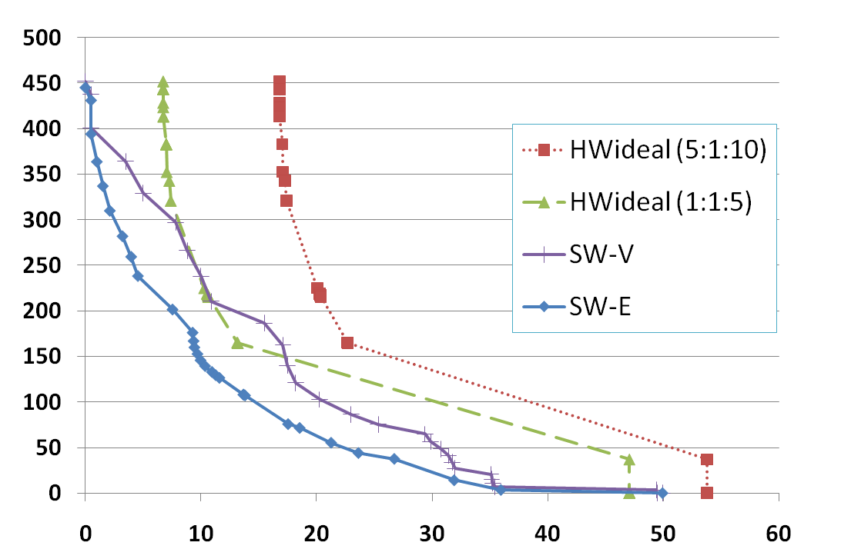
V-E Tradeoff Comparison
Energy overhead even for unprotected variables
(vulner. only)
(energy effic.)
E
(x10⁶)
Compiler approach is much more energy efficient than ideal hardware case
Proposed technique is more energy efficient than simple vulnerability optimization
http://www.public.asu.edu/~ashriva6

Slide 22
Conclusion
Motivated Compiler Approach to soft errors
  Requires hardware protection mechanism (partially protected RF)
  Optimal use of hardware feature by compiler
Proposed ARS, FRS
  ARS is easier to apply, optimize
  FRS is challenging to optimize but gives more energy reduction
  Can be combined for highest energy efficiency
Encouraging Results
  Much more energy efficient than hardware approaches
  Can reduce energy overhead by 24% compared to simple vulnerability optimization
http://www.public.asu.edu/~ashriva6

