Slide 1
Efficient Heap Data Management on Software Managed Manycore Architectures
Aviral Shrivastava
Arizona State University

Slide 2
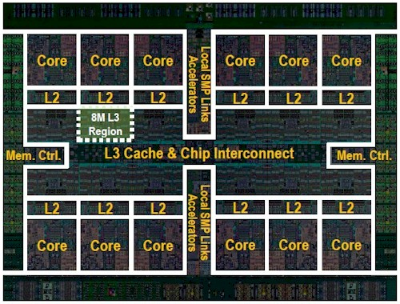
Challenges of Cache-Based Memory Architecture
Caches as On-chip Memories
Universal application
Data management done by hardware logic
Challenges
Large area
50% chip area [1]
High energy consumption
50% energy consumption [1]
Coherency unscalable with core count [2]
IBM Power8 [3]
[1] Niar et al., ICM 2004, pp. 244-247.
[2] Xu et al., ICS 2011.
[3] www.itjungle.com/2014/02/17/tfh021714-story01/
Notes:
[1] S. Niar, S. Meftali and J. L. Dekeyser, "Power consumption awareness in cache memory design with SystemC," Proceedings. The 16th International Conference on Microelectronics, 2004. ICM 2004., 2004, pp. 244-247.
[2] Y. Xu, Y. Du, Y. Zhang, and J. Yang, “A Composite and Scalable Cache Coherence Protocol for Large Scale CMPs,” in Proc. of ICS, 2011.
[3] www.itjungle.com/2014/02/17/tfh021714-story01/

Slide 3
Software Managed Many-core (SMM) Architectures
Instead of Caches use Scratchpad Memories (SPM)
SPM is Software Managed Memory
Data management explicitly controlled by instructions
Less Hardware Required
46% lower area overhead than cache [4]
40% less energy consumption than cache [4]
Examples
IBM Cell BE [5]
The NEO CHIP [6]
SMM Architecture
core
core
SPM
SPM
DMA
DMA
Main Memory
Tag Array
Data Array
Tag Comparators, Muxes
Address Decoder
[4] Banakar et al, CODES2002, pp. 73-78.
[5] Flachs et al, SSC2006, pp.63-70. [6] REX Computing, 2014.
Cache
SPM
Notes:
[4] R. Banakar, S. Steinke, Bo-Sik Lee, M. Balakrishnan and P. Marwedel, "Scratchpad memory: a design alternative for cache on-chip memory in embedded systems," Proceedings of the Tenth International Symposium on Hardware/Software Codesign. CODES 2002 (IEEE Cat. No.02TH8627), Estes Park, CO, USA, 2002, pp. 73-78.
[5] B. Flachs at el., “The Microarchitecture of the Synergistic Processor for A Cell Processor,” IEEE Solid-state circuits, vol. 41, no. 1, pp. 63–70, 2006.
[6] REX Computing, Inc., “THE NEO CHIP,” http://rexcomputing.com/, 2014.

Slide 4
Insertion of Management Instructions
Core can only access the SPM
Data can be transferred between SPM and Main memory through explicit direct memory access (DMA) instructions
How can the application execute?
Instructions to bring data into SPM before it is used, and push it out after it is updated
core
int global;
f() {
int a, b;
DMA.fetch(global);
global = a + b;
DMA.writeback(global);
DMA.fetch(f2);
f2();
}
int global;
f() {
int a, b;
global = a + b;
f2();
}
SPM
DMA
Main Memory

Slide 5
Why Heap Data Management?
All data must be managed on the SPM
Code Data - [7][8][9]
Stack Data - [10][11][12]
Global Data - [13][14][15]
Heap Data?
particularly difficult to manage, due to its dynamic nature
Some applications use heap data very significantly
In MiBench, susan smoothing, 94% of all data access are heap accesses
Stack Data
Heap Data
Code Data
[7] Cai et al, DATE2017. [8] Lu et al, TECS2015.
[9] Kim et al, ICCAD2016. [10] Cai et al, ASAP2016.
[11] Lu et al, DAC2013. [12] Bai et al, ASAP2011.
[13] Liu et al, JCSE2015, [14] Cho et al, SIGPLAN2007
[15] Udayakumaran et al, TECS2006.
Global Data
Notes:
[7] Jian Cai, Yooseong Kim, Youngbin Kim, Aviral Shrivastava and Kyoungwoo Lee, “Reducing Code Management Overhead in Software-Managed Multicores,” 2017 International Conference on Design Automation and Test in Europe (DATE), 2017.
[8] Jing Lu, Ke Bai and Aviral Shrivastava, “Efficient Code Assignment Techniques for Local Memory on Software Managed Multicores,” In ACM Transactions on Embedded Computing Systems (TECS), 2015.
[9] Youngbin Kim, Jian Cai, Yooseong Kim, Kyoungwoo Lee and Aviral Shrivastava, “Splitting Functions in Code Management on Scratchpad Memories,” In Proceedings of the IEEE/ACM International Conference on Computer-Aided Design (ICCAD), 2016.
[10] Jian Cai and A. Shrivastava, "Efficient pointer management of stack data for software managed multicores," 2016 IEEE 27th International Conference on Application-specific Systems, Architectures and Processors (ASAP), London, 2016, pp. 67-74.
[11] Jing Lu, Ke Bai and Aviral Shrivastava, “SSDM: Smart Stack Data Management for Software Managed Multicores (SMMs),” In Proceedings of the 50th Design Automation Conference (DAC), 2013.
[12] Ke Bai, Aviral Shrivastava and Saleel Kudchadker, “Stack Data Management for Limited Local Memory (LLM) Multi-core Processors,” In Proceedings of the International Conference on Application Specific Systems, Architectures and Processors (ASAP), 2011.
[13] Y. Liu and W. Zhang. "Scratchpad Memory Architectures and Allocation Algorithms for Hard Real-Time Multicore Processors," Journal of Computing Science and Engineering, v.9, 2015.
[14] Hyungmin Cho, Bernhard Egger, Jaejin Lee, and Heonshik Shin, “Dynamic data scratchpad memory management for a memory subsystem with an MMU,” SIGPLAN Not. 42, 7 (June 2007), 195-206.
[15] S. Udayakumaran, A. Dominguez, and R. Barua, “Dynamic allocation for scratch-pad memory using compile-time decisions,” Trans. on Embedded Computing Sys., 5(2):472{511, 2006.

Slide 6
Related Works on Heap Data Management
Orthogonal to our research
[16] Dominguez et al, JEC2005.
Only maps a portion of heap data on SPM
Not applicable to SMM architectures
[18] Bai et al, DATE2013. (State-of-the-art work)
Manages heap data with set associative software cache having round robin replacement policy
Implements compiler inserted heap management function
43% less runtime than [17]
Notes:
[16] A. Dominguez, S. Udayakumaran, and R. Barua, “Heap Data Allocation to Scratch-pad memory in Embedded Systems,” J. Embedded Comput., vol. 1, no. 4, pp. 521–540, 2005.
[17] K. Bai and A. Shrivastava, “Heap Data Management for Limited Local Memory (LLM) Multi-core Processors,” in Proc. CODES+ISSS, 2010, pp. 317–326.
[18] K. Bai and A. Shrivastava, "Automatic and efficient heap data management for Limited Local Memory multicore architectures," 2013 Design, Automation & Test in Europe Conference & Exhibition (DATE), Grenoble, France, 2013, pp. 593-598.

Slide 7
[Bai 2013] uses Heap Management Function: g2l
Raw Code:
int *p;
p = malloc(20);
*p = 10;
Converted Code:
int *p;
p = malloc(20);
*g2l(p) = 10;
core
core
0x00000000
0x000FFFFF
0x00000000
0x000FFFFF
SPM
SPM
g2l(p)
DMA
0x000FFFFF
0xFFFFFFFF
0x000FFFFF
0xFFFFFFFF
Main Memory
Main Memory
p
p
Without g2l
With g2l
Notes:
Demo: Running code with and without g2ls on SMM architectures

Slide 8
g2l Implementation
Main Memory Address
Entry Offset
Address Check
SPM
Get Set Index with Hash
Set Index
SPM Address Calculation
S Sets
Sequential
Search in Set
Entry Index
Modified Bit
Tag
Heap Block
4 Entries
Replacement Policy
Entry Index
Data Movement

Slide 9
[Bai2013] calls too many g2l
Why are g2ls inserted at every data access?
Heap accesses are identified at runtime
Raw Code:
int *p1, *p2;
p1 = malloc(20);
p2 = p1;
*p2 = 10;
Converted Code:
int *p1, *p2;
*g2l(&p1) = malloc(20);
*g2l(&p2) = *g2l(&p1);
*g2l(*g2l(&p2)) = 10;

Slide 10
[Bai2013] g2l implementation is complex
Entry Offset
SPM
Main Memory Address
Address Check
S Sets
Get Set Index with Hash
Set Index
SPM Address
Calculation
Modified Bit
Tag
Heap Block
4 Entries
Sequential
Search in Set
Entry Index
Replacement Policy
Entry Index
Case | g2l Instructions
Hit | ~56
Miss | 145
Miss with Write-back | 172
Data Movement
Notes:
Haswell L1 cache hit latency: 4 cycles

Slide 11
Our Optimizations to Lower Management Overhead
Objectives
Reduce g2l insertions
Reduce dynamic instruction of each g2l
Optimizations
Statically Detect Heap Access
Identify heap accesses at compile-time
Insert g2l only at heap accesses – not on all accesses
Eliminate run-time checking
Simplifying Management Framework
Implement direct map software cache instead of set associative software cache
Simplify SPM address calculation
Inlining and Combining Management Code
Inline g2ls
Combine common steps and place them before any heap access
Adjusting Block Size
Compiler selects block size according to heap access pattern
Optional optimization for embedded applications
Notes:
Optimizations added one by one in the listed order.

Slide 12
Statically Detect Heap Access
Steps:
Find heap allocations
Find aliasing pointers (aka. heap pointers)
Insert g2l only at data accesses through heap pointers
Sample Code:
int* p1, *p2;
p1 = malloc(20);
p2 = p1;
*p2 = 10;
malloc
p1
p2
*g2l(p2) = 10;

Slide 13
Statically Detect Heap Access
Raw Code:
int *p1, *p2;
p1 = malloc(20);
p2 = p1;
*p2 = 10;
Prior Work:
int* p1, *p2;
*g2l(&p1) = malloc(20);
*g2l(&p2) = *g2l(&p1);
*g2l(*g2l(&p2)) = 10;
Our Work:
int* p1, *p2;
p1 = malloc(20);
p2 = p1;
*g2l(p2) = 10;

Slide 14
Demo: Statically Detect Heap Access
Benchmark | Heap Size (KB) | Number of g2l calls |  | Reduction
 |  | Before | After
Adpcm Decode | 0 | 116702082 | 0 | 100%
Adpcm Encode | 0 | 10211280 | 0 | 100%
Dijkstra | 6.43 | 149209166 | 19077784 | 87%
FFT | 32 | 336608 | 90188 | 73%
iFFT | 32 | 336671 | 90204 | 73%
Patricia | 766 | 3114668 | 893184 | 71%
SHA | 0 | 8350153 | 0 | 100%
String Search | 0 | 2198090 | 0 | 100%
Susan Corner | 92.16 | 1238553 | 273717 | 78%
Susan Edge | 42.81 | 2628207 | 579221 | 78%
Susan Smoothing | 17.35 | 37252034 | 4891730 | 87%
Notes:
Demo: Number of g2ls inserted before and after optimization

Slide 15
Uncertainties of Statically Detect Heap Access
int main() {
int a[10], *b, *c;
b = malloc(40);
if(rand() % 2)
c = b;
else
c = a;
a[2] = 25;
b[3] = 20;
c[4] = 15;
}
(a) Sample code
int main() {
int a[10], *b, *c;
b = malloc(40);
if(rand() % 2)
c = b;
else
c = a;
a[2] = 25;
*g2l(&b[3]) = 20;
*g2l_rc(&c[4]) = 15;
}
(b) Insert g2l at definite heap accesses. Otherwise insert g2l_rc to first check if an access is to heap at runtime

Slide 16
Statically Detect Heap Access
Main Memory Address
Entry Offset
SPM
Address Check
S Sets
Get Set Index
with Hash
Set Index
SPM Address
Calculation
Modified Bit
Tag
Heap Block
4 Entries
Sequential
Search in Set
Entry Index
Case | g2l Instructions
 | Before | After
Hit | ~56 | ~50
Miss | 145 | 139
Miss + Write-back | 172 | 166
Replacement Policy
Entry Index
Data Movement
Notes:
Demo: Code difference of new and old g2l

Slide 17
Results of Statically Detect Heap Access

Slide 18
Our Approach to Lower Management Overhead
Objectives
Reduce g2l insertions
Reduce dynamic instruction of each g2l
Optimizations
Statically Detect Heap Access
Identify heap accesses at compile-time
Insert g2l only before heap accesses
Eliminate run-time checking
Simplifying Management Framework
Implement direct map software cache instead of set associative software cache
Simplify SPM address calculation
Inlining and Combining Management Code
Inline g2ls
Combine common steps and place them before any heap access
Adjusting Block Size
Compiler selects block size according to heap access pattern
Optional optimization for embedded applications

Slide 19
Simplifying Management Framework
Entry Offset
Main Memory Address
SPM Offset
SPM
SPM
Get Set Index with Hash Function
Set Index
SPM Address
Calculation
Get Entry Index with Hash
S Sets
S Sets
Modified Bit
Tag
Heap Block
Sequential
Search in the Set
Entry Index
Modified Bit
Tag
Heap Data
4 Entries
1 Entry
Replacement Policy
Entry Index
Case | g2l Instructions
 | Before | After
Hit | ~50 | ~21
Miss | 139 | ~43
Miss + Write-back | 166 | 58
Data Movement
Notes:
Demo: Show code implementation of g2l in prior work vs after optimization

Slide 20
Results of Simplifying Management Framework

Slide 21
Our Approach to Lower Management Overhead
Objectives
Reduce g2l insertions
Reduce dynamic instruction of each g2l
Optimizations
Statically Detect Heap Access
Identify heap accesses at compile-time
Insert g2l only before heap accesses
Eliminate run-time checking
Simplifying Management Framework
Implement direct map software cache instead of set associative software cache
Simplify SPM address calculation
Inlining and Combining Management Code
Inline g2ls
Combine common steps and place them before any heap access
Adjusting Block Size
Compiler selects block size according to heap access pattern
Optional optimization for embedded applications

Slide 22
Inlining and Combining Management Code
int main() {
heap[0] = 2;
heap[1] = 4;
for(i = 2; i < n; i++)
heap[i] = i;
}
spm_addr g2l(mem_addr):
G2L_COMMON;
spm_addr =
G2L_SPECIFIC(mem_addr);
return spm_addr;
int main() {
*g2l(&heap[0]) = 2;
*g2l(&heap[1]) = 4;
for(i = 2; i < n; i++)
*g2l(&heap[i]) = i;
}
int main() {
G2L_COMMON;
*G2L_SPECIFIC(&heap[0]) = 2;
*G2L_SPECIFIC(&heap[1]) = 4;
for(i = 2; i < n; i++)
*G2L_SPECIFIC(&heap[i]) = i;
}
(a) Sample code
(b) Management calls with prior technique
(c) Inlining management calls and eliminate common operations
Notes:
G2L_COMMON: Access invariant instructions
G2L_SPECIFIC(): Access dependent instructions

Slide 23
Demo and Results
Case | g2l Instructions
 | Before | After
Hit | ~21 | ~9
Miss | ~43 | ~37
Miss + Write-back | 58 | 45
Notes:
Demo: Show g2l inserted before and after optimization

Slide 24
Results of Inlining and Combining Management Code

Slide 25
Our Approach to Lower Management Overhead
Objectives
Reduce g2l insertions
Reduce dynamic instruction of each g2l
Optimizations
Statically Detect Heap Access
Identify heap accesses at compile-time
Insert g2l only before heap accesses
Eliminate run-time checking
Simplifying Management Framework
Implement direct map software cache instead of set associative software cache
Simplify SPM address calculation
Inlining and Combining Management Code
Inline g2ls
Combine common steps and place them before any heap access
Adjusting Block Size
Compiler selects block size according to heap access pattern
Optional optimization for embedded applications

Slide 26
Adjusting Block Size
Reduce block size when multiple heap objects accessed in innermost loop
hp1 = malloc(…);
hp2 = malloc(…);
for(i = 0; i < n; i++)
hp1[i] = i ^ hp2[i];
Increase block size when only one heap objects accessed in innermost loop
hp = malloc(…);
for(i = 0; i < n; i++)
hp[i] = rand();
Thrashing Prevention
Exploit Spatial Locality
hp1
hp2
hp
SPM
SPM

Slide 27
Adjusting Block Size – Compiler Heuristic
Statically detect heap access
Profiling
Heap access location
Heap object size
Heap access pattern
Multiple heap objects accessed within innermost loop?
Yes
No
Shrink block size
Increase block size
Reduce thrashing
Exploit spatial locality
Notes:
Demo: Block size before and after optimization

Slide 28
Results of Adjusting Block Size

Slide 29
Scalability Results Without Adjusting Block Size
Notes:
Dijkstra’ Increase: Flush Instructions (slide 29)
Others’ Decrease: Bigger SPM -> More Sets -> Less Conflict Misses Caused by Direct-Mapping

Slide 30
Scalability Results With Adjusting Block Size
Notes:
Impact of spm flushing decreases as added optimization increases block size and thereby decreasing set count for benchmarks such as dijkstras

Slide 31
Summary
Problem
Heap data is very common and thus should be managed on SMM architectures
Prior work
Inefficiently manages heap data on SMM architectures with software caching
Our Work
Reduced g2l calls
Reduced g2l overhead
Result
Reduced prior work’s runtime by 83%

Slide 32
Backup Slides

Slide 33
Experiment Setup
Compiler: LLVM v3.8.0
Simulation Platform: Gem5
Benchmark: Mibench
Default Block Size: 64 bytes
Benchmark | Heap Size (KB)
ADPCM Dec. | 0
ADPCM Enc. | 0
Dijkstra | 6.43
FFT | 32
iFFT | 32
Patricia | 766
SHA | 0
String Search | 0
Susan Corner | 92.16
Susan Edge | 42.81
Susan Smoothing | 17.35
Notes:
Gem5 version: 2.0

Slide 34
Prior Work – Software Overhead

Slide 35
Percentage of Heap Accesses Over All Accesses

Slide 36
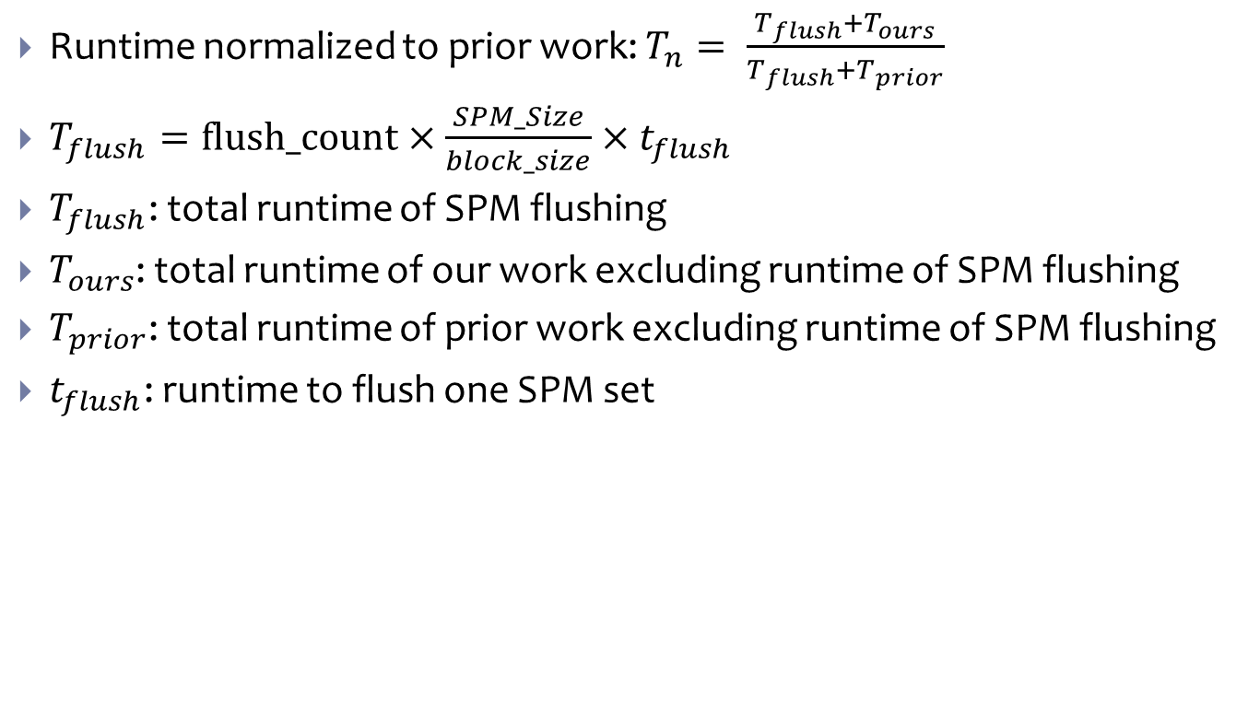
Case Study: Scalability of Dijkstra
Runtime normalized to prior work: $T_{n}= \frac{T_{flush}+T_{ours}}{T_{flush}+T_{prior}}$
$T_{flush}=flush_count×\frac{SPM_Size}{block_size}×t_{flush}$
$T_{flush}$: total runtime of SPM flushing
$T_{ours}$: total runtime of our work excluding runtime of SPM flushing
$T_{prior}$: total runtime of prior work excluding runtime of SPM flushing
$t_{flush}$: runtime to flush one SPM set

