Slide 1
InCheck – An Integrated Recovery Methodology for nZDC
Dheeraj Lokam
Compiler Microarchitecture Lab
Arizona State University

Slide 2


Slide 3
Key Takeaways
Implementing light weight checkpointing at assembly level
Accomplishing a quick recovery on top of an existing detection scheme
A recovery methodology with near zero failure rate

Slide 4
Reliability is a first class design concern:
Aggressive transistor feature scale down rendered processors to become more and more susceptible to Soft-Errors.
Typically cause by cosmic particle strikes
Transient Errors/LETs are a major threat to system reliability
Silent Data Corruptions
System Hangs
Segmentation Faults
Silent Data Corruptions (SDC) are the most difficult errors to catch
They don’t generate any symptom
Undetectable by simple hardware/software detectors
0
1

Slide 5
Why Software Level Techniques?
Flexibility
They can optimized based on the workload characteristics without having to change the hardware
Coverage
There are software techniques that can provide near zero SDC
Eg. nZDC
Cheap
They can be implemented on any off-the-shelf processor
Software level techniques can now be used
to protect any application from soft-errors

Slide 6
Soft-Error detection through Software
Full duplication should detect almost all soft-errors
Can be done at multiple levels of abstraction
Process-level duplication
Assembly-level Instruction duplication
Provides fine details of actual execution
Easy to optimize
Coarse-grained approach
Fine-grained approach
Process A
Process A*
Core 1
Core 2
comparator

Slide 7
Software Implemented Detection
Main Stream
Shadow
Re-execute
Error Detected?
In many real-life applications, restart is not an option!
Interactive applications
Applications with considerably long execution times

Slide 8
Recovery by Triplication
Main Stream
Shadow1
Shadow2
Majority Voting

Slide 9
Implementing recovery on top of detection is tricky
Improperly done Triplication could jeopardize detection’s fault coverage:
Majority voting becomes a single point of failure
Adding more instructions within vulnerable windows makes things worse
Lessons learnt from the past!
Transforming SWIFT to SWIFT-R compromises the error coverage

Slide 10
SWIFT is not effective!
mov x1, #0x04
mov x1*, #0x04
= Vulnerable
mov
mov
Original Code
= Protected
cmp x1, x1*
b.ne error
load x2, [x1]
mov x2*, x2
mov x1, #0x04
load x2, [x1]
add x2, x2, #0x10
and x1, x2, #0x10
store x2, [x1]
Checking Value
load
Load value duplication
add x2, x2, #0x10
add x2*, x2*, #0x10
and x1, x2, #0x10
and x1*, x2*, #0x10
add
add
and
and
cmp x2, x2*
b.ne error
cmp x1, x1*
b.ne error
store x2, [x1]
Checking Address
Checking Value
store

Slide 11
SWIFT-R makes things worse!
= Vulnerable
mov
mov
mov
= Protected
SWIFT
SWIFT-R
Checking Value
mov
mov x1, #0x04
mov x1*, #0x04
mov x1, #0x04
mov x1*, #0x04
mov x1**, #0x04
mov
Checking Value
Checking Value
cmp x1, x1*
b.ne error
load x2, [x1]
mov x2*, x2
Checking Value
majority_voting (x1, x1*, x1**)
load x2, [x1]
mov x2*, x2
mov x2**,x2
load
load
Load value duplication
Load value duplication
add x2, x2, #0x10
add x2*, x2*, #0x10
and x1, x2, #0x10
and x1*, x2*, #0x10
add
add
add
add x2, x2, #0x10
add x2*, x2*, #0x10
add x2**, x2**, #0x10
and x1, x2, #0x10
and x1*, x2*, #0x10
and x1**, x2**, #0x10
and
add
and
add
and
majority_voting (R, R*, R**)
cmp R, R*
b.ne recover from R**
cmp R,R**
b.ne recover from R*
cmp R*,R**
b.ne recover from R
and
Checking Address
and
Checking Address
Checking Address
cmp x2, x2*
b.ne error
cmp x1, x1*
b.ne error
store x2, [x1]
Checking Address
Checking Value
Checking Value
Checking Value
store
majority_voting (x2, x2*, x2**)
majority_voting(x1, x1*, x1**)
store x2, [x1]
Checking Value
store

Slide 12
SWIFT vs SWIFT-R SDC Distribution
10,000 experiments per benchmark

Slide 13
Recovery by checkpointing:
Main Stream
Shadow
check-point
Error Detected?

Slide 14
Lessons learnt from prior checkpointing approaches
Coarse grained approaches pause the execution to make checkpoints.
More Storage space needed – 0.5-1 GB *
Most HPC facilities spend almost half their time in checkpointing **
Fine-grained checkpointing were proposed by integrating checkpointing into the application itself.
Storage space needed for checkpointing – in the order of bytes
Checkpointing overhead – in the order of ns
Recovery time can be more deterministic and quick
Existing methods of fine-grained checkpointing could not produce guaranteed recovery. Eg: FASER
Unsafe Checkpointing
Unsafe recovery
* Dong, Xiangyu, et al. "A case study of incremental and background hybrid in-memory checkpointing." Proc. of the 2010 Exascale Evaluation and Research Techniques Workshop. Vol. 115. 2010.
**Elmootazbellah N Elnozahy and James S Plank. Checkpointing for
peta-scale systems: A look into the future of practical rollback-recovery.
IEEE Transactions on Dependable and Secure Computing, 1(2):97–
108, 2004.

Slide 15
FASER* - Fine-grained Soft-Error Recovery
Inherits all the vulnerabilities from SWIFT.
SWIFT Basic Block
FASER Basic Block
Save_BB_label
cmp R1, R1*
b.ne error
load R2, [R1]
mov R2*, R2
add R2, R2, #0x10
add R2*, R2*, #0x10
cmp R2, R2*
b.ne error
mov chkpt_reg, R2
cmp R1, R1*
b.ne error
load R2, [R1]
mov R2*, R2
add R2, R2, #0x10
add R2*, R2*, #0x10
Xu, Jianjun, et al. "An instruction-level fine-grained recovery approach for soft errors." Proceedings of the 28th Annual ACM Symposium on Applied Computing. ACM, 2013.

Slide 16
Goal of InCheck:
Integrating recovery on top of a detection technique,
Without compromising the coverage provided by detection
With a low recovery latency
Recent work, nZDC could accomplish near Zero SDC by detecting every error. So, it was chosen as the candidate to implement InCheck Recovery.

Slide 17
nZDC: Compiler transformations for complete protection from SDC
nZDC could accomplish full instruction duplication
Logical and Computational Instructions
Memory read instructions
Memory write instructions!
Checking load instructions act as duplication for Stores
Compare instructions
Duplicated by nZDC CFC
Branch instructions
Direction as well as target address checking
nZDC could achieve its goal
Near zero Silent Data Corruption at Processor Level
nZDC protected programs execute faster than their SWIFT counterparts

Slide 18
nZDC transformations:
nZDC transformation
mov x1, #0x04
mov x1*, #0x04
Un-Reliable Code
load x2, [x1]
load x2*, [x1*]
mov x1, #0x04
load x2, [x1]
add x2, x2, #0x10
and x1, x2, #0x10
store x2, [x1]
add x2, x2, #0x10
add x2*, x2*, #0x10
and x1, x2, #0x10
and x1*, x2*, #0x10
store x2, [x1]
load x2, [x1*]
cmp x2, x2*
b.ne error

Slide 19
InCheck + nZDC:
InCheck is a fine-grained technique that performs recovery by
making light weight checkpoints
Yes
Recovery Mechanism
check-
pointing
redundant execution
Detection Mechanism
Error Diagnosis Mechanism
error detected?
error recoverable?
No
Detected/
Unrecoverable
InCheck performs recovery only when it’s sure that its going to be error-free.

Slide 20
InCheck Transformation:
InCheck Basic block:
CHECK POINTING
Register File Preservation
Memory Preservation
Checkpoint Error Detection
Control Flow Error Check
Restart
nZDC Basic block:
Redundant Execution
main thread
shadow thread
Error detected?
nZDC error detected!
Recovery
Memory Restore
Register File Restore

Slide 21
Key Features of Recovery
Memory preservation and Restoration
2 Phase Checkpointing
Recovery from CF errors

Slide 22
Need for Memory Preservation & Restoration:
Original program
First-cut recovery scheme (with register restoration only)
InCheck recovery (with memory and register restoration)
checkpoint:
Soft-error happens on R1
checkpoint:
Soft-error happens on R1
preserve (R2)
preserve (R2)
preserve ([R2])
BB: load R1 <- [R2] load R1* <- [R2*] R1++
R1*++ store R1 -> [R2] load R1 <- [R2*] cmp R1, R1* b.ne recovery
BB: load R1 <- [R2] load R1* <- [R2*] R1++
R1*++
store R1 -> [R2] load R1 <- [R2*] cmp R1, R1* b.ne recovery
load R1 <- [R2]
R1++
store R1 -> [R2]
recovery:
recovery:
register recovery:
load R1 <- [memory] load R2 <- [memory, #4] branch to BB
memory recovery:
restore([R2])
register recovery:
restore R2 branch to BB
Value in memory location [R2]:
[R2]
10
16
16
16
17
Q
10
10
11
P
10
11
[R2]
10
10
[R2]
10
10
16
In recovery block, R2 is loaded with correct initial address but [R2] remains un-restored
In recovery block, [R2] is re-loaded with its initial value before store operation

Slide 23
2 Phase Checkpointing:
Memory A
Check pointing to mem. A:
Memory B
Register File Preservation
Checkpoint Error Detection
Error detected?
Inter block Recovery:
Restore from check pointing memory B
Jump back to beginning of prev. BB
BB1
Redundant Execution
Memory A
main thread
shadow thread
Intra block Recovery:
Memory B
Restore from check pointing memory A
Re-execute from the beginning of current BB
Error detected?
Memory A
Check pointing to mem. B:
Memory B
Register File Preservation
Checkpoint Error Detection
Error detected?
Inter block Recovery:
BB2
Restore from check pointing memory A
Jump back to beginning of prev. BB
Redundant Execution
Intra block Recovery:
main thread
Restore from check pointing memory B
Re-execute from the beginning of current BB
shadow thread
Memory A
Error detected?
Memory B

Slide 24
Recovery from Control Flow Errors:
nZDC + InCheck
Check pointing:
Check pointing:
Register File Preservation
Checkpoint Error Detection
Save label addr. of current BB
Register File Preservation
Checkpoint Error Detection
Save label addr. of current BB
nZDC
BB 3:
BB 1:
BB 3:
BB 1:
Redundant computation
Redundant computation
Redundant computation
Redundant computation
main thread
shadow thread
main thread
shadow thread
main thread
shadow thread
main thread
shadow thread
cond. branch BB 2
cond. branch BB 2
cond. branch BB 2
cond. branch BB 2
BB 2:
Check pointing:
Redundant computation
main thread
shadow thread
Register File Preservation
Checkpoint Error Detection
Control Flow Error Detection
if error detected?
BB 2:
Redundant computation
nZDC Control Flow Error Detection:
CF error detected? -> exit( )
recovery:
main thread
shadow thread
step-1:Restore Registers & memory step-2: Jump back to label address stored in label_reg
nZDC Control Flow Error Detection:
CF error detected? -> exit( )

Slide 25
Experimental Setup
ARM cortex A-53 like micro-processor simulated in gem5
Parameter | Value
CPU Model | ARM64 bit in-order processor
Pipeline | Two way/4-stage
Number of FUs | 2Int, 1Mul, 1Div, 1Float, 1Mem
L1 D/I-Cache | 64KB(2-way) / 32KB (2-way)
TLB Size | 512 entries
Integer registerfile | 32 registers (64-bit width)
Store Buffer Size | 5 entries

Slide 26
Experimental Setup
Processor Components subjected to FI
Register File
Load Store Queue
Pipeline Registers
Functional Unit
6 benchmarks from MiBench were subjected to FI
72,000 Faults Injection Experiments Overall
12,000 FI Experiments per benchmark for all 4 components
3000 FI Experiments per component per benchmark
95% confidence level and 1% error margin

Slide 27
Understanding Results:
Segmentation Fault
Recognizable Change
in program behaviour
ARM Cortex
A 53
Program Abort
Masked
No Change
in program behaviour
Recovered
SDC
Un-Recognizable Change
in program behaviour
Detected/Not-Recoverable
*For InCheck only

Slide 28
SDC Distribution in Processor-wide Fault Injection Experiments
Processor components subjected to FI
Register File
Load Store Queue
Pipeline Registers
Functional Units
72,000 Random Faults Overall
12,000 per benchmark
3000 per component in each benchmark
1% Error Margin
95% Confidence
Segmentation Fault
Recognizable Change
in program behaviour
ARM Cortex
A 53
Program Abort
No Change
in program behaviour
Masked
Recovered
SDC
Un-Recognizable Change
in program behaviour
Detected/Not-Recoverable
*For InCheck only
0

Slide 29
SDC Distribution in Component-wise Fault Injection Experiments
0
0
0
0

Slide 30
Recoverable & UnRecoverable Errors in InCheck

Slide 31
Performance evaluation:
nZDC+InCheck programs run 105% faster than SWIFT-R
386%
281%

Slide 32
Dynamic Instruction breakdown of InCheck+nZDC

Slide 33
Future Work:
RTL level fault injection experiments have to be performed to evaluate the effectiveness of InCheck
Gem5 may not be modeling all the architectural bits accurately
Moving towards formal analysis methods to evaluate InCheck's Fault Tolerance more precisely

Slide 34
My Publications & Other Projects:
NEMESIS: A Software Approach for Computing in Presence of Soft Errors
Moslem Didehban, Dheeraj Lokam, Aviral Shrivastava
*Under review. Submitted to ASPLOS 2017.
InCheck: An Integrated Recovery Methodology for fine-grain Soft Error Detection Approaches
Dheeraj Lokam, Moslem Didehban, Aviral Shrivastava
*Submitting to DAC 2017
VeriFi: A Versatile Fault Injection Methodology for an accurate estimation of Soft-Error Resilience
*Work Under Progress

Slide 35
Backup Slides

Slide 36
Fault, Error and Failure
activation
propagation
FAULT
ERROR
FAILURE
fault latency
error latency
a physical defect that
occurs within hw or sw
components
a deviation from accuracy or correctness
nonperformance of
some action that is due or expected
manifestation of a fault
malfunction
HW defect, SW bug
Physical
Universe
Informational
Universe
External
Universe
physical entities
making up a system
units of information
(eg: data words)
the user of a system
ultimately see the effects
[Geffroyand, 02] Jean-Claude Geffroyand Gilles Motet, “Design of Dependable Computing Systems”, KluwerAcademic Publishers, 2002, ISBN 1-4020-0437-0
Notes:
Now we like to distinguish faults, soft errors and failures to get rid of naming confusions.

Slide 37
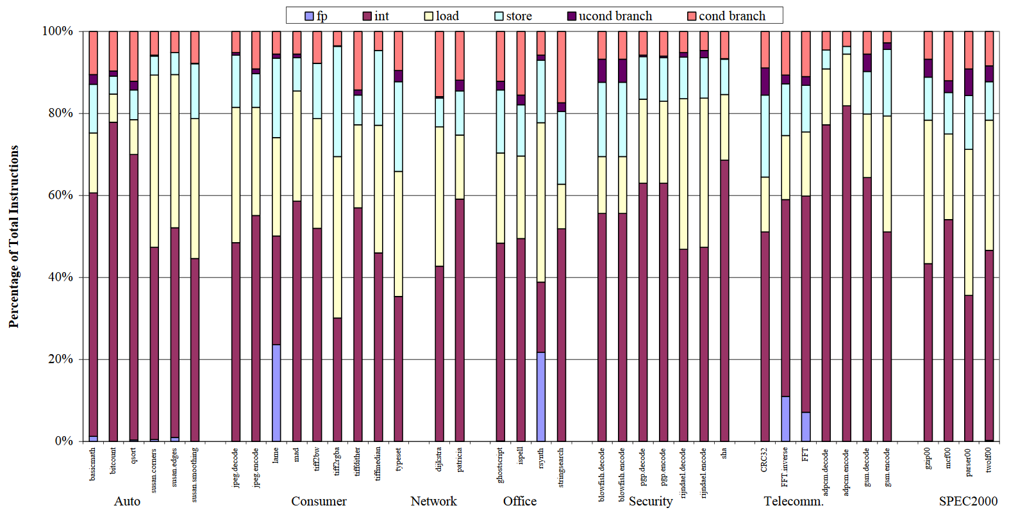
SWIFT Limitations
Duplicable (Protected)
Computational and Logical instructions
Non-Duplicable (Unprotected)
Memory operations and Control Flow instructions
More than 45% of dynamic instructions are non-duplicable

Slide 38
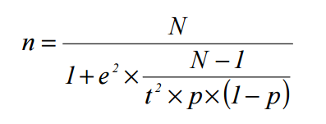
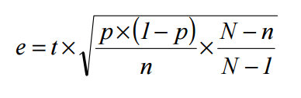
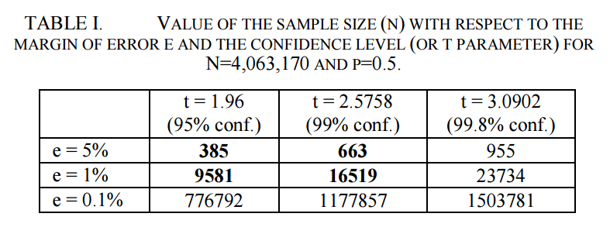
Statistical Fault Injection
N – Initial Population Size
p – estimated probability of faults resulting in a failure (standard error)
e – margin of error
t – confidence level. Probability that the exact value is actually within the error interval (computed w.r.t Normal distribution)
*Leveugle, Régis, et al. "Statistical fault injection: quantified error and confidence." 2009 Design, Automation & Test in Europe Conference & Exhibition. IEEE, 2009.

