Slide 1

Branch Penalty Reduction by Software Branch Hinting
Jing Lu
Yooseong Kim, Aviral Shrivastava, and Chuan Huang
Compiler Microarchitecture Lab
Arizona State University, USA

Slide 2
Summary
Branch predictor needed for high performance, but consumes too much power.
As power-efficiency becomes the key design metric, push to remove branch predictor
Possible solution: Software Branch Hinting
Contributions of this paper:
1. Develop a model of branch hinting for the compiler
2. Propose first solution to the problem of “Where to place branch hints”
3 basic methods
Combined heuristic
Reduce branch penalty by 20% on average, compared to SPU GCC –O3
Avg. performance improvement ~ 7%.
Notes:
Branch predictor is a powerful lever over performance, but it consumes so much power that as power efficiency becomes the key design metric, people are considering of removing it. One possible solution is to use software branch hinting to take place. In this paper, we develped a model of branch hinting for the compiler and propose our first solution to the problem of branch hint placement with 3 basic methods and a combined heuristic. Our solution can reduce branch penalty by 20% on average, compared to SPU GCC –O3

Slide 3
Branch Prediction
Improve performance in pipelined processors
1. Increasing branch mis-prediction penalty
Pipelines becoming longer
Branch penalty ~ 10-20 cycles in modern processors
2. Improve ILP
Speculative, OOO execution can reorder instructions
Without branch prediction – can only reorder inside BB
Every 5-8th instruction is a branch
Trend of Increasing Complexity of Hardware Branch Predictor
BTB Size
Alpha EV6 - 36kbit BTB, EV8 - 352 Kbit
Branch Prediction Complexity
Alpha EV6 - Hierarchical tournament, EV8 - e-gskew and bimodal
Notes:
Branch predictor has long been an important study area because it’s a power lever over performance. It improve performance in two aspects. Firstly, it reduce branch penalty, especially considering the fact that piplelines are becoming longer, with branch peanlty between 10- 20 cycles in modern processors. The other aspect is more subtle but also very important. That is, branch predictor can serve to improve instruction level parallalism. Becase in speculative architectur, out of order execution can be achieved by reordering instructions. Without branchprediction, reorder can only be done inside basic block. Howeve, because of branch predictor, more instructions can be prefeched, which increase the opportunity of reordering.
In order to reduce branch penalty, there is a clear trend that…
One limitation of pipelined……
That’s why ranch prediction has long been an important area of study for micro-architects, because prediction accuracy is such a powerful lever over performance.
In order to achieve high prediction accuracy, there is clear trend that processors tend to use larger, more energy demanding branch predictors. The Alpha EV6 that was released in 1997 used 36 Kbits in its branch predictor while Alpha EV8, which was planned for release after 2001 used 352Kbits, an almost ten-fold increase.
Comments: aviral: pronounciation of hierarchical. Find out what is 2BC-gskew?

Slide 4
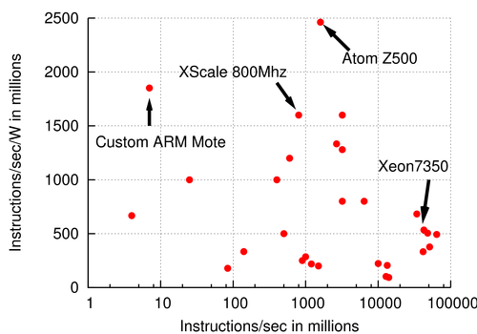
Times are a changing
Already dissipating more power than cooling efficiency
Cap on power and power-density
Cannot improve performance without improving power-efficiency
Multi-core era
Cores are becoming simpler
Simpler cores are more power-efficient
Power-efficiency of system = power-efficiency of core
Performance scaling by number of cores
Simple, power-efficient cores
No speculation
In-order execution
Branch predictor???

Slide 5
Can we get rid of Branch Predictor?
Needed for performance
Consumes too much power
10% of on-chip power dissipation^{[1]}
IBM Cell processor
Extremely power-efficient
5 Gops/W
Compare to Intel Core 2 duo
0.2 Gops/W
No branch prediction
NOT Taken
Runtime
Power
Branch Penalty on Cell SPUs can be high for some embedded applications
Benchmark | Branch penalty
cnt | 59%
Insert_sort | 31%
Janne_complex | 63%
ns | 51%
select | 36%
[1] D.Parikh et.al., Power Issues Related to Branch Prediction. In Proc. Of HPCA, 2002
Notes:
While we need to ….Wthe turn of the century, multi-cores and power-efficiency became an increasingly important consideration in processor design. With the total power budget capped, more cores can only be added by reducing the power and the complexity of each core
Consequently, reducing branch predictor energy consumption becomes important, as branch predictors already account for a large fraction of on-chip power dissipation, which is as much as 10%.

Slide 6
Software Branch Hinting
L3: shli $13,$11,2
selb $6,$6,$15,$8
rotqby $2,$12,$7
hbrr L14,L4
ai $6,$6,1
cgti $3,$6,2
a $5,$9,$2
lnop
selb $10,$5,$10,$8
L14: brz $3,L4
ai $11,$11,1
ceqi $18,$11,3
Branch Hint Instruction
hbr <branch address> <target address>
Branch instruction at <branch address> jumps to <target address>
Inserted by Compiler/Programmer
Negligible power consumption
Some branch targets are easily known
Unconditional branches
Loops branches
Benchmark | Branch penalty without hint | Branch penalty with GCC hint
cnt | 59% | 29%
Insert_sort | 31% | 19%
Janne_complex | 63% | 58%
ns | 51% | 28%
select | 36% | 32%
Notes:
To work around it, it seems software branch hinting can be a promising candidate to take place branch predictor. software branch hinting is implement in Cell SPU in the hope to cover lost performance, while at the same time, stay inside power budget. The branch hint instruction is composed of a branch address and a target address. indicate that the branch instructions at specified PC addresses will jump to specified target addresses. The hint instructions are inserted by compiler, all the decision making is in software, so it will lead to minimum power consumption.

Slide 7
Contributions of this work
Modeling Branch Hinting Mechanism
How does branch hinting work?
How can we make performance model of branch hinting for the compiler to use?

Slide 8

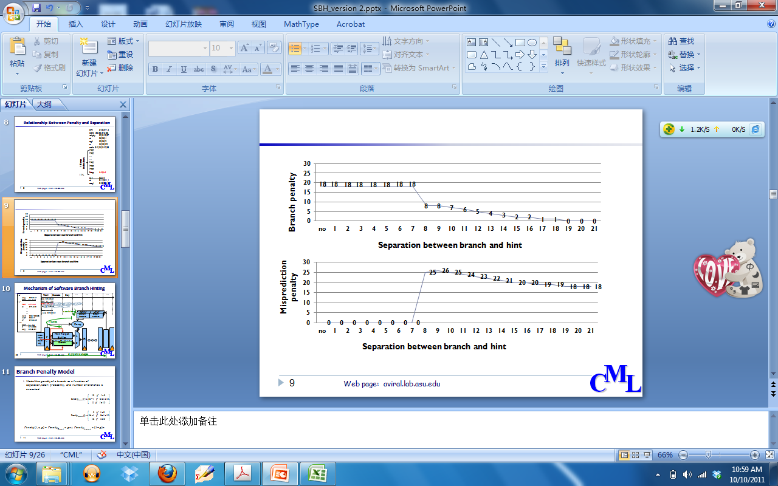
Branch and Hint Separation
shli $13,$11,2
selb $6,$6,$15,$8
rotqby $2,$12,$7
ai $6,$6,1
cgti $3,$6,2
a $5,$9,$2
selb $10,$5,$10,$8
lnop
lnop
…
…
Experiment on Cell SPU hardware:
Separate hint and branch by nop instructions
Execution time measured using SPU decrementer
18 nop instructions
lnop
lnop
Penalty when hint is correct
lnop
hbrr L14,L4
lnop
L14:
brz $3,L4
ai $11,$11,1
ceqi $18,$11,3
Notes:
In the experiment we run a synthetic benchmark composed a branch and a hint and separated them by vary number of instructions.

Slide 9
Mechanism of Software Branch Hinting
branch address
target address
branch address
target address
branch address
target address
Comparator
1
PC
IR
Instruction
memory
Hint Target
Buffer
1
BR
Inline Prefetch
Buffer
BH
0
Notes:
This figure shows how software branch hinting changes the prefetch behavior of a processor. Usually there are two instruction buffers in a processor. In most of the time, the processor fetches instruction from inline prefetch buffer. When there is a hint instruction coming, it first needs some time to be recognized, and then it load instructions from target address to hint target buffer. After the branch instruction is executed, the pipeline directly fetch instruction from hint target buffer.

Slide 10
3 Key Parameters of Software Branch Hinting
s entries
branch address
target address
branch address
target address
branch address
target address
f cycles
Comparator
PC
IR
Instruction
memory
Hint Target
Buffer
1
Inline Prefetch
Buffer
0
d cycles to register hint
Notes:
This figure shows how software branch hinting changes the prefetch behavior of a processor. Usually there are two instruction buffers in a processor. In most of the time, the processor fetches instruction from inline prefetch buffer. When there is a hint instruction coming, it first needs some time to be recognized, and then it load instructions from target address to hint target buffer. After the branch instruction is executed, the pipeline directly fetch instruction from hint target buffer.

Slide 11
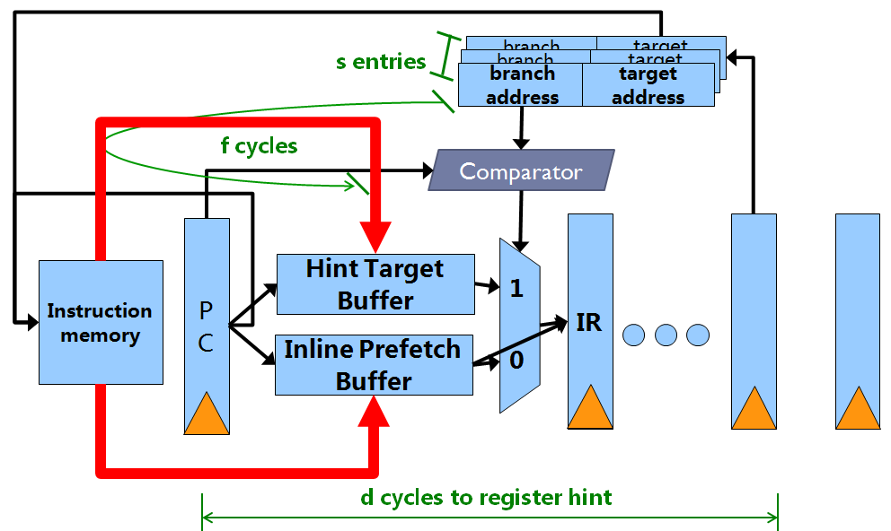
Parameters of Branch Hinting
d: How many cycles to register hint?
If separation less than “d”, then hint is not active
For Cell, d=8
s: Size of Branch Target
Buffer
How many hints can be
effective at a time?
For Cell, s = 1
f: Cycles to load instructions from memory
into hint target buffer
If separation is more than “d+f”, then no penalty
For cell, f = 11, therefore penalty =0, if separation > 18

Slide 12
Branch Penalty Model for Compiler
Model the penalty of a branch as a function of separation, taken probability, and number of branches is executed
Notes:
Our approach alleviates some of the problems of GCC. It carefully analyze conflicting branches and is able to hint them better through accurate cost functions. And it is based on an accurate branch penalty model. Here we model the penalty of a branch as a function of separation in terms of number of instructions, the branch probability, and the number of branches is executed.
To do this, we conducted experiments on Cell spu hardware, shows the change of branch penalty with the change of separation between a branch and its hint, when the hint is correct and incorrect, respectively. The first curve is when the hint si correct, that is, the branch is actually taken.
Overall, the penalty of a hinted branch is the sum of penalty of correct hint when branch is taken, plus the sum of penalty of incorrect hint when branch is not taken.

Slide 13
Branch Penalty Model for Compiler
Model the penalty of a branch as a function of separation, taken probability, and number of branches is executed
n = no. of times branch is executed
hbrr L14, L4
l = separation between branch and hint
L14:
brz $3, L4
p =branch probability
1-p
L15
L4
Notes:
Our approach alleviates some of the problems of GCC. It carefully analyze conflicting branches and is able to hint them better through accurate cost functions. And it is based on an accurate branch penalty model. Here we model the penalty of a branch as a function of separation in terms of number of instructions, the branch probability, and the number of branches is executed.
To do this, we conducted experiments on Cell spu hardware, shows the change of branch penalty with the change of separation between a branch and its hint, when the hint is correct and incorrect, respectively. The first curve is when the hint si correct, that is, the branch is actually taken.
Overall, the penalty of a hinted branch is the sum of penalty of correct hint when branch is taken, plus the sum of penalty of incorrect hint when branch is not taken.

Slide 14
Contributions of this work
1. Modeling Branch Hinting Mechanism
How does branch hinting work?
How can we make performance model of branch hinting for the compiler to use?
2. Branch Hint Placement
3 basic branch hint placement methods
NOP padding
Hint Pipelining
Loop restructuring

Slide 15
Related Work
Predication [Muchnick 97]
Extra hardware overhead and power consumption
Loop Unrolling [Muchnick 97]
Increase code size
Energy efficient branch prediction on Cell SPUs [Briejer 10]
Involving hardware branch predictor
Software branch hinting
Static Branch Probability Analysis
[Ball 93], [Wu 94]
Static Branch Hint Placement
[SPU GCC, This work]
Notes:
While most branch predictors are profiling based, program-based branch predictor has been proposed, in which the probability of non-loop branches was analyzed statically.
Another approach estimates not only branch probabilities but also the execution frequencies of blocks and edges, including function calls, in Control Flow Graphs (CFGs). These techniques are already embedded in GCC compiler. So it is not the focus of this paper.
In processors with only software branch hinting, branch penalty can be reduced by predication, executing both possible execution paths. But Predication will incur extra hardware overhead, and thus increase power consumption.
Loop unrolling can also reduce branch penalty by reducing the number of times branches are executed. But it will increase code size, for processing units designed with minimum hardware in multicore processors, such as Cell SPU processor, the size of local memory is limited, and increased code size would incur performance and power consumption overhead.
There are other studies on energy efficient branch prediction on Cell SPUs by modifying hardware. The perfomance and power trade-off of different hardware setupsis studied, and hardware branch predictor is present in conjunction with sorftware branch hinting. But this method involve hardware overhead and thus power consumption.
GCC compiler, included in IBM Cell BE SDK, has a heuristic to insert branch hint instructions to the code. This could be the closest related work.
It works with a set of principles such as moving hint instructions outside the loop to reduce the overhead of executing hints repeatedly., and giving priority to hinting innermost loop branches. GCC suffers from several problems in effectively hinting branches.

Slide 16
Branch Hint Placement Problem
Input：
Control Flow Graph
For each branch
Taken probability
execution count
Output:
Where to insert hint?
Which branches to hint?
Objective
Minimize total branch penalty
hbrr L14, L4
d=10
n₁
L14:
brz $3 , L4
1 - p₁
p₁
n₂
d=2
Too small!
hbrr L16, L5
L4
brz $3 ,L5
L16：
1– p₂
p₂
L5

Slide 17
SPU GCC Branch Hint Placement
GCC Compiler in IBM Cell BE SDK
Hint most important branches
Hint only one of two closely placed branches
Hint only innermost loop in nested loops
L1
L2
L3
hbrr b₃, L3
b₃:
brnz $4, L3
Separation too small
L4
hbrr b₄, L2
b₄:
brnz $5, L2

Slide 18
Branch Hint Reduction Methods
Three basic techniques:
NOP Padding
Finds out the number of NOP instructions needed between a branch and its hint to maximize profit
Hint Pipelining
Enables hinting branches that are very close to each other
Loop Restructuring
Hint nested loops
Notes:
In the following slides, I will talk about our branch hint reduction methods.
It will be composed of two parts, … In the second part, we developed a heuristic which combines the three techniques and apply each of them prudently

Slide 19
NOP Padding
Benefit of NOP Padding
Insert nop and lnop instructions to artificially in crease separation
Case (a):
Separation=4
Branch penalty=18 cycles
Case (b):
Separation=4
Branch penalty= 10cycles
Profit=8 cycles
hbrr
nop
lnop
nop
lnop
hbrr
…
…
…
…
…
…
separation=8
separation=4
br
br
(a)
(b)
Notes:
When the enough separation cannot be accommodated, we can insert nop and lnop instructions to artificially increase the separation. Here the condition when NOP padding can be beneficial to performance is analyzed. The benefit comes from the difference of branch penalty before and after applying nop padding. And the overhead is the execution time of extra nop instructions. We apply nop padding only when the profit is positive, that is, the benefit surpass the overhead

Slide 20
Hint Pipelining
L1:
L1:
hoist the hint for b₂ above b₁ to increase separation
Can not hint b₁
Place the hint for branch b₂ less than eight instructions ahead of branch b₁
hbrr b₁, L2
hbrr b₂, L3
l₁= 10
b₁:
br z $3, L4
b₁:
brz $3, L4
7
L2:
l₁+l₂ = 17
L2:
hbrr b₂, L3
l₂ = 10
br L3
b₂:
Case (a):
Penalty_b₁ =18 cycles, Penalty_b₂ =0 cycles
Branch penalty=18 cycles
b₂:
br L3
(a)
(b)
Case (b):
Penalty_b₁ =7 cycles, Penalty_b₂ =1 cycle
Branch penalty=8 cycles
Overhead: 1 hint instruction
Profit = 18-(8+1)=9 cycles
Notes:
As shown in this example, a compiler may try to hoist the hint for branch b2 above branch b1 to increase separation. This will lose any opportunity to hint branch b1, and this is another common performance limiting factor in GCC. In this case, GCC will simply give up hinting b1 since b2 has more priority. To overcome this problem, let us consider the fact that a hint is not effective if the separation is less than 8 instructions. This bive us an intuition that if we place the hint of b2 within 7 instructions above branch b1, the hint will not be active when branch b1 is executed. Now if we insert the hint for b1 above the hint for b2, it will not be overwritten by the second hint. As a result, we can hint both of the hints in this case. We always analyze the benefit againts the penalty before applying this method. Here …

Slide 21
Loop Restructuring
Branch penalty from loops will be accumulated
Observation: only inner most look can be hinted
Change structure of loop
Separation too small
L1
L1
b₁:
br L2
L2
L2
L3
hbrr b₃, L3
L3
hbrr b₃, L3
Inner loop body
b₃:
brnz $4, L3
b₃:
brnz $4, L3
brz $5, L5
Increased space
Outer loop body
L4
hbrr b₄, L2
L4
hbrr b₄, L2
Space for hint
Space for hint
b₂:
b₄:
brnz $5, L2
b₄:
brnz $5, L2
br L3
L5
L5
Notes:
The branch penalty from loops is important, because even a small penalty can be accumulated in the whole iteration and affect the performance significantly. Here we present a technique specially designed for nested loops. This technique is motivated by our observation that in nested loops, only innermost loop can be hinted. As shown in this figure, if the separation is too small to have the hint recognize, the hint need to be cancelled. Here we change the structure of nested loops, so that the space to hint the outer loop can be enlarged.

Slide 22
Contributions of this work
1. Modeling Branch Hinting Mechanism
How does branch hinting work?
Performance model of branch hinting for the compiler
2. Branch Hint Placement
3 basic branch hint placement methods
NOP padding
Hint Pipelining
Loop restructuring
Profitability analysis for each method
3. Heuristic to apply these techniques to a given application
Prudently apply each method with profitability analysis in each step
Please see paper for details

Slide 23
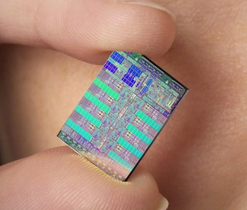

Experimental Setup
Baseline of Comparison is GCC compiler
Included in IBM Cell BE SDK
Benchmarks compiled with -O3 optimization level
Benchmarks from Multimedia Loops and WCET benchmarks
“low” and “high” group according to percentage of branch penalty
Performance measured using IBM SystemSim simulator
Cycle accurate
Provide statistic results:
Total execution cycle
Number of branch penalty cycle
nop cycle
Measurements are done only on user codes
Library functions are not changed
Branch probability and Cyclic frequencies obtained by static analysis
Also implemented in GCC
Multimedia Loops
WCET Benchmarks

Slide 24
Average 20% branch penalty reduction
high
low
Max 35% reduction
Deeply nested loops
Reduce average 19.2% of the branch penalty more than GCC
Consider the increased NOP cycles as part of branch penalty
More effective for deeply nested loops
Notes:
The effectiveness of our heuristic can be shown as the reduction of branch penalty after applying our heuristic.

Slide 25
Average 10% speedup
high
low
Peak Speed up of 18%
“High” group more susceptible to branch penalty reduction
Involves profitability analysis

Slide 26
Summary
Branch predictor needed for high performance, but consumes too much power.
As power-efficiency becomes the key design metric, push to remove branch predictor
Possible solution: Software Branch Hinting
Contributions of this paper:
1. Develop a model of branch hinting for the compiler
2. Propose first solution to the problem of “Where to place branch hints”
3 basic methods
Combined heuristic
Reduce branch penalty by 20% on average, compared to SPU GCC –O3
Avg. performance improvement ~ 7%.

