Slide 1

Application-aware Performance Optimization for Software Managed Manycore Architectures
Jing Lu
Computer Science, ASU
Supervisory Committee:
Prof. Aviral Shrivastava (Chair)
Prof. Hessam Sarjoughian
Prof. Carole-jean Wu
Prof. Adam Doupé

Slide 2
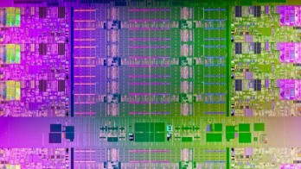
Power efficiency – key in architecture design
Adding Intelligent?
Heat (too much, hard to dissipate)
Power (too high)
Parallelism
Number of cores
Operating frequency
Intel’s Knights Corner is a many-core chip
Performance
power consumption

Slide 3

Challenge of scaling
Power cap
Intel Core i7-7700, 4-core consumes 91W at 4.2GHz
91 ∗ 100/4 = 2275W >> 250W
Coherence maintenance challenge
Snooping
Broadcasting
Shared bus
Not scalable
Directory-based
Additional storage
Increase memory access latency
Network traffic
AMD’s Bulldozer is an example of how bolting more cores together can result in a slower end product
Share logic/caches
Power consumption limits clock speed

Slide 4
Software Managed Manycore Architecture
Shifting intelligence from hardware to software to simplify hardware
Intel SCC (2011)
Kalray MPPA-256 (2013)
Challenges:
Which hardware component to remove?
How to minimize the software overhead?
Our exploration:
Caching mechanism -> Software managed SPM
Branch prediction -> Software branch hinting

Slide 5
Thesis Overview
Stack data management
[DAC 2013] SSDM: Smart Stack Data Management for Software Managed Multicores (SMMs)
Code management
Conference paper: [CODES+ISSS 2013] CMSM: An Efficient and Effective Code Management for Software Managed Multicores
Journal Article: [TECS 2015] Efficient Code Assignment Techniques for Local Memory on Software Managed Multicores
Heap management
[VLSID 2019] Efficient Heap Data Management on Software Managed Manycore Architectures
Software branch hinting
[CODES+ISSS 2011] Branch Penalty Reduction on IBM Cell SPUs via Software Branch Hinting
SPM: scratchpad memory
Main Memory
Simple Core
SPM
DMA Engine
branch address
target address
Instruction
memory
Hint Target
Buffer
IR
1
Inline Prefetch
Buffer
0
Instruction Fetch

Slide 6
Caching -> Software Managed SPM
Tag Array
Data Array
SPM based Multicore
A truly distributed memory architecture on-a-chip
Data transfer
Managed in software
Tag Comparators, Muxes
Address Decoder
Cache
SPM
Execution Core
Execution Core
Execution Core
Execution Core
Execution Core
Execution Core
SPM
SPM
SPM
SPM
SPM
SPM
DMA
Interconnect Bus

Slide 7
Data Management Challenges
Make it work!
Software needs to be aware of :
Local memory availability
Task requirement at every point of time
Minimize overhead
Minimize management code size
Each management instruction is an overhead!
Perform management only when necessary
Minimize data transfer
Size
Frequency
int global;
f1(){
int a;
DMA.fetch(global)
global = global + a;
DMA.writeback(global)
DMA.fetch(f2)
f2();
}
int global;
f1(){
int a;
global = global + a;
f2();
}

Slide 8
Stack Data Management is Important
Stack data management is important
Stack data accesses account for a significant portion of all the memory accesses
Stack data is dynamic
Execution time allocation & de-allocation
Function call & return
Function stack size is known at compilation time, but not stack depth
Recursive functions

Slide 9
Stack Data Management is Challenging
Local scratchpad memory has fixed size
When stack size larger than available memory
Explicit management is required
Or stack data will overwrite heap data which may cause program crash
F3 (30 bytes)
Crash!
F1() {
int a,b;
F2();
}
F2() {
F3();
}
F3() {
int j=30;
}
F1 (50 bytes)
F2 (20 bytes)
Stack Pointer
…...
heap
global
code
(a) Example
(b) State of scratchpad memory before F3 is called

Slide 10
Circular Stack Data Management
F4
F1
Intuitive solution –
Evict some stack data in the stack space to main memory
Bring them back to stack space when the evicted frame is needed
Scratchpad Memory Size = 128 bytes
F2
F3
Start
End
F4
Global SP
F1
Function | Frame Size (bytes)
F1 | 28
F2 | 40
F3 | 60
F4 | 54
32
F2
54
68
F3
128
Scratchpad Memory
Global Memory
[ASAP 2011] Stack Data Management for Limited Local Memory (LLM) Multi-core Processors

Slide 11
How to Manage Stack Data?
Dynamic software technique
fci(func_stack_size)
Check for available space in scratchpad memory
Move old frame(s) to global memory if needed
fco(func_stack_size)
Check if the caller frame exists in scratchpad memory!
Fetch from global memory, if it is absent
F1() {
int a,b;
F2();
}
F2() {
F3();
}
F3() {
int j=30;
}
F3 (30 bytes)
F1 (50 bytes)
F1() {
int a,b;
fci(F2);
F2();
fco(F1);
}
F2() {
fci(F3);
F3();
fco(F2);
}
F3() {
int j=30;
}
F2 (20 bytes)
Stack Pointer
…...
heap
global
code
(b) State of scratchpad memory before F3 is called
(a) Example

Slide 12
Drawbacks of Circular Stack Data Management
Stack memory fragmentation
Book-keeping of complicated information
Stack size of each function
Start & end address of the free slots
Information need to be checked & updated in each management
Better to make small number of large requests than large number of small requests
Memory pipeline is becoming longer
Waiting time to get the chance to access memory
Management function is inserted even when it is not necessary
Every function call
Scratchpad Memory Size = 128 bytes
F4
F1
54
F2
End
Start
68
Global SP
F3
128
Scratchpad Memory
Global Memory
[ASAP 2011] Stack Data Management for Limited Local Memory (LLM) Multi-core Processors

Slide 13
Motivation of Optimizing Stack Management (1)
Opportunities to reduce repeated API
F0() {
F1();
F2();
}
F0() {
F1(){
F2();
}
}
F0(){
while(<condition>){
F1();
}
}
Original code
F0() {
fci(F1);
F1();
fco(F0);
fci(F2);
F2();
fco(F0);
}
F0(){
fci(F1);
F1(){
fci(F2);
F2();
fco(F1);
}
fco(F0);
}
Circular Stack Management Outcome
F0(){
while(<condition>){
fci(F1)
F1();
fco(F0)
}
}
F0() {
fci(max(F1,F2));
F1();
fco(F0);
F2();
fco(F0);
}
F0(){
fci(F1+F2);
F1(){
F2();
}
fco(F0);
}
F0(){
fci(F1);
while(<condition>){
F1();
}
fco(F0);
}
Possible optimization
Sequential Calls
Nested Call
Call in a loop
Notes:
The state-of-the-art circular stack management is more like a brute force solution and has a lot of unnecessary management overhead. Here are some examples of reducing stack data management overhead by increasing the management granularity.
In the first example, there are two sequential functions F1 and F2. Instead of managing F1 and F2 separately, we can manage them all together and reduce management overhead
In the second example, there are nested function calls. Similarly, instead of managing F1 and F2 separately, we can first reserve space for F1 and F2 together, and make sure the stack frame of F0 is in local memory before returning to F0.
The third example is even more interesting. Since F1 is being called in a loop, instead of performing stack data management in every iteration, we hoist the management functions outside of the loop so that those functions will be called by only once.

Slide 14
Motivation of Optimizing Stack Management (2)
Opportunities to simplify management logic
Frequent API calls
Complicated book-keeping
Avoiding thrashing is critical – When to evict the stack frame?
F4
Scratchpad Memory Size = 128 bytes
SP
F1
F1
F2
32
F2
54
F3
68
F4
F3
128
Scratchpad Memory
Global Memory

Slide 15
Optimizing Stack Management
Not performing management when not absolutely needed
Fewer DMA calls
Memory latency of a task will be very strongly dependent on the number of memory requests
Performing minimal work each time management is performed
Transfer stack data at the whole stack space granularity
Management library (_sstore and _sload) becomes simpler
Avoiding thrashing
Place management functions judiciously

Slide 16
Smart Stack Data Management
Formulate the optimization problem of where to insert the management functions so as to minimize the management overhead
Finding an optimal cutting of a weighted call graph
A cutting of the graph is defined as a set of cuts on graph edges, indicating a pair of stack management functions to be inserted respectively before and after a function call.
Cut 0
F0
32
Cut 1
10
F1
128
50
5
F2
32
F4
32
25
Cut 0
F3
20
A new runtime library with less management complexity
An effective heuristic (SSDM)
Takes Weighted Call Graph as input
Generates an effective management function placement scheme
.c
Cut 0
Weighted Call Graph
SSDM
Place info about where to perform management
Runtime
Library .a
compiler
Executable

Slide 17
Cutting of Weighted Call Graph
transform
0
Cut 1
final
artificial edge
main: 128
SP
1
main
1
stream: 1936
print: 32
stream
1
0
Cut 2
Cut 5
1
10
final: 80
update: 1600
init: 0
100
0
Cut 3
1
transform: 352
0
Cut 4
Scratchpad Memory
Global Memory

Slide 18
Stack: Problem Formulation
Formulate library placement as a problem of optimal cutting of a weighted call graph (WCG)
0
Cut 1
artificial edge
main: 128
1
1
stream: 1936
print: 32
1
1
Cut 5
Cut 2
10
0
init: 0
update: 160
final: 80
0
100
1
Cut 3
Transform: 352
0
Cut 4
Notes:
With the idea of placing cutting on the weighted call graph, we formulated the stack data management problem as a problem of optimal cutting of a weighted call graph.

Slide 19
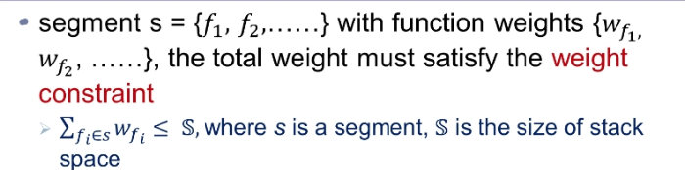
Stack: Management Constraint
0
Cut 1
main: 128
1
1
stream: 1936
print: 32
1
1
Cut 5
10
0
init: 0
update: 160
final: 80
0
100
1
Transform: 352
0

Slide 20
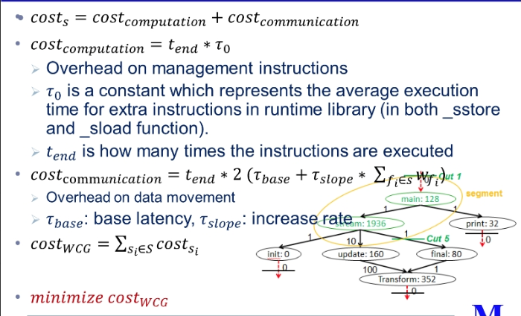
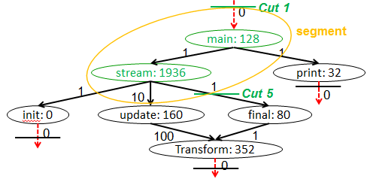
Stack: Overhead Estimation

Slide 21
Illustration of Heuristic SSDM[1]
Cut 0
Cut 0
F0
32
F0
32
Cut 1
10
Cut 1
10
F1
128
F1
128
50
5
iteration 1
50
5
Cut 2
Cut 4
Cut 4
F2
32
F4
32
F2
32
F4
32
Cut 3
25
Cut 0
Cut 3
25
Cut 0
F3
20
F3
20
Cut 0
Cut 0
Segment: <F0>,<F1>,<F1>,<F2>,<F3>,<F4>
Segment: <F0>, <F1,F2>, <F1>,<F3>,<F4>
Cut | 1 | 2 | 3 | 4
Removing benefit | 2104 | 12080 | 5920 | 1256
Cut | 1 | 3 | 4
Removing benefit | 2224 | 6400 | 1256

Slide 22
Illustration of Heuristic SSDM[2]
Cut 0
Cut 0
F0
32
F0
32
Cut 1
10
Cut 1
10
F1
128
F1
128
iteration 2
iteration 3
50
5
Cut 4
50
5
F2
32
F4
32
F2
32
F4
32
25
Cut 0
25
Cut 0
F3
20
F3
20
Cut 0
Cut 0
Segment: <F0>, <F1,F2,F3>,<F1>,<F4>
Segment: <F0>, <F1,F2,F3>,<F1,F4>
Cut | 1 | 4
Removing benefit | x | 1256
Cut | 1
Removing benefit | x

Slide 23

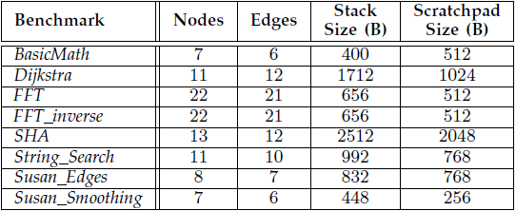
Experiment Setup
Hardware
IBM Cell BE
1 PPE @ 3.2 GHz
6 SPE @ 3.2 GHz
Benchmarks
Mibench – modified to run on SPEs

Slide 24
Overall Performance
11%

Slide 25
Reduction of Management Overhead
13X

Slide 26
Code Management: Problem
Designated code region in the local scratchpad memory
Divide code part of SPM in regions
Map functions to these SPM regions
Functions in the same region placed at the same address
F1
F5
REGION
F2
REGION
F3
F7
REGION
F6
•
•
•
F4
Local Memory Code Section

Slide 27
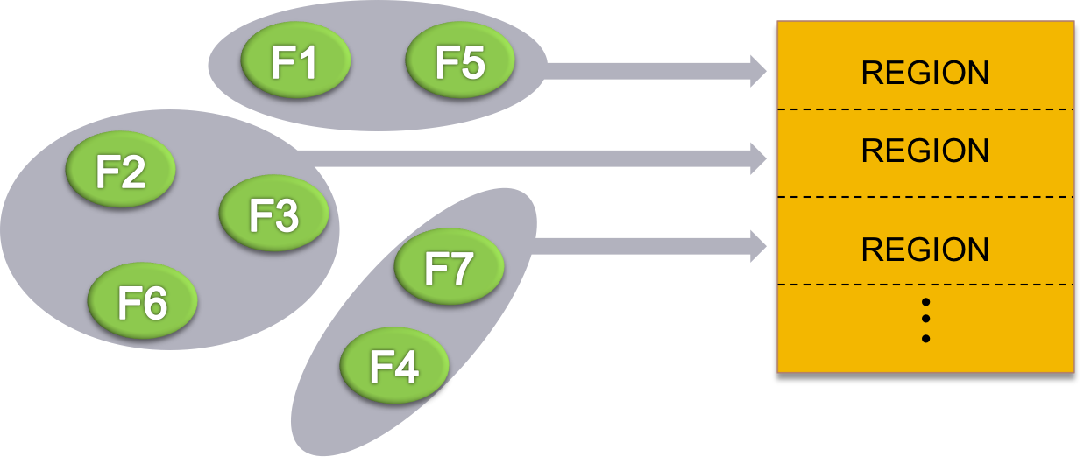
Code Management
Identify shortcomings in previous techniques
Update interference costs after mapping each function
Overhead that two functions were mapped in the same region
Correct interference cost calculation
Consider branch probabilities
Better mapping 89% of time
Accurate cost calculation improves performance by 12% even with previous mapping techniques

Slide 28
Heap Data Management: Problem
Heap data management is important
Heap data accesses may account for a significant portion of data accesses of an application
susan smoothing from MiBench – 94% of data accesses
Heap data management can be challenging
Dynamic nature of heap data
Stack Data
Heap Data
Code Data
Global Data

Slide 29
State-of-the-art: [Bai2013]
Heap management functions are inserted at every data access
Heap accesses are identified at runtime
Raw Code:
int *p1, *p2;
p1 = malloc(20);
p2 = p1;
*p2 = 10;
Converted Code:
int *p1, *p2;
*g2l(&p1) = malloc(20);
*g2l(&p2) = *g2l(&p1);
*g2l(*g2l(&p2)) = 10;
K. Bai and A. Shrivastava, "Automatic and efficient heap data management for Limited Local Memory multicore architectures," 2013 Design, Automation & Test in Europe Conference & Exhibition (DATE), Grenoble, France, 2013, pp. 593-598.

Slide 30
Optimized Heap Data Management
Objectives
Reduce management invocation
Reduce execution time of management library functions
Optimizations
Statically Detect Heap Access
Identify heap accesses at compile-time
Insert management functions only at heap accesses – not on all accesses
Simplifying Management Framework
Implement direct map software cache instead of set associative software cache
Simplify SPM address calculation
De-duplicate management functions
Adjusting Block Size Dynamically
Compiler selects block size according to heap access pattern
Optional optimization for embedded applications

Slide 31
Results of Optimized Heap Management

Slide 32
Data management publications
Stack data management
[DAC 2013] SSDM: Smart Stack Data Management for Software Managed Multicores (SMMs)
Code management
Conference paper: [CODES+ISSS 2013] CMSM: An Efficient and Effective Code Management for Software Managed Multicores
Journal Article: [TECS 2015] Efficient Code Assignment Techniques for Local Memory on Software Managed Multicores
Heap management
[VLSID 2019] Efficient Heap Data Management on Software Managed Manycore Architectures

Slide 33
Branch Prediction
Improve performance in pipelined processors
1. Reducing branch mis-prediction penalty
Pipelines becoming longer
Branch penalty ~ 10-20 cycles in modern processors
2. Improve ILP
Speculative, OOO execution can reorder instructions
Without branch prediction – can only reorder inside BB
Every 5-8th instruction is a branch
Consumes too much power
As high as 10% of on-chip power dissipation[1]
[1] D.Parikh et.al., Power Issues Related to Branch Prediction. In Proc. Of HPCA, 2002

Slide 34
Software Branch Hinting
L4: shli $13,$11,2
selb $6,$6,$15,$8
rotqby $2,$12,$7
hbrr L14,L4
ai $6,$6,1
cgti $3,$6,2
a $5,$9,$2
lnop
selb $10,$5,$10,$8
L14: brz $3,L4
ai $11,$11,1
ceqi $18,$11,3
Branch Hint Instruction
hbrr <branch address> <target address>
Branch instruction at <branch address> jumps to <target address>
Inserted by Compiler/Programmer
Negligible power consumption
Some branch targets are easily known
Unconditional branches
Loops branches

Slide 35
Mechanism of Software Branch Hinting
branch address
target address
branch address
target address
branch address
target address
Comparator
1
PC
IR
Instruction
memory
Hint Target
Buffer
1
BR
Inline Prefetch
Buffer
BH
0

Slide 36
Branch Hint Placement Problem
Only one hint target buffer
One effective hint at any time
Branch hint needs some time to be recognized. Hint target buffer needs time to be filled.
Distance requirement between hint and branch instruction
Objective
Minimize total branch penalty
Output:
Where to insert hint?
Which branches to hint?
hbrr L14, L4
d=10
n₁
L14:
brz $3 , L4
1 - p₁
p₁
n₂
d=2
Too small!
hbrr L16, L5
L4
brz $3 ,L5
L16：
1– p₂
p₂
L5

Slide 37
Branch Penalty Reduction Methods
Three basic techniques:
NOP Padding
Hint Pipelining
Loop Restructuring
Architecture: IBM Cell processor
Performance measurement: SystemSim
Cycle accurate simulator
Baseline: GCC compiler (O3)
Results:
Reduce average 19.2% of the branch penalty more than GCC
Average 10% speedup

Slide 38
Thesis Overview
Software branch hinting
[CODES+ISSS 2011] Branch Penalty Reduction on IBM Cell SPUs via Software Branch Hinting
Stack data management
[DAC 2013] SSDM: Smart Stack Data Management for Software Managed Multicores (SMMs)
Code management
Conference paper: [CODES+ISSS 2013] CMSM: An Efficient and Effective Code Management for Software Managed Multicores
Journal Article: [TECS 2015] Efficient Code Assignment Techniques for Local Memory on Software Managed Multicores
Heap management
[VLSID 2019] Efficient Heap Data Management on Software Managed Manycore Architectures
SPM: scratchpad memory
Main Memory
Simple Core
SPM
DMA Engine
branch address
target address
Instruction
memory
Hint Target
Buffer
IR
1
Inline Prefetch
Buffer
0
Instruction Fetch

