Slide 1
Robust Localization in Wireless Sensor Networks through the Revocation of Malicious Anchors
International Conference on Communications 2007
Satyajayant Misra, Guoliang (Larry) Xue, Aviral Shrivastava
Department of Computer Science and Engineering
School of Computing and Informatics
The Ira A. Fulton School of Engineering
Arizona State University.
E-mail: {satyajayant, xue, aviral.shrivastava}@asu.edu
Notes:
Speaker notes are added to slides where necessary.
A zooming title indicates that speaker notes are associated with that slide.

Slide 2
Problem Definition
In a WSN, sensor nodes (SNs) localize themselves with the help of location references received from anchors in the network.
Malicious anchors can easily subvert this localization process.
Schemes in literature perform robust localization and identify malicious anchors when less than majority of anchors are malicious and may or may not be colluding.

Slide 3


Accurate Localization of sensors in the absence of malicious anchors
Accurate Localization Performed
Anchor
Sensor
Base Station
Location reference
Notes:
The illustration sequence:
On first click:
The transmission of location references (x, y co-ordinate of the anchor) by three anchors in the lower right corner of the field and the subsequent receipt of the references by the sensors (demonstrated by a change in their color).
On next click:
The fast forwarded illustration of the broadcast of location references by the anchors and the subsequent correct localization of the sensors.
Explanation:
This slide illustrates the process of accurate localization.
We use the technique of time of arrival. The anchors periodically send two simultaneous radio and ultrasound signals containing their position. The sensors measure their distance from the anchor by observing the time difference between the arrival of the two signals.

Slide 4

Inaccuracy in localization due to malicious anchors
Inaccurate localization
False Anchor
Sensor’s Estimated Position
Error in Estimation
Notes:
Illustration sequence:
This illustration shows inaccurate localization resulting from the presence of the malicious false anchors.
On first click:
The transmission of location references (x, y co-ordinate of the anchor) by three anchors (including one malicious) in the lower right corner of the field and the subsequent receipt of the references by the sensors (demonstrated by a change in their color).
On next click:
The fast forwarded illustration of the broadcast of location references by the anchors and the subsequent receipt by the sensors is shown.
Next click: The yellow stars are the estimated locations of the sensors, they are farther from the correct locations due to the false anchors.
Next click: Shows the error in localization of the sensors due to the false anchors.

Slide 5
Related Works
Accurate localization in the presence of malicious anchors has been handled in [1, 2, 3].
[1], [2] identified anomaly in localization to perform compromise resistant localization.
[3] Detected and removed malicious anchors.
Performance of the schemes above is limited when more than majority anchors lie.
[1] W. Du, L. Fang, and P. Ning. LAD: Localization anomaly detection for wireless sensor networks. In Proceedings of the 19th IEEE International Parallel and Distributed Processing Symposium (IPDPS), 2005.
[2] Z. Li, W. Trappe, Y. Zhang, and B. Nath. Robust statistical methods for securing wireless localization in sensor networks. In Proceedings of Information Processing in Sensor Networks (IPSN), pages 91–98, 2005.
[3] D. Liu, P. Ning, and W. Du. Detecting malicious beacon nodes for secure location discovery in wireless sensor networks. In Proceedings of the 25th IEEE International Conference on Distributed Computing Systems (ICDCS), pages 609–619, 2005.

Slide 6
Findings from our analysis
The popular Minimum Square Error (MSE) method is vulnerable to inaccurate measurements.
Malicious anchors can cause the MSE to be inaccurate by an order of magnitude higher than when only true anchors are used.
Proposed methods only perform accurate localization when a small fraction of anchors are malicious.
WHAT IF MALICIOUS ANCHORS ARE MANY??!!
Notes:
MMSE method is widely used for localization in WSNs because of the low computation and energy requirements for it.
We noted the increased error in MMSE due to malicious anchors in simulations.
All methods breakdown theoretically when the fraction of false anchors is ≥ 50%. In practice the localization is inaccurate for even lesser percentages of false anchors and identification becomes very difficult.
Our solution provides identification of the malicious anchors even if they are in majority in the network.

Slide 7
Our Contribution
There is no known scheme that performs robust localization when more than the majority of anchors are malicious and are colluding.
We present a novel scheme that identifies a large proportion of malicious anchors even when more than the majority of the anchors in the network are malicious and colluding.
The malicious anchors may be revoked from the network. The SNs can re-localize themselves using references only from true anchors.
Resultant localization is more accurate.

Slide 8
Overview of Scheme
Our technique uses a passive mobile verifier (MV).
The MV travels in the network obtaining location references from the anchors.
After obtaining a given number of references from each anchors it performs statistical tests on each anchor’s sample to identify if it is malicious.
Since each anchor is evaluated independently, our technique identifies the malicious anchors even when they form a majority and are colluding.

Slide 9

Identification of malicious anchors by MV
Analyses performed to identify malicious anchors
Anchor
False Anchor
Mobile Verifier
Sensor
Notes:
Illustration sequence:
In this slide the verifier also receives the location estimates from the anchors (as shown by the teethering verifier).
On first click: Verifier receives the location estimates from 3 anchors at the bottom left of the slide.
The verifier then moves to another location in the lower side of the slide and receives the references from three anchors.
On next click: The verifier moves around the network getting references from the anchors and reaches the base station.
On next click: The verifier loads the sample at the BS.
On next click: The BS calculates the malicious anchors.

Slide 10
System Model and Assumptions
Anchors and SNs are deployed randomly and are stationary.
Each anchor a_{i} knows its own position.
The MV is GPS-enabled and can obtain its own position accurately.
TDoA used for localization (radio and ultrasound).
Measurement error, ñ ~ N(0, σ²), with domain [- δ_{max}, δ_{max}] (truncated normal distribution).
The anchors lie s.t. d’ = d.(1 + x ε_{max}), x ~ U[-1,1], ε_{max} is an unknown constant, d is true distance.

Slide 11
Threat Model and Security Requirements
Delayed key disclosure prevents malicious anchors from changing or faking references.
The MV can successfully identify wormhole attacks as it knows its own position. Even Sybil attack is thwarted by the MV.
Security Requirements
  If the path of motion of the MV in the network is known to the malicious anchors they can lie selectively. Unpredictable paths needed.
  Collection of enough number of samples to reduce Type I and Type II errors.

Slide 12
More on Possible attacks in our setting
Malicious anchor lying about distance estimate causes distance enlargement/reduction attack. Difficult to identify given the uncertainties and errors in measurement.
Also the anchor can lie about its position as well.
Hence the 3 possible means by which an anchor can lie are:
  About position.
  About distance to the SN.
  Lie about both.

Slide 13
Sub-problems studied
Given the threat model and security requirements, an efficient solution should address the following 4 questions:
  How to ensure that all anchors are covered by the MV ?
  How to make the route of the MV in the network appear random to an outside observer ?
  How to perform statistical testing of the location references obtained from each anchor ?
  How to revoke the anchors identified as malicious ?

Slide 14
How to ensure all anchors are covered ?
The network is overlaid with a virtual square grid (Gr). Grid size = R / √2, R is reception range of MV.
In each iteration, the MV visits each grid before returning to the base station (BS).
Each square in the grid is defined by S_{xy}, x and y are the bottom left coordinates of the square.
The grid is represented as a graph G(V, E) with every S_{ij} being a vertex, and any two adjacent S_{ij}, S_{kl} ε V connected by an edge (S_{ij}, S_{kl}).

Slide 15
How to make the path of the MV random
The path π_{i} taken by a MV in iteration ‘i’ is defined as π_{i} = {BS, S_{ab}, S_{bq}, …, S_{st}, BS}.
The set of paths used by the MV, π = {π₁, π₂, …, π_{m}} is an ordered sequence.
For any two paths, π_{i} , π_{j} ε π, we define a score function, F(π_{i} , π_{j}) = |{(S_{kl}, S_{qr})| (S_{kl}, S_{qr}) ε π_{i} , π_{j}}|.
π is chosen by the BS so that for some ‘p’,
^{m-p}Σ_{i = 1} ^{i+p}Σ_{j = i + 1} F(π_{i} , π_{j})
is minimized. This results increases unpredicatibility.

Slide 16
Statistical testing of location references.
Given an anchor a_{i}’s position a_{i} and the position m of the MV.
  d’_{i} = d_{i} (1 + δ_{i} ), δ_{i} ~ N(0, σ₀²), d’_{i} is the estimated distance and d_{i} is the true distance between MV and a_{i}.
  d_{i}^{calc} = ||m- a_{i} ||, is the distance calculated by the MV from the position of the anchor.
  Therefore, d’_{i} / d_{i}^{calc} – 1 = δ_{i}, the coeff. for meas. error.
Given that the measurement error is ñ ~ N(0, σ²), if a_{i} is true, then μ_{err} = μ₀ = 0, and σ²_{err} = σ₀².

Slide 17
Fundamental behind statistical testing
For a malicious anchor a_{j}, d’_{j} / d_{j}^{calc} – 1 ≠ δ_{j}, as the anchor lies about d’_{j} or a_{j}. Bigger the lie greater is the deviation.
Results in a shift in the sample mean (μ_{err}≠μ₀) and/or a increase in the sample variance (σ²_{err} > σ₀²) of the references obtained from a_{j.}
In each iteration, the MV obtains multiple number of references from each anchor.
The location references are tested at the end of each iteration to identify malicious anchors.

Slide 18
Hypothesis Testing
From the location references obtained, the MV performs two types of hypothesis testing for each anchor:
  H₀ : μ_{err} = μ₀ versus H₁ : μ_{err} ≠ μ₀
    If H₀ is rejected => the anchor is lying.
  H₀ : σ²_{err} = σ²₀ versus H₁ : σ²_{err} > σ²₀
    If H₀ is rejected => the anchor is lying.
The number of references used for each anchor is such that Type I and Type II errors are small.

Slide 19
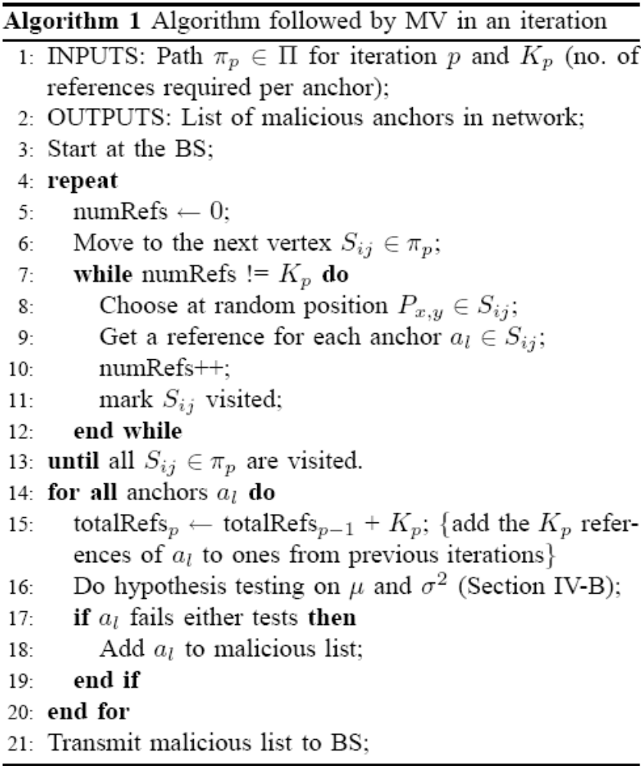
Algorithm followed by MV in each iteration

Slide 20
How to revoke the malicious anchors
The MV transmits a list of the malicious anchors to the BS.
The BS can flood the network with the list of the malicious anchors.
An SN that receives the list removes the references from the malicious anchors in the list and re-localizes itself.

Slide 21
Simulations Settings
WSN deployed in a field of 100 x 100 sq. units.
The field is overlaid with a grid of 20 x 20 sq. units.
In each square, 10 anchors are deployed randomly.
Maximum error coefficient, |δ_{max}| = 0.2, corresponding σ²₀ = 0.033.
Type I error coeff., α = 0.01, and type II error coeff. β = 0.1.
In each square, 3, 5, or 7 anchors are malicious.
For hypothesis testing of μ, the malicious anchors lie such that μ_{m} = 0.1.

Slide 22
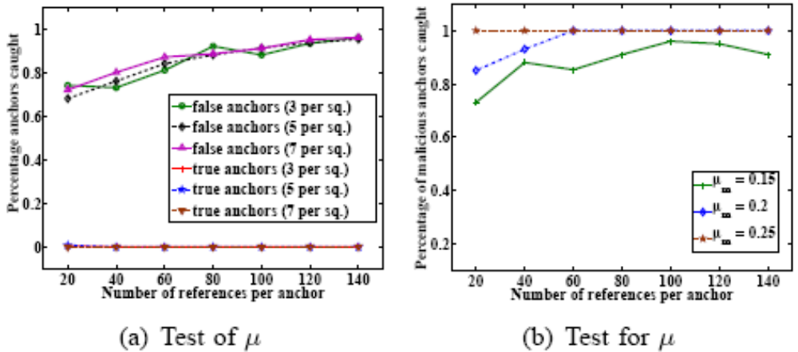
Results of test for μ
Fig. (a) shows that our scheme catches > 60% of the malicious anchors caught even with only 20 references collected per anchor. False positives are close to 0%.
Fig. (b) shows that when the malicious anchors lie more, the percentage caught is almost 100% even for only 20 references.

Slide 23
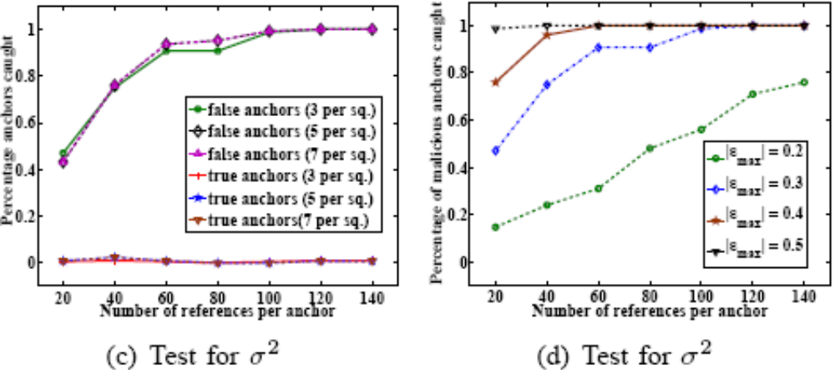
Results of test for σ²
In Fig. (c) with |ε_{max} | = 0.3, we are able to catch more than 80% of malicious anchors with only 60 references. False positives are again close to 0%.
Fig. (d) shows that with increasing |ε_{max} |, higher percentage of malicious anchors are caught, even with < 60 references.

Slide 24
Conclusions
In this paper we propose a scheme that identifies a large number of malicious anchors in the network even when they are more than the majority and colluding.
In the future we would like to work on:
  Improving the prediction using mechanisms such as control charts.
  Making the motion of the verifier in the network untraceable, by using energy-efficient disjoint paths.

Slide 25
Contact Information
Satyajayant Misra: satyajayant@asu.edu
Guoliang Xue: xue@asu.edu
Aviral Shrivastava: aviral.shrivastava@asu.edu
THANK YOU!

