Slide 1
FSAF - FILE SYSTEM AWARE FLASH TRANSLATION LAYER FOR
NAND FLASH MEMORIES
S K Mylavarapu*, A Shrivastava*, J-E Lee*, S Choudhuri^ and Tony Givargis^
*Arizona State University ^University of California, Irvine
M
C
L

Slide 2

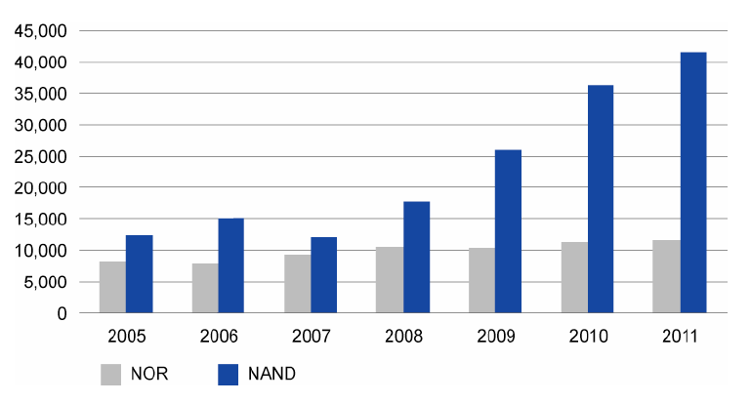

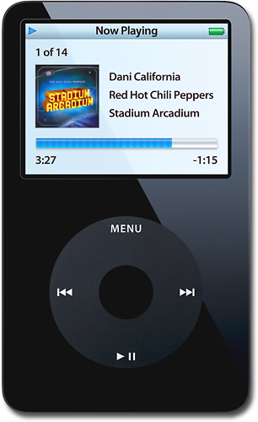
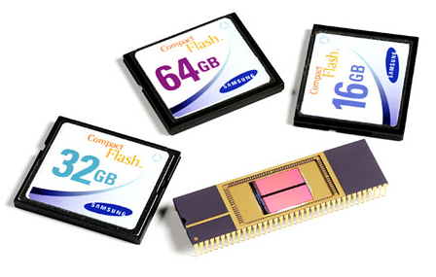
Popularity of Flash Memories
What is Flash? A non-volatile computer memory that can be electrically erased and reprogrammed
  Belongs to EEPROM family
Where is it used? Where mobility, power, speed, and size are key factors!
  Flash is ubiquitous!
How about its Market? NAND flash markets have more than tripled from $5 billion in 2004 to $18 billion in 2009.

Slide 3







Flash and Memory Hierarchy
Higher
Speed, Cost
Larger Size
Flash is faster, more robust, but expensive than hard disks
Some works proposed NAND flash for RAM

Slide 4
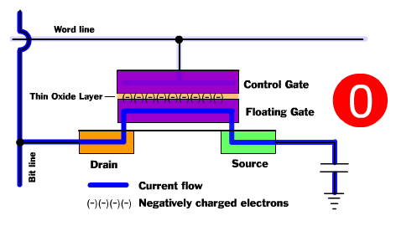
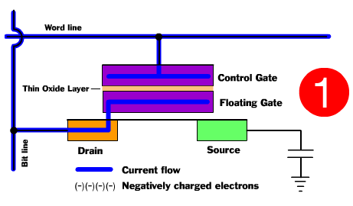
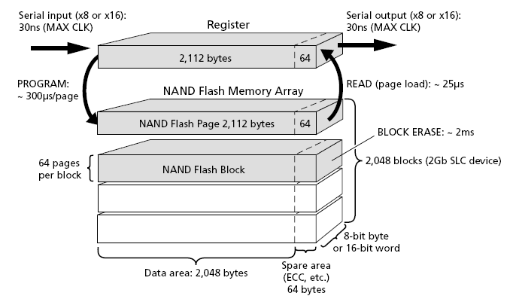
Flash at Work
Erase before rewrite! Once a flash cell is programmed, a whole block of cells needs to be erased before it can be reprogrammed.
In order to reduce the erasure overhead, erasures are done on a group of cells – called a Block
For faster reads and writes, Blocks are subdivided
into smaller granularity Pages
Each page update results in a Block
erasure !
  Extremely time consuming – increases page
  write time by an order
  Results in faster Flash wear
PROGRAMMED
Default State: ERASED

Slide 5
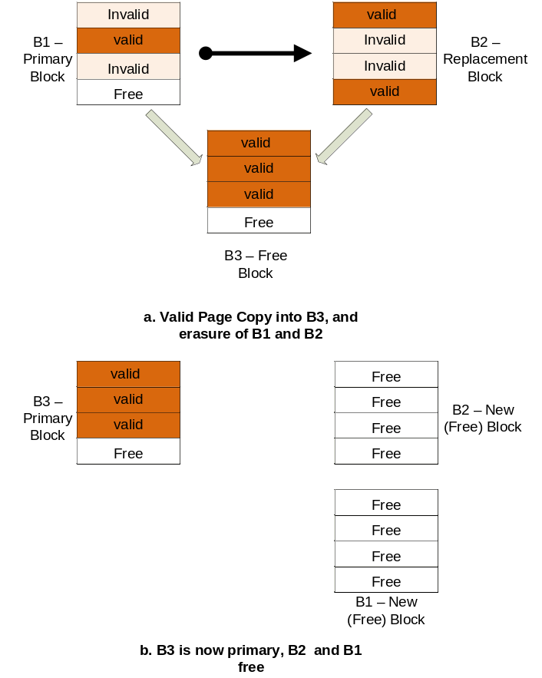
Flash at Work
Flash is organized as Primary and
Replacement Blocks.
  Replacement blocks serve as (re-)write log buffers, to hide Erase before rewrite limitation.
A Fold occurs when a re-write is issued to a
block with full replacement block
  Consolidate valid data into one new block
As the free space in the device falls below a critical threshold, free space needs to be generated by performing a series of Folds
  Garbage Collection (GC) - a series of folds
  Unpredictable and Long, depending upon data distribution
  Some blocks may be erased (wear) more than others
    A single block failure may lead to the whole device’s failure
    Wear Leveling (WL) – a regular operation to balance block wear
GC and WL operations determine application response times!

Slide 6
Flash Management and
Flash Translation Layers (FTL)
OS
Driver
Various operations need to be carried out to ensure correct operation of Flash:
    GC – Reclaims invalid space
    WL – Picks up a highly and least worn-out blocks as per a specific policy and swap their content
    Various other Flash operations to be carried out: Mapping, Bad Block Management, Error Management, Recovery, etc.
Applications can manage Flash, but:
  Only Flash-Aware Applications can run on Flash
  No Portability!
Solution:
  Let Flash Translations Layers undertake Flash management
  FTLs
    Unburden applications from managing Flash
    Hide complexities of device management from the application
    Enable mobility – Flash becomes plug and play!
    Flash can be used with existing File System Interfaces!
  GC and WL are by far the most important operations carried out
FTL
Log - Phy
mapping
Bad-block Mgmt.
Wear-leveling
Error Mgmt.
Garbage Collection
Power-On recovery
NAND Device

Slide 7
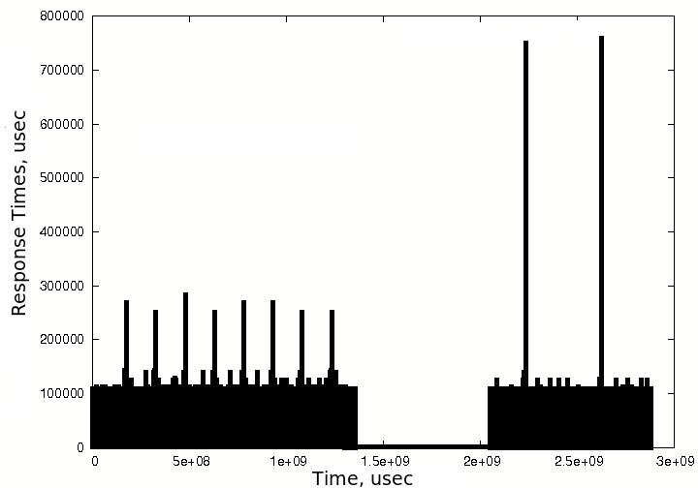
Impact of GC and WL on Application Response
Ran Digital Camera workload on a 64MB Lexar flash drive formatted as FAT32 and fed resulting traces to Toshiba NAND flash
GC Delays .. may take up to 40sec!!
Dead Data WL Overheads
Metric | % increase due to dead data
Device Delays | 12
Erasures | 11
W-AMAT | 12
Folds | 14

Slide 8
Outline
Related Work
Idea
Our Approach
Results

Slide 9
Prior Work on GC
Considerations:
  [When] A policy determining when to invoke the garbage collector.
  [Which] A block selection algorithm to choose the victim block (s) .
  [What] Determine how many blocks will be erased for each invocation of the garbage collector.
Various efforts have been proposed to improve GC Efficiency:
  [Wu94] Greedy: Select blocks with maximum invalid data for cleaning – least valid data copying costs
  [Kawaguchi95]Cost-Benefit: Selects the blocks which maximize:
    (age = the time span since the last modification, u: utilization of a block).
    Also, separates Hot and Cold data at block level
  [Chiang99] CAT: Works at Page granularity of Hot-Cold data segregation; takes block wear into account
  [Kwon07] Swap-Aware: Greedy and considers different swapped out time of the pages
  [Chang04] Real-Time: Greedy policy with a deterministic frame work
b/c = age * (1-u)/2u

Slide 10
Prior Work on WL and File Systems
[Ban04] Dynamic wear leveling:
  Achieves wear leveling by trying to recycle blocks with small erase counts.
  Hot-Cold data segregation has huge impact on performance
[Chang07] Static wear leveling:
  Levels all blocks – static and dynamic
  Longer life time at higher overhead!
[Kim06] Proposed MNFS to achieve uniform write response times by carrying out block erasures immediately after file deletions.

Slide 11
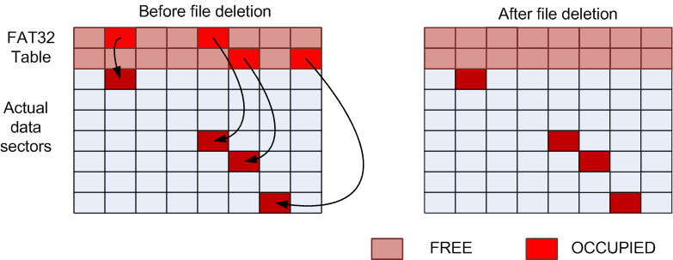
OPPORTUNITY TO IMPROVE – DEAD DATA
Problem - Implicit File Deletion:
  When a file is deleted or shrunk, the actual data is not erased!
  Dead data resides inside flash until a costly fold or GC operation
  is triggered to regain free space.
  Dead data results in significant GC and WL overhead!!
Intuition - If dead data can be detected and treated, we can eliminate above overheads
Challenge - File Systems do NOT share any formatting information with FTLs to detect dead data!

Slide 12
Outline
Related Work
Our Approach
  FSAF
Results

Slide 13
FSAF – File System Aware FTL
FSAF:
  Monitors write requests to FAT32 table to interpret any deleted data dynamically,
  Optimizes GC and WL algorithms to treat dead data
  Carries out proactive reclamation to handle large dead data content

Slide 14
Interpreting Flash Formatting
Format - the structure of file system data structure residing on Flash
FSAF interprets Format and keeps track of changes to the Master Boot Record (MBR) and the first sector in the file system called FAT32 Volume ID.
The location of FAT32 table:
: The size of the FAT32 table
FAT32 Table

Slide 15
Dead Data Detection
Calculate size and location of FAT32 Table by reading MBR and FAT32 Volume ID sectors
Monitor writes to FAT32 Table
If a sector pointer is being zeroed out, mark corresponding sector as dead
Mark a block as dead if all the sectors in the block are dead

Slide 16
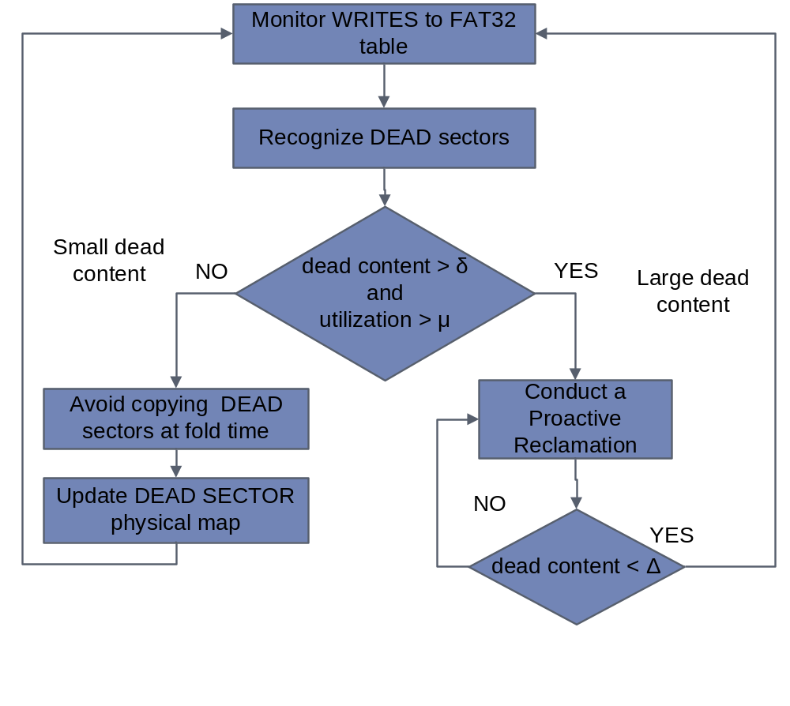
Dead Data
Reclamation
Avoidance of Dead Data Migration: Dead data is marked NOT to be copied during GC and WL
Proactive Reclamation:
  Large deleted files occupy complete blocks – no copying costs to reclaim these!
δ - dead content threshold
μ - system utilization threshold
Δ – threshold that determines #dead block reclamations

Slide 17
Outline
Related Work
Our Approach
  FSAF
Results

Slide 18
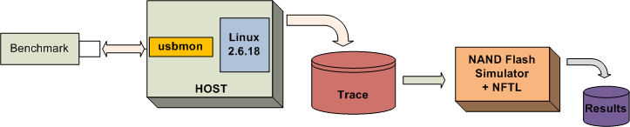
Experiments
Used trace-driven approach
Benchmarks:
  From several media applications and file scenarios (MP3, MPEG, JPEG, etc)
Initialized flash to 80% utilization
GC starts when #free blocks falls below 10% of total blocks and stops as soon as percent free blocks reaches 20% of total blocks.
WL is triggered whenever the difference between maximum and minimum erase counts of blocks exceeds 15.
The size of files used in various scenarios was varied between 32MB to 2KB.

Slide 19
Configuring FSAF Parameters
δ - dead content threshold
μ - system utilization threshold
Δ – threshold that determines #dead block reclamations
To set δ and μ:
  Ran proactive reclamation with various values of δ and μ
  Results – Higher values lead to higher efficiency
    By setting these to high as possible, proactive reclamation is triggered only when the system is low in free space, but runs frequently enough to generate sufficient free space.
To set Δ:
  observed variation in the total application response times, number of erasures, and GCs against various sizes of reclaimed dead data
  Flash delays and erasures decrease initially and increase afterwards with increasing δ` ( = (δ – Δ))
Set values:
  Δ: 0.18
  δ: 0.2
  μ: 0.85
proactive reclamation is triggered when the dead data size exceeds 20% of the total space and system utilization is greater than 85%.

Slide 20
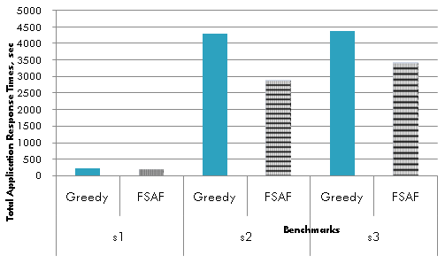
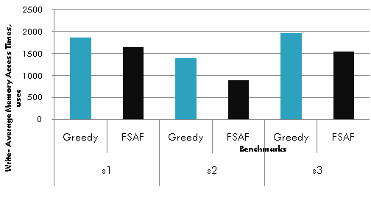
FSAF Results
FSAF improves response times by 22% on the average
FSAF :
➔ Improves Device Life time by reducing erasures
➔ Avoids undesirable GC peaks
FSAF :
➔ Improves Device Life time by reducing erasures
➔ Avoids undesirable GC peaks
Total application response times for various benchmarks
Average memory write-access times for various benchmarks
Dead Data content and distribution
strongly determines response times and W-AMAT, especially at higher utilizations!
Avoidance of Dead data results in lesser extra erasures and copying
Reads are cached .. So, W-AMAT is important!
 | Erasures |  |  | GCs |  |  | Folds
Benchmark | Greedy | FSAF | %Decrease | Greedy | FSAF | %Decrease | Greedy | FSAF | %Decrease
s1 | 4907 | 4347 | 11.41 | 10 | 7 | 30.00 | 2294 | 1979 | 13.73
s2 | 2631 | 1760 | 33.11 | 11 | 5 | 54.55 | 1249 | 792 | 36.59
s3 | 5384 | 4293 | 20.26 | 25 | 14 | 44.00 | 2541 | 1976 | 22.24
Improvement in erasures, GCs and folds

Slide 21
Conclusion
  Flash applications are increasing very fast.
    Want to use Flash transparently
    FTLs implement flash management
  File Systems do not share semantic information with FTLs
    Copying dead data has high overheads for GC and WL
  We propose File System Aware Flash Management
    Automatically detect and proactively manage dead data
      22% improvement in application response time
      Less erasures, deletes and W-AMAT

Slide 22
Overheads
  Algorithmic overhead introduced by FSAF is only per write – minimum 400 usec
  Reading MBR and Volume ID – O(1)
  Finding deleted sector – O(s), s: number of sector pointers per FAT32 table sector
    Typically s = 128, so overhead is minimal
  Proactive reclamation executes at a higher efficiency than a normal G, redcing overall overhead

Slide 23
References
[1] A. Ban. Flash file system. United States Patent, no.5404485, April 1995.
[2] A. Ban. Wear leveling of static areas in flash memory. US Patent 6,732,221. M-systems, May 2004.
[3] Elaine Potter, “NAND Flash End-Market Will More Than triple From 2004 to 2009”,
http://www.instat.com/press.asp?ID=1292&sku=IN0502461SI
[4] Richard Golding, Peter Bosch, John Wilkes, “Idlenessis not sloth”. USENIX Conf, Jan. 1995
[5] Hyojun Kim, Youjip Won , “MNFS: mobile multimedia file system for NAND flash based storage device”, Consumer Communications and Networking
Conference, 2006. CCNC 2006. 3rd IEEE
[6] Hanjoon Kim, Sanggoo Lee, S. G., “A new flash memory management for flash storage system,” COMPSAC 1999.
[7] Intel Corporation. “Understanding the flash translation layer (ftl) specification”. http://developer.intel.com/.
[8] J. Kim, J. M. Kim, S. Noh, S. L. Min, and Y. Cho. “A space-efficient flash translation layer for compact flash systems”. IEEE Transactions on Consumer Electronics, May 2002.
[9] A. Kawaguchi, S. Nishioka, H. Motoda, “A Flashmemory Based File System”, USENIX 1995.
[10] Li-Pin Chang, Tei-Wei Kuo, Shi-Wu Lo, “Real-Time Garbage collection for Flash-Memory Storage Systems
of Real-Time Embedded Systems”, ACM Transactions on Embedded Computing Systems, November 2004
[11] V. Malik, 2001a.” JFFS—A Practical Guide”, http://www.embeddedlinuxworks.com/articles/jffs
guide.html.

Slide 24
References contd..
[12] Mei-Ling Chiang, Paul C. H. Lee, Ruei-Chuan Chang, “Cleaning policies in mobile computers using flash memory,”
Journal of Systems and Software, Vol. 48, 1999.
[13] Microsoft, “Description of the FAT32 File System”, http://support.microsoft.com/kb/154997
[14] Ohoon Kwon, Kern Koh, “Swap-Aware Garbage collection for NAND Flash Memory Based Embedded
Systems”, Proceedings of the 7th IEEE CIT2007.
[15] M. Rosenblum, J.K. Ousterhout, “The Design and Implementation of a Log-Structured FileSystem,”
ACM Transactions on Computer Systems, Vol. 10, No. 1, 1992.
[16] S.W. Lee, D.-J. Park, T.-S. Chung, D.-H. Lee, S.W. Park, H.-J. Songe. “FAST: A log-buffer based ftl
scheme with fully associative sector translation”. The UKC, August 2005.
[17] Toshiba 128 MBIT CMOS NAND EEPROM TC58DVM72A1FT00, http://www.toshiba.com, 2006.
[18] M. Wu, W. Zwaenepoel, “eNVy: A Non-Volatile, Main Memory Storage System”, ASPLOS 1994.
[19] Yuan-Hao Chang, Jen-Wei Hsieh, Tei-Wei Kuo, “Endurance Enhancement of Flash-Memory Storage,
Systems: An Efficient Static Wear Leveling Design”, DAC’07

Slide 25
Thank You!

