Slide 1
IMPROVING APPLICATION RESPONSE TIMES OF NAND FLASH BASED SYSTEMS
Sai Krishna Mylavarapu
Compiler-Microarchitecture Lab
Arizona State University
M
C
L

Slide 2

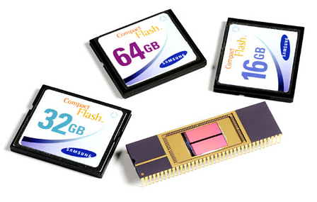
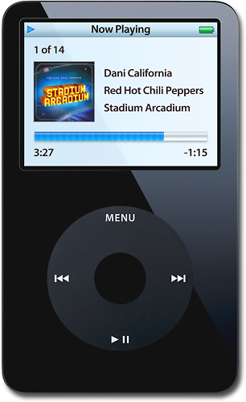
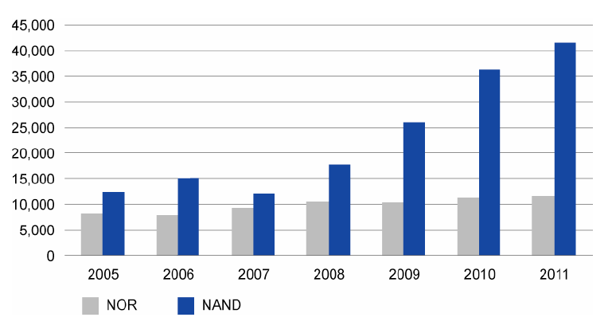

Popularity of Flash Memories
What is Flash? A non-volatile computer memory that can be electrically erased and reprogrammed
  Belongs to EEPROM family
Where is it used? Where mobility, power use, speed, and size are key factors!
  Flash is ubiquitous!
How about its Market? NAND flash markets have more than tripled from $5 billion in 2004 to $18 billion in 2009.

Slide 3







Flash and Memory Hierarchy
Higher
Speed, Cost
Larger Size
Flash is faster, more robust, but expensive than hard disks
Some works proposed NAND flash for RAM

Slide 4
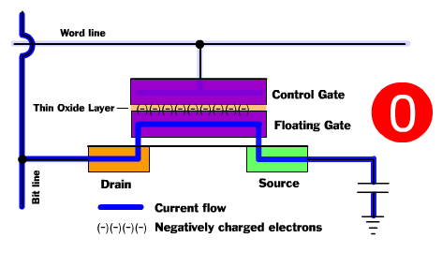
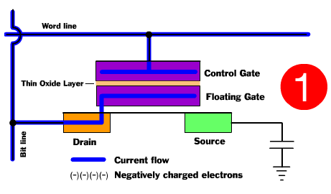
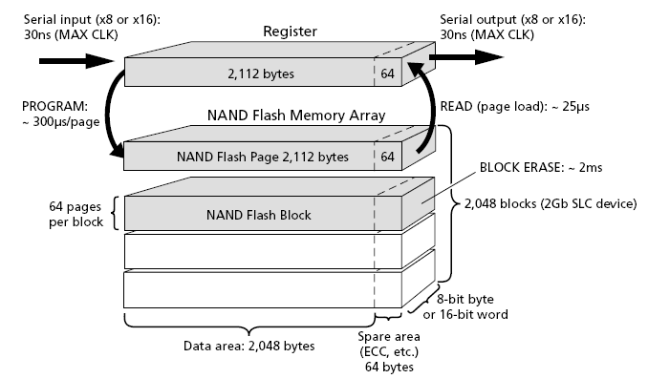
Flash at Work
Erase before rewrite! Once a flash cell is programmed, a whole block of cells need to be erased before it can be reprogrammed.
In order to reduce the erasure overhead, erasures are done
on a group of cells – called a Block
For faster reads and writes, Blocks are subdivided
into smaller granularity Pages
Each page update results in a Block
erasure !
  Extremely time consuming – increases page
  write time by an order
  Results in faster Flash wear
PROGRAMMED
Default State: ERASED

Slide 5
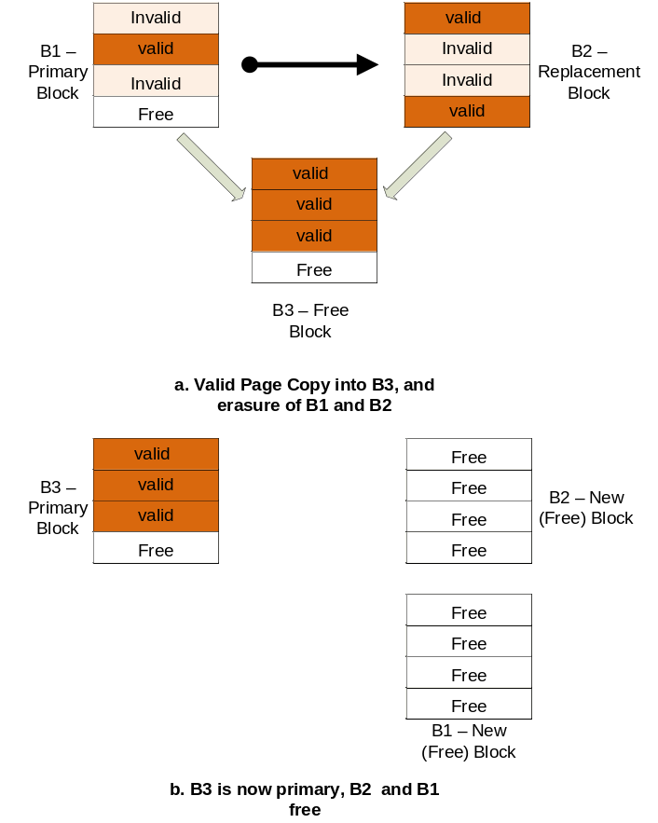
Flash at Work
Flash is organized as Primary and
Replacement Blocks.
  Replacement blocks serve as (re-)write log buffers, to hide Erase before rewrite limitation.
A Fold occurs when a re-write is issued to a
block with full replacement block
  Consolidate valid data into one new block
As the free space in the device falls below a critical threshold, free space needs to be generated by performing a series of Folds
  Garbage Collection (GC) - a series of folds
  Unpredictable and Long, depending upon data distribution
  Some blocks may be erased (wear) more than others
    A single block failure may lead to the whole device’s failure
    Wear Leveling (WL) – a regular operation to balance block wear
GC and WL operations determine application response times!

Slide 6
Flash Management and
Flash Translation Layers (FTL)
OS
Driver
Various operations need to be carried out to ensure correct operation of Flash:
    GC – Reclaims invalid space
    WL – Picks up a highly and least worn-out blocks as per a specific policy and swap their content
    Various other Flash operations to be carried out: Mapping, Bad Block Management, Error Management, Recovery, etc.
Applications can manage Flash, but:
  Only Flash-Aware Applications can run on Flash
  No Portability!
Solution:
  Let Flash Translations Layers undertake Flash management
  FTLs
    Unburden applications from managing Flash
    Hide complexities of device management from the application
    Enable mobility – Flash becomes plug and play!
    Flash can be used with existing File System Interfaces!
  GC and WL are by far the most important operations carried out
FTL
Log - Phy
mapping
Bad-block Mgmt.
Wear-leveling
Error Mgmt.
Garbage Collection
Power-On recovery
NAND Device

Slide 7
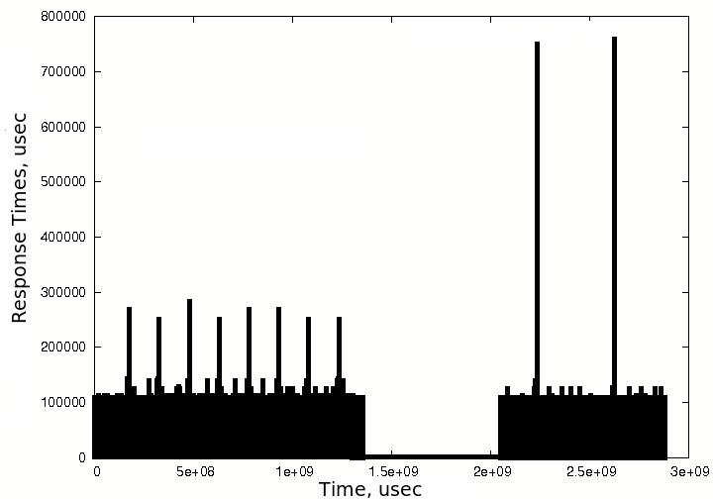
Impact of GC and WL on Application Response Times
Ran Digital Camera workload on a 64MB Lexar flash drive formatted as FAT32 and fed resulting traces to Toshiba NAND flash
GC Delays .. may take up to 40sec!!
Dead Data WL Overheads
Metric | % increase due to dead data
Device Delays | 12
Erasures | 11
W-AMAT | 12
Folds | 14

Slide 8
Outline
Related Work
Our Approach
Combined Results
Future Work

Slide 9
Prior Work on GC
Considerations:
  [When] A policy determining when to invoke the garbage collector.
  [Which] A block selection algorithm to choose the victim block (s) .
  [What] Determine size of segments, i.e., the erase unit.
  [How many] Determine how many blocks will be erased after each invocation of the garbage collector.
  [How & Where] How should we write back those live data in victim blocks? Where should we accommodate those data? This is also called the data redistribution policy.
  [Where] Where are (new) data allocated in flash memories? This is also called the data placement policy.
Various efforts have been proposed to improve GC Efficiency:
  Greedy: Select blocks with maximum invalid data for cleaning – least valid data copying costs
  Cost-Benefit: Selects the blocks which maximize:
  (age = the time span since the last modification, u: utilization of a block). Also, separates Hot and Cold data at block level
  CAT: Works at Page granularity of Ho-Cold data segregation; takes block wear into account
  Swap-Aware: Greedy and considers different swapped out time of the pages
  Real-Time: Greedy policy with a deterministic frame work
Above approaches do NOT consider applications characteristics, or result in system interface changes!
b/c = age * (1-u)/2u

Slide 10
Prior Work on WL and File Systems
Dynamic wear leveling:
  Achieves wear leveling by trying to recycle blocks with small erase counts.
  Hot-Cold data segregation has huge impact on performace
Static wear leveling:
  Levels all blocks – static and dynamic
  Longer life time at higher overhead!
Kim et. Al proposed MNFS to achieve uniform rite response times by carrying out block erasures immediately after file deletions.
Draw-backs of existing approaches:
  Are device-centric: WL ad GC are triggered irrespective of application needs i.e., application characteristics are disregarded
  Result in significant system interface changes.

Slide 11
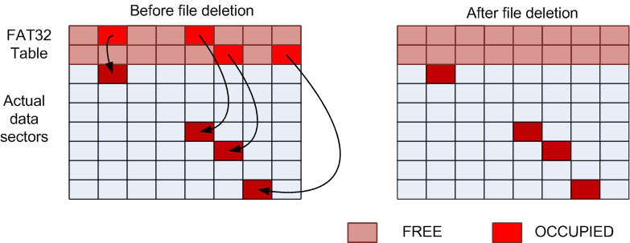
OPPORTUNITIES TO IMPROVE
APPLICATION RESPONSE TIMES – File System Aware FTL
Problem - Implicit File Deletion:
  When a file is deleted or shrunk, the actual data is not erased!
  Dead data resides inside flash until a costly fold or GC operation
  is triggered to regain free space.
  Dead data results in significant GC and WL overhead!!
Intuition - If dead data can be detected and treated, we can eliminate above overheads
Challenge - File Systems do NOT share any formatting information with FTLs to detect dead data!

Slide 12
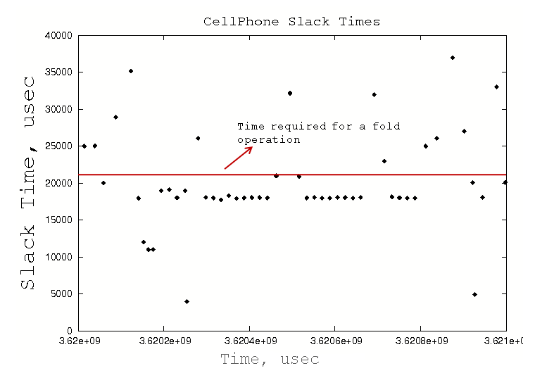
OPPORTUNITIES TO IMPROVE
APPLICATION RESPONSE TIMES – Slack-time Aware GC
Application Slack-Time: Idle time between subsequent I/O requests
during which NAND flash is not operated on
Applications have reasonable slack that allows for GC to be taken up
in background
Intuition - Employing highly efficient GC policy in slack can be a great opportunity to
improve application response times!
Challenge – How to break-up a GC and when to schedule?

Slide 13
Outline
Related Work
Our Approach
Combined Results
Future Work

Slide 14
Outline
Related Work
Our Approach
  FSAF
  SLAC
Combined Results

Slide 15
FSAF – File System Aware FTL
FSAF:
  Monitors write requests to FAT32 table to interpret any deleted data dynamically,
  Optimizes GC and WL algorithms to treat dead data
  Carries out proactive reclamation to handle large dead data content

Slide 16
Interpreting Flash Formatting
Format - the structure of file system data structure residing on Flash
FSAF interprets Format and keeps track of changes to the Master Boot Record (MBR) and the first sector in the file system called FAT32 Volume ID.
The location of FAT32 table:
: The size of the FAT32 table
FAT32 Table

Slide 17
Dead Data Detection
Calculate size and location of FAT32 Table by reading MBR and FAT32 Volume ID sectors
Monitor writes to FAT32 Table
If a sector pointer is being zeroed out, mark corresponding sector as dead
Mark a block as dead if all the sectors in the block are dead

Slide 18
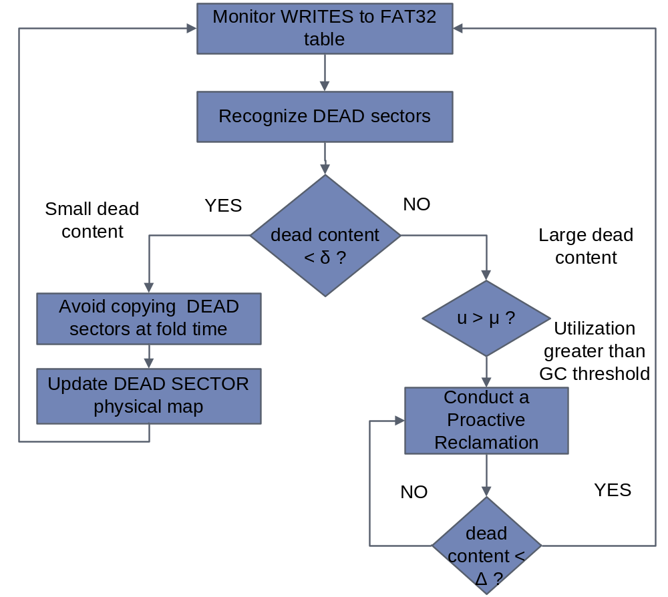
Dead Data
Reclamation
Avoidance of Dead Data Migration: Dead data is marked NOT to be copied during GC and WL
Proactive Reclamation:
  Large deleted files occupy complete blocks – no copying costs to reclaim these!

Slide 19
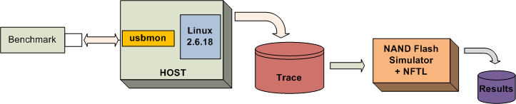
Experiments
Used trace-driven approach
Benchmarks:
  From several media applications and file scenarios (MP3, MPEG, JPEG, etc)
Initialized flash to 80% utilization
GC starts when #free blocks falls below 10% of total blocks and stops as soon as percent free blocks reaches 20% of total blocks.
WL is triggered whenever the difference between maximum and minimum erase counts of blocks exceeds 15.
The size of files used in various scenarios was varied between 32MB to 2KB.

Slide 20
Configuring FSAF Parameters
δ - dead content threshold
μ - system utilization threshold
Δ – threshold that determines #dead block reclamations
To set δ and μ:
  Ran proactive reclamation with various values of δ and μ
  Results – Higher values lead to higher efficiency
    By setting these to high as possible, proactive reclamation is triggered only when the system is low in free space, but runs frequently enough to generate sufficient free space.
To set Δ:
  observed variation in the total application response times, number of erasures, and GCs against various sizes of reclaimed dead data
  Flash delays and erasures decrease initially and increase afterwards with increasing δ` ( = (δ – Δ))
Set values:
  Δ: 0.18
  δ: 0.2
  μ: 0.85
proactive reclamation is triggered when the dead data size exceeds 20% of the total space and system utilization is greater than 85%.

Slide 21
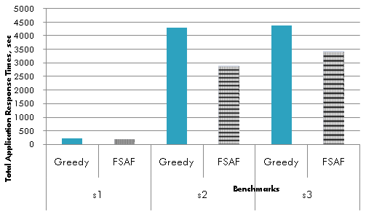
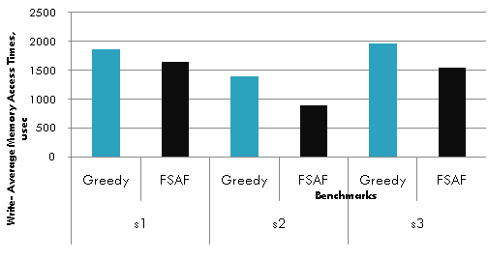
FSAF Results
FSAF improves response times by 22% on the average
FSAF :
➔ Improves Device Life time by reducing erasures
➔ Avoids undesirable GC peaks
FSAF :
➔ Improves Device Life time by reducing erasures
➔ Avoids undesirable GC peaks
Total application response times for various benchmarks
Average memory write-access times for various benchmarks
Dead Data content and distribution
strongly determines response times and W-AMAT, especially at higher utilizations!
Avoidance of Dead data results in lesser extra erasures and copying
Reads are cached .. So, W-AMAT is important!
 | Erasures |  |  | GCs |  |  | Folds
Benchmark | Greedy | FSAF | %Decrease | Greedy | FSAF | %Decrease | Greedy | FSAF | %Decrease
s1 | 4907 | 4347 | 11.41 | 10 | 7 | 30.00 | 2294 | 1979 | 13.73
s2 | 2631 | 1760 | 33.11 | 11 | 5 | 54.55 | 1249 | 792 | 36.59
s3 | 5384 | 4293 | 20.26 | 25 | 14 | 44.00 | 2541 | 1976 | 22.24
Improvement in erasures, GCs and folds

Slide 22
Outline
Related Work
Our Approach
  FSAF
  SLAC
Combined Results

Slide 23
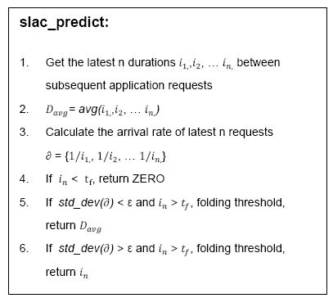
SLAC - Application SLack Time Aware Garbage Collection
Application request
  SLAC – Considerations :
  When and How many blocks to fold?
  During the application Slack, as many allowed!
    Maintain a list of last n application request time stamps to
    predict what is next slack going to be
  Which blocks to fold?
  Select blocks with highest reclamation benefit!
    With the help of estimated slack, choose victim blocks
    with maximum reclamation benefits
SLAC
Prediction Logic
High request rate
Stable and sufficient slack
Unstable but sufficient slack
Selective Folding

Slide 24
Selective Folding
To improve overall GC efficiency, Selective Folding identifies blocks with minimal cleaning costs (or, highest reclamation benefits).
Process:
  Determine and extract blocks with dead page count >
  ➔ Hot Blocks
  If slack allows all the above blocks to be reclaimed, done!
  Else, return first k blocks allowed by slack

Slide 25
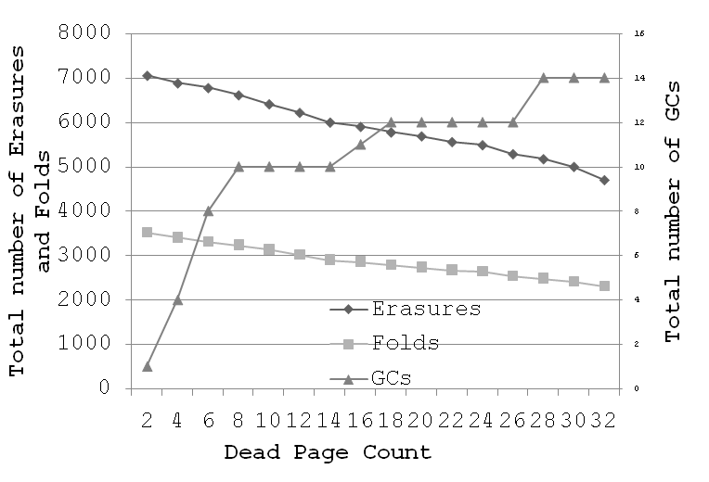
Configuring SLAC Parameters
GC efficiency increases with the increasing values of – set to 32,
  i.e. hot blocks only with dead page count equal to 32 are considered by SLAC for folding.

Slide 26
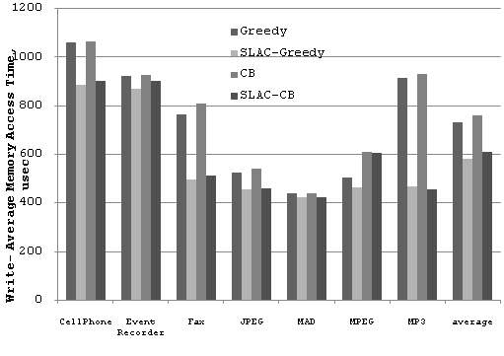
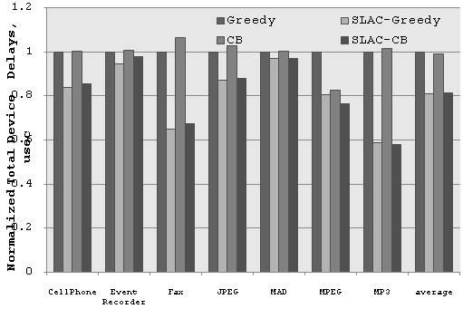
SLAC Results
Variation in results is because of:
variation in the locality of reference
2. difference in the slack times available to each benchmark
Background GC and Selective Folding allow SLAC to achieve much better WAMAT and response times …
Average page-write access times with various GC policies
Normalized total device delays with various GC policies

Slide 27
Reduction in GCs and Erasures
 | FTL-triggered GCs |  | Erasures |  |  | FTL-triggered GCs |  | Erasures
Benchmark | Greedy | SLAC-Greedy | Greedy | SLAC -Greedy | %Decrease | Cost-benefit | SLAC- Cost-benefit | Cost-benefit | SLAC- Cost-benefit | %Decrease
CellPhone | 23 | 14 | 5020 | 5000 | 0.4 | 28 | 12 | 5020 | 5000 | 0.4
Event Recorder | 14 | 13 | 3345 | 3288 | 1.7 | 17 | 14 | 3343 | 3318 | 0.75
Fax | 111 | 19 | 7659 | 7292 | 4.79 | 111 | 19 | 7659 | 7292 | 4.79
JPEG | 21 | 6 | 1449 | 1410 | 2.69 | 26 | 7 | 1449 | 1423 | 1.79
MAD | 2 | 0 | 134 | 96 | 28.36 | 2 | 0 | 134 | 96 | 28.36
MPEG | 38 | 7 | 2647 | 2581 | 2.49 | 1 | 0 | 1756 | 1315 | 33.54
MP3 | 78 | 0 | 25414 | 25078 | 1.32 | 97 | 0 | 25414 | 25056 | 1.41

Slide 28
Outline
Related Work
Our Approach
  FSAF
  SLAC
Combined Results
Future Work

Slide 29
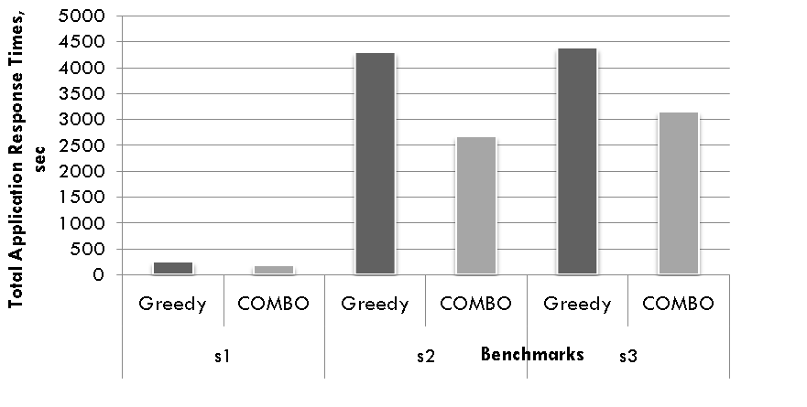
Combined Results - Improvement in Application Response Times

Slide 30
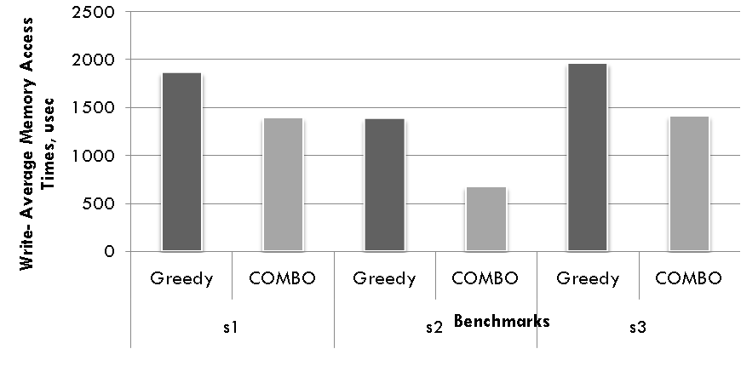
Experimental Results - Improvement in Write Access Times

Slide 31
Improvement in Erasures, GCs and Folds
 | Erasures |  |  | GCs |  |  | Folds
Benchmark | Greedy | COMBO | %Decrease | Greedy | COMBO | %Decrease | Greedy | COMBO | %Decrease
s1 | 4907 | 4211 | 14.18 | 10 | 0 | 100.00 | 2294 | 1560 | 32.00
s2 | 2631 | 1324 | 49.68 | 11 | 1 | 90.91 | 1249 | 597 | 52.20
s3 | 5384 | 3219 | 40.21 | 25 | 5 | 80.00 | 2541 | 1563 | 38.49

Slide 32
Overheads
SLAC:
  Slack Prediction - O(n)
    Minimal, because n is small
  Selective Folding - O(k), where k is the number of blocks.
  By carrying out efficient folds in slack, GC burden on FTL is minimized
  By setting dTh to 32 sorting overheads are eliminated
FSAF:
  Algorithmic overhead introduced by FSAF is only per write – minimum 400 usec
  Reading MBR and Volume ID – O(1)
  Finding deleted sector – O(s), s: number of sector pointers per FAT32 table sector
    Typically s = 128, so overhead is minimal
  Proactive reclamation executes at a higher efficiency than a normal G, redcing overall overhead

Slide 33
Further Work …
Scale these solutions to MLC NAND
  MLC has higher density, lower reliability ➔ poor performance
  Incorporate above solutions fro Error Checking
Better ECC algorithms
Flash as RAM
  Read and Write BWs are a major bottleneck
  Byte addressability in NAND Flash

Slide 34
Contributions
Awaiting results from DATE2009 Conference
Submitting the comprehensive approach to
  DAC-2009 Conference
  ACM Transactions on Embedded Systems Journal

Slide 35
References
A. Ban. Flash file system. United States Patent, no.5404485, April 1995.
A. Ban. Wear leveling of static areas in flash memory. US Patent 6,732,221. M-systems, May 2004.
Elaine Potter, “NAND Flash End-Market Will More Than triple From 2004 to 2009”, http://www.instat.com/press.asp?ID=1292&sku=IN0502461SI
Golding, Richard; Bosch, Peter; Wilkes, John, “Idleness is not sloth”. USENIX Conf, Jan. 1995
Hyojun Kim Youjip Won , “MNFS: mobile multimedia file system for NAND flash based storage device”, Consumer Communications and Networking Conference, 2006. CCNC 2006. 3rd IEEE
Hanjoon Kim, Sanggoo Lee, S. G., “A new flash memory management for flash storage system,” COMPSAC 1999.
Intel Corporation. “Understanding the flash translation layer (ftl) specification”. http://developer.intel.com/.
J.W. Hsieh, L.-P. Chang, and T.-W. Kuo. Efficient On-Line Identification of Hot Data for Flash-Memory Management. In Proceedings of the 2005 ACM symposium on Applied computing, pages 838.842, Mar 2005.
J. Kim, J. M. Kim, S. Noh, S. L. Min, and Y. Cho. “A space-efficient flash translation layer for compact flash systems”. IEEE Transactions on Consumer Electronics, May 2002.
J. C. Sheng-Jie Syu. An Active Space Recycling Mechanism for Flash Storage Systems in Real-Time Application Environment. 11th IEEE International Conference on Embedded and Real-Time Computing Systems and Application (RTCSA'05), pages 53.59, 2005.

Slide 36
References
Kawaguchi, A., Nishioka, S., and Motoda, H., “A Flash-memory Based File System”, USENIX 1995.
Li-Pin Chang, Tei-Wei Kuo, and Shi-Wu Lo, “Real-Time Garbage collection for Flash-Memory Storage Systems of Real-Time Embedded Systems”, ACM Transactions on Embedded Computing Systems, November 2004
L.-P. Chang and T.-W. Kuo. An Adaptive Striping Architecture for Flash Memory Storage Systems of Embedded Systems. In IEEE Real-Time and Embedded Technology and Applications Symposium, pages 187.196, 2002.
Malik, V. 2001a.” JFFS—A Practical Guide”, http://www.embeddedlinuxworks.com/articles/jffs guide.html.
Mei-Ling Chiang, Paul C. H. Lee, Ruei-Chuan Chang, “Cleaning policies in mobile computers using flash memory,” Journal of Systems and Software, Vol. 48, 1999.
M.-L. Chiang, P. C. H. Lee, and R.-C. Chang. Using data clustering to improve cleaning performance for flash memory. Software: Practice and Experience, 29-3:267.290, May 1999.
Microsoft, “Description of the FAT32 File System”, http://support.microsoft.com/kb/154997
Ohoon Kwon and Kern Koh, “Swap-Aware Garbage collection for NAND Flash Memory Based Embedded Systems”, Proceedings of the 7th IEEE CIT2007.
Rosenblum, M., Ousterhout, J. K., “The Design and Implementation of a Log-Structured FileSystem,” ACM Transactions on Computer Systems, Vol. 10, No. 1, 1992.
S.-W. Lee, D.-J. Park, T.-S. Chung, D.-H. Lee, S.-W. Park, and H.-J. Songe. “FAST: A log-buffer based ftl scheme with fully associative sector translation”. The UKC, August 2005.
Toshiba 128 MBIT CMOS NAND EEPROM TC58DVM72A1FT00, http://www.toshiba.com, 2006.
Wu, M., Zwaenepoel, W., “eNVy: A Non-Volatile, Main Memory Storage System”, ASPLOS 1994.
Yuan-Hao Chang Jen-Wei Hsieh Tei-Wei Kuo, “Endurance Enhancement of Flash-Memory Storage, Systems: An Efficient Static Wear Leveling Design”, DAC’07
Zaitcev, “The usbmon: USB monitoring framework”, http://people.redhat.com/zaitcev/linux/OLS05_zaitcev.pdf

Slide 37

Approach
  Enable FTL to interpret File System Operations – treat dead data efficiently
  Empower FTL to understand application timing characteristics – schedule fine-grained garbage collections in the background
Solution works both at
  File System Level and
  Flash Management Level
The approach is
  Compatible with existing systems – No Change in existing System Architectures is needed!.
  Resource Efficient
  Results in overall Improvement in Flash Management
    Reduced Erasures - increased Life Time of Flash
    Improved Power Consumption

Slide 38
Thank You!

