Slide 1



Automatic Generation of
Operation Tables for Fast Exploration of Bypasses in Embedded Systems
Aviral Shrivastava¹ Nikil Dutt¹ Alex Nicolau¹
Sanghyun Park² Yunheung Paek²
Eugene Earlie³
¹CECS, ICS,
UC Irvine, CA, USA
²SEE, SNU
Seoul, Korea
³SCL, Intel,
Hudson, MA, USA
S
L
C

Slide 2
Processor Bypasses : Boon or Bane?
Improve performance of pipelined processors
  Eliminating certain data hazards
  Most existing processors are heavily bypassed
Significantly increase
  Power consumption
  Cycle time
  Wiring complexity
RF
RF
F
D
OR
X1
X2
WB
F
D
OR
X1
X2
WB
R4 ← R4 + R1
R1
R4 ← R4 + R1
R1 ← R2 + R3
R1
R1 ← R2 + R3
Notes:
However, taken as a whole, is bypassing always nice? The answer is 'no'.

Slide 3
Bypasses in Embedded Systems
Embedded Systems
  Characterized by multi-dimensional design constraints
  Power, Performance, Complexity etc.
To meet all the design constraints in-chorus
Customize the bypasses in Embedded Systems
  Keep only the important ones
  Remove the less needed ones
RF
F
D
OR
X1
X2
WB
Partial Bypassing

Slide 4
Partial Bypassing
Performance of partially bypassed processor is very sensitive on the Compiler
  Bypass-cognizant compiler can improve performance by up to 20%
  [CODES+ISSS 2004] - Operation Tables for Scheduling in Partially Bypassed Processors
    - Aviral Shrivastava, Eugene Earlie, Nikil Dutt, and Alex Nicolau
Important to include compiler while evaluating the effectiveness of bypasses
  Not including compiler results in in-accurate evaluation and sub-optimal design decisions
  [DATE 2005] – PBExplore: A Framework for Compiler-in-the-Loop Exploration of Bypasses
    - Aviral Shrivastava, Nikil Dutt, Alex Nicolau, and Eugene Earlie
Compiler-in-the-Loop Exploration of Partial Bypasses

Slide 5
Compiler-in-the-Loop Exploration of Partial Bypasses
Bypasses are described in
  Processor Configuration
Compiler generates executable
  sensitive to the bypass configuration
Simulate the executable
  Processor with the given bypass configuration
Bypass Design Space Exploration
Application
Application
Bypass-sensitive Compiler
Processor
Configuration
Executable
Cycle Accurate
Simulator
Exploration

Slide 6
Bypass-sensitive Compiler
Operation Tables
Operation Table for ADD R1 R2 R3
1. F
2. D
3. OR
ReadOperands
R2
C1 RF
R3
C2 RF
C5 EX
DestOperands
R1 RF
4. EX
BypassOperands
R1
C5 OR
5. WB
WriteOperands
R1
C3 RF
RF
C3
C1
C2
C5
F
D
OR
EX
XWB
ADD R1 R2 R3
Operation Table
  Describes the mapping of an Operation to the processor resources
  Detect Resource Hazards
  Describes the mapping of an Operation to the processor registers
  Detect Data Hazards
OTs can detect all pipeline hazards
  Bypass-sensitive scheduling

Slide 7
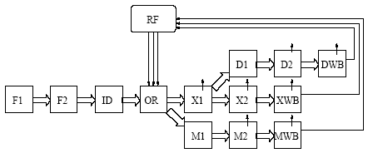
Processor Exploration using OTs
Manual (first time) specification of OTs
  59 OTs
  2000 lines of specification
  Time ~ 6 days
During exploration (every time), OTs may need to change
  E.g. add/remove bypassing or pipeline unit
    21 OTs (36%) need to be modified
    ~ 300 lines need to be modified
    Takes ~ 2 days
  Need to detect when and which OTs to modify
Time consuming
Error-prone
Bottleneck in Automatic DSE of embedded processors
Application
Application
Bypass-sensitive Compiler
Processor
Configuration
Executable
Cycle Accurate
Simulator
Our Contribution: Automatic Generation of OTs

Slide 8
Automatic generation of Operation Table
1. F
2. D
3. OR
ReadOperands
R2
C1 RF
R3
C2 RF
C5 EX
DestOperands
R1 RF
4. EX
BypassOperands
R1
C5 OR
5. WB
WriteOperands
R1
C3 RF
Details in the paper
OT-based Compiler
Operation
EXPRESSION description
Processor
Architecture
AutoOT
OT
RF
C3
C1
C2
ADD R1 R2 R3
C5
F
D
OR
EX
XWB
On-demand generation of OTs
AutoOT
  Inputs – Operation, High Level Processor Description
  Output – Operation Table

Slide 9
AutoOT: First Time Benefits
Manually specify OTs
59 OTs
~ 2000 lines of specification
Time ~ 6 days
Manual processor description
Automatic OT generation
~ 500 lines of specification
Time ~ 2 days
More intuitive
AutoOT: ~3X savings in initial time and effort

Slide 10
AutoOT: Recurring Benefits
Design Exploration (every time)
Add/remove a unit in the X-pipeline of the Intel XScale
Manual Specification of OTs
21 OTs (36%) need to be modified
~ 300 lines need to be modified
~ 2 days
Manual modification of processor description
Automatic generation of OTs
~ 18 lines need to be modified
~ 5 minute
More intuitive
AutoOT: Huge savings (~ 500X) in time and effort
at each step of exploration

Slide 11
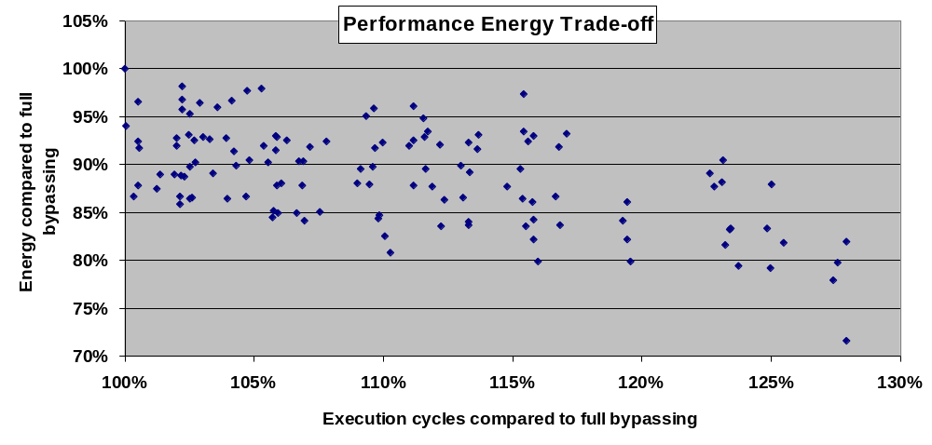
AutoOT: Key Enabler for DSE
Enables exploration of large design space of the processor
Find interesting pareto-optimal design points
Bypass Configuration 1
  15% less energy of bypass control logic vs. full bypassing
  <1% performance loss

Slide 12
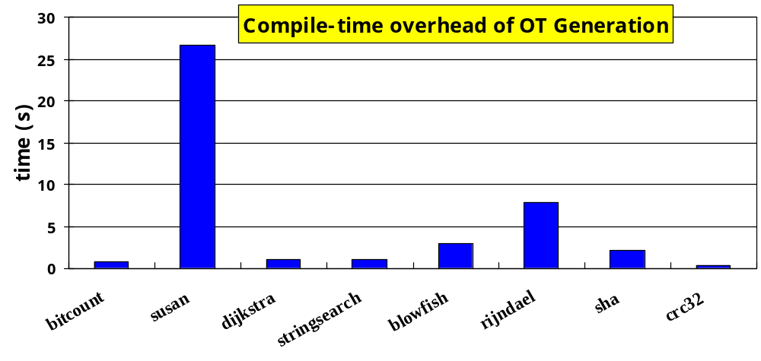
Compile-time overhead of AutoOT
OT-based Compiler
EXPRESSION description
AutoOT
OT
Small Compile-time Overhead

Slide 13
AutoOT DataBase
Architecture description contains all operation formats
Pre-generate partial OTs for each operation format
At compile-time
  Get the partial OTs from the database
  Stitch them together to make the OT
  Decorate it with operation parameters, e.g. register numbers
OT-based Compiler
Operation
EXPRESSION
Processor
Architecture
Database
AutoOTDB1
OT
OTs for each
operation format
AutoOTDB2
Operation
Formats
Notes:
Question?

Slide 14
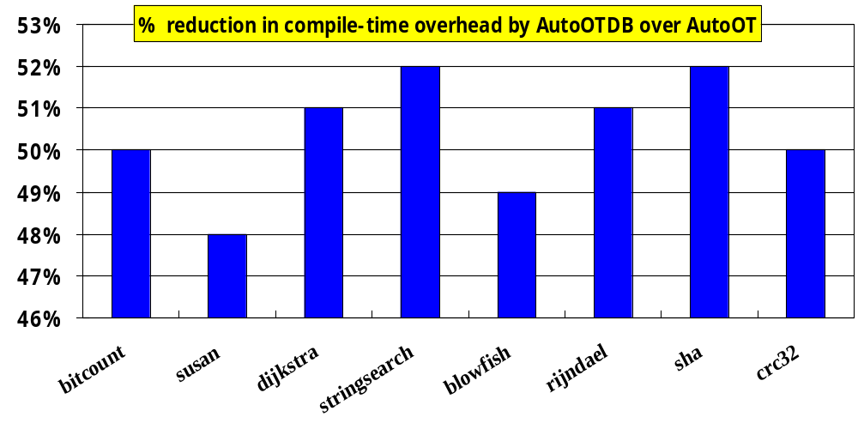
Compile-time overhead of AutoOTDB
AutoOTDB – 50% reduction in compile-time overhead

Slide 15
Related Work
No existing technique to Automatically generate OTs from a high-level processor description
RTGen: Automatically Generate RTs from high-level processor description
  RTs can detect resource hazards only
  Cannot perform bypass-sensitive scheduling
PIPEGEN: Automatically Generate RTs from low-level processor description

Slide 16
Summary
Customizing bypasses in processors is an effective way to perform performance-energy-complexity trade-offs
To perform bypass exploration an OT-based compiler is needed
Manual specification of OTs is a not only time consuming process, but is also highly error-prone.
Automate bypass exploration process
  AutoOT: Method to automatically generate OTs from a high-level processor description
  Enables Automated DSE
  Find new pareto-optimal designs
OT generation has compile-time overhead
  AutoOTDB reduces compile-time overhead by 50%

Slide 17
Micro-operations
Some complex operations break-down into smaller/simpler operations during execution
  If operation breaking is not data dependent (e.g. opcode dependent)
    OT can be pre-generated
  If operation breaking is data dependent
    only partial OTs can be pre-generated
  Example – MLD R1 R4 2 breaks in D unit into
  SLD R1 R4 (R1←M[R4])
  SLD R2 R4 4 (R2←M[R4+4])
Specify this operation breaking in decode unit.
The micro-operation SLD should be a "brand new" instruction.
OT of MLD is only until decode unit.
OT of SLD starts after decode unit
RF
C3
OT(MLD)
C1
C2
F
D
OR
LS
LWB
OT(SLD)
OT(SLD)
MLD
SLD
Notes:
"Data dependent" means "into how many operations" can this operation break depends on the data it contains……………-_-;;

Slide 18
OTs vs. RTs
OTs can detect all pipeline hazards
RTs can detect only resource hazards
We extend the definition of RTs
  to support bypasses
  to support micro-operations
A large number of RTs even for not-so-complex processors
Intel XScale
  15,592 RTs
  59 OTs
Intel XScale pipeline diagram
#RTs ~ 300X #OTs

