Slide 1



Bypass Aware Instruction Scheduling for Register File Power Reduction
Sanghyun Park² Aviral Shrivastava¹
Nikil Dutt¹ Alex Nicolau¹ Yunheung Paek²
Eugene Earlie³
¹CECS, ICS,
UC Irvine, CA, USA
²SEE, SNU
Seoul, Korea
³SCL, Intel,
Hudson, MA, USA
S
L
C

Slide 2
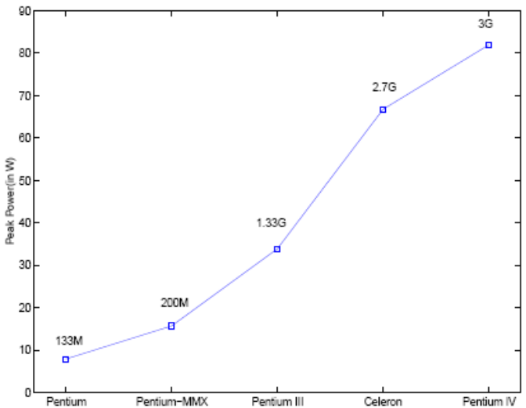
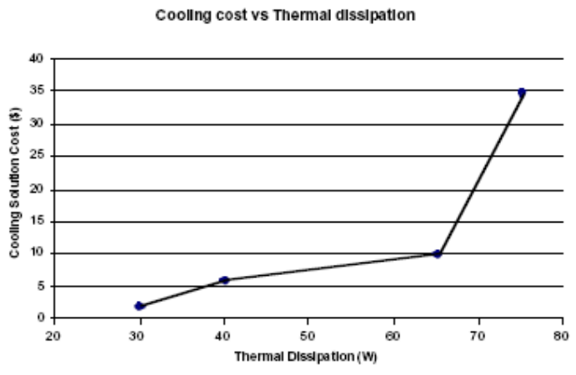
Processor Power
Power is now a primary architectural concern
  E.g.: Processor power consumption doubles w/ Pentium generations
High Power Consumption
  Increases packaging/cooling cost
  Limits achievable performance
Especially Important for handheld embedded devices
  Battery life
  Weight
Increasing power consumption
Cost of Removing heat from a microprocessor
Managing the Impact of Increasing…
Gunther, Binns et. al,
Intel Technology Journal
Intel website
http://www.intel.com

Slide 3
Power Density
Power Density = power per unit area
Silicon is not a good conductor of heat
  Areas with high power density becomes hot
  Higher temperature increases leakage
    Positive feedback loop, possibly leading to thermal runaway
Important to distribute power over the die
  Must “attack” hot-spots [Fred Pollack, Intel Corp, MICRO 32 keynote]
  Heat Stroke - Have to stop if any part of die has more than critical temperature
Research beginning to address power density
  Temperature-Aware Floorplanning
    Surround high power density components with low-power density components
  Migrate tasks across cores
    Distribute heat-intensive tasks across die
  Many other efforts…

Slide 4
Register File Power
Register File is a significant source of power dissipation
  Motorola M.CORE – approx. 16% processor power
  RF may consume up to 25% of processor power
High Register File Power density
  Small size, causes Hotspots
  e.g., Alpha 21264, Intel Pentium
Trend: increasing RF power due to
  Microarchitectural enhancements to improve IPC
  Compiler techniques to improve IPC
  Large Register Files (esp. VLIW processors)

Slide 5
Heat Stroke from RF accesses
Example
        Label1:
        add $1, $2, $3
        br Label1
Repeated access to register file at high rate
Create repeated hot spots at register file
Heat-up time short (1.2ms), cooling time long (12ms)
Degrades CPU utilization to 10%
Slide from “Heat Stroke: Power-Density-Based Denial of Service in SMT”, Jahangir Hasan et. al, ISHPC 2005

Slide 6
Outline
Previous work in reducing RF Power
  On-Demand RF Read
Instruction Scheduling technique for RF Power reduction
Experiments
Summary

Slide 7
Reducing RF Power: Related Work
Evaluation/Estimation of RF Power and RF Power Density
  [ISLPED 98], [TCAD 01], [DATE 02]
Three ways to reduce RF Power
  Reduce energy per access to RF
  Reduce # registers in RF
  Reduce # accesses to RF
1. Reduce energy per access to RF
  Register File Design Considerations… Farkas, Jouppi, Chow, WRL Research Report, 1995
  The Energy Complexity of Register Files, Zubyan, Kogge, ISPLED 1998
  Energy Efficient Register Access, Tseng, Asanovic, SBCCI 2000

Slide 8
Reducing RF Power: Related Work
2. Reduce # registers in RF
  Instruction Scheduling to minimize # overlapping live range
    Power-Aware Modulo Scheduling, Yun, Kim, ISLPED 2001
    Lifetime-Sensitive Modulo Scheduling, Huff, PLDI 1993
    Stage Scheduling … Eichenberger, Davidson, MICRO 1995
3. Reduce # accesses to RF
  Hierarchical Register File
    Reducing the Complexity of RF …, Balasubramonion et. al., MICRO 2001
  Most lifetimes are short ➔ Temporarily hold register value in a buffer
    Reducing Register File Power… Hu, Martonosi, Workshop on Complexity-Effective Design 2000
    Reducing Register Ports using… Kim, Mudge, ICS 2003

Slide 9
Outline
Previous work in reducing RF Power
  On-Demand RF Read
Instruction Scheduling technique for RF Power reduction
Experiments
Summary

Slide 10
“On-Demand” RF Read
Existing processors anticipatorily read RF
  e.g., Pentium 4, Alpha 21264
SpecInt95 running on MIPS II
  36% operands come from bypasses
8-issue SimpleScalar running SpecInt2K
  50-70% operands come from bypasses
Read from RF only if necessary (Teng & Asanovic, SBCCI 2000)
  First find out if the value is present in the bypasses
  If not, then read the value from RF
  We’ll call this “On-Demand RF Read”
When applied to Intel XScale model
  58% energy reduction
  < 3% performance loss
This paper: Further reduction in RF power by Instruction Scheduling

Slide 11
Outline
Previous work in reducing RF Power
  On-Demand RF Read
Instruction Scheduling technique for RF Power reduction
Experiments
Summary

Slide 12
Processor Model
RF
F
D
OR
X1
X2
WB
Partially Bypassed Processor
Pipeline Bypasses
  Improve performance
Full bypassing
  Best performance, but high power & wiring complexity
Partial Bypassing
  Keep only some bypasses
  Popular in embedded processors, e.g., Intel XScale

Slide 13
Operation Execution Model
RF
F
D
OR
X1
X2
WB
Add R1 R2 R3
Read R2, R3 from RF and bypasses
Bypass R1 to second port of OR
Do nothing
Write back R1 to RF
On Demand RF Read
Read source operands → bypass result → write back

Slide 14
How can scheduling help?
RF
F
D
OR
X1
X2
WB
Add R1 R2 R3
ADD R10 R11 R12
SUB R4 R5 R1
Add R1 R2 R3
SUB R4 R5 R1
ADD R10 R11 R12
SUB CANNOT use bypass to read R1
SUB CAN use bypass to read R1
Instruction Scheduling can reduce RF usage!

Slide 15
Bypass-sensitive RF Power-Aware Scheduling
RF
F
D
OR
X1
X2
WB
Add R1 R2 R3
ADD R10 R11 R12
SUB R4 R5 R1
Add R1 R2 R3
SUB R4 R5 R1
ADD R10 R11 R12
Schedule instructions so that
  Dependent instruction transfer operands using bypasses
  Reduce RF usage
Compiler needs to know
  When does an instruction bypass result?
  Which operands can read the result?
  When result is written into register file?
Compiler needs a detailed processor-operation model

Slide 16
Operation Table (OT)
1. F
2. D
3. OR
ReadOperands
R2
C1 RF
R3
C2 RF
C4 X1
DestOperands
R1 RF
4. X1
WriteOperands
R1
C4 OR
5. X2
6. XWB
WriteOperands
R1
C3 RF
RF
C1
C2
C4
C3
F
D
OR
X1
X2
WB
Model all the resources and registers used by an operation in each cycle of its execution
Can determine which operands are available for each source operand
Use OTs for scheduling to reduce the usage of RF
Operation Tables for Scheduling in Partially Bypassed Processors – Shrivastava, Earlie, Dutt, Nicolau, CODES + ISSS 2004
Operation Table for ADD R1 R2 R3

Slide 17
OT-based RF Power-Aware Scheduling
Operation Tables (OTs) provide a mechanism
  To accurately estimate the number of operands read from RF
Exploit OTs for scheduling to reduce RF usage
  Various scheduling strategies can be employed
  Choose scheduling heuristic with the least RF usage
We evaluated 3 BB scheduling techniques
  RFPEX: Exhaustive
  RFPN: Greedy O(n)
  RFPN2: Greedy with one level of backtracking O(n²)

Slide 18
Outline
Previous work in reducing RF Power
  On-Demand RF Read
Instruction Scheduling technique for RF Power reduction
Experiments
Summary

Slide 19
Experimental Setup
Application
Intel XScale
  7 –stage, partially bypassed
  On-Demand RF Read Architecture
RF Power Model
  = # Register File Accesses
MiBench benchmarks
Scheduler
  Operation Table - based
  RF Power-Aware Scheduling
  Within Basic Block
    Tried 3 strategies
RF Power Results
  Compare with On-Demand RF Read architecture as baseline
GCC –O3
OT – based Scheduler
Assembly
GCC linker
Executable
Cycle-Accurate
Simulator
Runtime
RF Reads

Slide 20
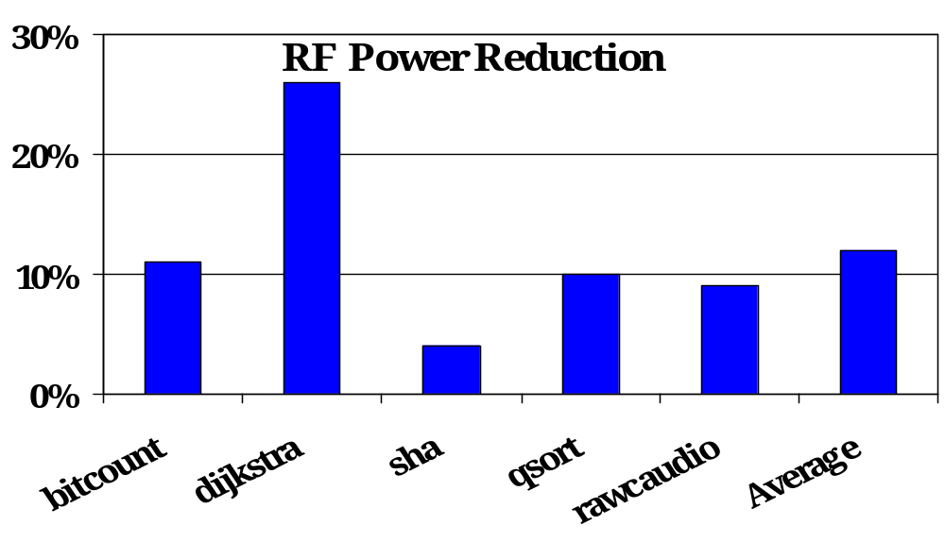
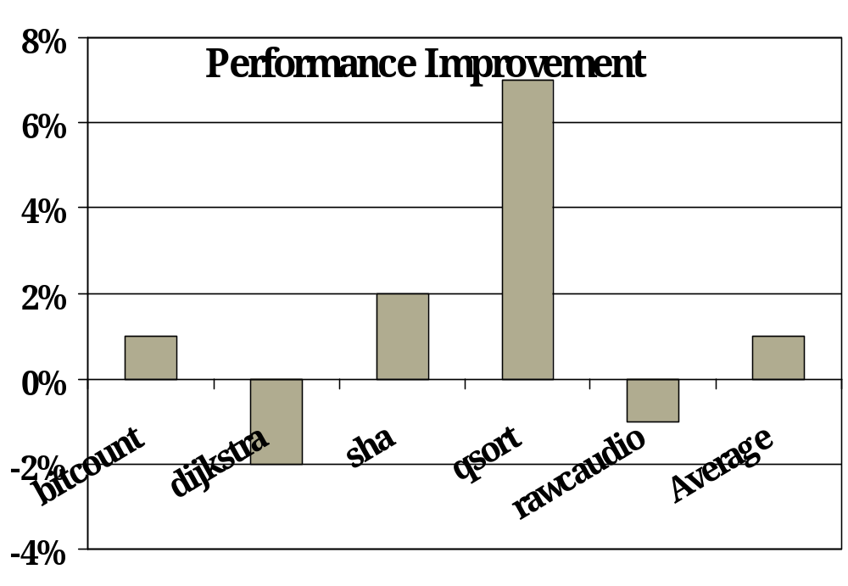
1. RFPEX Scheduling
26% reduction
Exhaustive
  Try all legal permutations of instructions
  O(n!) Complexity
    n - # instructions in BB
Compilation Time
  Hours
  Could not schedule susan, rijndael (2 days)
RF Power Reduction
  Average 12%
Performance Improvement
  Average 1.4%
7% improvement

Slide 21
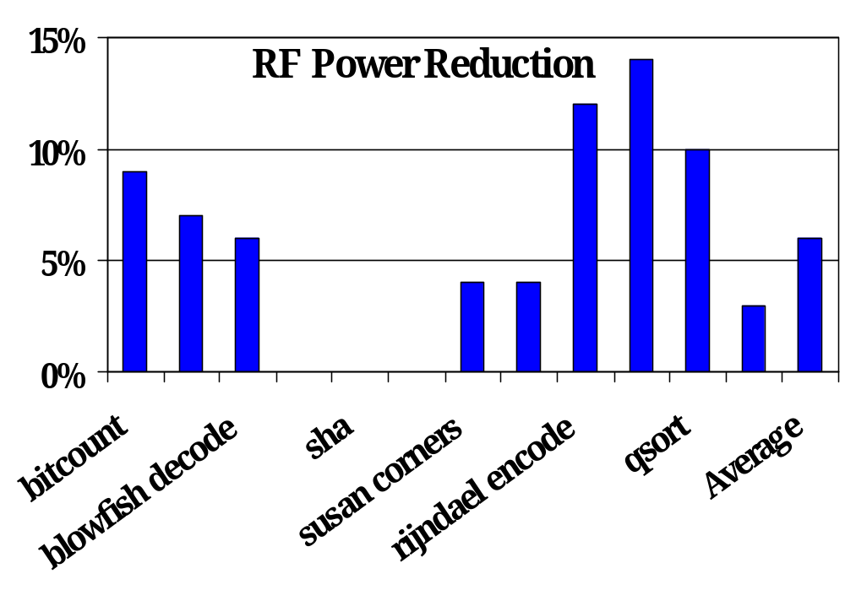
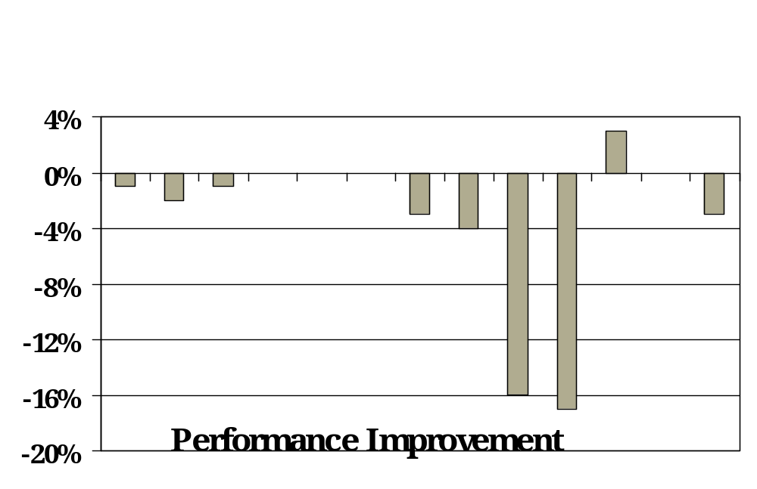
2. RFPN Scheduling
Greedy O(n) scheduling
  Pick instructions one by one
  Pick instruction which gets most operands from bypass
  O(n) Complexity
    n - # instructions in BB
Compilation time
  Seconds
RF Power Reduction
  Average 6%
Performance Improvement
  Average: -3.5%

Slide 22
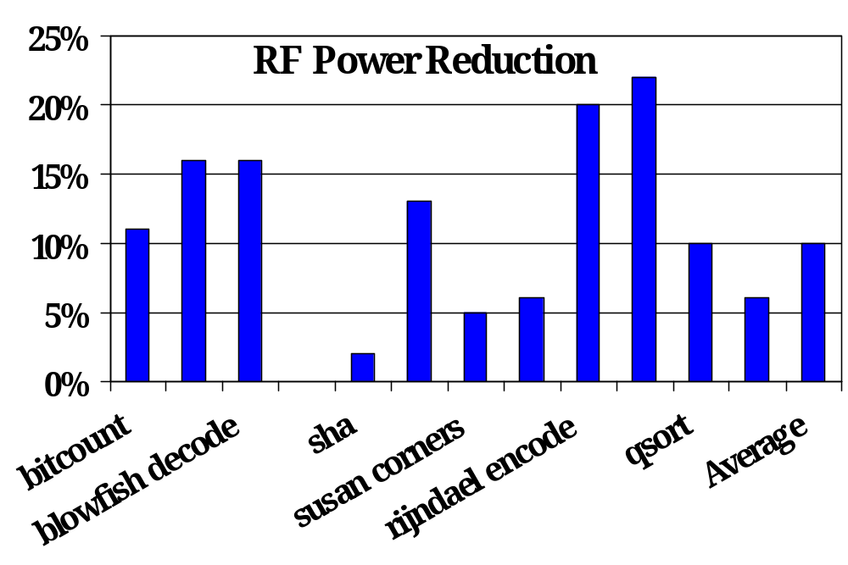
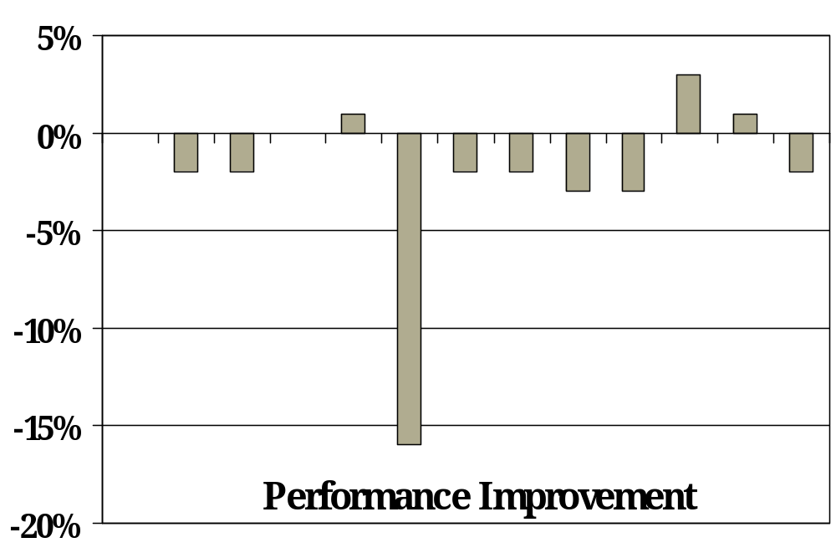
3. RFPN2 Scheduling
Average
10% reduction
RFPN2 - Greedy with one level of backtracking
  O(n²) Complexity
    n - # instructions in BB
Compilation time
  Minutes
RF Power Reduction
  Average 10%
Performance Improvement
  Average: -2%
RFPN2 works well !!

Slide 23
Outline
Previous work in reducing RF Power
  On-Demand RF Read
Instruction Scheduling technique for RF Power reduction
Experiments
Summary

Slide 24
Summary
Register File is one of the main hotspots in processors
Very important to reduce RF Power
  Repeated accesses cause “Heat Stroke”
  Up to 90% performance degradation
On-Demand RF Read is an effective technique
  58% RF power reduction
Scope for further RF power reduction via instruction scheduling
Contribution: Instruction Scheduling Technique for further RF power reduction
  Up to 26%, Average 12% RF power reduction
  2% performance degradation
  Over and above On-Demand RF Read architecture as baseline
  RFPN2 is an effective heuristic for RF Power reduction
Future Work
  Beyond basic block scheduling

