Slide 1



Hiding Cache Miss Penalty
Using Priority-based Execution for Embedded Processors
Sanghyun Park, §Aviral Shrivastava and Yunheung Paek
SO&R Research Group
Seoul National University, Korea
§ Compiler Microarchitecture Lab
Arizona State University, USA

Slide 2
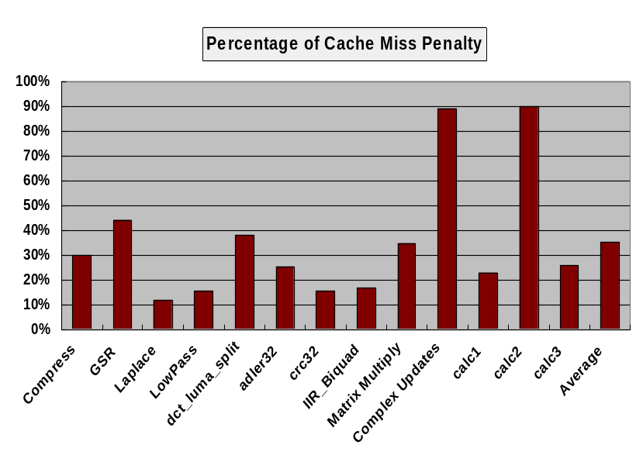
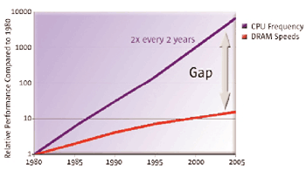
Memory Wall Problem
Increasing disparity between processors and memory
In many applications,
  30-40% memory operations of the total instructions
  streaming input data
Intel XScale spends on average 35% of the total execution time on cache misses
From Sun’s page : www.sun.com/processors/throughput/datasheet.html
2
Sanghyun Park : DATE 2008, Munich, Germany

Slide 3


Hiding Memory Latency
In high-end processors,
  multiple issue
  value prediction
  speculative mechanisms
  out-of-order (OoO) execution
    HW solutions to execute independent instructions using reservation table even if a cache miss occurs
Very effective techniques to hide memory latency
3
Sanghyun Park : DATE 2008, Munich, Germany

Slide 4

Hiding Memory Latency
In the embedded processors,
  not viable solutions
  incur significant overheads
    area, power, chip complexity
In-order execution vs. Out-of-order execution
  46% performance gap*
  Too expensive in terms of complexity and design cycle
Most embedded processors are single-issue and non-speculative processors
  e.g., all the implementations of ARM
*S.Hily and A.Seznec. Out-of-order execution may not be cost-effective
on processors featuring simultaneous multithreading. In HPCA’99
4
Sanghyun Park : DATE 2008, Munich, Germany

Slide 5
Basic Idea
Place the analysis complexity in the compiler’s custody
HW/SW cooperative approach
  Compiler identifies the low-priority instructions
  Microarchitecture supports a buffer to suspend the execution of low-priority instructions
Use the memory latencies for the meaningful jobs!!
cache miss
Original
execution
stall...
high-priority
instructions
load instructions
Priority based
execution
low-priority
instructions
low-priority execution
5
execution time
Sanghyun Park : DATE 2008, Munich, Germany

Slide 6
Outline
Previous work in reducing memory latency
Priority based execution for hiding cache miss penalty
Experiments
Conclusion
6
Sanghyun Park : DATE 2008, Munich, Germany

Slide 7
Previous Work
Prefetching
  Analyze the memory access pattern, and prefetch the memory object before actual load is issued
  Software prefetching [ASPLOS’91], [ICS’01], [MICRO’01]
  Hardware prefetching [ISCA’97], [ISCA’90]
  Thread-based prefetching [SIGARCH’01], [ISCA’98]
Run-ahead execution
  Speculatively execute independent instructions in the cache miss duration
  [ICS’97], [HPCA’03], [SIGARCH’05]
Out-of-order processors
  can inherently tolerate the memory latency using the ROB
Cost/Performance trade-offs of out-of-order execution
  OoO mechanisms are very expensive for the embedded processors [HPCA’99], [ICCD’00]
7
Sanghyun Park : DATE 2008, Munich, Germany

Slide 8
Outline
Previous work in reducing memory latency
Priority based execution for hiding cache miss penalty
Experiments
Conclusion
8
Sanghyun Park : DATE 2008, Munich, Germany

Slide 9



Priority of Instructions
High-priority Instructions
Instructions that can cause cache misses
data-dependent on…
control-dependent on…
generates the source operands of the high-priority instruction
All the other instructions are low-priority Instructions
Instructions that can be suspended until the cache miss occurs
9
Sanghyun Park : DATE 2008, Munich, Germany

Slide 10
Finding Low-priority Instructions
01:L19: ldr r1, [r0, #-404]
02: ldr ip, [r0, #-400]
03: ldmda r0, r2, r3
04: add ip, ip, r1, asl #1
05: add r1, ip, r2
06: rsb r2, r1, r3
07: subs lr, lr, #1
08: str r2, [r0]
09: add r0, r0, #4
10: bpl .L19
1
2
3
9
r1
ip
7
4
r2
r3
r0
cpsr
ip
5
10
r1
6
8
Innermost loop of the Compress benchmark
  1. Mark all load and branch instructions of a loop
  2. Use UD chains to find instructions that define the operands of already marked instructions, and mark them (parent instructions)
  3. Recursively continue Step 2 until no more instructions can be marked
10
Sanghyun Park : DATE 2008, Munich, Germany

Slide 11
Scope of the Analysis
Candidate of the instruction categorization
  instructions in the loops
  at the end of the loop, execute all low-priority instructions
Memory disambiguation*
  static memory disambiguation approach
  orthogonal to our priority-based execution
ISA enhancement
  1-bit priority information for every instruction
  flushLowPriority for the pending low-priority instruction
* Memory disambiguation to facilitate instruction…, Gallagher, UIUC Ph.D Thesis,1995
11
Sanghyun Park : DATE 2008, Munich, Germany

Slide 12
Architectural Model
2 execution modes
  high/low-priority execution
  indicated by 1-bit ‘P’
Low-priority instructions
  operands are renamed
  reside in ROB
  cannot stall the
  processor pipeline
Priority selector
  compares the
  src regs of the
  issuing insn with
  reg which will miss
  the cache
From decode unit
ROB
P
Instruction
Rename Manager
Rename Table
P
src regs
high
low
Priority
Selector
MUX
operation bus
cache missing register
Memory
Unit
FU
12
Sanghyun Park : DATE 2008, Munich, Germany

Slide 13
Execution Example
L 04: add ip, r17, r18, asl #1
L 04: add ip, ip, r1, asl #1
L 04: add ip, r17, r18, asl #1
L 04: add ip, ip, r1, asl #1
Rename Table
r12 | r17
r1 | r18
H 03: ldmda r0, r2, r3
H ---: mov r18, r1
H 02: ldr ip, [r0, #-400]
H 03: ldmda r0, r2, r3
H 02: ldr r17, [r0, #-400]
H 01: ldr r1, [r0, #-404]
H 02: ldr ip, [r0, #-400]
H 01: ldr r18, [r0, #-404]
H 02: ldr r17, [r0, #-400]
high
low
high
low
10: bpl .L19
01: ldr r1, [r0, #-404]
All the parent instructions reside in the ROB
The parent instruction has already been issued
‘mov’ instruction
  shifts the value of the real register to the rename register
13
Sanghyun Park : DATE 2008, Munich, Germany

Slide 14
We can achieve the performance improvement by…
  executing low-priority instructions on a cache miss
  # of effective instructions in a loop is reduced

Slide 15
Outline
Previous work in reducing memory latency
Priority based execution for hiding cache miss penalty
Experiments
Conclusion
14
Sanghyun Park : DATE 2008, Munich, Germany

Slide 16
Experimental Setup
Application
Intel XScale
  7-stage, single-issue, non-speculative
  100-entry ROB
  75-cycle memory latency
  cycle-accurate simulator validated against 80200 EVB
  Power model from PTscalar
Innermost loops from
  MultiMedia, MiBench, SPEC2K and DSPStone benchmarks
GCC –O3
Assembly
Compiler Technique for PE
Assembly with Priority Information
Cycle-Accurate Simulator
Report
15
Sanghyun Park : DATE 2008, Munich, Germany

Slide 17
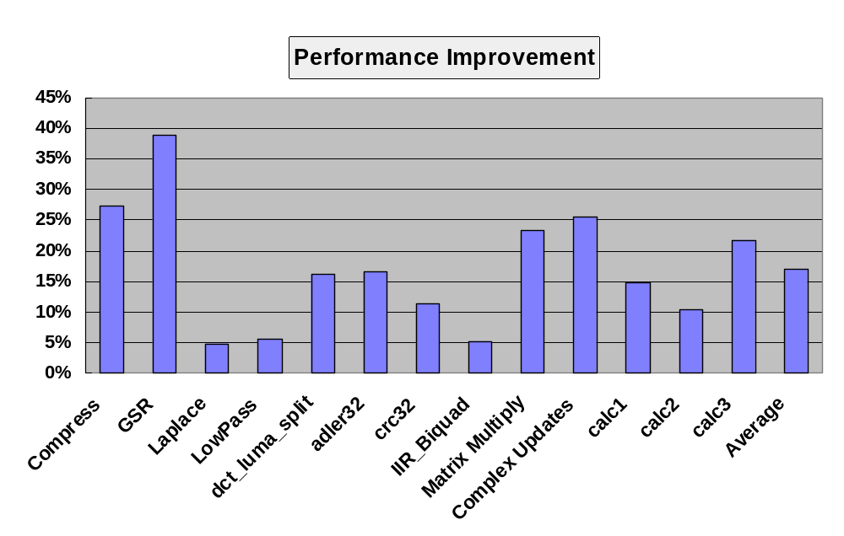
Effectiveness of PE (1)
39% improvement
17% improvement
Up to 39% and on average 17 % performance improvement
In GSR benchmark, 50% of the instructions are low-priority
  efficiently utilize the memory latency
16
Sanghyun Park : DATE 2008, Munich, Germany

Slide 18
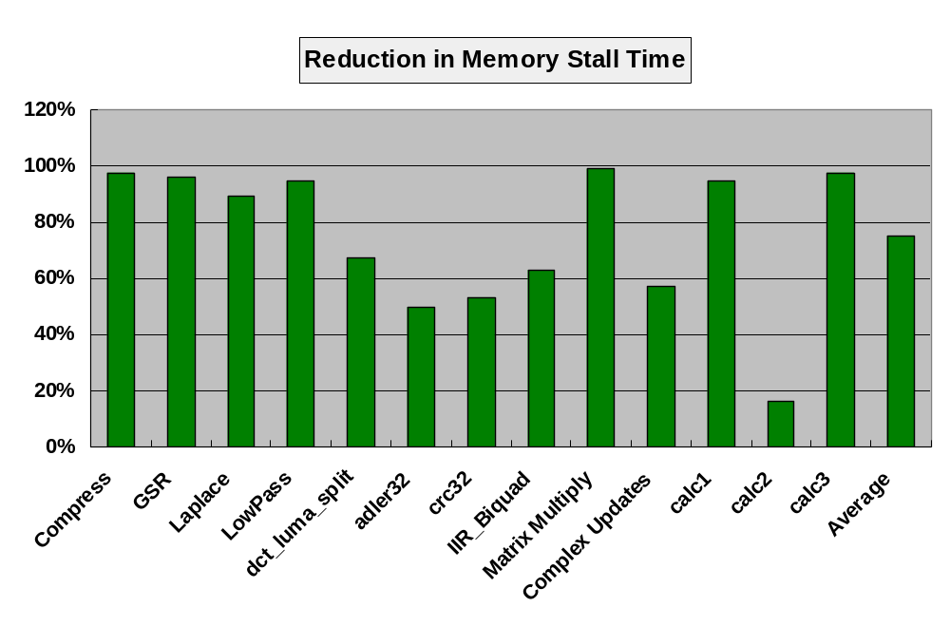
Effectiveness of PE (2)
On average, 75% of the memory latency can be hidden
The utilization of the memory latency
➔ depends on the ROB size and the memory latency
how many low-priority instructions can be hold
how many cycles can be hidden using PE
17
Sanghyun Park : DATE 2008, Munich, Germany
Notes:
how much we can hide the memory stall time

Slide 19
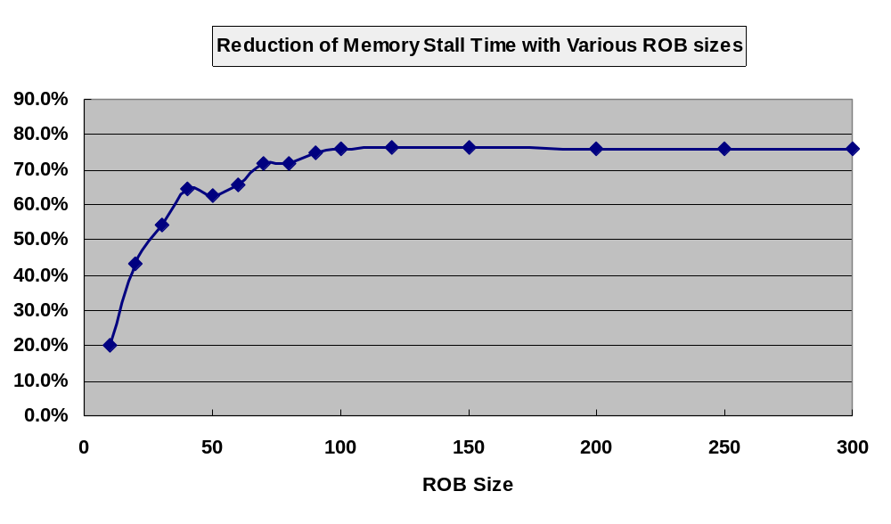
Varying ROB Size
average reduction for all the benchmarks we used
memory latency = 75 cycles
ROB size ➔ # of low-priority instructions
Small size ROB can hold very limited # of low-priority instructions
Over 100 entries → saturated due to the fixed memory latency
18
Sanghyun Park : DATE 2008, Munich, Germany

Slide 20
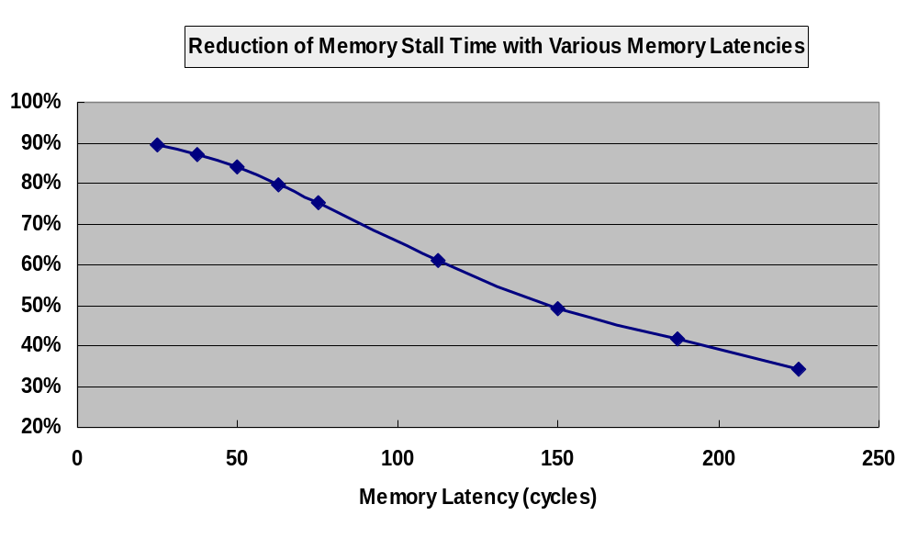
Varying Memory Latency
average reduction for all the benchmarks we used
with 100-entry ROB
The amount of latency that can hidden by PE
keep decreasing with the increase of the memory latency
  smaller amount of memory latency → less # of low-priority instruction
Mutual dependence between the ROB size and the memory latency
19
Sanghyun Park : DATE 2008, Munich, Germany

Slide 21
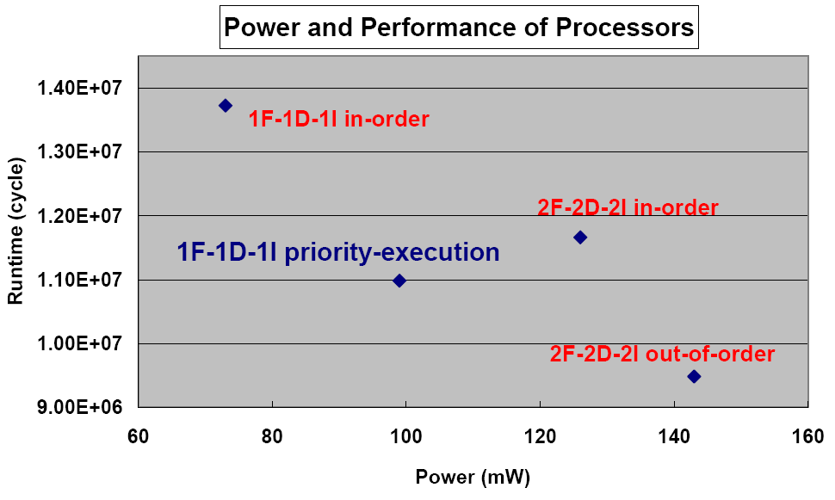

Power/Performance Trade-offs
Anagram benchmark from SPEC2000
1F-1D-1I in-order processor
  much less performance / consume less power
2F-2D-2I in-order processor
  less performance / more power consumption
2F-2D-2I out-of-order processor
  performance is very good / consume too much power
20
Sanghyun Park : DATE 2008, Munich, Germany

Slide 22
Conclusion
Memory gap is continuously widening
  Latency hiding mechanisms become ever more important
High-end processors
  multiple-issue, out-of-order execution, speculative execution, value prediction
  not suitable solutions for embedded processors
Compiler-Architecture cooperative approach
  compiler classifies the priority of the instructions
  architecture supports HWs for the priority based execution
Priority-based execution with the typical embedded processor design (1F-1D-1I)
  an attractive design alternative for the embedded processors
21
Sanghyun Park : DATE 2008, Munich, Germany

Slide 23
Thank You!!
22

