Slide 1

Path Selection based Branching for CGRAs
ShriHari RajendranRadhika
Thesis Committee:
Prof. Aviral Shrivastava (Chair)
Prof. Jennifer Blain Christen
Prof. Yu (Kevin) Cao

Slide 2
Accelerators for Energy Efficiency
Demand for high performance at low power consumption.
Accelerators help achieve power efficient computing.
  Specialized hardware to efficiently execute dominant computations of a program.
  Scales from mobile devices to super computers
Hardware accelerators
goal
Power
Efficiency
CGRAs
GPGPUs
FPGAs
General purpose processors
Flexibility
Source : Fine and Coarse Grain Reconfigurable Computing, Springer.
Notes:
Demand for high performance at low power consumption,
accelerators special hardware.
Desirable features – power efficiency and flexibility
High power efficiency , scaling

Slide 3



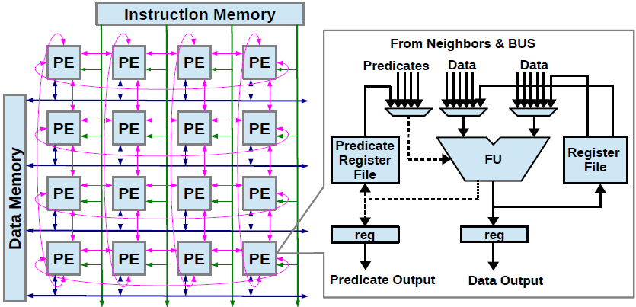
Coarse-Grained Reconfigurable Architectures (CGRAs)
2D array of Processing Elements (PEs)
ALU + Local register files → PE
Torus interconnection
Processor
Accelerator
Shared Memory
Notes:
2d array of processing elements , interconnected to each other ..
Functional unit , operands for the functional unit

Slide 4
Acceleration of loops using CGRAs
Programs spend majority of their execution time in loops[2].
Research on CGRAs has been accelerating loops.
Acceleration of loops can
result in faster execution time.
for(…)
{
a = a + X;
b = b - X;
c = a * b;
d = c - b;
e = d + X;
}
[2]terative modulo scheduling: An algorithm for software pipelining loops,” in Proceedings of the 27th Annual International Symposium on Microarchitecture, ser. MICRO 27
Notes:
Context of acceleration obtained by CGRAs

Slide 5
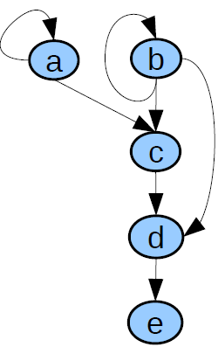





Data Flow Graph Generation
  Create a DFG from a simple loop kernel
for(…)
{
a = a + X;
b = b - X;
c = a * b;
d = c - b;
e = d + X;
}
Notes:
DFG generation – meaning of a DFG , nodes represetn operation and edges represent dependencies between operations

Slide 6
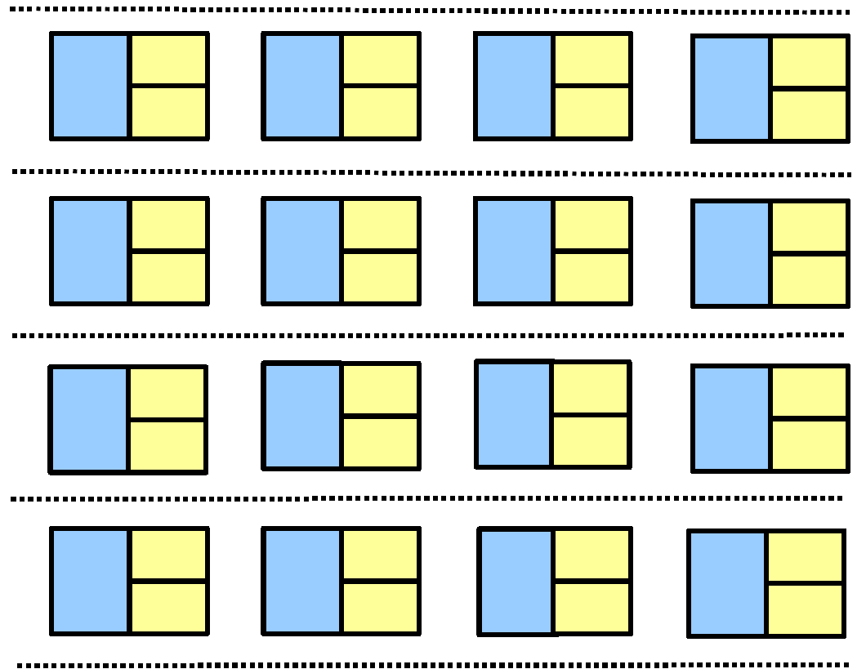
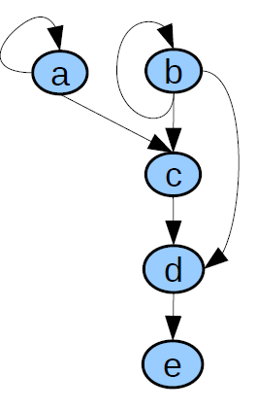






Mapping DFG to CGRA
Time
4
PE 1
PE 2
PE 3
PE 4
0
1
2
3
Notes:
Talk about PE under utilization !! Show bad schedule length !! Don’t talk about II yet

Slide 7










Mapping DFG to CGRA using Modulo Scheduling
Time
2
PE 1
PE 2
PE 3
PE 4
0
1
2
3
Notes:
We have good resource utilization, we overlapped multiple iterations in the same cycle,

Slide 8
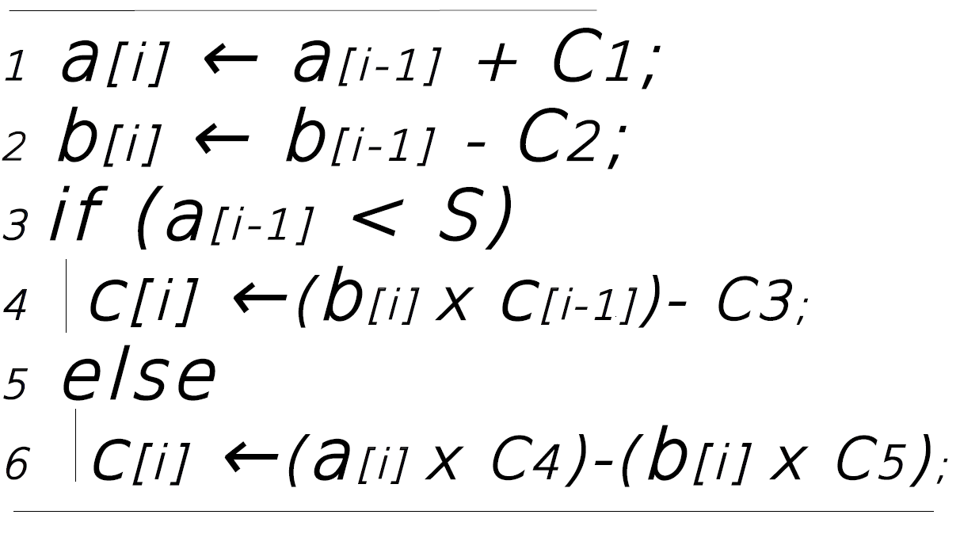
One of the major challenges in CGRAs
How to efficiently accelerate execution of loops with if–then-else structures ?
Notes:
Loop with if –then –else .. Mention that we will accelerate this loop kernel throughout the presentation

Slide 9
Why accelerate loops with control flow ?
40% of the loops that could be accelerated by CGRAs have control flow (if-then-else structures) in them in SPEC2006 benchmarks.[3]
50.1% of the instructions in a loop with control flow are in the conditional path on an average.
Relatively there are limited number of compiler solutions to accelerate loops with control flow.
[3]Branch-aware loop mapping on cgras,” in Proceedings of the The 51st Annual Design Automation Conference on Design Automation Conference, ser. DAC ’14.
Notes:
Why I should worry about accelerating loops with if-then-else

Slide 10
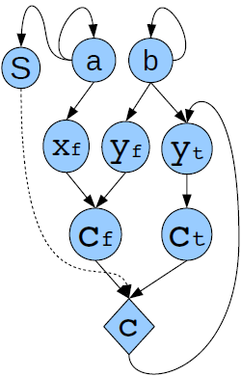
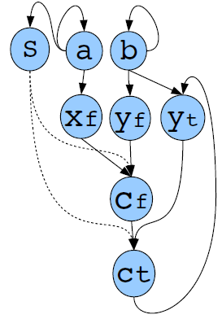
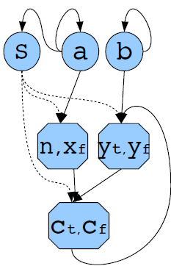
Inefficiency of Existing Techniques
  Firstly, instructions from both the paths of the branch are fetched and issued unconditionally to the CGRA.
Partial predication
Full predication
II = 3
Dual Issue
II = 5
II = 3
zt
zf
If-path node
else-path node
Notes:
Instruction issuance and unnecessary execution

Slide 11
Inefficiency of Existing Techniques
  Predicate value needs to be communicated to nodes handling instructions in control flow block.
Partial predication
Dual Issue
Full predication
II = 3
II = 3
II = 5
Notes:
Predicate communication overhead

Slide 12
Proposed Solution: Path Selection based Branching
PSB executes the branch operation as early as possible
Communicate the branch outcome to the Instruction Fetch Unit.
Only the instructions from the path taken by the branch are issued to the CGRA.
Very much like how processors execute
However need compiler support in CGRAs
Notes:
Explain PSB solution : 2 aspects :
Execute branch instruction as early as possible
Communicate the branch outcome to the IFU of the CGRA.

Slide 13
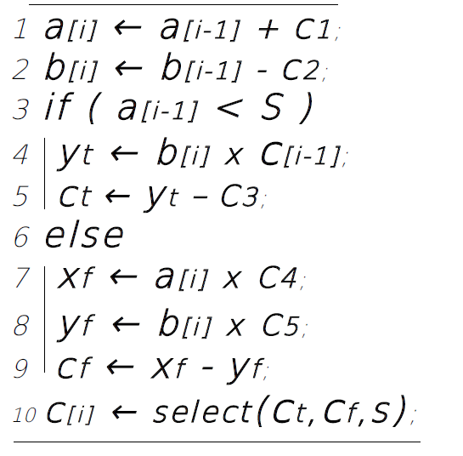
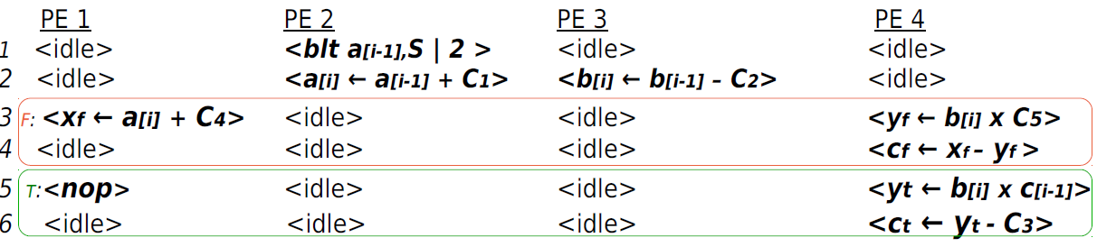
Arrangement of Instructions for PSB Approach
Notes:
SSA form
True path and false path instruction

Slide 14
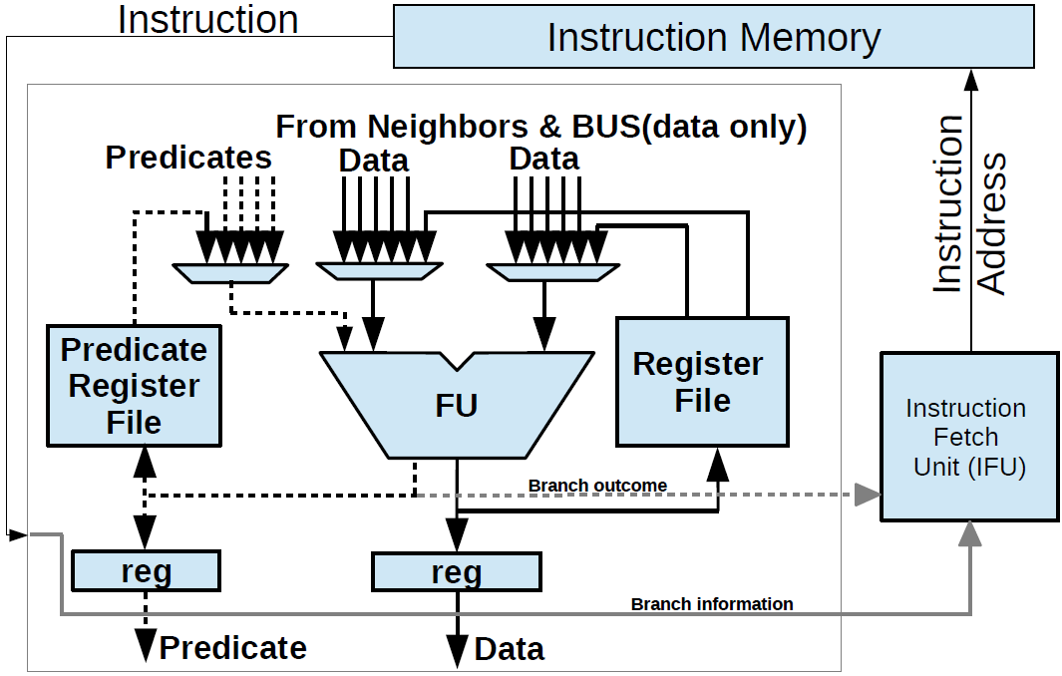
Architecture Support for PSB

Slide 15
What must the compiler do ?
Map operations from the if-path and else-path on the time extended CGRA.
  The total number of PEs required execute the branch is the union of PEs required to map the if-path and else-path operations.
In order to improve the resource utilization each operation from the if-path must be “paired” with an operation from the else path and mapped to the same PE resource.

Slide 16
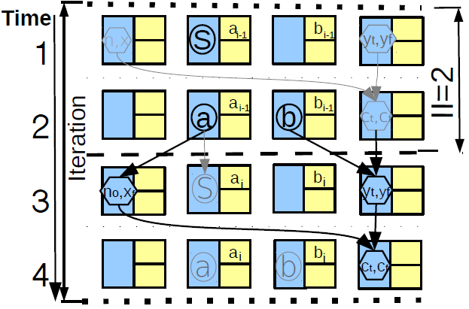
Pairing of operations
Achieved the lowest II so far !!
Notes:
Emphasis on the II !!!

Slide 17
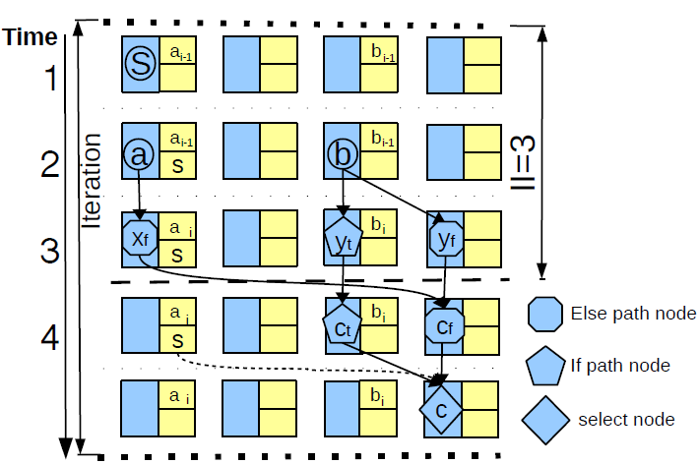
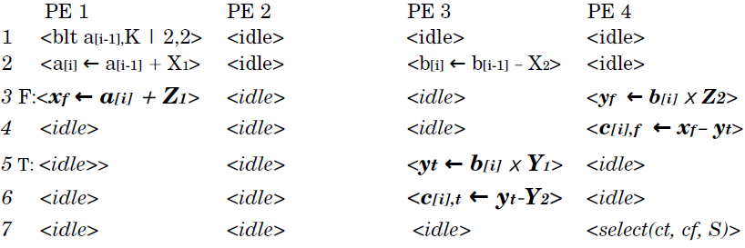
Why do we need to pair operations ?
If pairing is not done, the resources required to execute operations from the conditional path is the sum of the resources required to execute the if-path and the ellsepath.
Such a mapping results in poor resource utilization.
Notes:
Sum of resources used
And emphasis on the bad II.

Slide 18
Problem Formulation
Input: Data Flow Graph with if and else-path operations
Output: Data Flow Graph with fused nodes with each fused node having two operations – one from if-path and the other from else-path
Valid output: Such a transformation/pairing is valid iff the order of dependence of both the if-path operations and else-path operations are maintained in the dependence exhibited in the output.
Optimization: Minimize the number of nodes in the output Data Flow Graph while maintaining validity.

Slide 19
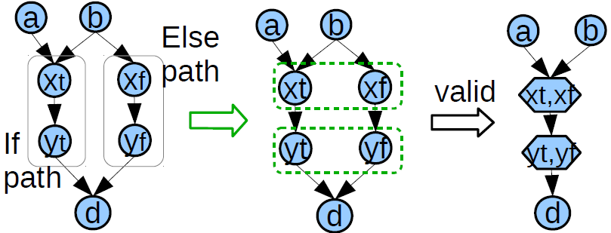
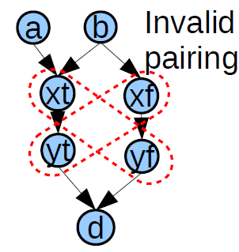
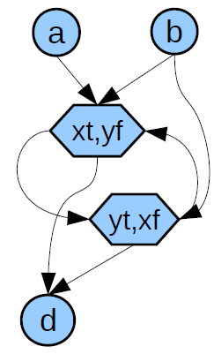
Are all possible pairings correct ?
Valid pairing:
Invalid pairing:

Slide 20
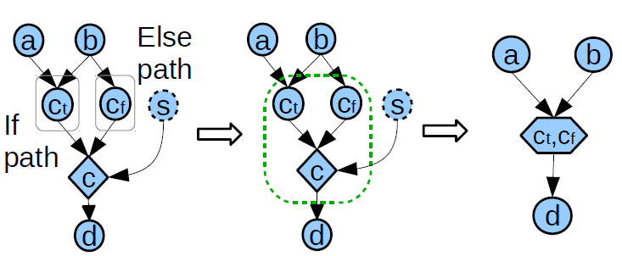
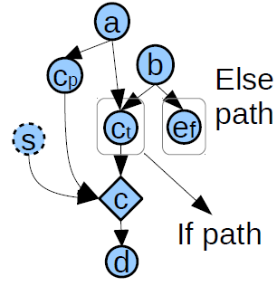
Optimization: Minimize the number of nodes
We minimize the number of nodes by elimination of eligible Phi nodes.
Eligible:
Not Eligible:

Slide 21
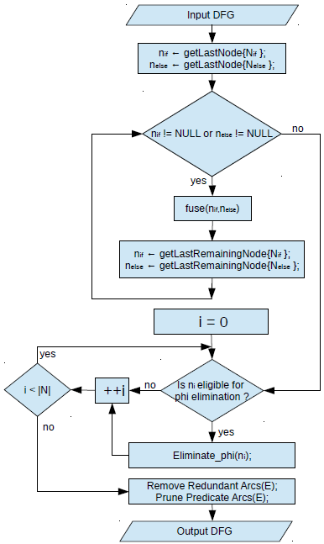
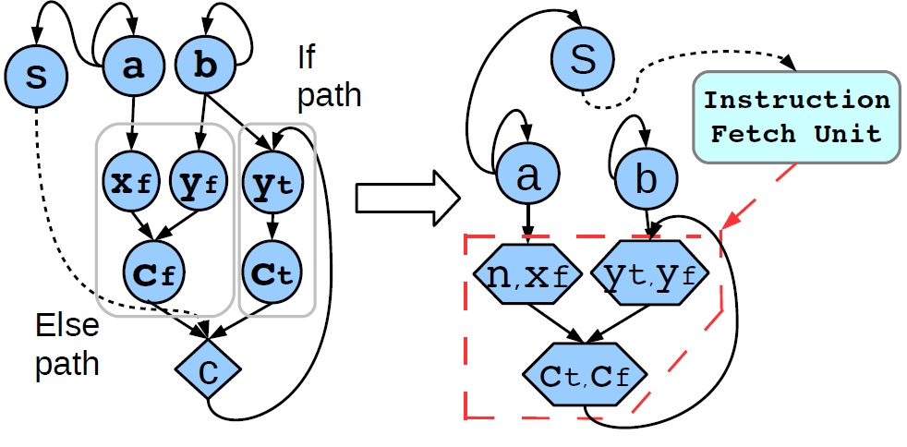
Our Heuristic

Slide 22
Performance Evaluation Model
  CGRA is implemented in Gem5 system simulation framework.
  We have integrated our PSB compiler technique as a separate pass in the LLVM compiler framework .
  Computational loops with control ﬂow are extracted from SPEC2006 , Biobench benchmarks.
  We use REGIMap mapping algorithm to obtain a mapping for all approaches.
  We map the loops on a 4 × 4 regular torus interconnected CGRA.

Slide 23
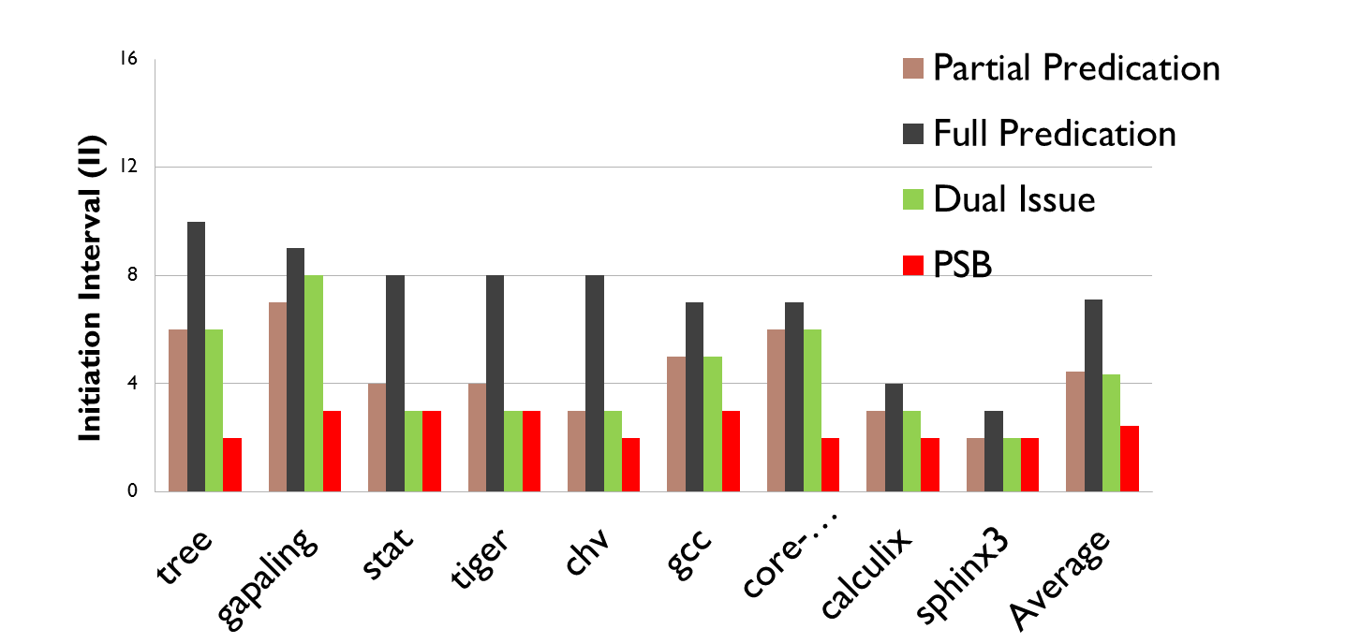
PSB achieves the best acceleration of loops
PSB achieves better acceleration (lower II) compared to existing techniques to accelerate control ﬂow loops
Notes:
Make these simpler and coloured, talk about how this is less cylcles

Slide 24
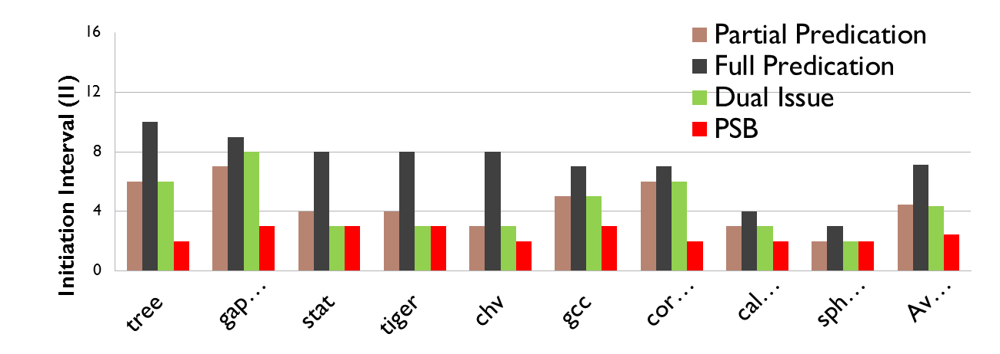
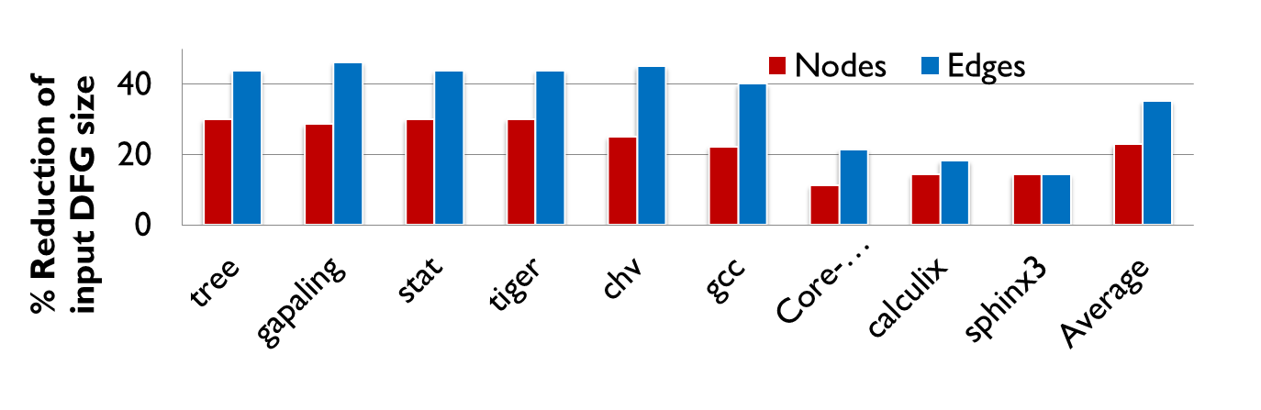
Why we are able to achieve better II?
Notes:
Color it and simplify it. Mention the axes

Slide 25
Hardware Implementation
We implemented an RTL model of a 4x4 CGRA with torus interconnect network including the Instruction fetch unit for all CGRA architectures.
Synthesized using 65nm technology library using RTL compiler tool. The models were verified for functionality after synthesis.
To obtain the accurate impact of predicate communication in a PSB architecture on the overall frequency and area of CGRA, place and route was performed using Cadence Encounter tool.

Slide 26
PSB Architecture has comparable Area and Frequency
PSB Architecture has comparable Area, Frequency and Power with existing solutions.
CGRA+IFU* | Partial Predication | Full Predication | Dual Issue | PSB
Area(sq.um) | 375708 | 384539 | 411248 | 384154
Frequency (MHz) | 462 | 477 | 454 | 458
*IFU – Instruction Fetch Unit

Slide 27
Energy Model
Total energy to execute the loop kernel = Energy spent by PE per cycle per kernel + dynamic energy spent on an instruction fetch operation per PE per kernel.
Energy spent by PE per cycle per kernel (estimated for ALU operation, routing operation and idle operation )
Energy expenditure for instruction access is estimated for each architecture from cacti 5.3 tool.

Slide 28
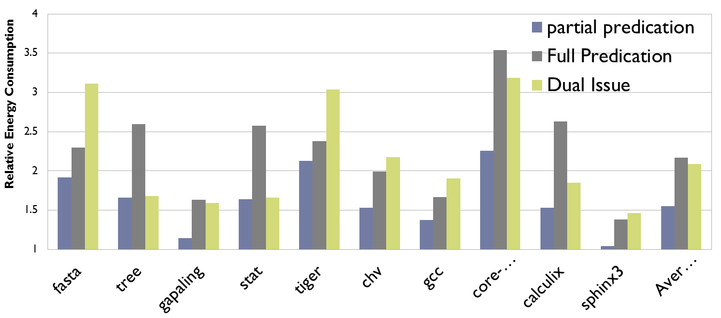
Relative Energy consumption
Relative energy consumption for executing the kernel of each benchmark relative to our PSB technique.
Notes:
Add intermediate info pe power and instr fetch power,
Fix normalize to 100

Slide 29
Conclusion
PSB issues instruction only from the path taken by the branch at run time.
Utilizes the branch outcome which is available at run time.
Alleviates the predicate communication overhead.
Achieves lower II.
Achieves better energy efficiency.

Slide 30
Publications
ShriHari RajendranRadhika, Aviral Shrivastava and Mahdi Hamzeh, “Path Selection Based Acceleration of Conditionals in CGRAs”, DATE 2015, (UNDER REVIEW).
QUESTIONS ? ?

Slide 31
Back up slides

Slide 32
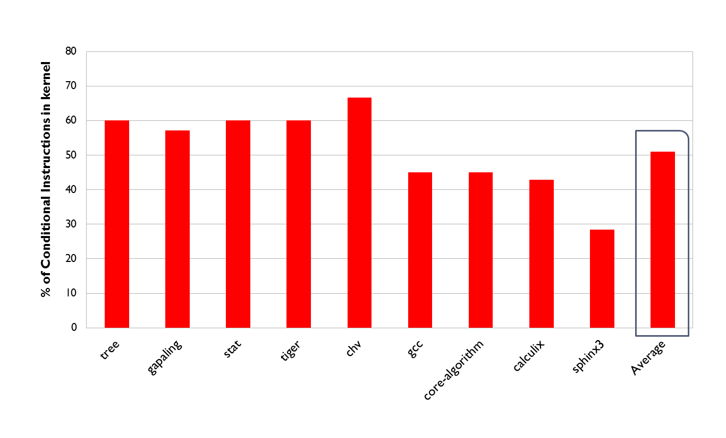
Percentage of instructions in the conditional path

Slide 33
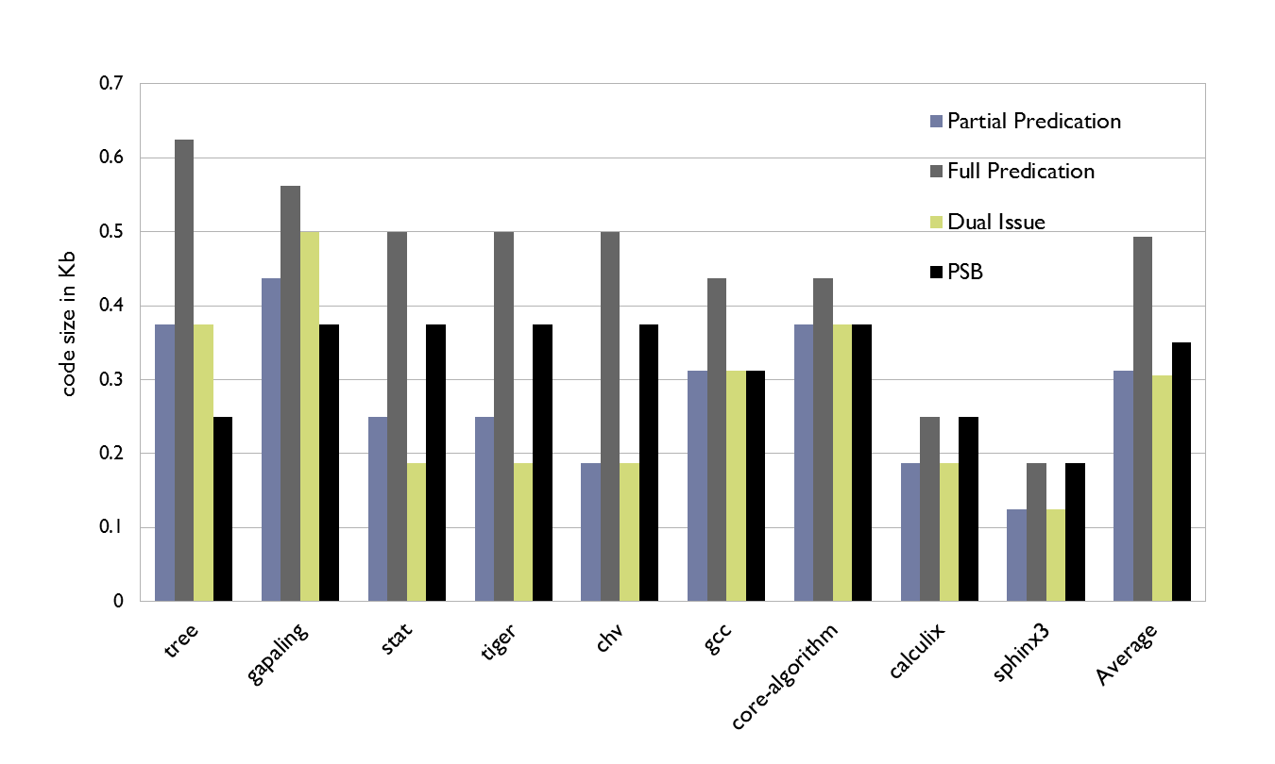
Instruction memory overhead

Slide 34
Related Work
Control Flow execution is commonly handled by two techniques:
Predication:
  In a predication scheme both paths of the branch are executed in parallel at run time.
  Final result is selected between outputs of both paths based on the branch conditional’s outcome.
Dual issue(State of the art):
  In dual scheme an instruction from if-path and else path is issued to a processing element.

Slide 35
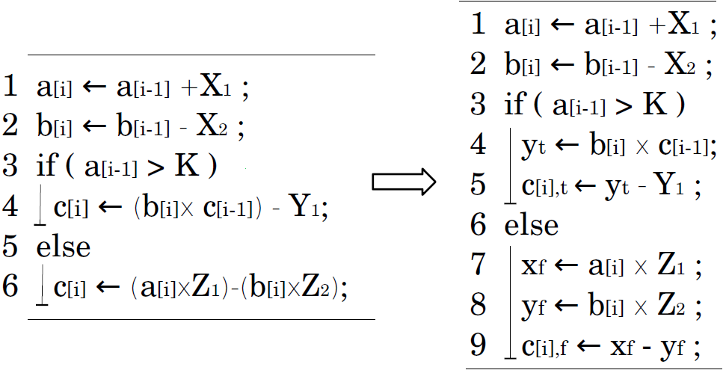
Consider an example of a loop with control flow
SSA transformation
Notes:
Trsditional DFGs wont work here

Slide 36
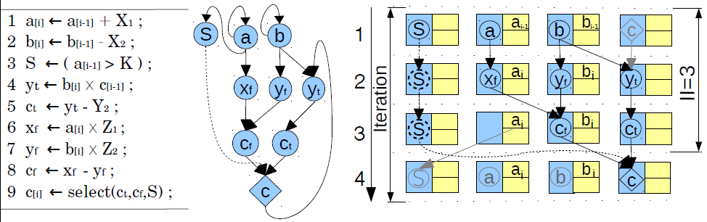
Partial Predication Scheme:
Need new DFG for loops with control flow
Add select instructions
Notes:
-Executes both parts of the branch and selects one outcome using a special select operation.
-Incurs unnecessary execution of instructions in the path not taken.
-Added overhead of a select operation
-Firstly, instructions from both the paths of the branch are fetched and issued unconditionally to the CGRA.
-Secondly, the predicate value must be communicated to all operations in the conditional path.

Slide 37
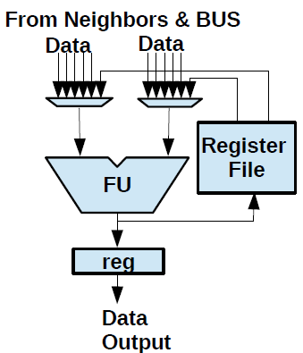
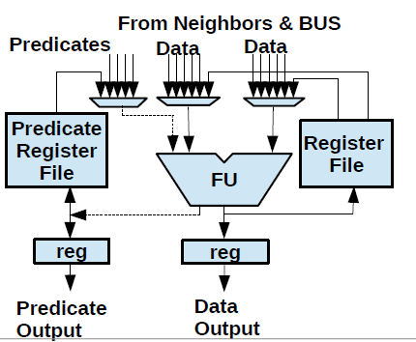
Hardware Support

Slide 38
Obtained II after pairing of operations

Slide 39
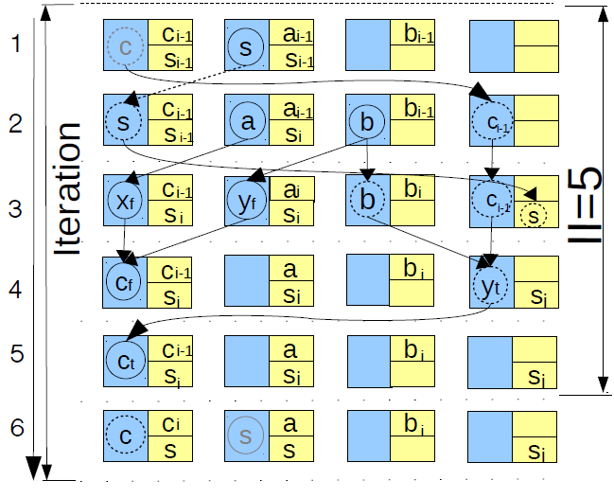
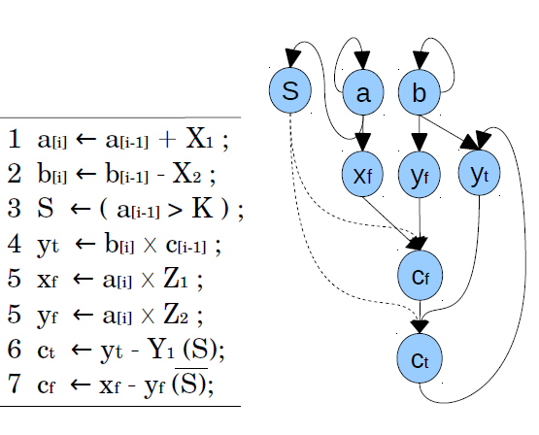
Full Predication scheme:
Restriction in where the nodes updating the same variable can be mapped.
Notes:
-Executes both parts of the branch and commits one outcome to the register of the PE executing the instruction from the if-path and the else-path.
-Incurs unnecessary execution of instructions in the path not taken.
-Tight restriction on where the instructions updating the same variable must be mapped
-Firstly, instructions from both the paths of the branch are fetched and issued unconditionally to the CGRA.
-Secondly, the predicate value must be communicated to all operations in the conditional path.

Slide 40
All PEs connected to IFU
Area = 384898.257
Power = 141 mW
Frequency = 458 Mhz

Slide 41
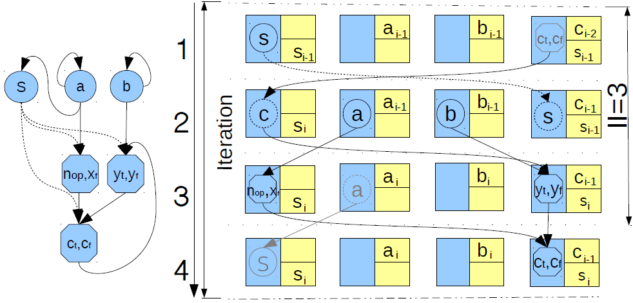
Dual Issue Scheme(state of the art):
Create new DFG with packed nodes.
Better II than predication schemes.
Notes:
-Packs an instruction from the if-path and else path and executes one at runtime.
-Issues 2 instructions per PE
-A single instruction is selected at run time based on a predicate value available at the PE executing the packed node.
-Firstly, instructions from both the paths of the branch are fetched and issued unconditionally to the CGRA.
-Secondly, the predicate value must be communicated to all operations in the conditional path.

Slide 42
Synthesis Incremental Optimization
area
0
delay

Slide 43

IFU synthesis results

Slide 44
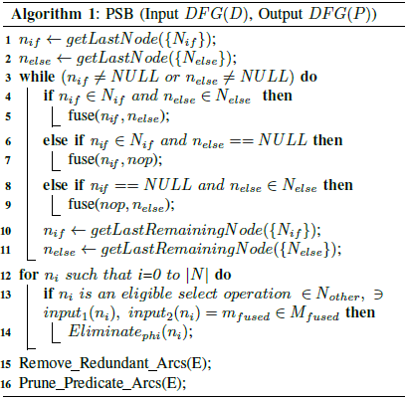
Algorithm:

Slide 45

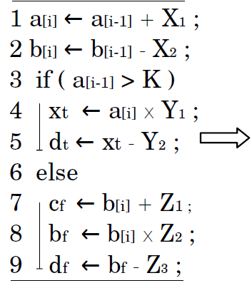

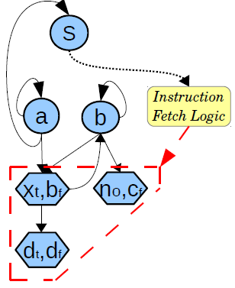


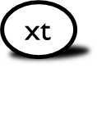




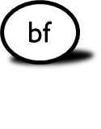

Create fused nodes
Notes:
Pack instruction from the if –path and the else path
Create animation fused instructions into instructions moving to their proper places
Change S to if
What is a fused node ?
-Fused node has at most 2 instructions associated with it.
-One from the if-path and the other from the else path.
-Fused node executes only one of its instructions at run time.
-The instruction fetch unit determines the behavior of the fused node depending up on the branch taken at runtime

Slide 46
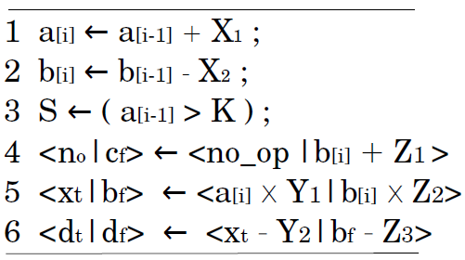
Create DFG with fused nodes
Fused nodes

Slide 47
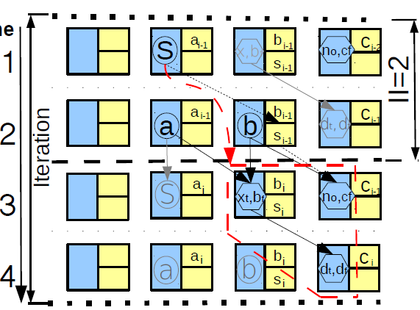

Mapping DFG onto a CGRA
Time

Slide 48

















Initiation Interval
Time
4
2
0
1
2
3

