Slide 1
Enabling Multi-threaded Applications on Hybrid Shared Memory Manycore Architectures
Masters Thesis Presentation
Tushar Rawat
Supervisory Committee
Dr. Aviral Shrivastava
Dr. Partha Dasgupta
Dr. Georgios Fainekos
Notes:
My research topic is <title> What I mean by Hybrid Shared Memory Manycore Architectures are systems that have a combination of on-ship (SRAM or scratchpad-like memory) as well as the traditional off-chip DRAM.
Let me first provide some background for this work. Bear with me and I’ll get to the main work quickly.

Slide 2
Rise of the multicore
High power requirements for a fast, single core
Limits on increasing voltage due to current leakage and heat dissipation
Promise of parallelism for increased performance
Multiple smaller, more power-efficient cores
Distribution of tasks across multiple cores
Leverage thread-level parallelism during software development
High-count multicore processors are ‘manycore’
Usually > 16 cores. Up to thousands of cores.
Often paired with Network-on-chip (NoC) architecture to facilitate data and communication traffic b/w cores
Notes:
The emergence of multicore processors has largely been a product of power and performance limitations on single-core platforms. Single-core chips are limited in improving performance through simply raising voltage due to a combination of current leakage and heat dissipation, which makes cooling the chips infeasible.
As a result, multicore systems are composed of smaller, more power efficient cores. Programmers leverage thread-level parallelism to distribute concurrent tasks among cores.

Slide 3
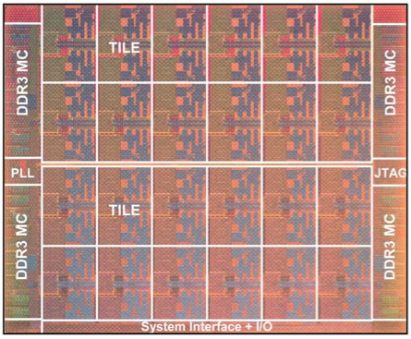
HSM Architecture: The 48-core Intel SCC
Tile
Tile
Tile
Tile
Tile
Tile
R
R
R
R
R
R
MC
MC
Tile
Tile
Tile
Tile
Tile
Tile
R
R
R
R
R
R
Tile
Tile
Tile
Tile
Tile
Tile
R
R
R
R
R
R
Tile
Tile
Tile
Tile
Tile
Tile
R
R
R
R
R
R
MC
MC
Bus to PCI
R
Router
MC
Memory Controller
Notes:
This is the target architecture, the 48-core Intel Single-chip Cloud Computer, or SCC for short. There are 24 Tiles in a 4x6 grid connected to a grid of routers which have their own TCP/IP stack. There are also four memory controllers which provide access to a total of up to 64 GB of DRAM.

Slide 4
HSM Architecture: The 48-core Intel SCC
Tile
CC
Cache Controller
256 KB
L2 cache
P54C
Core
L1 cache
MPB
Message Passing Buffer
CC
MIU
[to router]
16 KB
MPB
“on-chip” SRAM
MIU
Mesh Interface Unit
CC
P54C
Core
L1 cache
256 KB
L2 cache
P54C
Pentium® processor core
Notes:
L1$ - 16KB
L2$ - 256KB (bypassed for MPB operation)
I will focus mostly on this part. Unique to the SCC it is called a Message Passing Buffer, or MPB. It is addressable by Lookup table (LUT) and enables any given core to access the MPB of any other core. This type of shared memory communication bypasses both the L2$ and the main memory (DRAM). There is s total of 384 KB of storage space for MPB

Slide 5
Motivation
Scaling memory architecture for increasing core count is a difficult challenge
Enable existing multithreaded programs for novel many-core architectures
Manage and optimize for both on-chip and off-chip shared memory within parallel programs
Implement automated translation tools to convert existing multi-threaded programs
Notes:
Four main motivators
Address the challenges of performance degradation which came with increasing number of cores. Specifically, the issues with maintaining cache coherency.
There exists a large body of programs painstakingly written for multicores which need some work to run on many-core architectures
This conversion involves detection of shared data and management of new memory hierarchies that involve both on-chip and off-chip shared data
This requires automation as not every program can be converted by hand (really, only few can be)

Slide 6
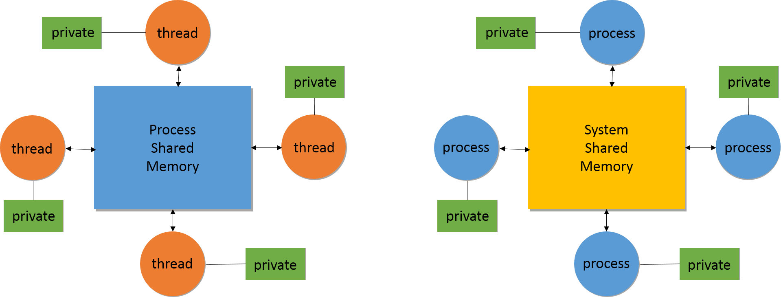
HSM manycores and multi-threading
Shared spaces with Multithreading Shared spaces with multiprocesses
Notes:
I’ve included this slide to highlight, at a very broad level, the similarities and differences between shared memory in a multi-threaded environment and a multi-process environment.
The picture on the left depicts threads interacting within the shared resource space of the parent process. Each thread retains it’s own private stack, yet implicitly can access the process address space. Additionally, writes made from one thread into a cache are propagated to other cores and other threads through cache coherency protocols. All of this maintains an illusion of shared memory (from the perspective of the programmer)
On the right is a system where multiple processes are interacting with the shared memory on the system. Each process must explicitly allocate such data, and variables global to threads within one process are not readily available to other threads in other processes.
A large portion of this work involves identifying shared data in the multi-threaded environment and mapping it to the shared memory space in the multiprocess environment.

Slide 7
Need for Many-core Programming Tools
Existing multi-thread programs do not run properly on many-core systems
Expect threads to access data easily within shared space of parent process
Compute tasks are distributed - based on threads as unit of control
In Many-core systems, each core may run its own OS. In Multicore, only one OS manages resources
Updates within one thread not propagated to threads in other processes
Notes:
Expectation based on the existence of cache coherency – the SCC lacks hardware cache coherency
Multi-threaded applications distribute tasks and work as threads, whereas the target architecture has processes as high level collaborators
On the SCC each core may potentially run a full Linux OS. Programs which expect a single OS to manage the threads will not work across such an architecture
Updates within one thread (one process) are not communicated as easily as within the shared space of a process on a multicore system utilizing multithreading

Slide 8
Contribution
Parser: Identifies and catalogs shared data within multithreaded (Pthread) programs
Translator: Converts multithreaded programs to many-core applications
Initially map all shared data to off-chip shared memory (DRAM)
Mapping more-frequently used shared data to on-chip shared memory (SRAM)
Notes:
Two major parts:
Parser which identifies and manages the shared data information extracted from the Pthread programs.
As well as a Translator, which converts the multithreaded application into a multiprocess one.
Initially the shared data is mapped to off-chip shared memory. But the translator also allows for mapping to the on-chip shared memory, based on either frequency of use or locality of data (storage).

Slide 9
Contribution
Framework is built on top of CETUS infrastructure
Purpose is to facilitate source-to-source transformation of C-based programs
Written and extensible in Java programming language
Features inter-procedural analysis where analysis and transformation are done in passes
Each pass is executed in series by a “Driver” program. In this manner the entire source program is transformed according to each rule the passes represent.
After each pass the program is checked for correctness, ensuring that the intermediate presentation (IR) [essentially an abstract syntax tree] remains a legal form of C program.
Enable efficient execution of MT programs on many-core architectures. Programs which do not natively run or which would execute very poorly on the HSM architectures.
Notes:
I’ve built the parsing analytics and translation capability on top of CETUS
CETUS is a framework for source-to-source transformation of C programs. It is written in Java and is extremely modular. Each analytic step within an algorithm is written into a rule. Each rule constitutes either an inter-procedure analysis or transformation which is called a pass.
Each pass is executed one by one, serially, by a wrapper program to coordinate data between the passes as well as ensure the integrity of the code being transformed.
Overall, this work enables efficiently running multi-threaded programs on HSM many-core architecture. This programs do not natively run, or if they do, they exhibit very bad performance on the HSM architecture.

Slide 10
Analysis and translation
Five-stage approach:
Determine access frequency and scope of program variables
Classify variables within threads through an inter-thread analysis
Identify shared and non-shared data via alias and pointer analysis
Partition data
Translate multi-threaded constructs to multiprocess instances
Notes:
I’ll go over the major components in each stage in detail.

Slide 11
Stage 1 – Variable Scope Analysis
The first stage takes as input the multi-threaded program source code and performs a rudimentary analysis of local and global variables
Extract approximate read and write count for each variable, as well as size and type.
Each variable is given a “sharing state” with global variables initially all being assigned a value of True for their sharing state.
int array[10];
array[0] = 6;
int foo = array[0]
Notes:
The process starts by passing the multi-threaded program source code into the analysis pass. Here, basic properties of variables are determined and stored for future use.

Slide 12
Stage 1 – Variable Scope Analysis
The first stage takes as input the multi-threaded program source code and performs a rudimentary analysis of local and global variables.
Size and type are noted.
Extract approximate read and write count for each variable, as well as size and type.
Each variable is given a “sharing state” with global variables initially all being assigned a value of True for their sharing state.
Type
Size
Variable
Declaration
int array[10];
array[0] = 6;
int foo = array[0]
Notes:
The process starts by passing the multi-threaded program source code into the analysis pass. Here, basic properties of variables are determined and stored for future use.
-----
For example, from this variable declaration the type and size of the variable are extracted.

Slide 13
Stage 1 – Variable Scope Analysis
The first stage takes as input the multi-threaded program source code and performs a rudimentary analysis of local and global variables.
Size and type are noted.
Extract approximate read and write count for each variable
Each variable is given a “sharing state” with global variables initially all being assigned a value of True for their sharing state.
Type
Size
Variable
Declaration
int array[10];
array[0] = 6;
int foo = array[0]
Variable write
Variable read
and write
Notes:
The process starts by passing the multi-threaded program source code into the analysis pass. Here, basic properties of variables are determined and stored for future use.
For example, from this variable declaration the type and size of the variable are extracted.
----
The read and write counts for all variables are obtained from the source code as well. In situations where the read and write counts are dependent at runtime, an estimation is made based on the surrounding context (for example: loop iterations, etc)

Slide 14
Stage 1 – Variable Scope Analysis
The first stage takes as input the multi-threaded program source code and performs a rudimentary analysis of local and global variables.
Size and type are noted.
Extract approximate read and write count for each variable
Each variable is given a “sharing state” Variables defined in global scope initially are assigned a sharing status of True
Type
Size
Variable
Declaration
int array[10];
array[0] = 6;
int foo = array[0]
Variable write
Variable read
and write
Notes:
The process starts by passing the multi-threaded program source code into the analysis pass. Here, basic properties of variables are determined and stored for future use.
For example, from this variable declaration the type and size of the variable are extracted.
The read and write counts for all variables are obtained from the source code as well. In situations where the read and write counts are dependent at runtime, an estimation is made based on the surrounding context (for example: loop iterations, etc)
----
As the properties for each variable are stored, the variables are given a “sharing state”. Initially, all variables defined as global are assigned a sharing state of True.
This state can be changed once but once determined as accurate is not changed again. No pass can overrule the final state of a variable, unless a variable is set to NULL

Slide 15
Stage 1 – Variable Scope Analysis
Name | Type | Size | Read | Written | Used In | Defined In
id | int | 1 | 1 | 0 | thread | null
local | int | 1 | 23 | 23 | main | main
rc | int | 1 | 0 | 2 | null | main
threads | pthread_t* | 10 | 2 | 0 | main | main
tid | N/A | N/A | 1 | 0 | thread | null
total_threads | int | 1 | 3 | 0 | thread | null
Notes:
This is an example of the data that is collected and stored within the first Stage, per variable. This particular table is a representation of the program which will be used in Stages 2 and 5 for demonstration.

Slide 16
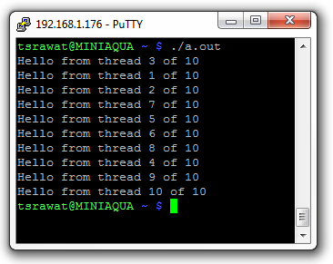
Stage 2 – Inter-thread Analysis
Notes:
I’m going to go through the analysis and transformation steps with an extremely simple, rather trivial program. This program is very simple, it simply creates 10 threads and prints “Hello from thread <threadID> of 10”

Slide 17
Stage 2 – Inter-thread Analysis
1 #include <stdio.h>
2 #include <pthread.h>
3
4 int total_threads = 10;
5
6 void *thread(void * tid) {
7 int id = (int)tid;
8 printf("Hello from thread %d of %d\n", id+1,total_threads);
9 pthread_exit(NULL);
10 }
11
1. given a variable… e.g. ‘total_threads’
2. check each variable within the program
3. upon finding match,
4. get name of procedure variable is in
Notes:
The goal of Stage 2 is to identify which variables can be classified as shared True based on whether they are used in multiple threads.
First, for a given variable, say ‘total_threads’ ^ check it against each variable within the program. ^ if there is a match and it is within a procedure. ^ Get the name of the procedure that the variable is in.

Slide 18
Stage 2 – Inter-thread Analysis
12 int main(int *argc, char *argv[]) {
13 int local = 0;
14 pthread_t threads[total_threads];
15 int rc;
16 for(local = 0; local < total_threads; local++) {
17 rc = pthread_create(&threads[local], NULL, thread, (void *)local);
18 }
19 for(local = 0; local < total_threads; local++) {
20 pthread_join(threads[local], NULL);
21 }
22 return 0;
23 }
5. consult pthread_create procedure launch map for entry
Procedures launched by pthread_create()
thread
6. if the procedure is being launched
via pthread_create(), does it execute
more than once?
7. multiple iterations are viewed as being
within for loops as well as repeated
pthread_create() calls
Every variable is checked for existence within multiple threads via this process
Notes:
^ check if the name of the procedure matches any of the procedures which are called by pthread_create() library functions. ^ If there is a match, check if the procedure is being called more than once.
^
This can be if the pthread_create() function is being repeatedly called within a loop, or if multiple pthread_create() calls launch the same procedure.
If the procedure is called more than once, than the variable shared status is set to True. ^Every variable is checked in this way, and the status is set to True as a conservative process. (If a variable is mistakenly made private (not shared within a thread – erroneous behavior may result – OTOH if a private variable is shared – memory is wasted, but there should not be any harm on the program)

Slide 19
Stage 3 – Alias and Pointer Analysis
Points-to analysis built into Cetus is used to uniquely identify program memory spaces
Uses a dataflow analysis to establish a relationship between pointer and pointed-to variables
Establishes definite (D) and possibly (P) point-to relationships
Re-evaluated at every program statement
Control Flow-based analysis
Interprocedural analysis
Notes:
Cetus has a points-to analysis built into it that I leverage for evaluating pointer relationships. A dataflow analysis progresses statement by statement, evaluating whether the relationship between pointer and pointed-to object is definite (Strong) or possibly (Weak).

Slide 20
Stage 3 – Alias and Pointer Analysis
1 int main(void)
2 {
3 int a, b, c, i;
4 int *p1, *p2, **p3;
5
6 /* [] */
7 p1 = &a;
8 /* [(p1,a,D)] */
9 p3 = &p1;
10 /* [(p1,a,D), (p3,p1,D)] */
11 p2 = *p3;
12 /* [(p1,a,D), (p2,a,D), (p3,p1,D)] */
Initially empty relationship map
p1 has a definite relationship to variable a
p3 has a definite relationship to p1
by way of p3 and p1, p2 and a have a definite relationship
Notes:
At the start of the analysis, the relationship map is empty. ^
The first statement assigns the address of a to pointer p1, which is recognized as a definite relationship and stored in the map ^
Next, the address of p1 is assigned to p3. So now p3 and p1 have a definite relationship as well. ^
Finally, p2 is assigned the value of pointer p3, which is nothing more than the address of a. So now p2 and a have a definite relationship as well.
This analysis is useful as it picks up on dynamically allocated data as well as data which is shared through shared pointers, but which may be allocated in a local rather than global context.

Slide 21
Stage 3 – Alias and Pointer Analysis
13 if (i > 0)
14 /* [(p1,a,D), (p2,a,D), (p3,p1,D)] */
15 p1 = &b;
16 else
17 /* [(p1,a,D), (p2,a,D), (p3,p1,D)] */
18 p1 = &c;
19 /* [(p1,b,P), (p1,c,P), (p2,a,D), (p3,p1,D)] */
20 return;
21 }
two potential paths of execution
two potential relationships classified as possibly (P)
Notes:
Of course often a relationship is more ambiguous. During static analysis, I can’t tell which branch will be taken. Therefore, Cetus will put both relationships as Possibly.
Since my analysis is extremely conservative to preserve correct program execution. Any possibly relationships resulting in shared data are marked with shared status True.

Slide 22
Stage 4 – Data Partitioning
If all shared data fits within on-chip memory, all the shared variables are allocated to on-chip SRAM. However, shared data may often exceed the size of the on-chip memory.
Shared data can be managed in several ways
size
type
frequency of access
Notes:
Once all the shared data has been identified, a qualification needs to be made whether or not all the shared data fits within the on-chip SRAM – that would be the scenario providing the best performance.
Realistically, this is not going to be the case. The MPB provides only 384 KB of shared memory, so large data objects must be placed at least partially into the off-chip memory.
Shared data is managed as a combination primarily of size and frequency of access, although type consideration is included as well (for example, arrays vs scalars)

Slide 23
Stage 4 – Data Partitioning
Sample conversion process…
double array[size]
If on-chip shared memory still has space…
Create MPB malloc call: array = (double *)RCCE_malloc(size); and, put and get primitives for data movement in and out of MPB
RCCE_put((t_vcharp)array, (t_vcharp)buffer, size, coreID) RCCE_get((t_vcharp)buffer, (t_vcharp)array, size, coreID)
If on-chip shared memory is all occupied
Create DRAM malloc call: array = (double *)RCCE_shmalloc(size * sizeof(double))
Notes:
Partitioning the shared data involves constructing the appropriate memory allocation API function. For off-chip shared memory, the allocation is very simple, not different at all from dynamically allocating memory in a generic C program. The specific function is different – RCCE_es-aechMALLOC, since I’m using the SCC built-in API called RCCE (Rocky)
For on-chip (SRAM) MPB allocation, there is another malloc call RCCE_malloc. However, additional low-level memcpy primitives for put and get are required. These facilitate transfer from the private memory of the core into the MPB of the destination (or receiving core) based on coreID. The put and get primitives calculate the appropriate offset to place the data into the given core’s MPB

Slide 24
Stage 5 – Program Translation
The transformation itself has two main components aside from data partitioning:
Transforming and/or removing the Pthread-specific source code
Adding SCC-specific API calls for multiprocess execution (RCCE code)
Notes:
The transformation is not complete with the data partitioning. The control flow of the program as given with the context of multi-threading in Pthreads must be converted (and in some cases, such as when the priority of the thread changes – removed as it is no longer applicable).
Additionally, SCC-specific RCCE API code must be added. One, to convert some of the Pthread constructs (including mutex variables!) and two to ensure that the program is recognized as a RCCE application (init, finalize, etc)

Slide 25
Stage 5 – Program Translation
int main(int *argc, char *argv[]) {
int local = 0;
pthread_t threads[total_threads];
int rc;
for(local = 0; local < total_threads; local++) {
rc = pthread_create(&threads[local], NULL, thread, (void *)local);
}
for(local = 0; local < total_threads; local++) {
pthread_join(threads[local], NULL);
}
return 0;
}
1. Analyze pthread_create calls
2. Extract and save the third and fourth
parameters… the name of the function
and argument it takes, respectively
thread((void *)local);
3. Using the parameters, create a new
function statement
4. Insert it into the program IR
void *thread(void * tid) {
int id = (int)tid;
…
}
5. If function argument is a thread ID,
create a coreID call to replace it.
int coreID = RCCE_ue()
Notes:
The first step starts with analyzing the pthread_create() calls. ^
Both the third and fourth parameters to pthread_create, which are the name of the function and the argument given to that function, are noted. ^
Using those parameters, a new function statement is created ^ and then inserted into the program intermediate representation ^
Sometimes the argument provided to the function is actually to be used as a thread ID. In such a case, by analyzing how the variable is used within the function, the translator determines whether or not to replace the ‘threadID’ with a coreID, which will perform the same function within the multi process application. If the argument is not a thread ID or it cannot be determined, it is left as is.

Slide 26
Stage 5 – Program Translation
thread IDs (if present) correspond 1:1 with core IDs, and is a value associated with the function name of the thread which launches it
int main(int *argc, char *argv[]) {
int local = 0;
pthread_t threads[total_threads];
int rc;
int coreID = RCCE_ue();
thread(coreID);
for(local = 0; local < total_threads; local++) {
pthread_join(threads[local], NULL);
}
return 0;
}
6. Process all pthread_create calls
before removing loops etc. Ensure all new supporting code is
placed in correct spots in IR
7. Conditional thread events must be
converted to occur based on coreID
for(local = 0; local < total_threads; local++) {
if(local == 1)
rc = pthread_create(&threads[local], NULL, thread, (void *)local);
}
becomes: if(coreID == 1)
becomes: thread(coreID);
Notes:
Once all of the pthread_create() calls have been processed, they can be removed. The delay of removing the pthread_create() calls is because if they are within a loop, and only one gets processed and the loop erased – the whole program has been broken.
Any new code to support the transformation must also be added in the precise locations. Generally new variable assignments are done in main.
^
A note about threads run conditionally. If based on threadID, these get converted to coreID as shown here. ^ The threadIDs are actually mapped 1:1 with coreIDs. During program analysis, every pthread_create call, argument, and function name is logged to facilitate this mapping.

Slide 27
Source and Transformed Applications
Notes:
After all of the analysis and transformations, the target code is output. Here are the original and transformed sources (next slide)

Slide 28
#include <stdio.h>
#include <pthread.h>
int total_threads = 10;
void *thread(void * tid) {
int id = (int)tid;
printf("Hello from thread %d of %d\n", id+1,total_threads);
pthread_exit(NULL);
}
int main(int *argc, char *argv[]) {
int local = 0;
pthread_t threads[total_threads];
int rc;
for(local = 0; local < total_threads; local++) {
rc = pthread_create(&threads[local], NULL, thread, (void *)local);
}
for(local = 0; local < total_threads; local++) {
pthread_join(threads[local], NULL);
}
return 0;
}
#include <stdio.h>
#include "RCCE.h"
int * total_threads;
void * thread(void * tid)
{
int id = ((int)tid);
printf("Hello from thread %d of %d\n", (id+1), total_threads);
}
Int RCCE_APP(int * argc, char * argv[])
{
total_threads=(int * )RCCE_shmalloc((sizeof(int)*1));
total_threads = 10;
RCCE_init(&argc, &argv);
int myID;
myID=RCCE_ue();
int rc;
thread(((void * )myID));
RCCE_finalize();
return(0);
}
ORIGINAL
TRANSFORM
Notes:
In many ways they are similar, however, the point of control has moved to processes and all the pthread-specific code has been removed. Additionally, RCCE-specific code has been added to enable execution as a RCCE application on the SCC.
This is a relatively simple program so the transformation is very clean. Sometimes minor tweaks are necessary (duplicate variables, etc)

Slide 29
Experimental Execution
Parser Development
Linux Mint 12 with
Java 1.6
ANTLR 2.7.5
Cetus 1.3
Target Architecture
Intel SCC, using 32 of 48 cores
384 KB on-chip SRAM, up to 64 GB off-chip DRAM
One Linux OS per core
800 MHz core frequency
1600 MHz network mesh frequency
1066 MHz off-chip DDR3 frequency
Benchmarks
9 multithreaded applications
Built using Pthreads
9 multiprocess RCCE applications
Converted for SCC using parser/translator
Pthread programs may utilize single core only
RCCE applications use 32 cores
Each application also has one optimization where the on-chip memory is utilized.
Total of 27 test programs, all run on SCC
Compiled using Intel C++ Compiler version 8.1 (gcc 3.4.5) with RCCE API version 2.0
Notes:
This is a very busy slide, so I’ll do my best to sort it out. On the top left are the details of the framework. As mentioned before I’m using Cetus. Cetus itself depends on the Java 1.6 environment, as well as ANTLR (ANother Tool for Language Recognition), which is a powerful parsing backend for processing text files (Cetus relies on this). All of this is running on Linux Mint 12
The target architecture as given before is the Intel SCC. For the RCCE applications I’m utilizing 32 of the 48 cores, all 384 KB of on-chip MPB, and a good amount, though usually not 64 GB of off-chip DRAM. Each core is running the same instance of Linux, and is running at a frequency of 800 MHz. The on-chip communications grid is at 1600 MHz and the DDR3 frequency is set to 1066 MHz. The SCC was originally being accessed remotely but there is now one on-site (originally in BYENG… now not sure)
There are 9 benchmarks, originally multi-threaded built using Pthreads. Using the translator they were converted to RCCE applications. The Pthread applications do run stock on the SCC, however they only run on one core at a time… one of the primary reasons to pursue this work. RCCE applications utilize each available core, and the applications were again optimized to use the on-chip memory as well.
27 applications… all run on SCC. Comparison of runtime (wall clock time)

Slide 30
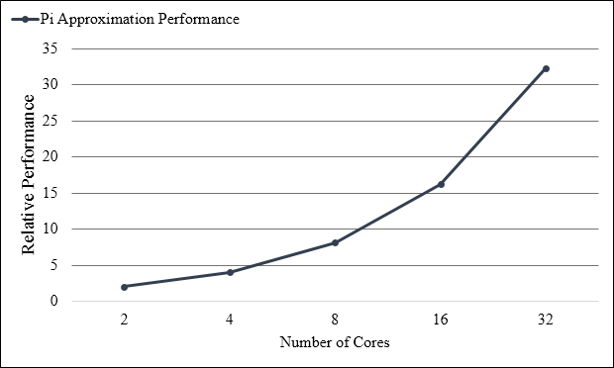
Results
Relative performance improvement over single-core Pthread application of multiprocessor RCCE program with varying core count on SCC.
Notes:
This graph shows performance improvement as core count increases of the RCCE application versus the Pthread application (which runs on only one core). While the speedup is obvious, this comparison would not have been so easy without the work given here.

Slide 31
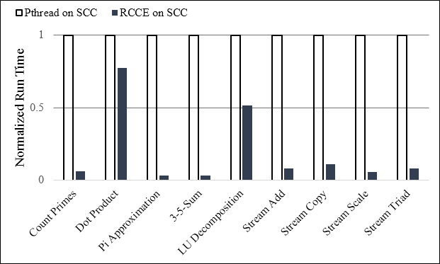
Results
Performance of RCCE applications utilizing off-chip shared memory and 32 cores normalized to the performance of the 32-thread Pthread programs running on a single core.
Notes:
This graph shows the performance of RCCE applications using only off-chip shared memory and 32 cores versus Pthread programs running on a single core. Programs which heavily rely on core computations show the best improvement (aside from Stream) whereas those with mixed operations – core and memory, do not show as much improvement as they have to divide time between computation and data transfer. They also have very large arrays in off-chip memory. Performance is very much application-dependent.

Slide 32
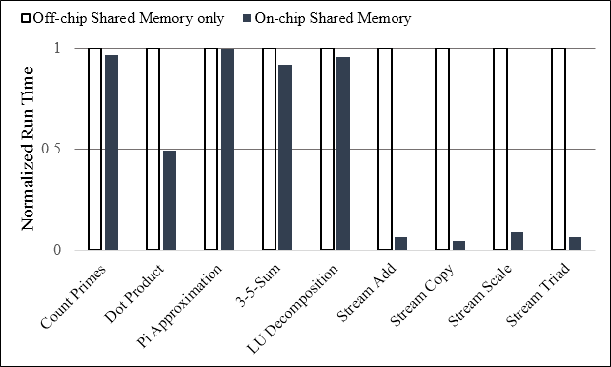
Results
Run time performance comparison of RCCE programs utilizing shared off-chip memory against the on-chip shared memory provided by the MPB.
Notes:
Here, the applications which are memory-bound show the largest improvement. Pi-Approximation, which is an application that is almost all core computation, show basically no change.

Slide 33
Summary
This work directly enables HSM architectures (e.g. SCC) to run multi-threaded (MT) applications originally written for multicore systems, the non-transformed programs either do not natively run, or run very poorly, on the architecture.
Implemented an analyzer+translator to convert Pthread programs to Intel SCC RCCE applications
Identified all shared data within multi-threaded program, extracted & mapped it within converted program to off-chip shared DRAM
Identified and mapped more frequently used, or spatially convenient, data to on-chip shared SRAM for improved performance
Up to linear improvement when going from Pthread to RCCE on SCC
On average 8x improvement over linear improvement with using on-chip SRAM vs only off-chip DRAM

Slide 34
Thank you
Questions

