Slide 1

Enabling Multi-threaded Applications on
Hybrid Shared Memory Manycore Architectures
Tushar Rawat and Aviral Shrivastava Arizona State University, USA
M
C
L

Slide 2
Port Multi-threaded Applications
Multicore
System
HSM
Manycore
System
?

Slide 3
Threading and Shared Memory
Multicore
System
Process
Threads have
Shared and Implicit
Access to Program
Data
Global Space
Thread

Slide 4
Processes and Shared Memory
HSM Manycore
System
Data is not implicitly
shared among
processes
Process
Process
Global
Global

Slide 5
Convenience Hardware
Multicore
System
HSM
Manycore
System
Hardware-based cache coherence

Slide 6
Convenience Hardware
Multicore
System
HSM
Manycore
System
Hardware-based cache coherence
Small scratchpad-like
on-chip memory
Lacks hardware
cache coherence

Slide 7
Contribution
Identify shared data in multi-threaded program
Map identified shared data to shared memory
On-chip
Off-chip

Slide 8
Five Stage Approach
Analysis
Variable
Scope
Within
Threads
Pointers
Partition
Data
Thread
To
Process
Translation

Slide 9
Stage 1 – Variable Scope Analysis
Input: Multi-threaded program source code
Output: Name, size, type, read count and write count for each variable
int array[10];
array[0] = 6;
int foo = array[0];
array
foo
Type: int array
Size: 10
Read Count: 1
Write Count: 1
Type: int
Size: 1
Read Count: 0
Write Count: 1

Slide 10
Stage 2 – Inter-thread Analysis
Input: A given variable (name) e.g. “total_threads”
Output: Result stating whether the given variable exists within 1 thread, 2+ threads or none
Loop (or multiple threads launching same function)
void thread
…
printf(“%d”,
total_threads);
…
pthread_exit(NULL);
Thread

Slide 11
Stage 3 – Alias and Pointer Analysis
Variable w has a Definite relationship with ptr1
Variables x and y have Possibly a relationship with ptr2
ptr1 = &w
if-path
else-path
ptr2 = &x
ptr2 = &y

Slide 12
Stage 4 – Data Partitioning
array = (double *)RCCE_malloc(size)
Processing
Core(s)
On-chip shared memory (SRAM)
RCCE_get
RCCE_put
array = (double *)RCCE_shmalloc(size * sizeof(double))
Off-chip shared memory (DRAM)

Slide 13
Stage 5 – Program Translation
Convert Pthread source to RCCE application code
Add RCCE-specific instructions and libraries
Pthread | RCCE
pthread_self() | RCCE_ue()
pthread_mutex_lock() | RCCE_acquire_lock()
pthread_mutex_unlock() | RCCE_release_lock()
pthread_create(&thread, NULL, funcName, (void *)arg) | funcName((void *) arg)
Any remaining pthread code is removed from the source
RCCE_init(argc, argv) | RCCE_finalize()
RCCE.h | RCCE_lib.h
SCC_API.h

Slide 14
Translator Development
Linux Mint 12
Java OpenJDK 1.6
CETUS 1.3
ANTLR 2.7.5

Slide 15
HSM Architecture – 48-core Intel SCC
Tile
Tile
Tile
Tile
Tile
Tile
R
R
R
R
R
R
MC
MC
Tile
Tile
Tile
Tile
Tile
Tile
R
R
R
R
R
R
Tile
Tile
Tile
Tile
Tile
Tile
R
R
R
R
R
R
Tile
Tile
Tile
Tile
Tile
Tile
R
R
R
R
R
R
MC
MC
R
Router
MC
Memory Controller

Slide 16
On-chip shared memory - MPB
Tile
CC
Cache Controller
256 KB
L2 cache
P54C
Core
L1 cache
MPB
Message Passing Buffer
CC
MIU
[to router]
16 KB
MPB
MIU
Mesh Interface Unit
CC
P54C
Core
L1 cache
256 KB
L2 cache
P54C
Pentium® processor core

Slide 17
Intel SCC Experiment Configuration
Using 32 of 48 available cores
384 KB on-chip SRAM, up to 64 GB off-chip DRAM
One Linux operating system per core
800 MHz core frequency
1600 MHz network mesh frequency
1066 MHz off-chip DDR3 frequency

Slide 18
Benchmarks
Both Core and Memory intensive programs
Originals developed for Pthread Multicore systems
Compiled using Intel C++ Compiler 8.1 (gcc 3.4.5), RCCE API version 2.0
Originals run on SCC for baseline
Translated into SCC RCCE applications
Run with only off-chip shared memory
Run with mix of on-chip and off-chip shared memory

Slide 19
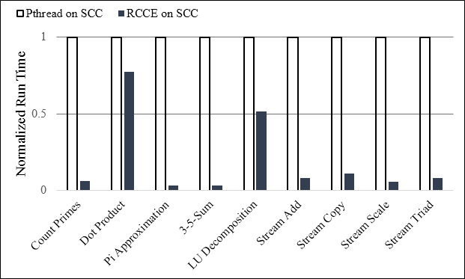
RCCE vs Pthread Performance

Slide 20
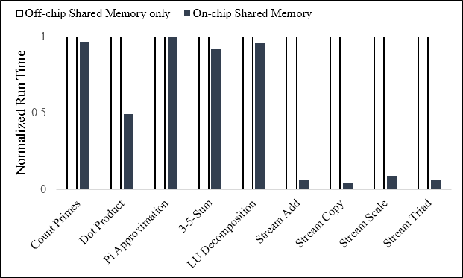
Off-chip vs On-chip Mem. Performance

Slide 21
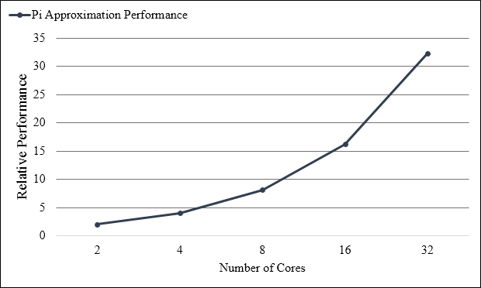
Enabling Manycores – Performance

Slide 22
Takeaways
Analyzer identifies all shared data within Pthread program
Translator maps data to both on-chip and off-chip memory
Enables execution of multi-threaded programs for HSM architecture after conversion to many-core applications
Important to use fast on-chip memory when possible: 8x improvement on average for benchmarks when using on-chip SRAM (MPB) vs only off-chip DRAM

Slide 23
Thank you
Questions

Slide 24
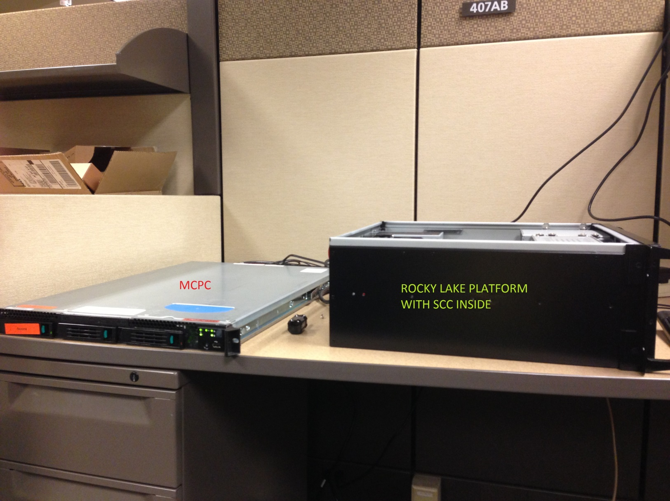
Intel SCC and MCPC

