Slide 1

REGISTER FILE ORGANIZATION FOR COARSE GRAINED RECONFIGURABLE ARCHITECTURES (CGRAs)
Dipal Saluja
Compiler Microarchitecture Lab,
Arizona State University, Tempe, Arizona, USA

Slide 2
Need for Power Efficient Computing
Power Efficient Computing Required at:
Micro-architecture level
Chip level
Data Center Level
Accelerators help achieve power efficient computing
Specialized Hardware for Application Specific Operations
Improve performance while reducing power
Scales from mobile devices to super computers
Qualcomm’s Adreno
Titan at Oak Ridge National Laboratory (NVIDIA Tesla)

Slide 3
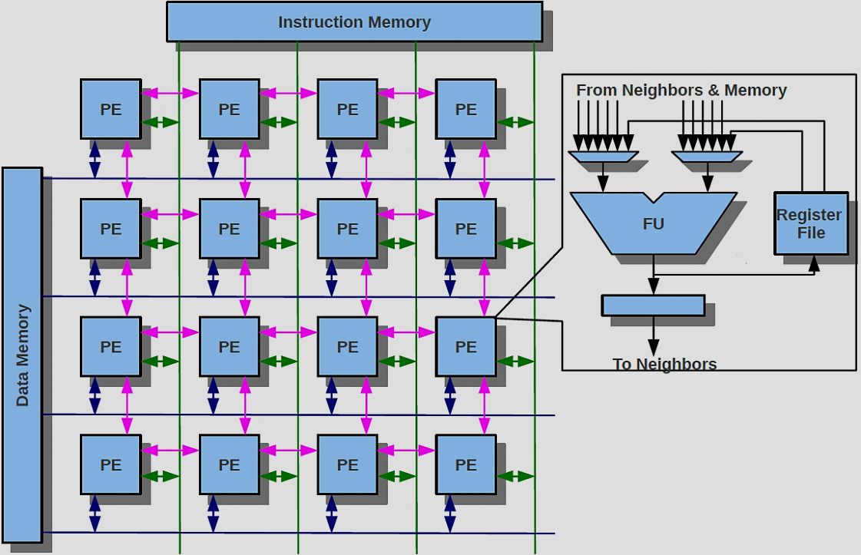
Coarse-Grained Reconfigurable Architectures (CGRAs)
2D array of Processing Elements (PEs)
ALU + Local register file → PE
Mesh interconnection
Shared data bus
Data memory
PE inputs:
4 Neighboring PEs
Output Register (Self)
Local register file

Slide 4
What to Map and How?
Time
4
1
2
0
3
4
b
b
b
a
b
a
a
1
2
1
3
4
d
c
d
c
c
d
1
2
e
e
f
e
2
f
3
4
f
g
g
g
1
2
3
3
4
Notes:
CPU: 7cycles, cgra: 4 cycles: modulo: every 2 cycles

Slide 5
What to Map and How?
Time
a
b
1
2
0
3
4
c
d
a
1
2
a
b
b
b
1
3
4
b
f
e
2
a
1
2
b
II is the performance metric
c
2
3
4
c
d
j
d
g
1
2
c
d
j+1
3
3
4
f
e
f
e
J+2
1
2
4
3
4
g
g
1
2
b
5
3
4

Slide 6
Comparison with GPUs and FPGAs
GPGPU | FPGA | CGRA
Data Parallel Loops | Data Parallel Loops | Data Parallel Loops
Non-Parallel Loops | Non-Parallel Loops | Non-Parallel Loops
Setup Time | Setup Time | Setup Time
Notes:
Issue column and rating table

Slide 7
Mapping w/o and with Registers
Time
P
1
Q
1
P
1
Q
1
for(…)
{
a=1;
b=a-1;
c=b*2;
d=c-a;
}
4
2
a
a
a
1
2
2
2
2
P
1
Q
1
P
1
Q
1
a
a
a
a
a
a
2
2
2
2
2
P
1
Q
1
Register utilization decreases II
P
1
2
2
b
Q
1
P
1
Q
1
b
b
b
a
a
3
2
2
2
2
c
c
c
P
1
Q
1
P
1
Q
1
d
4
2
2
2
2
d
d

Slide 8
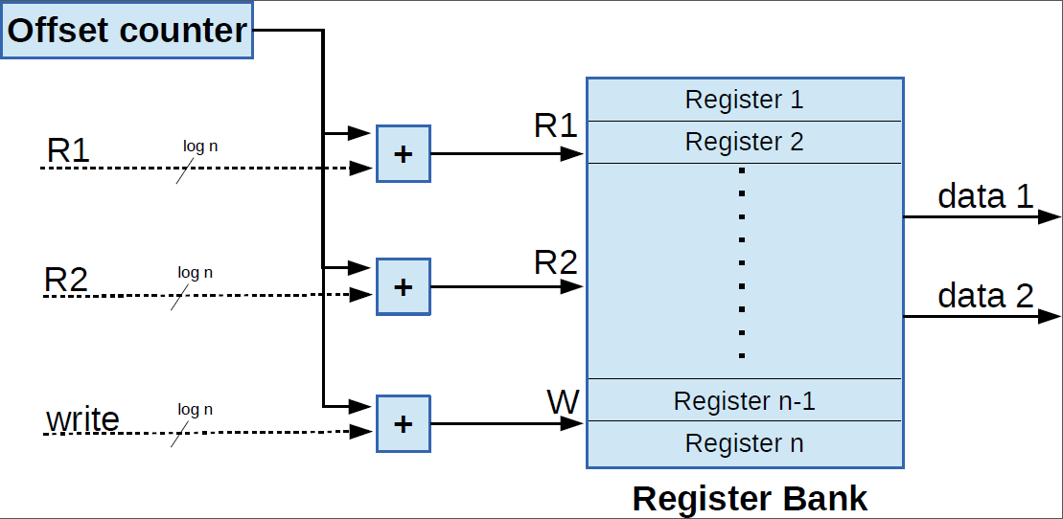
Rotating Register File Structure
Rotation performed every II cycles
Proposed in [Essen et al.]
Modulo #regs Counter
Offset Counter
clock
Divide by II
Increment every II cycles

Slide 9
Rotating Register File in Action
P
1
Q
1
Rotation performed every II cycles
0
1
2
a
1
a
0
0
1
2
2
P
1
Q
1
a
b
2
2
P
1
Q
1
a
c
a
2
2
a
P
1
Q
1
b
d
2
2
a

Slide 10
Introduction to the Problem
Loop kernels have constants
E.g., global variables, base address of arrays
Constants are difficult to propagate using Rotating Registers
We need both Rotating RF, as well as Non-Rotating RF in CGRA
My Question:
What kind of structures should we use to support both kind of RFs for CGRAs?
How to efficiently utilize these structures in the compiler?
Fixed RF
Shared RF
Programmable RF

Slide 11
State of the Art in RF Organizations for CGRA
Most work has explored how to use Rotating RFs in the CGRA
Architecture: RaPiD [Ebeling et al.] , ADRES [Bouwens et al.]
Compiler: EMS [Hynchul et al.], [Sutter et al.], REGIMap [Hamzeh et al.]
Hardware impact of Shared Register File configurations studied in [Essen et al., Kwok et al.] in terms of
Degree of connectivity, Number of ports, Number of registers in the RF
Estimate the power, area and frequency of the designs
Compilation for Hybrid Architecture (with rotating and non-rotating RF) is largely overlooked

Slide 12
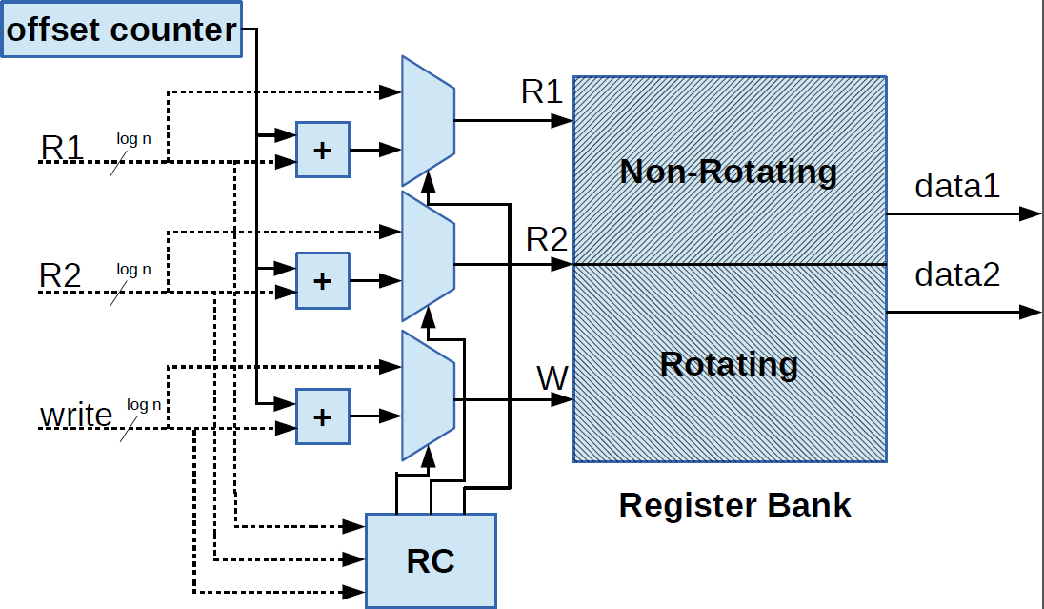
Fixed RF (FRF): Architecture
Physically partitioned into Rotating and Non-Rotating Region

Slide 13
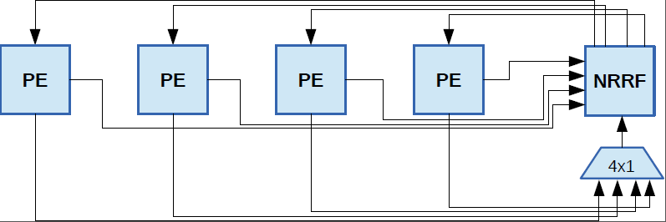
Shared RF: Architecture
Rotating Registers per PE and Shared Non-Rotating Registers/Row

Slide 14
Pros and Cons of each RF Structure
Shared RF | Fixed RF
Partition Fixed at design time | Partition Fixed at design time
Does not scale with the size of CGRA | Scales with the size of CGRA
Limited to 1 write/cycle/row | All PEs in a row can write to their local RF
Increase in Instruction Size | No increase in Instruction Size
High Area and Frequency Overhead | Low Area and Frequency Overhead
Desired RF
Partition Reconfigurable at run-time
Scales with the size of CGRA
All PEs in a row can write to their local RF
No increase in Instruction Size
Minimal Area and Frequency Overhead
Notes:
Global RF Partitioning
Local RF Partitioning
Scalability
Write Access to

Slide 15
Increase in Instruction Size
Fixed RF
PEs input limited to neighbors, local RF and itself
No increase in Instruction word size
Shared RF
PEs now also read from a Shared RF
Need new bits in Instruction word to read from Shared RF
Increase in Instruction word size

Slide 16
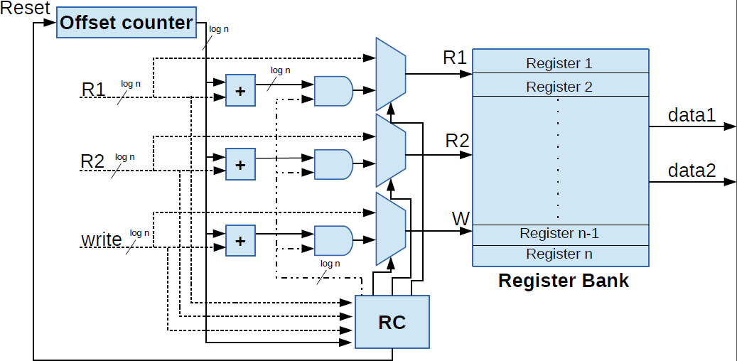
Programmable RF (PRF): Architecture
Logical boundary between Rotating and Non-Rotating Region
T
T
T

Slide 17
Pros and Cons of each RF Structure
Shared RF | Fixed RF
Partition Fixed at design time | Partition Fixed at design time
Does not scale with the size of CGRA | Scales with the size of CGRA
Limited to 1 write/cycle/row | All PEs in a row can write to their local RF
Increase in Instruction Size | No increase in Instruction Size
No configuration instructions needed | No configuration instructions needed
Maximum Area and Frequency Overhead | Least Area and Frequency overhead
1 instance of a variable amongst PEs in the same row. | Multiple copies of the same variable amongst PEs in the same row
Programmable RF
Reconfigurable at run-time
Scales with the size of CGRA
All PEs in a row can write to their local RF
No increase in Instruction Size
1 configuration instruction/PE introduced
Minimal Area and Frequency Overhead
Multiple copies of the same variable amongst PEs in the same row
Notes:
Global RF Partitioning
Local RF Partitioning
Scalability
Write Access to

Slide 18
Compiler Support
l
DFG contains:
Nodes:
Operation being performed
Type of operation [Arithmetic, Memory, Constant Operand]
Weighted Edges:
Depict data dependencies
Weight signifies loop carried dependency distance
for(…)
{
l=p1[i];
a[i]=l+d[i-2];
b=a[i]+1;
c=b-1;
d[i]=a[i]-c;
p2[i]=d[i];
}
a
b
2
c
d
s

Slide 19
Compiler Support
Easily integrates with any Mapping Algorithm.
Input: Kernel DFG and CGRA configuration
Output: A Valid Mapping of operations from the Input DFG to a Time Extended CGRA
Steps:
do{
mapping = getMapping (DFG, CGRA)
CheckRFconstraints(mapping, CGRA)
if(RF Constraints violated)
MappingNotFound
}while(MappingNotFound);

Slide 20
Compiler Support
CheckRFconstraints(mapping, CGRA)
{
RFconstraintsSatisfied = true;
for each operation op in mapping
{
pe_number = op.getMappedPE()
usesRF = op.isRFUsed()
if(usesRF)
{
usesNRF = op.isNRFUsed()
writeToRegister = op.performRegisterWrite();
RFconstraintsSatisfied = CheckPRFconstraints(pe_number, usesNRF, writeToRegister)
}
if(RFconstraintsSatisfied == false)
break;
}
return RFconstraintsSatisfied ;
}

Slide 21
Compiler Support
CheckPRFconstraints(pe_number:int, usesNRF:boolean, writeToRegister:boolean)
{
if(writeToRegister == true)
{
if(PE[pe_number].utilizedRegisters >= CGRA.registersPerPE)
return false;
else
PE[pe_number].utilizedRegisters++
}
else //read from RF
{
if(usesNRF == false) //uses Rotating RF
PE[pe_number].utilizedRegisters--
}
return true;
}

Slide 22
PRF is Best in a Register-Constrained CGRA (Lower II is better)
Mapping with 64 Registers
Mapping with 32 Registers

Slide 23
PRF Requires the Minimum no. of Registers to get a Mapping

Slide 24
Number of registers required to achieve the minimum II

Slide 25
PRF Imposes Minimal Area Overhead
Courtesy: Mahdi Hamzeh and Shri Hari

Slide 26
PRF Imposes Minimal Frequency Overhead
Courtesy: Mahdi Hamzeh and Shri Hari

Slide 27
Conclusion
Coarse-Grained Reconfigurable Architectures are promising accelerators
Specially to speedup Non-Parallel Loops
Registers can be used to improve the performance of loops on CGRA
Most existing work focused on Rotating Registers with CGRA
However, both Rotating and Non-Rotating registers are needed for efficient execution of loops on CGRA
Programmable Register File provides the highest flexibility in terms of application mapping to CGRAs
Flexible partitioning between rotating and non-rotating regions
Can map with minimal number of registers
Scalable architecture
Minimal area and power overhead

Slide 28
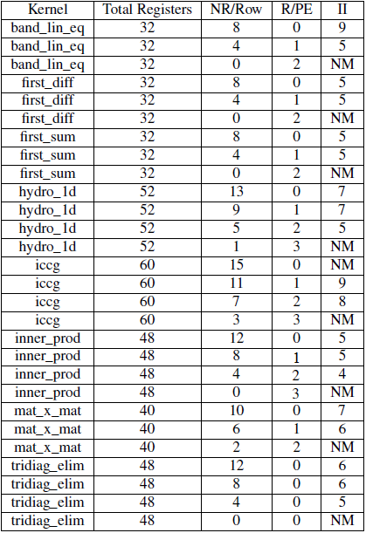
SNRRF CONFIGURATION LIMITS MAPPING

