Slide 1
Energy Efficient Code Generation Using rISA*
Aviral Shrivastava, Nikil Dutt
aviral@ics.uci.edu, dutt@ics.uci.edu
Center for Embedded Computer Systems,
University of California, Irvine, CA, USA.
http://www.ics.uci.edu/~aces
*This work was partially supported by SRC contract 2003-HJ-1111
and NSF Grants CCR 0203813 and CCR 0205712
Notes:
This presentation is about profile based code generation technique aimed at reducing energy consumption in processors that have rISA architectural feature.
This work is the result of an ongoing research effort at UC Irvine.

Slide 2
reduced bit-width Instruction Set Architecture (rISA)
Dual Instruction Set
  Normal 32-bit wide instructions
  16-bit wide instructions (rIS)
Normal 32-bit Instruction
20-bit
4-bit
4-bit
4-bit
Accessibility to 16 registers
16-bit rISA Instruction
7-bit
3-bit
3-bit
3-bit
Fewer opcodes
Accessibility to only 8 registers
Popular feature to reduce code size
  ARM7TDMI, MIPS, ARC-Tangent A5
Notes:
rISA or reduced bit width instruction set architecture is a processor that has two instruction sets.
One is the normal 32-bit instruction set, and the other is the narrow 16-bit instruction set.
rISA is a popular and effective architectural feature for code size reduction.
Several contemporary processors like ARM, MIPS, ST100 employ this feature.

Slide 3
rISA Code
rISA: reduced bit-width Instruction Set Architecture
Normal
Normal
Normal
Normal
Normal
Normal
Normal
Normal
Normal
Normal
Normal
rISA
rISA
Normal
Normal
rISA
rISA
Normal
Normal
Normal
Normal
Normal
Normal
Normal
rISA-ization (sounds like resize-ation):
normal instructions → rISA instructions
Notes:
We term the process of converting normal instructions to rISA instructions as rISAization.
Converting the selected normal instructions shown in orange to rISA instructions results in reduced code size.

Slide 4
Reducing Energy Consumption using rISA
Existing rISA compilers aim to achieve maximum code compression
  Energy reduction is a byproduct
Further energy savings can be achieved by compiling for minimum energy
We propose a code generation approach targeted to reduce energy consumption using rISA
Notes:
Energy consumption is a crucial design constraint in embedded systems.
Code compression techniques, as a by-product of code compression, reduce the energy consumption of the instruction memory.
rISA is an effective and popular architectural feature to reduce code size.
Existing compilers aim to achieve minimum code size using rISA.
However compilation for minimum code size is not the optimal solution to compilation for minimum energy.
In this paper we propose a code generation technique aimed to reduce energy consumption in processors that have the rISA feature.

Slide 5
rISAization: At what granularity?
32 bit
Function 1
16 bit
Function 2
Function 3
Previous approachs : Function level
Notes:
rISAization… but at what granularity.
Most rISA processors support rISAization at function level granularity.
This means that you can decide to rISAize all the instructions in a functions,
or decide not to rISAize any instruction in a function.
For example in the diagram, all the instructions in function 2 are rISAized, and
None of the instructions in functions 1 and 3 are rISAized.

Slide 6
rISAization :
Increased Register Pressure
20-bit
4-bit
4-bit
4-bit
Accessibility to only 8 registers
7-bit
3-bit
3-bit
3-bit
Fewer opcodes
Notes:
rISA instructions, due to bit-width constraints can access only a limited set of registers.
Thus it is possible that rISAizing large functions causes register spilling
and results in an increase in the code size.

Slide 7
rISAization: Instruction Level
32 bit
Function 1
Function 1
16 bit
Function 2
Function 2
Function 3
Function 3
Previous approach: Function level
Our approach: Instruction level
rISAization at Instruction Level granularity is better!
Notes:
However rISAization at instruction level granularity can resize only the profitable parts of a function.
This slide compares the Function level granularity of rISAization and instruction level granularity of rISAization.
rISAization at function level looses out because of two reasons-
1. It is not able to rISAize some profitable parts of functions 1 and 3 and
2. It is not able to leave out unprofitable parts of function 2.
We have shown in our Date 2002 paper that rISAization at Instruction Level granularity
achieves better and consistent code size reduction than rISAization at function level granularity.

Slide 8
Instruction-Level rISAization: Overhead
Normal
Normal
Normal
Normal
Normal
mx
Normal
rISA
rISA
Normal
rISA
rISA
Normal
rISA
rISA_mx
Normal
Normal
Normal
Need Mode change instructions
  mx – change mode from normal to rISA
  rISA_mx – change mode from rISA to normal
Notes:
rISAization at instruction level granularity has the overhead of extra mode change instructions before and after rISA instructions.
The normal instruction mx is needed to change the execution mode from normal to rISA,
And the rISA instruction rISA_mx switches the execution mode back to normal.

Slide 9
Where to Insert Mode Change Operations?
Solution 1
Solution 2
B1
5
B1
B1
mx
B2
mx
B2
10
B2
10
rISA_mx
B3
rISA_mx
B3
5
B3
Original code
Static Code Size = 17
Dynamic Code Size = 150
Static Code Size = 17
Dynamic Code Size = 112
Energy (Solution1) > Energy(Solution2)
Notes:
Now that you have to insert mode change instructions, the question is : where do you insert them.
Depending on where the mode change instructions are inserted, the application can have different energy characteristics.
As an example, let us consider an excerpt of CFG, which contains 3 basic blocks, B1, B2 and B3.
B1 and B3 contain 5 instructions, while B2 contains 10 instructions and is a loop, which is executed 10 times.
Suppose the profitability heuristic decides to rISAize all the instructions in basic block B2.
The mode change instructions can now be added either as the first and last instructions of B2 (solution 1),
or as the last instruction in B1 and first instruction in B3, which is solution 2.
In both cases, the static code size remains the same, however the dynamic code size which is the number of instructions executed is much less in the second case.
Thus although both the solutions are equally good if the aim is to minimize code size.
Second solution is superior for minimizing energy consumption.
Energy aware compilation thus requires information about the execution frequency of basic blocks.
In complicated control flow graphs, control can flow into a basic block from several places, the problem of
of “where to insert mode change instructions” may not be simple.

Slide 10
Compilation Flow for rISA
Generic Instructions
Solved using a graph theoretic approach in the paper.
Profile
Information
Mark rISAizable Instrs
Profitability Analysis
Convert to rISA Instrs
Insert mode change Instrs
Insert rISA_nop Instrs
Target Instructions
Notes:
This slide shows the compilation flow for rISAization.
First all rISAizable instructions are marked.
A list of contiguous marked instructions is called rISABlock.
A register preesure based profitability function decides which rISABlocks to convert to rISA instructions.
The mode change instructions and the padding instructions are then finally added.
The mode change instructions should be added where they will be executed the least.
This requires profile information, and is solved using a “graph theoretic” approach in the paper.

Slide 11
Experimental Setup
Non-cached
Architecture
Cached
Architecture
Processor
Memory
Processor
Cache
Memory
Modeling Infrastructure
Platune on-chip Power Models [VaGi00]
Instruction Memory Subsystem Energy
  Cache Energy
  Memory Energy
  Bus Energy
  Translation Logic Energy
Notes:
We demonstrate the efficacy of energy-aware compilation scheme for rISA on both cached and non cached architectures.
We use the Platune system-on-a-chip power models for various parts of our instruction memory subsystem.
We calculate the energy consumption by the instruction memory subsystem, which includes namely,
caches, memory, buses and the translation logic.

Slide 12
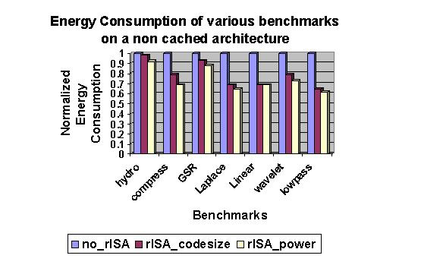
26% Energy Savings on
Non Cached Architecture
5% savings due to energy
aware compilation
26% overall
energy savings
*Instruction Memory Energy Savings
Notes:
On cached architectures, energy-aware rISA compilation can result in an average 26% reduction in energy consumption by instruction memory subsystem.
The blue bars show the energy consumption by the instruction memory subsystem in absence of rISA.
The red ones show the energy consumption when the code is compiled aiming to reduce code size,
And the while ones shows the energy consumption when using energy-aware rISA compilation approach.
An average of 5% savings in energy consumption is due to our energy-aware compilation technique.

Slide 13
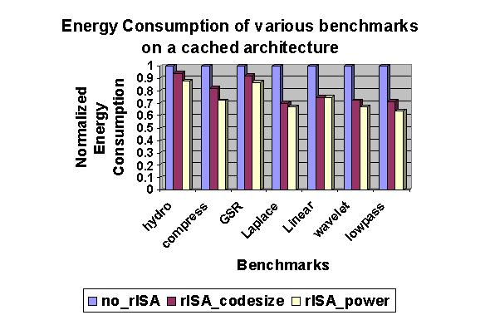
33% Energy Savings On
Cached Architecture
10% savings due to energy
aware compilation
33% overall
energy savings
*Instruction Memory Energy Savings
Notes:
On cached architectures, energy-aware rISA compilation can result in an average of 33% reduction in energy consumption by instruction memory subsystem.
The blue bars show the energy consumption by the instruction memory subsystem in absence of rISA.
The red ones show the energy consumption when the code is compiled aiming to reduce code size,
And the while ones shows the energy consumption when using energy-aware rISA compilation approach.
10% of the savings in energy consumption is due to our energy-aware compilation technique.

Slide 14
Conclusion
rISA is a popular architectural feature in processors to reduce code size and energy
We presented a rISA compilation technique to further reduce instruction memory energy
Our approach shows an average 30% reduction in instruction memory energy
Notes:
rISA or reduced bit-width Instruction Set Architecture is a popular and effective feature to reduce code size.
In this paper we present an approach for code generation that aims at reducing energy consumption.
Upto 30% reduction in the instruction memory energy consumption can be achieved using our compilation approach.

