Slide 1

Compilation Techniques for Energy Reduction in Horizontally Partitioned Cache Architectures
Aviral Shrivastava, Ilya Issenin, Nikil Dutt
Center For Embedded Computer Systems,
University of California, Irvine, CA, USA
Notes:
Good morning,
This work of Developing Compilation Techniques for Energy Reduction in Horizontally Partitioned Cache Architectures
was done at the Center for Embedded Computer Systems at UC Irvine.

Slide 2
Horizontally Partitioned Cache (HPC)
Originally proposed by Gonzalez et al. in 1995
More than one cache at the same level of hierarchy
Caches share the interface to memory and processor
Each page is mapped to exactly one cache
Mapping is done at page-level granularity
Specified as page attributes in MMU
Mini Cache is relatively small
Intel StrongARM and Intel XScale
Processor Pipeline
Main Cache
Mini Cache
Memory
HPC is a popular architectural feature

Slide 3
Performance Advantage of HPC
Observation: Often arrays have low temporal locality
  Each value is used for a while, and is then never used
  But they evict all other data from the cache
Separate low temporal locality data from high temporal locality data
  Array a – low temporal locality
  Array b – high temporal locality
Performance Improvement
  Reduce miss rate of Array b
  Two separate caches may be better than a unified cache of the total size
Key lies in intelligent data partitioning
char a[1024];
char b[1024];
for (int i=0; i<1024; i++)
c += a[i]+b[i%5];
Processor Pipeline
b[1000]
b[5]
Memory
Existing techniques focus on performance

Slide 4
Energy Advantage of HPCs
Energy savings due to two effects
  Reduction in miss rate
  AccessEnergy(mini cache) < AccessEnergy(main cache)
Reduction in miss rate
  Aligned with performance
  Exploited by performance improvement techniques
Less Energy per Access in mini cache
  Inverse to performance
  Energy can decrease even if there are more misses
  Opposite to performance optimization techniques!!
Existing techniques DO NOT exploit the second effect

Slide 5
Motivating Example
Processor Pipeline
8 KB Main Cache
Access Latency: 1 cycle
Access Energy: 3 nJ
Line size: 16 chars
1 KB Mini Cache
Access Latency: 1 cycle
Access Energy: 1 nJ
Line size: 16 chars
Memory
Access Latency: 20 cycles
Access Energy: 30 nJ

Slide 6
Motivating Example
Processor Pipeline
8 KB Main Cache
Access Latency: 1 cycle
Access Energy: 3 nJ
Line size: 16 chars
1 KB Mini Cache
Access Latency: 1 cycle
Access Energy: 1 nJ
Line size: 16 chars
char a[1024];
char b[1024];
for (int i=0; i<1024; i++)
c += a[i]+b[i%5];
Memory
Access Latency: 20 cycles
Access Energy: 30 nJ

Slide 7
Motivating Example
char a[1024];
char b[1024];
for (int i=0; i<1024; i++)
c += a[i]+b[i%5];
Array A
Array B
Main Cache
Mini Cache
Page Mapping:
Main Cache : A, B
Mini Cache : -
Main Cache | Mini Cache | Main Cache Accesses | Main Cache Misses | Mini Cache Accesses | Mini Cache Misses | Runtime (cycles) | Energy (nJ)
A, B
-

Slide 8
Motivating Example
char a[1024];
char b[1024];
for (int i=0; i<1024; i++)
c += a[i]+b[i%5];
Array A
Array B
Main Cache
Mini Cache
Main Cache Accesses:
1024
+ 1024
= 2048
Main Cache | Mini Cache | Main Cache Accesses | Main Cache Misses | Mini Cache Accesses | Mini Cache Misses | Runtime (cycles) | Energy (nJ)
A, B | -
2048

Slide 9
Motivating Example
char a[1024];
char b[1024];
for (int i=0; i<1024; i++)
c += a[i]+b[i%5];
Array A
Array B
Main Cache
Mini Cache
Main Cache Misses:
1024/16 = 64
+ 5/16 = 1
= 65
Main Cache | Mini Cache | Main Cache Accesses | Main Cache Misses | Mini Cache Accesses | Mini Cache Misses | Runtime (cycles) | Energy (nJ)
A, B | - | 2048
65
0
0

Slide 10
Motivating Example
char a[1024];
char b[1024];
for (int i=0; i<1024; i++)
c += a[i]+b[i%5];
Array A
Array B
Main Cache
Mini Cache
Runtime:
2048*1 = 2048
+ 65*20 = 1300
= 3348
Main Cache | Mini Cache | Main Cache Accesses | Main Cache Misses | Mini Cache Accesses | Mini Cache Misses | Runtime (cycles) | Energy (nJ)
A, B | - | 2048 | 65 | 0 | 0
3348

Slide 11
Motivating Example
char a[1024];
char b[1024];
for (int i=0; i<1024; i++)
c += a[i]+b[i%5];
Array A
Array B
Main Cache
Mini Cache
Energy:
2048*3 = 6144
+ 65*20 = 1950
= 8094
Main Cache | Mini Cache | Main Cache Accesses | Main Cache Misses | Mini Cache Accesses | Mini Cache Misses | Runtime (cycles) | Energy (nJ)
A, B | - | 2048 | 65 | 0 | 0 | 3348
8094

Slide 12
Motivating Example
char a[1024];
char b[1024];
for (int i=0; i<1024; i++)
c += a[i]+b[i%5];
Array A
Array B
Main Cache
Mini Cache
Page Mapping:
Main Cache: A
Mini Cache: B
Main Cache | Mini Cache | Main Cache Accesses | Main Cache Misses | Mini Cache Accesses | Mini Cache Misses | Runtime (cycles) | Energy (nJ)
A, B | - | 2048 | 65 | 0 | 0 | 3348 | 8094
A
B
1024
64
1024
1
3348
6046

Slide 13
Motivating Example
char a[1024];
char b[1024];
for (int i=0; i<1024; i++)
c += a[i]+b[i%5];
Array A
Array B
Main Cache
Mini Cache
Page Mapping:
Main Cache: B
Mini Cache: A
Main Cache | Mini Cache | Main Cache Accesses | Main Cache Misses | Mini Cache Accesses | Mini Cache Misses | Runtime (cycles) | Energy (nJ)
A, B | - | 2048 | 65 | 0 | 0 | 3348 | 8094
A | B | 1024 | 64 | 1024 | 1 | 3348 | 6046
B
A
1024
1
1024
64
3348
6046

Slide 14
Motivating Example
char a[1024];
char b[1024];
for (int i=0; i<1024; i++)
c += a[i]+b[i%5];
Array A
Array B
Main Cache
Mini Cache
Page Mapping:
Main Cache: -
Mini Cache: A, B
Main Cache | Mini Cache | Main Cache Accesses | Main Cache Misses | Mini Cache Accesses | Mini Cache Misses | Runtime (cycles) | Energy (nJ)
A, B | - | 2048 | 65 | 0 | 0 | 3348 | 8094
A | B | 1024 | 64 | 1024 | 1 | 3348 | 6046
B | A | 1024 | 1 | 1024 | 64 | 3348 | 6046
-
A, B
0
0
2048
96
3968
4928

Slide 15
Worse Performance, but Better Energy
Main Cache | Mini Cache | Main Cache Accesses | Main Cache Misses | Mini Cache Accesses | Mini Cache Misses | Runtime (cycles) | Energy (nJ)
A, B | - | 2048 | 65 | 0 | 0 | 3348 | 8094
A | B | 1024 | 64 | 1024 | 1 | 3348 | 6046
B | A | 1024 | 1 | 1024 | 64 | 3348 | 6046
- | A, B | 0 | 0 | 2048 | 96 | 3968 | 4928
Worse Performance
Better Energy
Energy Optimization can afford more misses
Optimizing for performance and energy are different!!

Slide 16
Related Work
Horizontally Partitioned Caches
  Intel StrongARM SA 1100, Intel XScale
Data Partitioning Techniques for HPC
  No Analysis (Region-based Partitioning)
    Separate array and stack variables
      Gonzalez et. al. [ICS’95], Lee et. al. [CASES’00], Unsal et. al. [HPCA’02]
  Dynamic Analysis (in hardware)
    Memory address based
      Johnson et. al. [ISCA’97], Rivers et. al. [ICS’98]
    PC-based
      Tyson et. al. [MICRO’95]
  Static Analysis (Compiler Reuse Analysis)
    Xu et. al. [ISPASS’04]
Existing techniques focus on performance optimizations
  Achieve energy reduction as a by-product
Existing compiler data partitioning techniques are complex
  O(m³n)
Data partitioning techniques aimed at energy reduction

Slide 17
Compiler Analysis Framework
Application
Compiler
Page Access Info.
Extractor
Performance/Energy
Estimator
Data Partitioning
Heuristic
Executable
Page Mapping
Data Partitioning Framework
Embedded Platform

Slide 18
Compiler Analysis Framework
Page Access Information Extractor
  Which pages are accessed
  # times each page is accessed
  Sorts pages in decreasing order of accesses
Data Partitioning Heuristic
  Finds best mapping of pages to caches
    Performance
    Energy
Performance/Energy Estimator
  Estimates performance/energy of a given partition
Page Mapping
  Sets the page bits
Application
Compiler
Page Access Info.
Extractor
Performance/Energy
Estimator
Data Partitioning
Heuristic
Executable
Page Mapping
Data Partitioning Framework
Embedded Platform

Slide 19
Experimental Framework
System
  Similar to hp iPAQ h4300
Benchmarks
  MiBench
Simulator
  SimpleScalar sim-cache
Performance Metric
  cache access +
  memory accesses
Energy Metric
  Main Cache Energy +
  Mini Cache Energy +
  Memory Bus Energy +
  SDRAM Energy
Processor Pipeline
32 KB Main Cache
32:32:32:f
1 KB Mini Cache
2:32:32:f
XScale
Memory Controller
PXA 255
SDRAM
SDRAM
Memory
Hp iPAQ h4300

Slide 20
Experiments
Experiment 1
  How good are energy oriented data partitioning heuristics?
  Develop several energy oriented data partitioning heuristics and evaluate them
Experiment 2
Experiment 3

Slide 21
Data Partitioning
Input: List of undecided pages L, sorted by number of accesses
Output: Partition the pages into two lists, M and m, such that
  M U m = L
  M Λ m = Φ
Exhaustive Search (OPT)
  Try all possible 2^{m} page mappings
  O(n2^{m})
n – Number of Memory Accesses
m – Number of Pages Accessed

Slide 22
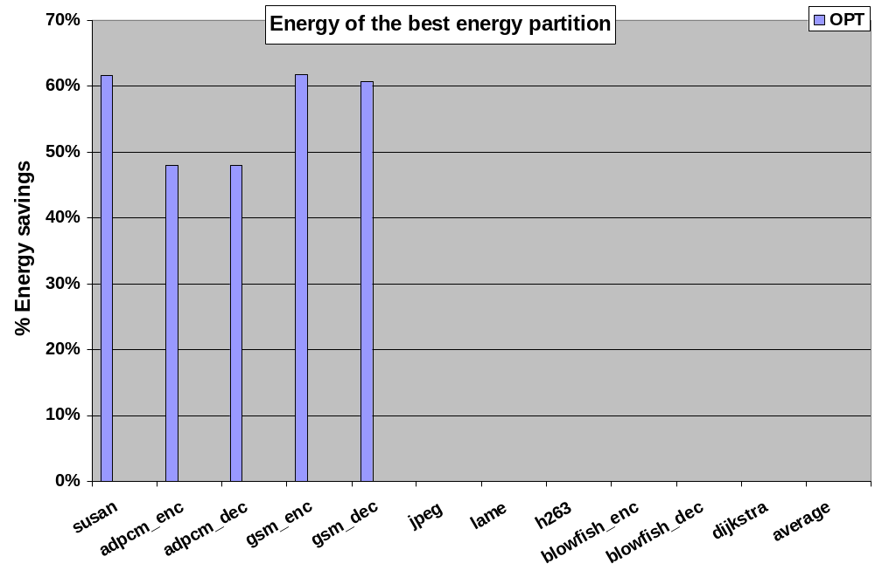
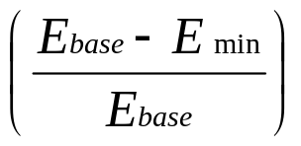
Significant Memory Energy Reduction
Memory subsystem energy savings achieved by OPT
Base Configuration – All pages are mapped to main cache
55% memory subsystem energy savings

Slide 23
Complex Data Partitioning Heuristic
Input: List of undecided pages L, sorted by number of accesses
Output: Partition the pages into two lists, M and m, such that
  M U m = L
  M Λ m = Φ
Exhaustive Search (OPT)
  Try all possible 2^{m} page mappings
  O(n2^{m})
Complex Heuristic (OM2N)
  Try m² page mappings
  O(m²n)
n – Number of Memory Accesses
m – Number of Pages Accessed

Slide 24
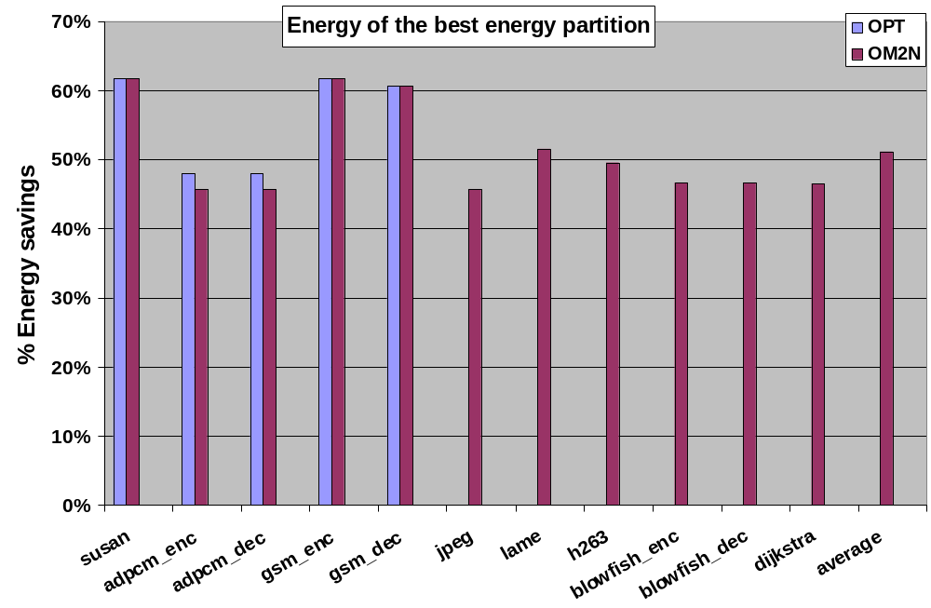
Significant Energy Reduction Contd.
Memory subsystem energy savings achieved by OM2N
Base Configuration – All pages are mapped to main cache
OM2N results are within 2% of exhaustive search

Slide 25
Simple Data Partitioning Heuristic
Input: List of undecided pages L, sorted by number of accesses
Output: Partition the pages into two lists, M and m, such that
  M U m = L
  M Λ m = Φ
Exhaustive Search (OPT)
  Try all possible 2^{m} page mappings
  O(n2^{m})
Complex Heuristic (OM2N)
  Try m² page mappings
  O(m²n)
Simple Heuristic (OMN)
  Try only m page mappings
  O(mn)
n – Number of Memory Accesses
m – Number of Pages Accessed

Slide 26
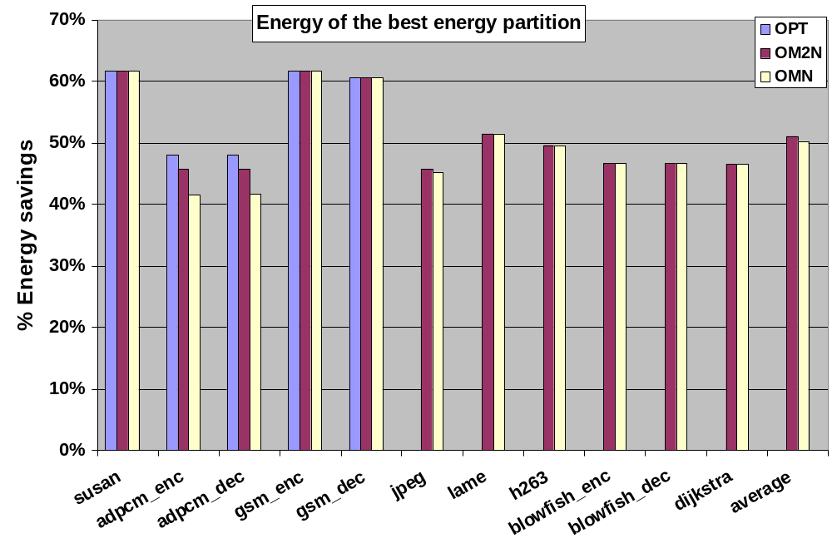
Even Simple Heuristic is good!!
Memory subsystem energy savings achieved by OMN
Base Configuration – All pages are mapped to main cache
OMN heuristic achieves 50% memory subsystem energy savings

Slide 27
Very Simple Data Partitioning Heuristic
Input: List of undecided pages L, sorted by number of accesses
Output: Partition the pages into two lists, M and m, such that
  M U m = L
  M Λ m = Φ
Exhaustive Search (OPT)
  Try all possible 2^{m} page mappings
  O(n2^{m})
Complex Heuristic (OM2N)
  Try m² page mappings
  O(m²n)
Simple Heuristic (OMN)
  Try only m page mappings
  O(mn)
Very Simple Heuristic (OkN)
  Try only k page mappings (k << m)
  O(kn)
n – Number of Memory Accesses
m – Number of Pages Accessed

Slide 28
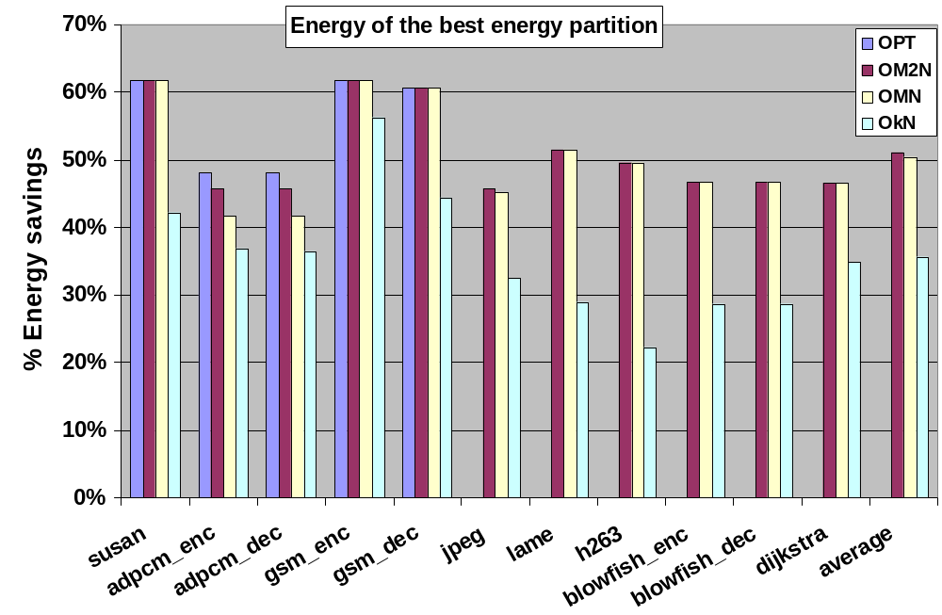
Very Simple Heuristic
Memory subsystem energy savings achieved by OkN
Base Configuration – All pages are mapped to main cache
OkN heuristic achieves 35% memory subsystem energy savings

Slide 29
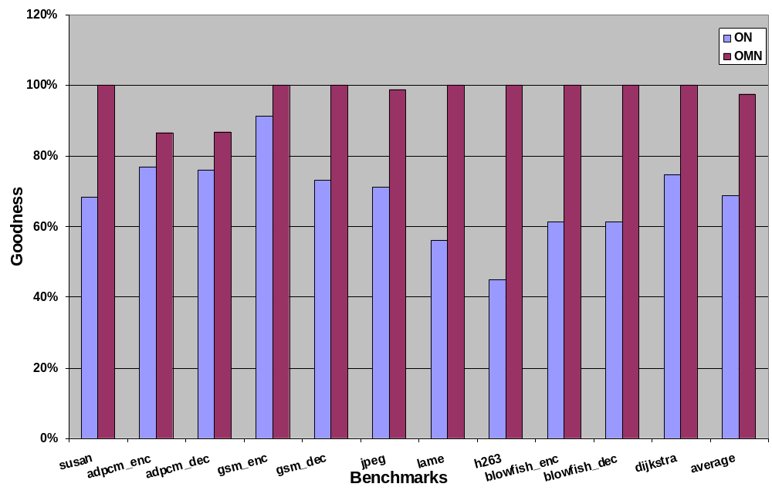
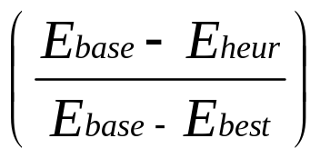
Goodness of Heuristics
How close to optimal this heuristic is?
Goodness of
  OMN is 97%
  OkN is 64%
Simple Heuristics are good enough for optimizing for energy!!

Slide 30
Experiments
Experiment 1
  How good are energy oriented data partitioning heuristics?
  Develop several energy oriented data partitioning heuristics and evaluate them
Experiment 2
  Energy oriented data partitioning heuristics suffer how much performance degradation?
  Compare
    Energy of best performing data partition
    Performance of best energy data partition
Experiment 3

Slide 31
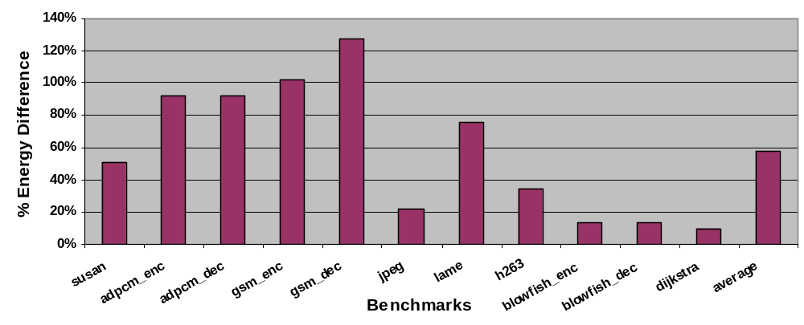
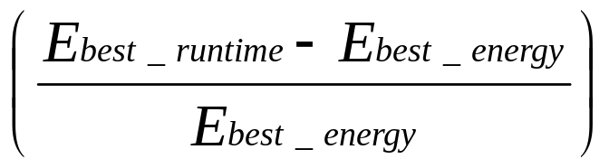
Best Performing Partition consumes 58% more Energy
Plots
Plots the increase in energy at the best performing partition
First 5 benchmarks exhaustive results
Last 7 benchmarks OM2N heuristic

Slide 32
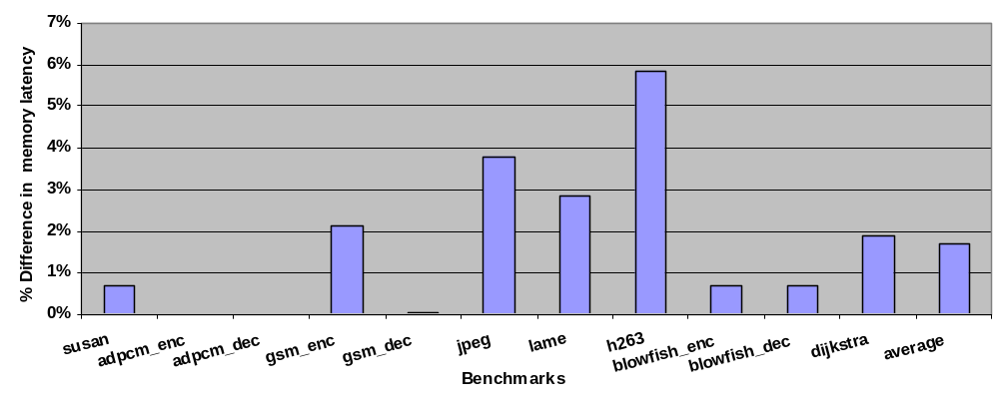
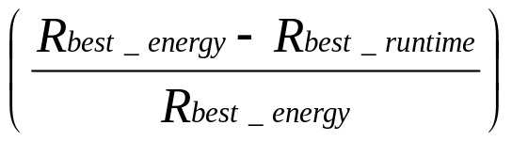
Best Energy Partition looses 2% Performance
Plots
Plots the increase in runtime at the best energy partition
First 5 benchmarks exhaustive results
Last 7 benchmarks OM2N heuristic
Optimizing for Performance and Energy are significantly different!!

Slide 33
Experiments
Experiment 1
  How good are energy oriented data partitioning heuristics?
  Develop several energy oriented data partitioning heuristics and evaluate them
Experiment 2
  Energy oriented data partitioning heuristics suffer how much performance degradation?
  Compare
    Energy of best performing data partition
    Performance of best energy data partition
Experiment 3
  Sensitivity of energy oriented data partitioning heuristics on cache parameters

Slide 34
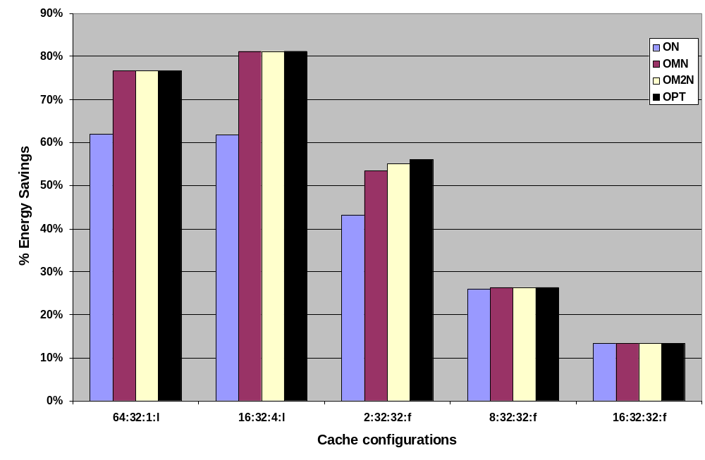
Sensitivity of Heuristics
Sensitivity of our heuristics with mini cache parameters
Middle is the base configuration, 2KB, 32-way SA FIFO cache
Vary associativity in the first configurations (64-way, and 16-way)
Vary size in the last two configurations (8KB, and 16 KB)
Proposed heuristics scale well with cache parameters

Slide 35
Summary
Horizontally Partitioned Caches are simple yet powerful architectural feature to improve performance and energy in embedded systems
Existing techniques focus on performance improvement and are complex O(m³n)
We showed that
  Goal of energy optimization ≠ Goal of performance optimization
  Potential of energy reduction by aiming for energy optimization
Simple heuristics achieve good results for energy optimization
  Up to 50% memory subsystem energy savings
  Marginal degradation in performance
Our heuristics scale well with cache parameters

