Slide 1

A Compiler-in-the-Loop (CIL) Framework to Explore
Horizontally Partitioned Cache (HPC) Architectures
Aviral Shrivastava*, Ilya Issenin, Nikil Dutt
*Compiler and Microarchitecture Lab,
Center for Embedded Systems,
Arizona State University, Tempe, AZ, USA.
ACES Lab,
Center For Embedded Computer Systems,
University of California, Irvine, CA, USA
M
C
L
Notes:
Good morning,
This work of Developing Compilation Techniques for Energy Reduction in Horizontally Partitioned Cache Architectures
was done at the Center for Embedded Computer Systems at UC Irvine.

Slide 2
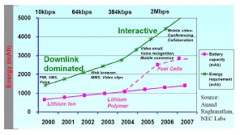
Power in Embedded Systems
Power: Most important factor in usability of electronic devices
Device | Battery life | Charge time | Battery weight/ Device weight
Apple iPOD | 2-3 hrs | 4 hrs | 3.2/4.8 oz
Panasonic DVD-LX9 | 1.5-2.5 hrs | 2 hrs | 0.72/2.6 pounds
Nokia N80 | 20 mins | 1-2 hrs | 1.6/4.73 oz
  Performance requirements of handhelds
  Increase by 30X in a decade
  Battery capacity
  Increase by 3X in a decade
  Considering technological breakthroughs, e.g. fuel cells
Notes:
Let me start by motivating my problem.
This talk and my work is about Embedded Systems.
Why should we care about embedded systems at all?
First is that embedded system market has been estimated to be about 45 billion dollars in 2004, and is expected to rise to 90 billion dollars before 2010.
We want to ensure this and enable possibly higher growth.
Now one trend that is common in the embedded systems is the increasing complexity of systems.
This increase in complexity is not only because of increasing demands from the same systems, but also because of convergence of functionality.
Not only the plam-top of today is much more faster than that of 2 years back, but it performs much more functions.
It is a cell phone, digital organizer, mp3 player, video player, speech recognition, etc…
With the increasing complexity of embedded systems, and shrinking time-to-market pressures, designer productivity becomes the key to successs.
Therefore programmable embedded systems are becoming increasing popular.
By programmable embedded systems, I mean an embedded system, which have a processor.
The program running on the processor can be changed fairly easily e.g. by downloading a new application.
Programmable embedded systems provide faster development, easier re-usability and upgradability of the system.
In such programmable embedded systems, the processor is the main controller, and as a result has major impact on the system power, performance etc.
Therefore the programmable processor, which is also called “embedded processor” is becoming the main focus of research.
My research theme is the embedded processor, both the hardware and software aspects.

Slide 3
Memory Subsystem
Embedded System Design
  Minimize power at minimal performance loss
Memory subsystem design parameters
  Significant impact on power and performance
    May be the major consumer of system power
    Very significant impact on performance
  Need to be chosen very carefully
Compiler influences the way application uses memory
  Compiler should take part in the design process
Compiler-in-the-Loop Memory Design

Slide 4
Horizontally Partitioned Cache (HPC)
Originally proposed by Gonzalez et al. in 1995
More than one cache at the same level of memory hierarchy
Caches share the interface to memory and processor
Each page is mapped to exactly one cache
Mapping is done at page-level granularity
Specified as page attributes in MMU
Mini Cache is relatively small
Example: Intel StrongARM and XScale
Processor
Pipeline
Main Cache
Mini Cache
Memory

Slide 5
Performance Advantage of HPC
Observation: Often arrays have low temporal locality
  Image copying: each value is used only once or a few times
  But the stream evicts all other data from the cache
Separate low temporal locality data from high temporal locality data
  Array a – low temporal locality – small (mini) cache
  Array b – high temporal locality – regular (main) cache
Performance Improvement
  Reduced miss rate of Array b
  Two separate caches may be better than a unified cache of the total size
char a[1024];
char b[1024];
for (int i=0; i<1024; i++)
c += a[i]+b[i%5];
Processor
Pipeline
a[1000]
b[5]
Memory

Slide 6
Power Advantage of HPCs
Power savings due to two effects
  Reduction in miss rate
  AccessEnergy(mini cache) < AccessEnergy(main cache)
Reduction in miss rate
  Aligned with performance
  Exploited by performance improvement techniques
Less Energy per Access to mini cache
  Inverse to performance
    Energy can decrease even if there are more misses
  Opposite to performance optimization techniques
Compiler (Data Partitioning) Techniques for performance improvement and power reduction are different

Slide 7
HPC Design Complexity
Power reduction very sensitive on data partition
  Up to 2x difference in power consumption
Power reduction achieved is also very sensitive on the HPC design parameters, e.g., size, associativity
  Up to 4x difference in power consumption
HPC Design
HPC Parameters
Choose
HPC Parameters
Choose
Data Partition
Application
Data Partition

Slide 8
HPC Design Space Exploration
Traditional Exploration
Compiler-in-the-Loop Exploration
Application
Application
Compiler
Sensitive Compiler
HPC Parameters
Executable
Executable
Cycle Accurate
Simulator
Cycle Accurate
Simulator
Best processor Configuration
Synthesize
Compiler-in-the-Loop (CIL) Design Space Exploration (DSE)
Aviral Shrivastava Final Defense

Slide 9
Related Work
Horizontally Partitioned Caches
  Intel StrongARM SA 1100, Intel XScale
Performance-oriented data partitioning techniques for HPC
  No Analysis (Region-based Partitioning)
    Separate array and stack variables
      Gonzalez et al. [ICS’95], Lee et al. [CASES’00], Unsal et al. [HPCA’02]
  Dynamic Analysis (in hardware)
    Memory address; PC based
      Johnson et al. [ISCA’97], Rivers et al. [ICS’98]; Tyson et al. [MICRO’95]
  Static Analysis (Compiler Reuse Analysis)
    Xu et al. [ISPASS’04]
HPC techniques focusing on energy efficient data partitioning
    Shrivastava et al. [CASES’05]
Compiler-in-the-Loop Design Space Exploration
  Bypasses in processors
    Fan et al. [ASSAP’03], Shrivastava et al. [DATE’05]
  Reduced Instruction Set Architecture
    Halambi et al. [DATE’02]
No prior CIL DSE techniques for HPC

Slide 10
HPC Exploration Framework
Application
Processor Description
Compiler
- compile to binary
- find optimal page mapping
HPC parameters
Delay Model
Executable
Page mapping
Energy Model
Embedded Platform Simulator
Design Space
Walker

Slide 11
HPC Exploration Framework
System
  Similar to hp iPAQ h4300
Benchmarks
  MiBench, H.263
Simulator
  Modified SimpleScalar
HPC Data Partitioning Technique
  Shrivastava et al. [CASES’05]
Performance Metric
  cache access +
  memory accesses
Energy Metric
  Main Cache Energy +
  Mini Cache Energy +
  Memory Bus Energy +
  SDRAM Energy
Processor Pipeline
32 KB Main Cache
32:32:32:f
Mini Cache
Variable config
XScale
Memory Controller
PXA 255
SDRAM
SDRAM
Micron 64MB Memory
Hp iPAQ h4300

Slide 12
Experiments
Experiment 1
  How important is exploration of HPC parameters?
Experiment 2
Experiment 3

Slide 13
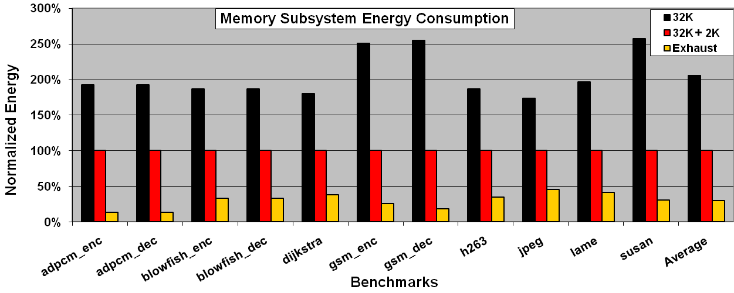
Importance of HPC DSE
Exhaustive Search (33 mini-cache configurations)
For each configuration, find the most energy-efficient partition
Compare:
  32K: No mini-cache
  32K+2K: XScale mini-cache parameters
  Exhaust: Optimal HPC parameter configuration
Performance degradation: 2% on average
Only Compiler Approach for HPCs: 2X savings
Choose the right HPC parameters also: additional 80% savings

Slide 14
Experiments
Experiment 1
  How important is exploration of HPC parameters?
Experiment 2
  How important is the use of Compiler-in-the-Loop for HPC exploration?
Experiment 3

Slide 15
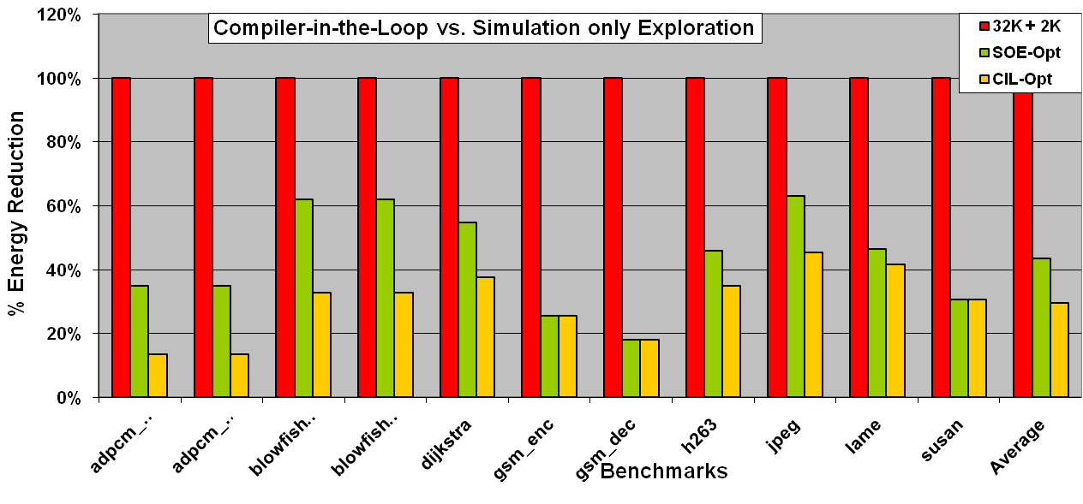
Importance of Compiler-in-the-Loop DSE
  32K+2K: XScale configuration
  SOE-Opt: Simulation-only exploration
    find the best data partitioning for 32K+2K,
    then find the best HPC configuration by Simulation-Only DSE
  CIL-Opt: Exhaustive Compiler-in-the-Loop DSE
Simulation-Only DSE: 57% savings;
Compiler-in-the-Loop DSE: additional 30% savings

Slide 16
Experiments
Experiment 1
  How important is exploration of HPC parameters?
Experiment 2
  How important is the use of Compiler-in-the-Loop for HPC exploration?
Experiment 3
  Design Space Exploration Heuristics

Slide 17
Design Space Exploration Heuristics
We propose and compare 3 heuristics:
  Trade-off between Runtime and Power Reduction
Exhaustive algorithm
  Try all possible cache size and associativities
Greedy algorithm
  First increase cache size until power decreases,
  then increase associativity until power decreases
Hybrid algorithm
  Search for the optimal cache size and associativity skipping every other size, or associativity
  Explore exhaustively in the size-associativity neighborhood
Greedy is faster, but hybrid finds better solution

Slide 18
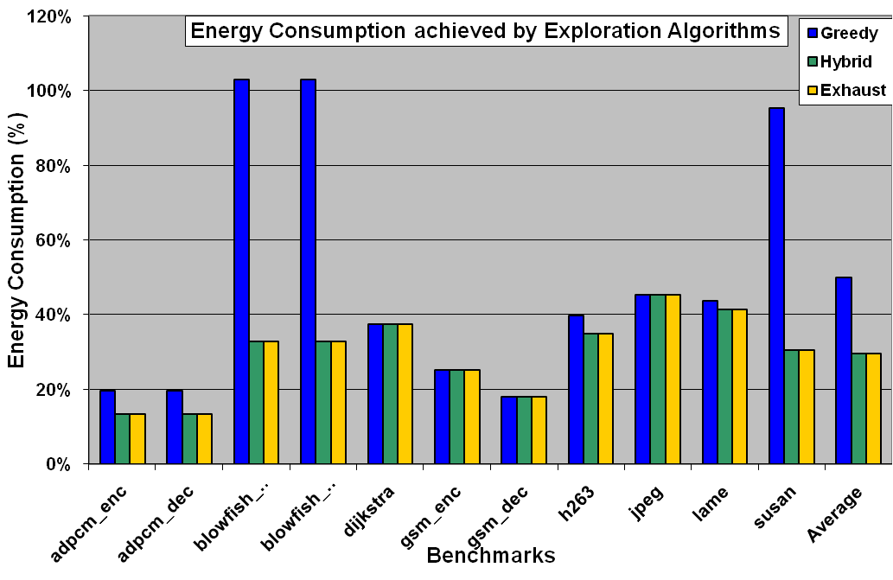
Achieved Energy Reduction
Greedy algorithm is sometimes very bad
Hybrid algorithm always found the best solution

Slide 19
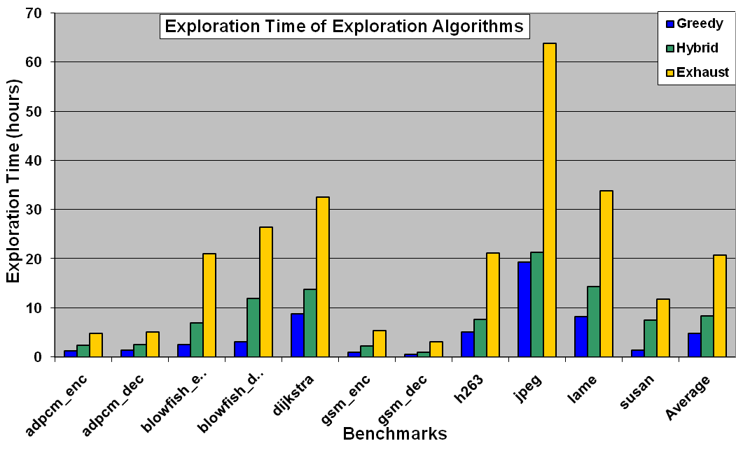
Exploration time
Greedy is 5x faster than exhaustive;
hybrid is 3x faster than exhaustive

Slide 20
Summary
Horizontally Partitioned Caches are simple yet powerful architectural feature to improve performance and energy in embedded systems
Power reduction obtained by HPCs is highly sensitive on
  Data partition
  HPC design parameters
Traditional: Simulation-Only Exploration
  Generate binary once, then perform simulations to find out HPC parameters
Our Approach: Compiler-in-the-Loop HPC DSE
  Compile and simulate everytime to explore HPC design space
CIL DSE can reduce memory subsystem power consumption by 80%
Hybrid technique reduces exploration space by 3X

