Slide 1


Cache Vulnerability Equations for Protecting Data in Embedded Processor Caches from
Soft Errors
†Aviral Shrivastava, €Jongeun Lee, †Reiley Jeyapaul
†Compiler and Microarchitecture Lab, € High Performance Computing Lab,
Arizona State University, USA UNIST, Ulsan, South Korea
LCTES 2010
Stockholm, Sweden
http://www.public.asu.edu/~ashriva6

Slide 2
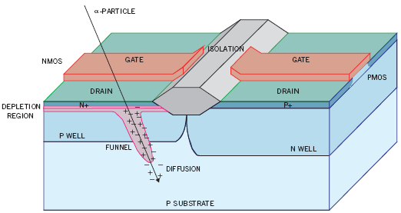
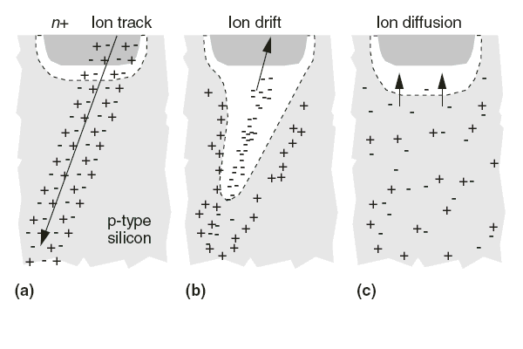
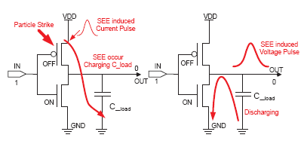
Phenomenon of Soft Error
Transient Faults
  Random and spontaneous bit-changes in system
Can be caused by
  Circuit noise
  Cross-talk
More than 50% due to radiation strike
http://www.public.asu.edu/~ashriva6

Slide 3
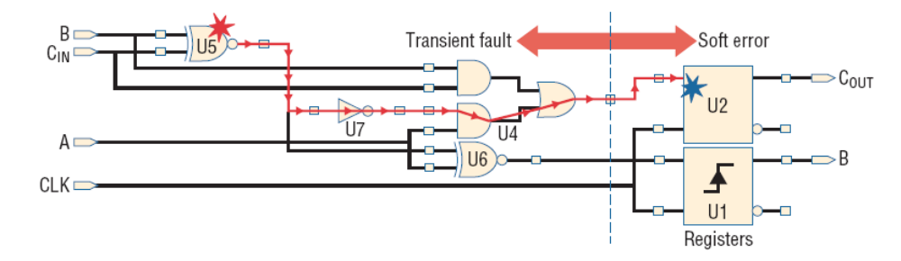
Masking Effects
Logic Masking
Electrical Masking
Latching Window Masking
Microarchitectural Masking
Software Masking
http://www.public.asu.edu/~ashriva6

Slide 4
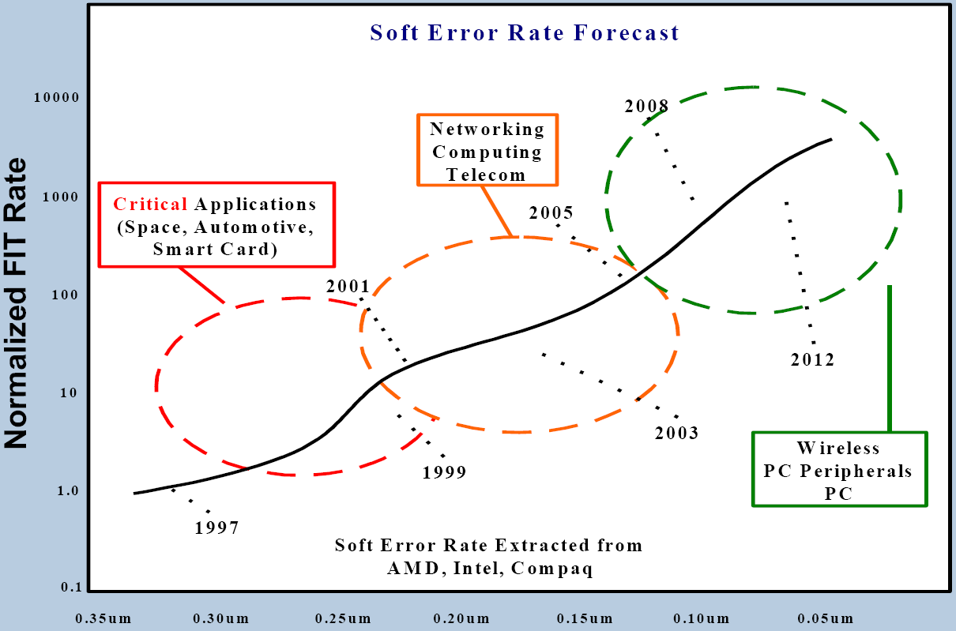
Growing Problem
Soft Error rate is currently about 1 per year
Increasing exponentially with technology scaling
Projected to become 1 per day in a decade
Will soon become a problem in earth-bound electronics
http://www.public.asu.edu/~ashriva6

Slide 5
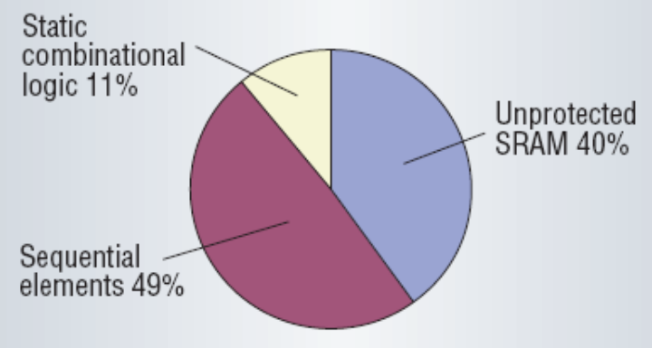
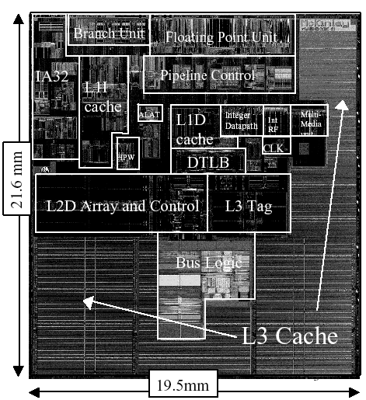
Caches most vulnerable
Temporal masking is very effective
Caches occupy majority of chip-area
Much higher % of transistors
  More than 80% of the transistors in Itanium 2 are in caches.
Caches operated at low voltage levels for higher speed and low-power
  Even low energy particles can cause errors
ECC is not enough
  has high power and performance overheads for L1 cache
  ECC used up in manufacturing error correction
http://www.public.asu.edu/~ashriva6

Slide 6
Cache Vulnerability
CE
CE
R
W
R
R
W
R
Time
A cache location is vulnerable if
  It will be read by the processor, or it will be committed to memory
  AND it is dirty
Note: Non dirty data is not vulnerable
  Can always re-read non-dirty data from lower level of memory
Instantaneous (cache) Vulnerability (bytes) is the number of cache locations that are vulnerable [Mukherjee 2003]
Total (cache) Vulnerability of a program (in bytes * cycles) is the summation of cache vulnerability in each cycle of program execution.
http://www.public.asu.edu/~ashriva6

Slide 7
Existing Schemes
Hardened memory cells
  8T, 10T designs, add cross resistance
    High power and performance overhead
Error Correction Codes
  Single Error Correction, and Double Error Detection (SECDED)
  Need log₂n bits to protect n-bits
  Most popular, but high overhead for L1 cache
    Increase power consumption by >25% [Phelan 2003]
  ECC used up in covering manufacturing defects
Write-through cache
  Zero vulnerability, but high cache-memory traffic
Periodically write-back all dirty lines
  Simple, but not very smart. Less protection for high overhead.
Need Efficient technique for Vulnerability Reduction
http://www.public.asu.edu/~ashriva6

Slide 8
Explore Compiler Techniques
Need to reduce the amount of time, data is vulnerable in the cache
Vulnerability depends on the access pattern of data
for ( i : 0 ≤ i < N ) {
for ( k : 0 ≤ k < N ) {
for ( j : 0 ≤ j < N ) {
A[i][k] += B[i][j] * C[j][k]
}
}
}
for ( i : 0 ≤ i < N ) {
for ( j : 0 ≤ j < N ) {
for ( k : 0 ≤ k < N ) {
A[i][k] += B[i][j] * C[j][k]
}
}
}
Low Vulnerability
but also
High Runtime
Completely compute A[i][k] in the innermost loop
Need A[i][k] across iterations of outermost loop
http://www.public.asu.edu/~ashriva6

Slide 9
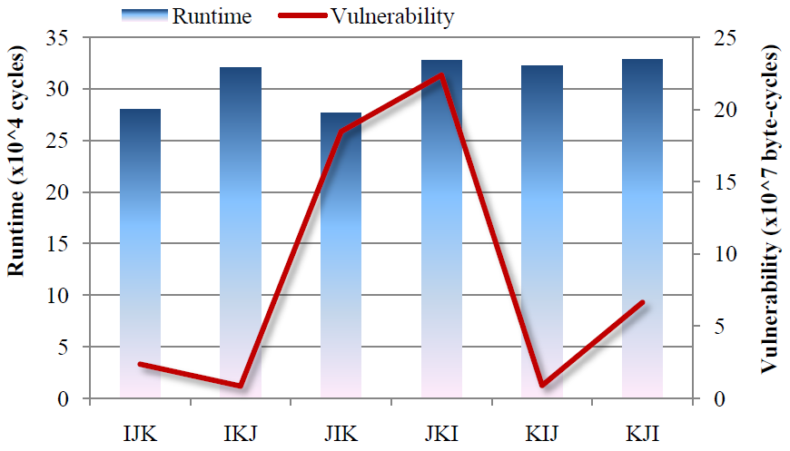
MatMul Loop Interchange
Vulnerability trend not same as performance
Loop Interchange on Matrix Multiplication
Interesting configurations exist, with low vulnerability and low runtime.
96% variation in vulnerability for
16% variation in runtime
Opportunities may exist to trade off little runtime for large savings in vulnerability
http://www.public.asu.edu/~ashriva6

Slide 10
How to Exploit the trade-off?
Need to compute the vulnerability
  Can be done by simulation
  Run the application with different data access patterns, and pick the one with the least vulnerability
May be applicable for extremely embedded systems
Runtime maybe an issue
  Some program run indefinitely
Number of configurations to run is too large
  E.g., Array padding
How to scale the results to slightly different configuration
  E.g., increase cache size
Need efficient method of computing vulnerability
http://www.public.asu.edu/~ashriva6

Slide 11
Outline
Growing threat of soft errors
Efficient techniques needed for L1 cache protection
Need efficient techniques to estimate vulnerability
Cache Miss Equations
Vulnerability Calculations
Experiments
http://www.public.asu.edu/~ashriva6

Slide 12
Access and Cache Space
n
Cache Space
for (i=0; i < N; i++)
for (j=0; j < N; j++)
for (k=0; k < N; k++)
A[i][k] += B[i][j] * C[j][k]
endFor
endFor
endFor
Reference & Access
line 2
Access Space:
Every point is an iteration of the loop
L: # lines in the cache
j
(0,0)
m
CacheAddr: Memory Address → Cache Address
Cache Line = (MemAddr/L)
y
Memory Space
N
i
(1,4,2)
i = N
C(4,2)
(0,0)
x
i = 1
N
MemAddr: Iteration → Memory Address
AF(1,2,4) = C+N²+4N+2
(0,0,0)
k

Slide 13




Data Reuse
for (i=0; i < N; i++)
for (j=0; j < N; j++)
for (k=0; k < N; k++)
A[i][k] += B[i][j] * C[j][k]
endFor
endFor
endFor
When the same data is accessed from iteration and iteration ,
we say, there is data reuse in direction
Access Space:
Every point is an iteration of the loop
j
y
Data Space
N
i_{N}(N,4,2)
i
i₂(1,4,2)
= (1,0,0)
i = N
C(4,2)
i₁(0,4,2)
(0,0)
x
i = 1
N
http://www.public.asu.edu/~ashriva6
(0,0,0)
k

Slide 14

Cache Miss
n
Cache Space
for (i=0; i < N; i++)
for (j=0; j < N; j++)
for (k=0; k < N; k++)
A[i][k] += B[i][j] * C[j][k]
endFor
endFor
endFor
The element of array C is evicted from the cache and replaced by an element from array B.
line 2
j
(0,0)
m
y
Memory Space
C(4,2)
N
i_{N}(N,4,2)
B(0,7)
i
C(4,2)
B(0,7)
i(1,4,2)
(1,0,0)
i = N
C(4,2)
C(4,2)
Another iteration accesses data of array B, mapped to the same cache location causing a cache Miss.
p(0,4,2)
(0,0)
x
i = 1
N
http://www.public.asu.edu/~ashriva6
(0,0,0)
k

Slide 15
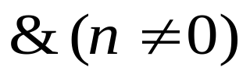



Cache Misses
Cache Miss Equation
  Returns 1 if the reuse in reference r along the reuse vector v was not realized at iteration j due to a conflict by reference q at iteration k.
k,q
j,r
j-v, r
http://www.public.asu.edu/~ashriva6

Slide 16
Cache Misses
Miss Iterations
  Iterations at which the reference r misses, along the reuse vector r, due to interference with another reference q.
Miss:
because k exists
Hit:
No k exists
http://www.public.asu.edu/~ashriva6

Slide 17
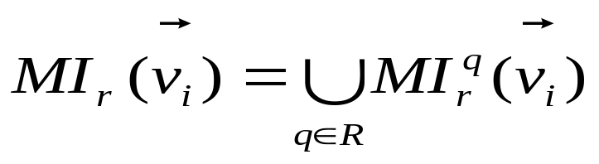
Cache Misses
Miss Iterations due to multiple references
  There is a miss at iteration j, if there is a miss due to any reference
Miss:
because of reference q
k1, q
Miss:
because of reference s
k2, s
http://www.public.asu.edu/~ashriva6

Slide 18
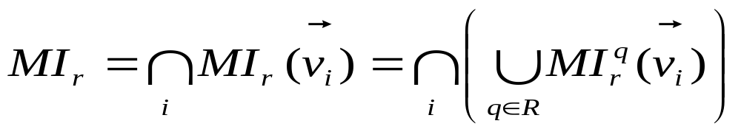
Cache Miss
Miss Iterations due to multiple reuse vectors
  There will be a miss at iteration j if there is miss along all the reuse vectors
Miss:
Because of the smallest reuse vector
http://www.public.asu.edu/~ashriva6

Slide 19
Outline
Growing threat of soft errors
Efficient techniques needed for L1 cache protection
Need efficient techniques to estimate vulnerability
Cache Miss Equations
Vulnerability Calculations
Experiments
http://www.public.asu.edu/~ashriva6

Slide 20
Computing Vulnerability
State | Access |  | Read | Write
Dirty | Hit |  | (1) | None
 | Repl. Miss |  | (2)
 | Cold Miss |  | None
Clean | Any |  | None
(1)
Hit Vul.
p = j-v
j
(2)
Miss Vul.
p = j-v
k*
k
j
http://www.public.asu.edu/~ashriva6

Slide 21
Challenges in Vul. Estimation
Miss(j): I → {0,1}
  Miss at iteration j is a Boolean function
Vul(j): I → I⁺
  Vulnerability at iteration j is an integer function
  How to represent integer function as a set?
Much more complexity:
  Misses are in iterations, while vulnerability is in cycles
  Only dirty blocks are vulnerable
http://www.public.asu.edu/~ashriva6

Slide 22
Computing Vulnerability
Suppose a variable is accessed several times
  Cold miss
  Incremental Vul.
  Post-access Vul.
Incremental Vul.
  Compute vulnerability from the last access
  Total Vul. = Sum of Incremental Vul.
Cold Miss
Last Access
http://www.public.asu.edu/~ashriva6

Slide 23
Computing Vulnerability
Two key ideas:
If vulnerability at iteration j = l
  Make l copies of vector j
Compute Non-vulnerability
  And then subtract it from total possible vulnerability
http://www.public.asu.edu/~ashriva6

Slide 24
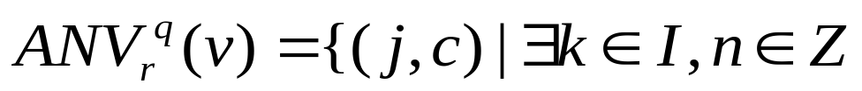
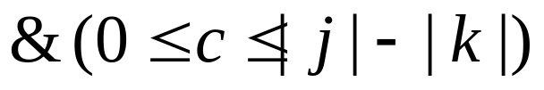
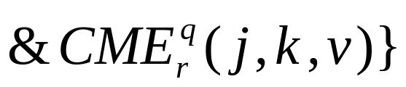
Computing Vulnerability
Access Non Vulnerability
If no k exists
  ANV = ф
HIT
j
j -v
http://www.public.asu.edu/~ashriva6

Slide 25
Computing Vulnerability
Access Non Vulnerability
If a k exists
  Then ANV
  = {(j,1), (j,2), …(j,|j|-|k|)}
ANV contains all the points on the RED line
MISS
j
j -v
http://www.public.asu.edu/~ashriva6

Slide 26
Computing Vulnerability
Access Non Vulnerability
If multiple k exist
  Then ANV =
  {(j,1), (j,2), …(j,|j|-|k*|)}
  Where k* is the smallest k
MISS
j
k
k
k*
j -v
http://www.public.asu.edu/~ashriva6

Slide 27
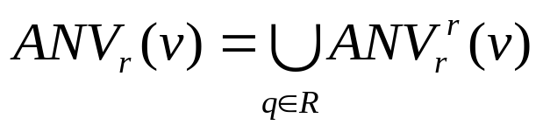
Computing Vulnerability
Access Non Vulnerability across references
  ANV for multiple references is the maximum of the individual ANVs
MISS
j
k1,q
k2,s
k*
j -v
http://www.public.asu.edu/~ashriva6

Slide 28

Computing Vulnerability
Access Vulnerability
  AV = Total possible vulnerability - ANV
MISS
j
k*
j -v
http://www.public.asu.edu/~ashriva6

Slide 29

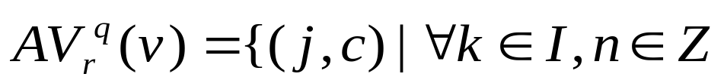
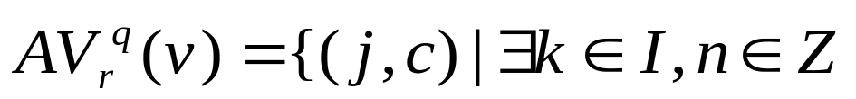
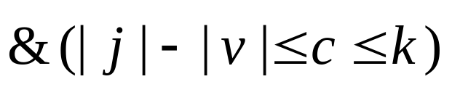
Why not compute AV directly?
We computed
What if we compute
j
k2
k1
j -v
http://www.public.asu.edu/~ashriva6

Slide 30
Other Issues
Identifying cold misses
Computing post-access vulnerability
Cache block effect
Translating from iterations to cycles
Derived reuse vectors
Computing no. of elements in a set
http://www.public.asu.edu/~ashriva6

Slide 31
Outline
Growing threat of soft errors
Efficient techniques needed for L1 cache protection
Need efficient techniques to estimate vulnerability
Cache Miss Equations
Vulnerability Calculations
Experiments
http://www.public.asu.edu/~ashriva6

Slide 32
Experimental Setup
Simplify CVEs in Omega
  Output: set containing vulnerability of loop.
Count the number of elements with Barvinok
Benchmark kernels from Spec200 and Multimedia kernels
Simplescalar configured to single-issue in-order processor with 32KB direct mapped data cache and 25 cycle L1 miss penalty
http://www.public.asu.edu/~ashriva6

Slide 33
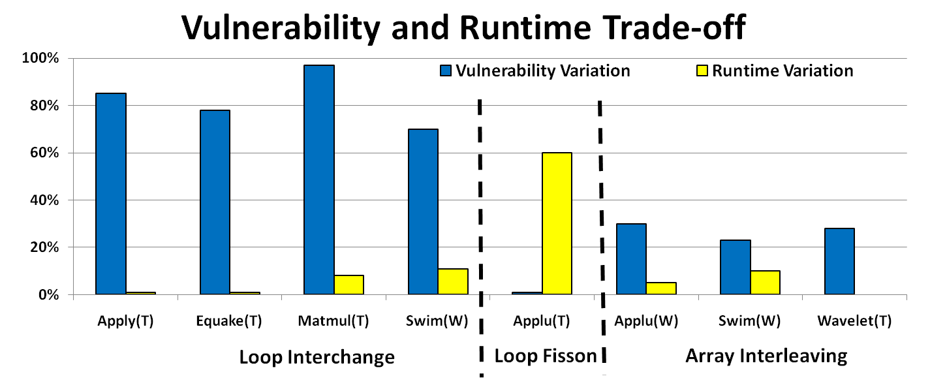
Interesting Trade-off exists!
46% vulnerability reduction for
16% runtime trade-off
55% vulnerability reduction for 6.5% runtime improvement
http://www.public.asu.edu/~ashriva6

Slide 34
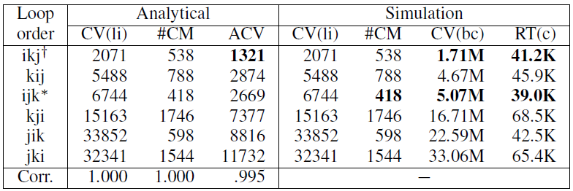
Validation
Variation in CV: 19X
Variation in Runtime: 1.7X
➔ Can trade off lot of vulnerability with little performance impact
Min Vul: ikj
Min Runtime: ijk
➔ Not the same trend
High Correlation between ACV and CV
Min Vul with only 5.7% runtime penalty
http://www.public.asu.edu/~ashriva6

Slide 35
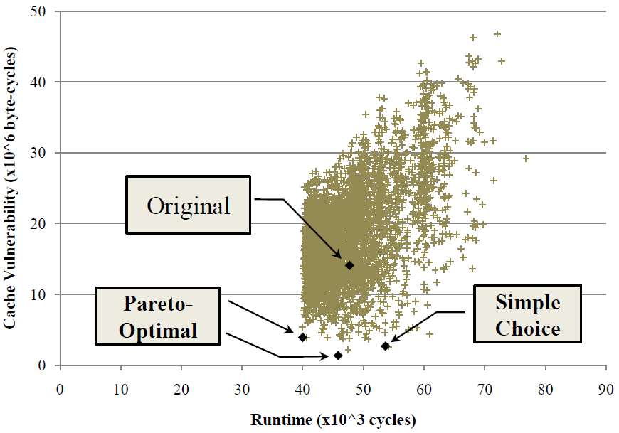
Application of CVE (case study)
Cache vulnerability calculated for varying array placement offsets on swim
http://www.public.asu.edu/~ashriva6

Slide 36
Conclusion
Soft Errors are soon to become a major concern even in terrestrial computing systems
Caches are most vulnerable, and for L1 cache:
  ECC is costly
  ECC may not be enough
Need nimble techniques to reduce vulnerability without much power and performance overheads
Compiler techniques can change the read/write access pattern of data
  therefore can effect vulnerability of program
Interesting trade-off between vul. and runtime may exist in code generation
Exploiting them using simulation may not be feasible
  Need efficient techniques to estimate vulnerability
Proposed re-use vector based analysis to estimate vulnerability
  Starting point for compiler support
http://www.public.asu.edu/~ashriva6

Slide 37

Questions?
http://www.public.asu.edu/~ashriva6

Slide 38



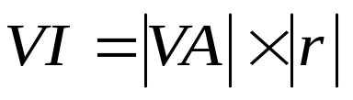
Hit Vulnerability
j
Access Iteration
Cache Miss Iteration
Reuse Direction:
Direction along which the data element is reused.
Access Iterations:
- Iterations accessing the array element.
i
i = N
Cache Miss Iterations:
- Iterations at which reuse is not realized due to reference X (same or different)
i
k
(0,0,0)
Vulnerable Accesses (Cache Hits):
- Iterations at which the reuse is realized (hits).
Vulnerable Iterations (Read Vulnerability):
- Iterations between successive reuses.
http://www.public.asu.edu/~ashriva6

Slide 39
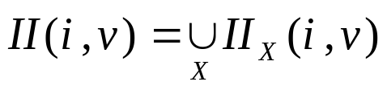



Miss Vulnerability
Cache Interference Points (CIP)
- The set of possible interference points { j }
Intermediate Iterations
- The set of Intermediate Iterations { v }
y
j₄
The set of points between any existing j and the iteration i.
All v points are greater than the first CIP for every iteration i.
j₃
j₂
q
j₁
VI
Vulnerable Iterations
Vulnerability
http://www.public.asu.edu/~ashriva6
x

